Slide 1
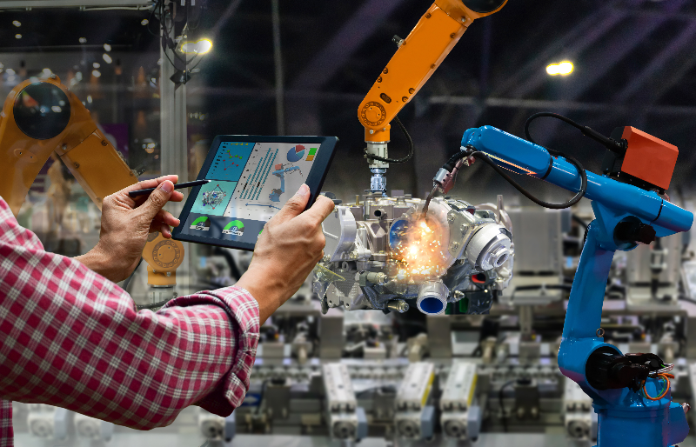
Mechanical Technologies ??

Slide 2
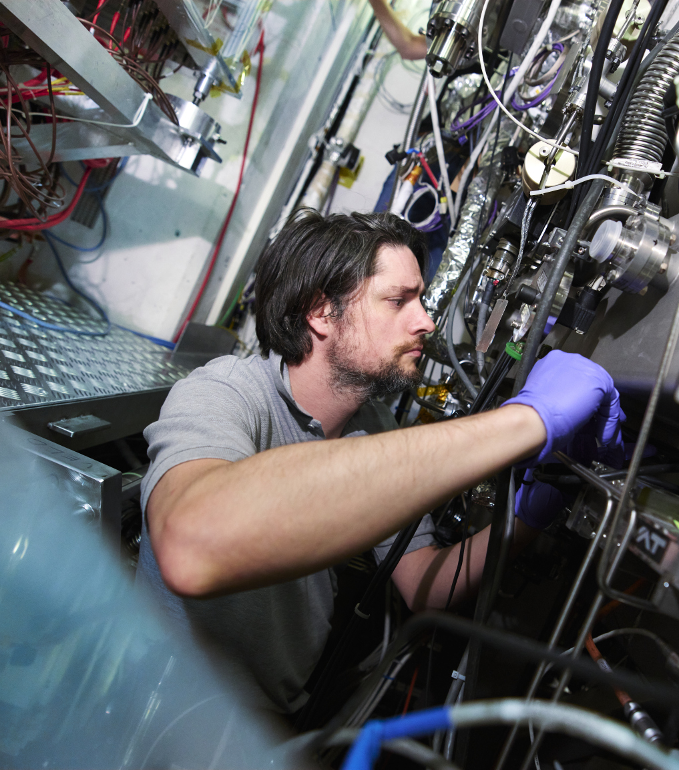
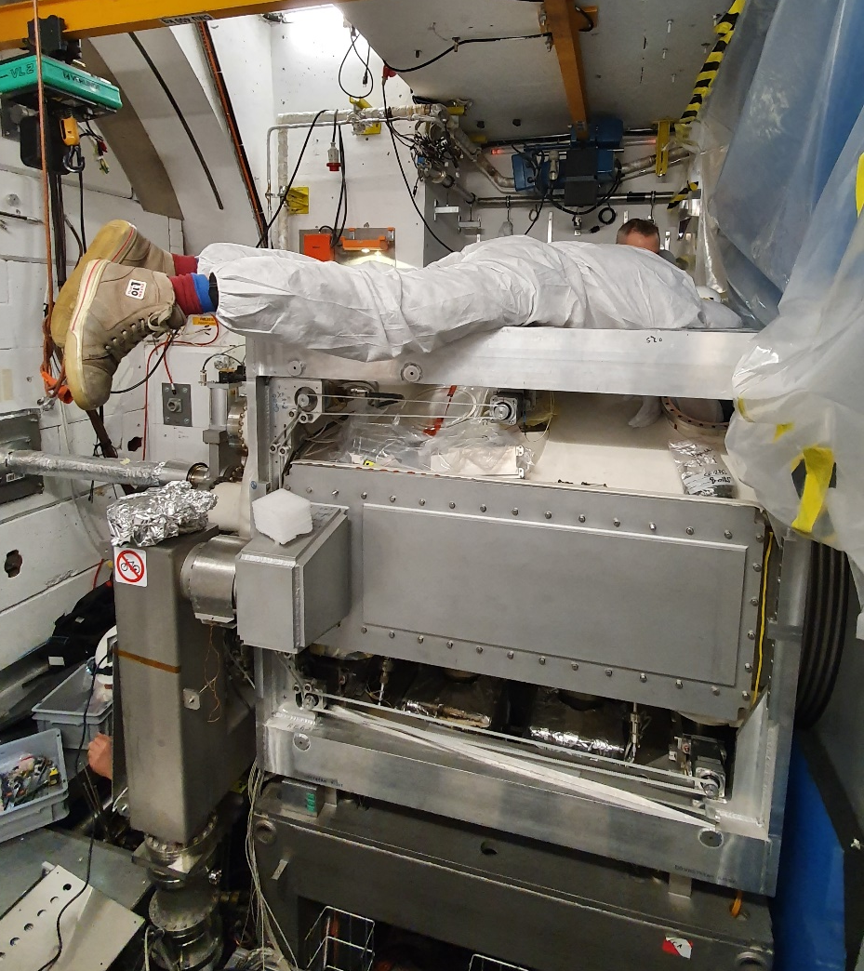
Who am I
Started at Nikhef 8 years, worked on LHCb as an Engineer, stayed at CERN for 2 years
8 years ago started at nikhef

Slide 3
A team player from the start

Slide 4
I am a proud father

Slide 5
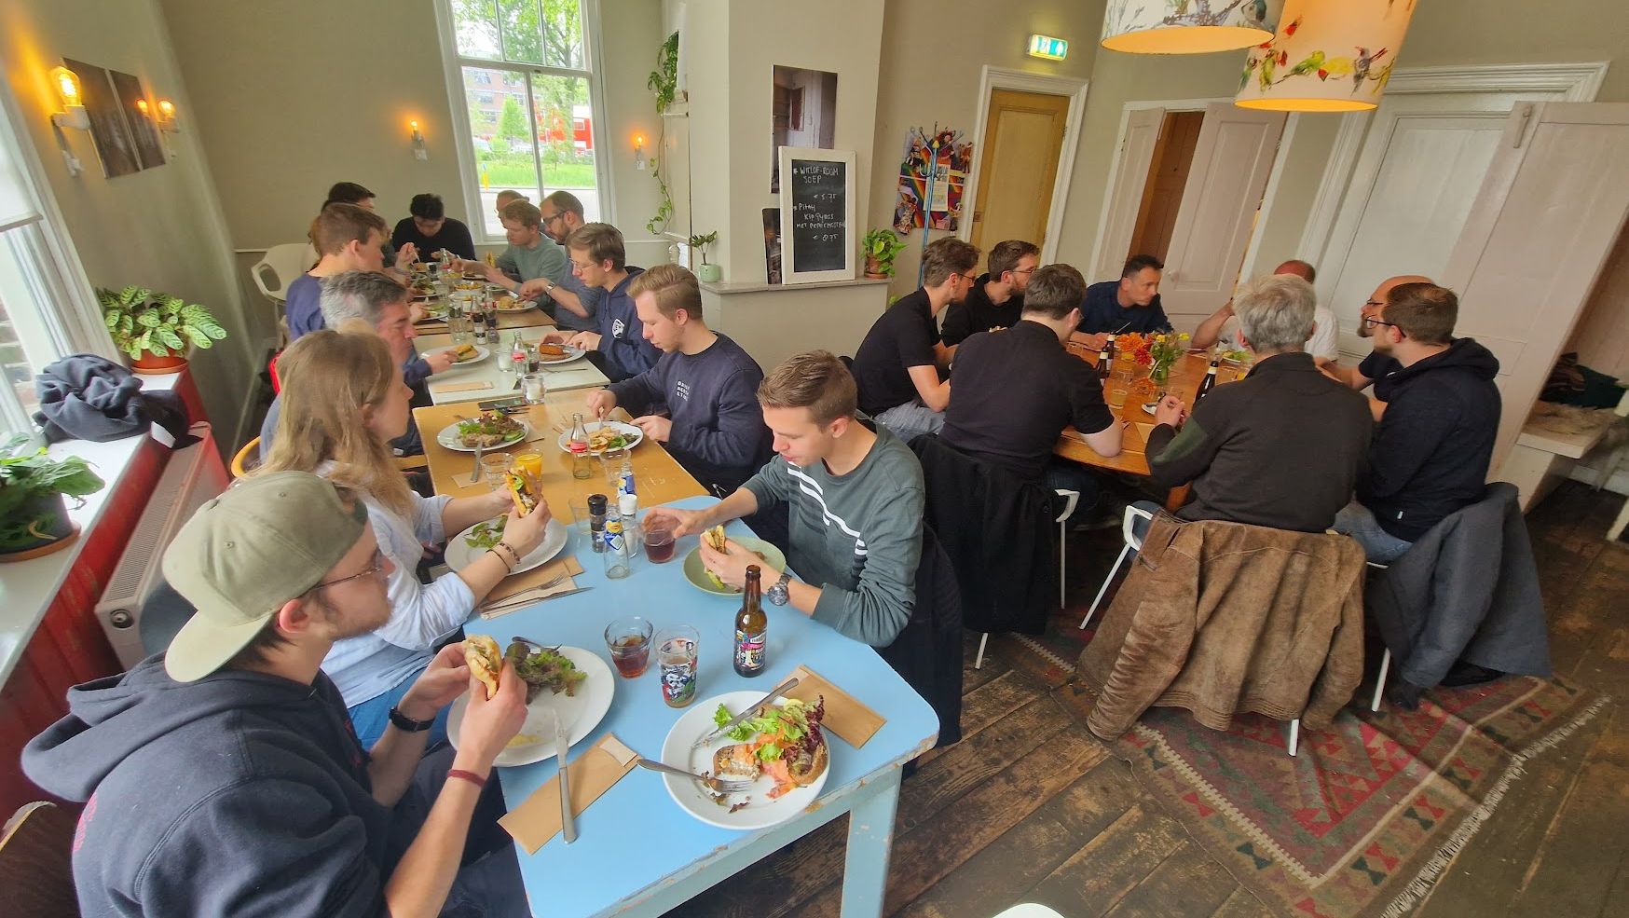
Proud manager of this bunch

Slide 6
But who are we?

Slide 7
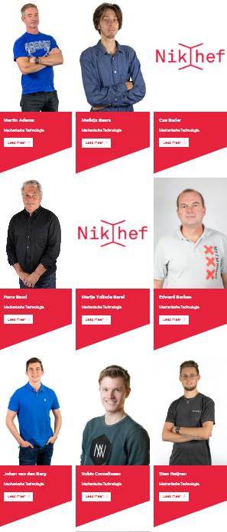
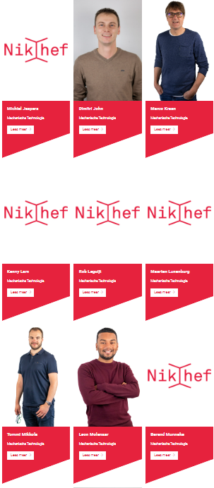
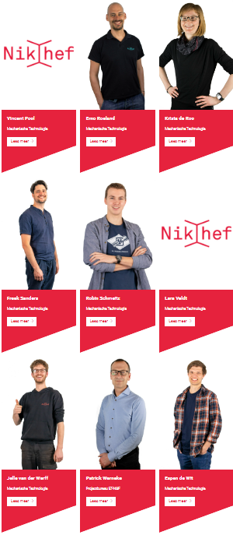
Very active:
NOR
PV
BHV

Slide 8
Average age of 43,4 years
Average age in the Netherlands is 42,4 years

Slide 9
But what do we do?

Slide 10
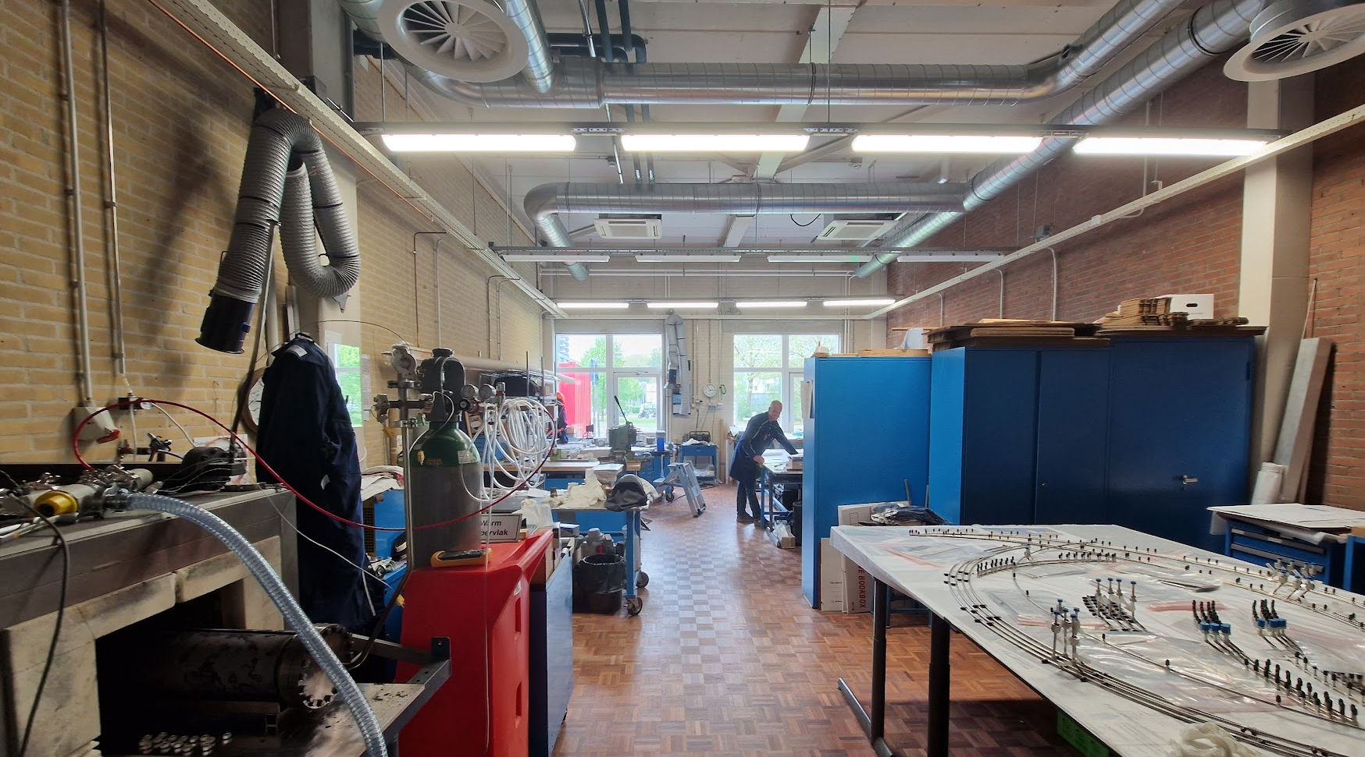

Slide 12
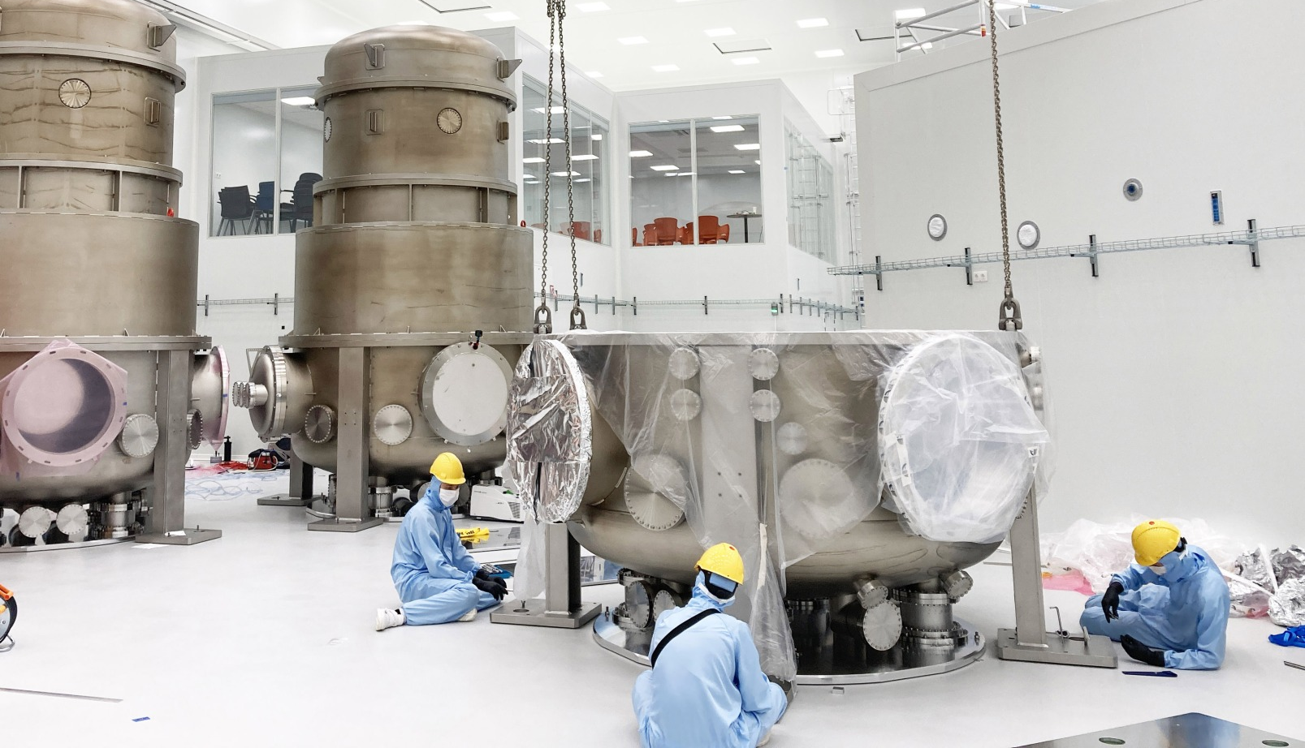

Slide 13
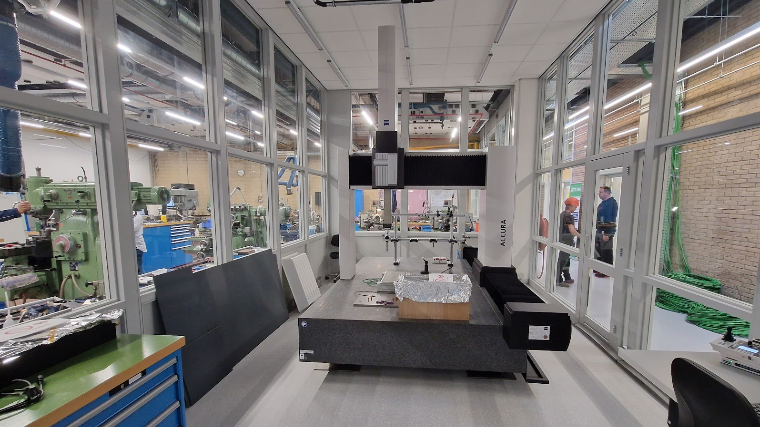

Slide 14
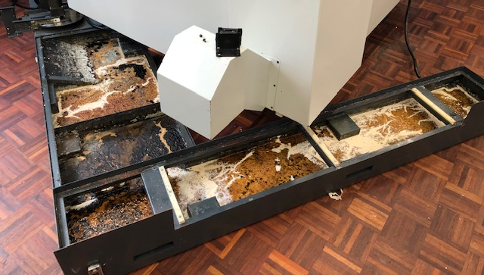
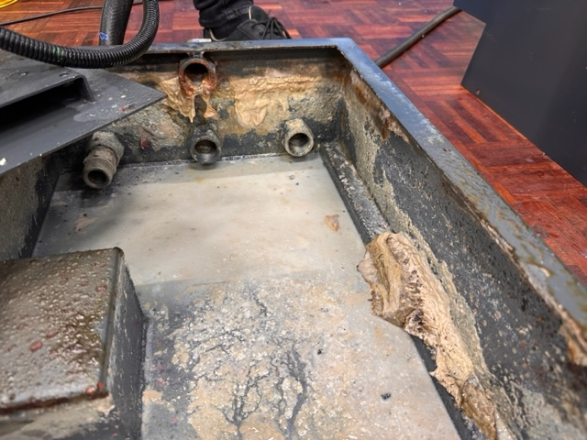
We clean up shit

Slide 17
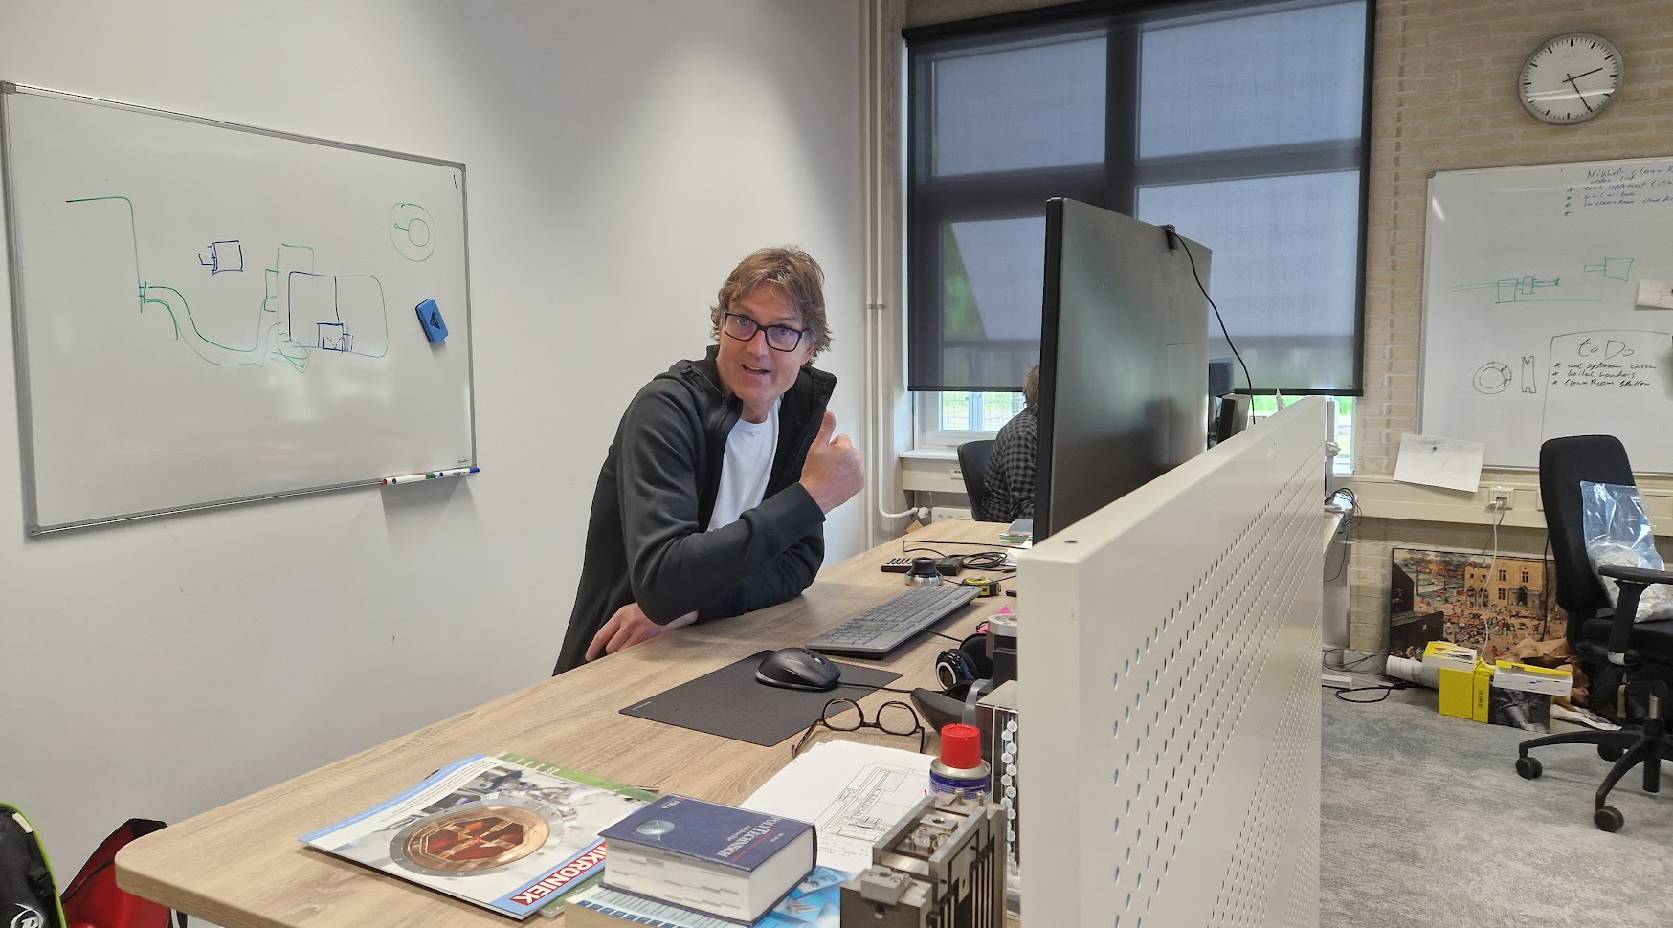
What do we do?
https://www.youtube.com/@marcokraan7637

Slide 18
