Slide 2
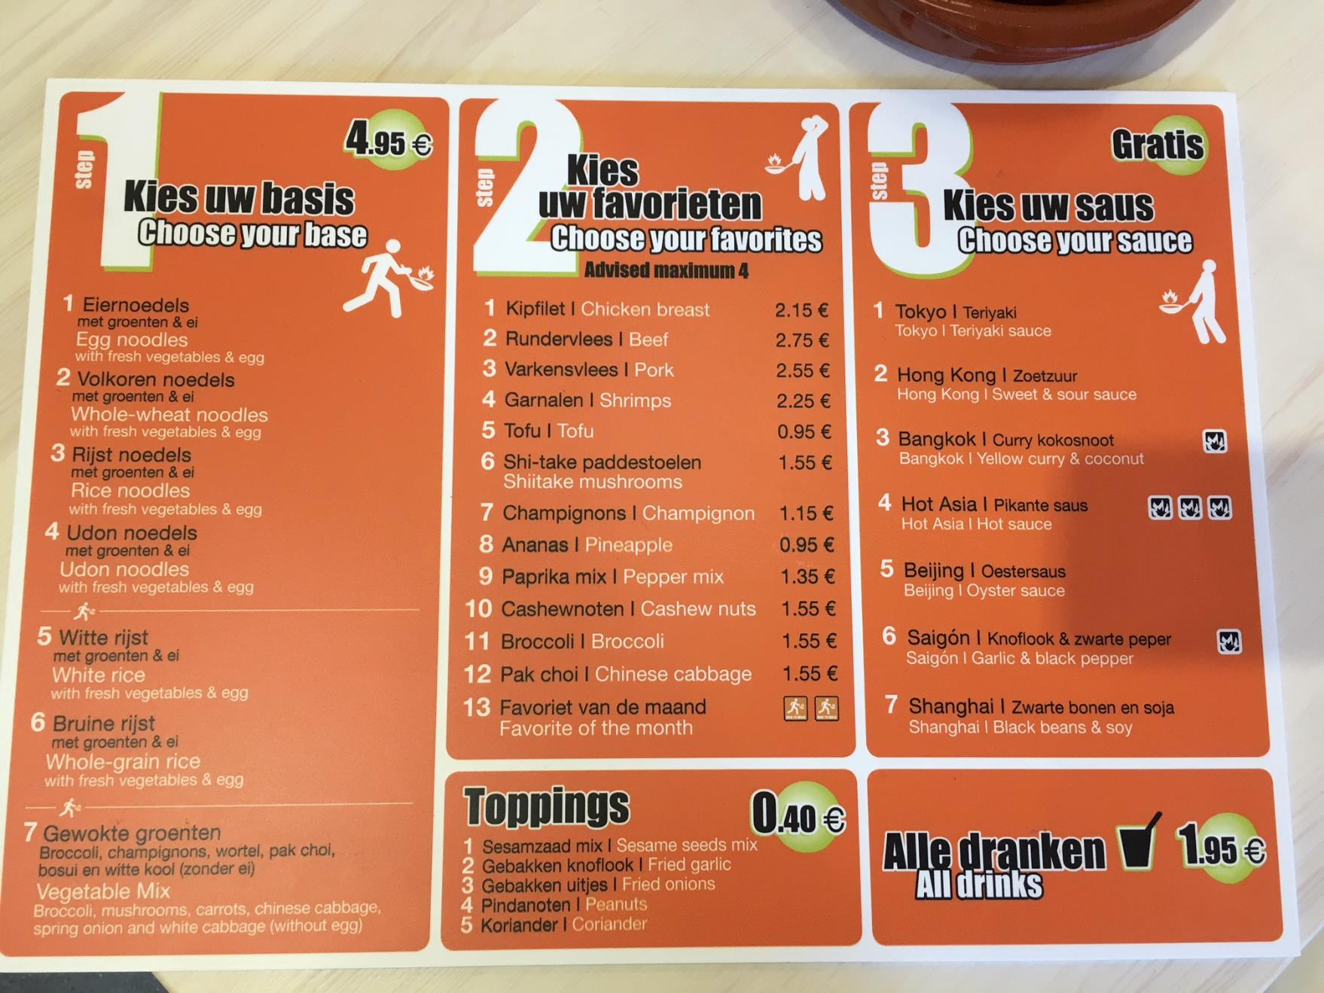

Slide 3
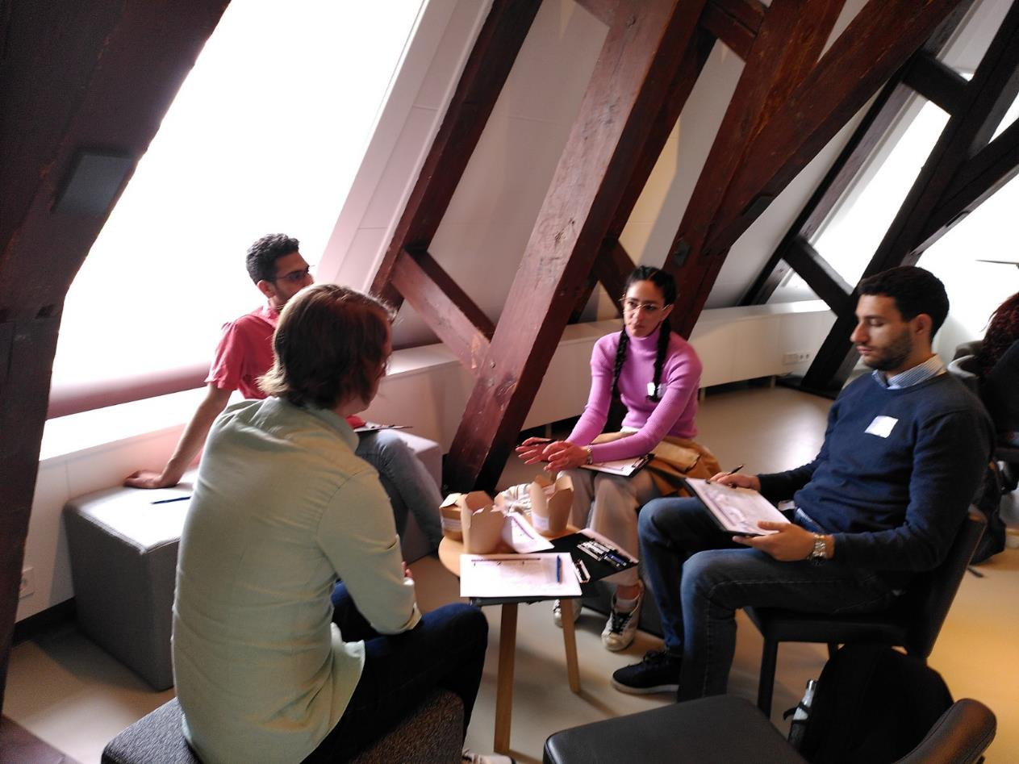
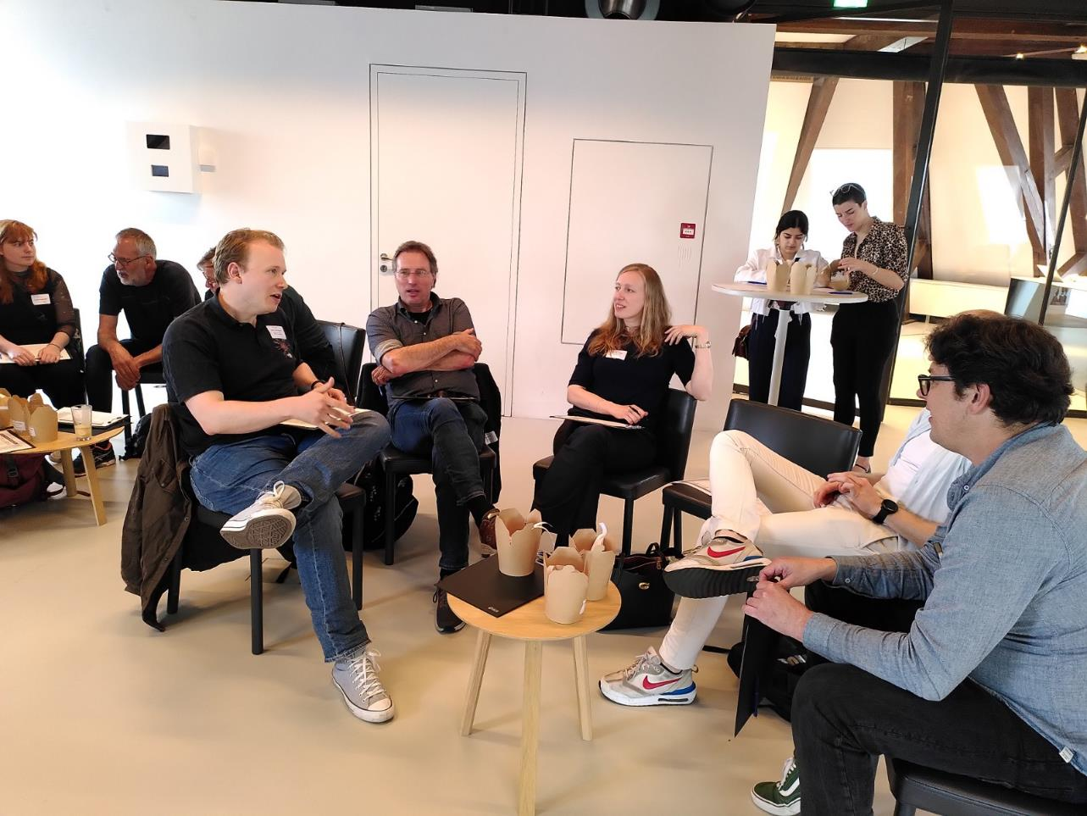
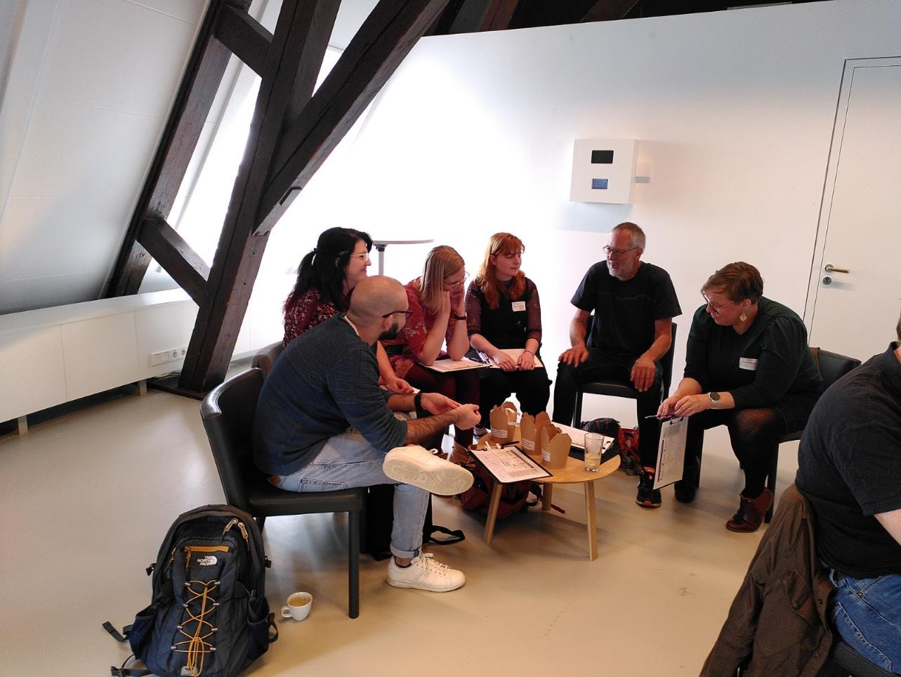
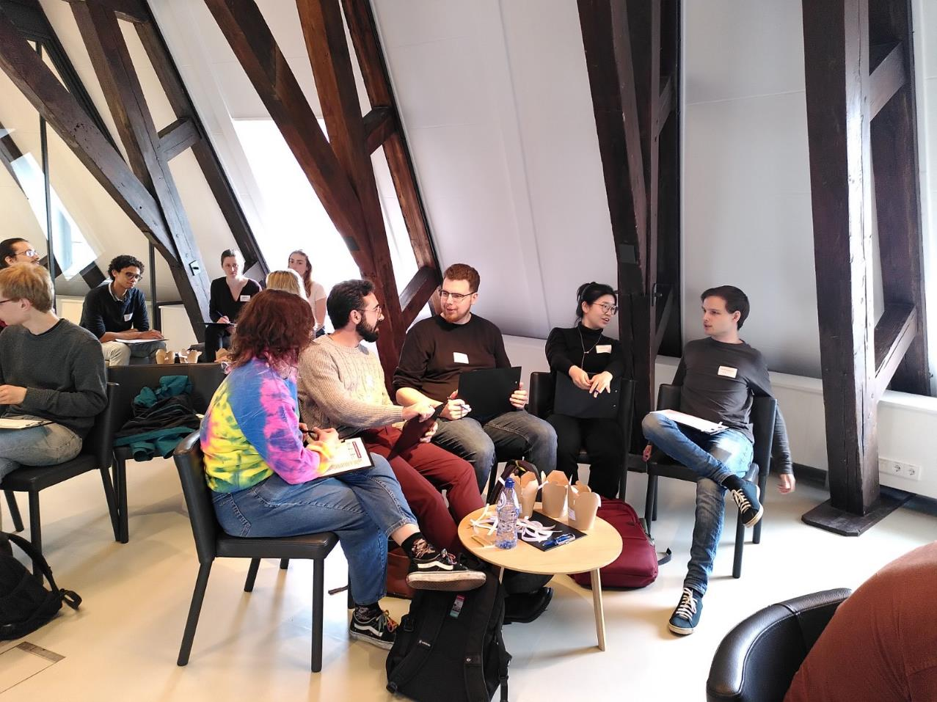
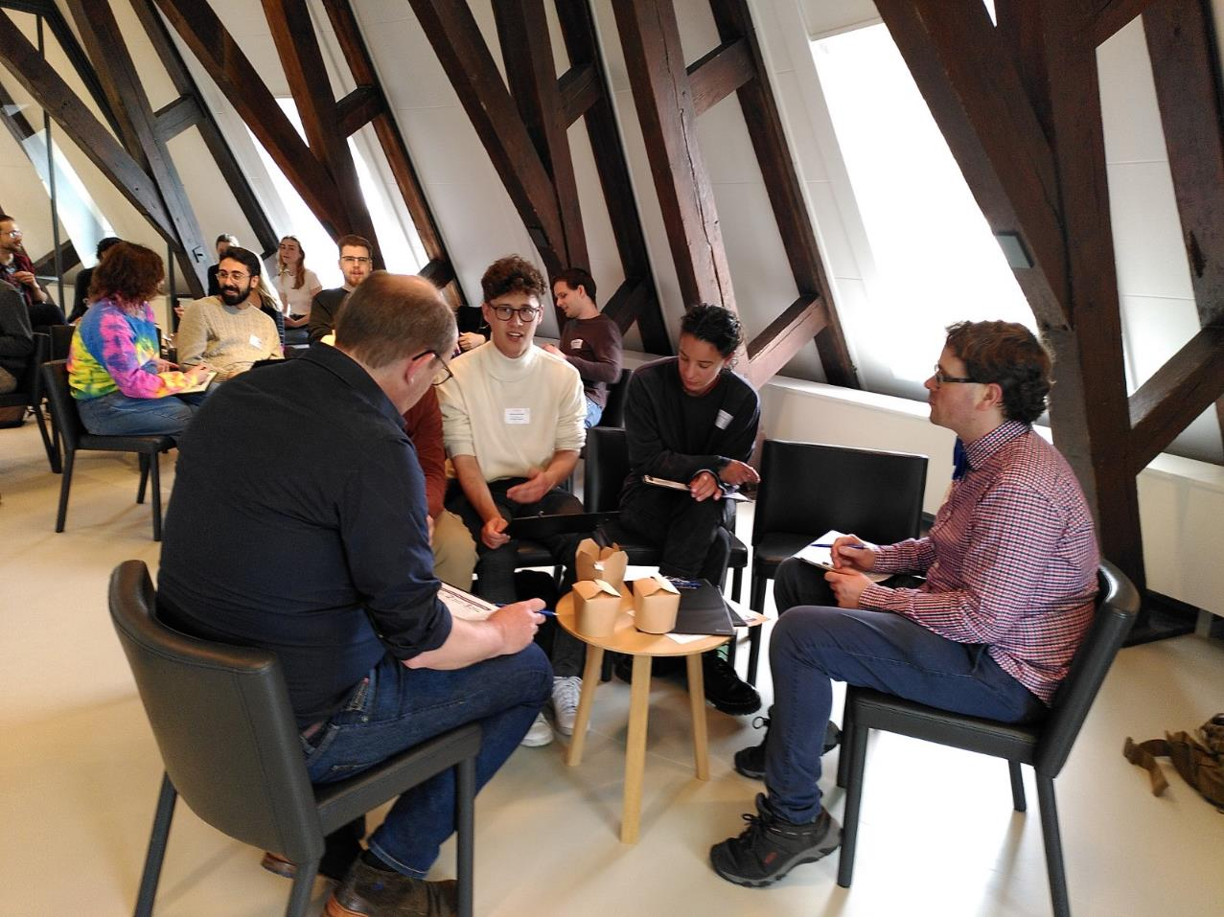
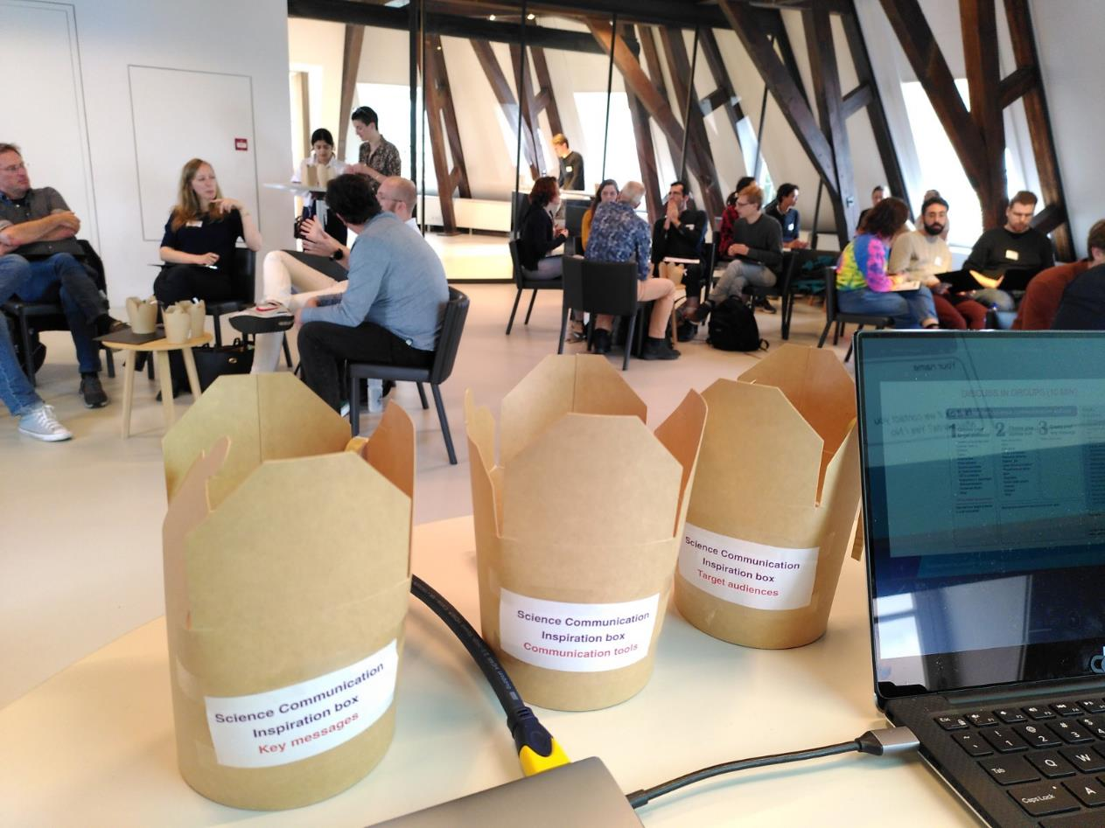

Slide 4
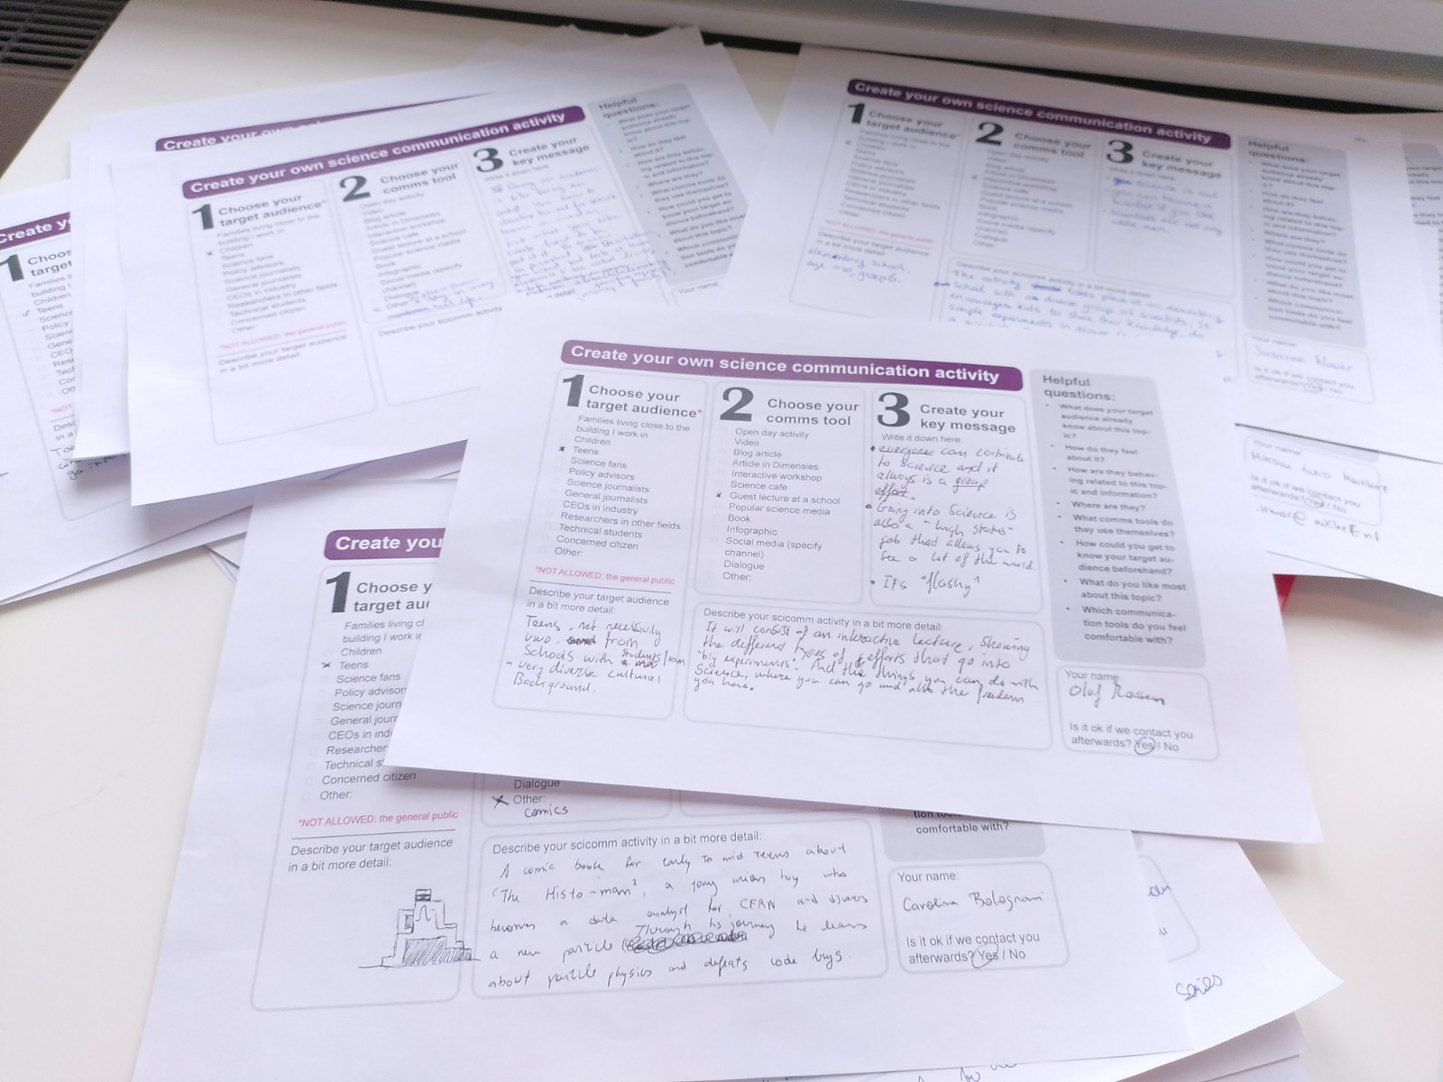

Slide 5
Target audience | Comms tool | Key message
Science fans | Infographic showcasing range of technologies which need to be developed for 3G GW detectors | 3G GW detectors are technological marvels that you should be excited to see/be involved with

Slide 6
Target audience | Comms tool | Key message
Concerned citizens (people on the verge of becoming conspiracy theorists) | Social media, podcast or Youtube. Interactive series of Q&A sessions involving the audience. “The secrets of science” | We are not secretive and we are not summoning demons

Slide 7
Target audience | Comms tool | Key message
Researchers in other fields (may referee proposals or help/hinder with future facilities) | Dialogue | Particle physics is an endeavour that can benefit (from) many other disciplines

Slide 8
Target audience | Comms tool | Key message
Teens | A comic book for early to mid teens about ‘The Histo-man’, a young boy who becomes a data analyst for CERN and discovers a new particle. Through his journey he learns about particle physics and defeats code bugs. | There’s a huge amount of data coming from detectors, dealing with them is a fascinating challenge

Slide 9
Target audience | Comms tool | Key message
Teens (not necessarily vwo, from schools with students from very diverse backgrounds) | Guest lecture at a school, interactive lecture showing the different types of efforts that go into big experiments. And the things you can do with science, where you can go and also the freedom you have | Everyone can contribute to science and it always is a group effort Going into science is also a 'high status'job that allows you to see a lot of the world It's flashy

Slide 10
Curious to see what will be implemented!

