Slide 1
Track reconstruction with a quantum algorithm
Davide Nicotra
Notes:
- Reduce the text to 1/2

Slide 2
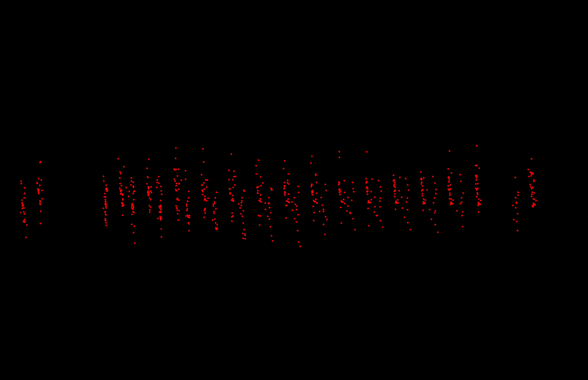
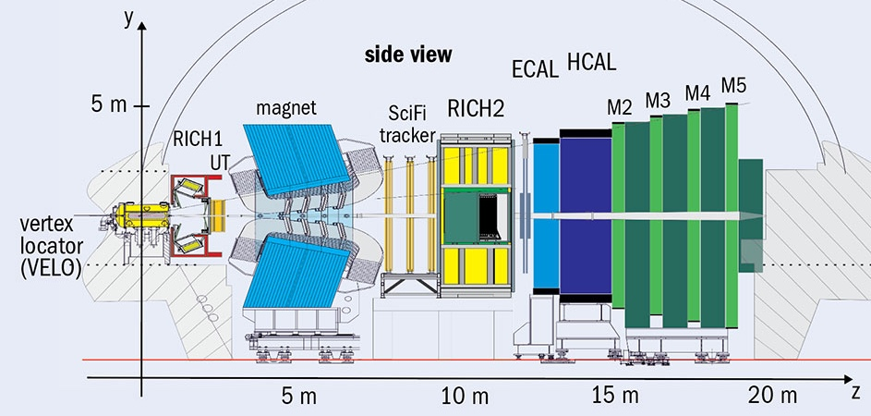
Connecting dots in the LHCb VELO
Charged particles leave hits in the VELO.
Reconstruction of the tracks crucial step of the LHCb pipeline.
The most computationally expensive algorithm at trigger level.
Here
Notes:
Make picture bottom larger
Straight tracks only say it
Animation larger (full page)
Say it quick

Slide 3
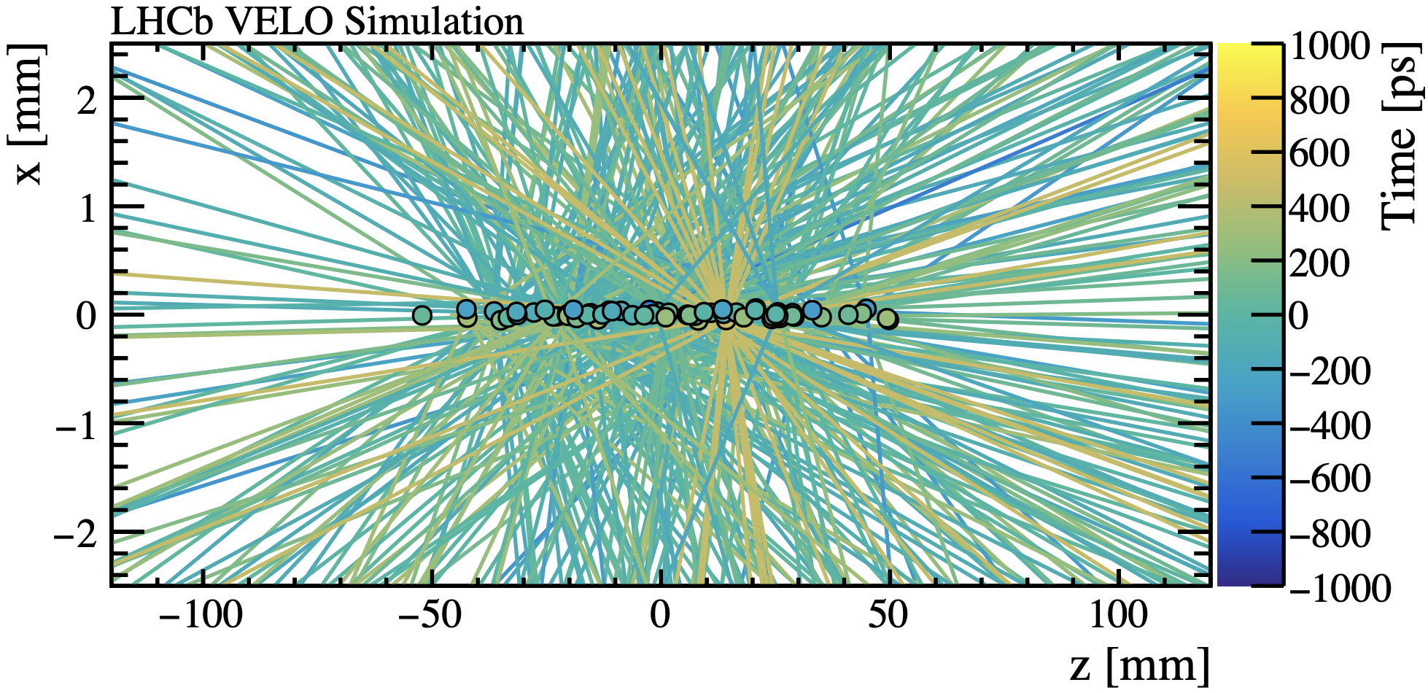
Tracking challenges in HL-LHC
Number of collisions per crossing: ~7
Substantial boost in luminosity in the future
10x more collisions
10x more particles
New algorithms will be required to deal with the new operating conditions
Can quantum computing play a role?
Courtesy of Robbert Geertsema
Notes:
Simplify the bunch crossing concept
1.6 run1
7 run 3
10xrun3 hl
Maybe get rid of first 2 bulll

Slide 4
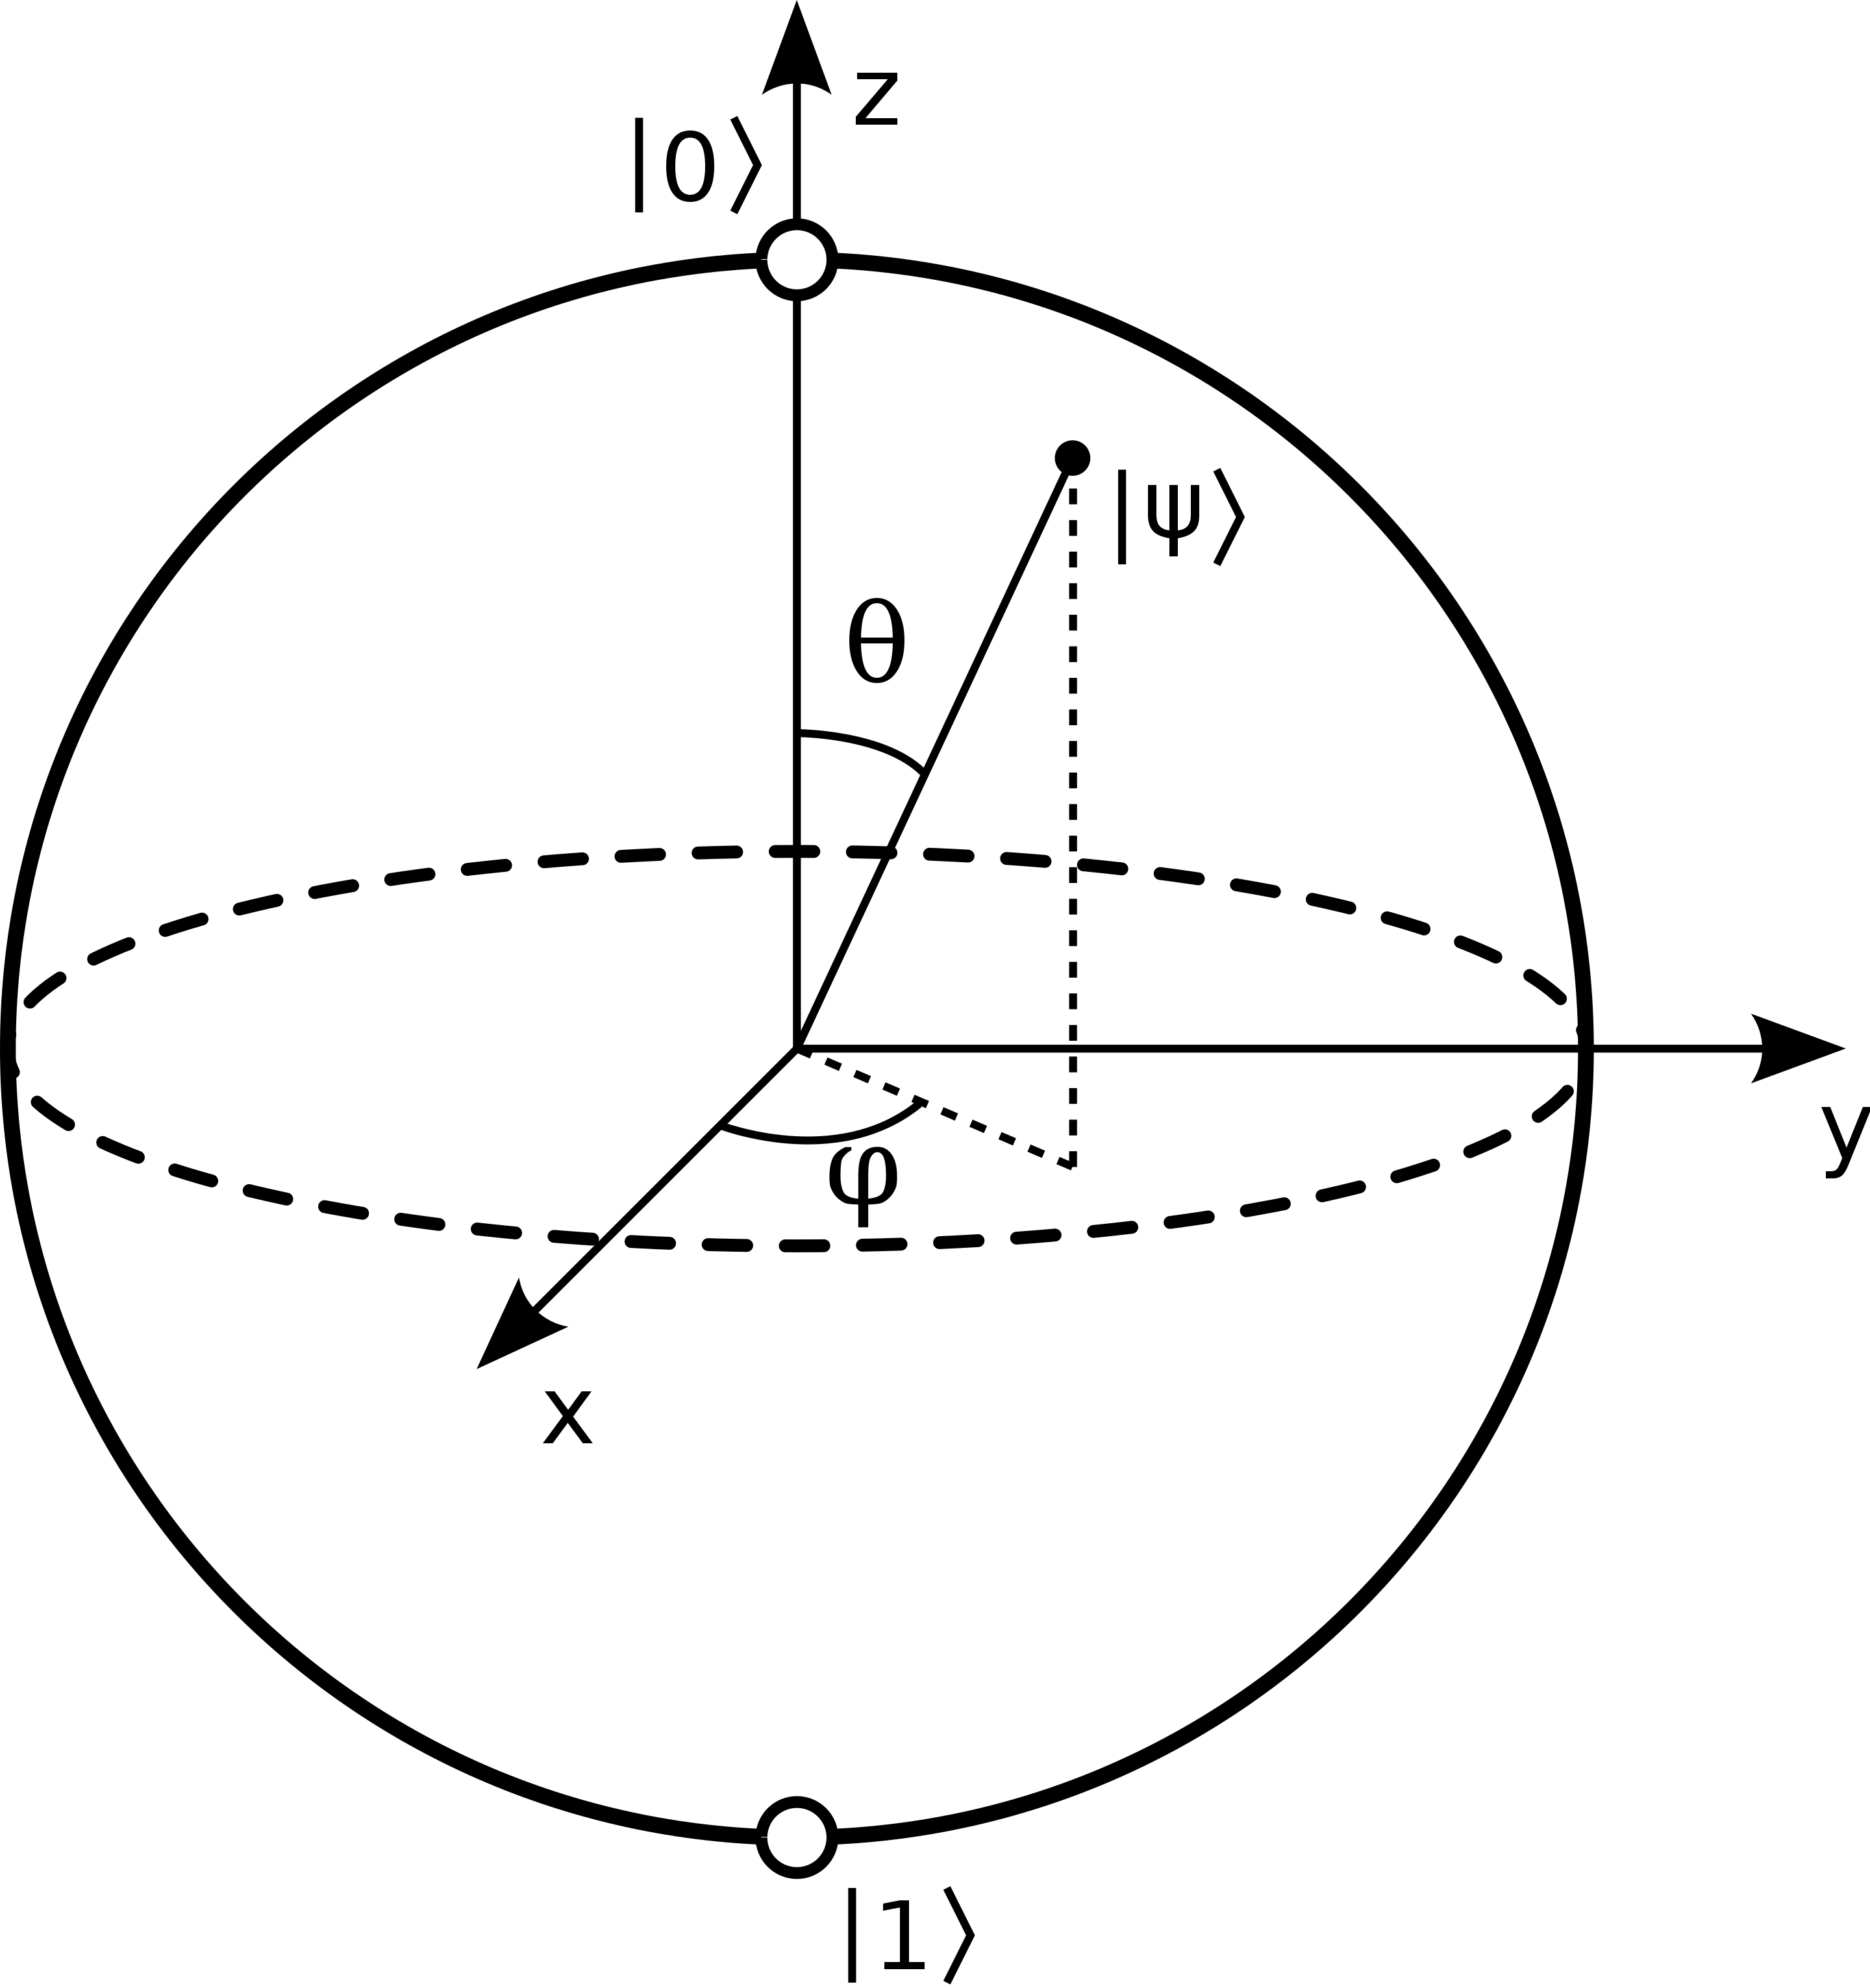
Quantum Computing
Using a system of qubits to perform calculations
Tracking algorithms not easy to port to a quantum computer
Translate the tracking problem to something compatible with a quantum computer
$$\left|ψ\right\rangle =α\left|0\right\rangle +β|1⟩$$
Notes:
This would require 2/3 slides
We want to rewrite tracking in such a way it is “compatible” with quantum computing
Skip intro di QC
Maybe put it to the slides
Skip pros cons

Slide 5
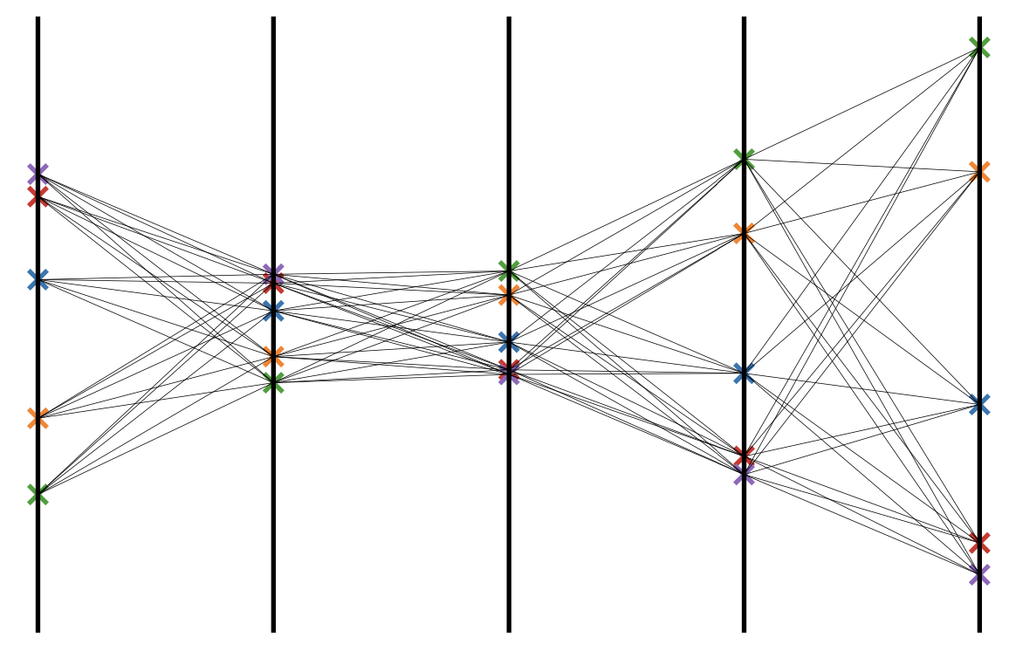
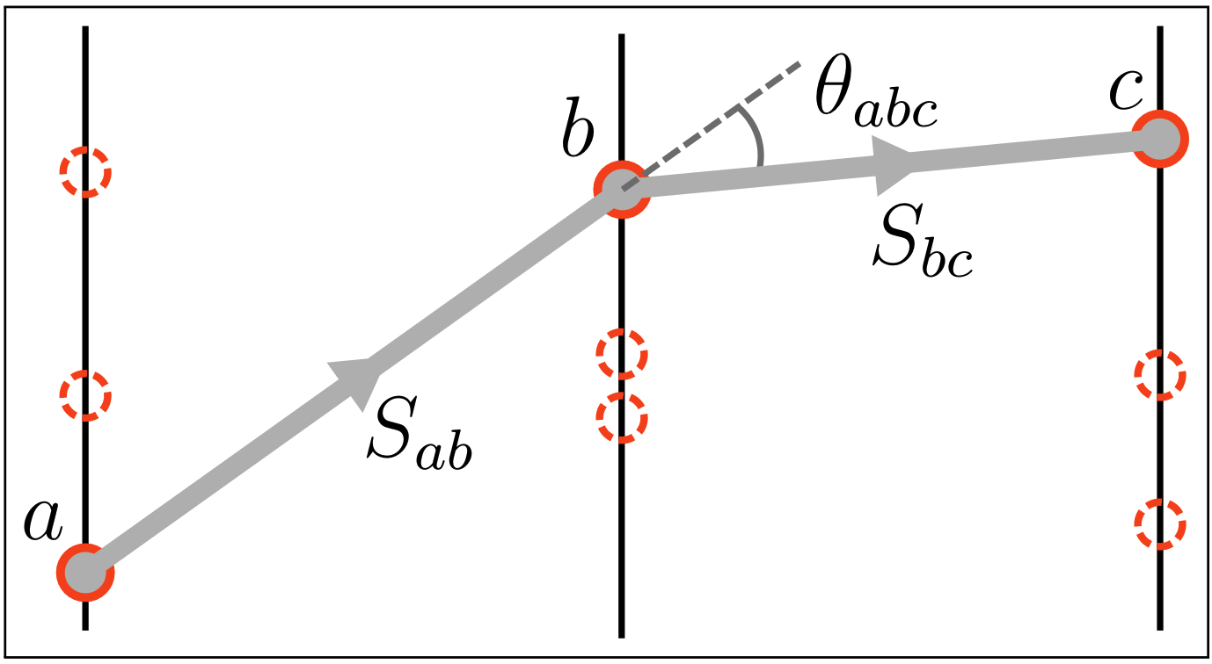
A quantum algorithm for tracking
From Hits to an Ising-like Hamiltonian
Inspired by Denby-Peterson^{[1]} model
Candidate doublets constructed $N=\#Layers × \#Particles^{2}$
Initialise the Hamiltonian
Only linear and quadratic terms. It’s Ising!
$$S_{j}$$
$$S_{i}$$
[1] R Mankel. “Pattern Recognition and Event Reconstruction in Particle Physics Experiments.” Reports on Progress in Physics 67, no. 4 (March 25, 2004): 553. https://doi.org/10.1088/0034-4885/67/4/R03.
Notes:
Picture larger, less text
Formula bigger
- Add the formula for number of doublts here

Slide 6
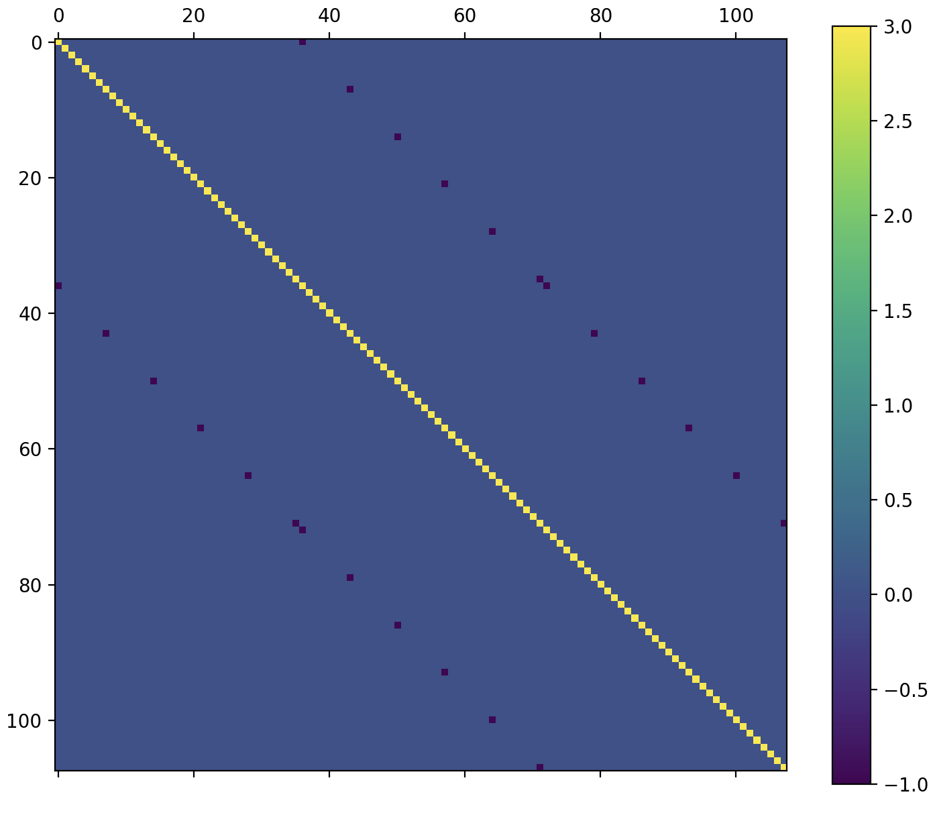
A quantum algorithm for tracking
From Ising to an Linear Algebra
$$S_{j}$$
Spins take discrete values: on or off
Relaxation of the problem promoting
Hamiltonian is a differentiable
Solve this huge $N×N$ system
Discretize back the solution
$$S_{i}$$
$$N=\#Layers × \#Particles^{2}$$
Notes:
Add the scaling
Add picture matrix
Maybe remove matrix and put the same picture of previous slide

Slide 7
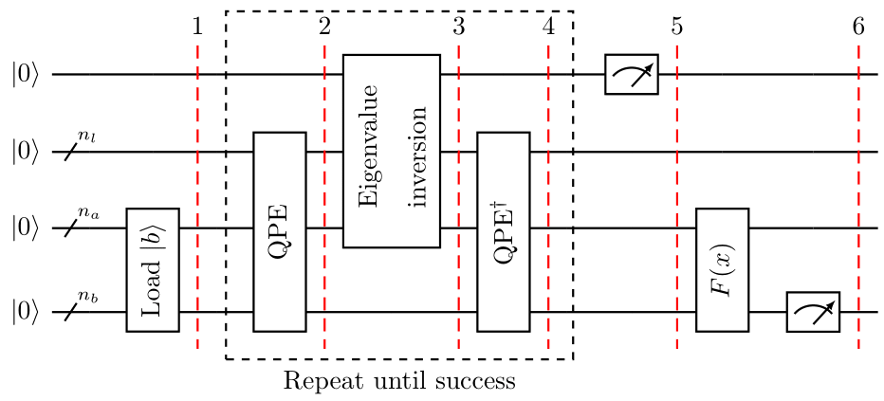
A quantum algorithm for tracking
Quantum Algorithm for Systems of Linear Equations
Also called Harrow-Hassadim-Lloyd (HHL) algorithm
State preparation (loading $|b⟩$)
Quantum Phase Estimation
Inversion
Quantum Phase Estimation$^{†}$
Measurement
Under certain conditions
Classical $O\left(N\right)$
Quantum $O\left(\log{N}\right)$
Exponential speed-up!
Quantum Phase Estimation
The core of many exponentially faster algorithms, like Shor’s algorithm that breaks RSA
QPE is applied to $e^{iA}$ (Hamiltonian simulation)
Notes:
Reduce QPE explaination

Slide 8
Pros and Cons of HHL
Exponential scaling. 100 qubits can accommodate ${10}^{15}$ hits
IBM has recently presented a 433-qubit machine
HHL requires 2 efficient subroutines
State preparation Solved by carefully designing the Hamiltonian
Hamiltonian simulation
Theoretical works suggest that can be simulated efficiently
An explicit implementation is not available yet
Very deep quantum circuits hard to simulate, impossible to run (noise)
The read-out issue
Reading out the solution vector will void the advantage
Quantum post-processing of the final state is required
Notes:
Mention the limit of circuit depth + coherence time
Stick to the point!!

Slide 9
Does it work?

Slide 10
Animation
LHCb Simulated Event 1 collision event
Half of the VELO
$$B_{s}→φφ$$
To validate our new Hamiltonian approach, HHL has been replaced with a classical linear solver
LHCb events on quantum simulator/hardware is not possible yet.
Circuit too deep
Hardware too noisy
Notes:
Say that we have 1 collision event

Slide 11
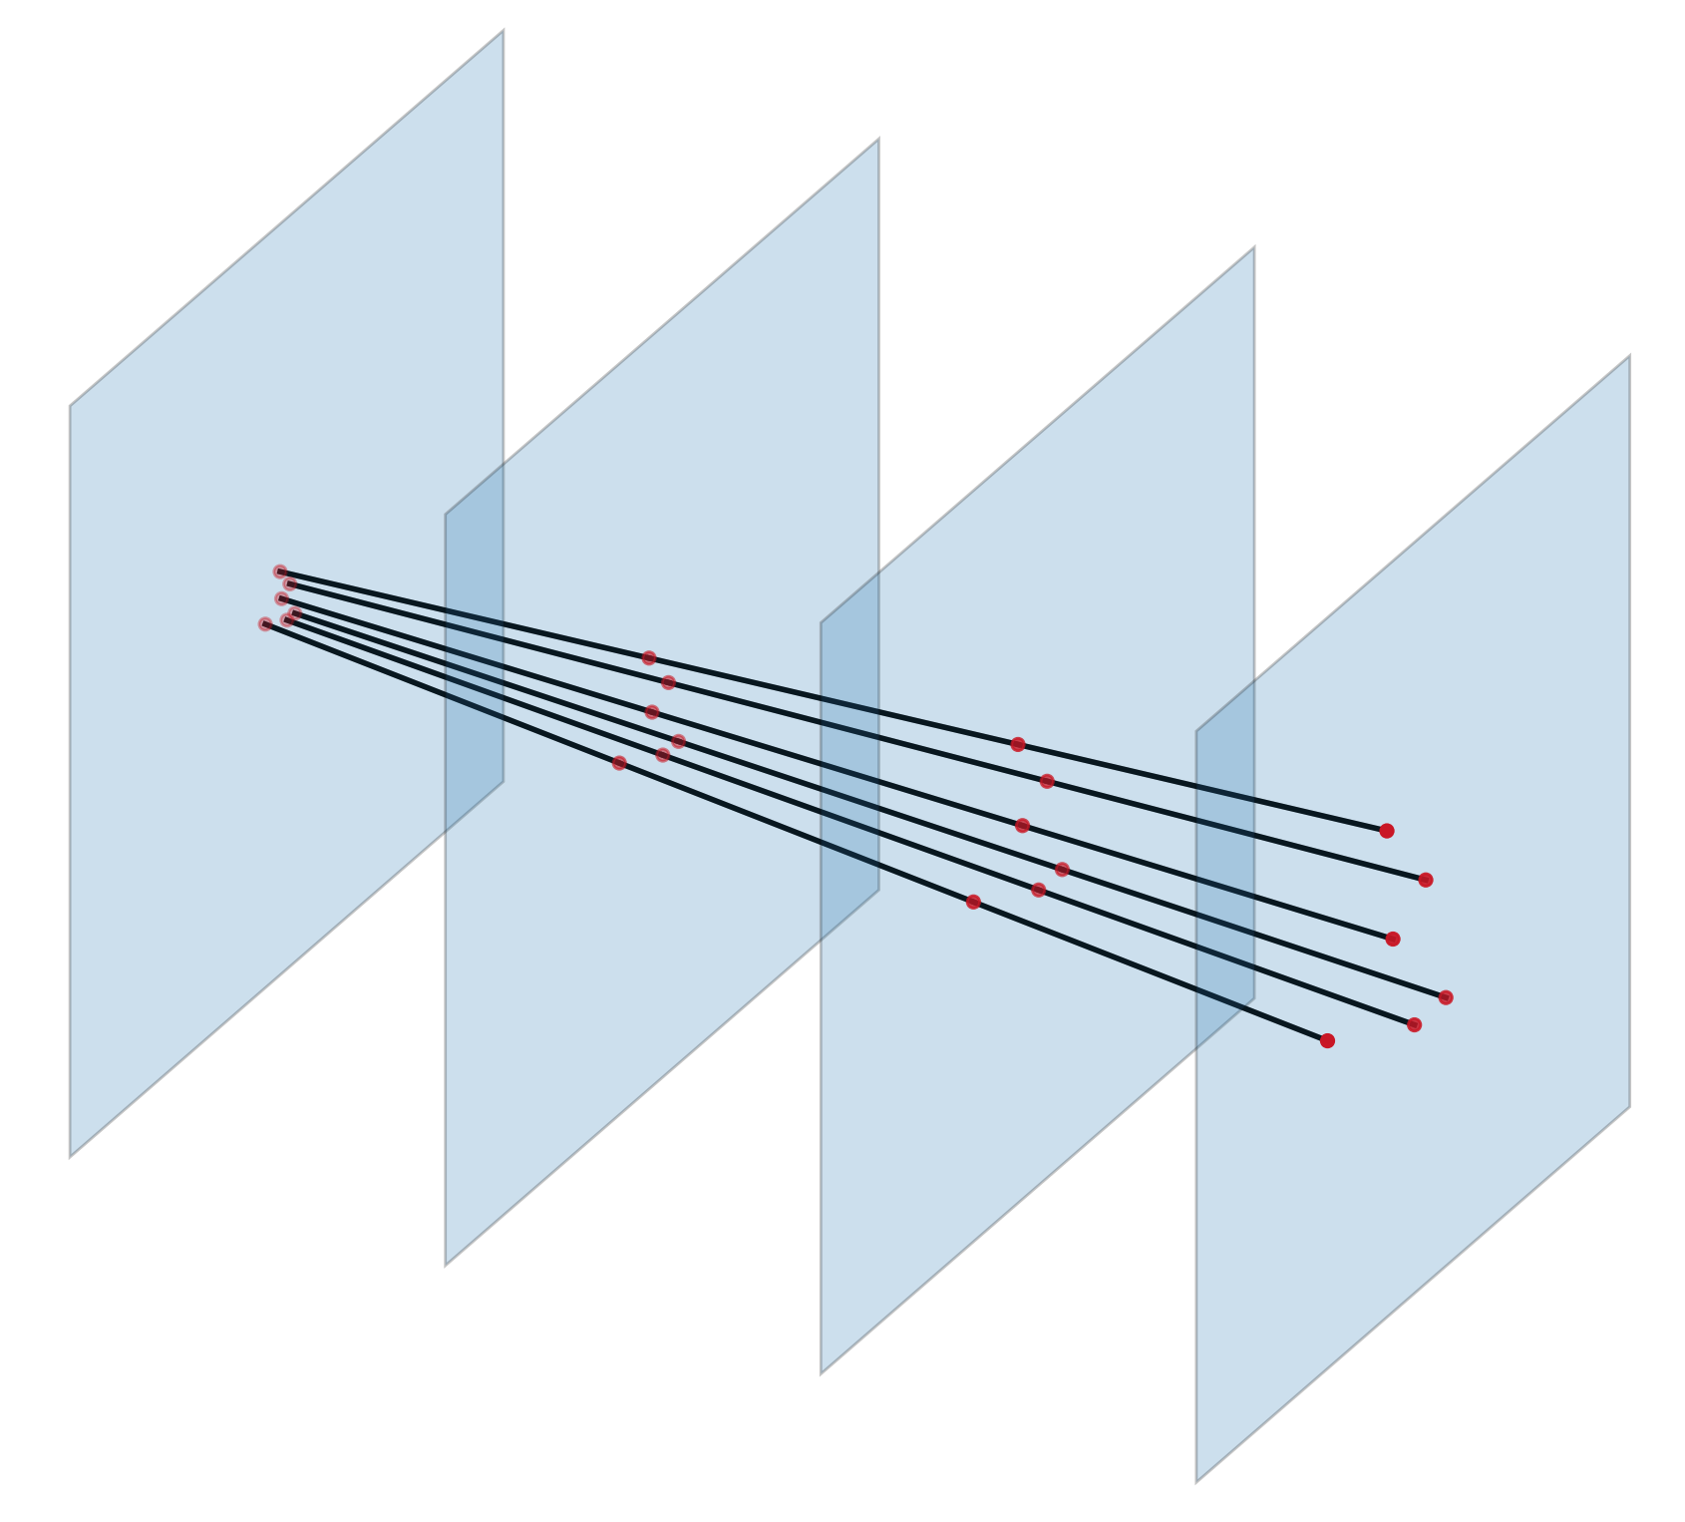
Tracking performances
6 particles – 4 layers detector
quantum simulation
Test the HHL algorithm Smaller events with quantum simulator
Validate the Hamiltonian LHCb simulated events with a classical solver
Took 2 days to complete
Notes:
2 main messages
- We cannot test on actual event because too big
we tested smaller event on simulators and it works
Hardwere testing is not possible because of Hamiltonian simulations
Thicker points and lines
Remove first 2 bullets say it in previous slide. Simply say that on hardware is not possible yet.
Put a huge circuit in backup
Make point 2 very clear

Slide 12
Tracking performances
Very good performance
Close to state of the art
Integrated fake rate: 4.3%
Notes:
Only as a function of momentum
Make clear that this is not quantum implementation
Start the plot form 1gev
Just show efficiency

Slide 13
Conclusions
New track reco algorithm based on Ising-like Hamiltonian
Tested and validated classically on LHCb simulated events
Good performance!
First track reco algorithm based on the HHL quantum algorithm
Tested on smaller events
Still many open challenges
Efficient Hamiltonian simulation
Quantum Post-processing
Hardware implementation
A paper draft on these results will be ready soon… stay tuned!
Notes:
Split the results on classical and the actual quantum implementation

Slide 14
Thank you
Questions?

Slide 15
Backup

Slide 16
QC example - swap test
Pros
Complexity scales exponentially better for some problems
Active field of research (theory and hardware)
Potentially powerful for optimization and simulation
Cons
A concrete useful application is yet to be found
Developing algorithms is extremelly hard https://quantumalgorithmzoo.org/
Current quantum hardware is not mature enough: Limited access to noisy qubits ~100

Slide 18
Connecting dots in the LHCb VELO
Charged particles produced in the proton-proton collisions leave hits crossing the layers of the LHCb Vertex Locator.
The reconstruction of the tracks of the particles is a crucial step of the LHCb pipeline.
The most computationally expensive algorithm at trigger level.
In the VELO the effect of the magnetic field is negligible: straight tracks.
Here
Notes:
Make picture bottom larger
Straight tracks only say it

Slide 19
Tracking challenges in HL-LHC
Current number of interactions per bunch crossing: ~1.6
The LHCb detector is going to face a substantial boost in luminosity that will increase the complexity of tracking
10x more vertices multiplicity
10x more particles multiplicity
New algorithms will be required to deal with the new operating conditions
Can quantum computing play a role?
Courtesy of Robbert Geertsema
Notes:
Simplify the bunch crossing concept

Slide 20
Quantum Computing
Using a quantum system as a fancy calculator
Example: computing the overlap between two quantum states
SWAP test algorithm
Prepare state $|ψ⟩$ and $|φ⟩$
Apply an H gate to the ancilla
Apply the CSWAP gate
Reapply an H gate to the ancilla
Measure the probability distribution on the ancilla
$$P\left(0\right)= \frac{1}{2}(1−{\left|\left\langle ψ | φ\right\rangle \right|}^{2})$$
Complexity scales exponentially better than classical for some problems
Extremelly active field of research in the last few years (theory and hardware)
Potentially a very powerful tool for optimization and simulation tasks
A concrete useful application is yet to be found
Developing algorithms is extremelly hard Only a few of them are know https://quantumalgorithmzoo.org/
Current quantum hardware is not mature enough: Limited access to (a few) noisy qubits
Notes:
This would require 2/3 slides
We want to rewrite tracking in such a way it is “compatible” with quantum computing
Skip intro di QC

Slide 21
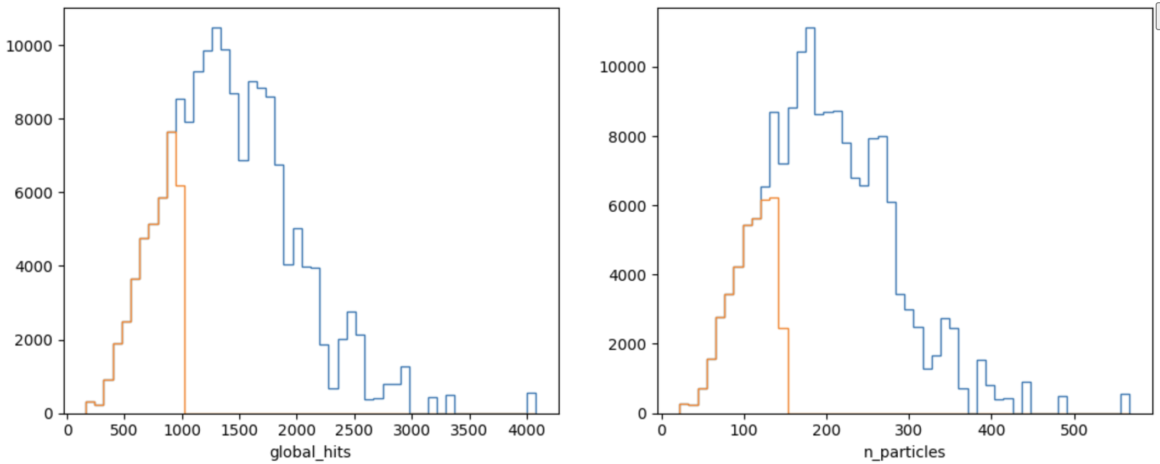
N. hits and particles

