Slide 1
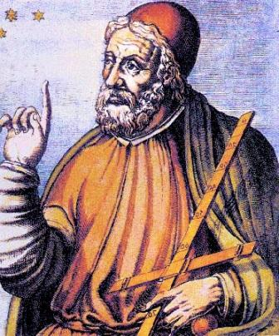
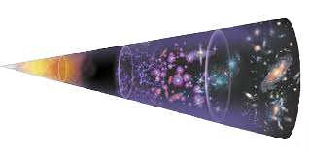
Magnet and Filter Updates
https://ptolemy.lngs.infn.it
Wonyong Chung, Andi Tan*, Chris Tully
Oct 7, 2022
PTOLEMY Collaboration Meeting
Amsterdam
*couldn’t make it to the meeting

Slide 2
Updates
Updated magnet design, built at Princeton
Filter implementation in simulation (CST)
A. Apponi et al 2022 JINST 17 P05021, https://arxiv.org/abs/2108.10388
End-to-end transport in simulation (Kassiopeia)
Design of LNGS magnet
Plans for Princeton magnet
Validate drift balancing

Slide 3
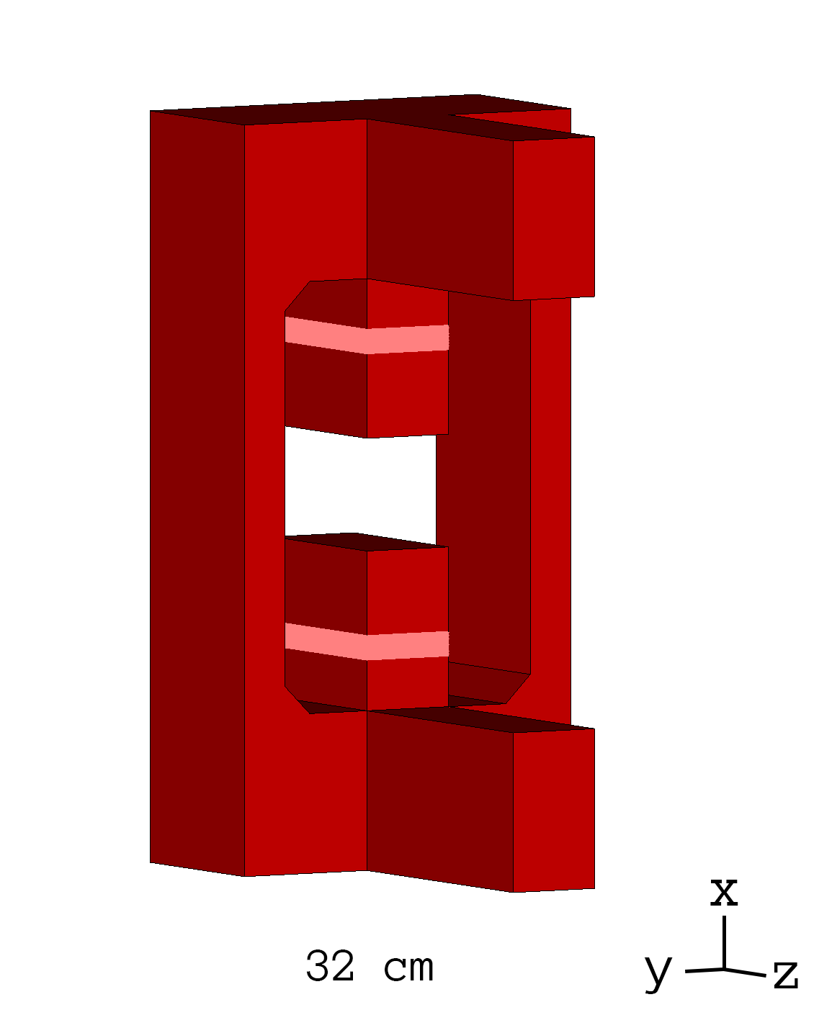
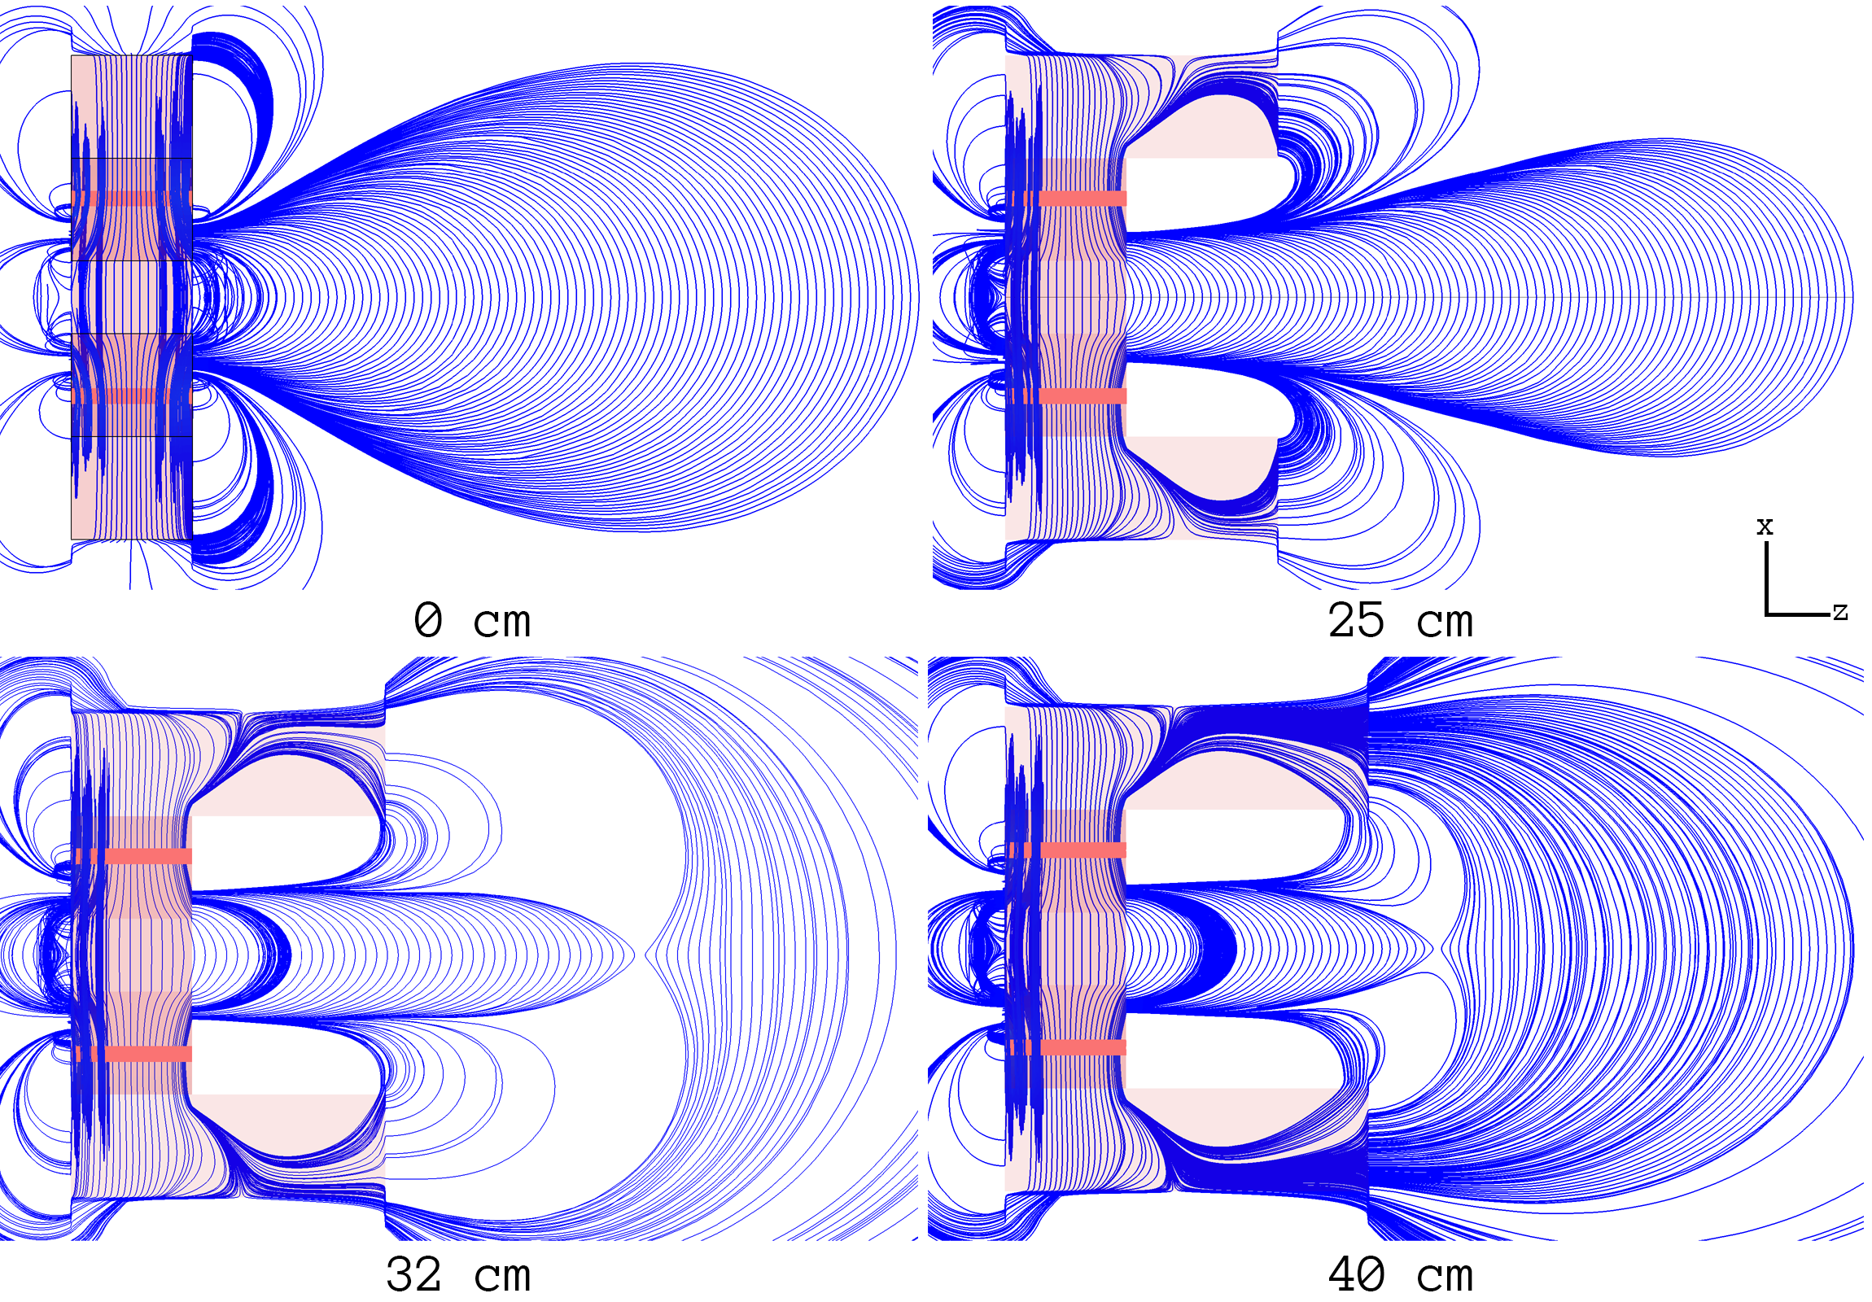
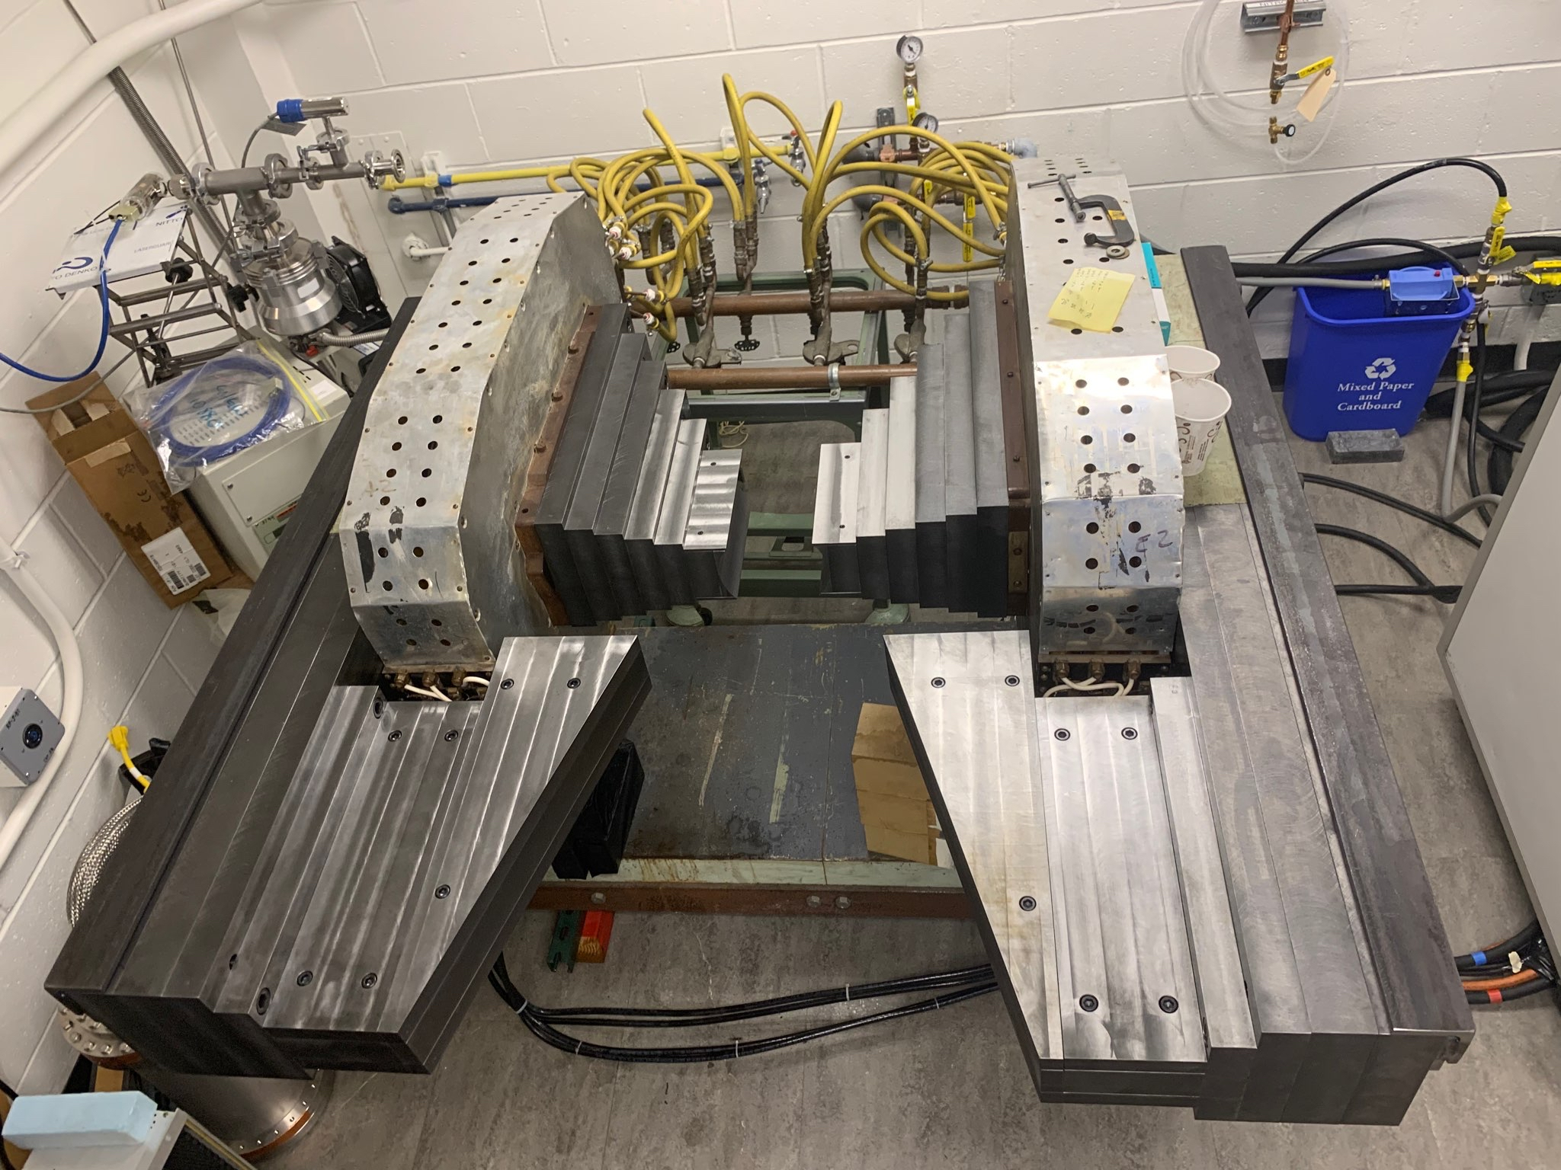
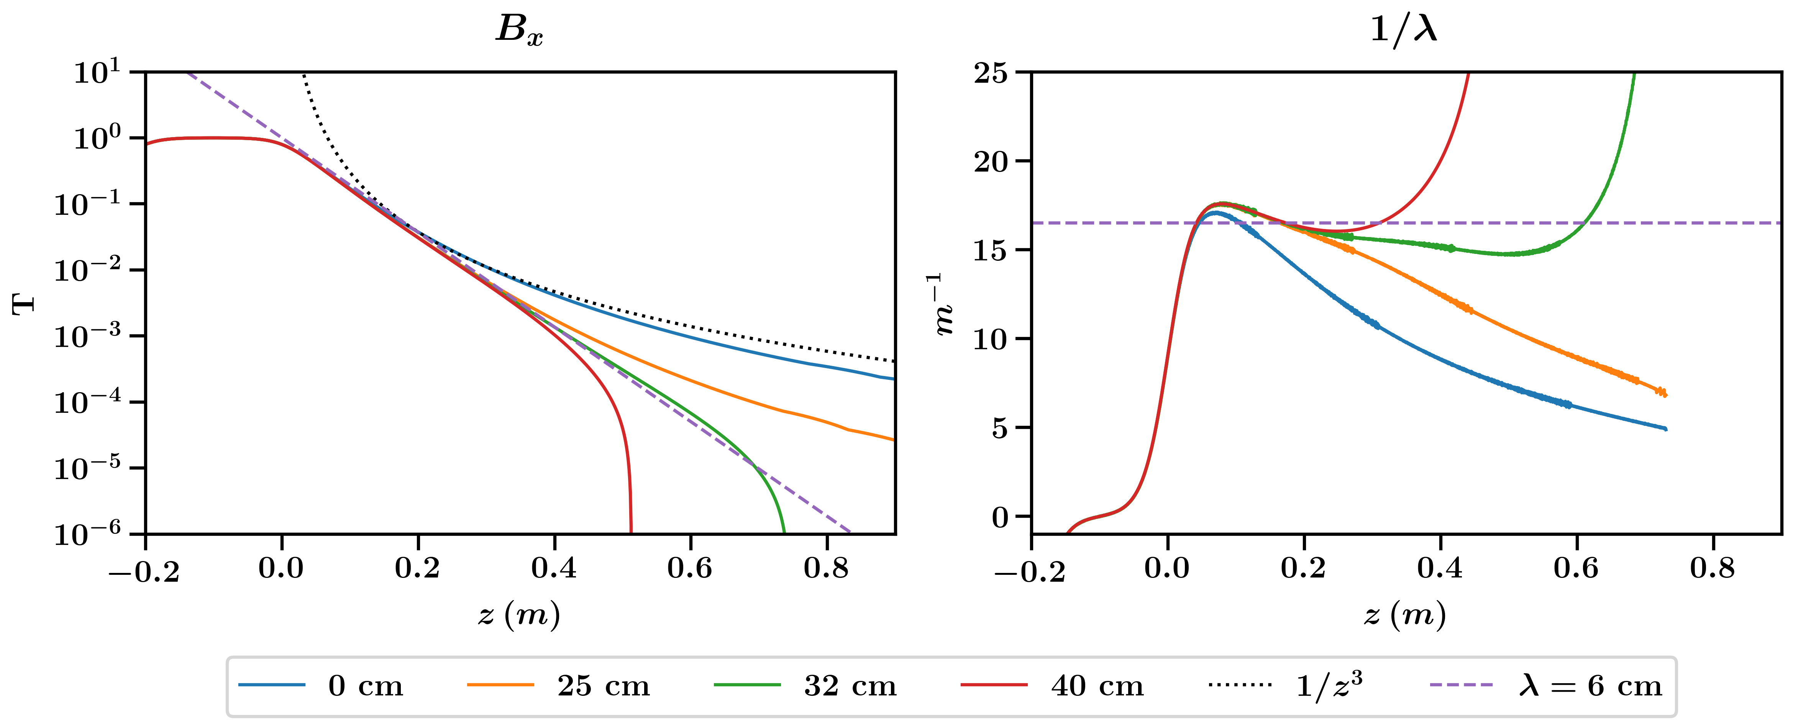
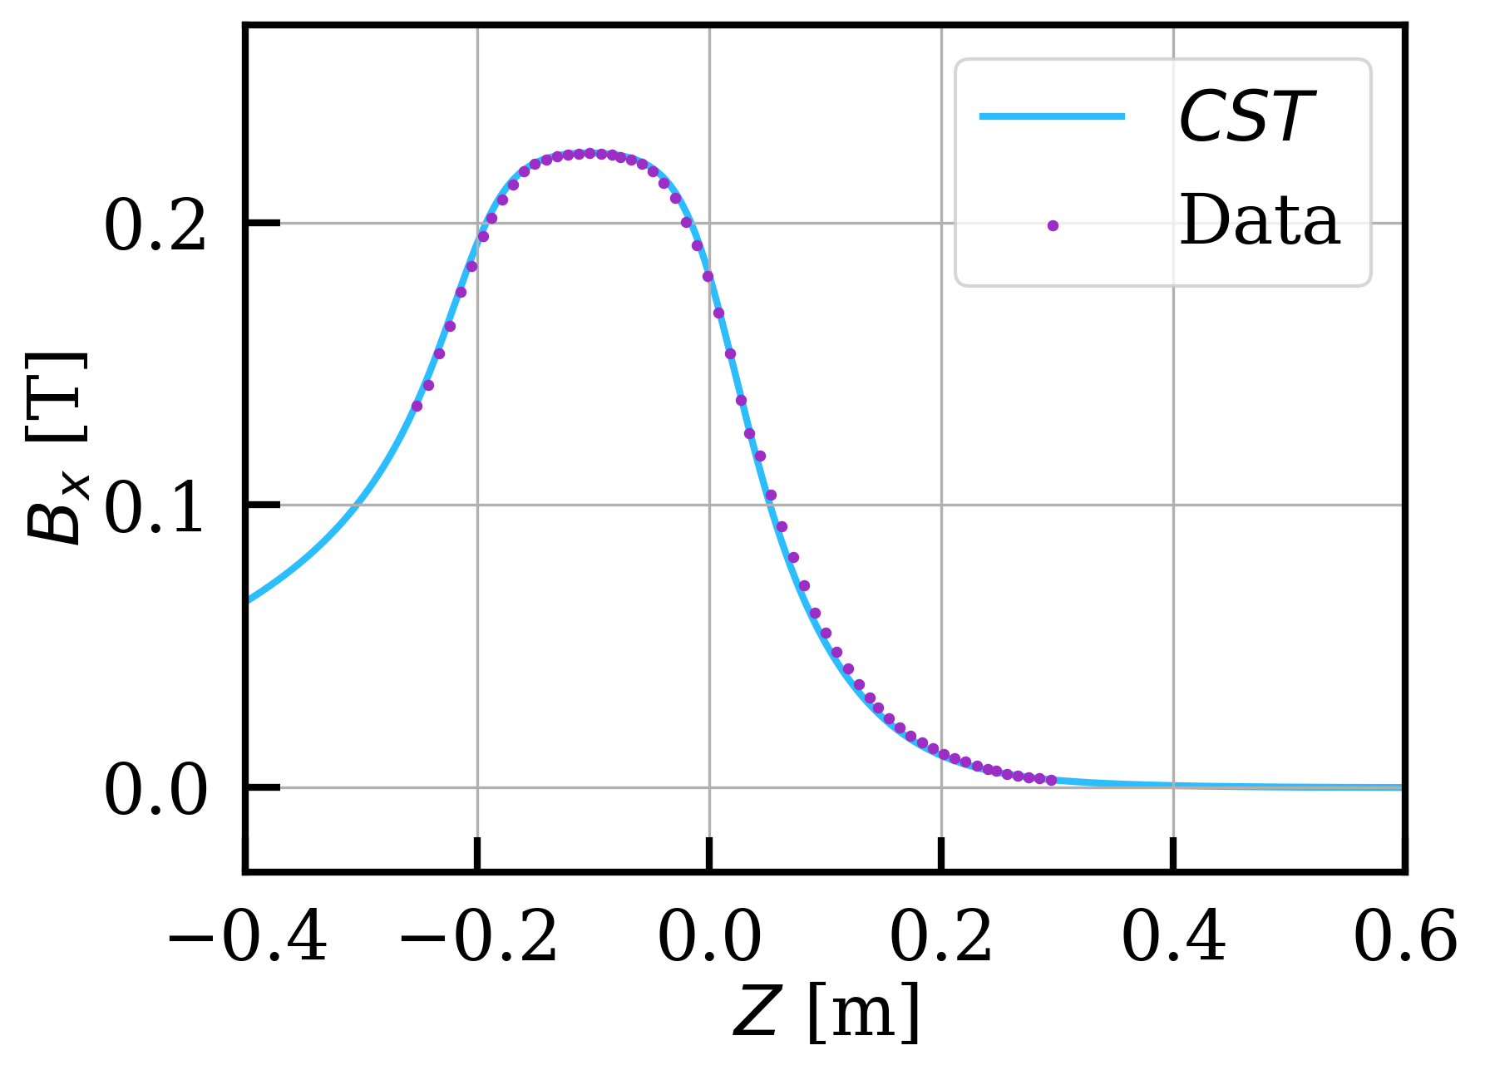
Magnet Design and Build
Shape magnetic field lines with iron extensions
Look for curvatures of constant radius
Radius is equal to exponential decay parameter 𝜆
Zero-field region (quadrupole point) is suitable for location for microcalorimeter inside mu-metal
Built at Princeton and central field line characterized to good agreement
Andi Tan (Princeton)

Slide 4
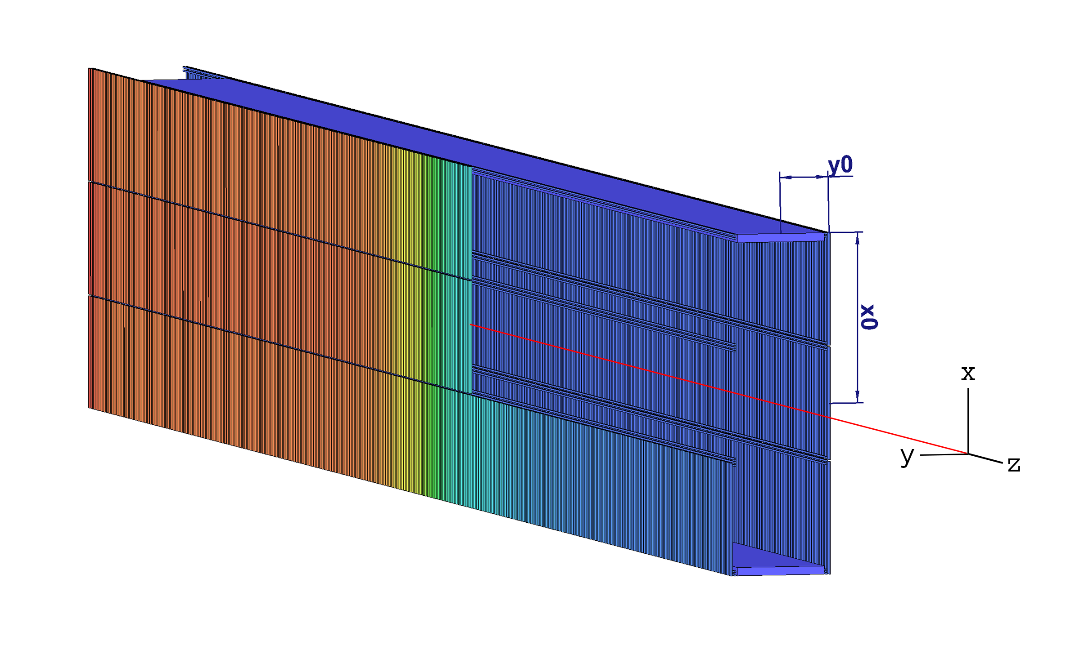
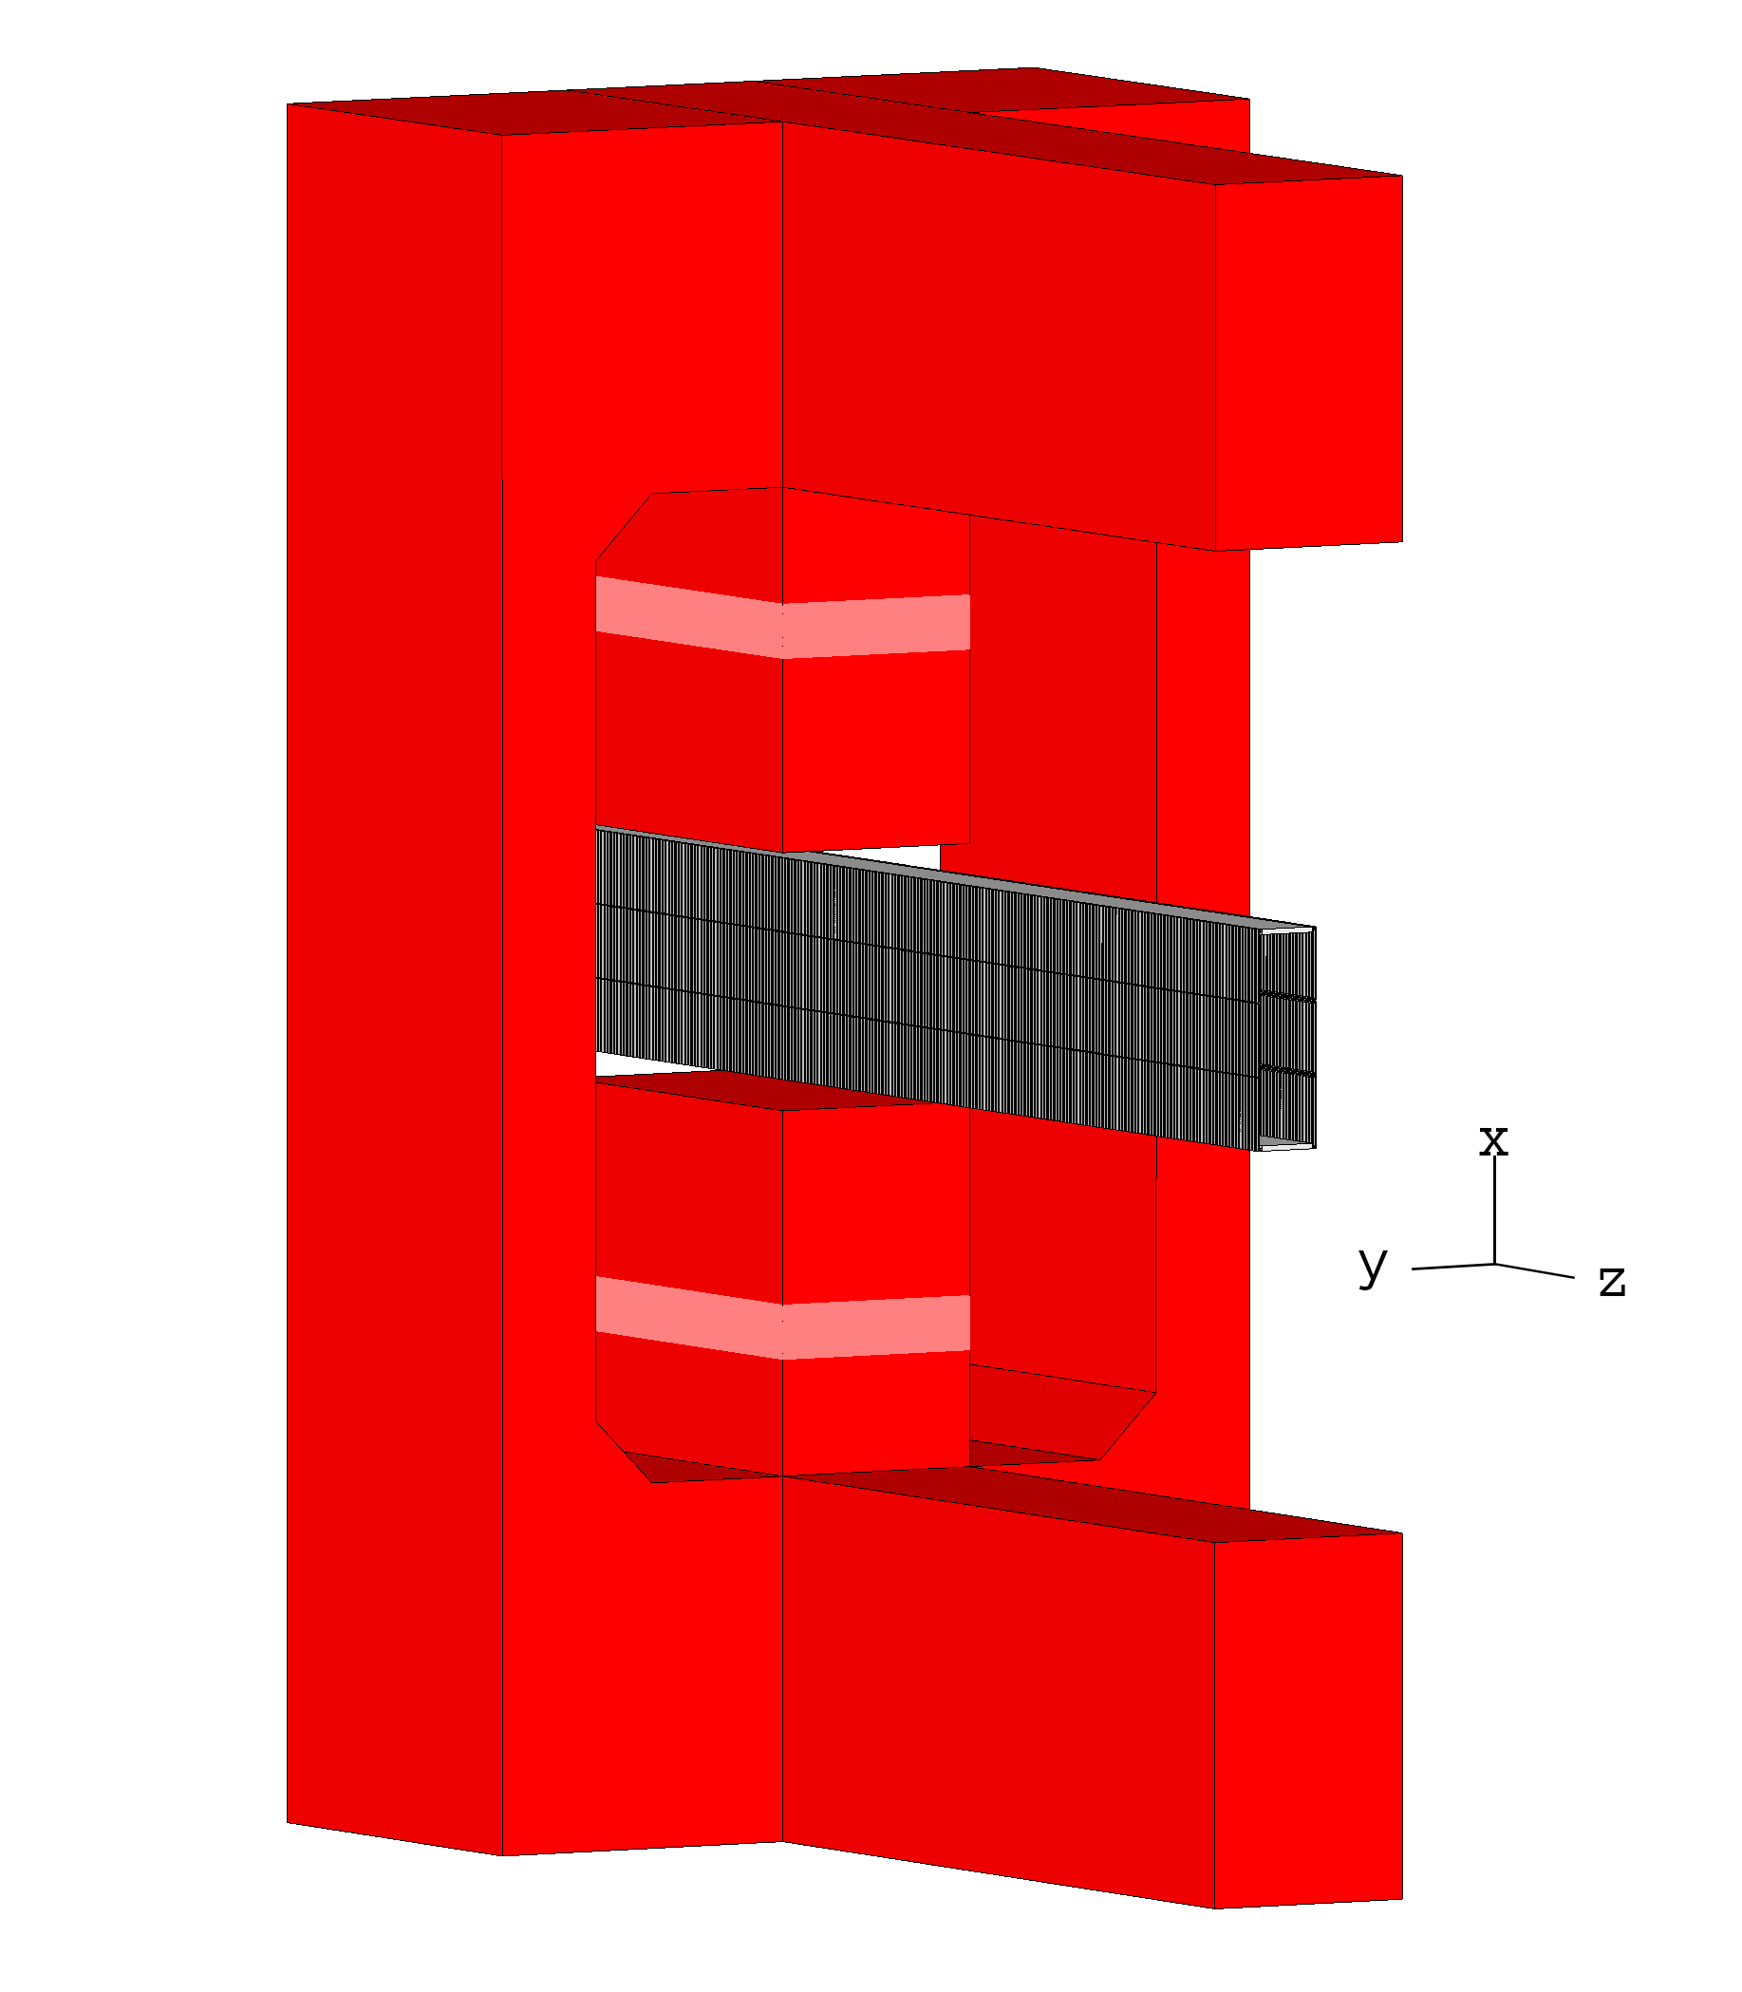
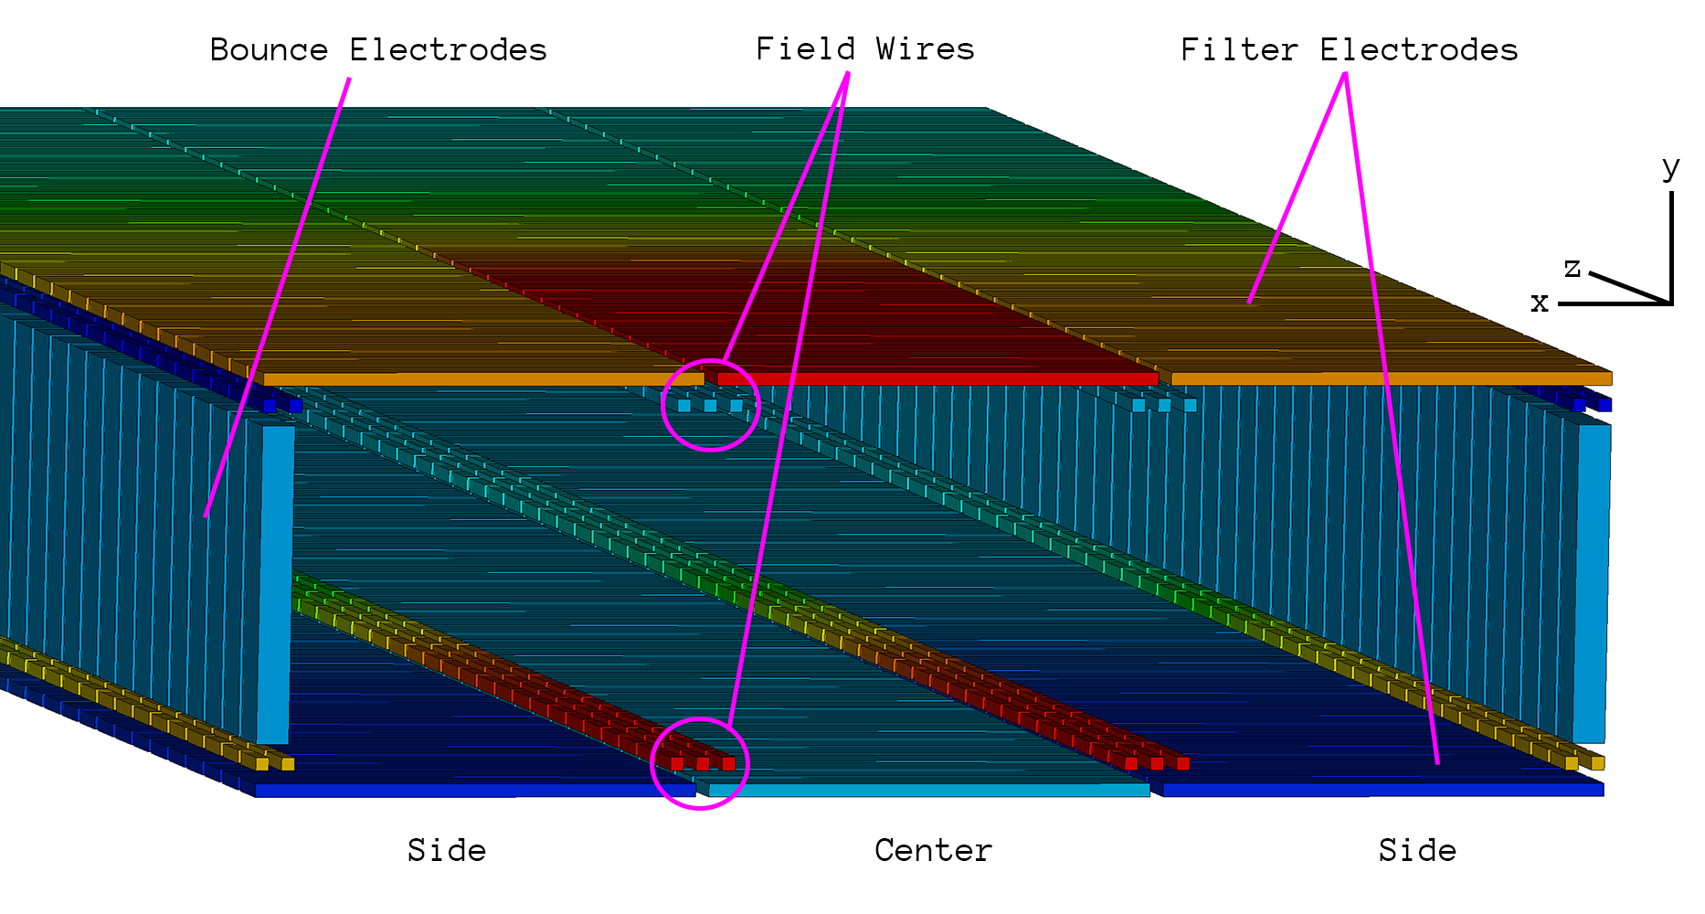
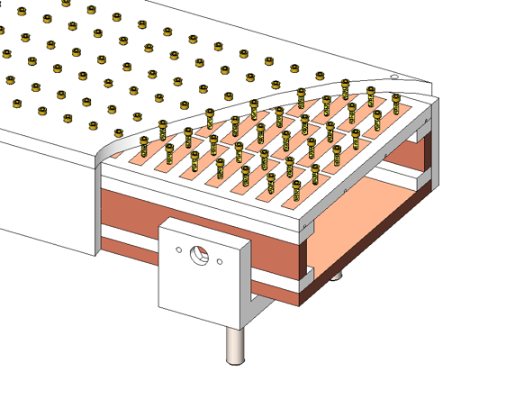
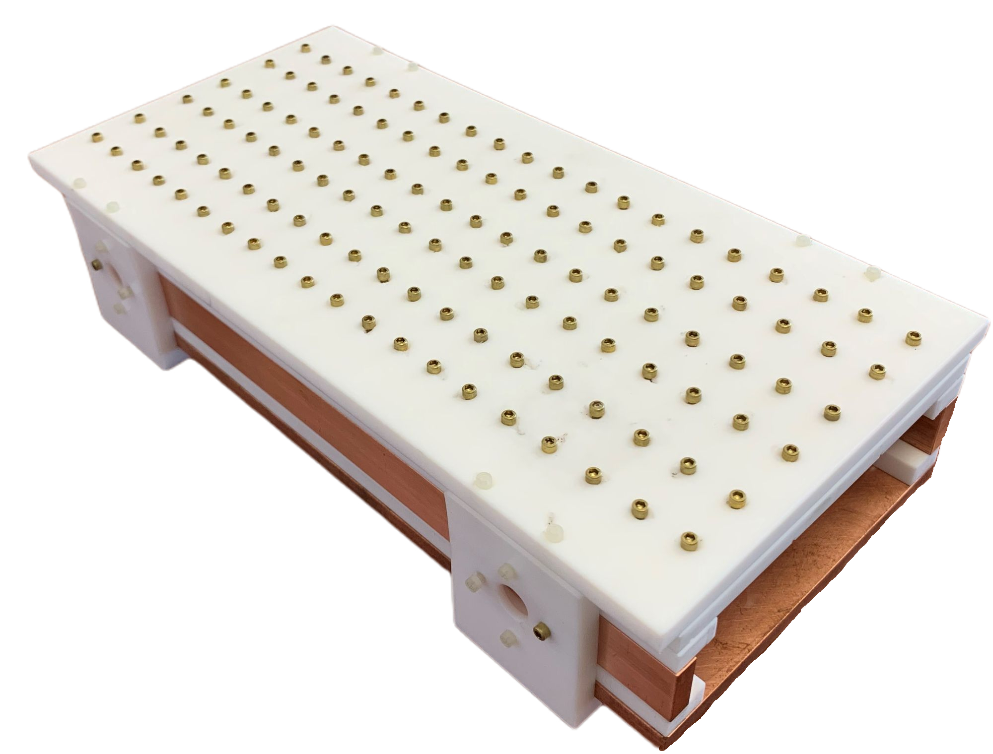
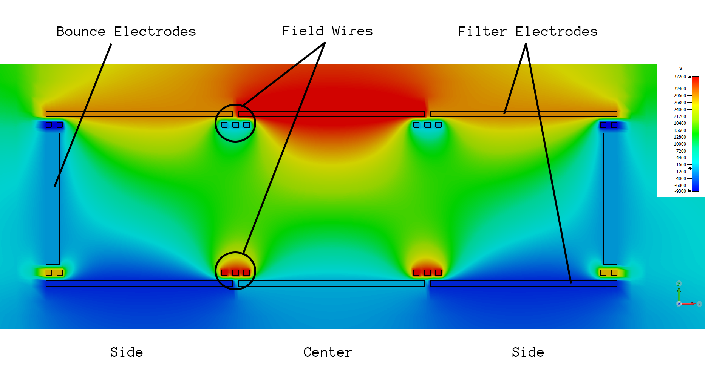
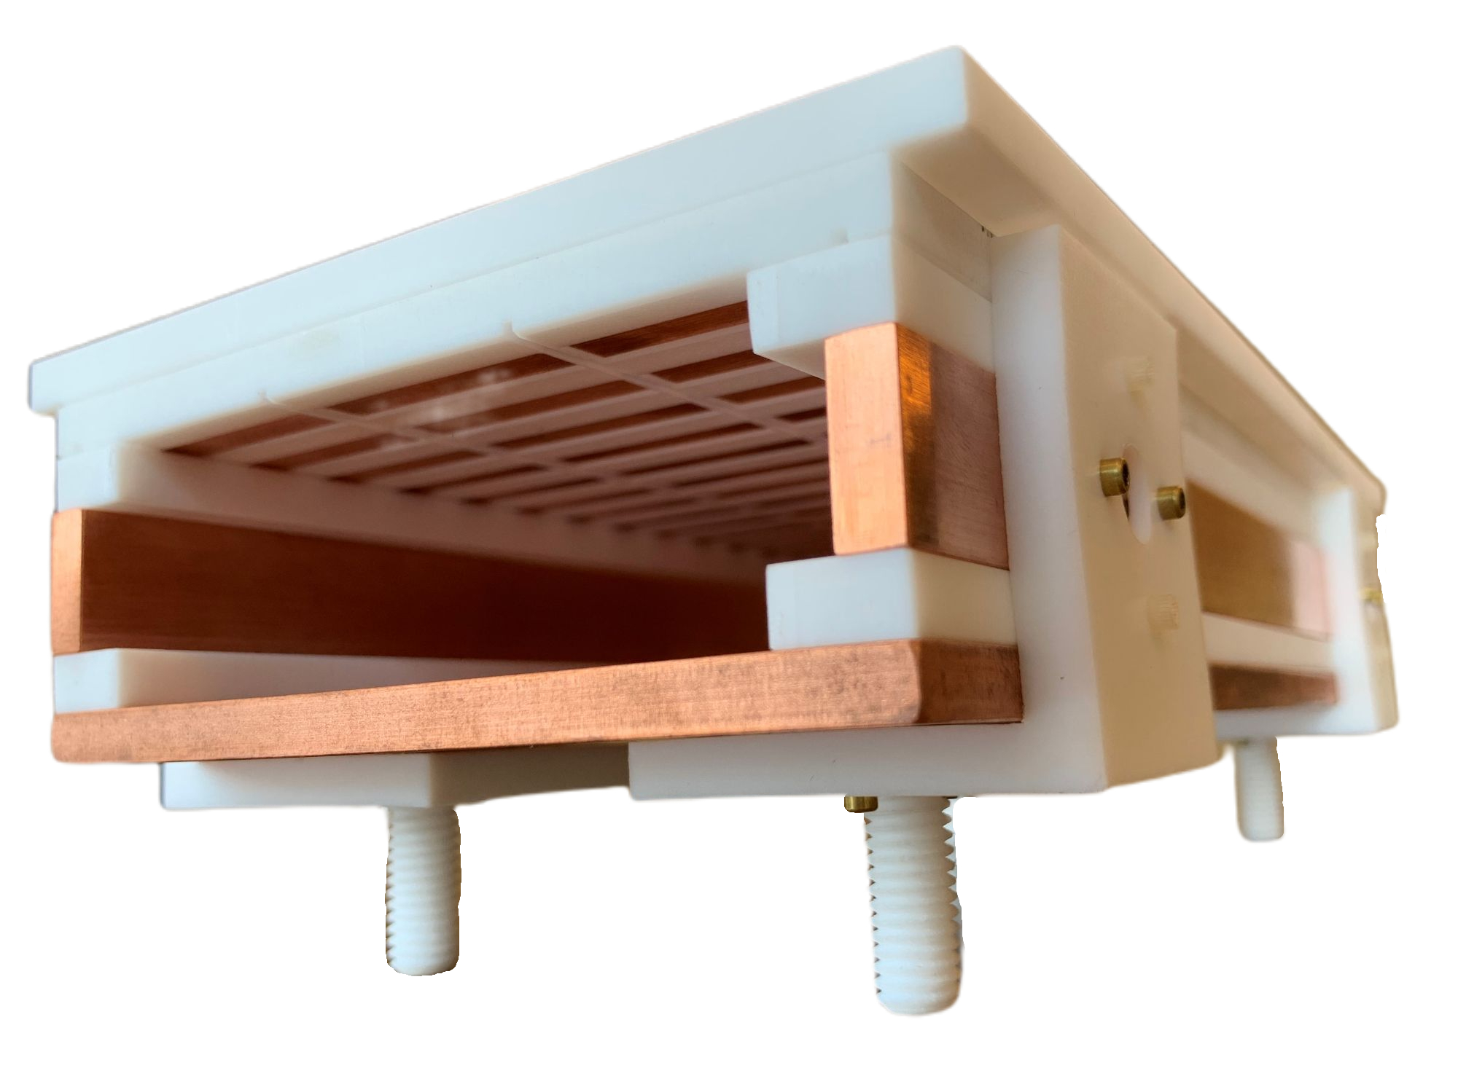
Filter Implementation
Dimension constraints
Radius of B field curvature
Growth of cyclotron radius
Aspect ratio x0/y0 (field uniformity)
Here we use:
y0 = 1.5 cm
x0 = 5 cm
Pole face gap: 12 cm
Andi Tan (Princeton)

Slide 5
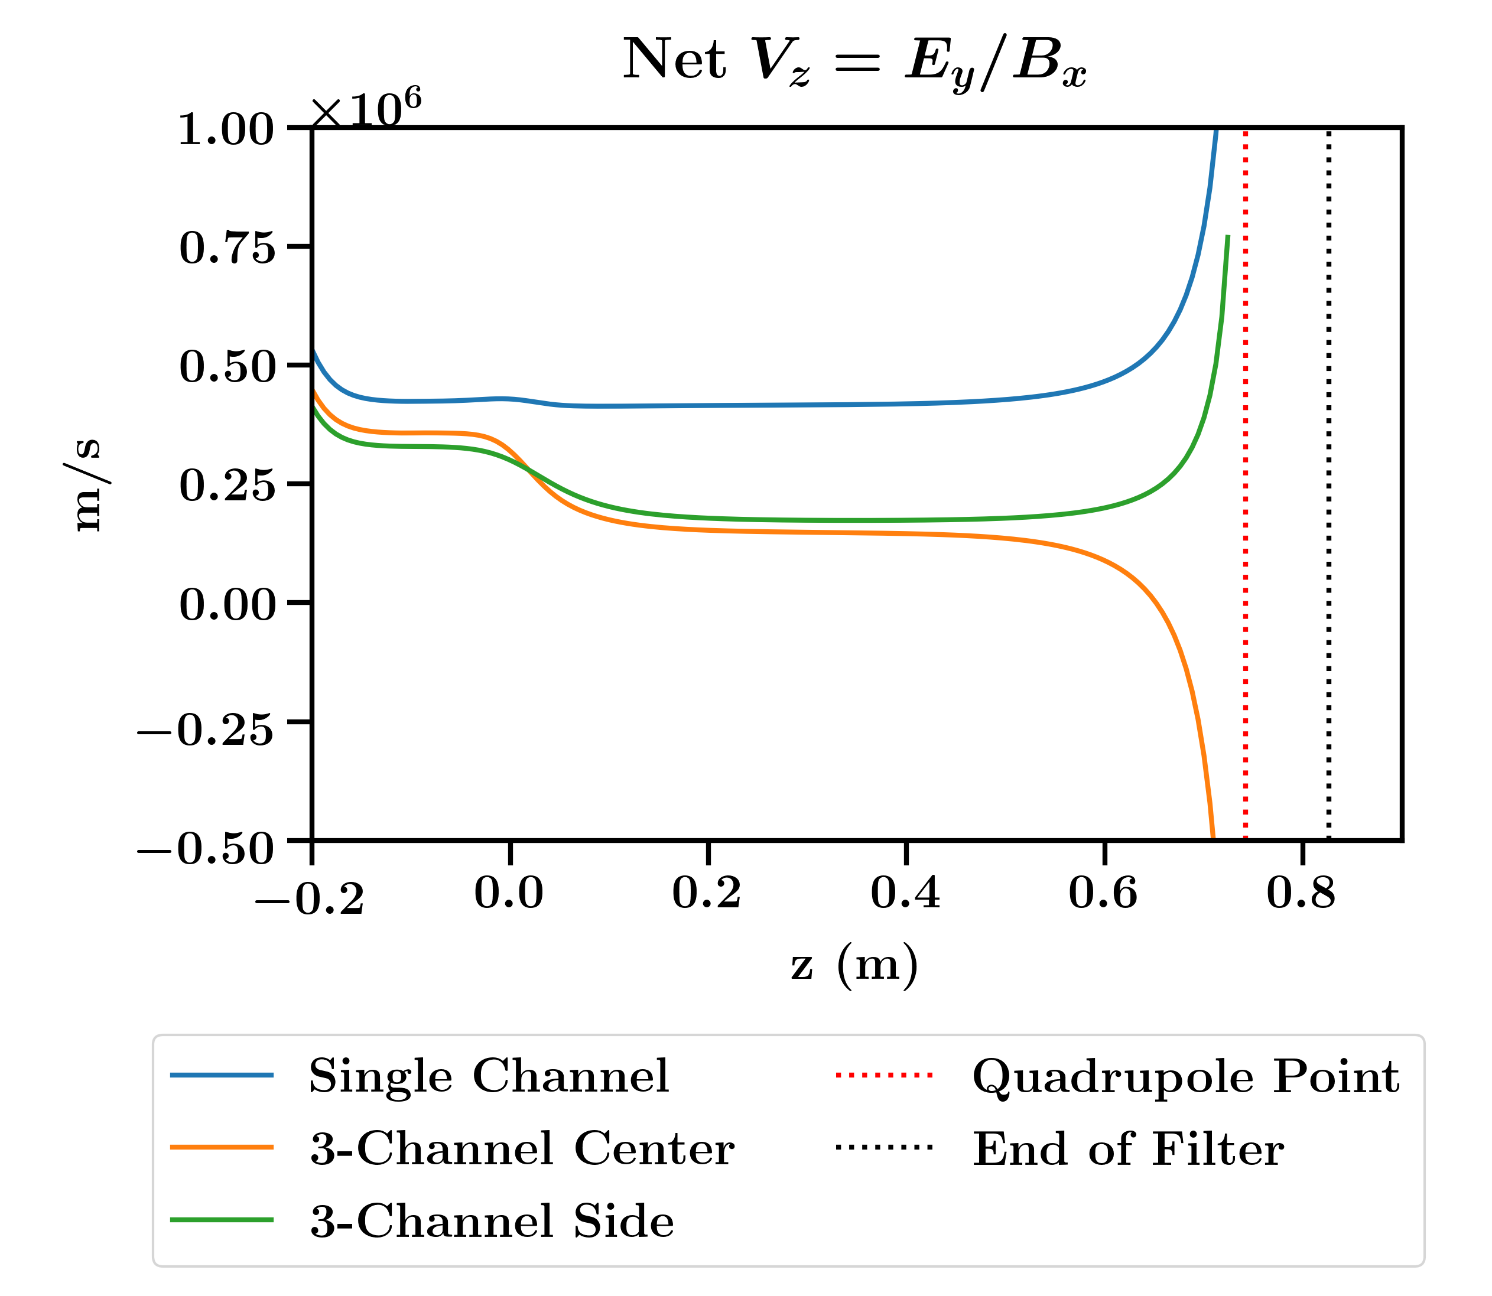
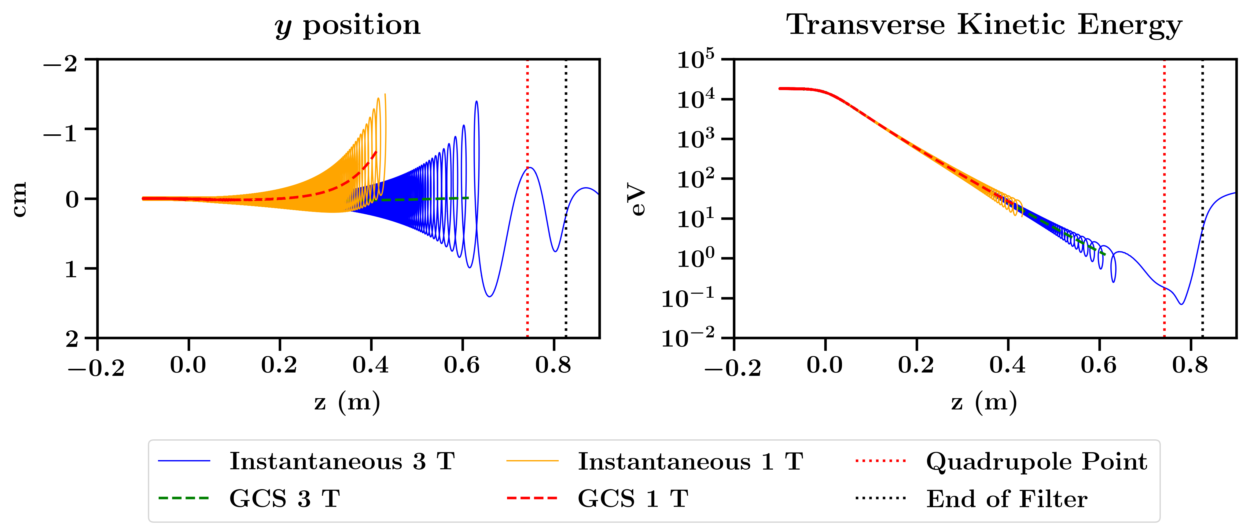
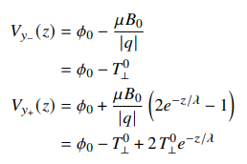
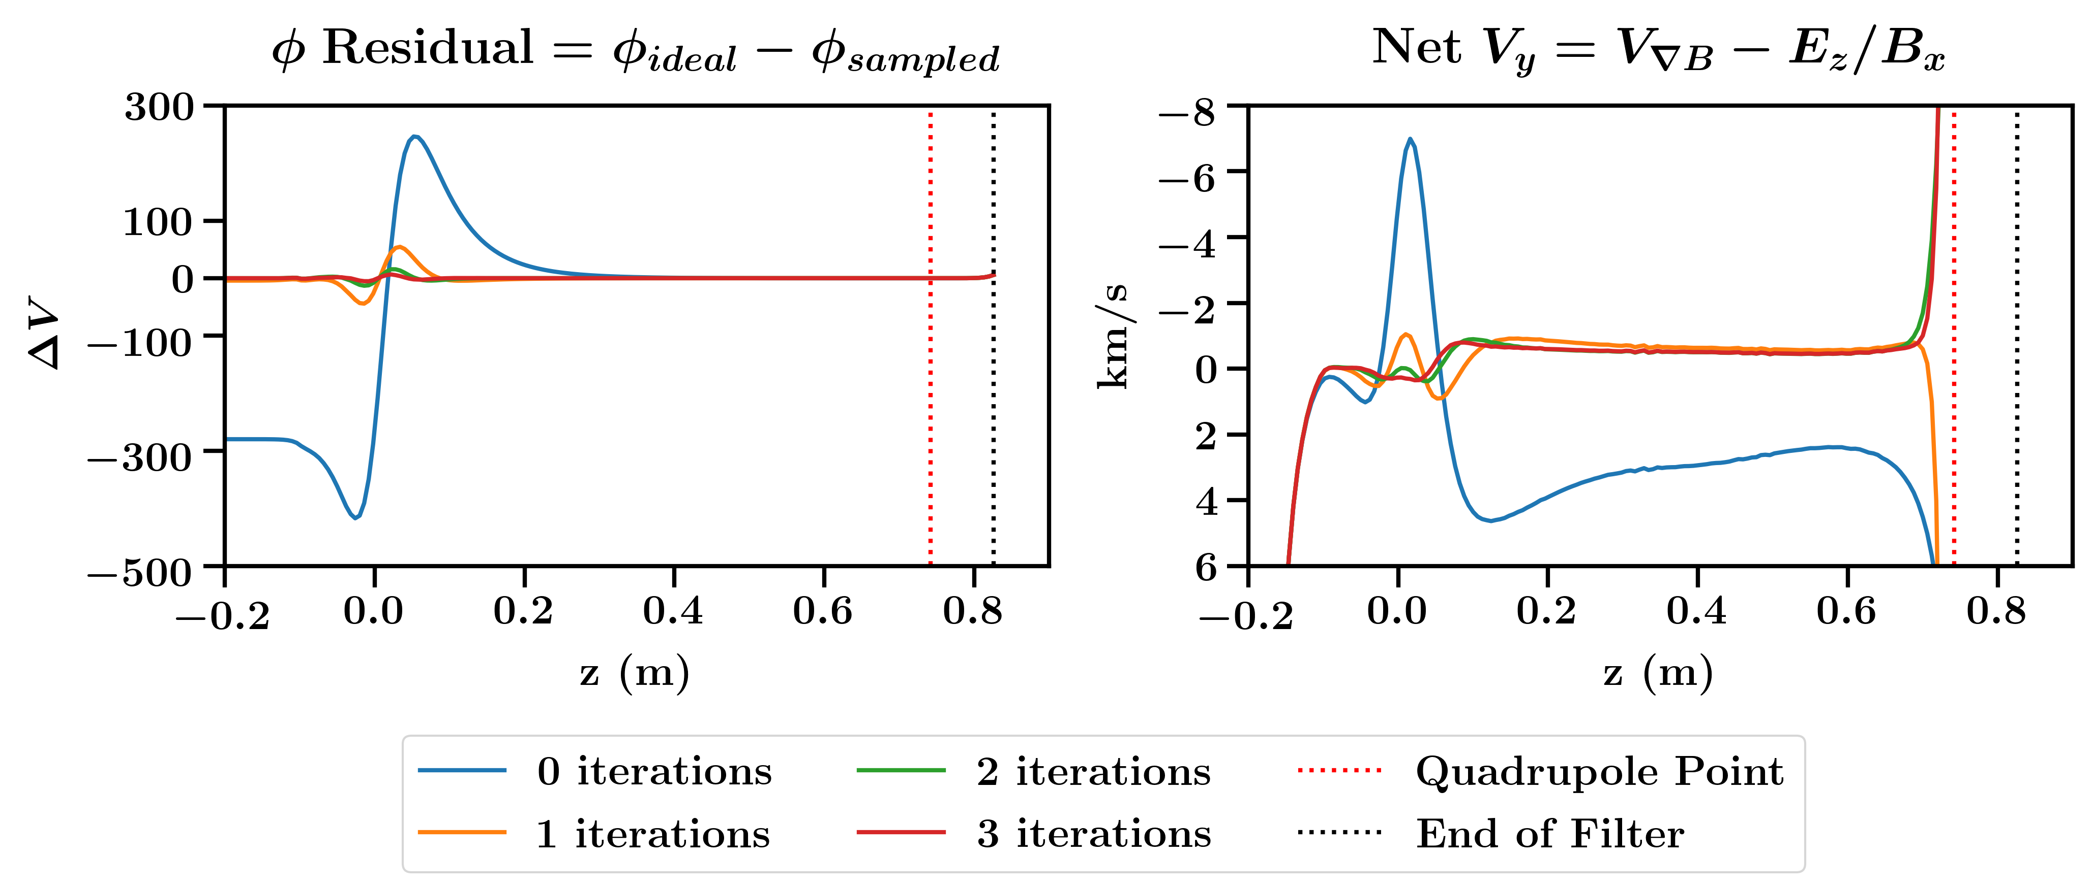
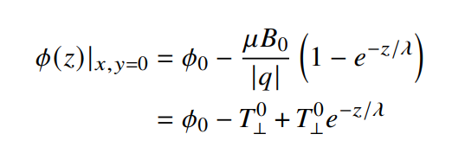
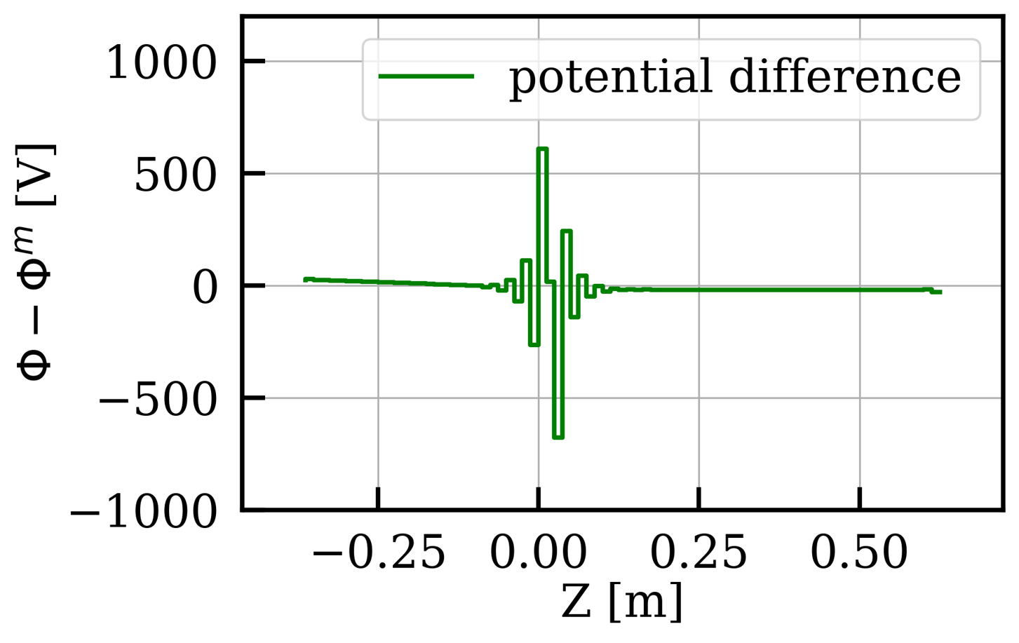
Filter Voltage Settings
Using sampled B-field, two ways to calculate voltages:
Residual iteration on electrode voltages to achieve ‘ideal’ potential along center line
Boundary-value method on same conditions
Drift balancing at entrance is sensitive
Tolerance test of displaced electrode (0.5mm)
Andi Tan (Princeton)

Slide 6
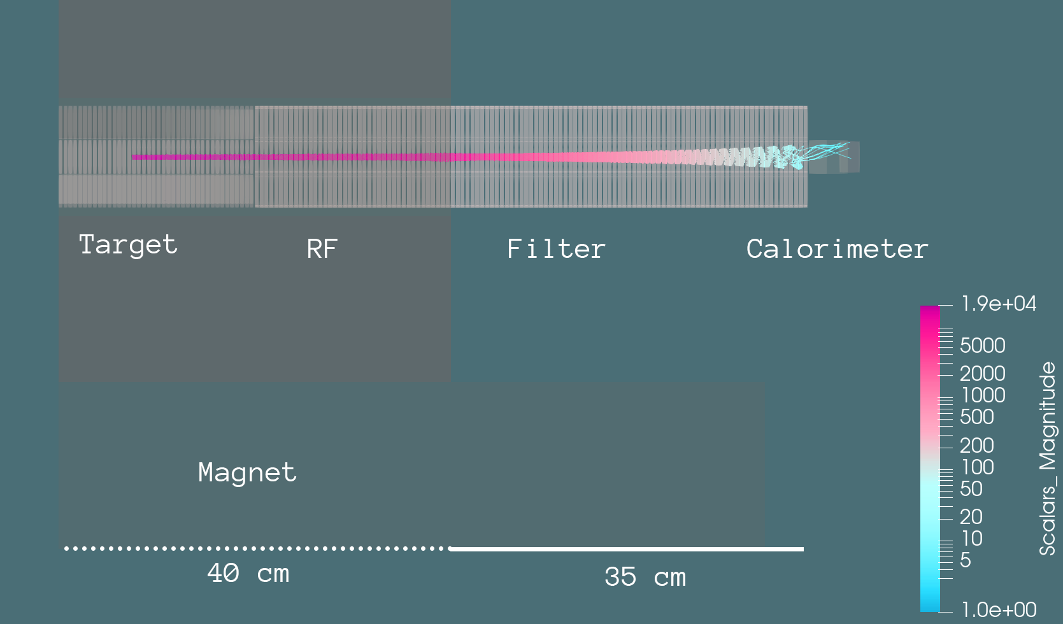
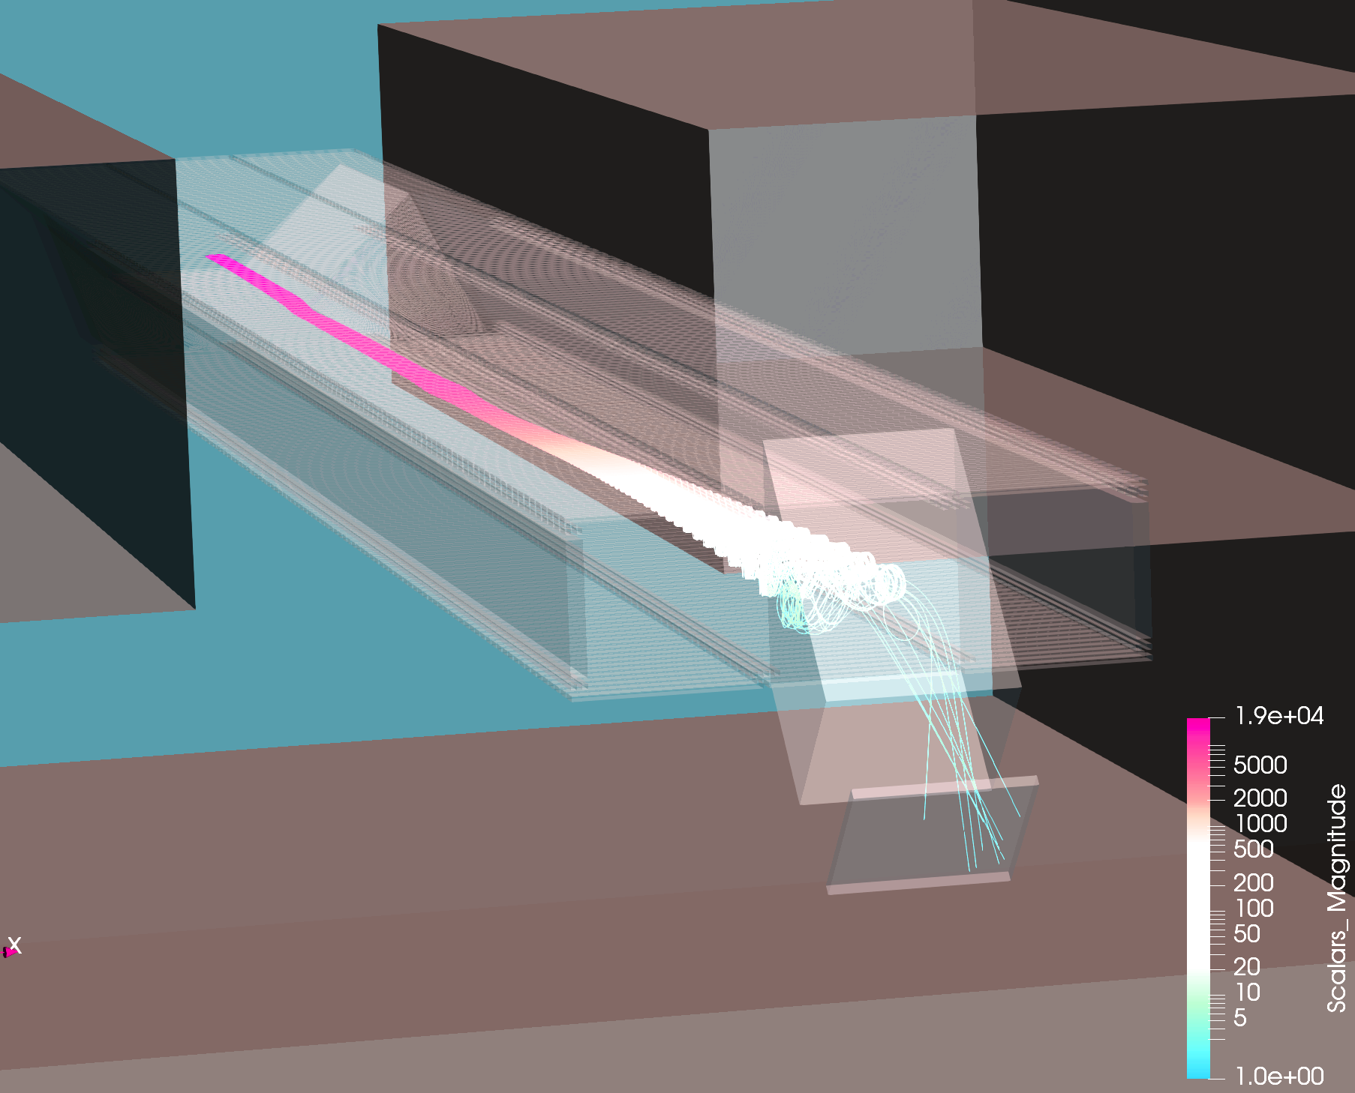
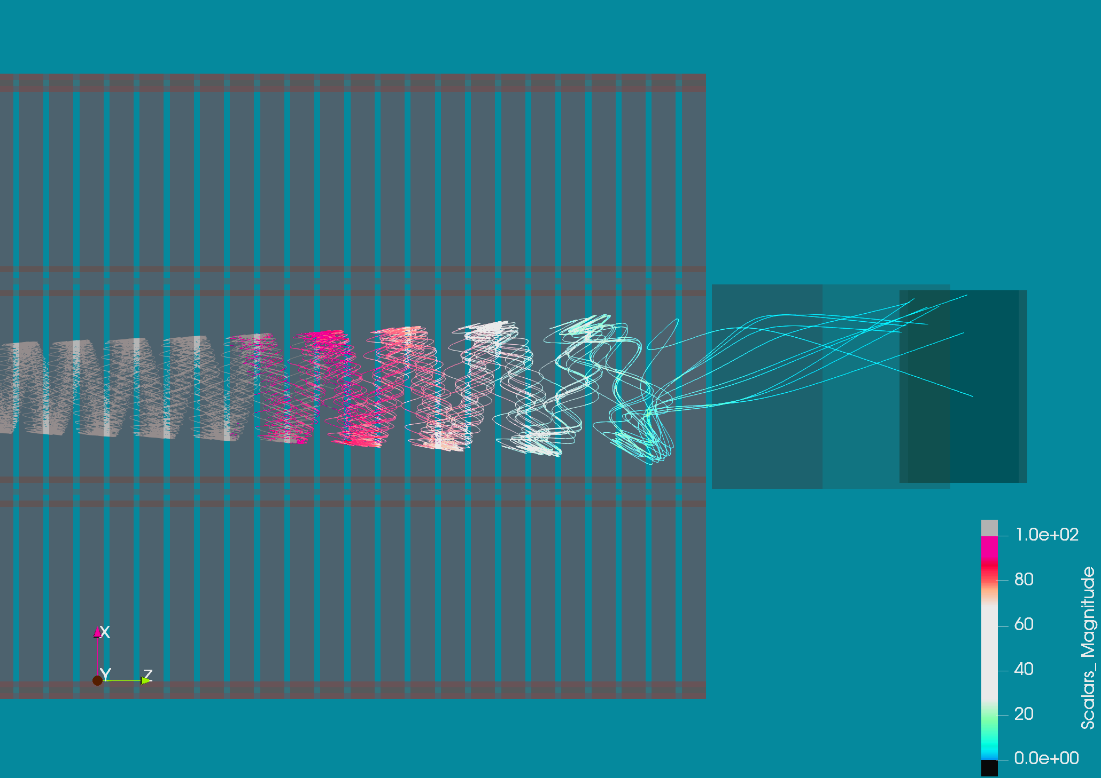
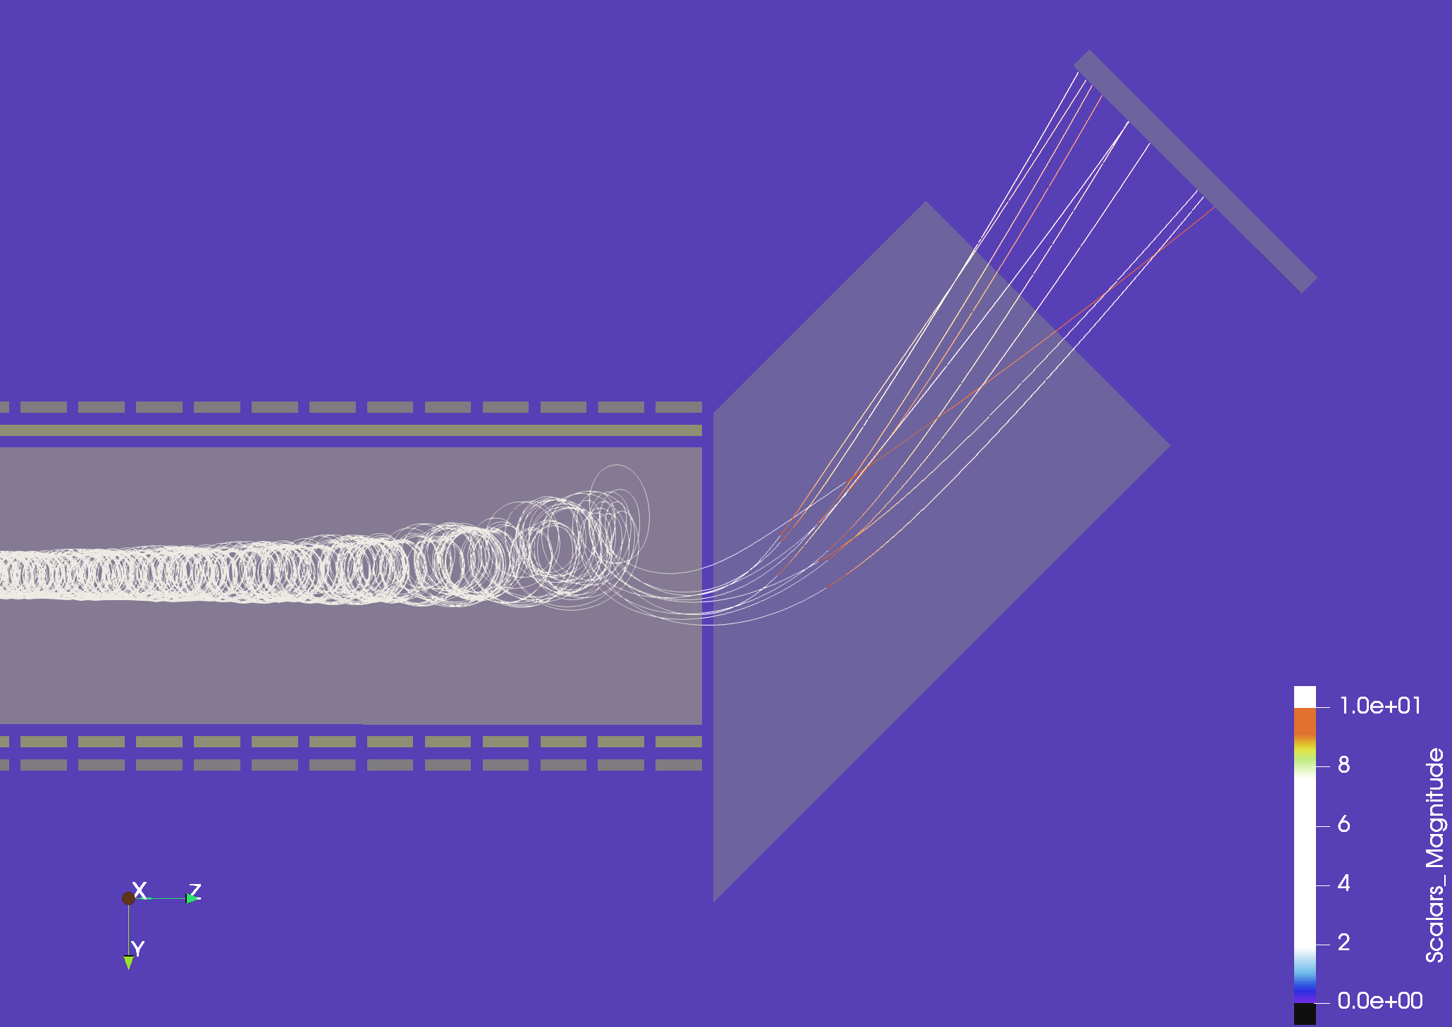
End-to-End Transport in Kassiopeia
Modded to import B field from CST (no iron in Kassiopeia)
Simple ASCII file held in memory
Field mesh size is 0.5mm cubes throughout filter volume
~80 million cells
Trajectories:
Integration: 8th order Runge-Kutta
Interpolation: Continuous Runge-Kutta (CRK)
1/64 cyclotron period time steps
18.6 keV electrons at pitch 85
Target at 18.6 kV to calorimeter (0 V)
Acceptance
Challenging, as expected, but improvements in progress

Slide 7
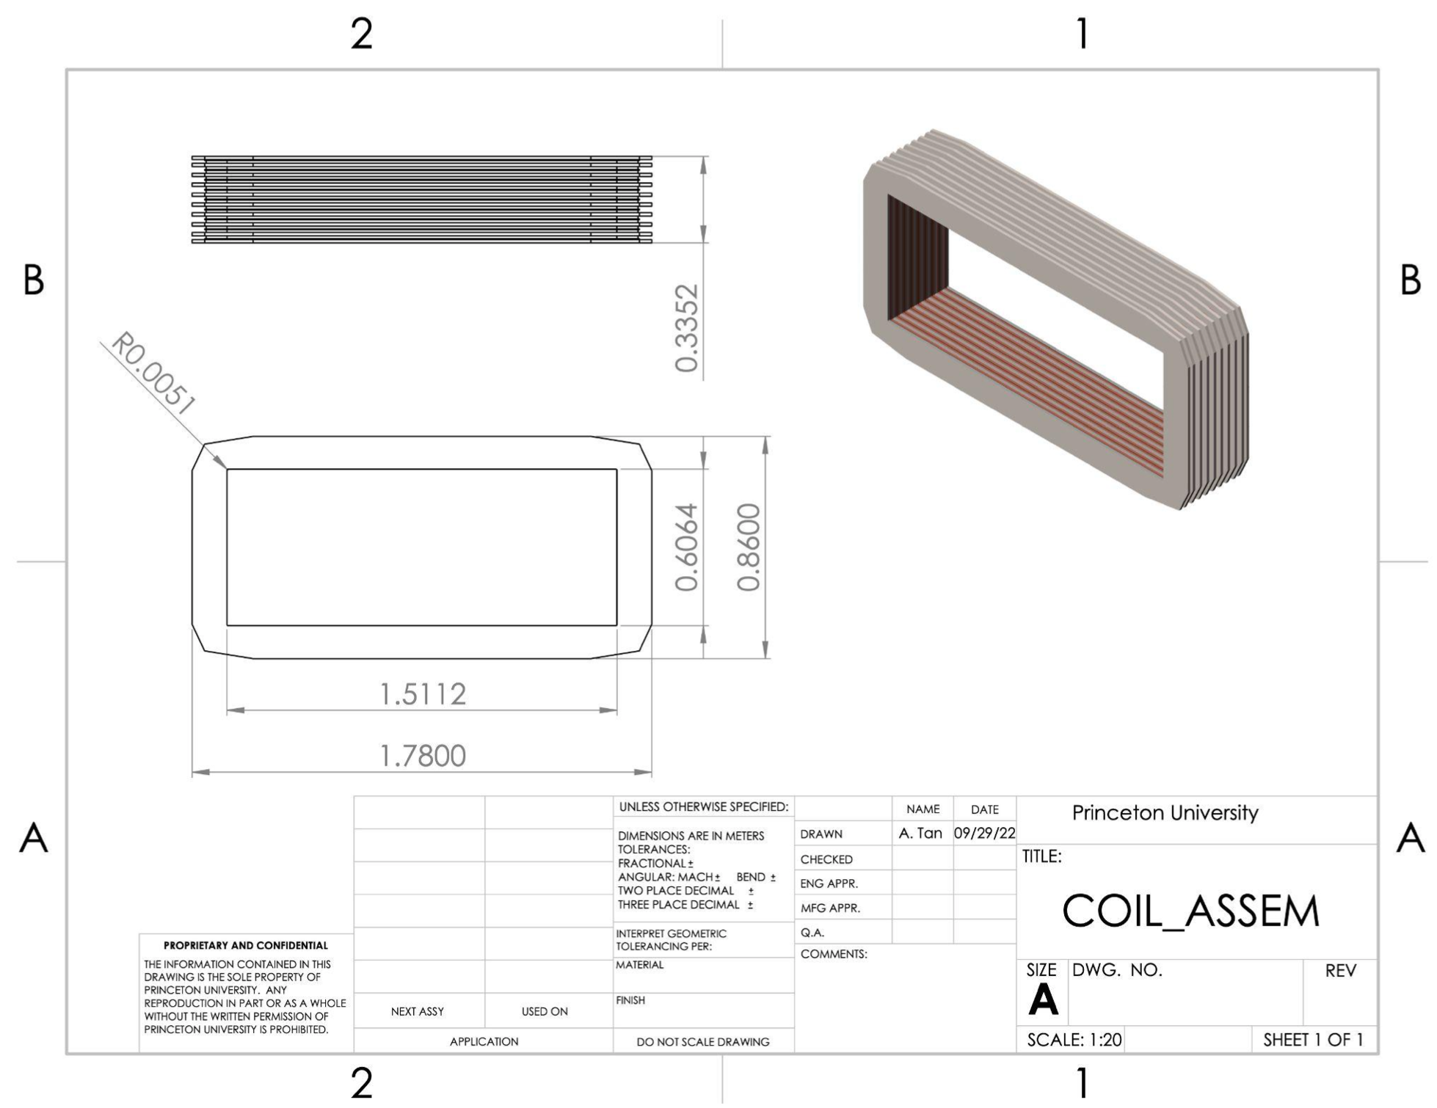
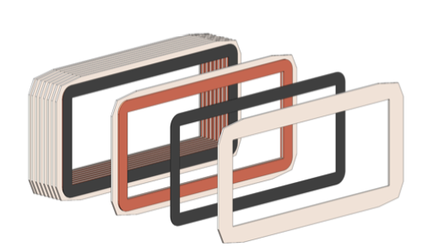
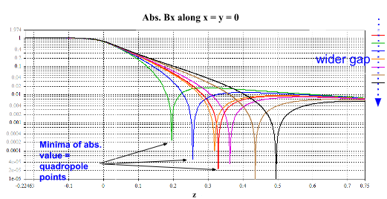
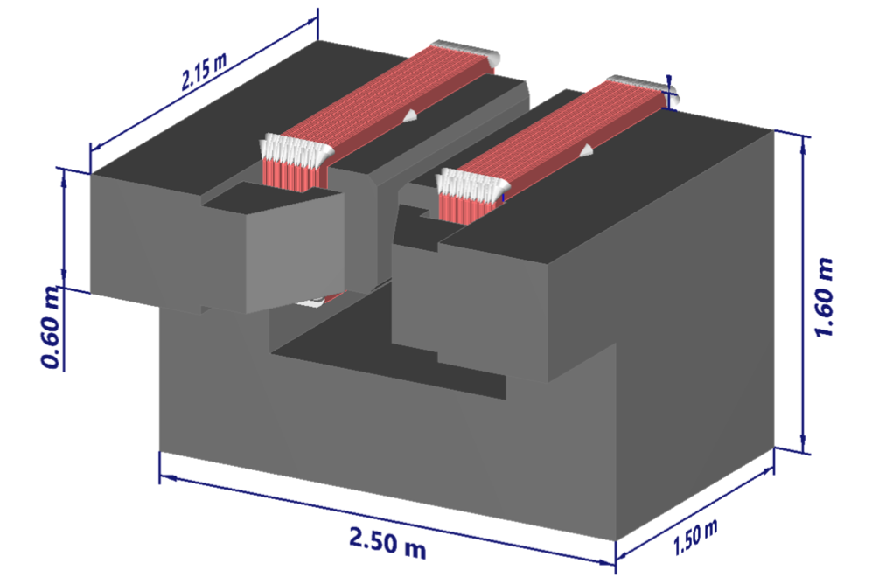
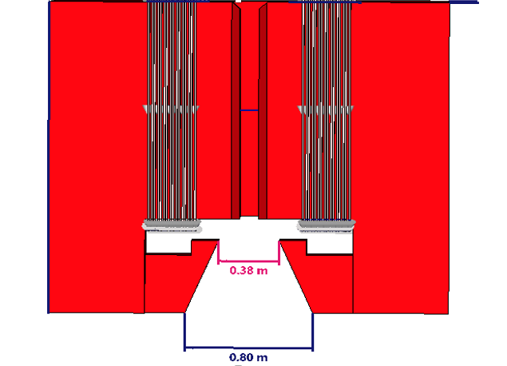
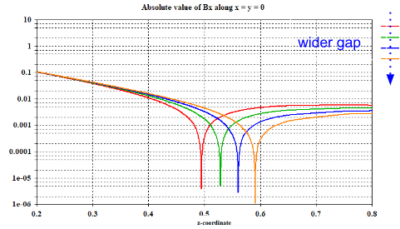
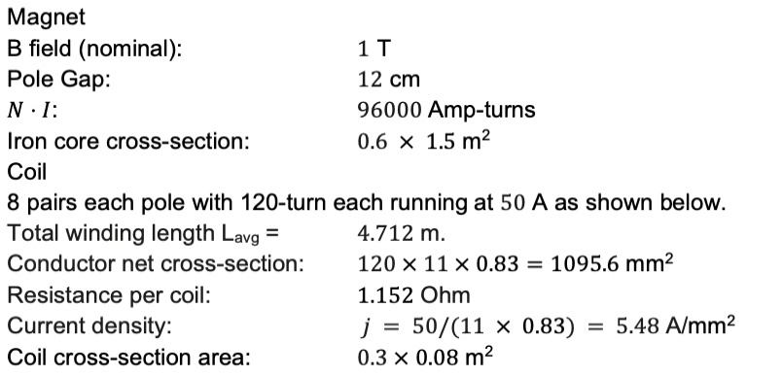
Design of LNGS Magnet
Andi Tan (Princeton)
8 coils, 117V/50A per pair
Power supply: 150V/450A
In talks with Danfysik
Ongoing parameter optimization for iron extensions
Yuno Iwasaki (Princeton)

Slide 8
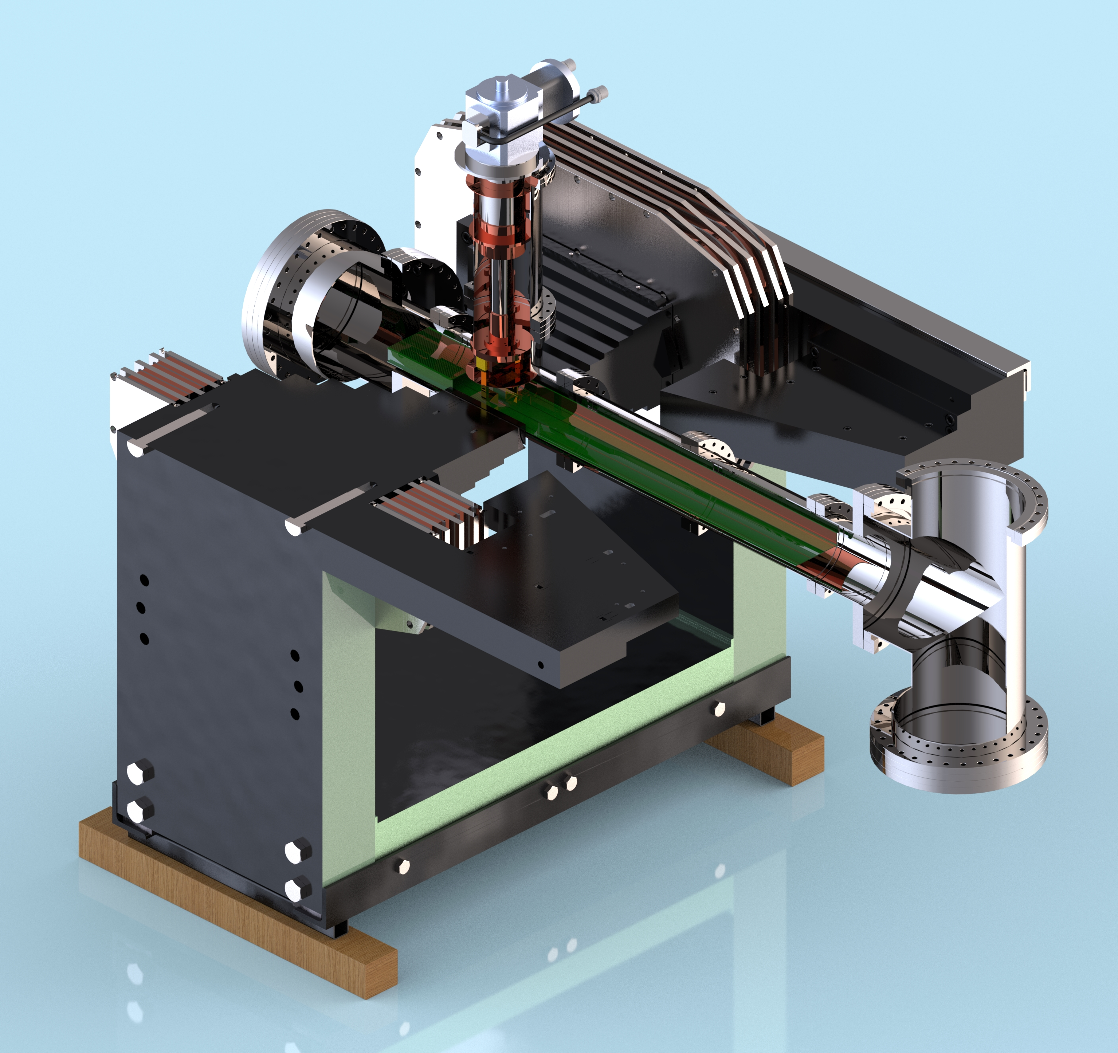
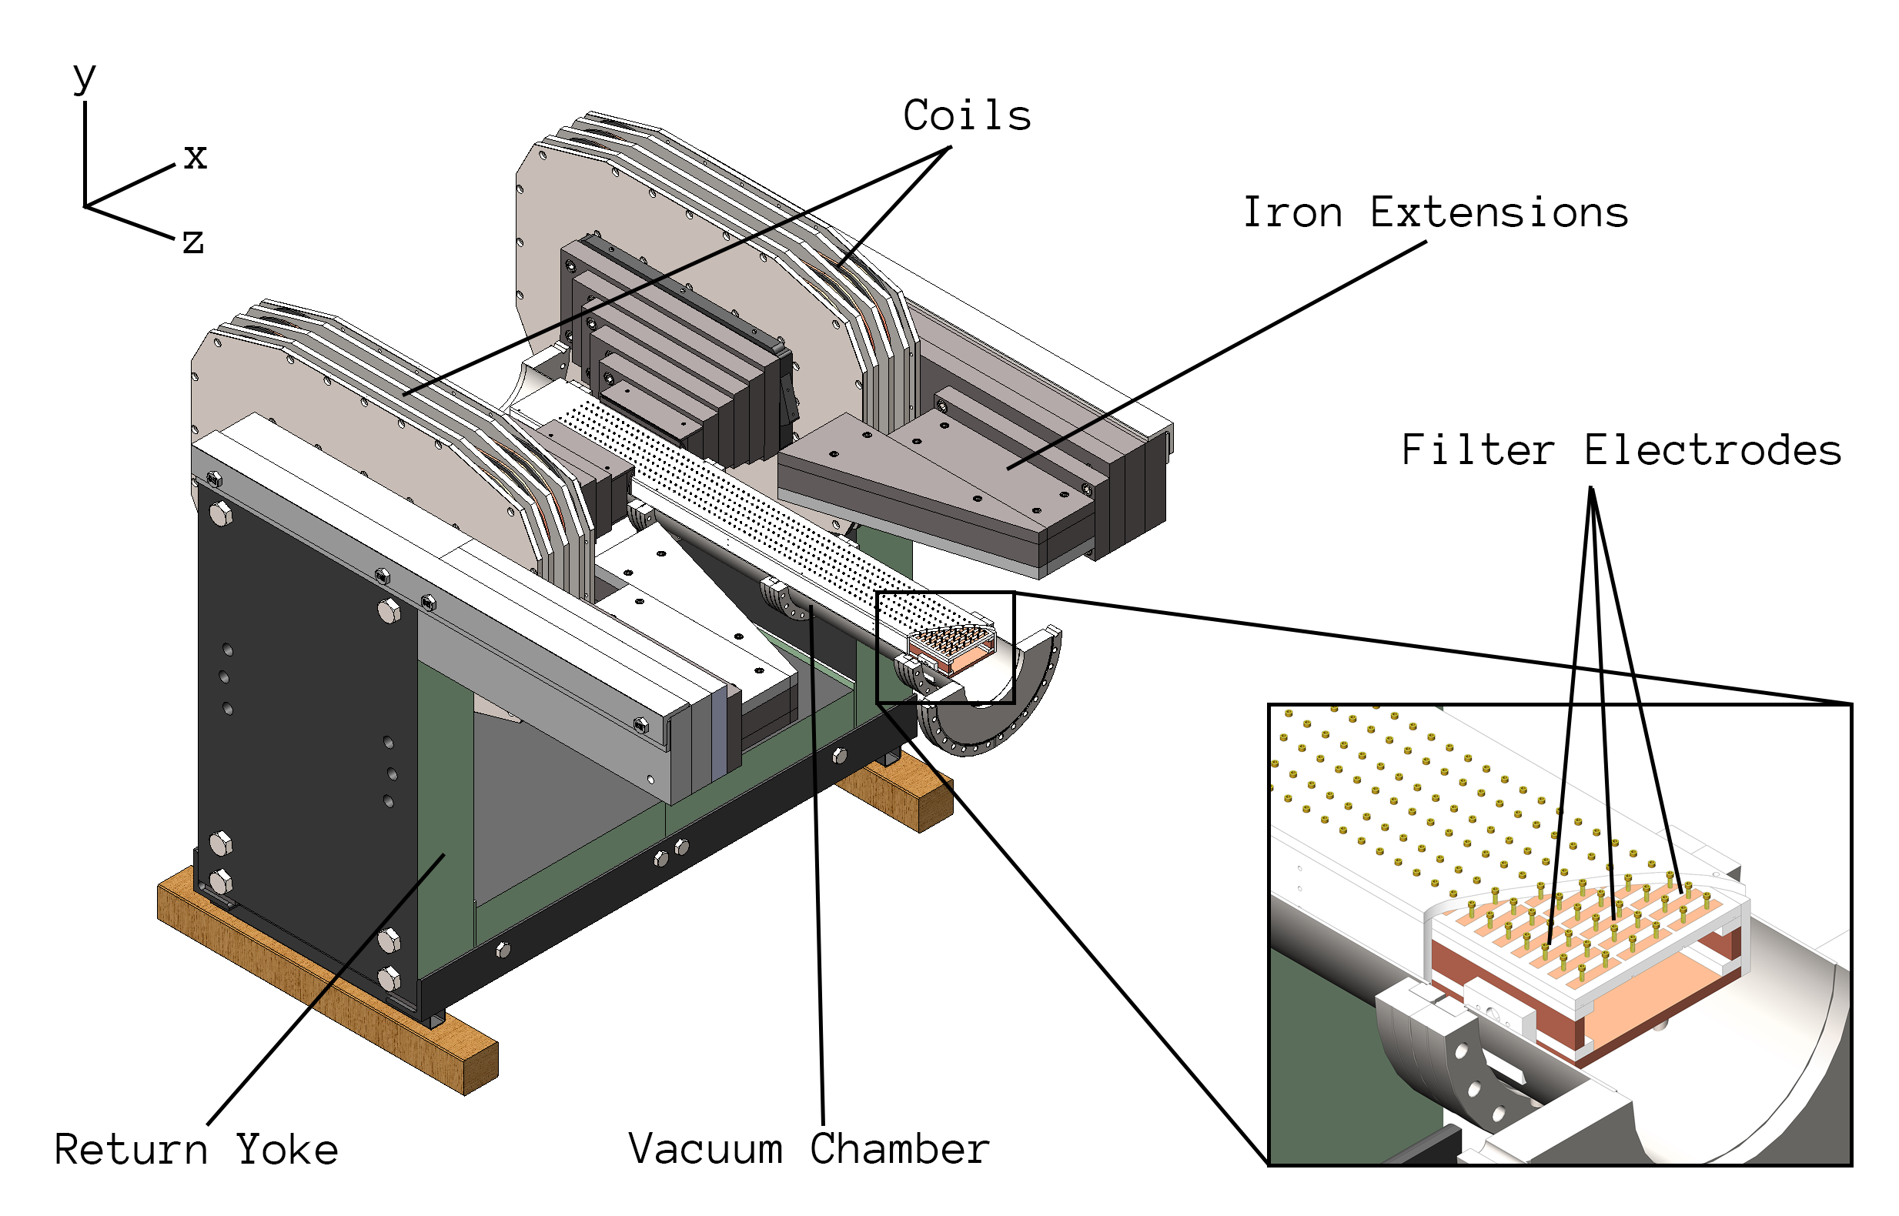
Plans for Princeton Magnet
Validate drift balancing
Readout with silicon drift detector (~150 eV ) or windowless APDs (~5 keV)
Planar C14 source, broad isotropic emission
Vacuum system
~20 cm filter
Andi Tan (Princeton)

