Slide 1
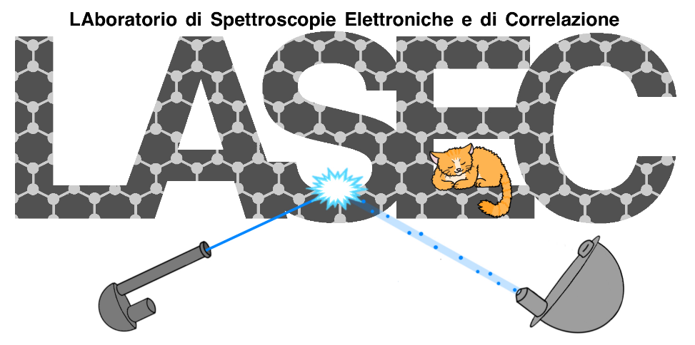
Measuring the Absolute efficiency of a Micro Channel Plate
at Roma Tre and perspective of e⁻ source
Alice Apponi, Alessandro Ruocco
Università Roma Tre and INFN Roma Tre
Gianluca Cavoto, Carlo Mariani
Università Sapienza and INFN Roma
Francesco Pandolfi, Ilaria Rago
INFN Roma
PTOLEMY meeting 06-07.10.2022

Slide 2
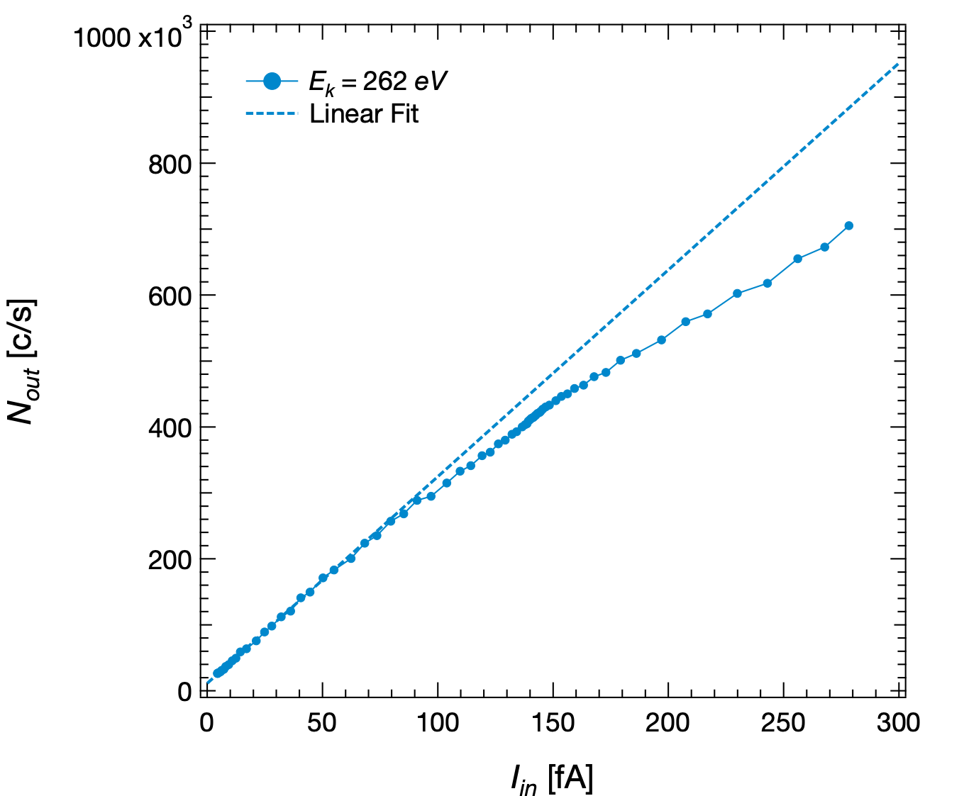
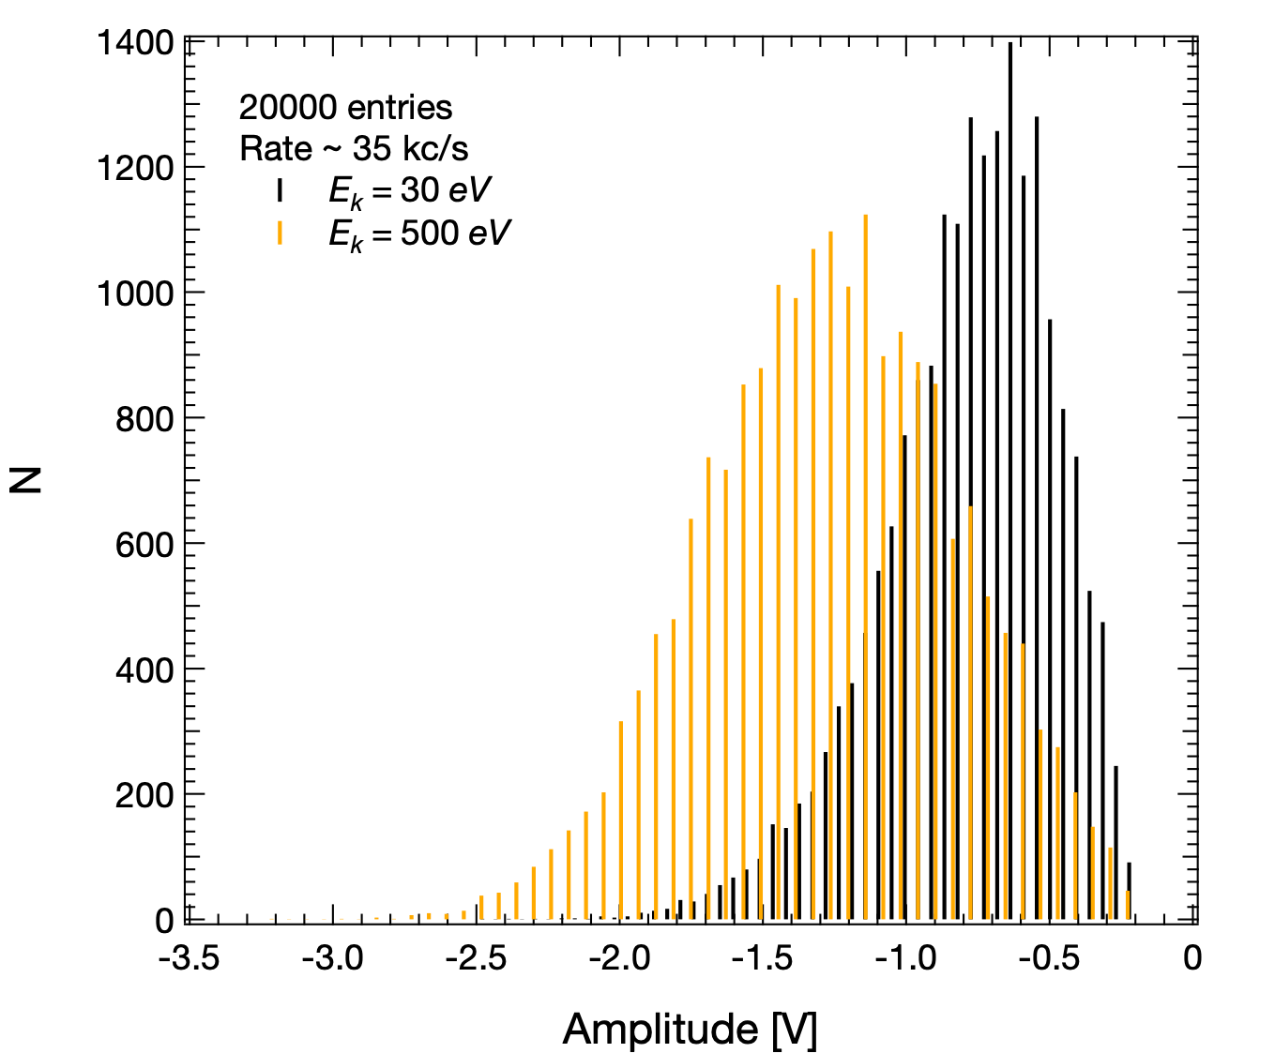
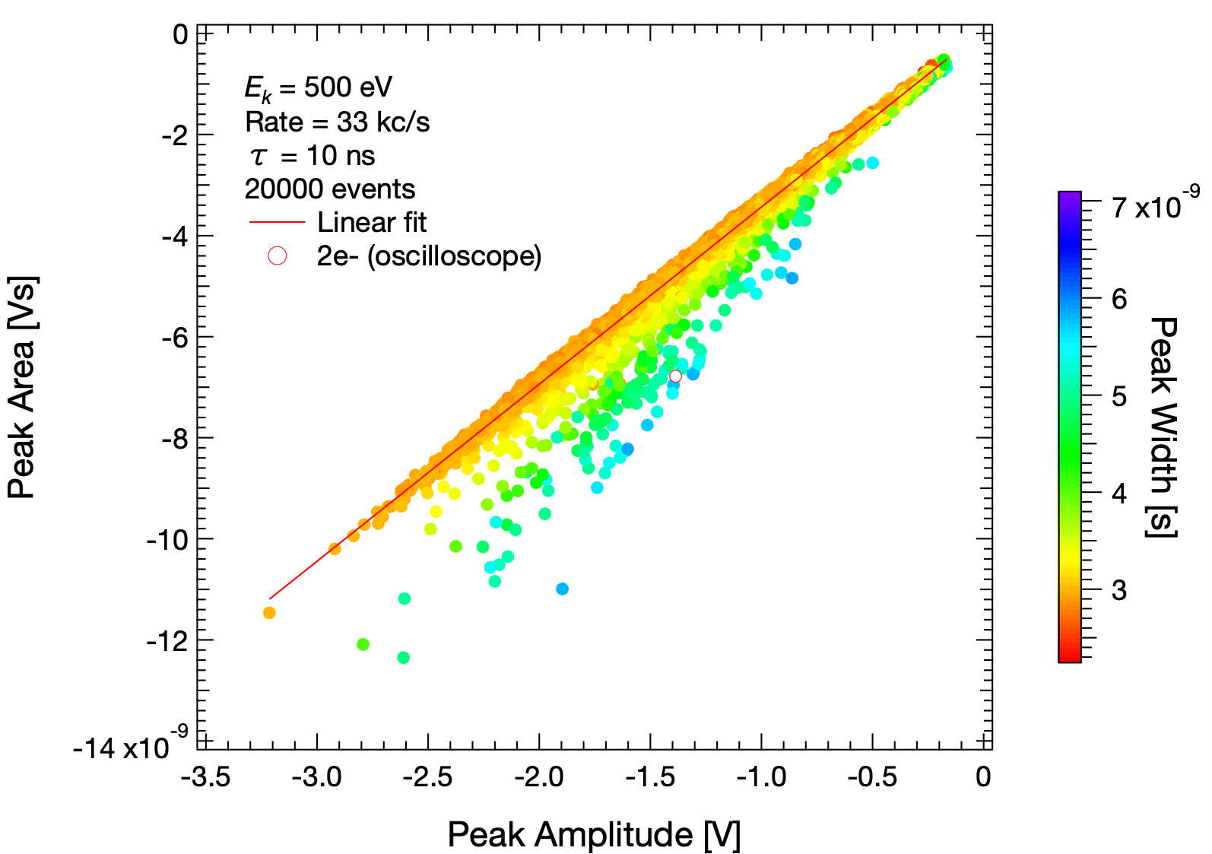
MCP characterisation in the (30-900) eV energy range
Absolute efficiency (ε)
$$ε=\frac{eN_{out}}{I_{in}}$$
Pulse Height Distribution (PHD) and Resolution (PHR)
Single- to multi-electron events discrimination

Slide 3
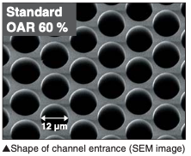
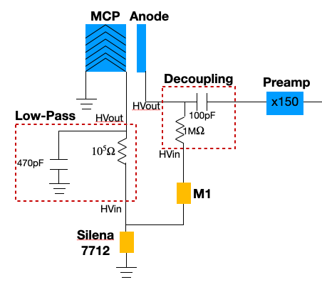
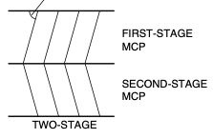
Two-stage MCP
Hamamatsu MCP F1551-21S
Outer size $⊘$ = 27 mm
Effective diameter $⊘$ = 14.5 mm
Channel $⊘$ = 12 $μ$m
Open Area Ratio 60%
Two-stage chevron
Bias angle ~8°
Max MCP supply voltage 2.0 kV
27 mm
14.5 mm
Bias
angle
MCP supply voltage 1800 V
∆Anode +100 V

Slide 4
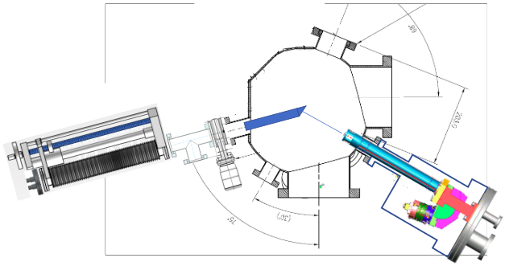
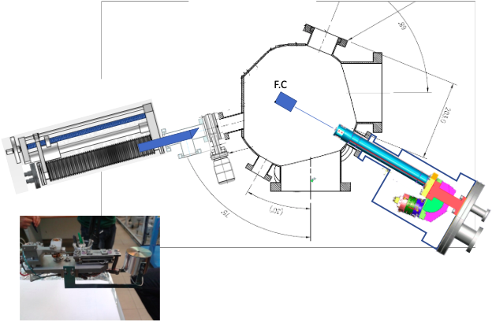
We measure the absolute beam current or MCP output
MCP
e-gun
$$ε=\frac{eN_{out}}{I_{in}}$$
e-gun
Mono gun main feature:
Beam energy (30 - 900) eV
Beam current in fA range
Continuous beam
UH-Vacuum
~10⁻¹⁰ mbar

Slide 5
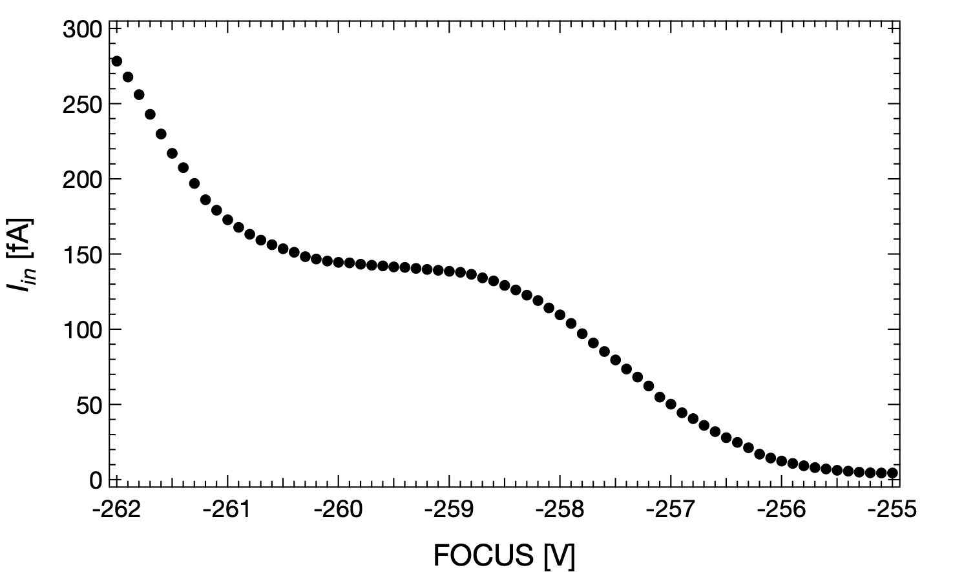
Efficiency measurement: the method
Current scan in range [ ~5, ~280 ] fA
$$I_{0}$$
FOCUSED beam: current scan on FC
E2
FOCUSED beam:
$$I_{0}$$
TIME ~2h
Why?
FC hole $⊘$ = 3 mm
Slight beam shift during scan
Full current integration
LARGE beam: current scan on MCP
$$I_{0}$$
LARGE beam
FOCUSED beam: current scan on FC
Why?
MCP area $⊘$ = 14.5 mm
Avoid damages
Higher efficiency expected
Verify that the beam size variation modifies the current density only (not the total current!)
Check stability with current measurement before and after

Slide 6
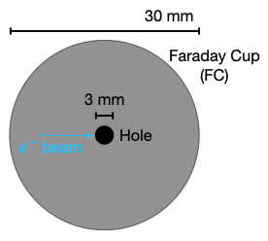
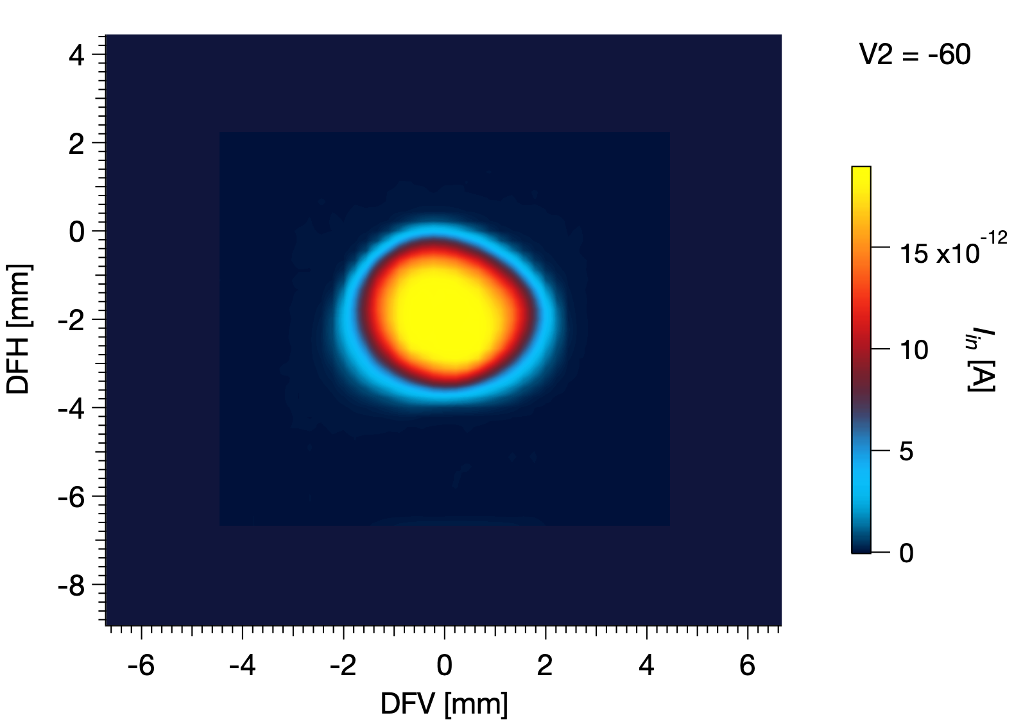
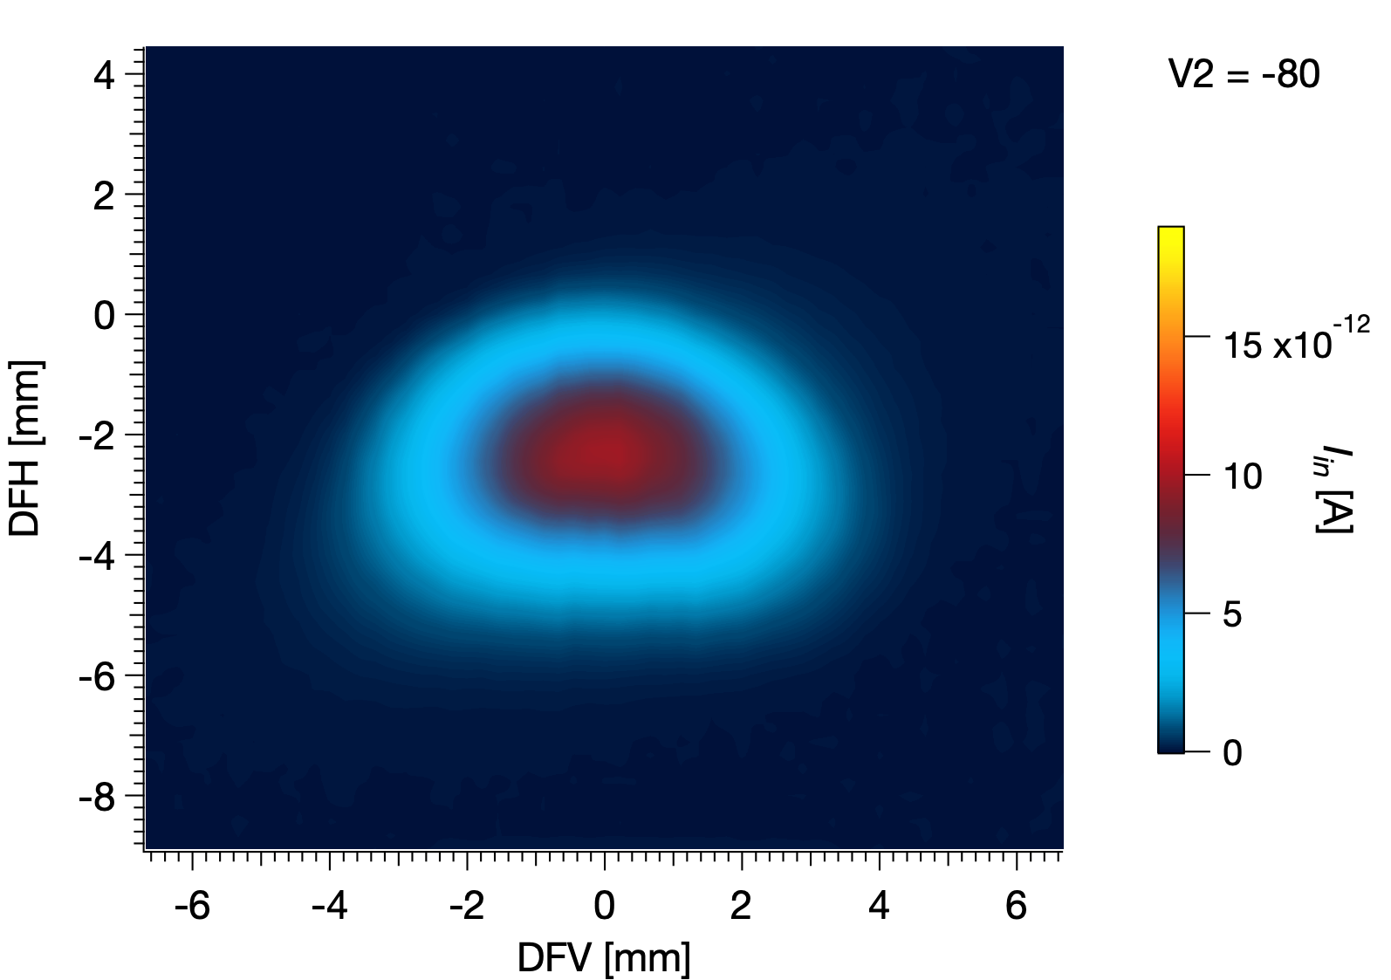
The beam size variation modifies the current density only
2D spatial scan on FC
Measurement time ~2h
FOCUSED beam
LARGE beam
$$E_{k}=90eV$$
$$\underset{i}{∑}I_{i}=3.2⋅{10}^{−9}A$$
$$\underset{i}{∑}I_{i}=3.3⋅{10}^{−9}A$$

Slide 7
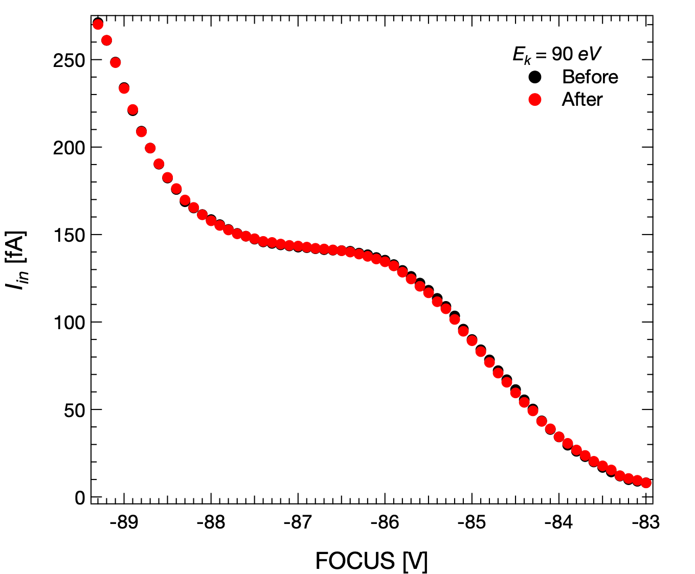
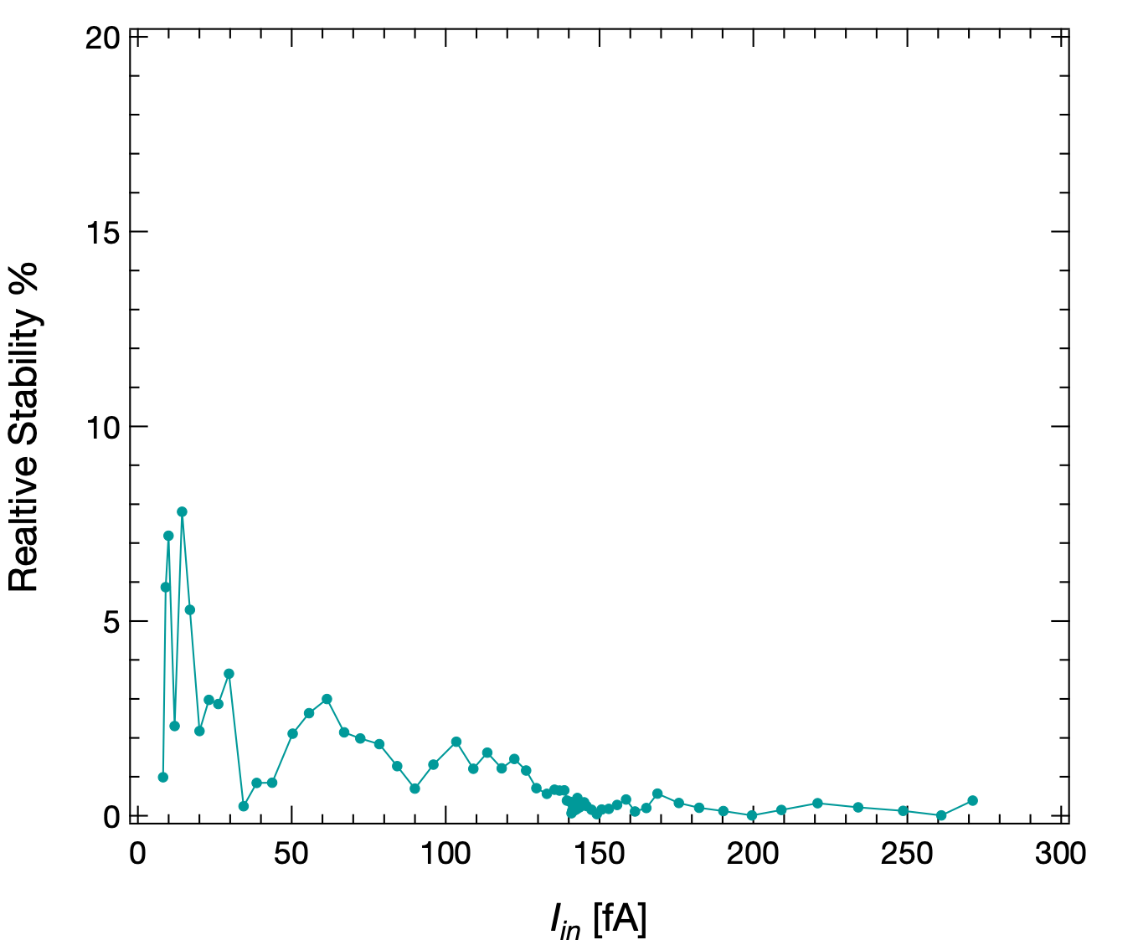
We have a good stability on current
Stability $→$ before-after difference
Accuracy $→$ 1% + 3 fA
Total uncertainty $ΔI_{in}=\sqrt{\text{( ( }\text{Accuracy}\text{ )2 + ( }\text{Stability}\text{ )2 )}}$

Slide 8
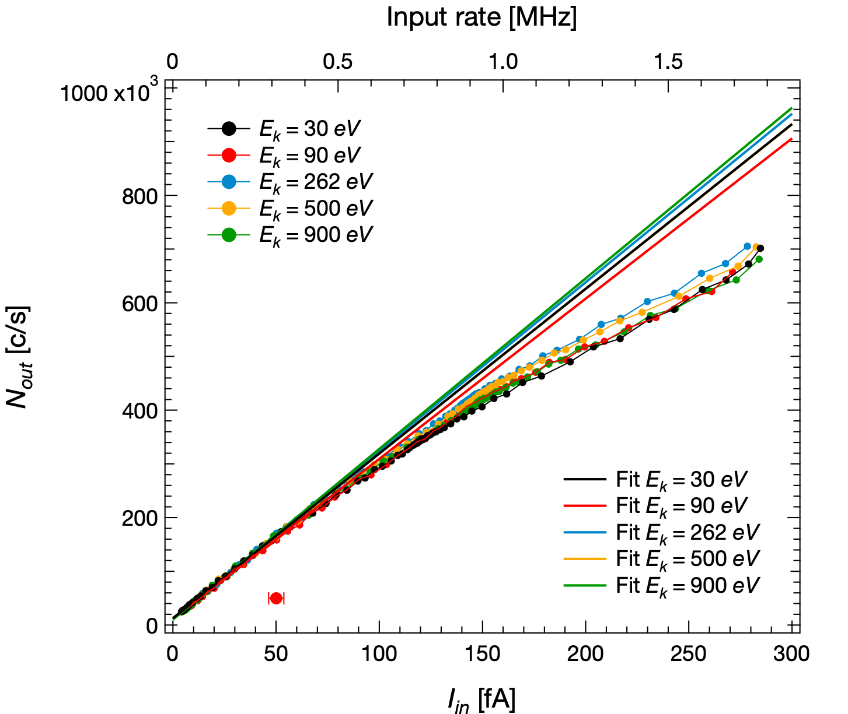
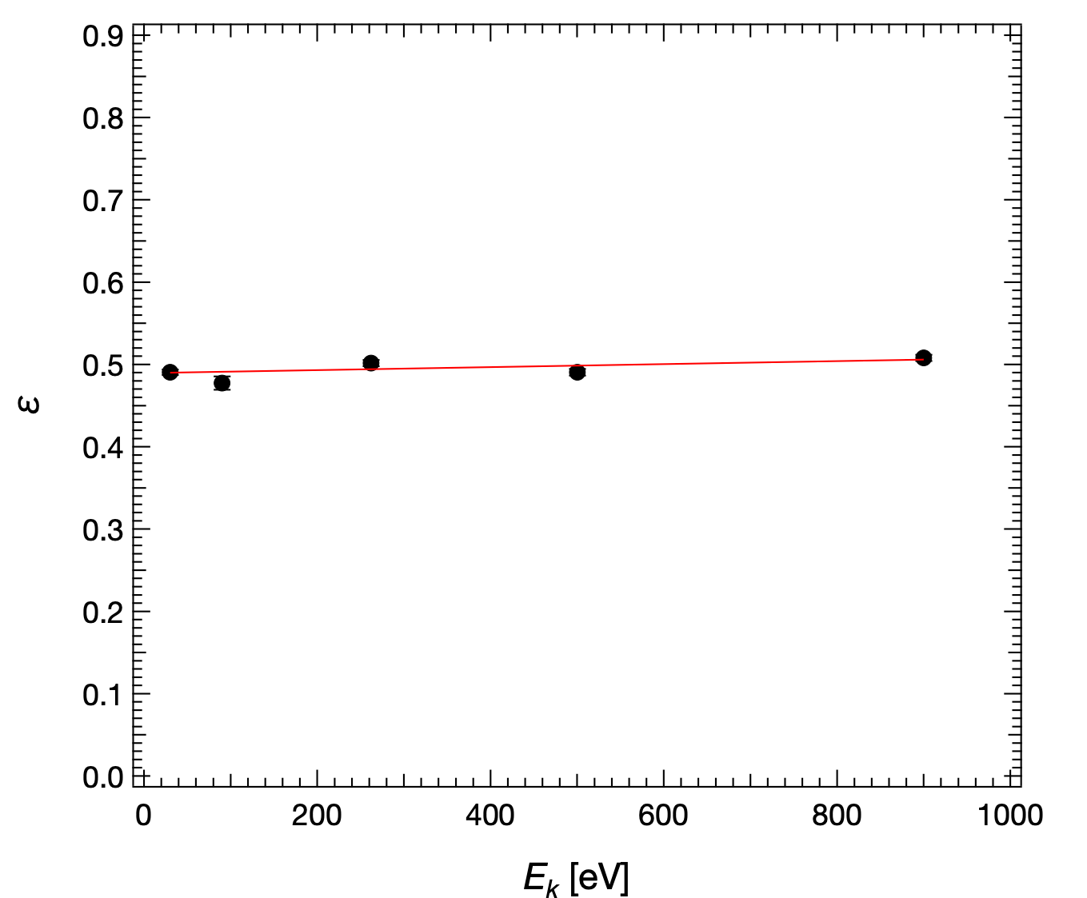
The efficiency is ~49% with no energy dependence
Fit result:
f(x) = q + mx
q = 0.489 ± 0.003
m = (1.8e-05 ± 5e-06) eV⁻¹
Efficiency $ε$ defined as $N_{out}=ε⋅\frac{I_{in}}{e}$
Linear fit from min current to ~50 fA (300 kCounts/s)
Efficiency ~49% with no evident energy dependence within 30-900 eV

Slide 9
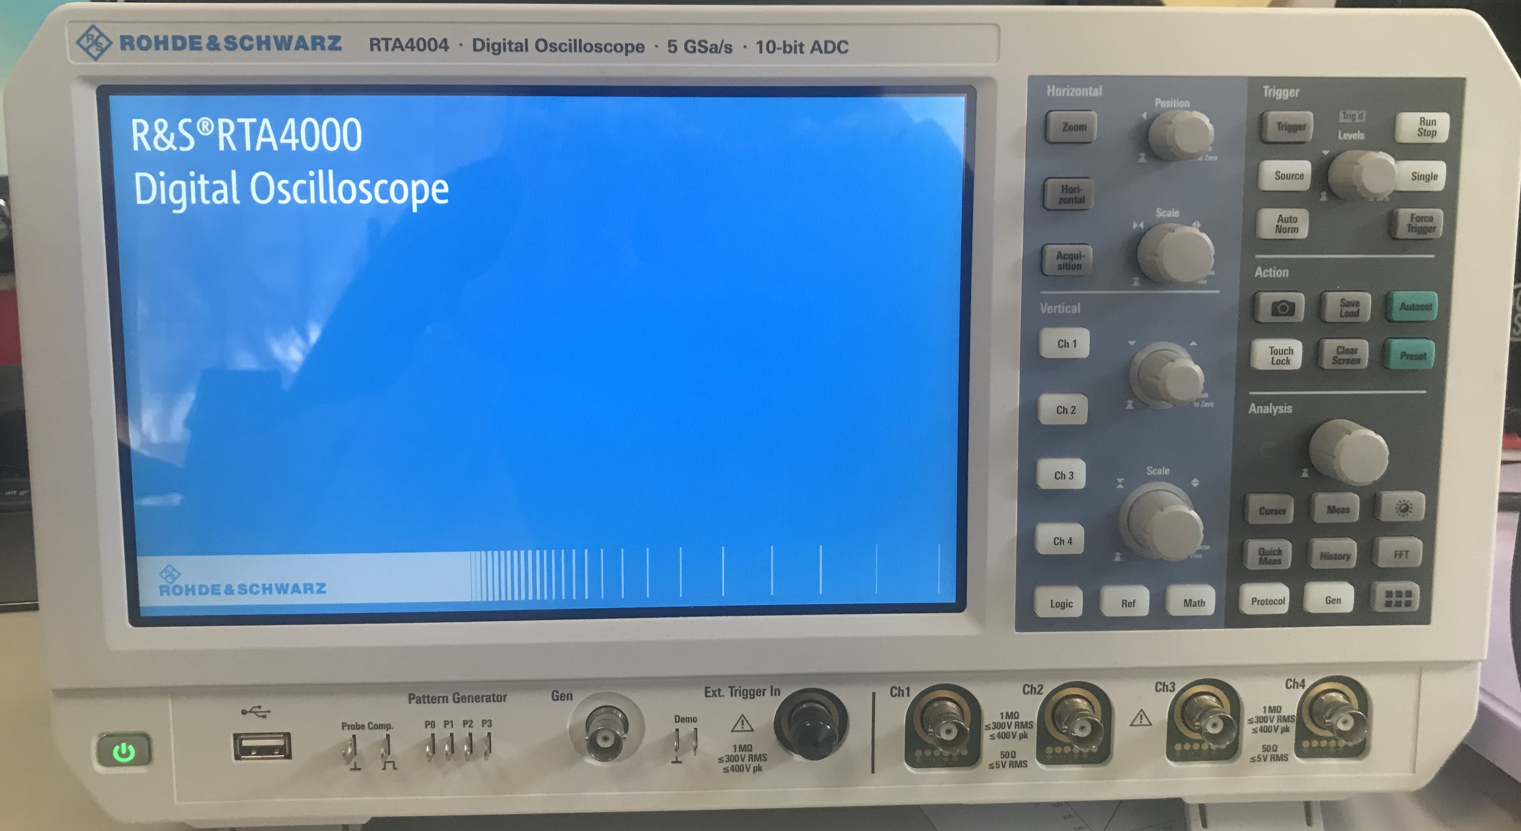
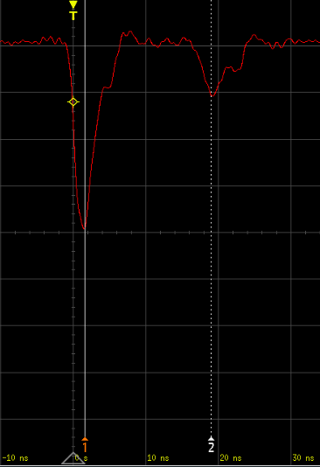
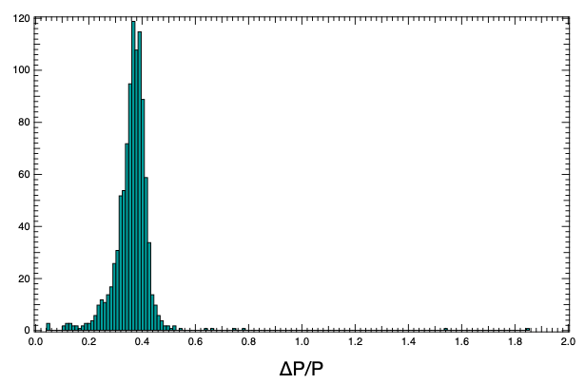
Pulse shape analysed with digital oscilloscope
Rhode&Schwartz Digital Oscilloscope RTA4004
Typical pulse shape
Reflection after ~17 ns always present
Reflection area is a fraction ~const of the main pulse (~36%)
1000 entries
~17 ns
N
∆A/A

Slide 10
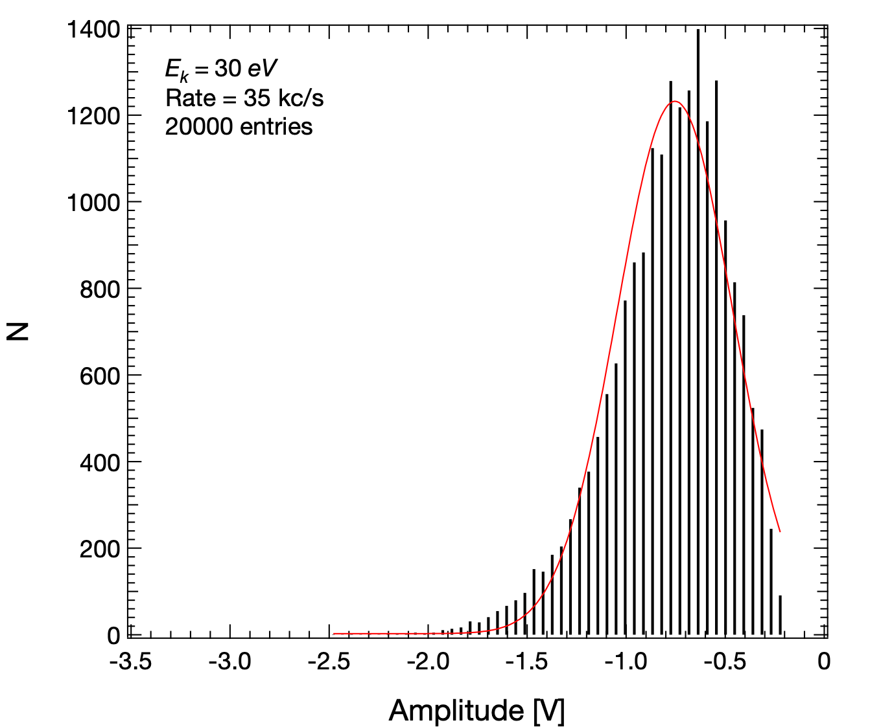
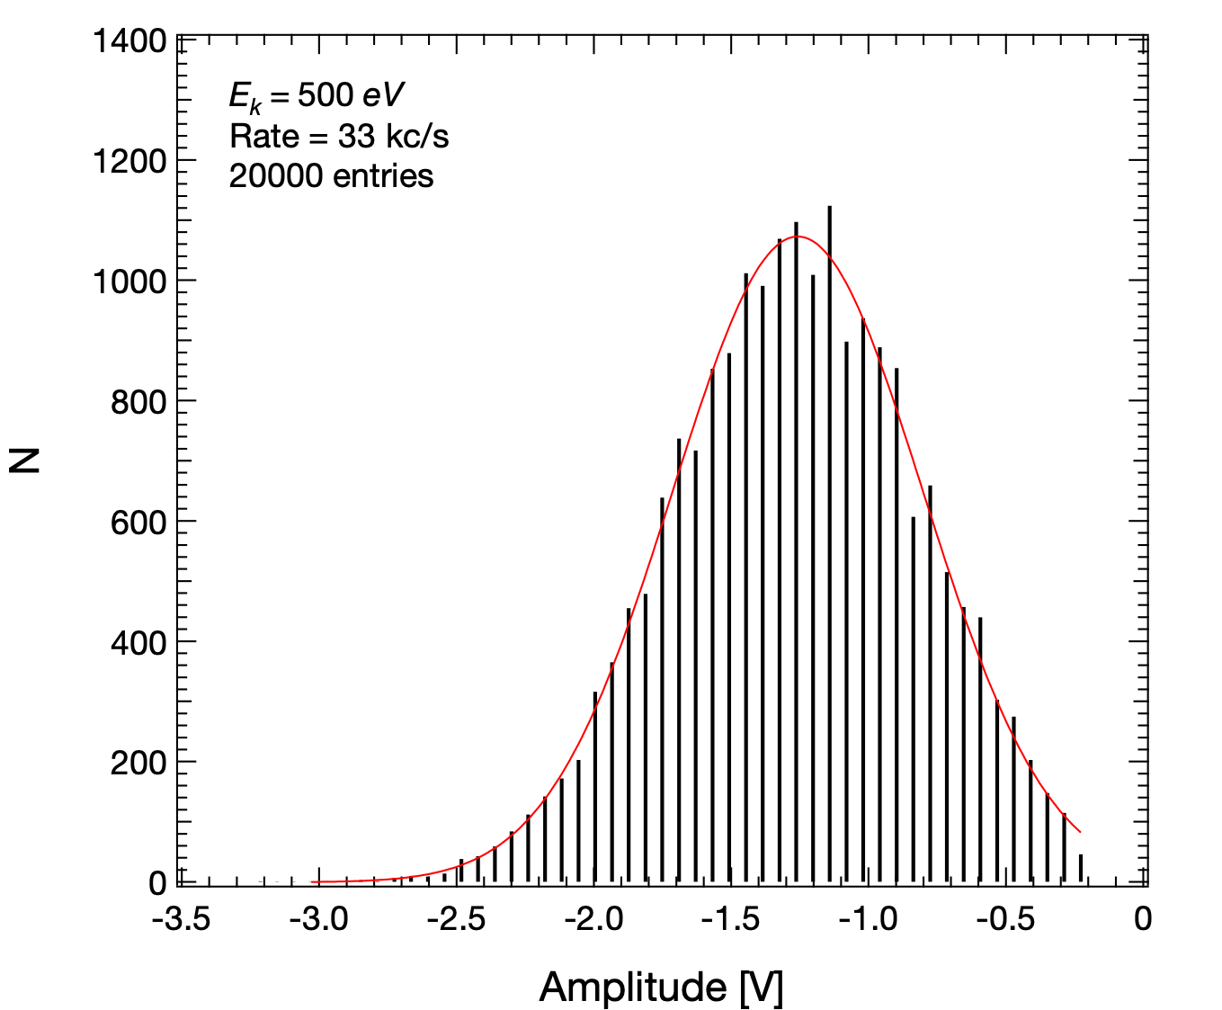
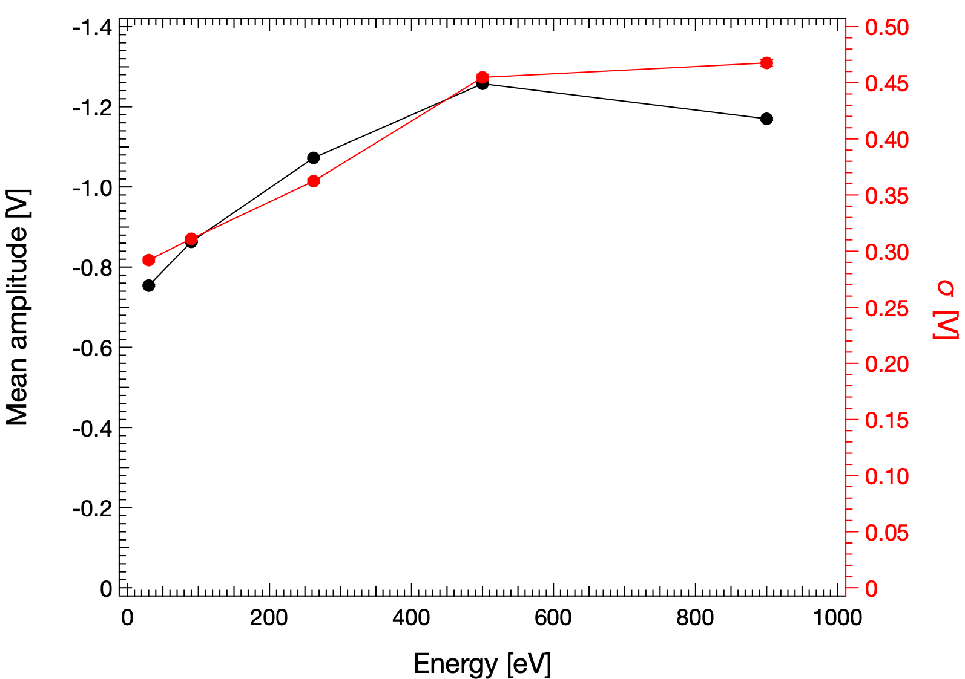
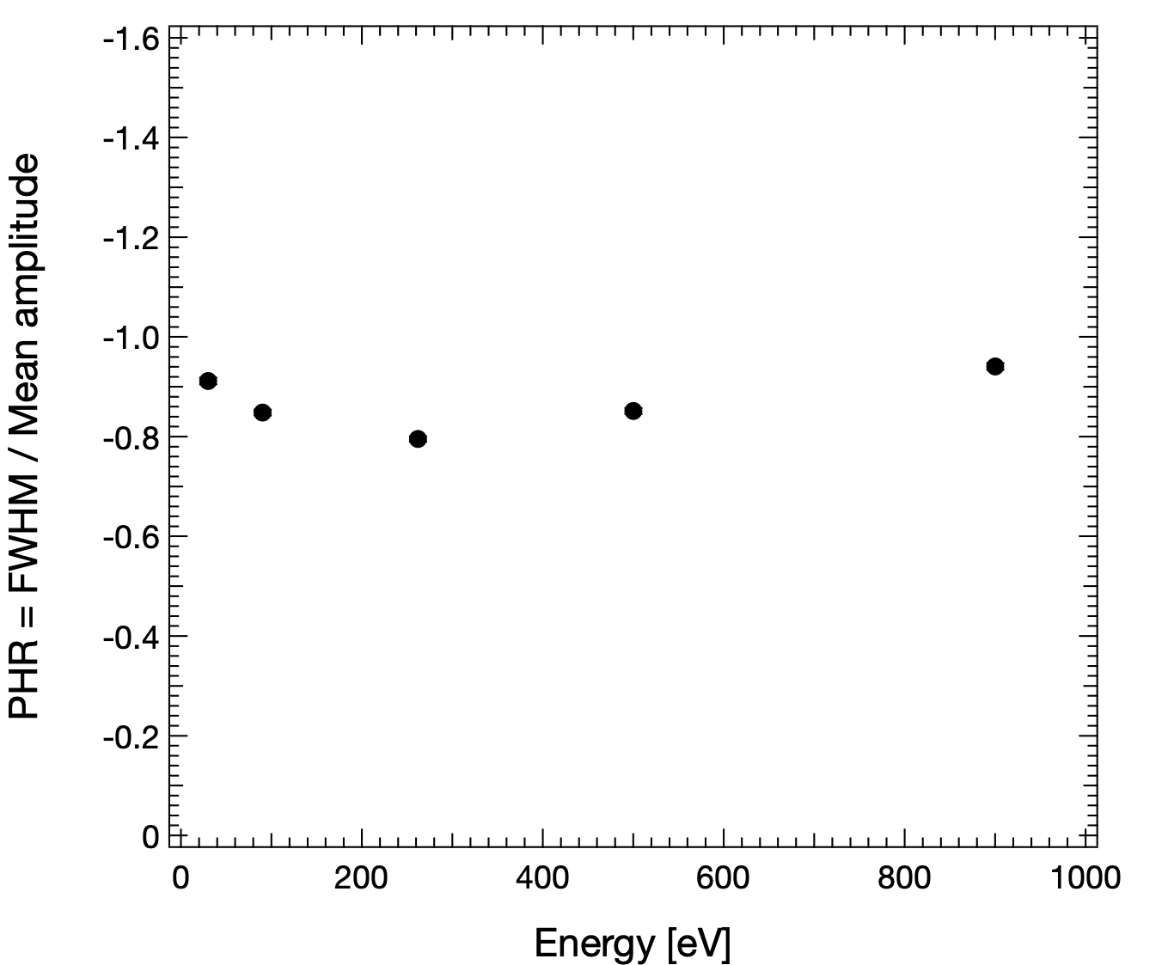
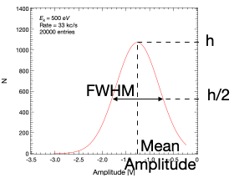
PHD: a weak energy resolution
Discriminator threshold vt = 120 mV
Pulse Height
Pulse Height Resolution
PHR = FWHM / Mean amplitude
@ 260 eV min PHR ~0.79
Energy dependence of the Pulse Height Distribution (PHD)

Slide 11
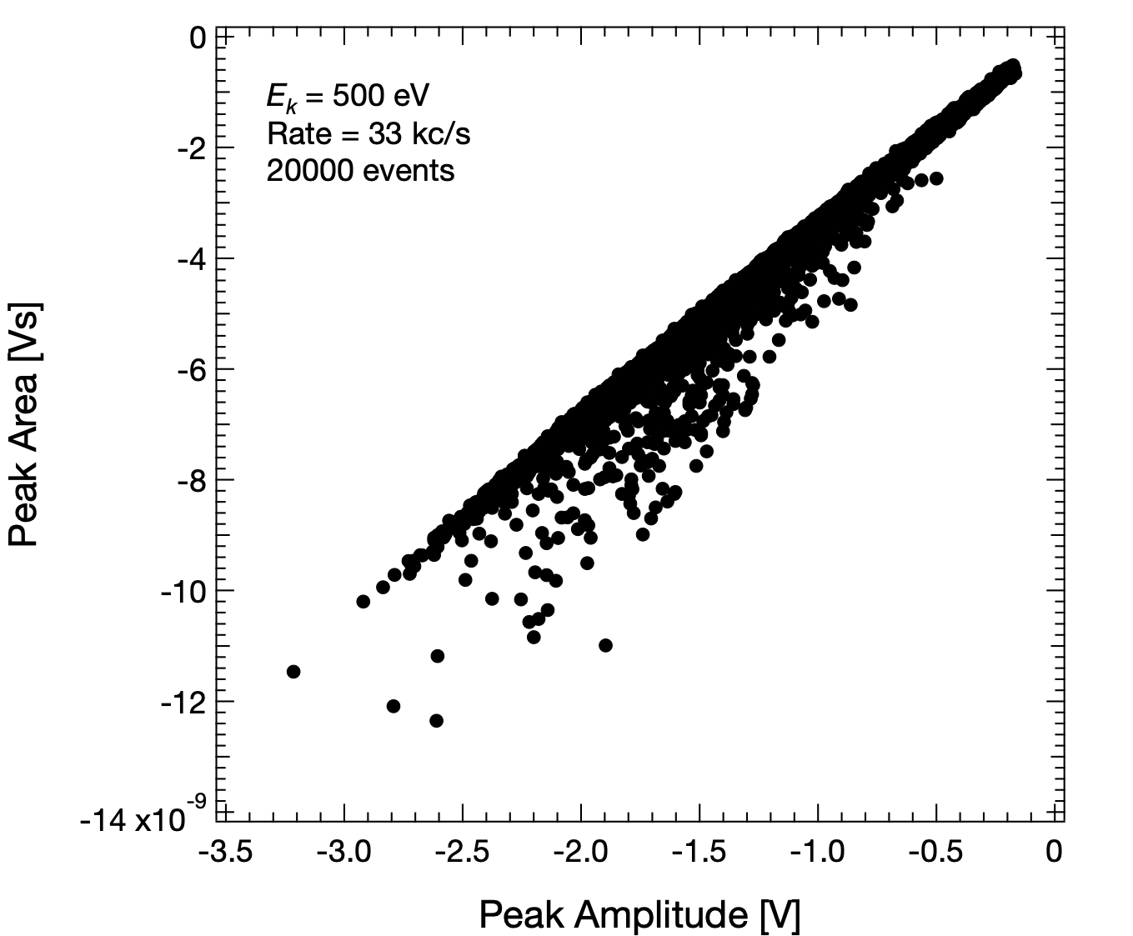
Aligned and not aligned points
A further analysis of the pulse shape:
Look at the peak area-amplitude correlation
The majority of points are aligned
~1.5% are off-diagonal

Slide 12
Aligned and not aligned points
~3 ns
~3 ns
~6 ns

Slide 13
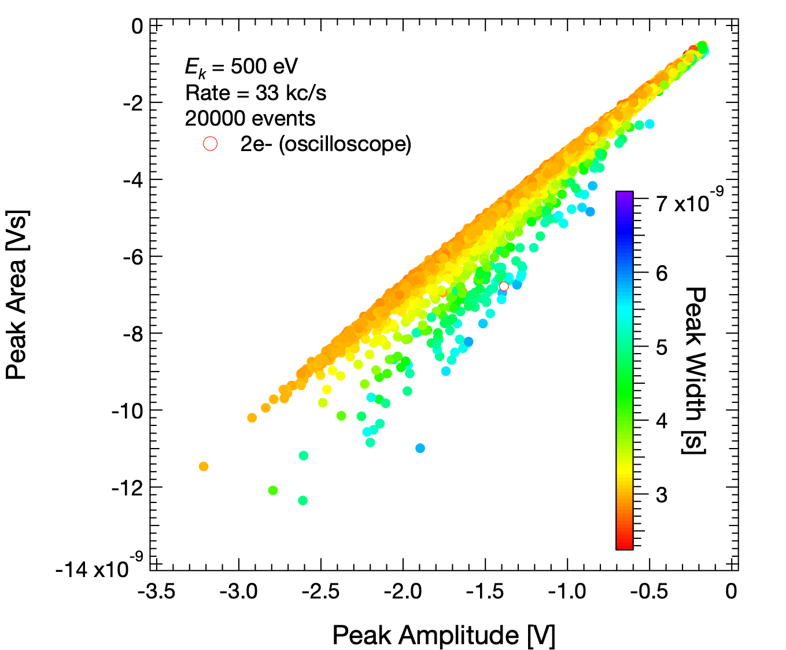
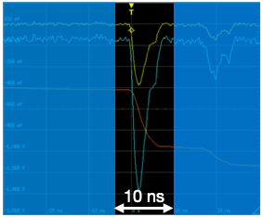
Third information: the peak width
Add a third information:
The peak width
Aligned points have ~same width
Off-diagonal are wider
Except for separated peaks
$τ$ = 10 ns

Slide 14
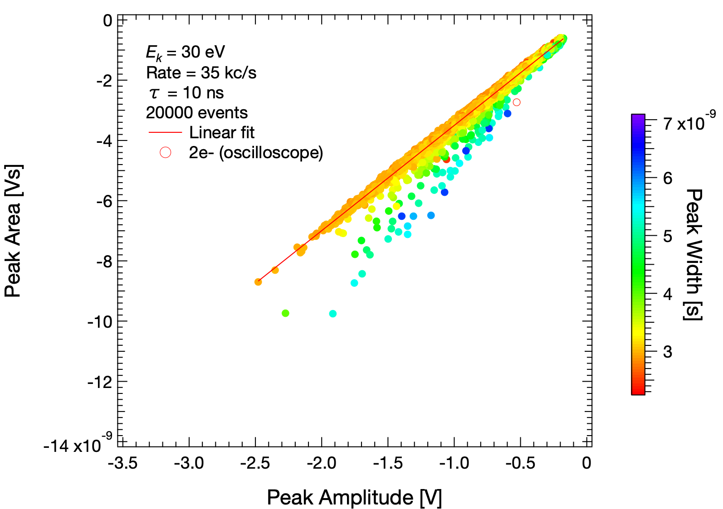
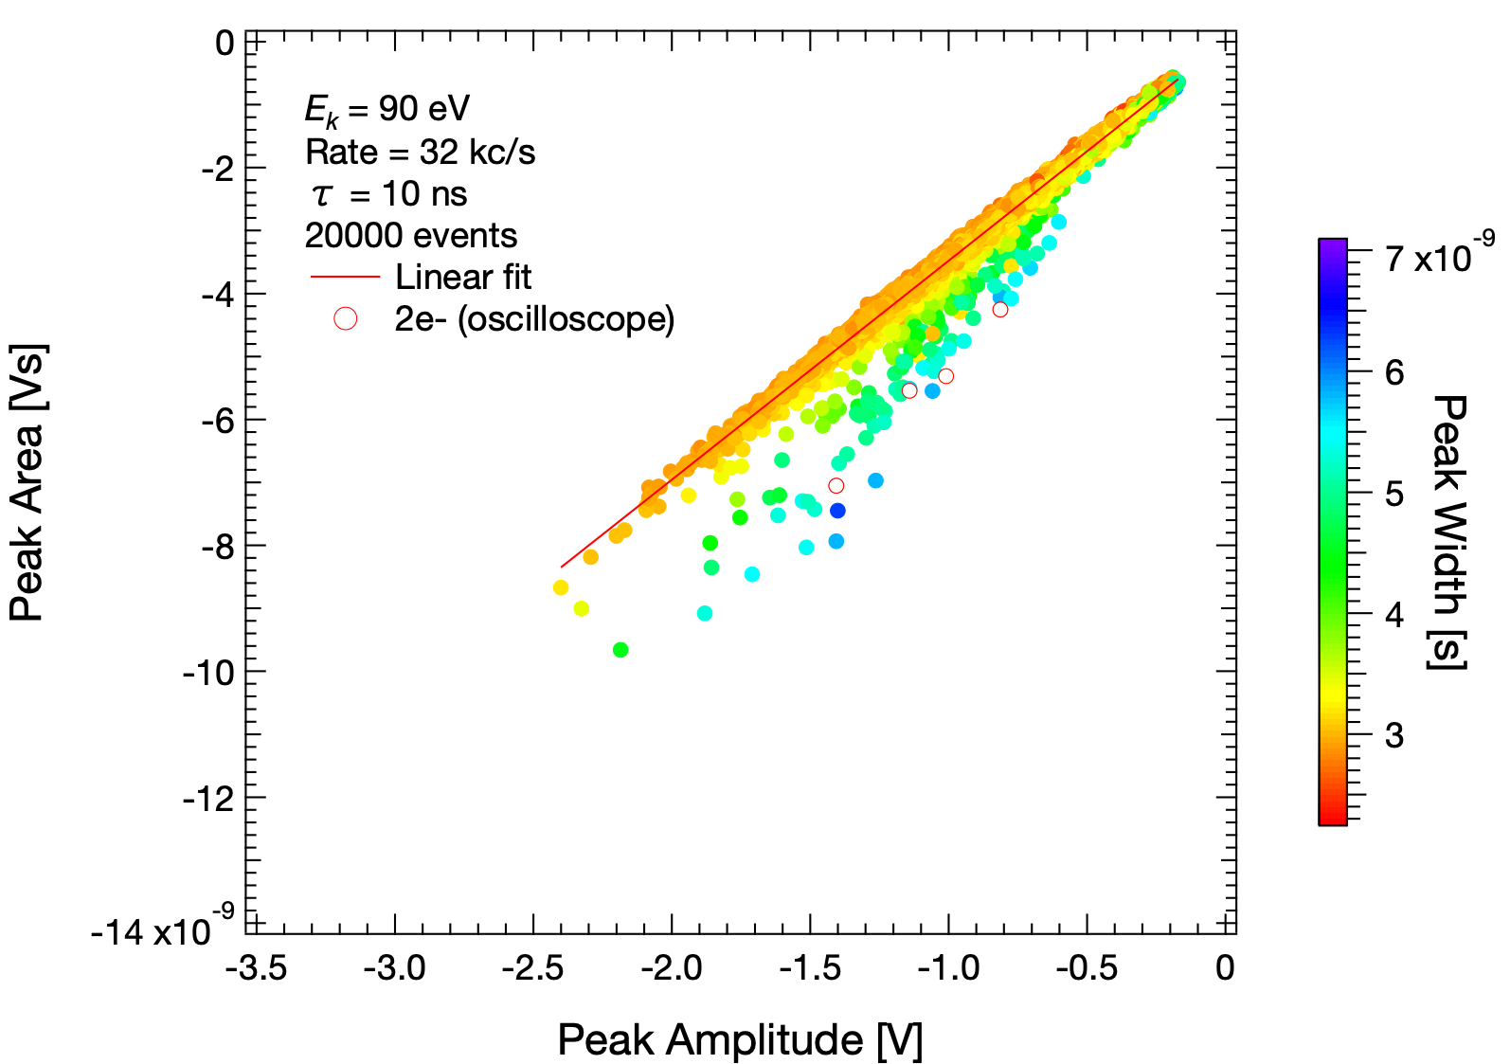
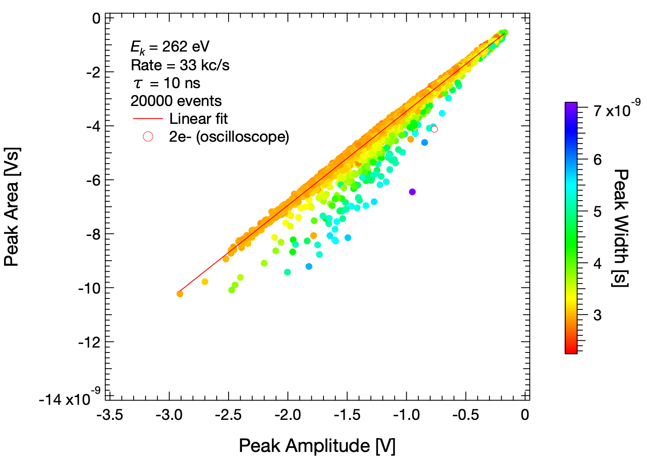
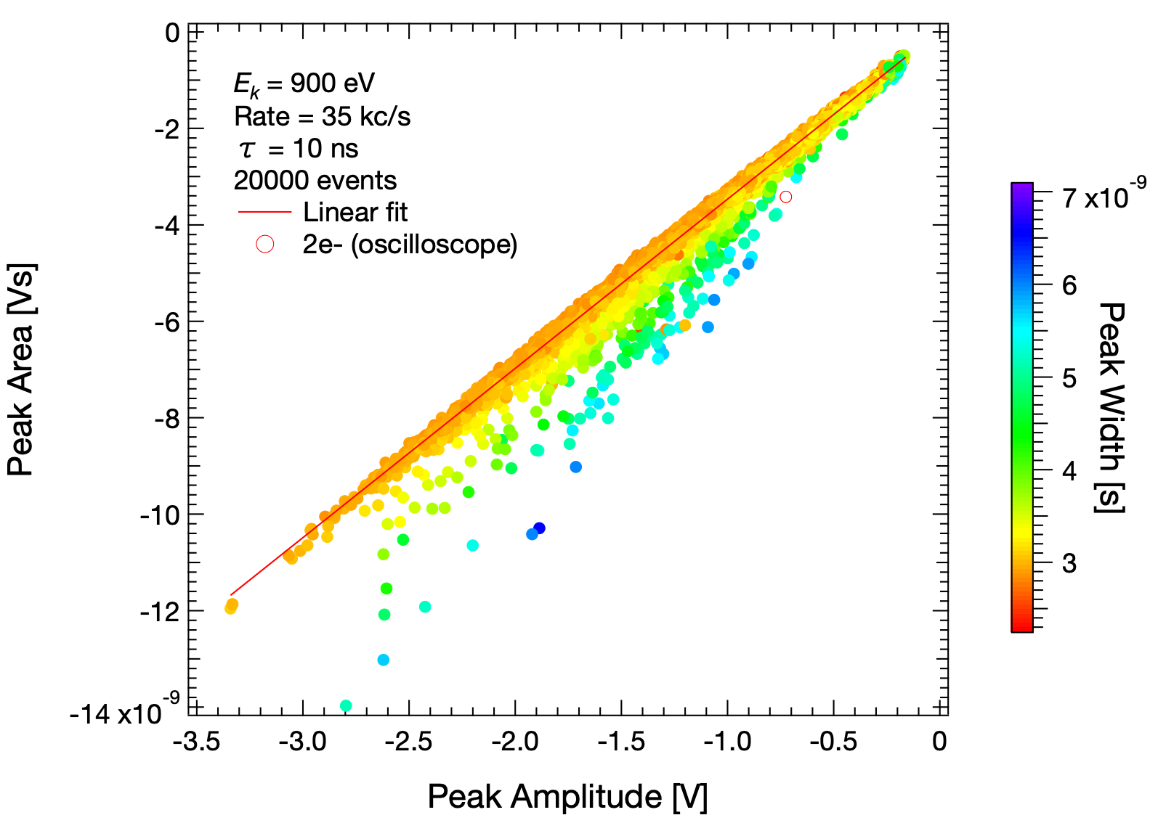
This behaviour does not depend on energy

Slide 15
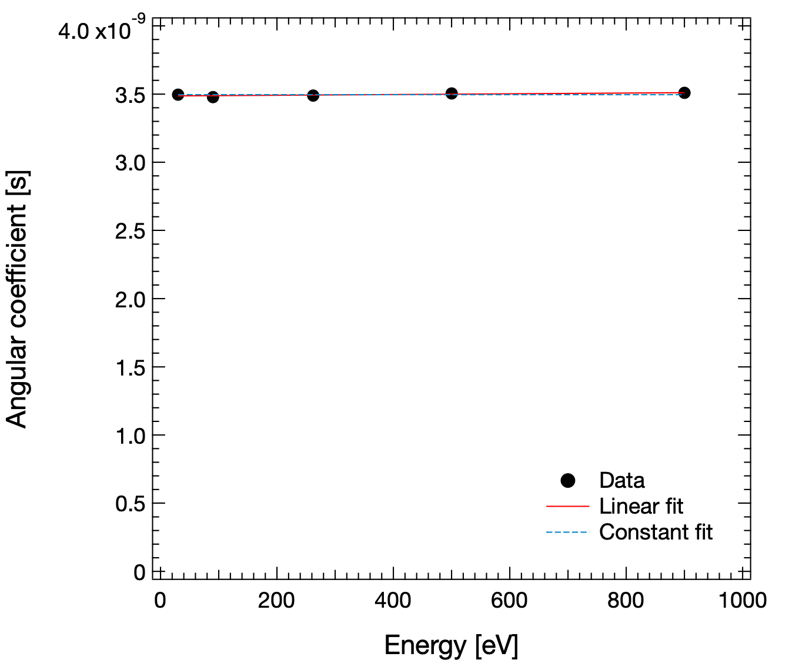
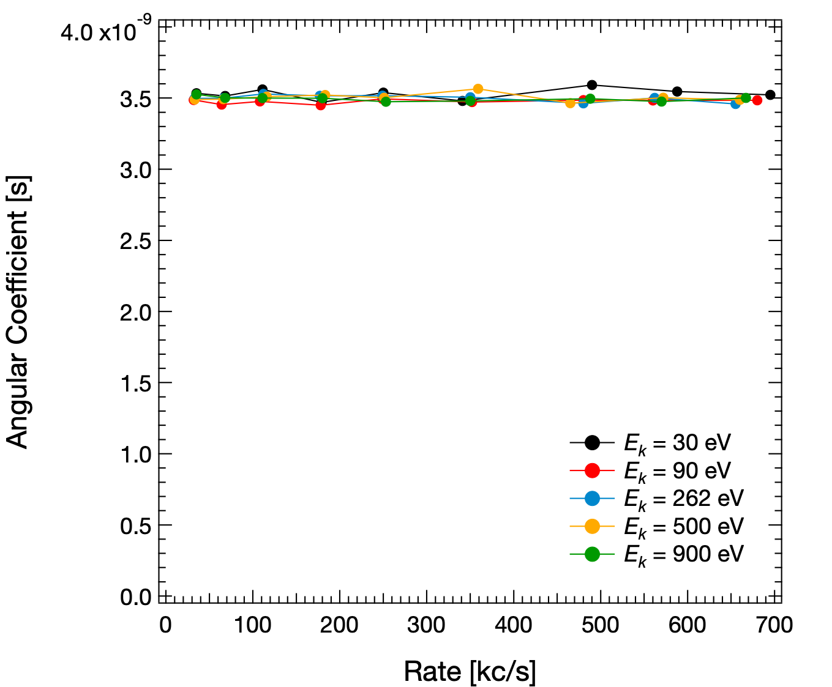
Not on energy nor on output rate
From linear fit on area vs amplitude

Slide 16
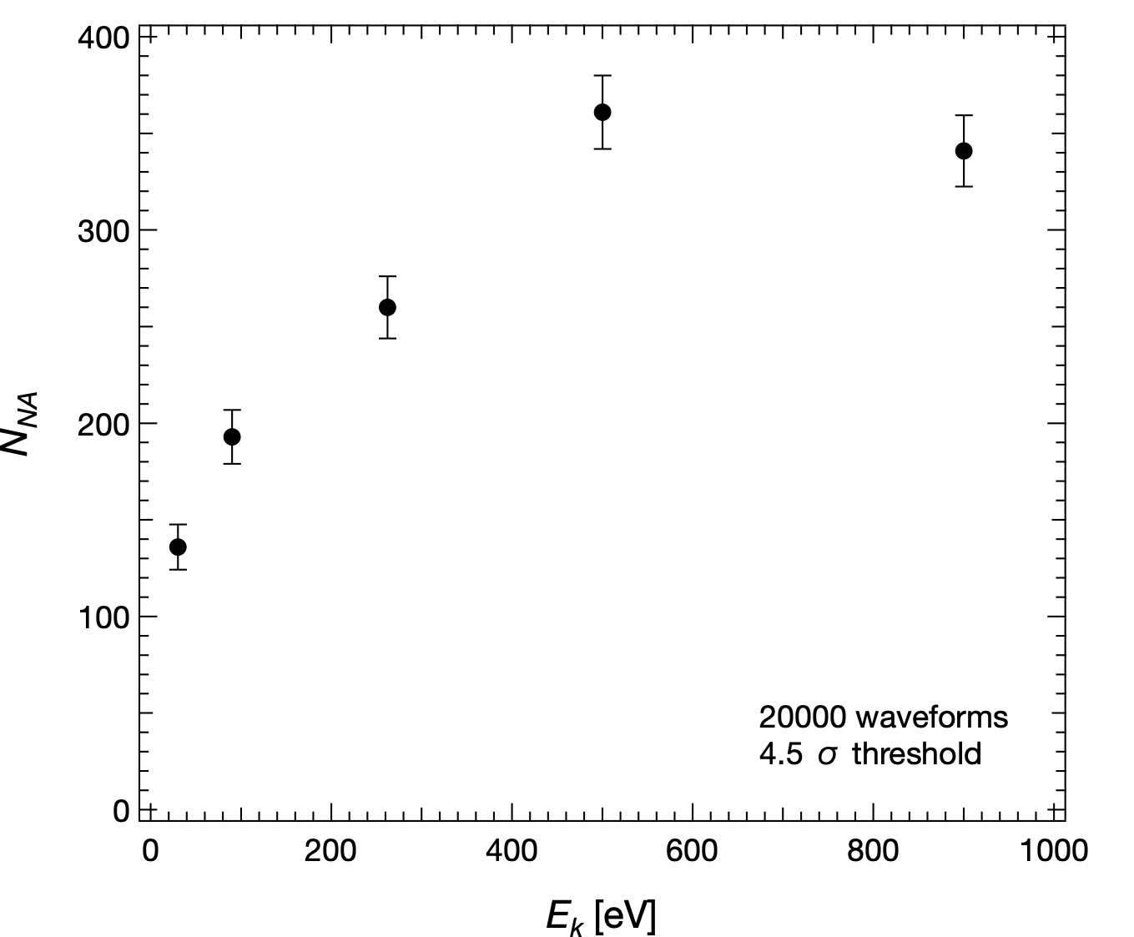
The nature of the off-diagonal events
𝜏
t
$$τR$$
Previous slide example
Two independent events in fixed time window $τ$ :
$N_{acc}=tτR^{2}=nτR$
$n=Rt$ = total events, $R$ = MCP rate
$N_{acc}$ = 6 in this case $≠N_{off}$
There is some instrumental effect
Which is energy dependent
Noff
20000 events
$τ$ = 10 ns
$R$ = $30⋅{10}^{3}$ c/s

Slide 17
To conclude
MCP characterisation with custom electron gun in range 30 - 900 eV at Roma Tre:
Absolute efficiency of the detector ~50% with no evident dependence on energy
Weak energy resolution observed in the Pulse Height Distribution (PHD) analysis
Further studies on pulse shape allows single- to multi-electron events discrimination, quantitative results require deeper analysis

Slide 18
The key ingredients for measuring detector efficiency
Monogun at Roma Tre:
max count rate for MCP in single electron count mode: 300 kHz
minimum stable current from e-gun 10 fA
capability to measure the low current
emitted from e-gun (picoamm. Keysight B2987A) < 1fA
Monogun Main features
Energy range | 30 – 900 eV
Energy resolution | 45 meV
Current - range | 10 fA – 100 nA
Current - resolution | 200 aA
Spot size diam. | < 0.5mm

Slide 19
Present and Future Experiments and Electron Sources
Experiment
Detector efficiency
Ptolemy (e.m.)
Graphene transmission
single count mode limit
Available
e⁻ source
Specs (Roma Tre)
Monogun (Roma Tre)
Kimball (LNGS)
Future
e⁻ source
Milan e-source
SPECS + new P.S.

Slide 20
Thank you for your attention!!
Alice Apponi, Alessandro Ruocco
Università Roma Tre and INFN Roma Tre
Gianluca Cavoto, Carlo Mariani
Università Sapienza and INFN Roma
Francesco Pandolfi, Ilaria Rago
INFN Roma
PTOLEMY meeting 06-07.10.2022

Slide 21
The key ingredients for measuring graphene transmission
Monogun at Roma Tre:
transmission through graphene measured with I=200 pA
minimum stable current from e-gun 10 fA
capability to measure the low current
emitted from e-gun (picoamm. Keysight B2987A) < 1fA
Monogun Main features
Energy range | 30 – 900 eV
Energy resolution | 45 meV
Current - range | 10 fA – 100 nA
Current - resolution | 200 aA
Spot size diam. | < 0.5mm

Slide 22
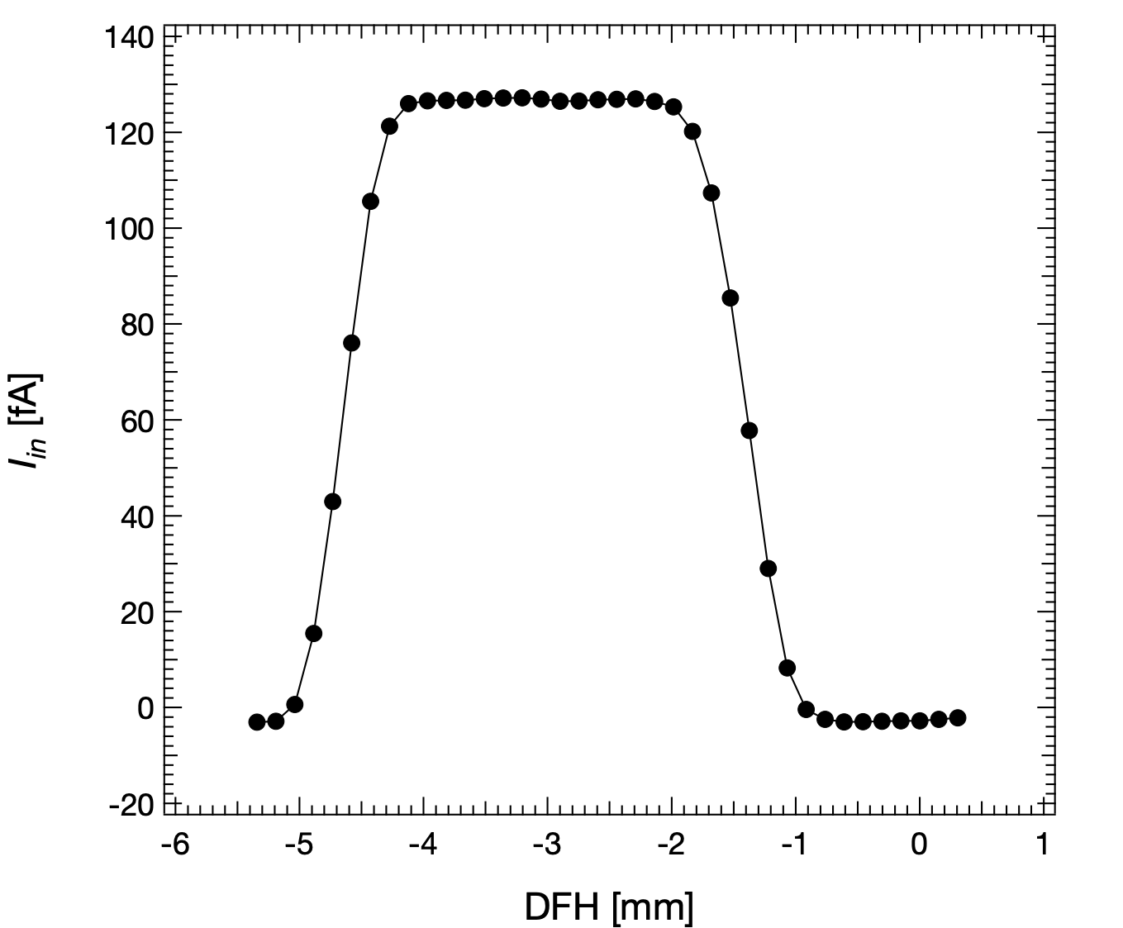
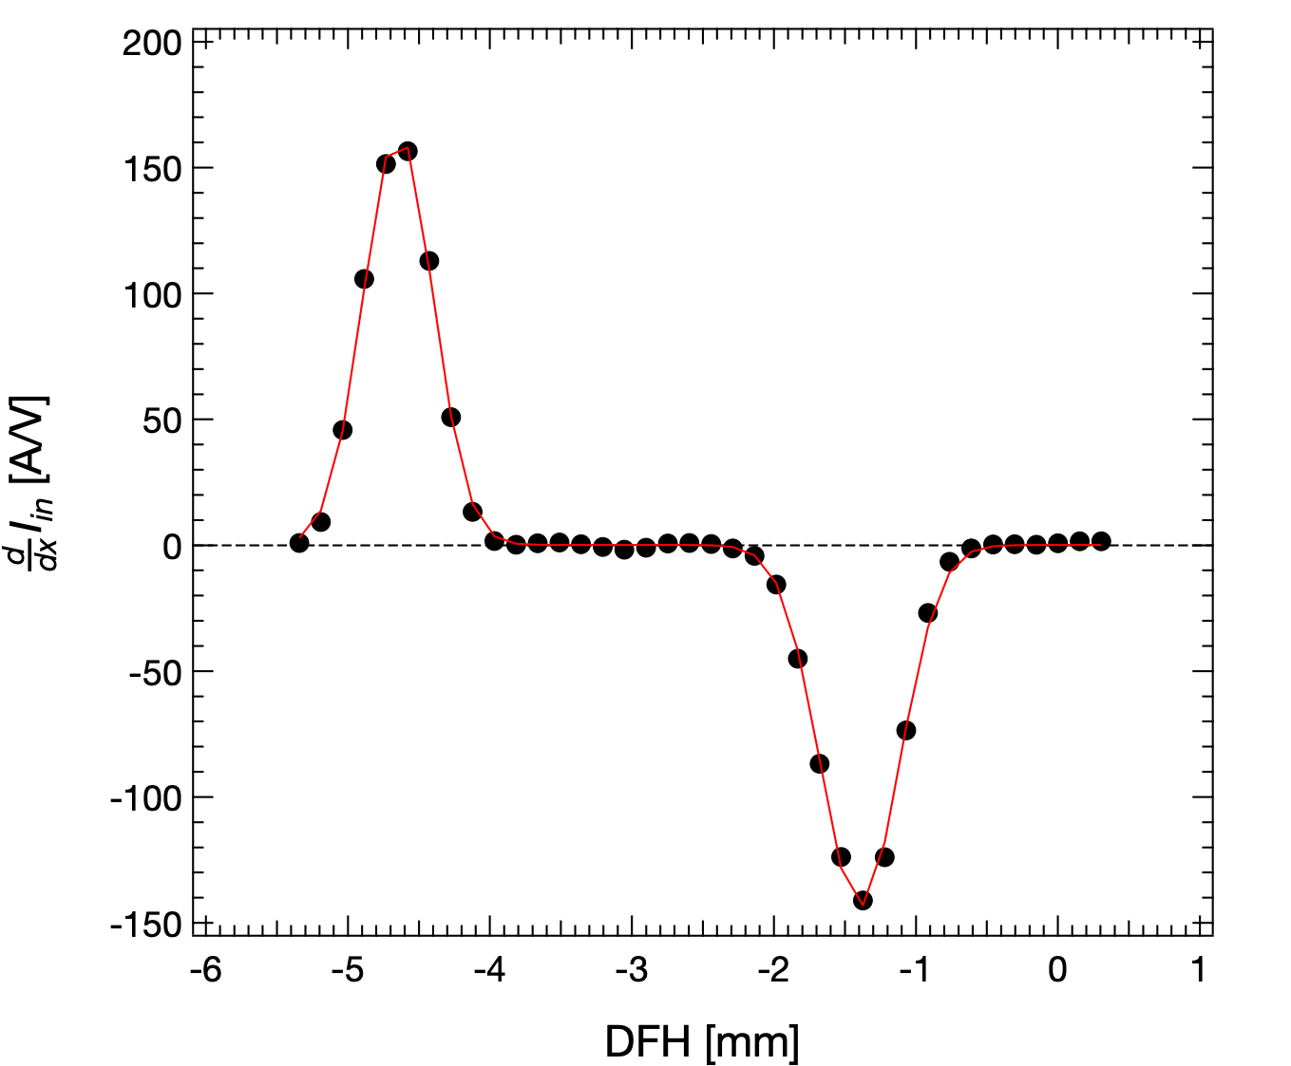
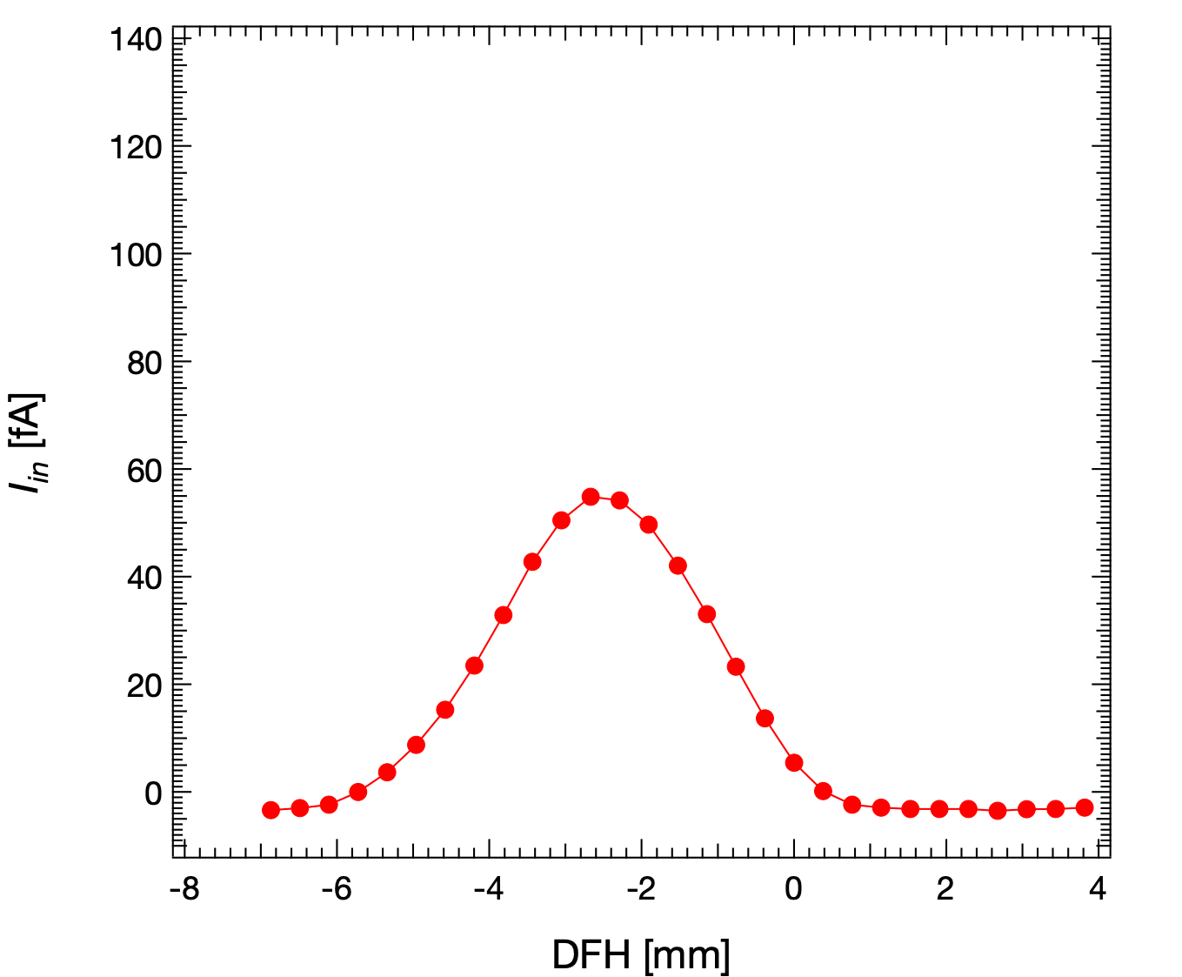
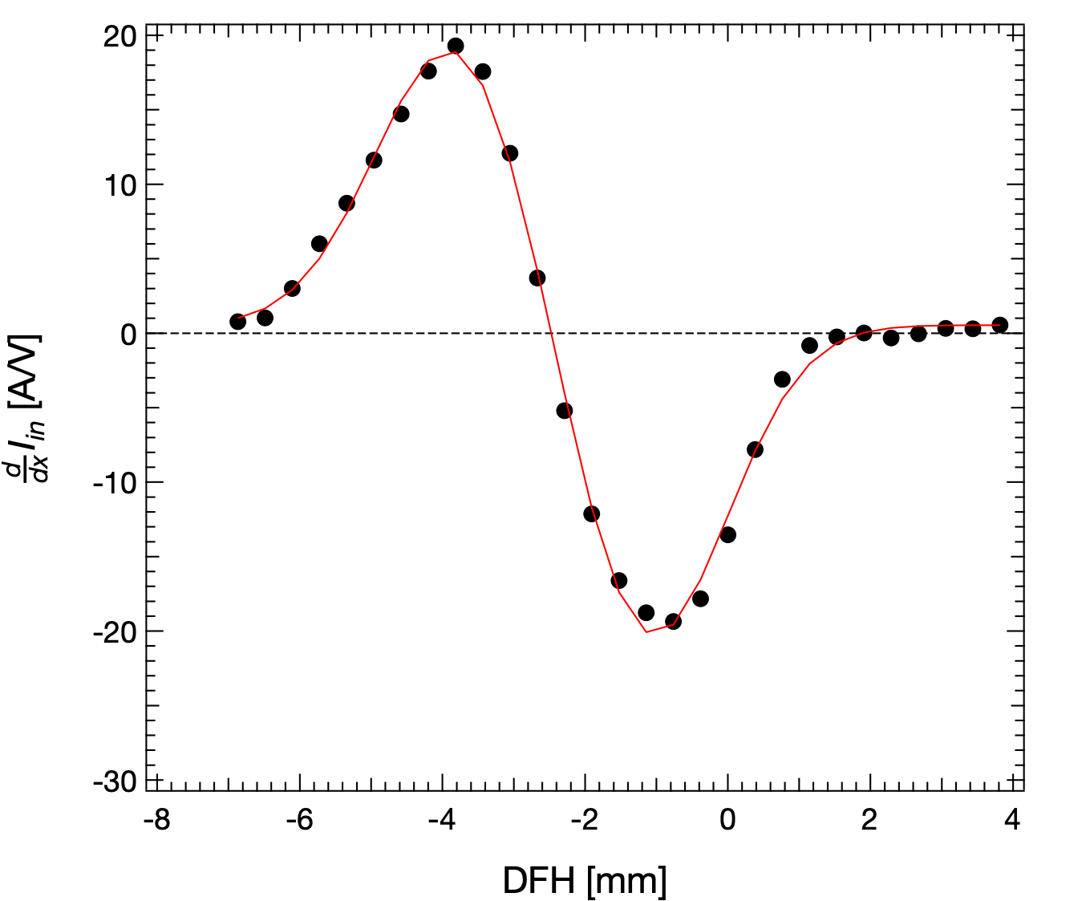
Two beam sizes
Variation of the beam size:
Change polarisation of acceleration stage of e-gun
Spatial scan on Faraday Cup (FC)
Beam size = FWHM of the scan derivative
FWHM ~0.5 mm
Derivate
FWHM ~3 mm

Slide 23
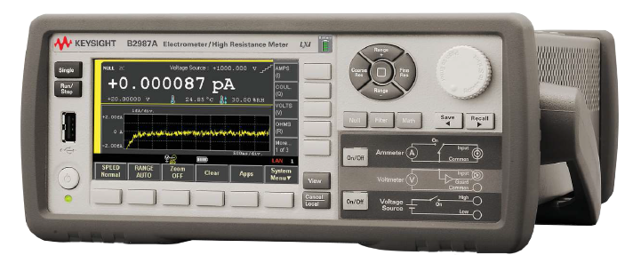
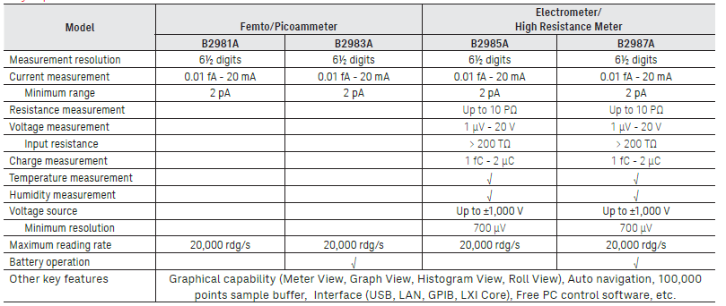
New test condition:
electron beam current measured with a Faraday Cup
picoamperometro Keysight B2987A
triaxial cable
common disconnected from ground
case of the picoamperometer connected to the same
ground of the F.C.
picoamperometer powered on battery

Slide 24
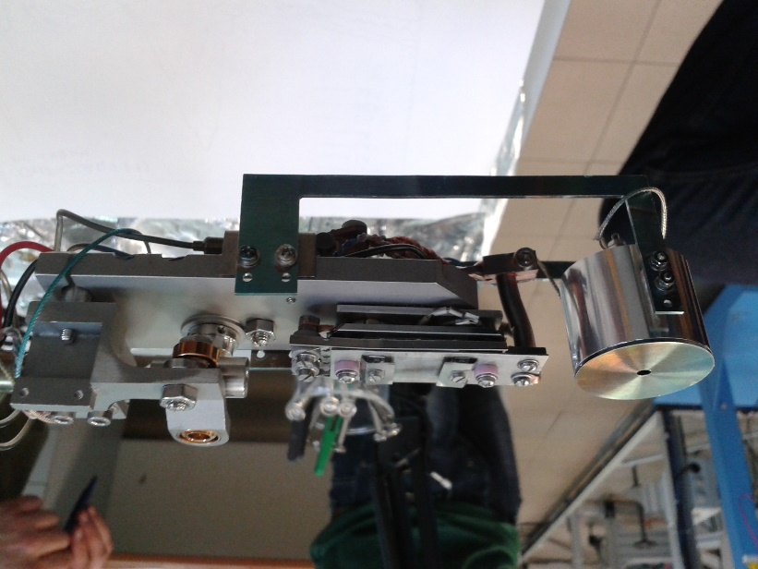
Medium resolution e-gun: Test (I)
test with Faraday cup:
- range of current: 180 fA – 100 nA
- Stability vs time
- Beam dimension
Stability

Slide 25
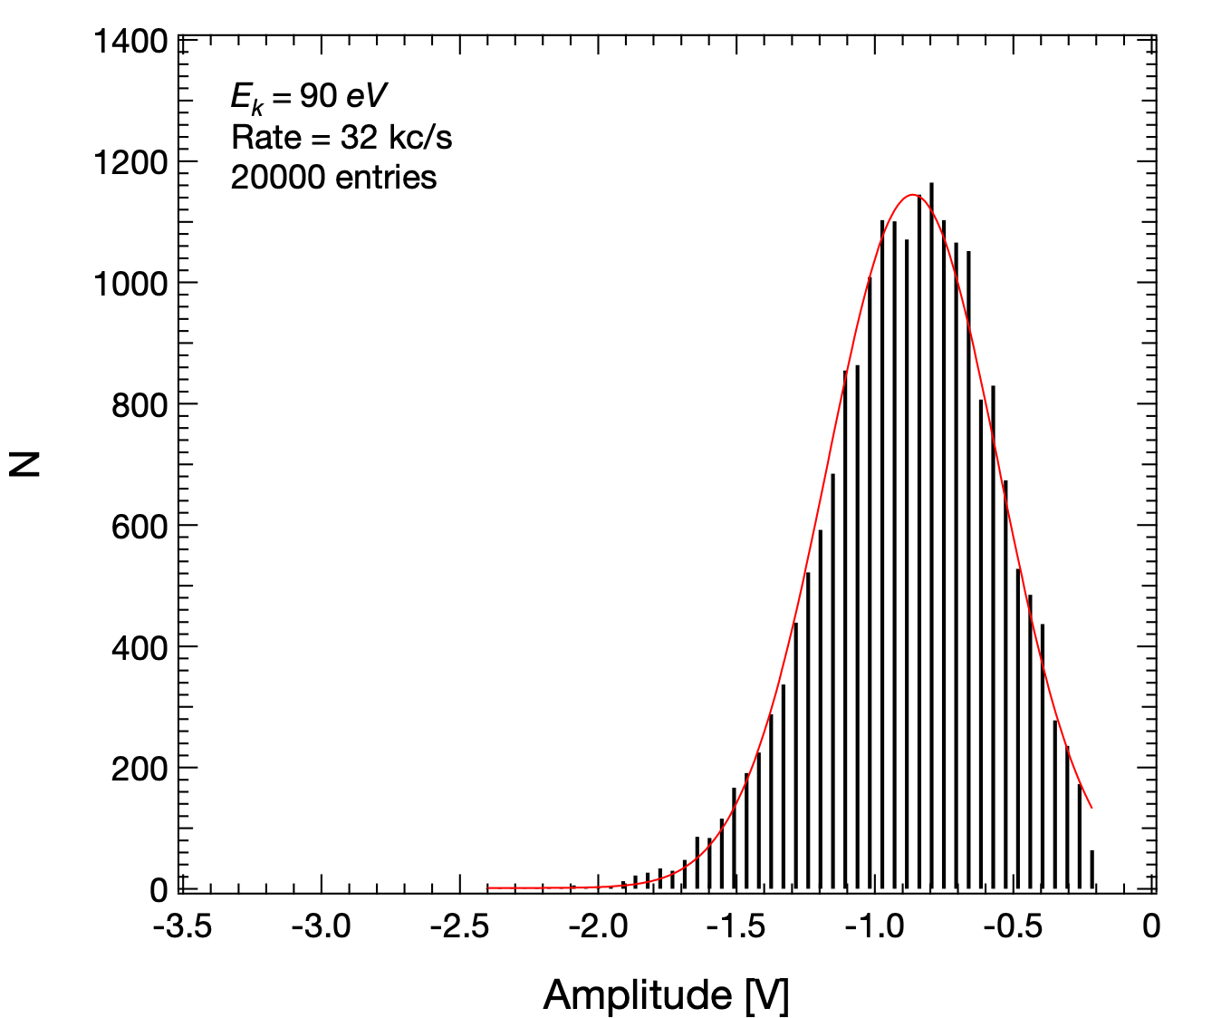
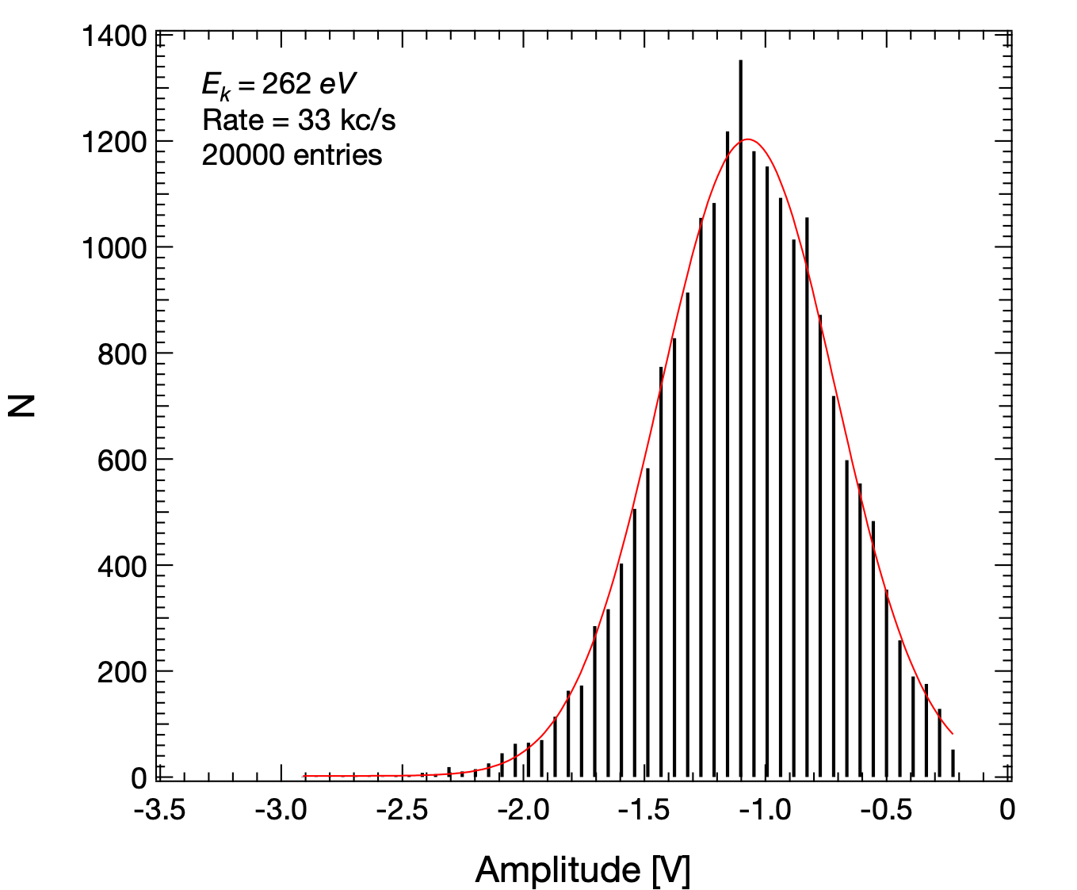
PHD: a weak energy resolution
Discriminator threshold vt = 120 mV
Pulse Height

