Slide 1
INRiM work on calorimetry
Carlo Pepe^{1,2}, Hobey Garrone^{1,2}
Eugenio Monticone¹, Mauro Rajteri¹
6-7 October 2022 Zandvoort (NL)
(1)
(2)

Slide 2
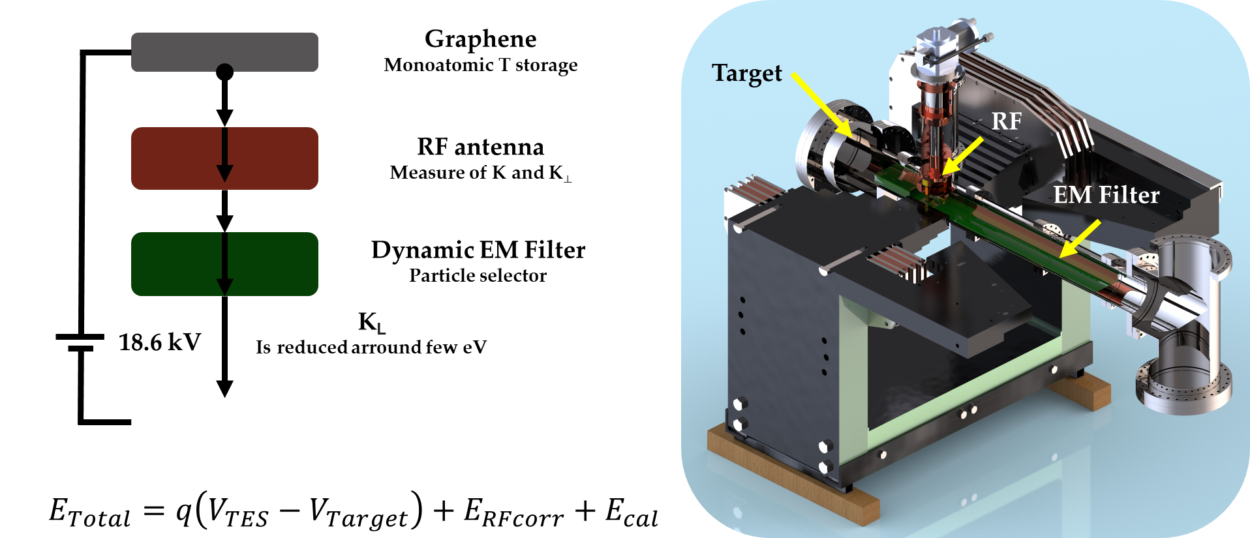
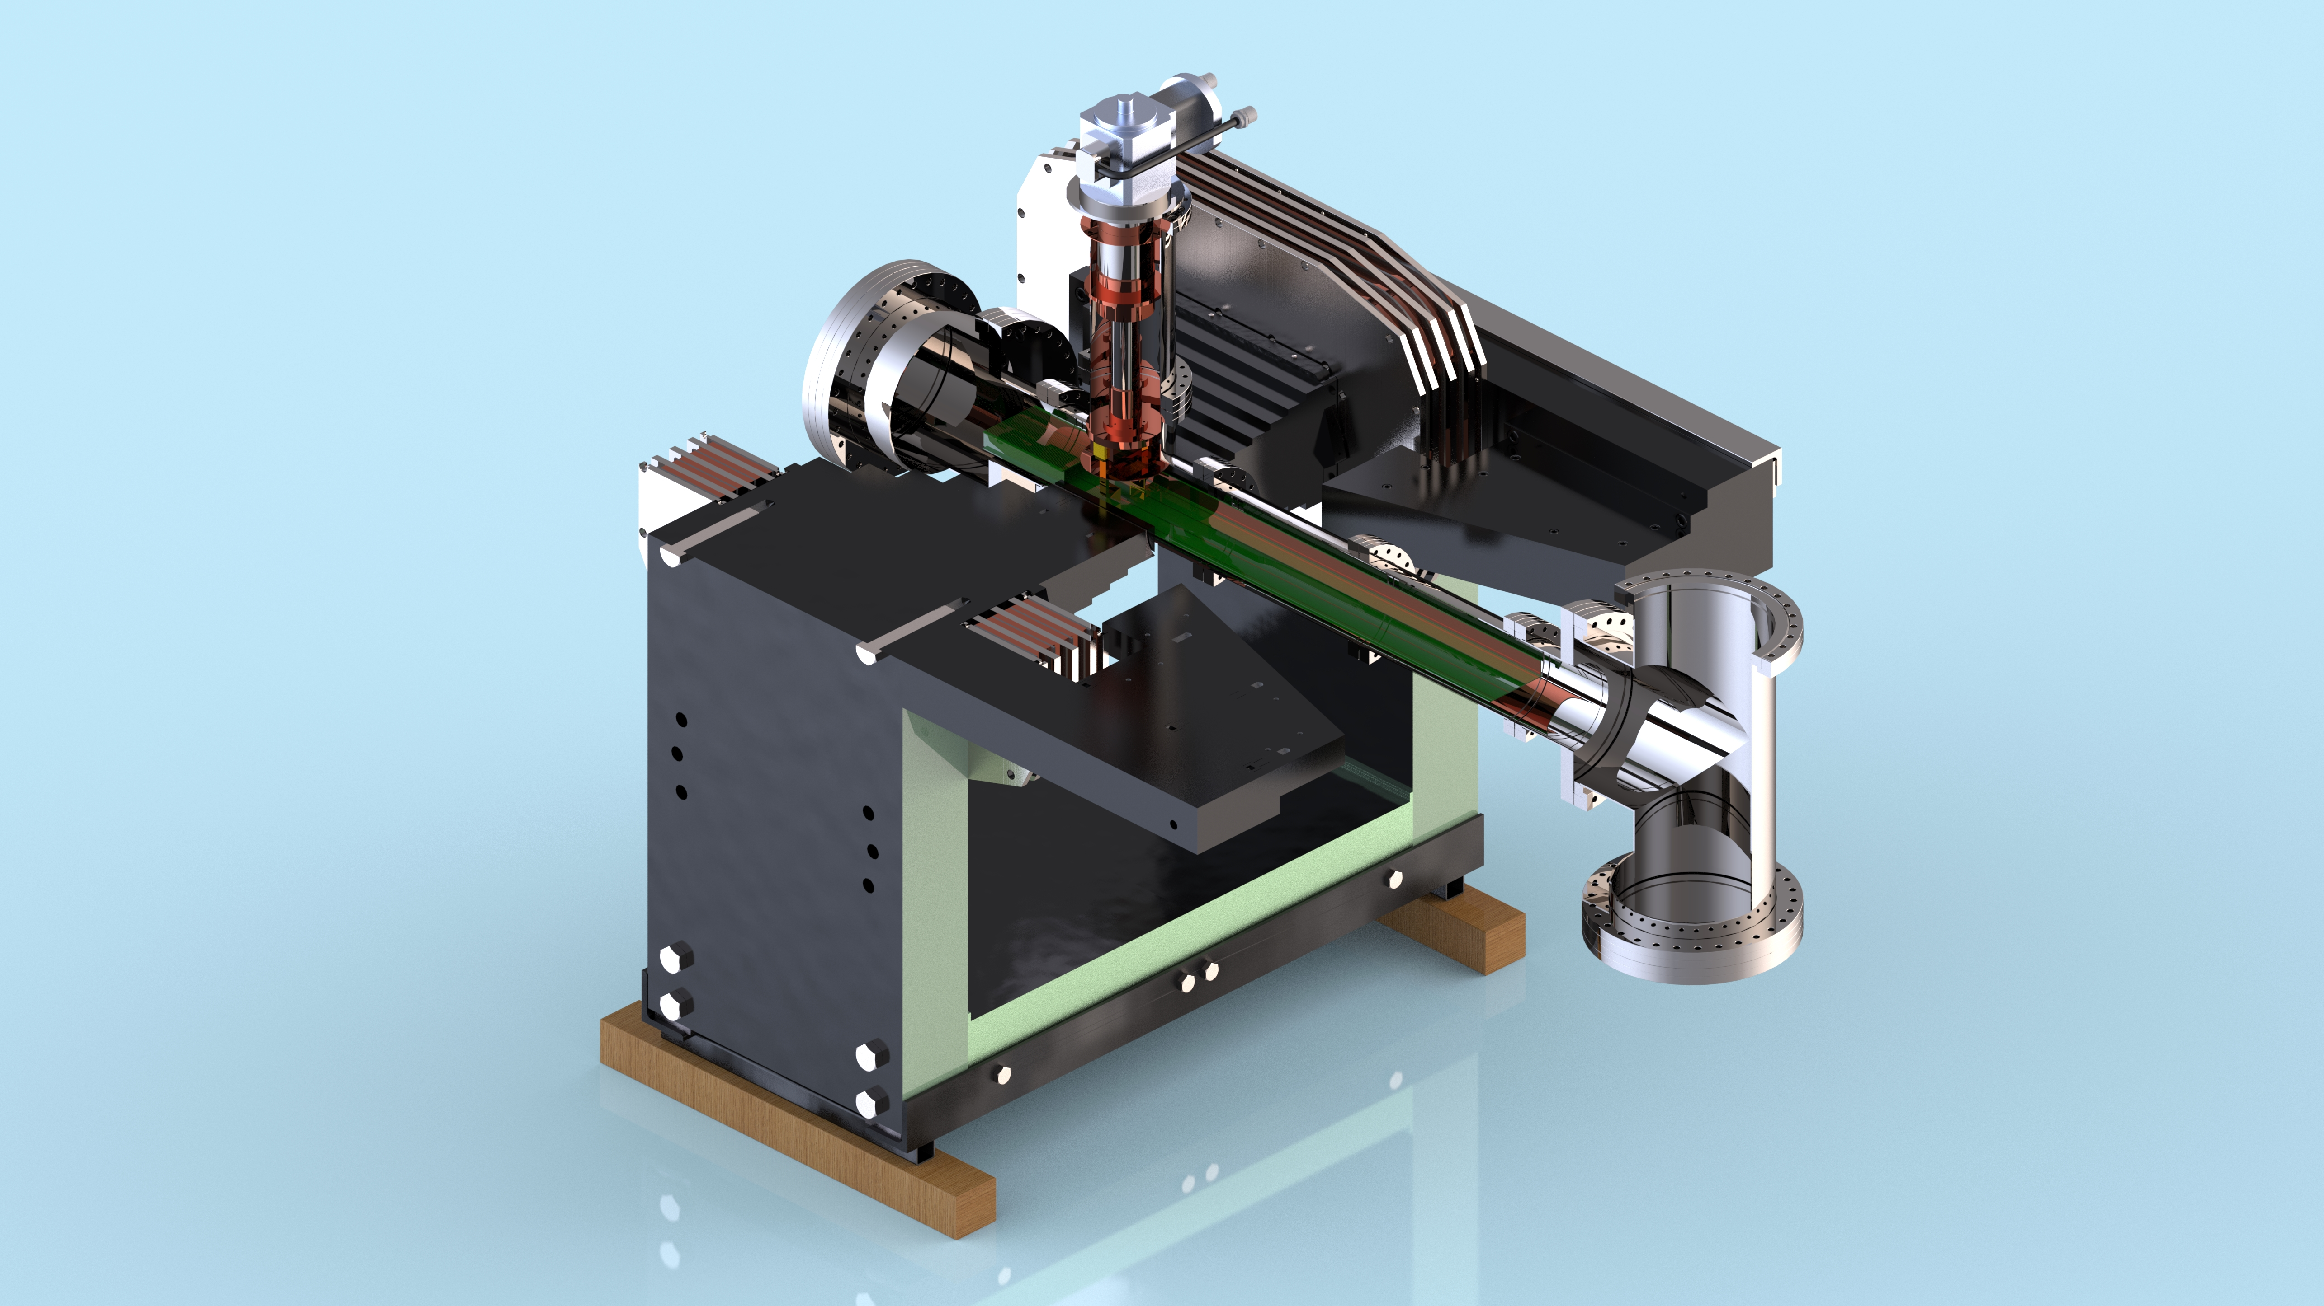
INRiM role in PTOLEMY
Andi Tan
(Princeton)
Graphene
Monoatomic T storage
Target
RF
RF antenna
Measure of K and K⟂
EM Filter
Dynamic EM Filter
Particle selector
K_{L}
Is reduced arround few eV
18.6 kV
Calorimeter
TES provide a differential E measurement
Calorimeter
TES provide a differential E measurement
Microcalorimeter
Microcalorimeter
$$E_{Total}=q\left(V_{TES}−V_{Target}\right)+E_{RFcorr}+E_{cal}$$
Notes:
Più preciso su cosa lo rende un detector nelle varie applicazioni

Slide 3
Calorimeter
A Calorimeter is a device used to measure the change in temperature due to absorbed energy
E_{γ}
T
C = heat capacity
G = Thermal conductance
ΔT=E/C
C
ΔT
Energy resolution
τ = C/G
G
$$∆E≈{\text{(}\text{k}\text{B}\text{T} \text{2 }\text{C} \text{B}\text{)}}^{\frac{1}{2}}$$
T_{bath}
t
Sensor performance better at low temperature and with small C
Notes:
Più preciso su cosa lo rende un detector nelle varie applicazioni

Slide 4
Transition-Edge Sensors
Microcalorimeters based on the steep superconductive transition of a metallic film with:
Excelent energy resolution
Low dark count rates
Near unit quantum efficiency
Measuring absorbed energy, it is sensible to:
energy of a single particle
number of particles
Applications:
X-rays detection
Telecommunications
Quantum technologies
Metrology
Astrophysics
Particle experiments
20 µm
Notes:
Più preciso su cosa lo rende un detector nelle varie applicazioni

Slide 5
How they work
TES is part of an electrothermal circuit and is operated in voltage bias mode (negative feedback).
The photons absorbed by the TES generate electrical signals that are readout through an inductance L coupled to a dc-SQUID used as transimpedance amplifier.
The amplitude of the impulse is proportional to the energy of the incident photons.
voltage bias
voltage bias
I_{TES}
V_{out}
T
R_{TES}
V_{OUT}
P_{J0}
V_{out}
I_{TES}
R_{fb}
I_{TES}
R_{TES} (T)
R_{fb}
Electrical circuit
SQUID
L_{fb}
R_{N}
SQUID
L_{fb}
t
R_{bias}
L_{in}
Electrical circuit
R_{bias}
L_{in}
I_{bias}
I_{bias}
R_{TES}
R_{TES}
R_{TES}
R_{TES}
R_{bias}<< R_{N}
Amplifier
R_{bias}<< R_{N}
Amplifier
Bias point
Bias point
0
T
V_{out}
Notes:
Voltage bias perché Rbias molto piccola.

Slide 6
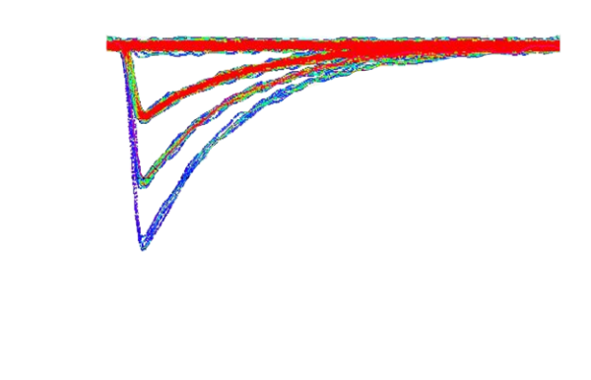
How they works: detector features
Critical temperature
Histogram of pulses amplitude for fixed photon energy
$$T_{C}^{}$$
Temperature sensitivity
$$∆T_{C}^{}$$
time (μs)
0 20 40 60
0
-0.1
-0.2
Amplitude (V)
0 γ
1 γ
Effective response time
Energy resolution
Saturation energy
$τ_{eff}∝$ $T_{C}^{−3}$
$$∆E∝T_{C}^{3/2}$$
$$E_{sat}∝T_{C}^{}$$
2 γ
3 γ
The energy resolution improves for low T_{C}

Slide 7
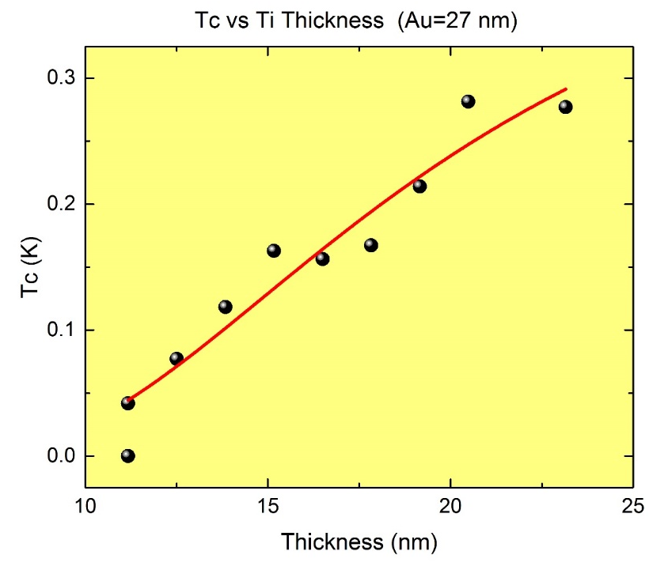
T_{C} tuning: proxymity effect
R (T)
$d_{n}$Varius
Au
Au
$$d_{n}$$
R_{N}
$$d_{n}$$
Au
$$d_{n}$$
$$d_{s}$$
Ti
SiN_{X} substrate
$d_{s}$ Fixed
0
T
T_{C0}
$$T_{C}=T_{C0}{\left[\frac{d_{s}}{\frac{π}{2}k_{B}T_{C0}n_{s}λ_{F}^{2}}\frac{1}{1.13(1+\frac{d_{s}n_{s}}{d_{n}n_{n}})}\right]}^{\frac{d_{n}n_{n}}{d_{s}n_{s}}}$$
J. M. Martinis, G. C. Hilton, K. D. Irwin, and D. A. Wollman, “Calculation of Tc in a normal-superconductor bilayer using the microscopicbased Usadel theory,” Nucl. Instrum. Methods Phys. Res. Sect. A: Accel., Spectrometers, Detect. Assoc. Equip., vol. 444, no. 1/2, pp. 23–27, 2000

Slide 8
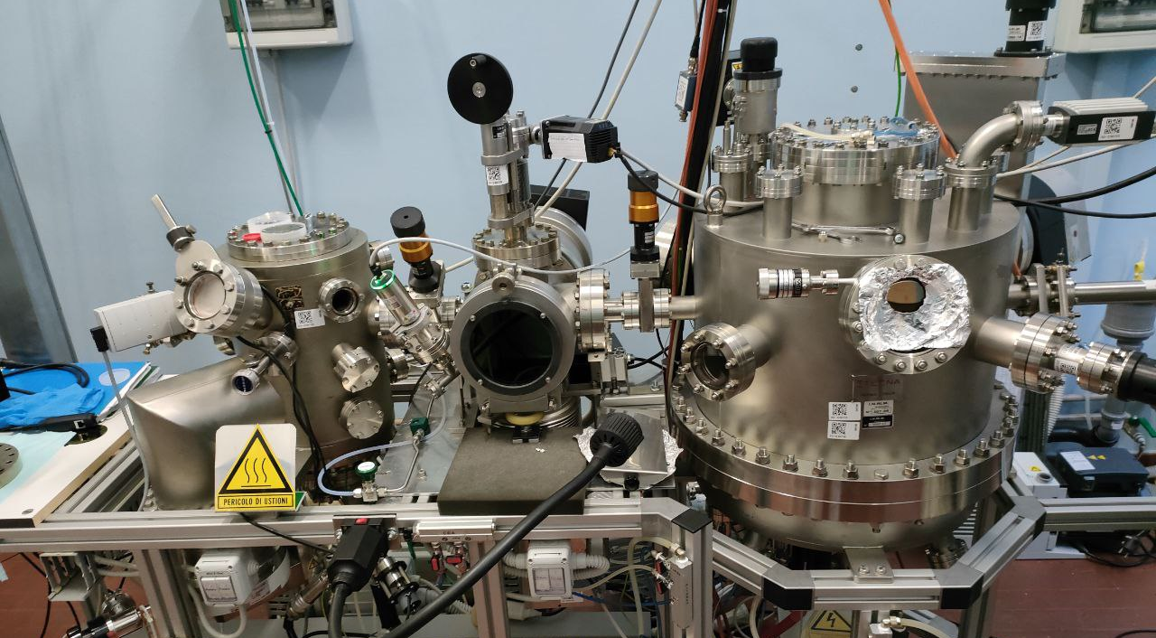
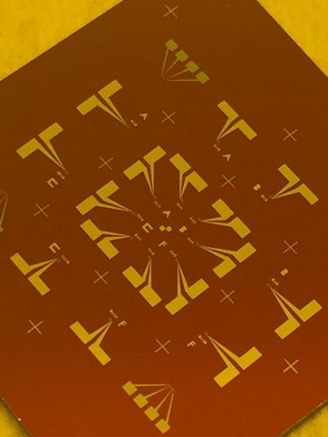
INRiM Facilities: Fabrication
Laser writer
People:
Hobey Garrone (hobey.garrone@polito.it)
Eugenio Monticone
(e.monticone@inrim.it)
Thermal evaporation Au ,Ti
Up to 16 TESs per deposition
Sputtering Nb, Al technology

Slide 9
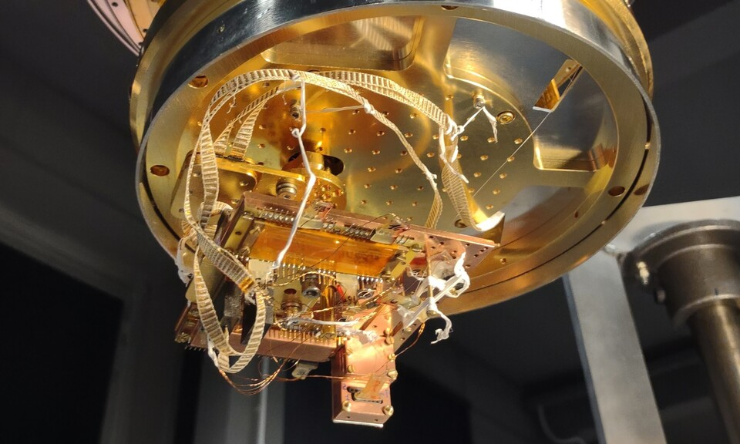
INRiM Facilities : Measure
Adiabatic Demagnetization Refrigerator:
Base temperature down to 30 mK
Optical fiber integrated in the system
People:
Carlo Pepe
(carlo.pepe@polito.it)
Mauro Rajteri
(m.rajteri@inrim.it)

Slide 10
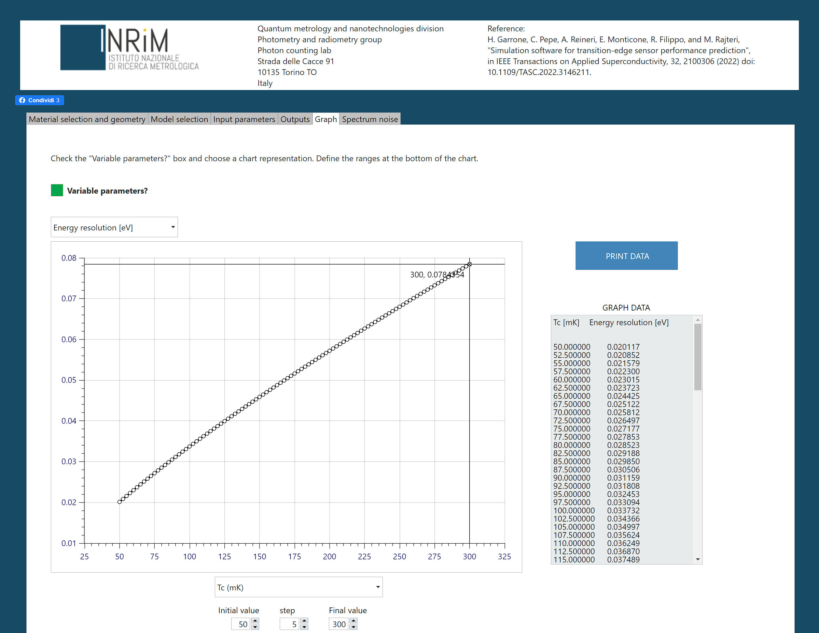
INRiM Simulation of TES performances
https://tes.inrim.it/
INRiM online program:
Free access
TES performance simulations in the most established theoretical framesworks.
H. Garrone, C. Pepe, A. Reineri, E. Monticone, R. Filippo and M. Rajteri, "Simulation software for transition-edge sensor performance prediction," in IEEE Transactions on Applied Superconductivity, doi: 10.1109 / TASC. 2022. 3146211.

Slide 11
INRiM TESs for PTOLEMY

Slide 12
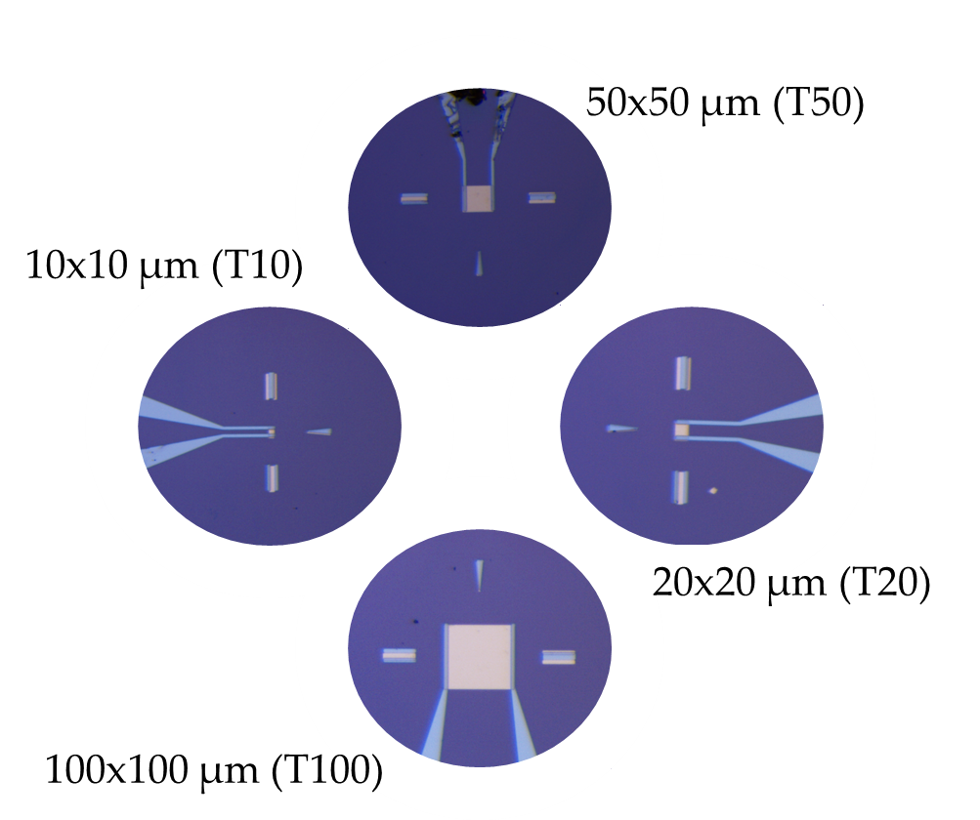
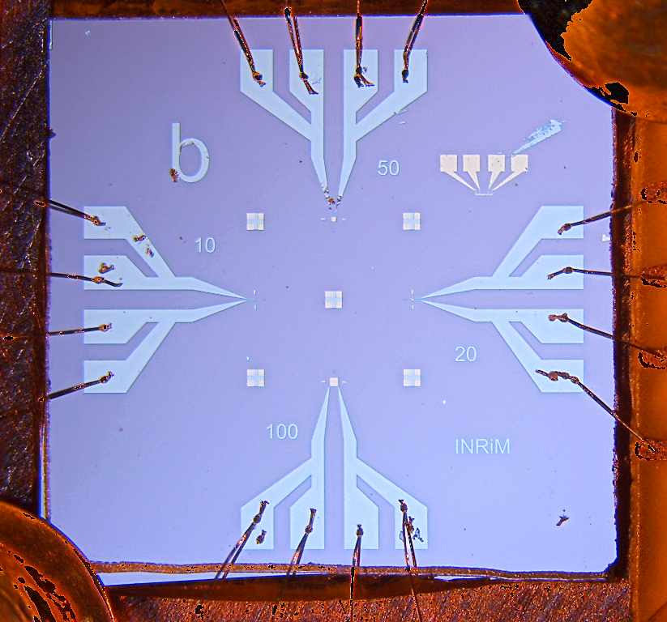
TES structure: Lito1 and Lito2
Au 30 nm
Nb
wiring
Ti 12 nm
SiN_{X} 500 nm
Si
SiN_{X} 500 nm
Thermal bath

Slide 13
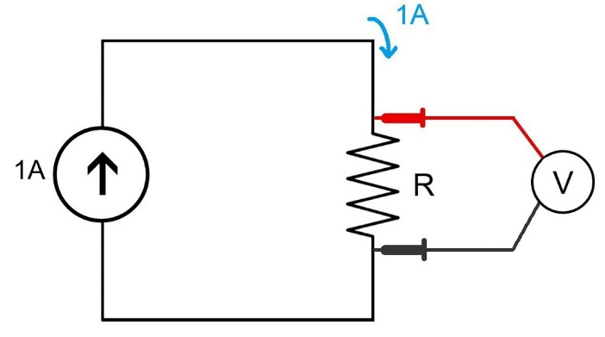
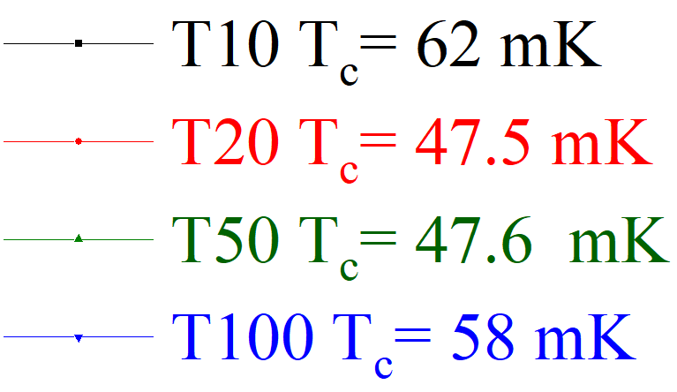
Lito1
Four terminal resistance measurement

Slide 14
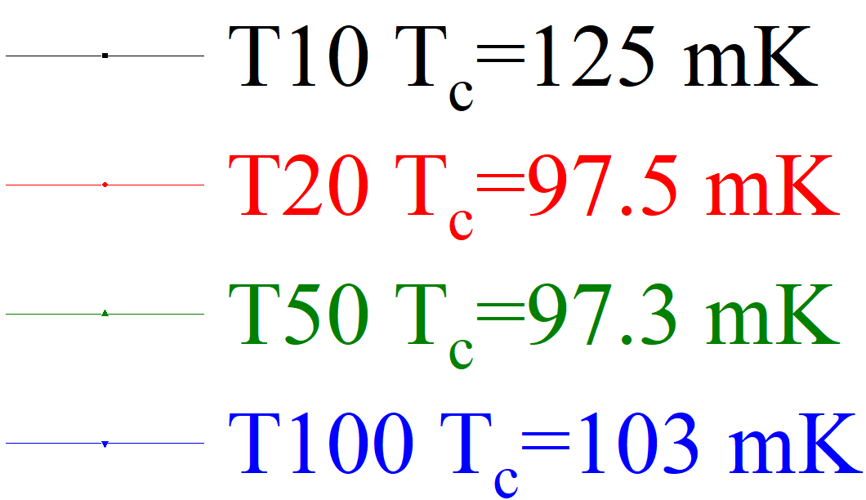
Lito2
Four terminal resistance measurement

Slide 15
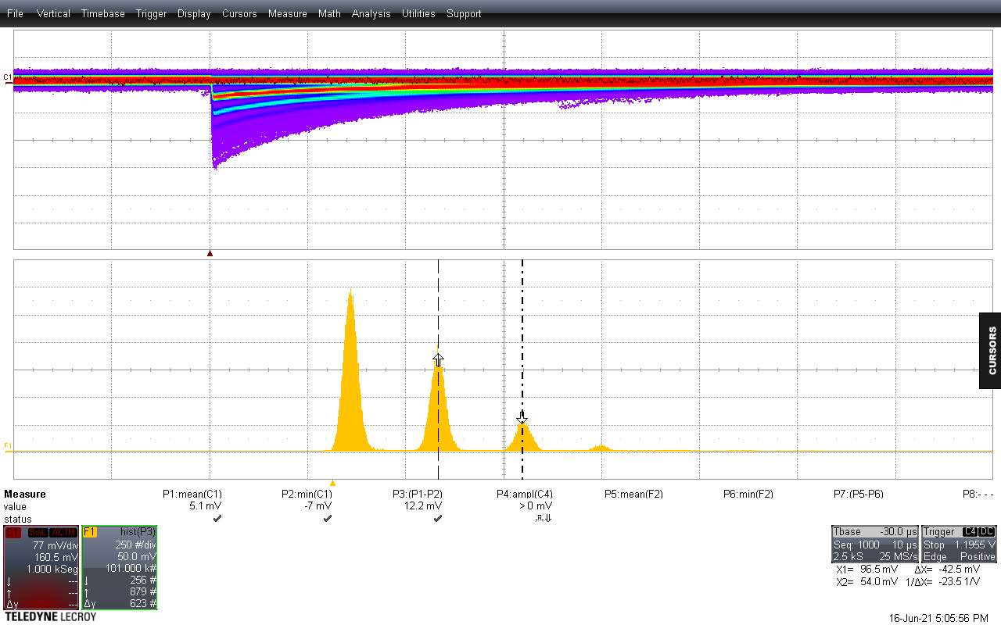
Photon counting characterization
Laser trigger
Amplitude
Amplitude
baseline
min
λ= 1540 nm
baseline
min
0 ph
Amplitude histogram
(baseline-min)
Counts
Counts
1 ph
2 ph
3 ph
Amplitude histogram
avg(baseline)-min
0 ph
1 ph
2 ph

Slide 16
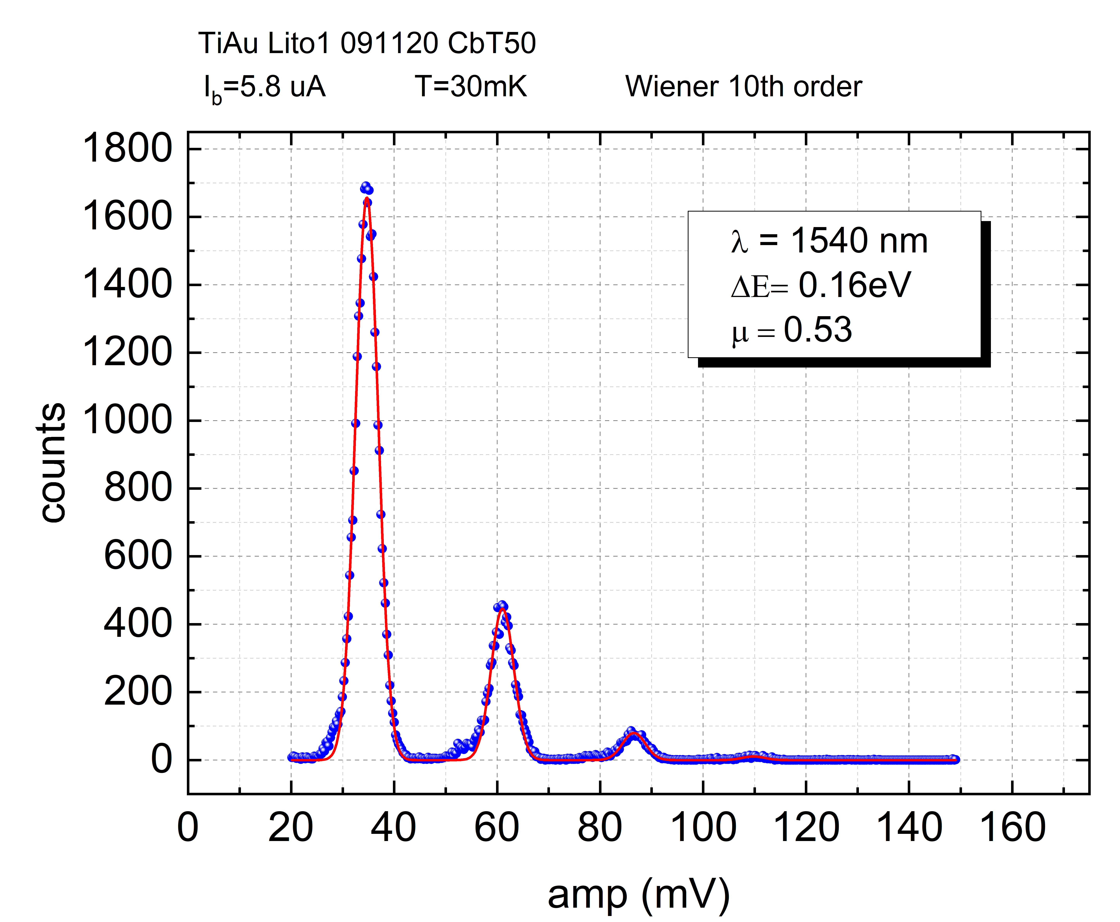
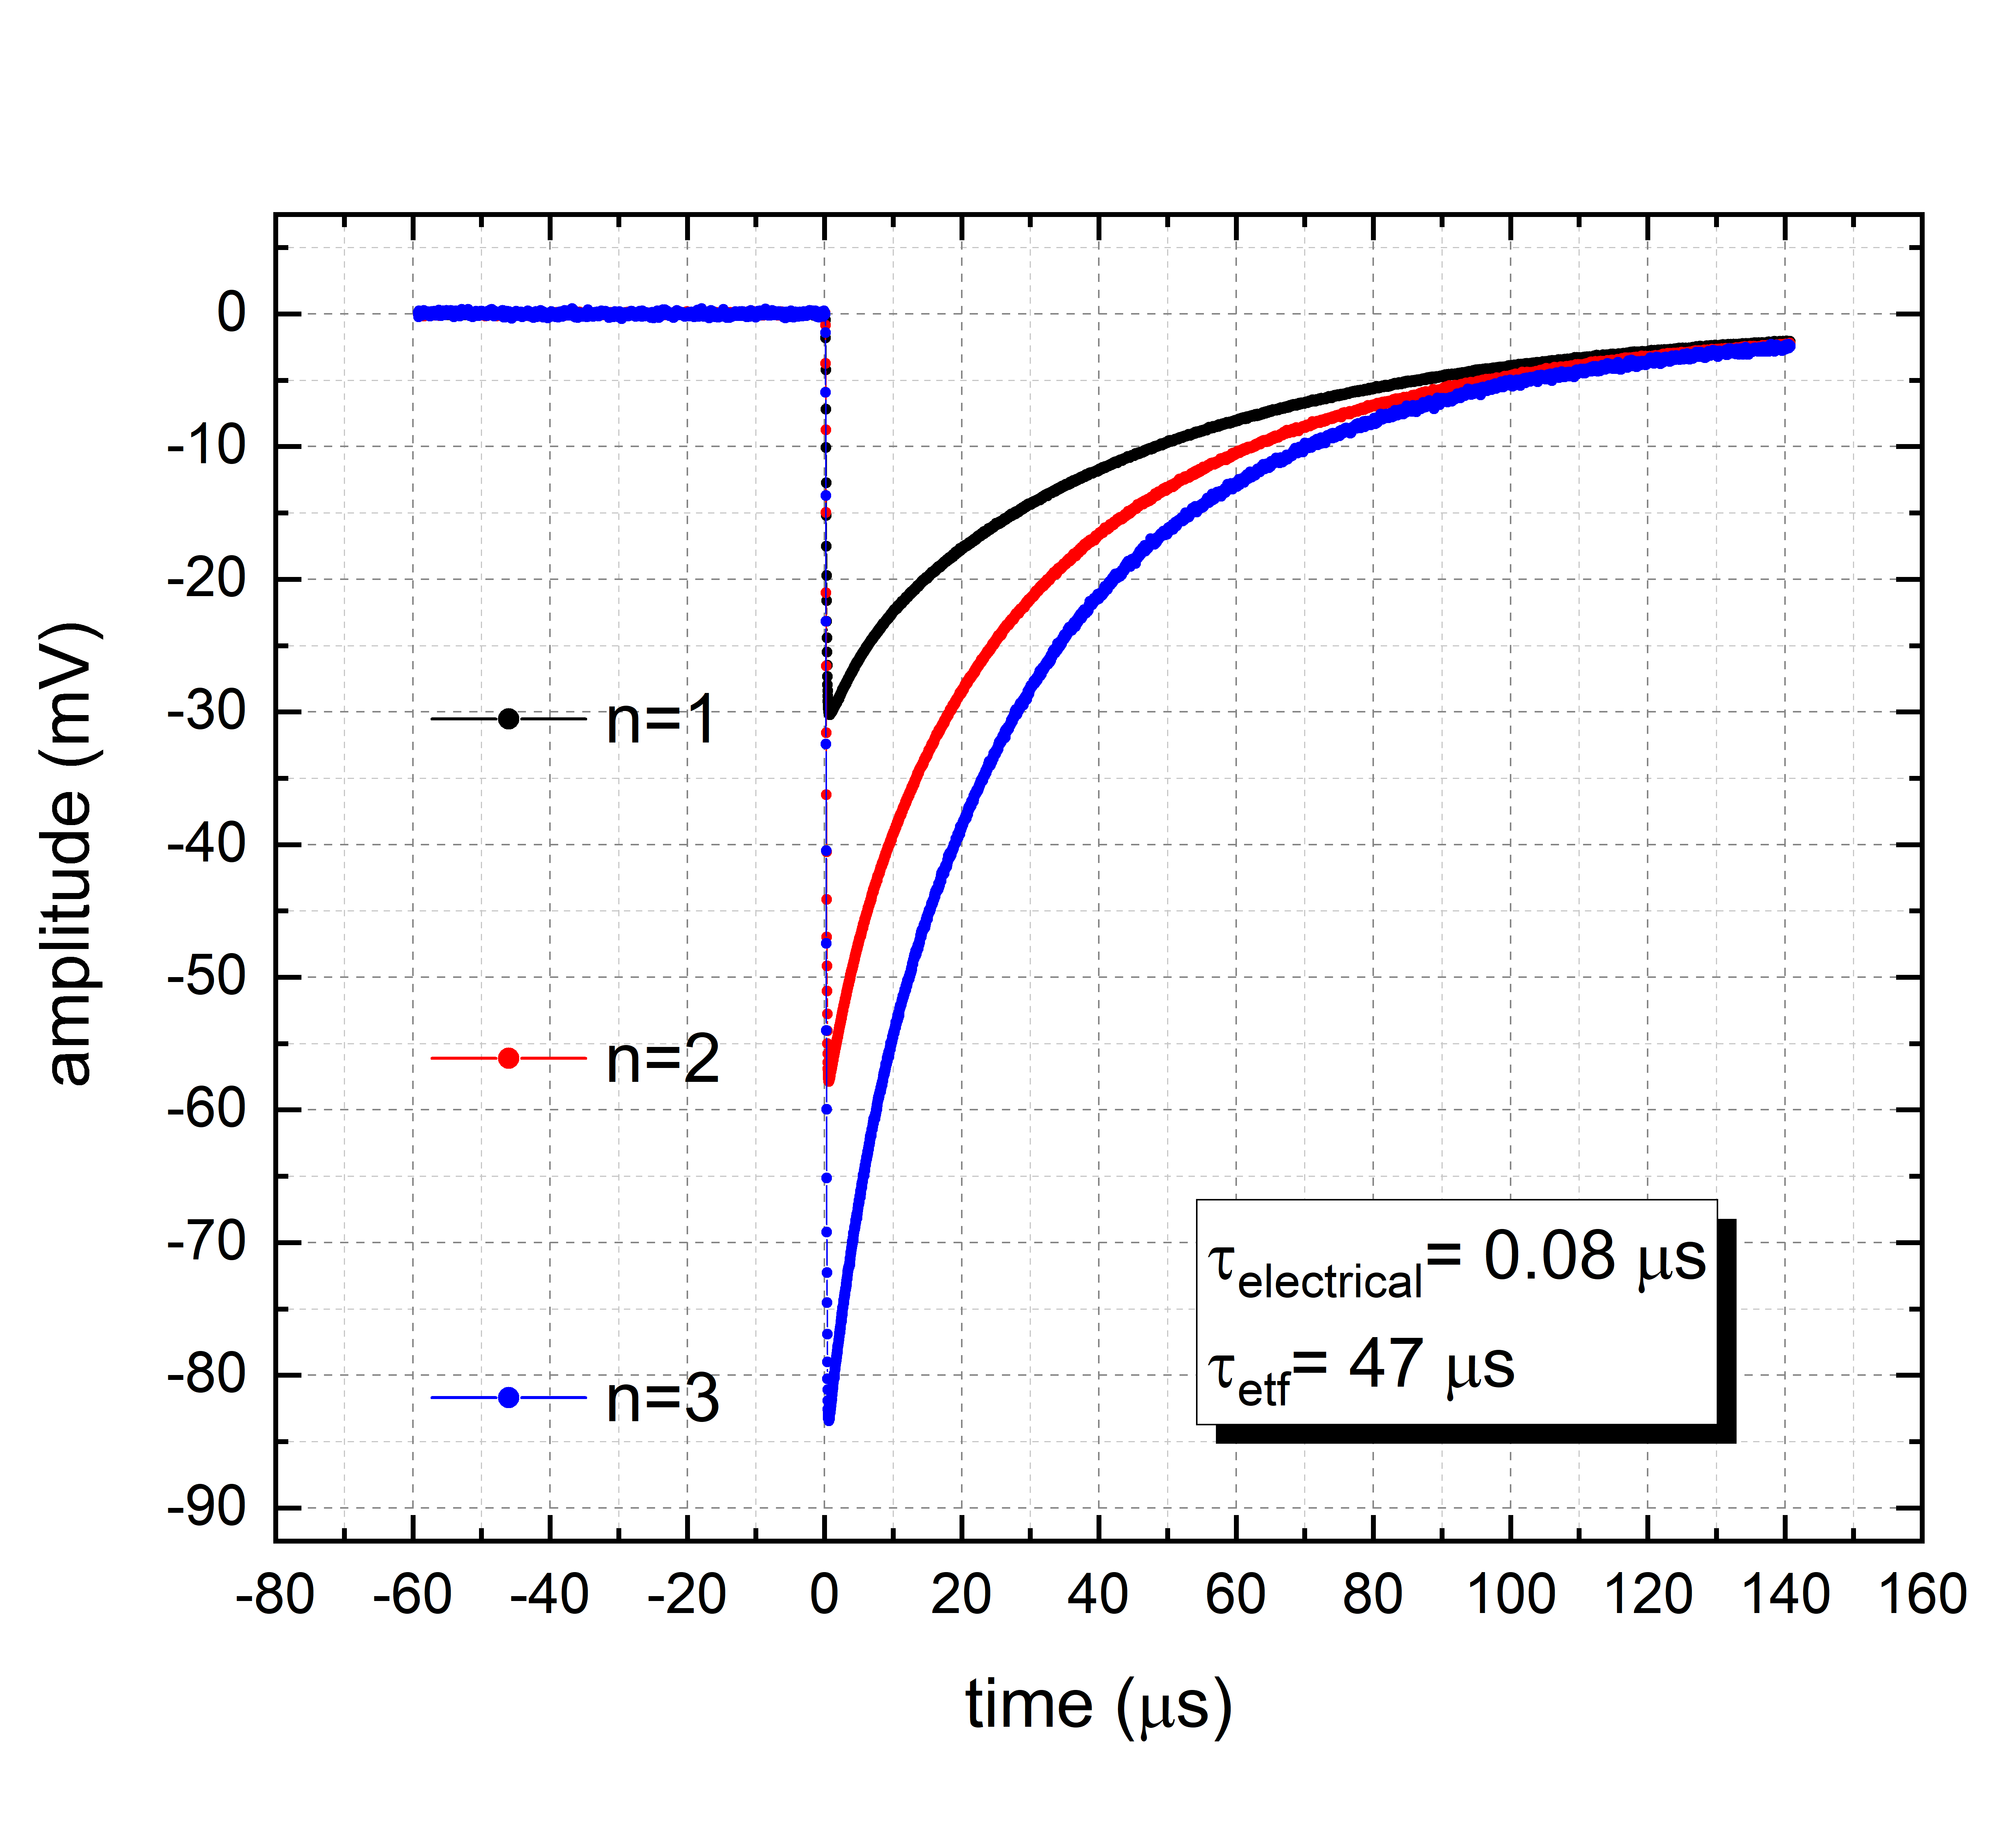
Lito1: T50
Histogram of pulses amplitude for fixed photon energy
50x50 µm (T50)
T_{C}= 47 mK
1
2
3

Slide 17
Lito2: T20
20x20 µm (T20)
R_{TES}= 20% R_{N}
T_{bath}= 40 mK
λ = 1540 nm (0.8 eV)
same result our APL13
but with an area
4 times greater

Slide 18
Lito2: T20
R_{TES}= 20% R_{N}
Tbath= 40 mK
λ = 1540 nm (0.8 eV)
Saturation energy 12 eV

Slide 19
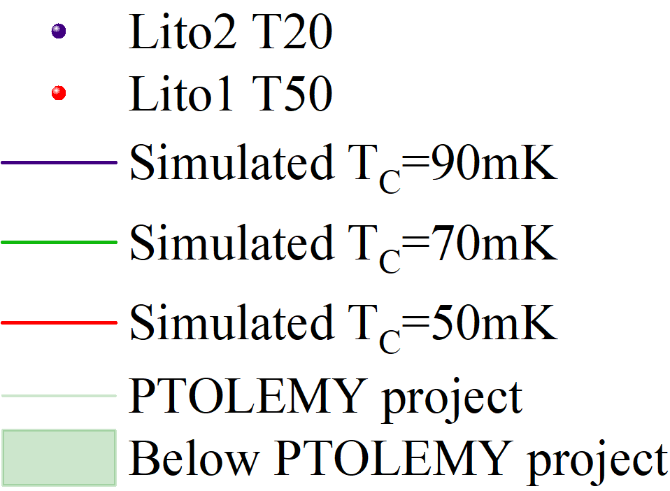
Simulation resutls
Simulation for a squared TES with l x l area

Slide 20
Q&A
Questions
Answers
Lito1 and Lito2 have the same structure but different T_{C,} why?
Why smaller TES of Lito1 were not measured considering the simulation?
Why in both Lito1 and Lito2 the transition of T10 TESs are not sharp as the larger TESs?
The pressure in the deposition chamber was lower for Lito2, we resulting in a better quality of Titanium and its properties
Lito1 deteriorate in time losing the SC properties. Probably due the lower deposition quality
The Nb wiring has a proximity effect on the small TESs. This effect affect the small TESs more than the larger one

Slide 21
Annealing
Ti/Au strip1
Thermal annealing at 130°C
Tune the T_{C} in the range of 50-70 mK is challenging working only on Ti/Au thinknesses
It Has been shown that thermal annealing can be used to have a fine tune of the T_{C} in a Ti/Au bilayer
Van Der Heijden, N. J., et al. "Diffusion behaviour in superconducting Ti/Au bilayers for SAFARI TES detectors." Journal of Low Temperature Physics 176.3 (2014): 370-375.
Ti/Au strip2
Before annealing
After annealing

Slide 22
Summary
Results
Further investigation
TiAu TES with T_{C} < 100 mK fabricated.
First characterization with 0.8 eV photons
Best results up to now: ΔE=0.114 eV @ Tc~ 90 mK T20
Reduce the effect of wiring proximity effect using Ti instead of Nb.
Further test of the effect of the annealing to fine tune the T_{C} of the TESs
It is time to work on the detection of electron with TESs:
Cryogenic e-gun
First characterization of TESs with keV electron?

Slide 23
Thank you for the attention
Carlo Pepe^{1,2}, Hobey Garrone^{1,2}
Eugenio Monticone¹, Mauro Rajteri¹
6-7 October 2022 Zandvoort (NL)
(1)
(2)

Slide 24
Discussion

Slide 25
Backup slide

Slide 26
TES: Performances
Transition sharpness

Effective response time
□
Trade-off between response time and energy resolution
$$ΔE_{FWHM}≃2.36\sqrt{4kT_{c}^{2}\frac{C_{e}}{α}\sqrt{n/2}}∝T_{c}^{3/2}$$
Energy resolution
□
Trade-off between energy resolution and saturation energy
Saturation Energy
$$E_{max}=10 eV T_{c}=50 mK n=5$$
$ΔE_{FWHM}≃$ 39 meV

Slide 27
How they works: equations and results
INRiM BEST ENERGY RESOLUTION
Temperature sensitivity
time (μs)
0 20 40 60
0
-0.1
-0.2
0 γ
Amplitude (V)
1 γ
Effective response time
Energy resolution
$τ_{eff}=\frac{τ_{th}}{1+\frac{α}{n}\left(1−\frac{T_{s}^{n}}{T_{C}^{n}}\right)}\sim \frac{n}{α}τ_{th}\sim \frac{C}{G}∝$ $T_{C}^{−3}$
$$∆E≈2.355\sqrt{4kT_{C}^{2}\frac{C_{e}}{α}\sqrt{n/2}}∝T_{C}^{3/2}$$
2 γ
3 γ
Temperature variation

Slide 28
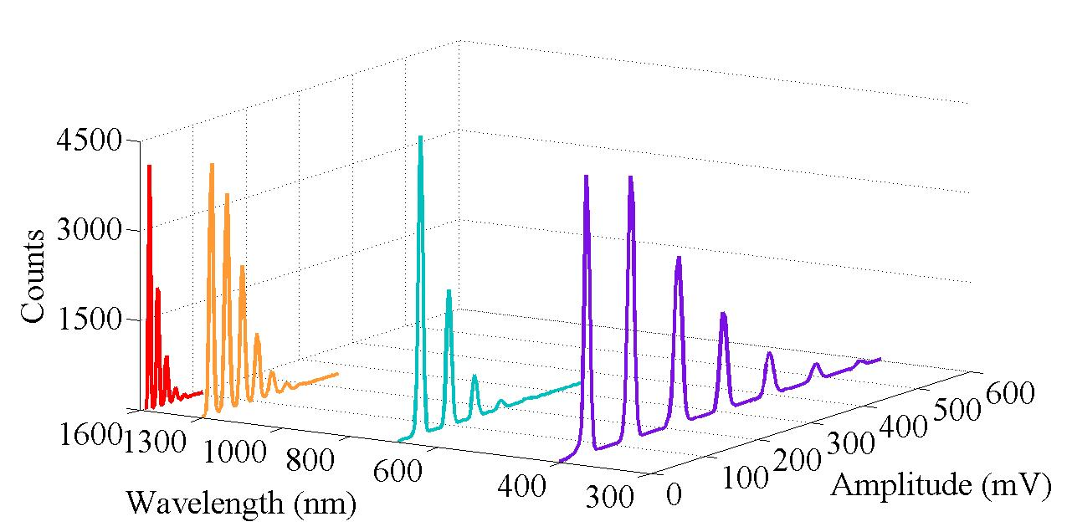
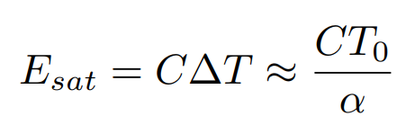
TES behaviour
TES behaviour depend on the working point, i.e. bias current, and on the wavelength of the incident particles.
TES saturation energy depend on TES properties only.
4500
Counts
3000
1500
600
1600
400
Amplitude (mV)
800
200
400
0
RESPONSE vs BIAS
λ (nm)
Saturation energy

Slide 29
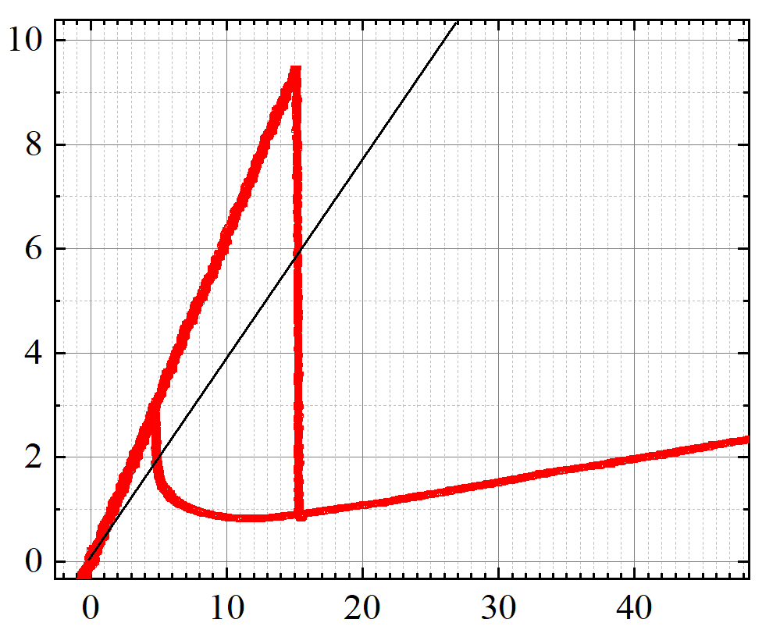
TES polarization curve
77 mK
voltage bias
Superconductive
V_{out}
I_{TES}
R_{fb}
Working point
I_{Bias}=7.7 µA
R₀=5% R_{n}
Electrical circuit
SQUID
L_{fb}
I_{TES} (μA)
R_{bias}
L_{in}
I_{bias}
R_{TES}
Normal
R_{bias}<< R_{N}
Amplifier
R_{n} =0.4 Ω
0
10
20
30
40
I_{BIAS} (μA)

Slide 30
Simulation resutls
Saturation energy → 4 keV

