Slide 1
Dutch National Science Agenda 2022 – NWA
One second after the big bang
Tritiated graphene to find relic neutrinos

Slide 2
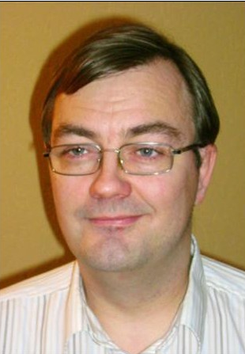
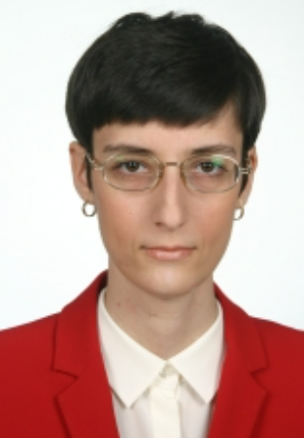
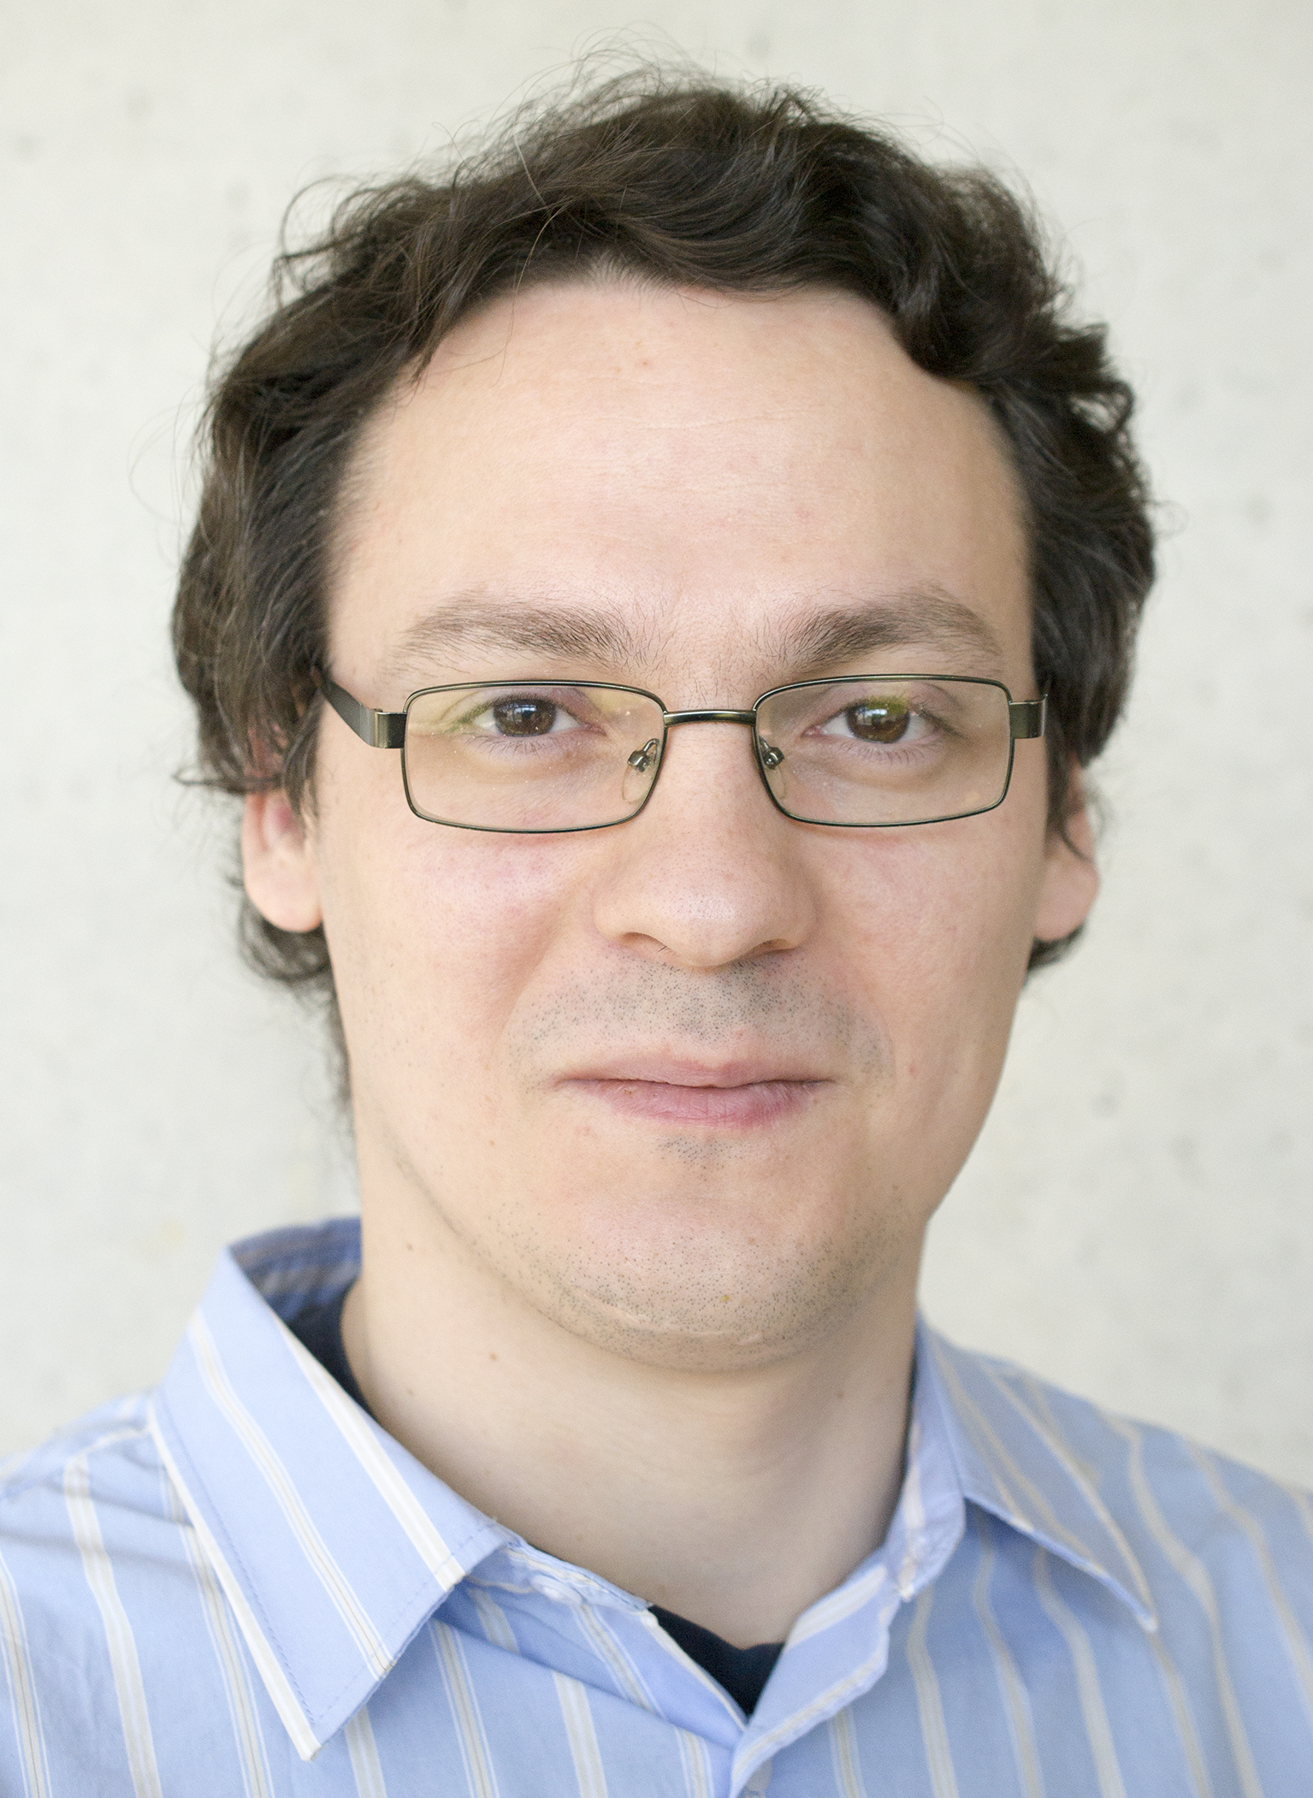
The Nijmegen group
Uli Zeitler
(RU HFML-FELIX)
Nicolo de Groot
(RU IMAPP)
Nicoleta Cucu-Laurenciu
(RU IMAPP)
Inge van Rens
(RU IMAPP)
Oleksandr Zheliuk
(RU HFML-FELIX)
Martijn Velders
(RU IMAPP)
Dave van Wijk
(RU IMAPP)

Slide 3
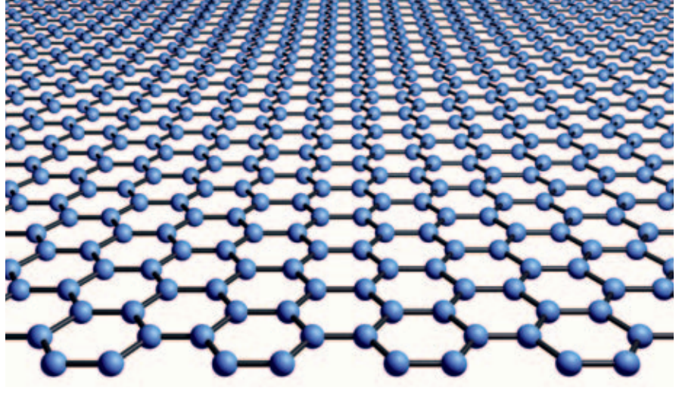
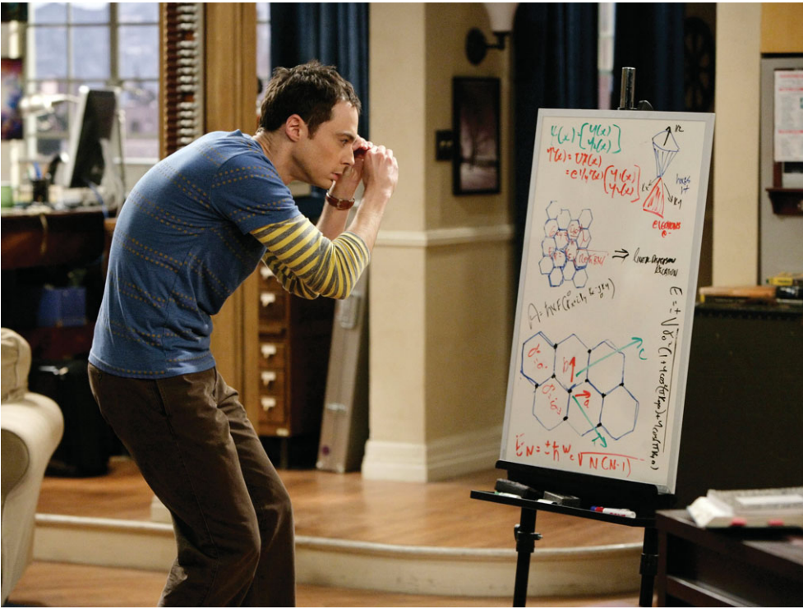
Tritium on graphene (graphite)
Why?
securely bound to surface
no-vibrations ?!
larger “mass” ? ( → Mössbauer)
+
Extra benefits
graphene-based detectors
measure tritium decay
Fig.11, Rev. Mod. Phys. 83, 837 (2011)
Photo: Sonja Flemming/CBS 2010
© CBS Broadcasting Inc.

Slide 4
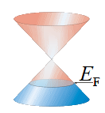
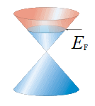
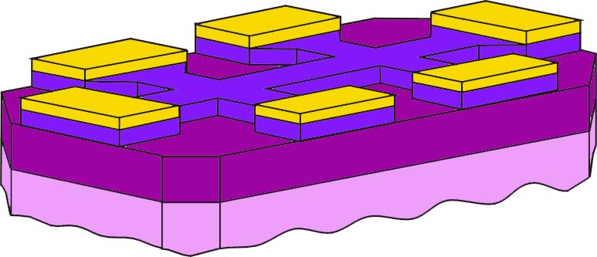
Graphene FETs
Field effect doping in a MOSFET
6
graphene
Au contacts
4 K
SiO₂
gate insulator
4
ρ (kΩ)
Si backgate
2
holes
electrons
260 K
0
Novoselov et al.,
Science 2004, PNAS 2005
-80
-40
0
40
80
V_{G} (V)
Resistance depends on doping → measure n (t)
Most simple FET ( → graphene FET lab @THUAS)

Slide 5
Idea: particle detectors
$$e^{−}$$
particle hits graphene
dumps part of its energy
creates electronic excitations
⇒ resistance change R(t)
correlate resistance changes
with scintillator signal
scintillation detector

Slide 6
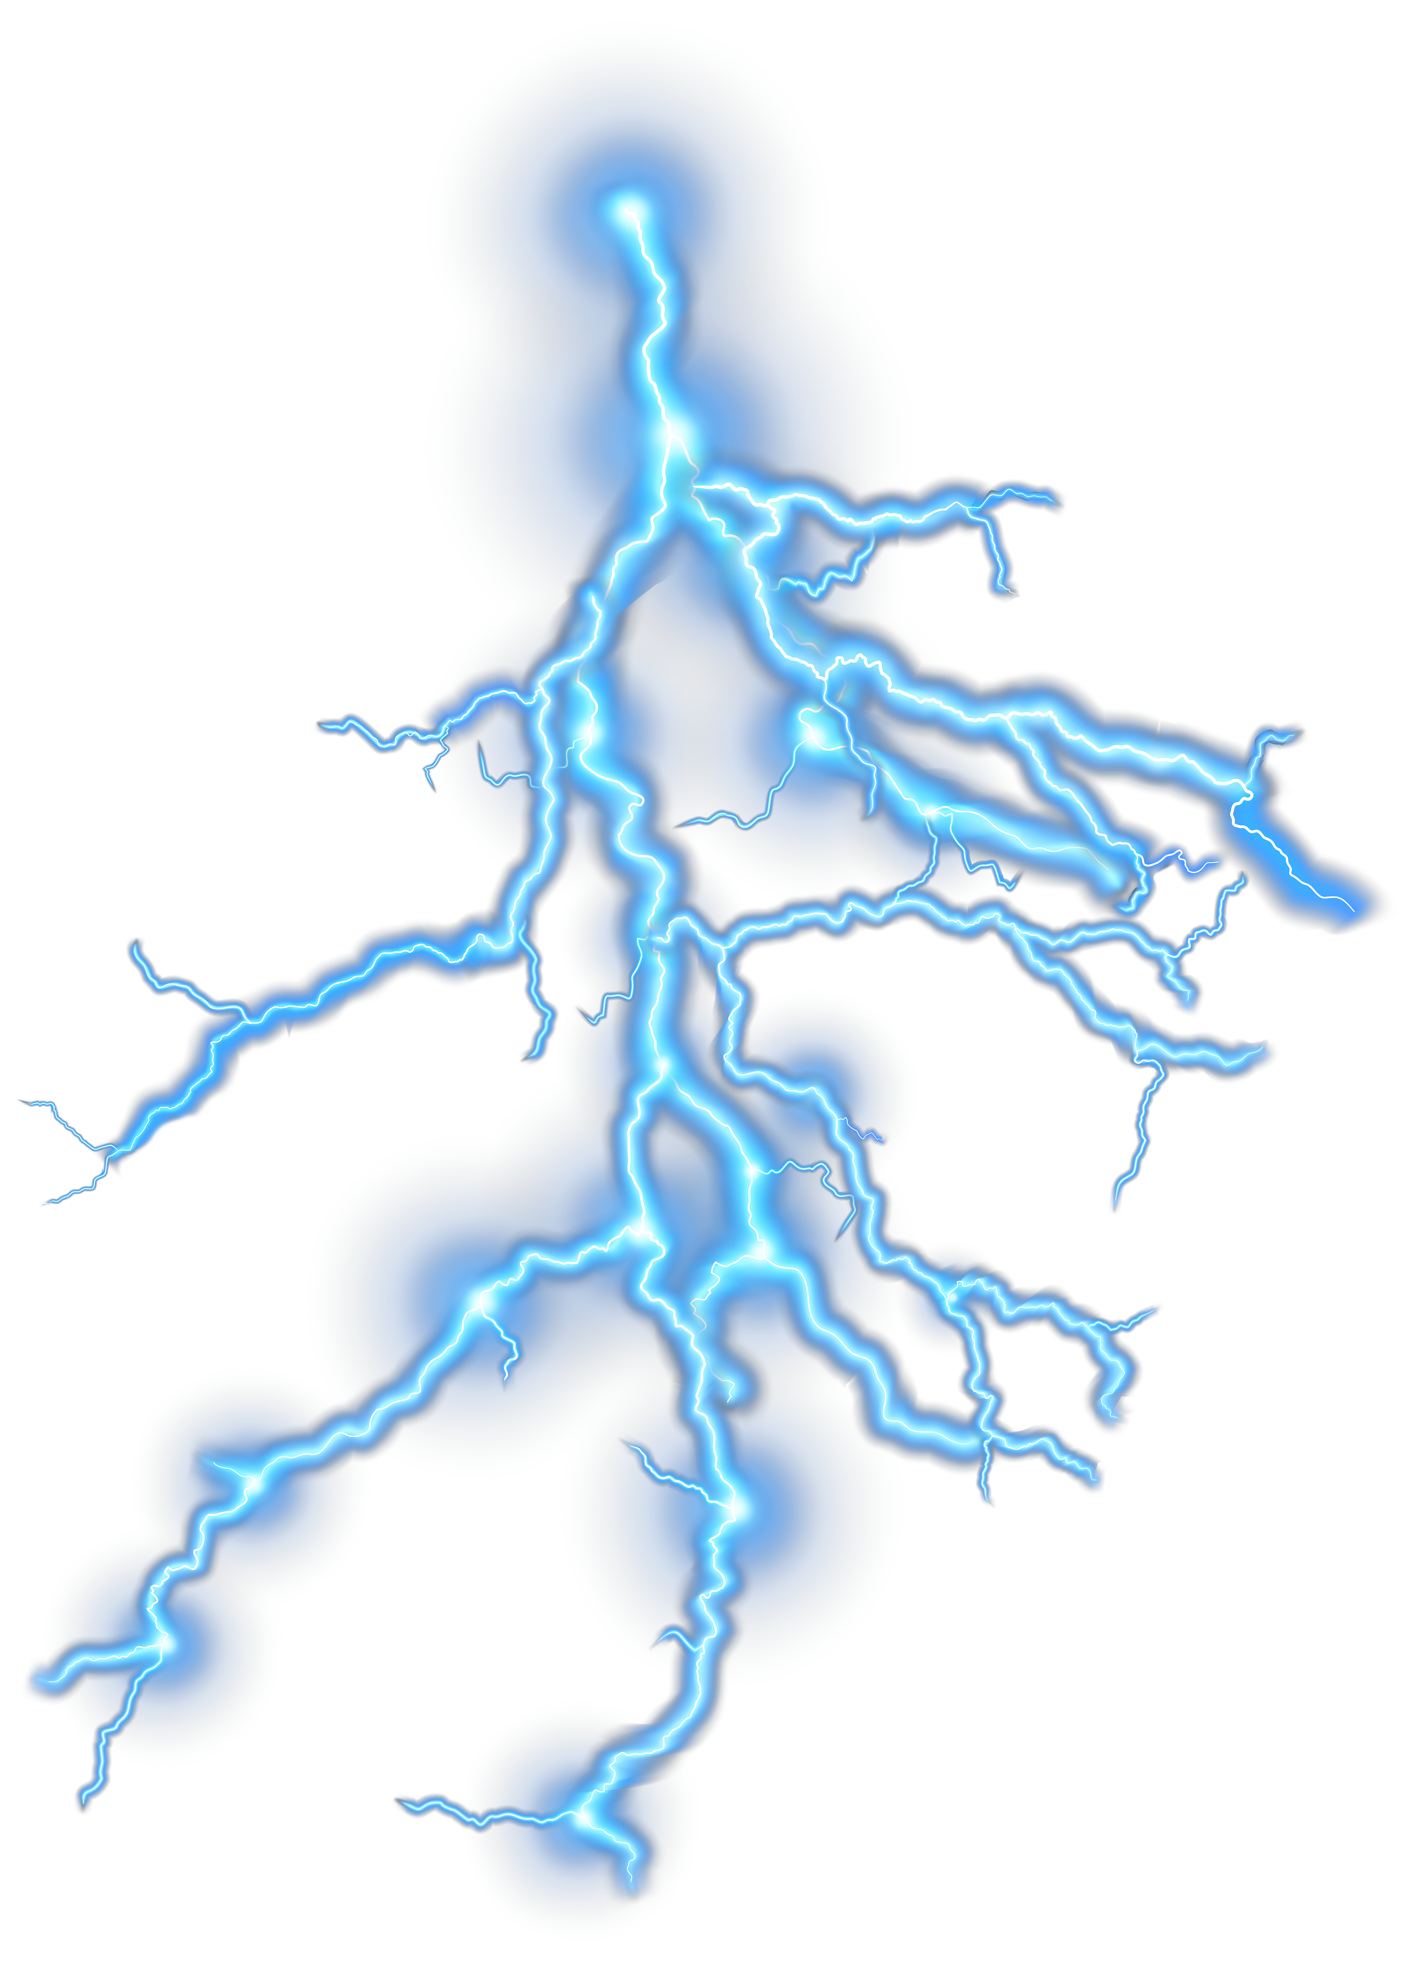
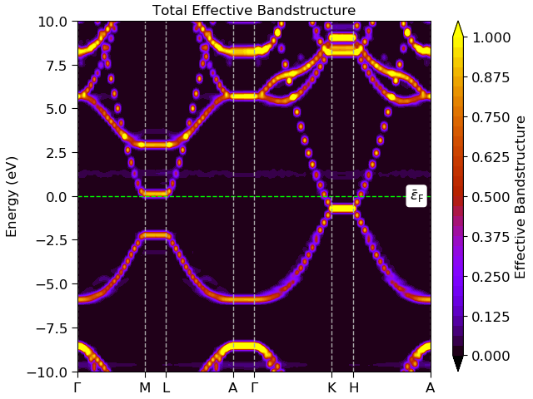
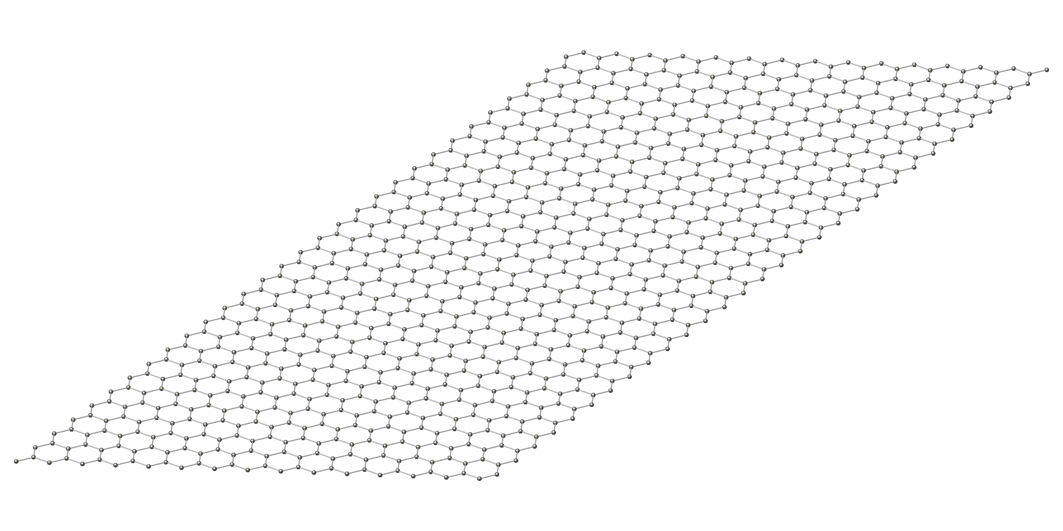
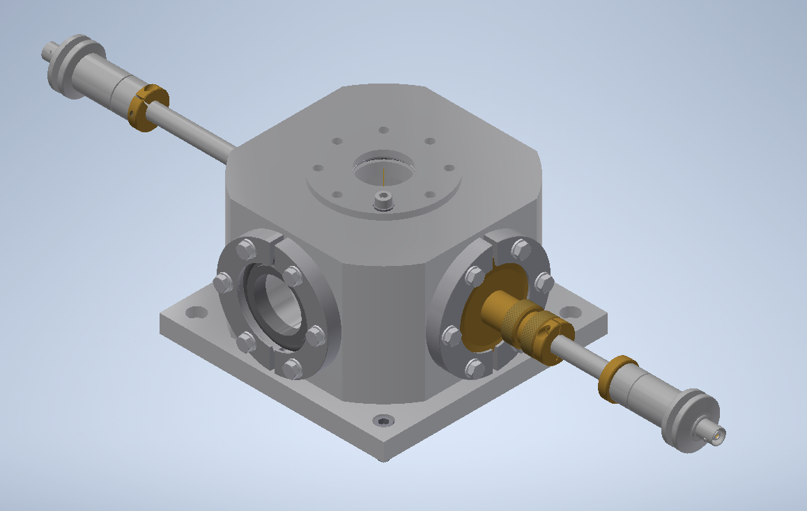
Hydrogenated graphene
H₂
·H
H·

Slide 7
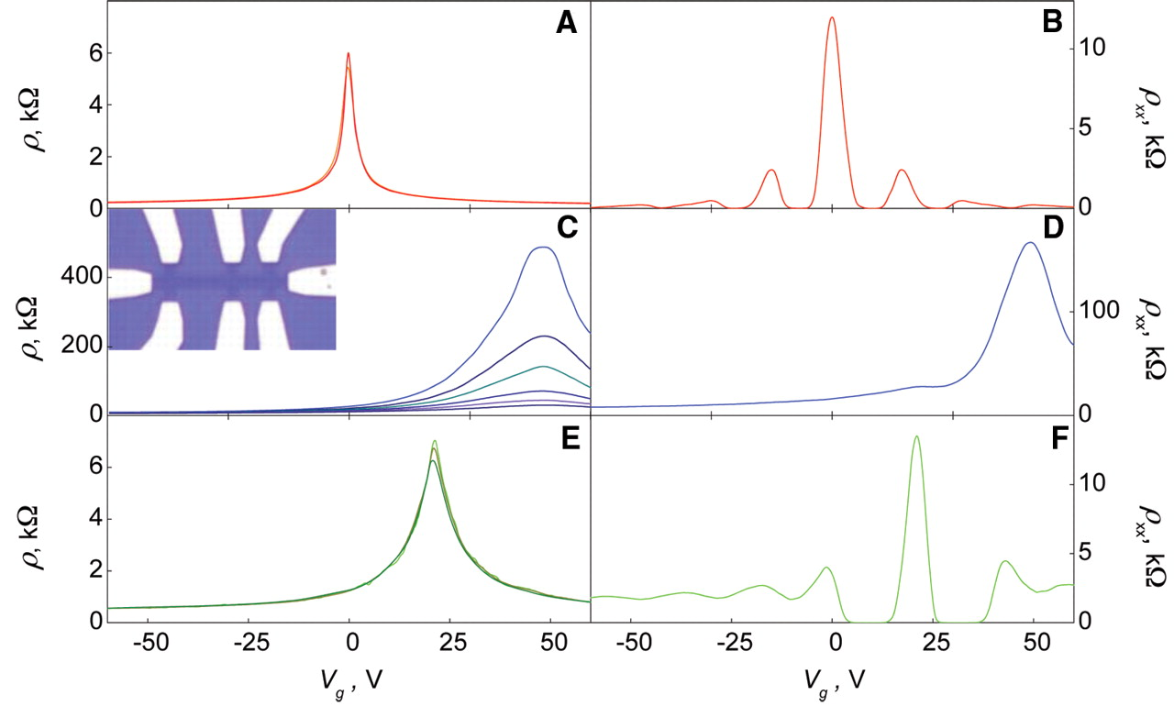
Hydrogenated graphene
B = 0
B = 14 T
pristine
graphene
plasma
hydrogenated
graphene
annealed
Elias et al., Science 323, 610-613 (2009)
Key message: hydrogen changes resistance of graphene - reversible

Slide 8
Tritiated graphene
Questions to address:
Small numbers if H-atoms absorbed – single atom measurable?
How to replace H with T?
How to fix large quantities of T on graphene?
Idea:
Measure T decay:
Detect resistance changes in graphene
Correlate with electron detection
³$T→\text{3}\text{He}\text{+}e^{−}+{\overline{ν}}_{e}$
Fundamentally address the question of energy resolution for T-decay

Slide 9
Summary and outlook
Graphene as particle detectors
Tritium on graphene:
Seed-experiment for Ptolemy
To do:
Cold plasma graphene hydrogenation (tritiation)
Simultaneous resistance change and $e^{−}$ particle detection
Future:
100 g tritium target

Slide 10
Thanks you for your attention!

Slide 11
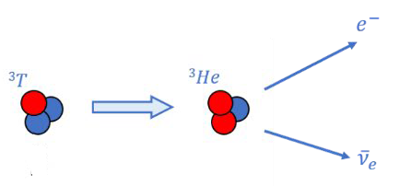
Tritium decay
a) Spontaneous decay
Excess energy: Δm c² = 14.949 keV
Q-Value: 18.589 keV
Life time: τ = 17.7 y / t_{1/2} = 12.32 y
$$N\left(t\right)= N_{0}∙e^{−t/τ}$$
$\frac{1}{N}\frac{dN}{dt}=2.5∙{10}^{−9} s^{−1}$= $9∙{10}^{−6} h^{−1}$
b) Induced by Cν B
Extra energy from incident neutrino
⇒ different electron spectrum
Notes:
2’

Slide 12
NWA project – key questions
What is the underlying physics of relic neutrinos?
How much tritium will the PTOLEMY experiment need?
Can we make the tritium loaded graphene target?
Can we measure the electron energy through radio-frequency detection?
Can we tag electrons from a tritium source in a radio-frequency system?
Can we use graphene based nano-devices as particle detectors?
WP1 (UvA)
WP2 (RU)
WP3 (UvA/
Nikhef & TNO)
WP6 (NNV)
WP4 (INF)
WP5 (THUAS)

Slide 13
Collaborations
Graphene (nano-)devices
Hydrogenation
Tritium
Theory
Spectroscopy (FIR, STM)

Slide 14
NWA project in a nutshell
WP1 (UvA) Relic Neutrinos: What happened at the Big Bang and ever after?
WP2 (RU) The tritiated graphene target
WP3 (UvA/Nikhef & TNO) RF detection of single electron quanta
WP4 (INF) System testing and development at Gran Sasso
WP5 (THUAS) Education developments
WP6 (NNV) Outreach

Slide 15
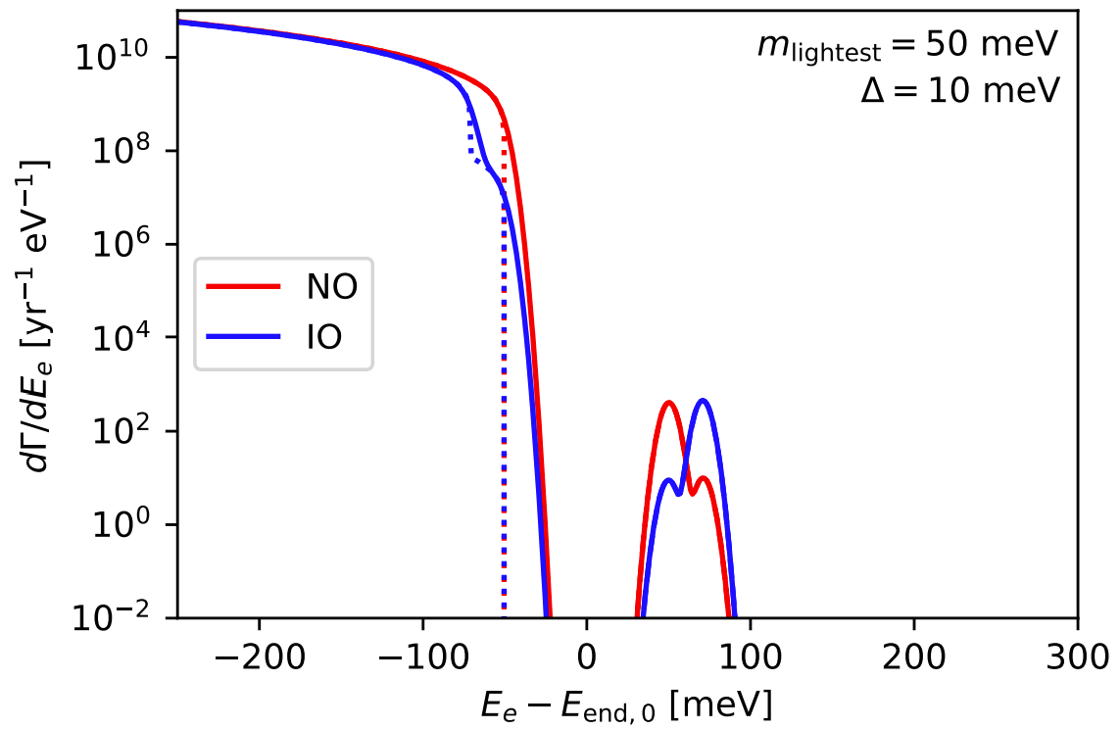
Free T decay vs. ν-induced decay
the end game
³$T→\text{3}\text{He}\text{+}e^{−}+{\overline{ν}}_{e}$
extra peak above endpoint
due to Cν B
orders of magnitude smaller than normal decay
differences due to different theoretical scenarios
“Problems”:
small relative energy
need ~50 meV resolution
Vibrations of T₂ (300 meV)
Heisenberg uncertainty
arXiv:2101.10069 [hep-ph]
$${2m}_{ν}c^{2}$$
Endpoint of
spectrum
³$T+υ_{e}→\text{3}\text{He}\text{ +}e^{−}$
100 g tritium target !
M. Betti et al. (PTOLEMY), JCAP 07, 047 (2019),
arXiv:1902.05508 [astro-ph.CO].
Notes:
2’

Slide 16
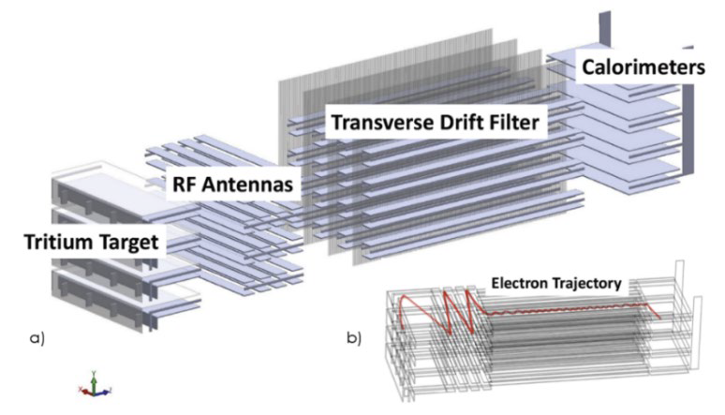
The tritinated graphene target

