Slide 1
Single electron RF emission detection at LNGS
PTOLEMY General Meeting
Zandvoort (NL)
Oct. 7, 2022
Alfredo G. Cocco
Istituto Nazionale di Fisica Nucleare
Laboratori Nazionali del GranSasso

Slide 2
Single electron RF emission detection
Aim: Detect single electron RF emission signal @ 27 GHz having low intensity (~ 1 fW)
in a relatively short time (hopefully below 100 μs)
Purpose(s): First measurement of this kind in the PTolemy Collaboration
First step toward the demonstrator
Key step in funding agencies timetables
Setup: Permanent magnet (1 Tesla field) hosting an “electron trap”
Timescale: Well before prototype magnet commissioning (hopefully first half of 2023)

Slide 3
The Magnet

Slide 4
Halbach cylinder permanent magnet
Proposal: Use the Halbach configuration to produce a uniform 1 Tesla field using Nd permanent magnets
Halbach arrays: magnetic levitation trains, wiggler magnets, brushless DC motors and many more
Cylindrical Halbach arrays:
After market survey China Magnet Source Materials Ltd was selected to build a 1 Tesla Halbach array
of NdFeB permanent magnets having a bore diameter of at least 5 cm and a lenght of about 12 cm

Slide 5
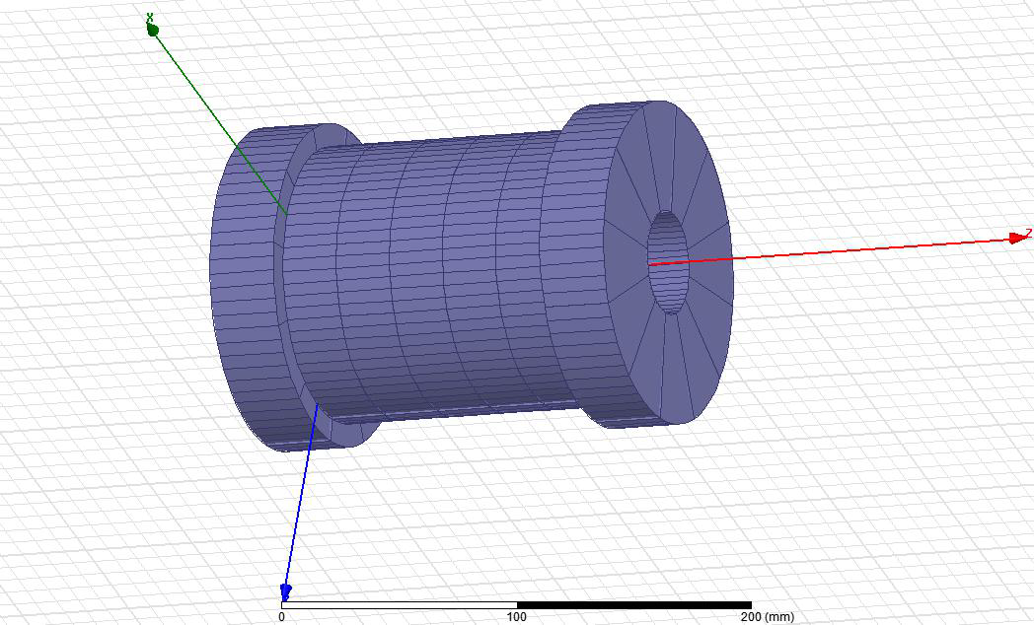
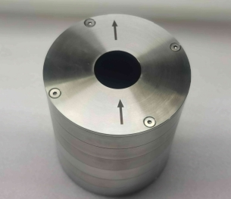
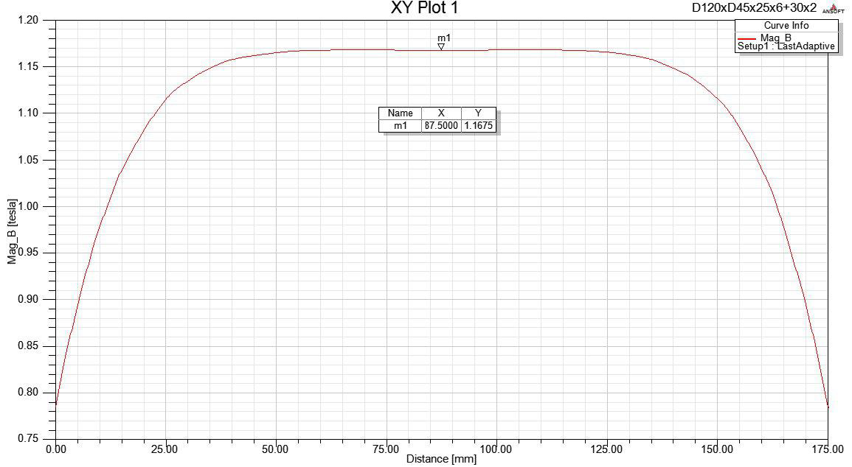
Halbach cylinder permanent magnet
Manufactured by China Magnet Source Materials Ltd
Shenzhen (China)
Delivered in Italy (Genova) on May 19, 2022
10⁻³ uniformity in the central region
B field: 1 Tesla
Outer diameter: about 170mm
Inner diameter: about 50 mm
Height: about 191mm
Weight: about 32kg

Slide 6
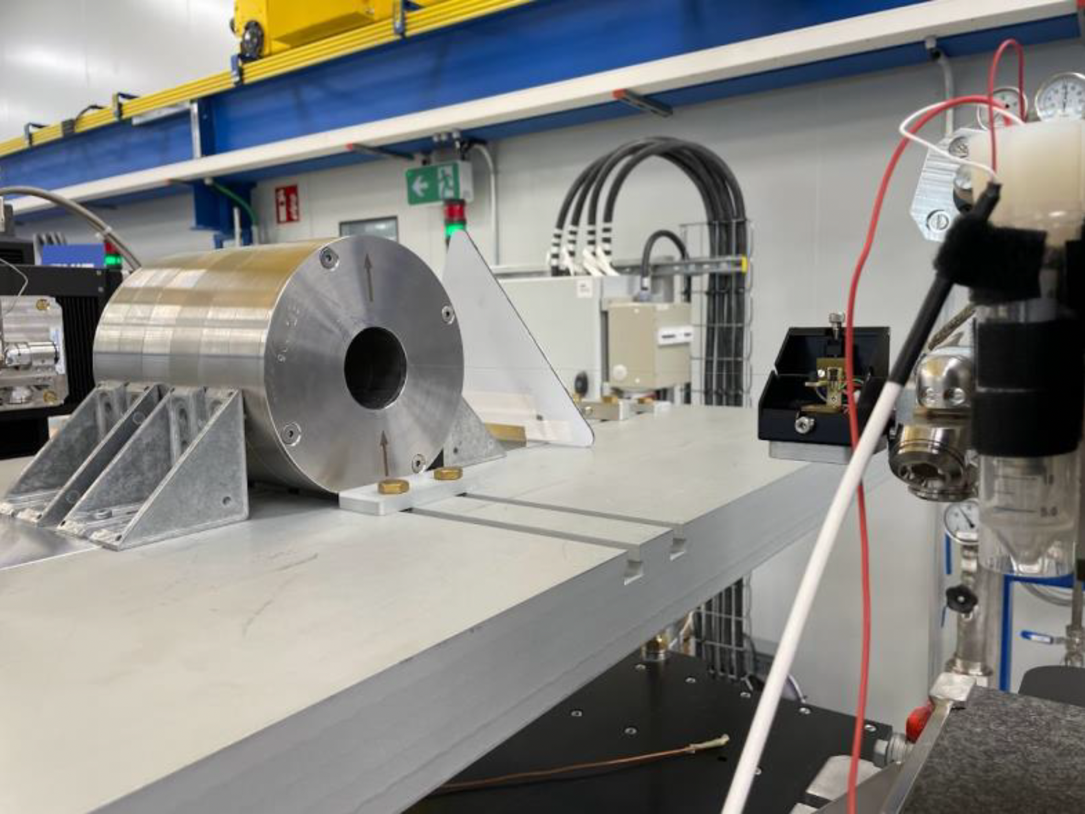
Halbach cylinder permanent magnet
The magnet was immediately shipped to CERN in order to be characterized
Measurements have been carried out by M.Buzio team (TE-MSC Magnets, Supercondictors and
Cryostats Division) in the context of the framework collaboration agreement KN3083
Measurements:
- The central field module, obtained by NMR teslameter
- The integrated field homogeneity (multipoles),
obtained by Single-Stretched Wire (SSW)
- The 5 G (0.5 mT) perimeter outside the magnet,
representing the safety limit for static magnetic fields at
CERN, for persons carrying a pacemaker or an
implantable defibrillator. A 3-Axes Hall probe teslameter
was used to assess this limit

Slide 7
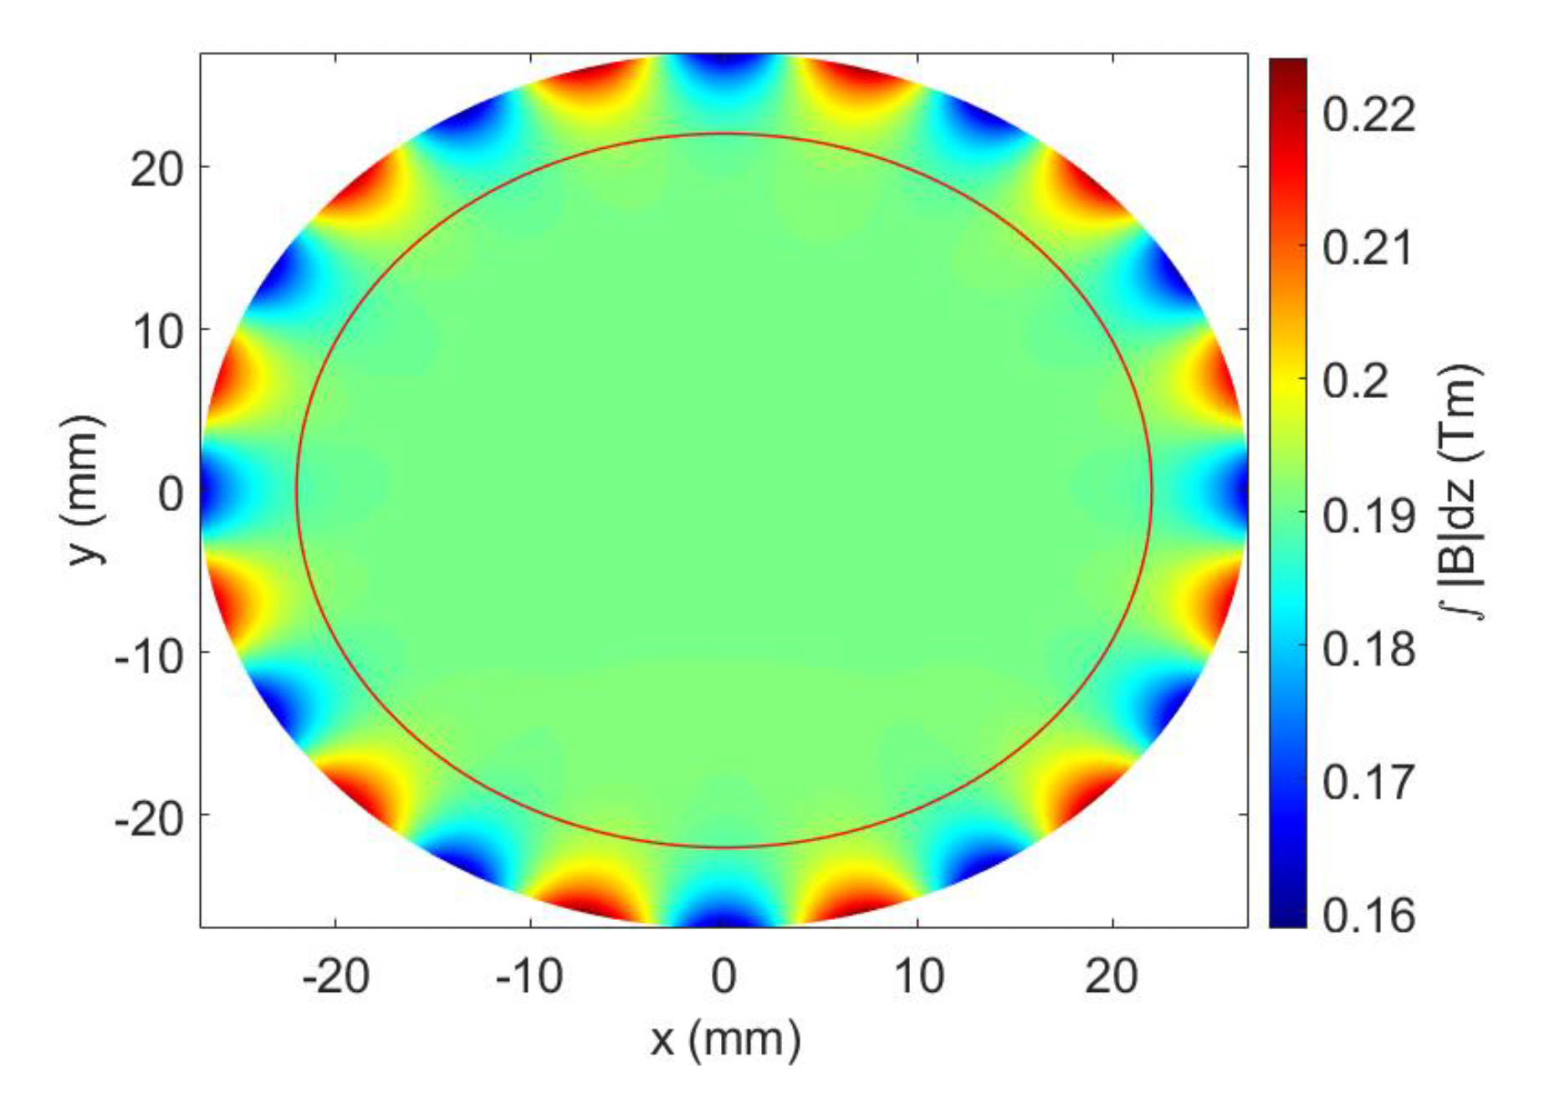
Halbach cylinder permanent magnet
CERN measurements results
The central field measured by NMR is 0.9843661 T.
Even though the measurement accuracy of the NMR is 5 ppm of the measured value, the positioning
uncertainty determines a higher field uncertainty, assumed conservatively to be in the order of 10⁻⁴ T
Field Uniformity:
- at the reference radius of 22 mm (red circle), the maximum
deviation from an ideal dipole is 0.00338 Tm (1.76 %), and the
Total Harmonic Distortion (THD) is 1.38%
- at 18 mm the maximum deviation from an ideal dipole is
0.00065 Tm and the THD = 0.24%
Stray field:
Magnetic field decreases rapidly outside the magnet and falls
below 0.5 mT (5 Gauss) at a distance of 23 cm radially and
25 cm along the cylinder axis on both sides.
Therefore, using a safety coefficient of 1.1, the 5 G perimeter should
be set at a distance of 27.5 cm from the magnet surface in all directions

Slide 8
The Electron Trap

Slide 9
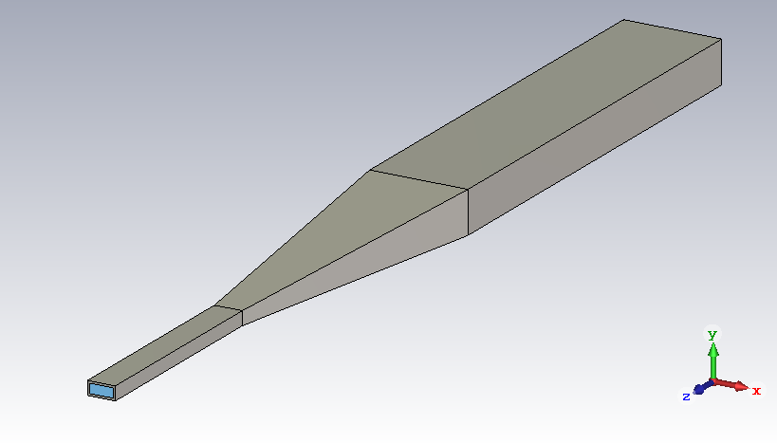
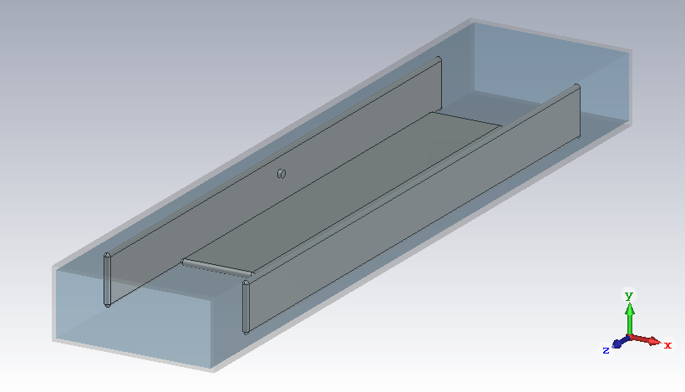
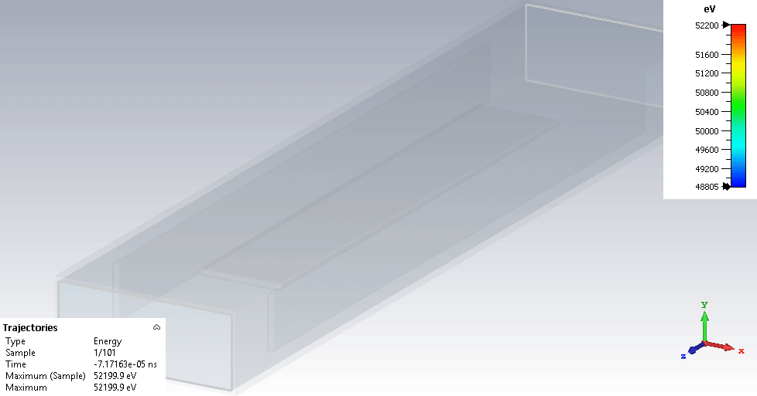
Electron Trap layout
4 x WR42
160 mm
120 mm
WR42
Taper
WR42 waveguide specs: 10.668 x 4.318 mm²
To cryogenic LNA
Bouncing + ExB drift on the equipotential surface
About 1 ns bouncing and 500 ns needed to complete a full loop
f₀(γ) + f and power (k_{T}) modulated (bouncing) x Doppler shifted

Slide 10
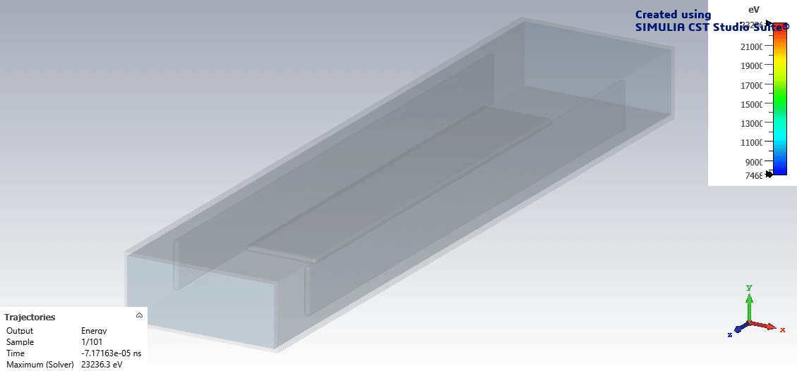
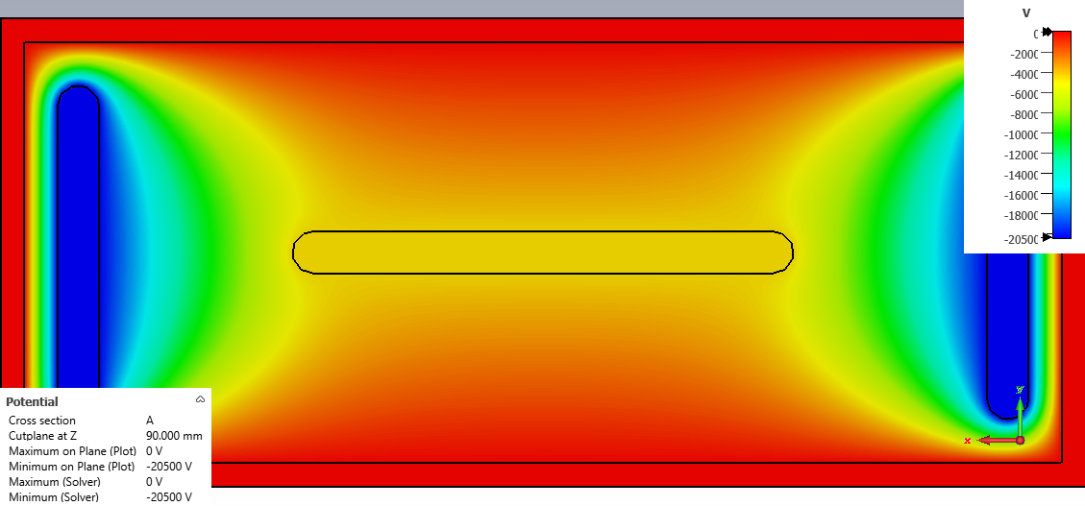
Study of RF emitted by “trapped” electrons RF readout test bench before the real prototype
ExB drift
B field
ExB drift + left-right bouncing
unique pattern of doppler-shifted frequencies/intensities
as a function of kinetic energy and pitch angle
E field

Slide 11
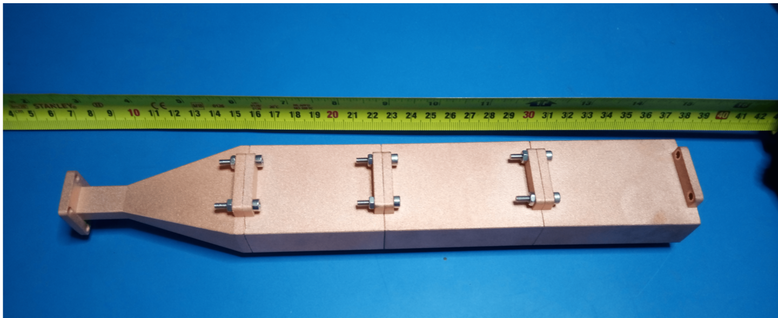
Electron trap
Copper prototype 3D printed by LNGS Additive Manufacturing Workshop
Attenuation @ 26 GHz measured to be less than 2 dB

Slide 12
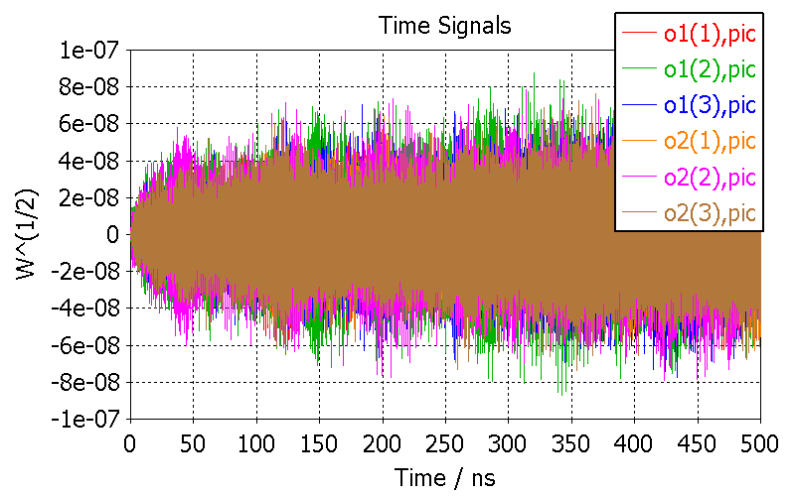
Electron Trap RF emission simulation using CST

Slide 13
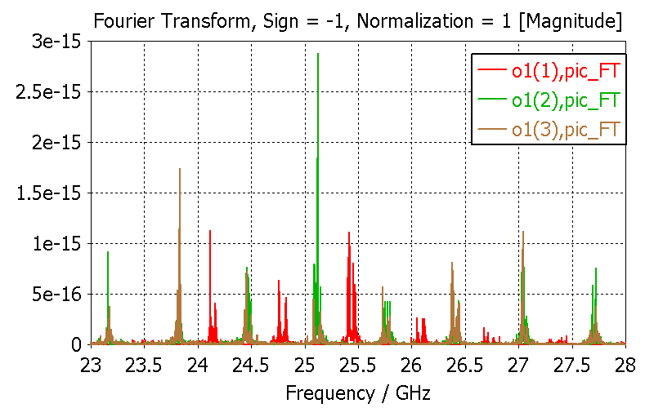
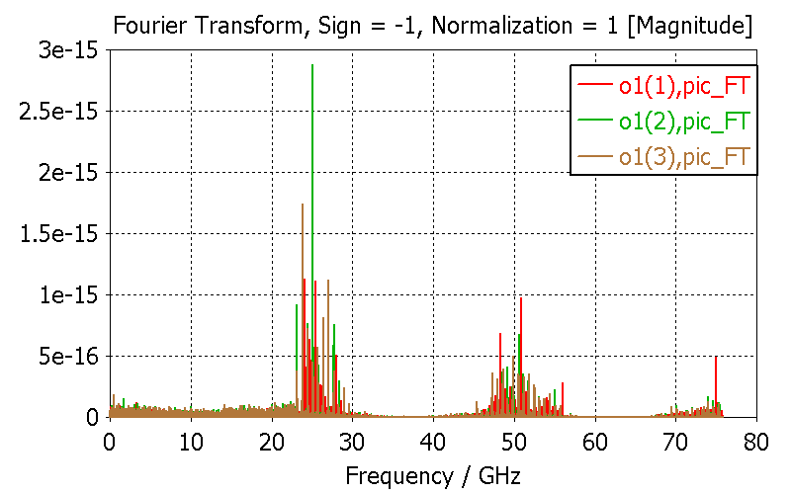
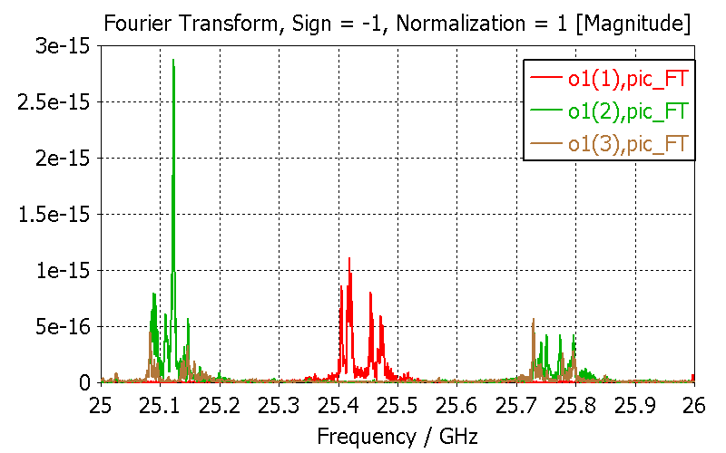
RF signal FFT analysis (CST)
Notes:
Progressive zoom

Slide 14
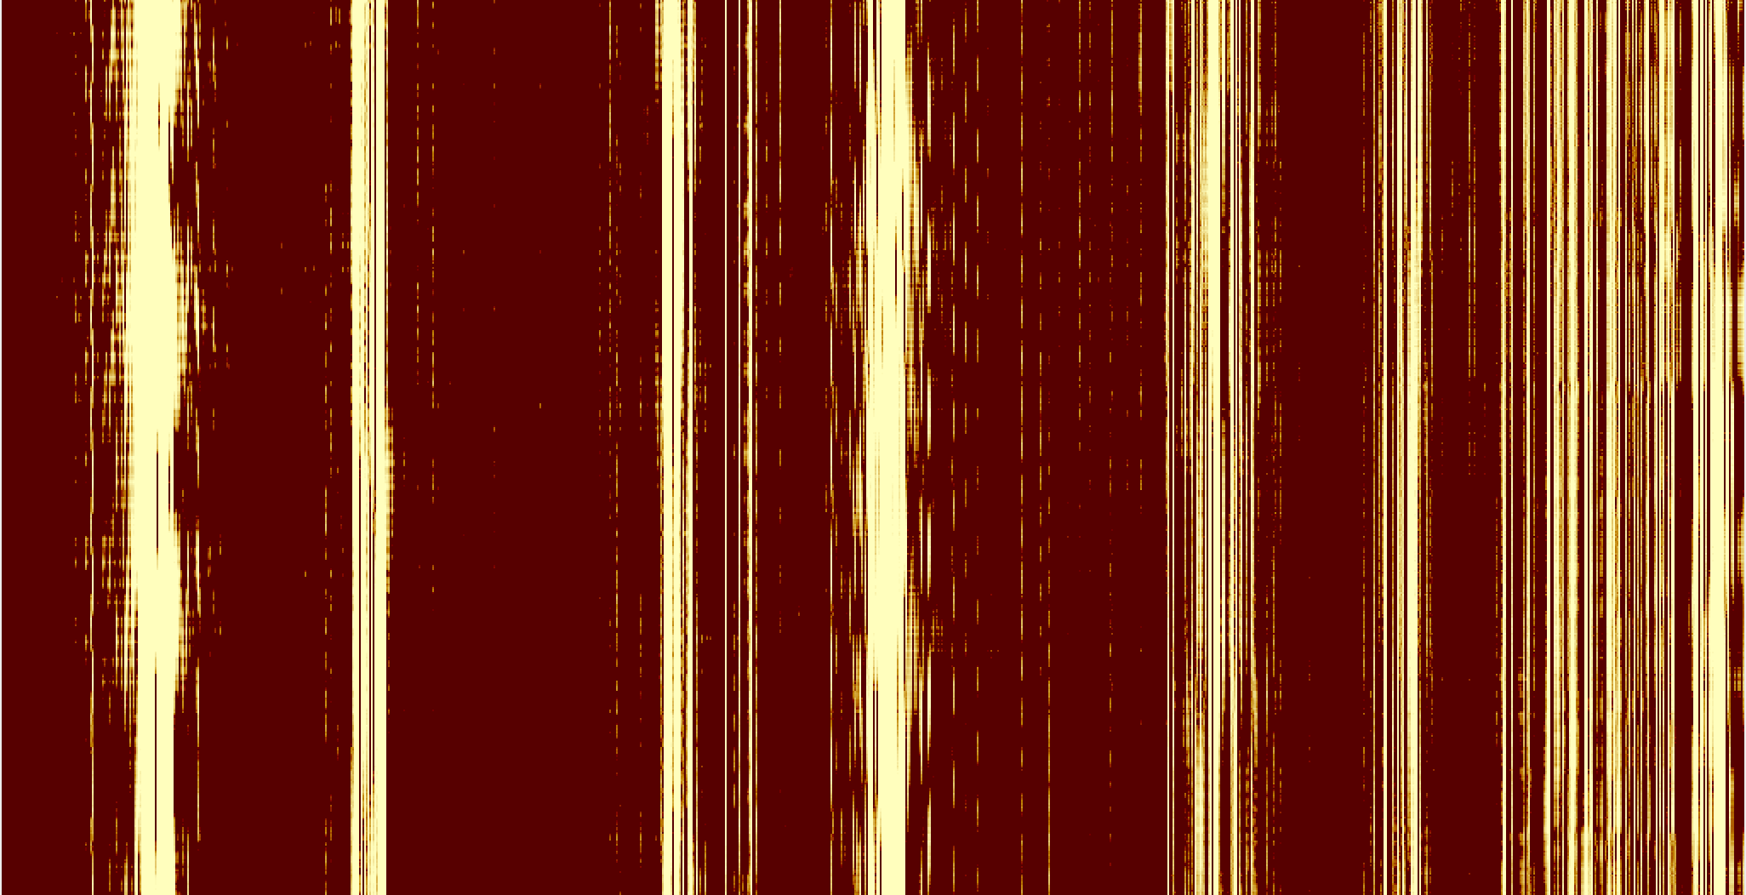
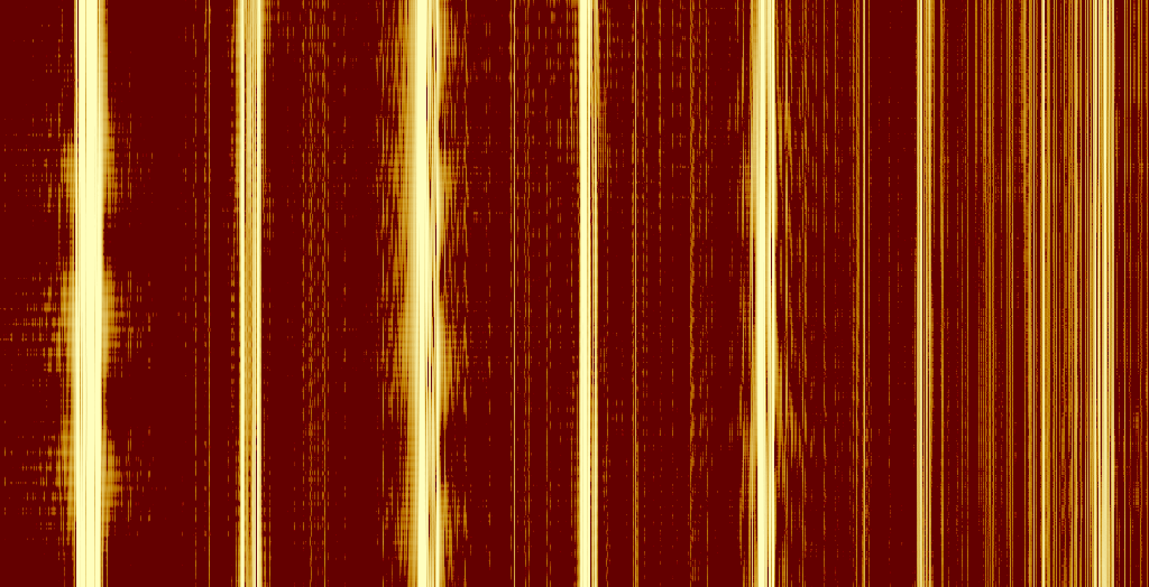
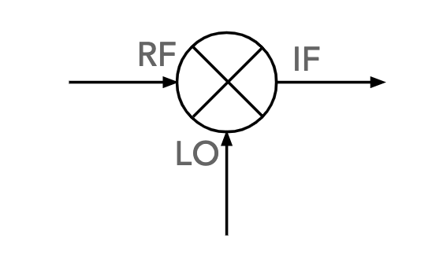
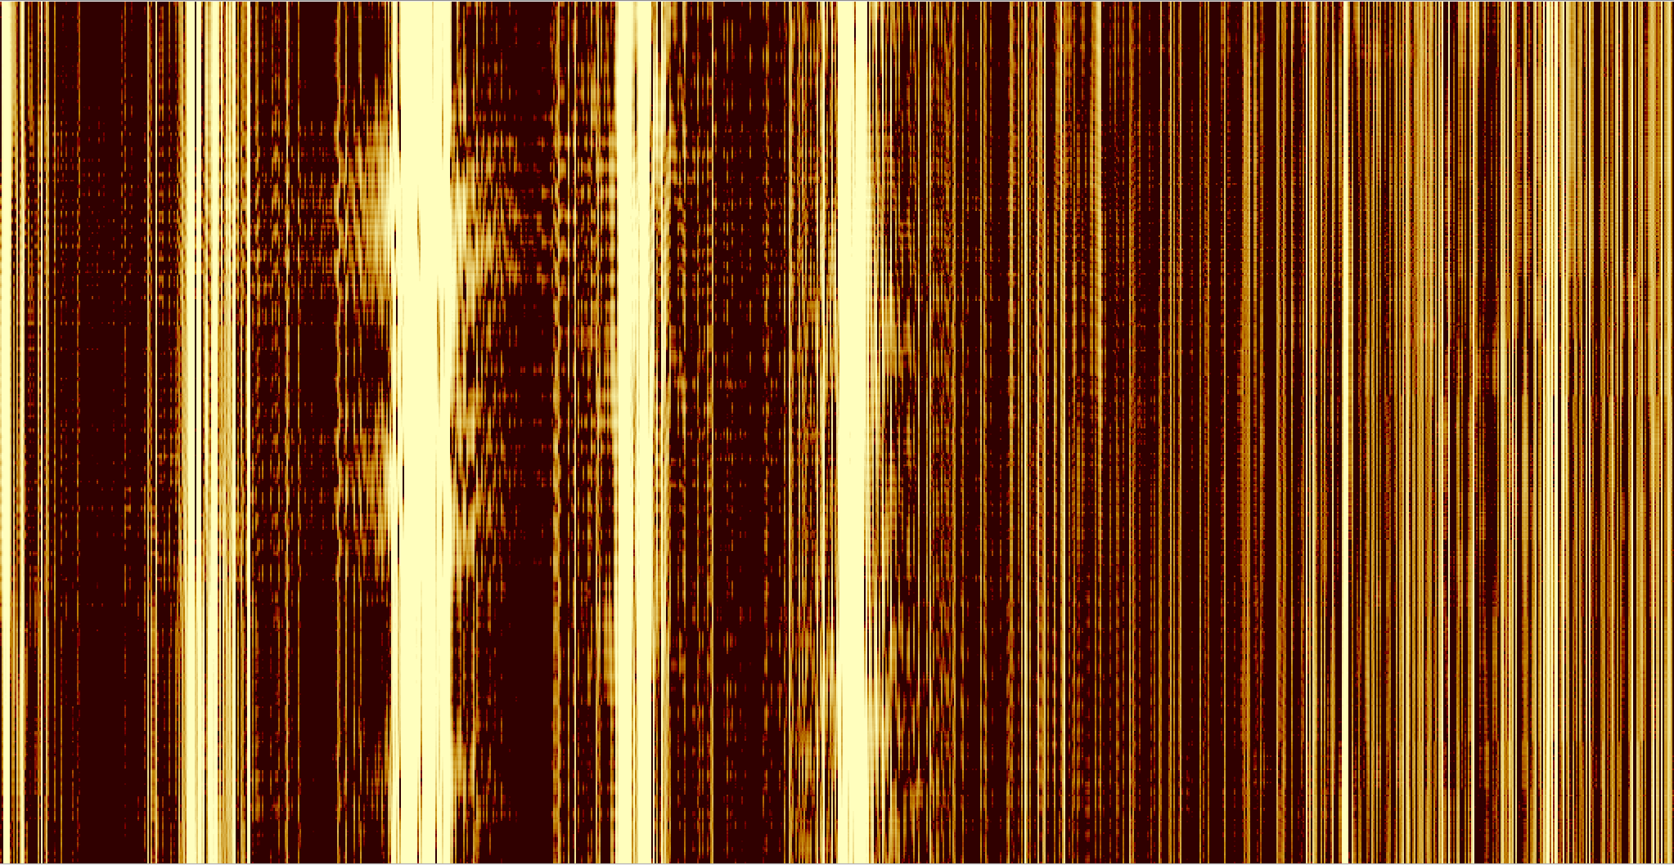
Preliminary RF signal FFT analysis (CST)
Pitch angle
45º
LO
60º
time (samples)
CST RF signal
+
simulated mixing
LO = 26.7 GHz
+
re-sampling (0.1 ns)
+
FFT
83º
freq
5 GHz

Slide 15
The electron source(s)

Slide 16
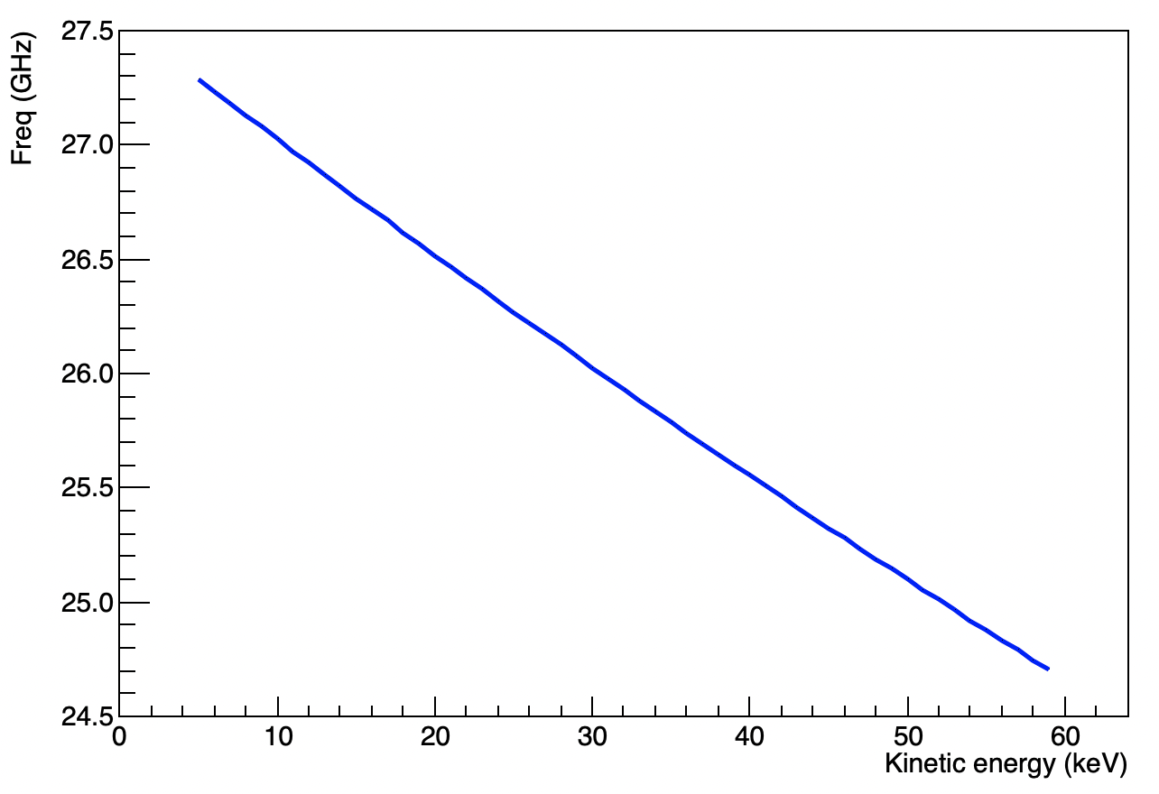
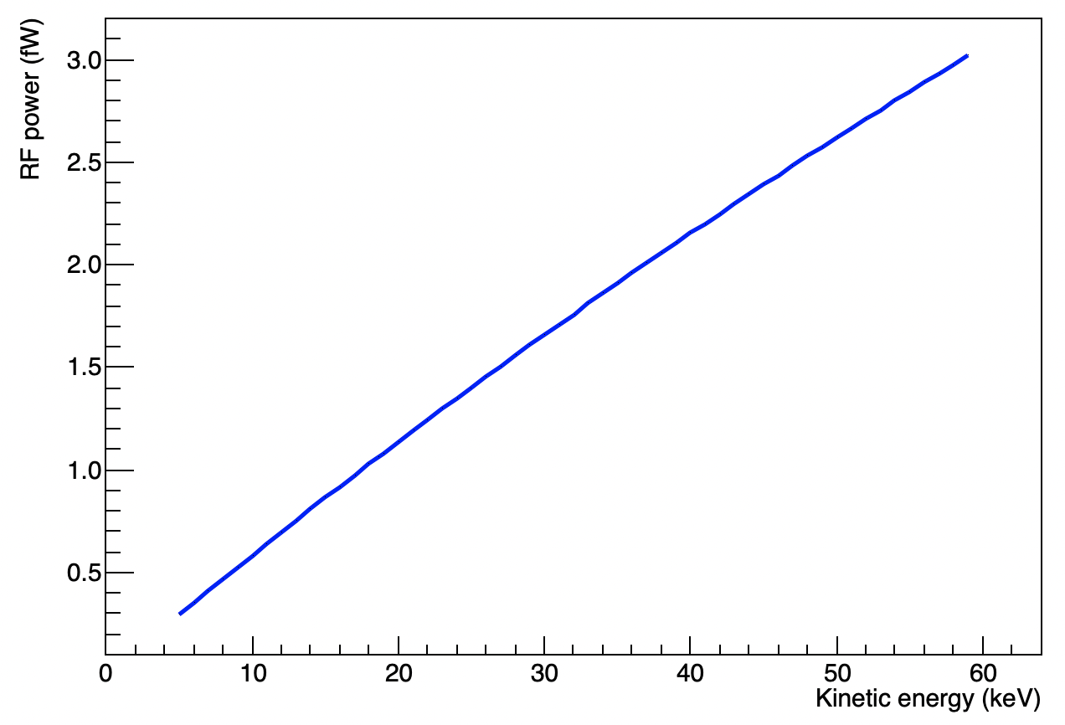
Radioactive sources under development/study
Electron Gun: Kimball 1-20 keV @ LNGS
Gas Tritium: procurement of a significant amount of tritium gas (74 GBq)
design and realization of a titanium sponge tritium container
Gas ⁸³Rb/^{83m}Kr: waiting to receive a quote for a small source (20 kBq)
advantage: monocromatic electrons (30 keV)
Solid ¹⁴C

Slide 17
The RF front-end electronics and DAQ

Slide 18
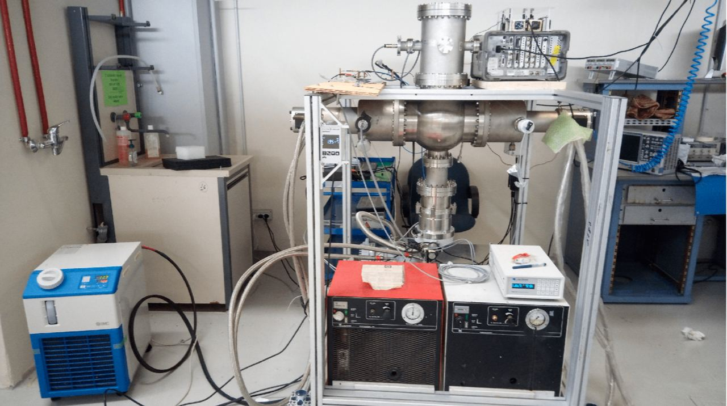
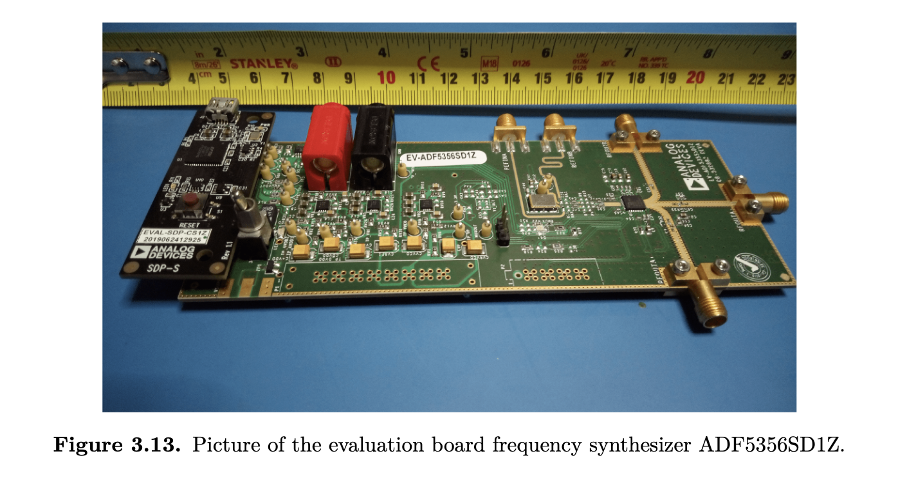
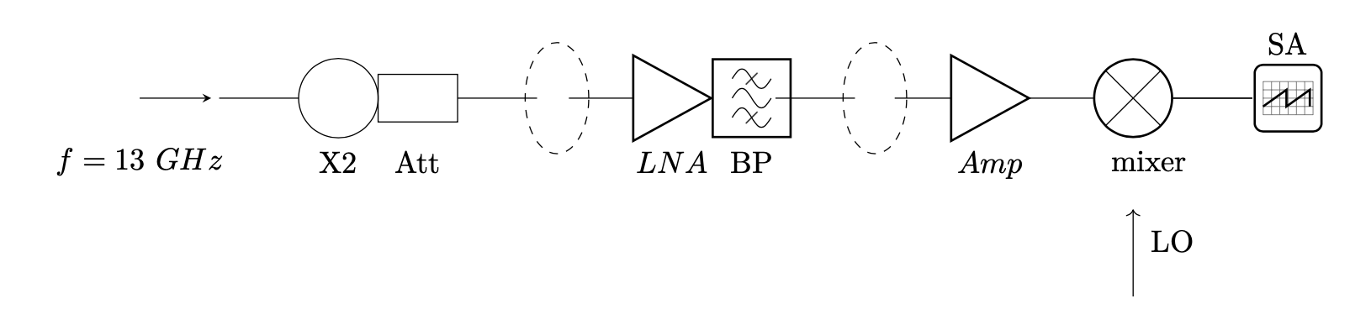
RF detection: measurement of the noise floor F.Virzi Master Thesis (Sapienza/INFN) See Federico’s talk
Successful down-conversion and detection of a -120 dBm reference signal
AGILENT E4407B
25 ºK

Slide 19
Electron trap RF readout improved setup
BPF 21-27 GHz
QUANTUM MW
QMC-CRYO-BPF-2127
MARKI DPX-9516
Diplexer
BPF 0.8-1.2 GHz
QUALWAVE
QBF-800-1200-45
LNA
LNA
LA1
LA2
Oscilloscope
Marki AMM-6702UC
LO buffer +28 dB small signals
Output : +9 dBm
-130 dBm input signal @ 26 GHz
-127 dBm = 0.18 fW (~ GPS receiver sensitivity)
MICZEN MZP2180265GA
18-26.5 GHz power divider
LO monitoring
-30 dBm = 1 μW = 7 mV (50 Ω)
MMD-1030HS
PASSIVE DOUBLE BALANCED
MMIC DOUBLER 10-30 GHz
LA1 = Wenteq microwave ALN2225-38-4025
LA2 = Wenteq ABL-0240-33-4800
Mixer = MARKI MM1-1467LUB
12.5 GHz input signal
Notes:
All components have been purchased

Slide 20
Electron trap RF readout
Electron trap could be a good test bench for the NIKHEF RF front-end board
Notes:
All components have been purchased

Slide 21
The cryogenic setup

Slide 22
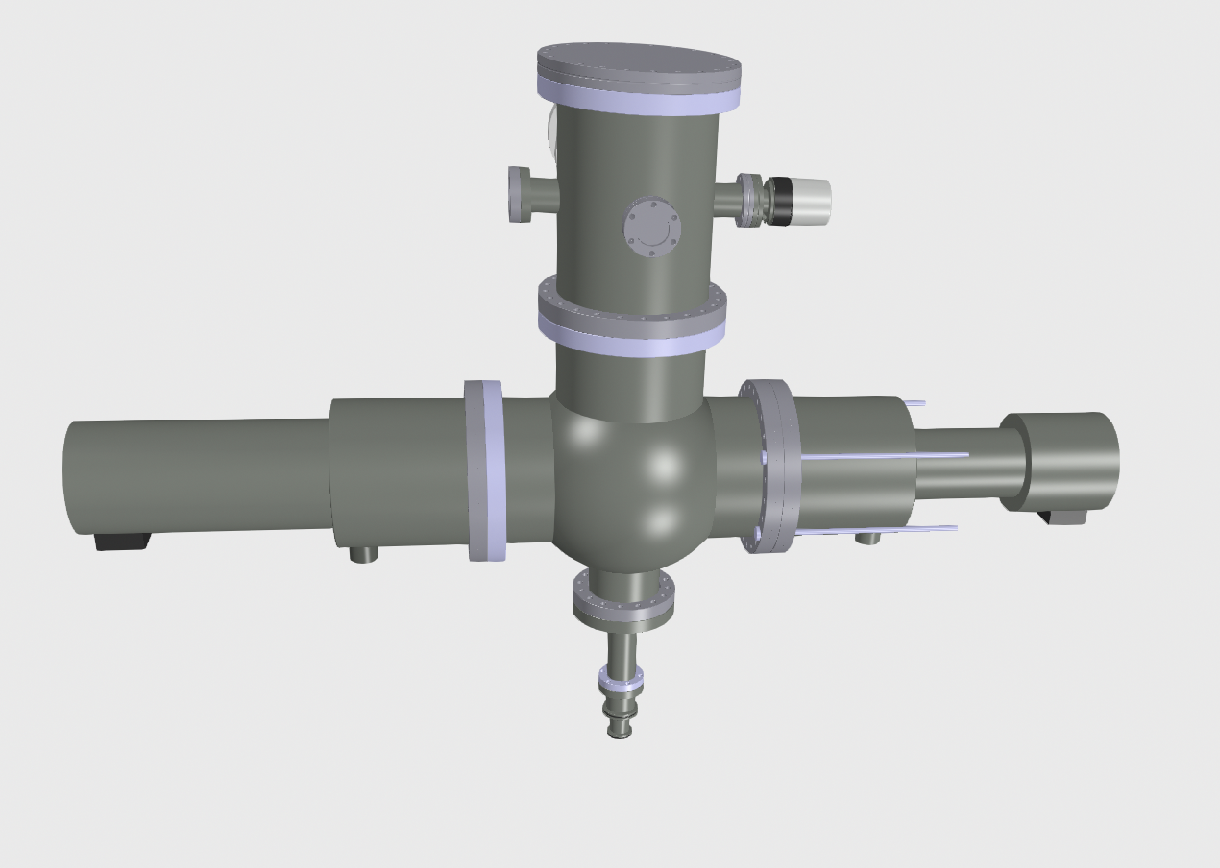
Cryogenic RF setup @ LNGS
GM cold heads

Slide 23
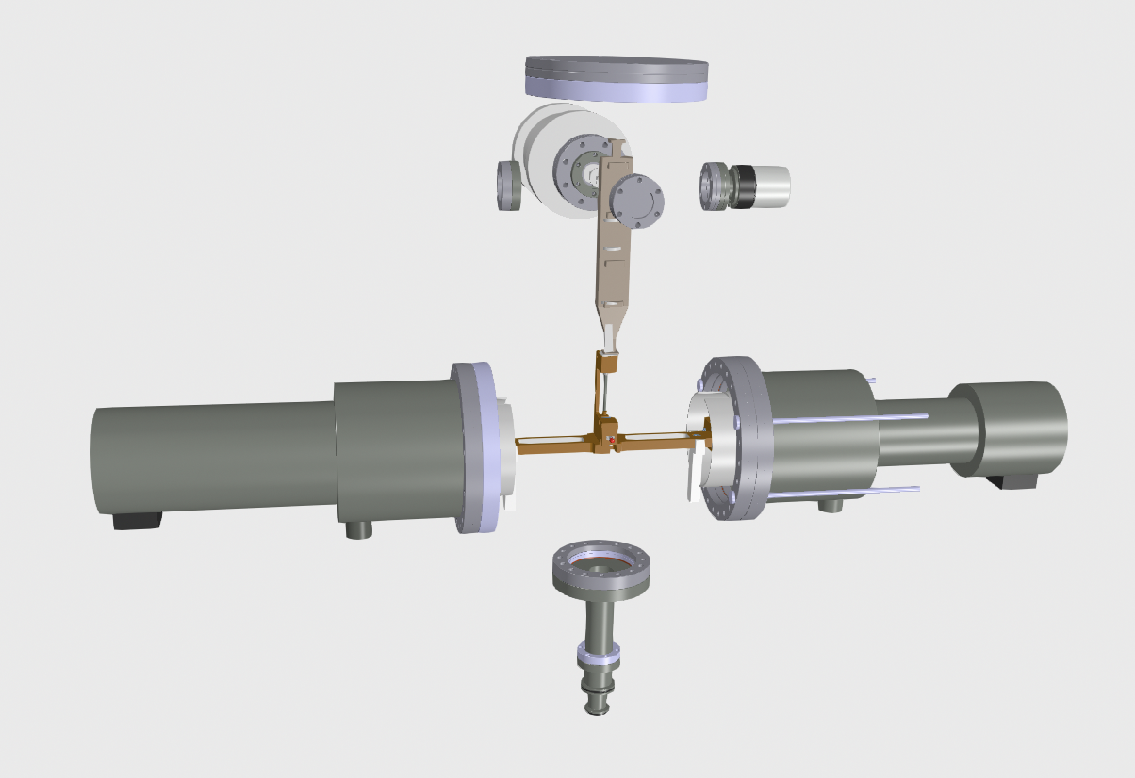
Cryogenic RF setup @ LNGS
Electron trap
LNA
LowNoiseFactory
LNF-LNC16_28WB

Slide 24
Conclusions
The electron trap is being setup at LNGS to detect single e⁻ RF emission
Important step towards the full demonstrator
Building blocks procured
Results expected (hopefully) by first half of next year

Slide 25
Thank You

