Slide 1
The relic neutrino number density: Gravitational clustering with N-body simulations
Fabian Zimmer University of Amsterdam, GRAPPA
Collaborators: Camila Correa, Shin’ichiro Ando, Auke-Pieter Colijn

Slide 2
The neutrino number density
Gravitational Clustering
Gravitational Deflection
Neutrino Decay
Hernandez+ 2205.00808
Akita+ 2109.02900
n_{ν} ?
Temporary Enhancement
Alternative T_{ν,0}
Safdi+ 1404.0680
Alvey+ 2111.12726
Lepton Asymmetry
Long+ 1405.7654
Secondary CNB
McKeen 1812.08178

Slide 3
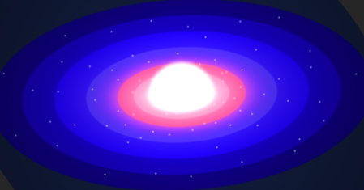
Neutrino clustering: What has been done so far?
“Hybrid” simulations
Banerjee+ 1606.06167
Bird+ 1803.09854
Yoshikawa+ 2010.00248
“Recycle” simulations
Chen+2011.12503
Zennaro+1905.08696
Chen+ 2011.12504
N-body simulations
Brandbyge+ 1004.4105
Early works
Villaescusa-Navarro+ 1212.4855
“N-1-body” simulations
Kofman+ astro-ph/9509145
De Salas+ 1706.09850
Ringwald+ hep-ph/0408241
Zhang+ 1712.01153
Mertsch+ 1910.13388

Slide 4
Mathematical Framework
Hamilton’s equations (momentum)
Hamilton’s equations (velocity)
Number density with initial momentum
Liouville’s Theorem

Slide 5
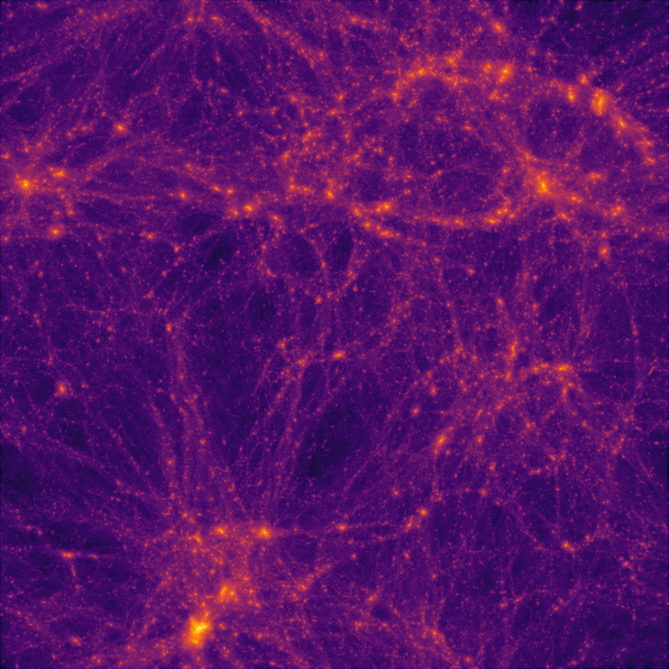
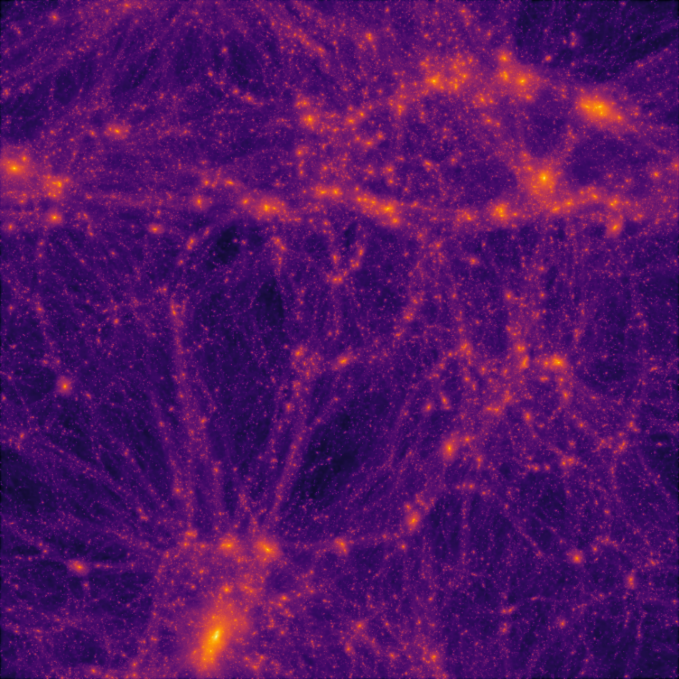
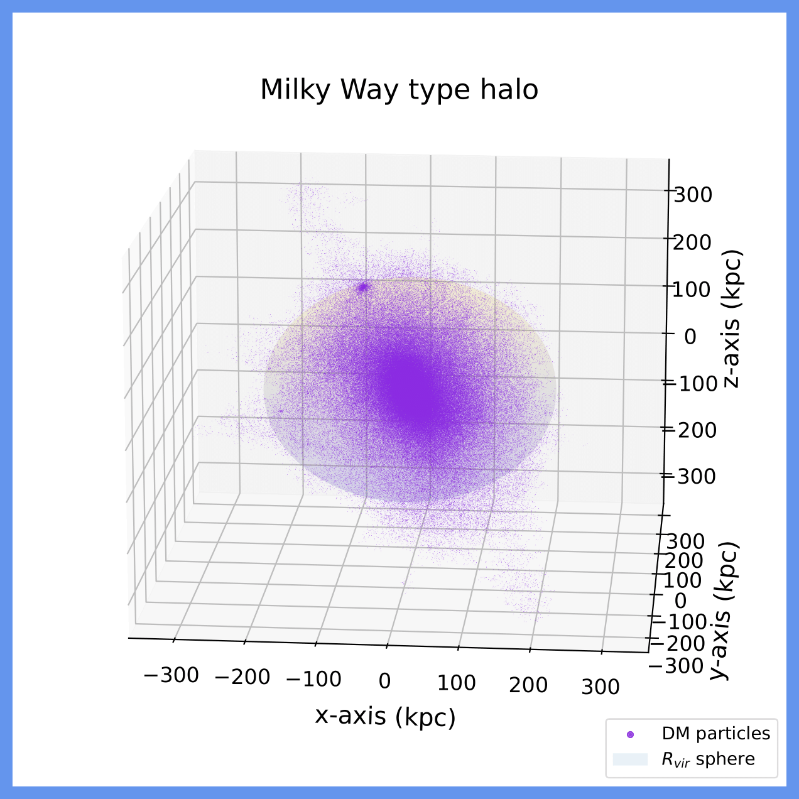
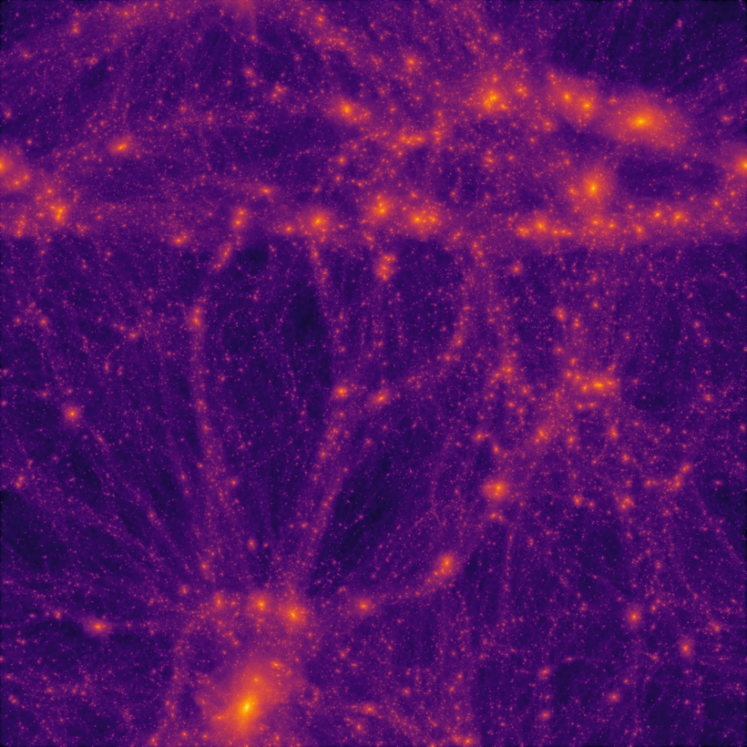
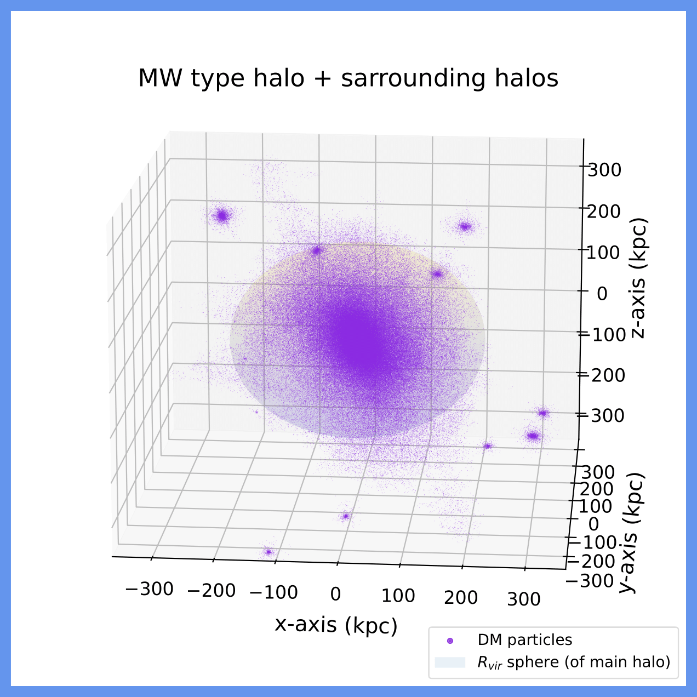
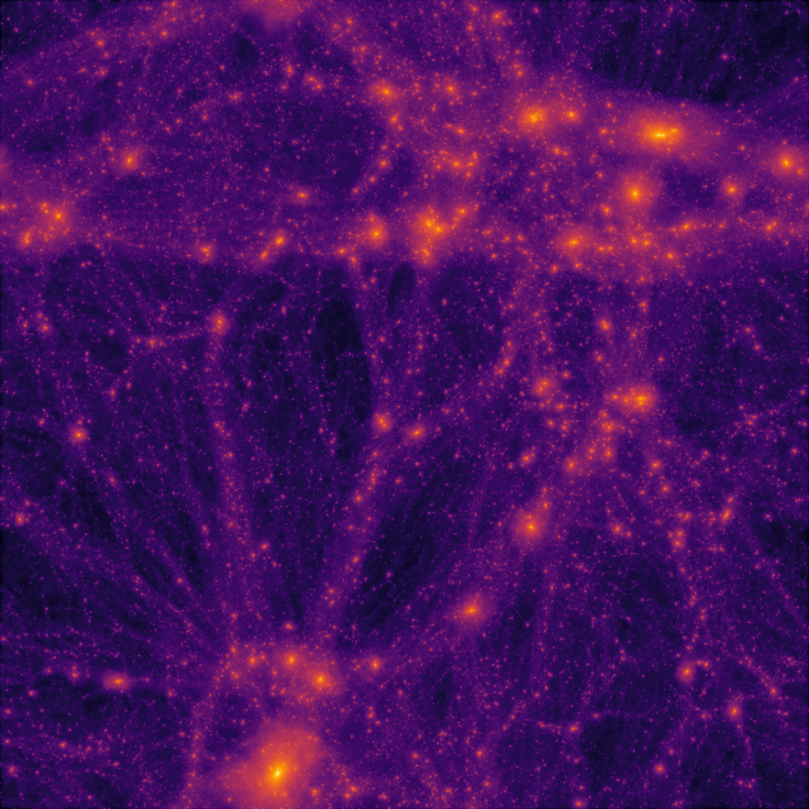
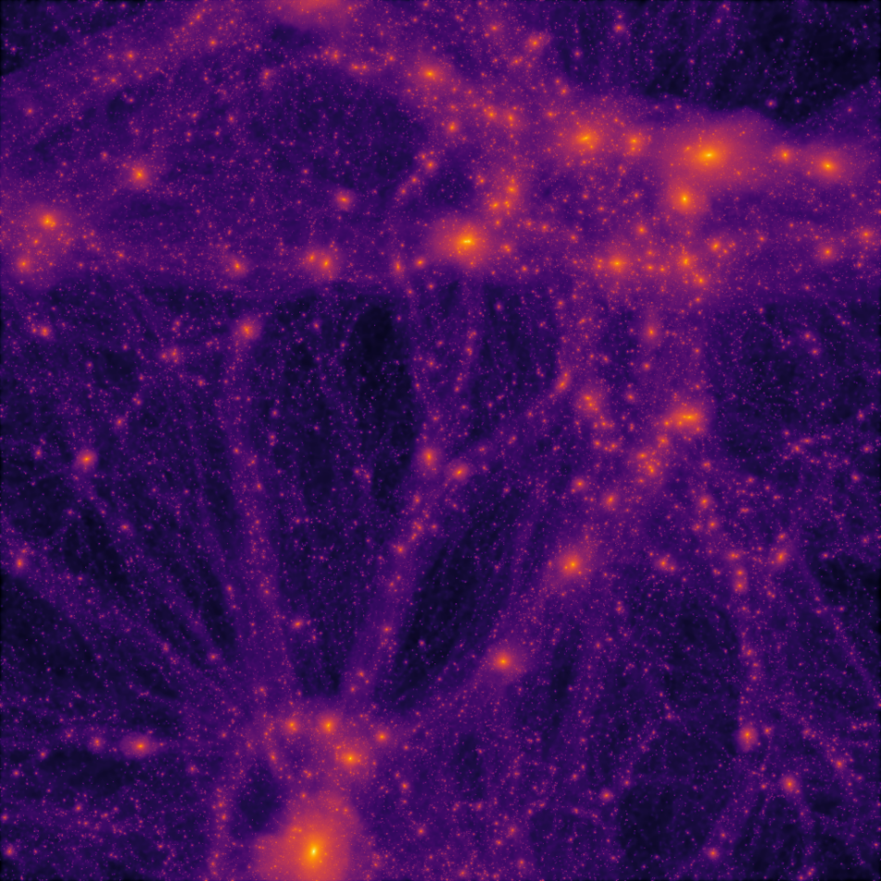
Project CubeSpace: CDM simulation as external input
Correa+ 2206.11298
z

Slide 6
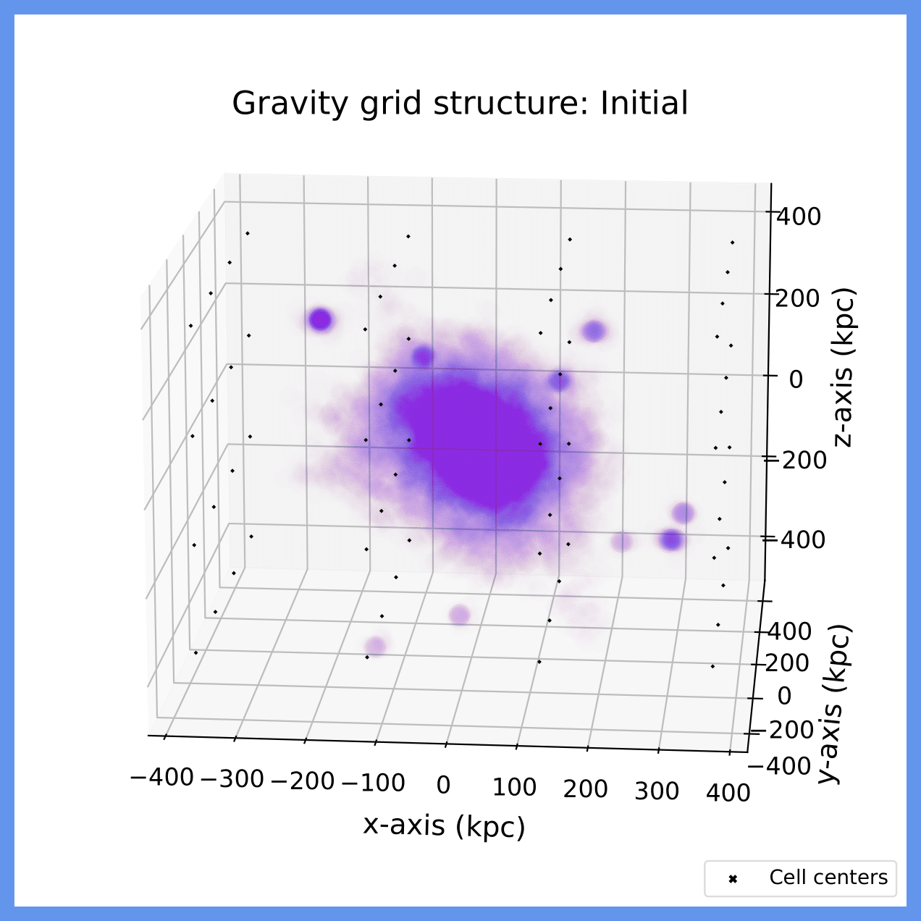
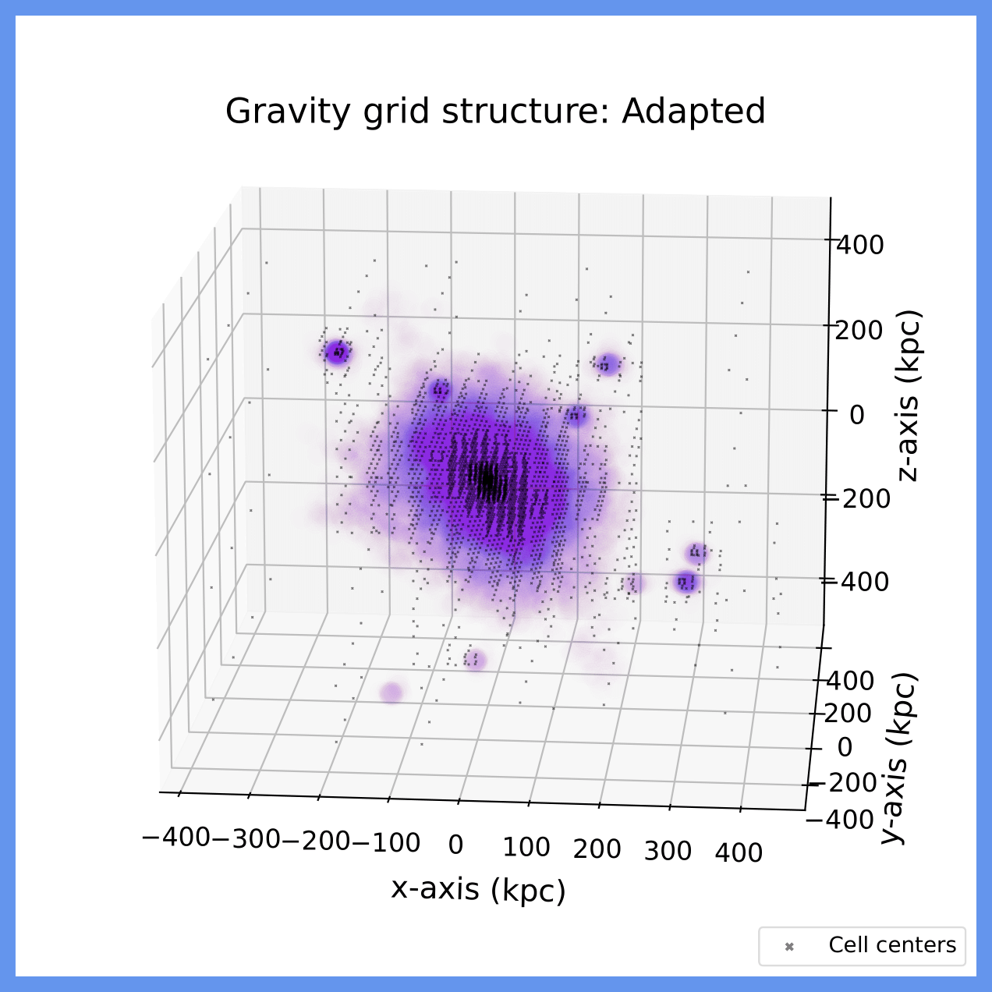
Project CubeSpace: Capturing gravity
1. Discretize space
2. Cell division
3. Fine-tuned gravity

Slide 7
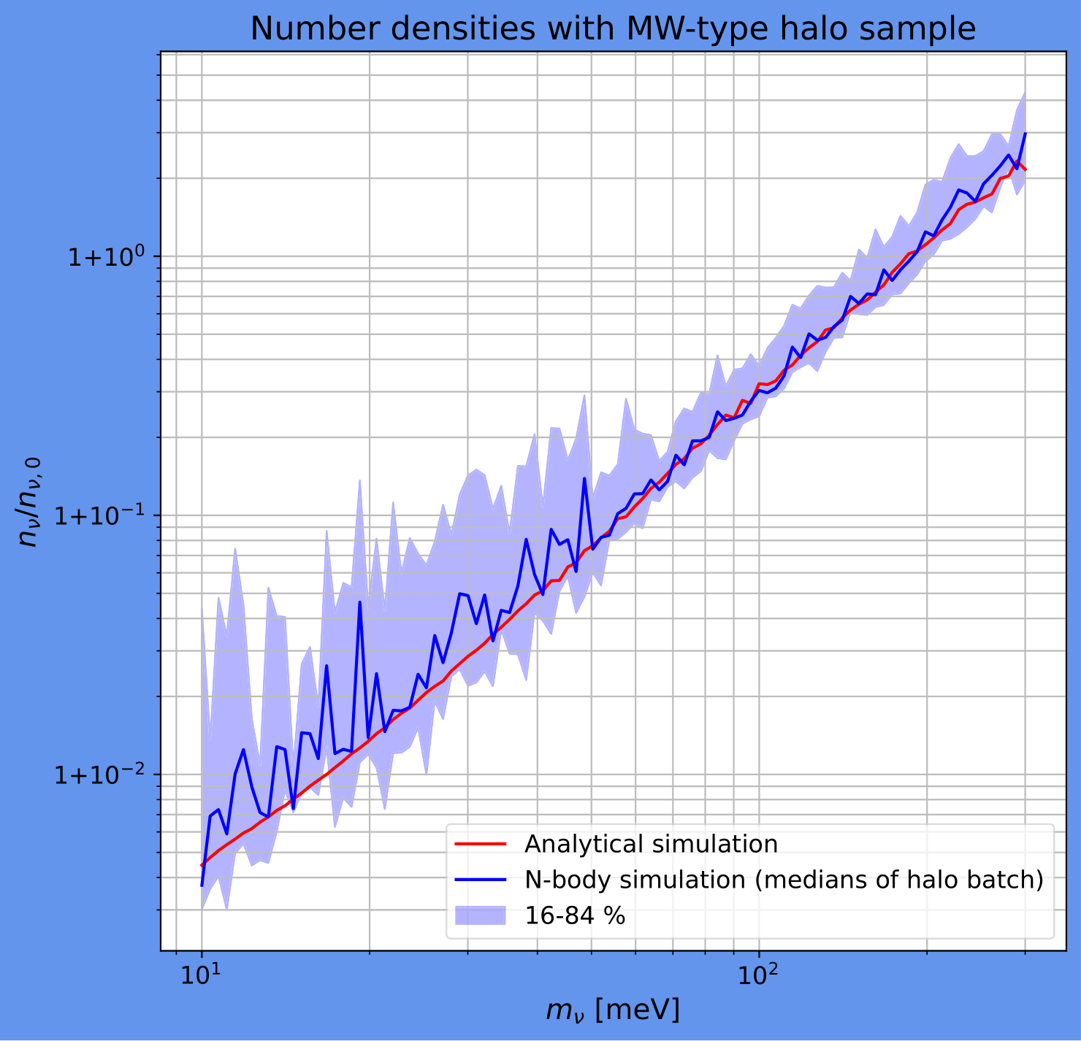
Project CubeSpace: Preliminary results
Current status:
Simulation through any complex environment
Exploiting the DM distributions of different halos
Agreement with complementary approaches
Results for a spectrum of neutrino masses
Comparable computing time to previous works, between 1 and 8 hours on 16 CPU’s & 16GB RAM (2 hours for this plot)
Preliminary

Slide 8
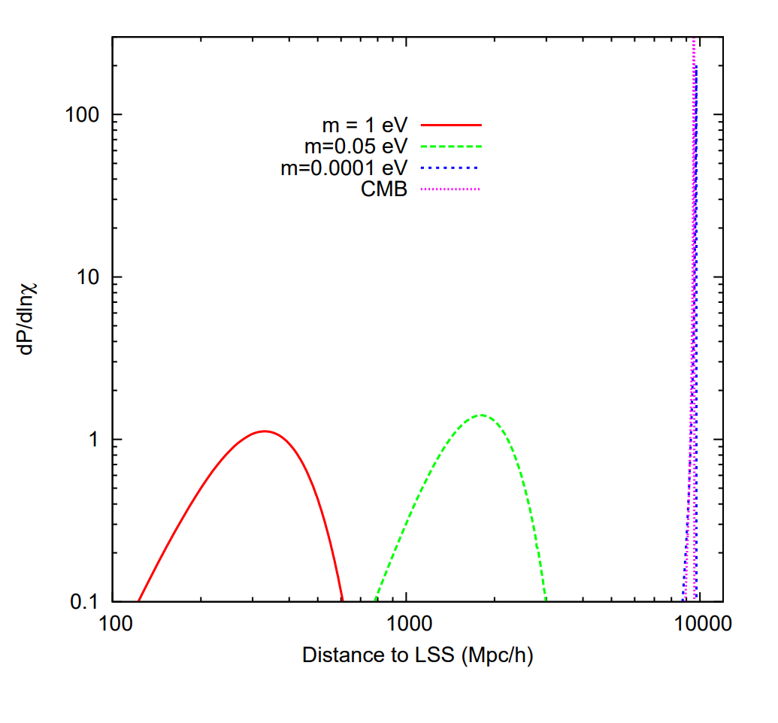
Project CubeSpace: Goals and future outlook
Last Scattering Surface
Sphere of Influence in simulation?
Effects of including baryonic physics?
Predictions for capture rates?
Dodelson+ 0907.2887

Slide 9
Thank you for your attention!
n_{ν}

