Slide 1
Exploring trust for Communities
Trust & Identity Enabling Communities
Maarten Kremers, SURF
EUgridPMA #55 24th May 2022
LRZ, Garching bei München

Slide 2
GN 4-3 T&I
Expand the Reach of Federated Access
Operate T&I services
Develop and Enhance the T&I services
Explore new or disruptive ideas
Engage with the relevant stakeholders

Slide 3
Paul Dekkers
(SURF)
Davide Vaghetti
(GARR)
T&I Services
Christos Kanellopoulos (GÉANT)
Michelle Williams (GÉANT)

Slide 4
Incubator
Enabling Communities
T&I Services
Identity Feds
r/e-infras
EOSC
eGov
Operational Support

Slide 5
Enabling Communities

Slide 6
T&I eScience Global Engagement
The 'eScience Global Engagement' of EnCo in the GEANT project is there to support those developments in the policy and best practice areas that would benefit the community at large, and do that by means of supporting the work in the existing forums such as WISE, FIM4R, IGTF, REFEDS, AARC-community, and the research and e-Infra communities directly

Slide 7
T&I Enabling Communities
INTEROPERABILITY
TRUST
SECURITY

Slide 8
REFEDS
IGTF
AARC
EnCo
FIM4R
WISE

Slide 9
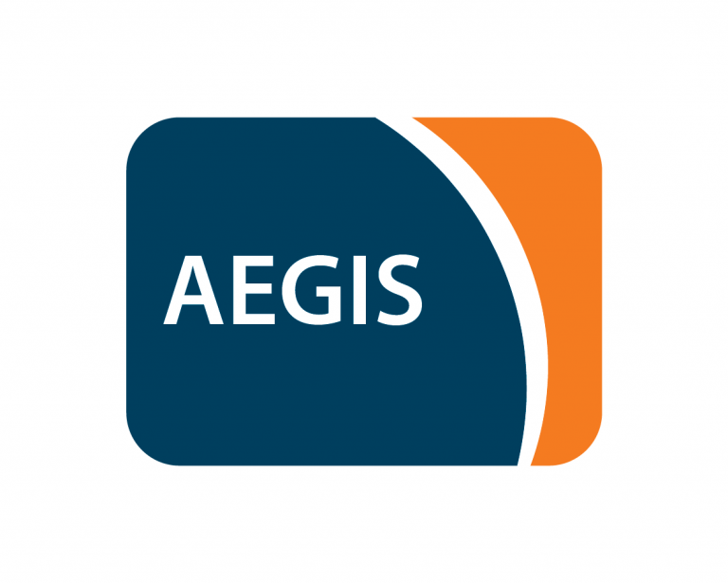
AEGIS
The AARC Engagement Group for Infrastructures (AEGIS) brings together global representatives from AAI operators in research infrastructures and e-infrastructures, which are implementing authentication and authorisation services that support federated access, to discuss adoption of policy and technical best practices that facilitate interoperability across e-infrastructures ands e-infrastructures.
Facilitated by EnCo

Slide 10
T&I Enabling Communities
REFEDS (the Research and Education FEDerations group) is to be the voice that articulates the mutual needs of research and education identity federations worldwide.

Slide 11
T&I Enabling Communities

Slide 12
T&I Enabling Communities
REFEDS Assurance Profile (v1.0)
Consisting of three individual specifications:
REFEDS Assurance Framework (RAF), ver 1.0, published 2018
REFEDS Single Factor Authentication Profile (SFA), ver 1.0, 2018
REFEDS Multi Factor Authentication Profile (MFA), ver 1.0, 2017
Component-based approach
Two identity assurance profiles: Espresso (high assurance) and Cappuccino (moderate assurance)
v2.0 in progress
Assurance is on the agenda

Slide 13
T&I Enabling Communities
Full paper published
https://doi.org/10.22323/1.378.0029

Slide 14
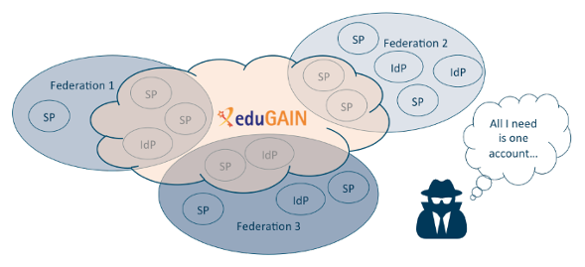
T&I Enabling Communities
Contributions to SIRTFI v2
Source and more information: https://refeds.org/wp-content/uploads/2016/02/Why_Sirtfi.pdf

Slide 15
T&I Enabling Communities
The Wise Information Security for Collaborating e-Infrastructures (WISE) community enhances best practice in information security for IT infrastructures for research.
SCI (Security for Collaboration among Infrastructures) Workgroup focusses on best practices, trust and policy standards for collaboration with the aim of managing cross-infrastructure security risks

Slide 16
T&I Enabling Communities
SCI Trust Framework
Enable interoperation of collaborating Infrastructures in managing cross-infrastructure operational security risks.
Builds trust between Infrastructures by adopting policy standards for collaboration especially in cases where identical security policy documents cannot be shared.
Self Assessment Tool
Guidance Doc
On the agenda

Slide 17
T&I Enabling Communities
Self Assessment Tool
Guidance Doc
On the agenda

Slide 18
T&I Enabling Communities
Revision PDK in progress based on feedback and experience
On the agenda
Service Operations Security
Data Protection / Privacy

Slide 19
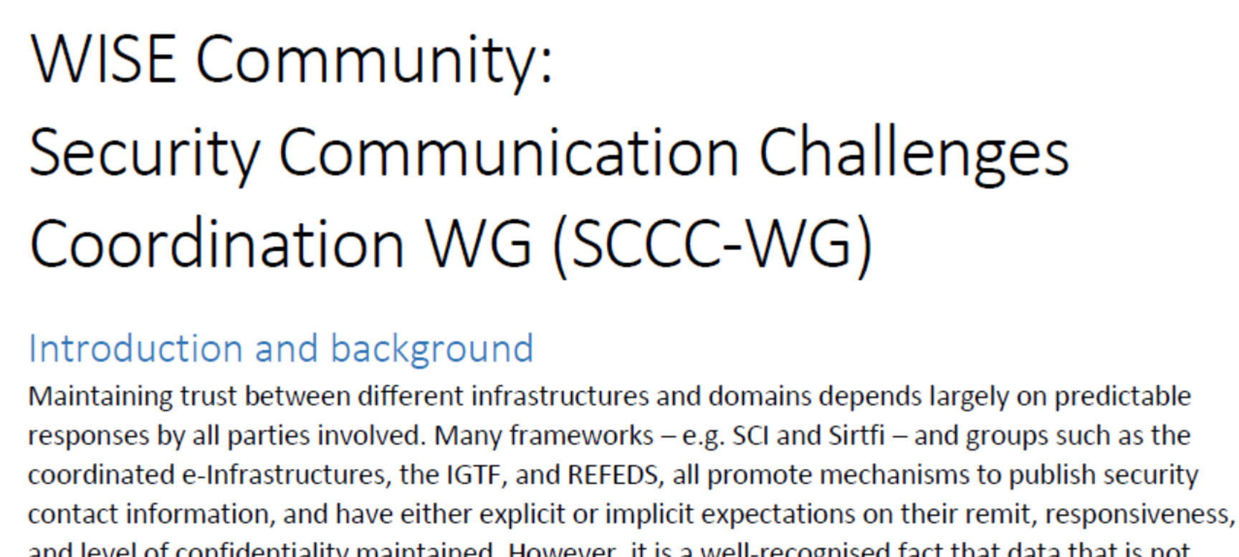
T&I Enabling Communities
Contributions by EnCo
On the agenda

Slide 20
T&I Enabling Communities
The Interoperable Global Trust Federation (IGTF) is a body to establish common policies and guidelines that help establish interoperable, global trust relations between providers of e-Infrastructures and e-Research, identity providers, and other qualified relying parties.

Slide 21
T&I Enabling Communities
AA Operations Security Guideline 2022 (AARC-G071)
AEGIS endorsed
https://www.eugridpma.org/guidelines/aaops/

Slide 22
T&I Enabling Communities
FIM4R (Federated Identity Management for Research) is a collection of research communities and infrastructures with a shared interest in enabling Federated Identity Management for their research cyber infrastructures. In order to achieve this, FIM4R develops requirements bearing on technical architecture, federated identity management, and operational policies needed to achieve a harmonious integration between research cyber infrastructures and R&E Federations.

Slide 23
T&I Enabling Communities
Support by EnCo
Work in progress: Assurance

Slide 24
T&I eScience Global Engagement
GN4-3 Project Updates
EnCo Policy presentation at ISGC2022
Accepted presentation for TNC22 !

Slide 25
T&I eScience Global Engagement
GN5-1 preparations
1st Jan 2023 – 31st Dec 2024 (2y)
Proposal submitted

Slide 26
T&I eScience Global Engagement
GN5-1 preparations & EnCo
Possible new topics
Policy for token based interopable trust frameworks
SNCTFI revisited

Slide 27
T&I eScience Global Engagement
Relevant meetings
TNC22 14^{th –} 16th June (Trieste, Italy)
REFEDS 13th June (Trieste, Italy)
Security day
17th June (Trieste, Italy)

Slide 28
T&I eScience Global Engagement
GN4-3 Project Updates
Review our own workplan
Activities that need or more less attention
New Activities
Activities to dropped
https://edu.nl/ctxxg

Slide 29
Engage!
https://fim4r.org
https://refeds.org
https://wise-community.org
https://www.igtf.net
https://aarc-community.org
Contact us: policy@aarc-community.org

Slide 30
Thank you
Any questions?
maarten.kremers@surf.nl
As part of the GÉANT 2020 Framework Partnership Agreement (FPA), the project receives funding from the European Union's Horizon 2020 research and innovation programme under Grant Agreement No. 856726 (GN4-3).​​​

