Slide 1
Workshop SURF UM Nikhef
Solving correlation clustering with QAOA and a Rydberg qudit system:
a full-stack approach
12-09-2022
Jordi Weggemans
Based on arXiv: 2106.11672 (published in Quantum 6, 687 (2022)), joint work with
Alexander Urech, Alexander Rausch, Robert Spreeuw, Richard Boucherie, Florian Schreck, Kareljan Schoutens, Jiří Minář and Florian Speelman

Slide 2
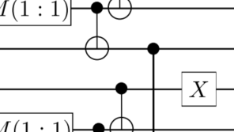
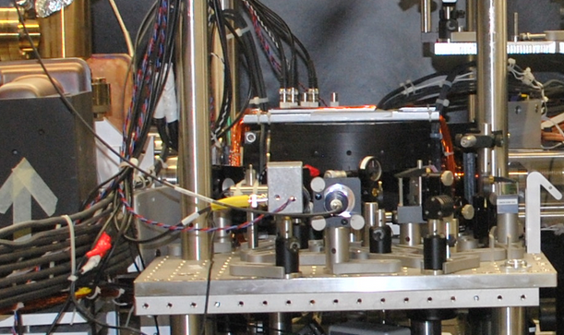
Motivation
Noisy intermediate-scale quantum era (NISQ)
Quantum supremacy experiment [Google, 2019]
Practical advantages possible for, say, optimization problems? (QuSoft collaborations with industry)
Noise severely limits performance: lose advantage depth $\sim p^{−1}$ for noise probability $p$ [Franca, Garcia-Patron 2020]
Requires an optimized interplay between software and hardware
→ Full-stack approach [Alexeev et al., 2021]
Problem definition
Quantum algorithm
Compilation:
Processor design/Gate implementation
Performance analysis
Full-stack
2

Slide 3
Where are we at the stack? (1)
Problem definition
Quantum algorithm
Compilation:
Processor design/Gate implementation
Performance analysis
Full-stack
3

Slide 4
Correlation clustering
Problem definition
MIN-DISAGREE
MAX-AGREE
$$α=\frac{f\left(x^{∗}\right)}{OPT}$$
+
+
-
+
+
+
+
+
+
+
+
+
+
+
MAXAGREE on general graphs: It is NP Hard to approximate both weighted [Charikar et al., 2003] and unweighted [Tan, 2007] within $79/80+ε$
Best approximation algorithm has $α=0.7666 [$Swamy, 2004]
Heuristics: pivot, Best one-element move (BOEM), simulated annealing etc.
-
-
-
+
+
+
+
+
+
+
+
+
+
+

Slide 5
Where are we at the stack? (2)
Problem definition
Quantum algorithm
Compilation:
Processor design/Gate implementation
Performance analysis
Full-stack
5

Slide 6
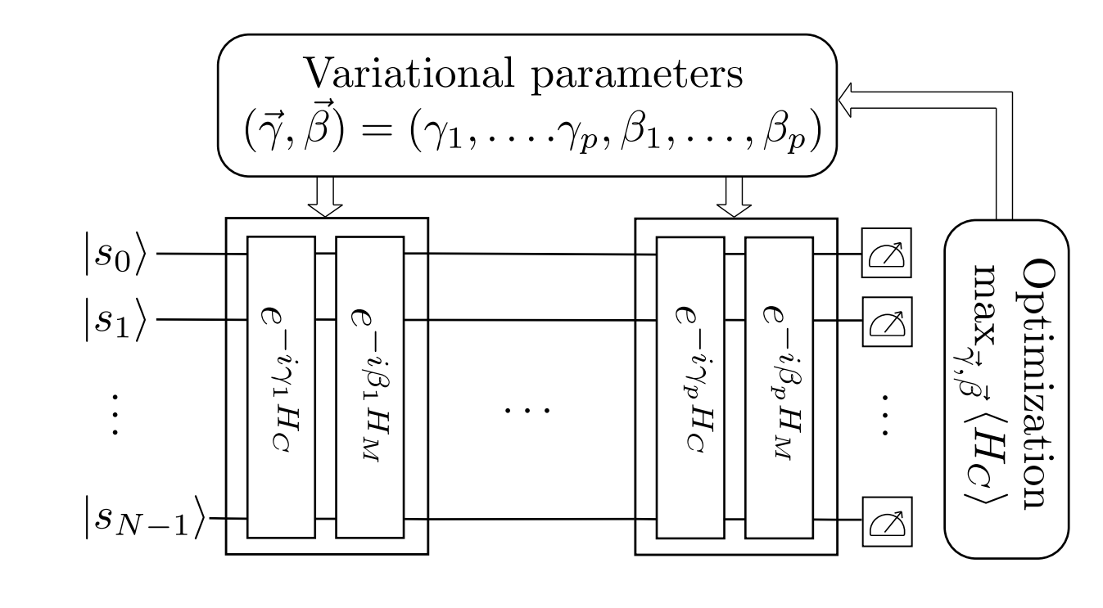
The quantum approximate optimization algorithm
Quantum algorithm
Optimization problem:$\max_{x∈D}{f(x)}$
QAOA of depth $p$, parametrized in $\vec{γ},\vec{β}$:
Initial state $|s⟩$
Cost operator $U_{C}(γ_{i})$ that depends on $f:U_{c}\left(γ_{i}\right)=e^{−i γ_{i} H_{C}}$, $\text{where} H_{c}\left|x\right\rangle =f\left(x\right)|x⟩$
Mixing operator $U_{M}\left(β_{i}\right)$ that depends on $D$ and its structure: $U_{M}\left(β_{i}\right)=e^{−i β_{i}{ H}_{M}}$
QAOA circuit creates state $\left|\vec{γ},\vec{β}\right\rangle$ by applying $p$alternating applications of operators from these two families on an initial state $\left|s\right\rangle$ :
[E. Farhi et al., 2014]
Goal: obtain states $\left|\vec{γ},\vec{β}\right\rangle$ that give ‘good bit strings’ with high probability
6

Slide 7
The quantum approximate optimization algorithm
Quantum algorithm
Expectation value objective function value output circuit:
[E. Farhi et al., 2014]
$$F_{p} \left(\vec{γ},\vec{β}\right)=\left\langle \vec{γ},\vec{β}\left|H_{c}\right|\vec{γ},\vec{β}\right\rangle$$
Best possible expectation value
$$M_{p} =\max_{\vec{γ},\vec{β}}{F_{p} \left(\vec{γ},\vec{β}\right)}$$
Some properties:
$M_{p}≥M_{p−1}$
${\lim_{p →∞}M}_{p}=\max_{x}{f(x)}$
Runtime linear in $p$, polynomial in problem size $N$
Finding good $\vec{γ},\vec{β}$ is NP-hard in the worst case*, but we do have some concentration of parameters across instances **
*[Bittel, Kliesch, 2021]
** [Akshay et al. 2021]

Slide 8
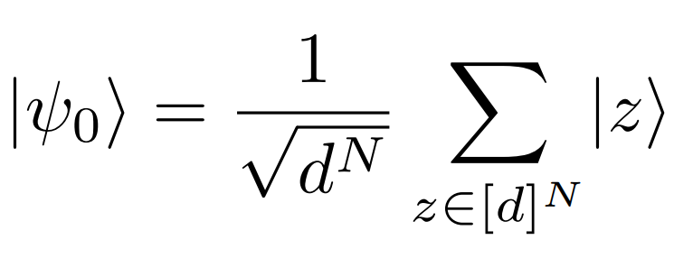
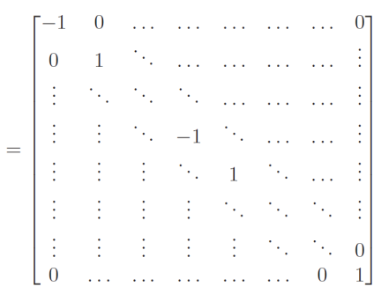
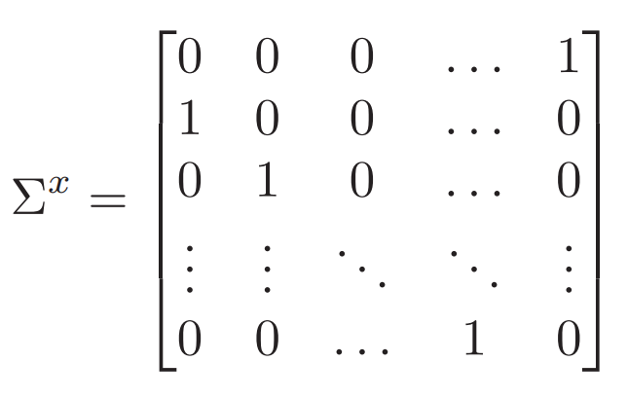
A formulation for multi-level systems (qudits)
Quantum algorithm
The initial state
$$G=\left(V,E\right), N=|V|$$
$z=(z_{0},…,z_{N−1})$
$z_{u}∈[d]$
$$\left|d−1\right\rangle$$
$$⋮$$
$$⋮$$
The cost Hamiltonian
$$h_{m}$$
$$\left|1\right\rangle$$
$h_{C}$= $I−2\sum_{i=1}^{d}{{\left|i\right\rangle }_{u}{\left|i\right\rangle }_{v}\left\langle i{\left.​\right|}_{u}\right.\left\langle i{\left.​\right|}_{v}\right.}$
$$u$$
$$\left|0\right\rangle$$
$$h_{c}$$
$$H_{C}=\sum_{\left(u,v\right)∈E}{{w_{(u,v)}h}_{C}}$$
$$v$$
The mixing Hamiltonian
where
8

Slide 9
Where are we at the stack? (3)
Problem definition
Quantum algorithm
Compilation:
Processor design/Gate implementation
Performance analysis
Full-stack
9

Slide 10
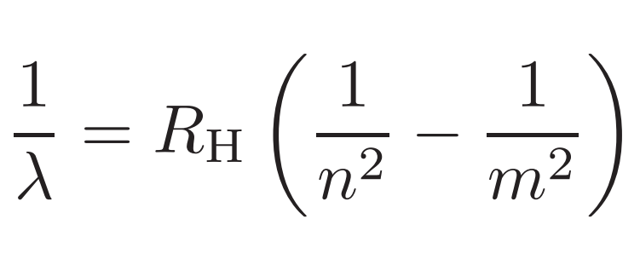
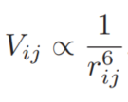
Rydberg quantum computers
Compilation
Rydberg quantum computer:
Array of Rydberg atoms
Rydberg atom
High principal q. number $n\sim 100$
Large dipole moments $∝n^{2}$: strong interactions
[Rydberg, 1888]
Rydberg orbital ($n\sim 100$)
Electron
Atom core
Spin flip
Chemical potential
Long-range interaction
Larger than several $100 nm$
10

Slide 11
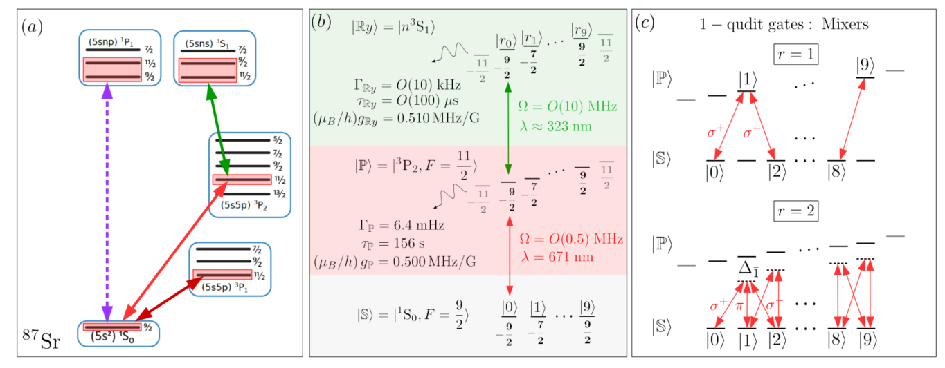
Physical system: fermionic strontium
Compilation
⁸⁷Sr
$d_\max{=10}$ hyperfine states in the ground state manifold → qudits
Large coherence times
11

Slide 12
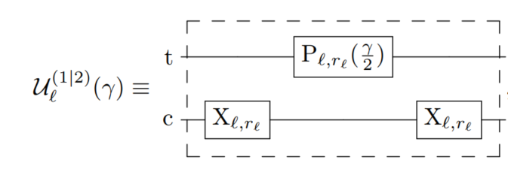
Experimental building blocks
Compilation
Building blocks
Algorithm
Implementation scheme
Initialisation
Cost gates
Mixing gates
Swap gates
Measurement
Resonance fluorescence by collecting the light scattered from the strongly driven $\left|0\right\rangle −{\left.​\right|}^{3}P_{1},F^{′}=\frac{11}{2},m_{F^{′}}=−11/2⟩$ transition
12

Slide 13
Where are we at the stack? (4)
Problem definition
Quantum algorithm
Compilation:
Processor design/Gate implementation
Performance analysis
Full-stack
13

Slide 14
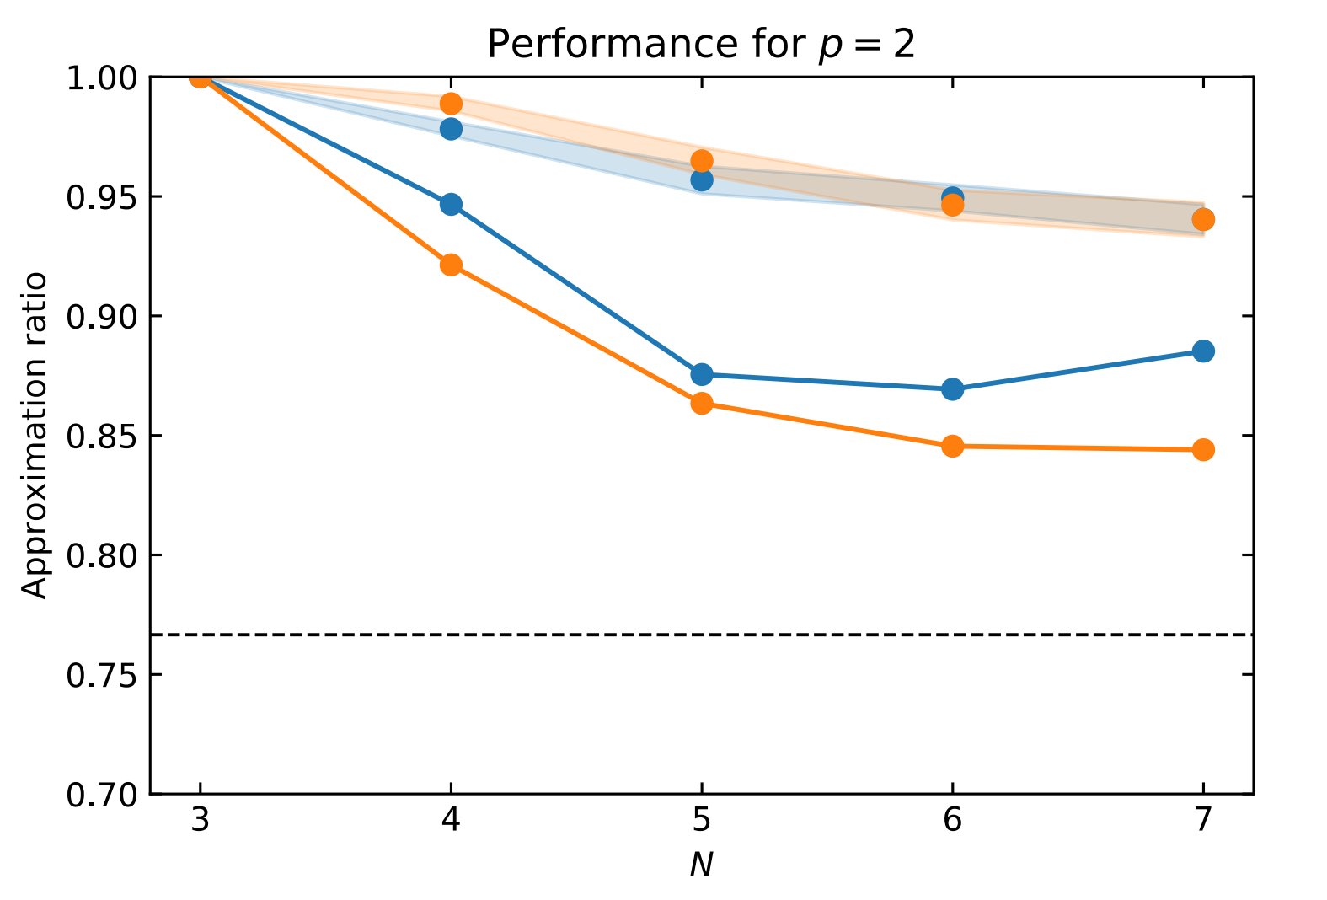
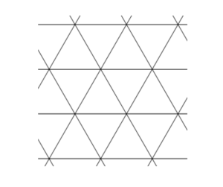
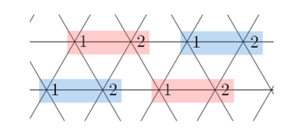
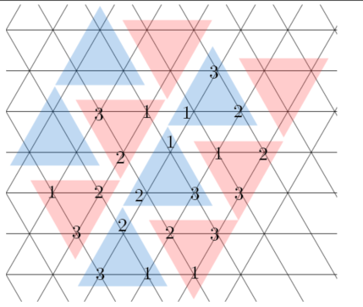
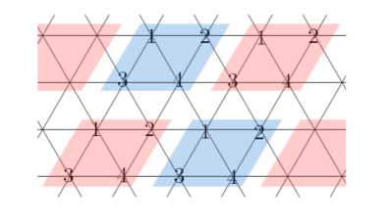
Results
Performance analysis
Average performance
Improved constants in leading contribution in terms of $|E|$)
Worst performance
Theorem (conjecture): 3-regular graphs approximation ratio at $p=1$ bounded by $r≥0.637 (0.670)$
Proof techniques/ideas:
Look at subgraph energy contributions
Construct a minimax fractional LP
Construct relaxations for exact upper/lower bounds
Solve numerically to obtain an estimate
Result holds for a fixed $γ,β$, and parameter optimization only slightly improves the obtained approximation ratio!

Slide 15
Conclusions
We encoded the correlation clustering problem into the QAOA paradigm, specifically tailored for qudit quantum systems. We gave several improvements to the vanilla QAOA guided by simulations, including experiments with various meta-optimization strategies.
We proved (conjectured) that our slightly modified version of QAOA at p = 1 has an approximation ratio of at least 0.6367 (0.6699).
We derived operation schemes for a Rydberg quantum computer (specifally ⁸⁷Sr) .We showed that this qudit formulation is (slightly) superior to the best known qubit formulation in terms of the 2-qudit/2-qubit operation count.
We analysed the algorithm’s performance in the presence of noise corresponding to a random Pauli method and showed performance on complete graphs quickly deteriorates with increasing noise.
15

Slide 16
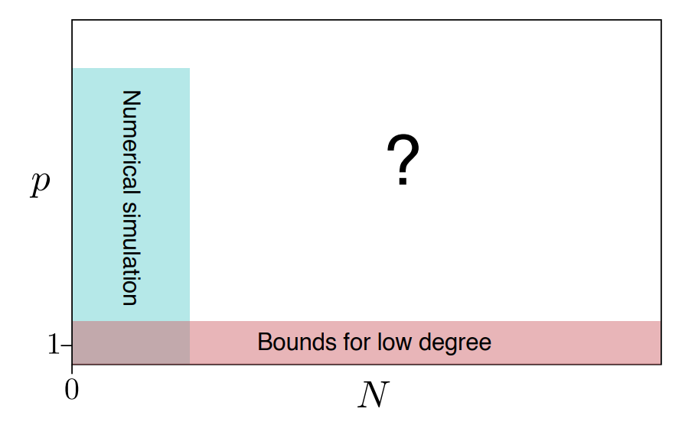
Outlook & future work
Modify novel QAOA simulation methods* to study larger instances
New techniques to obtain approximation ratio guarantees at larger $p$
Exploit hardware constraints further
Long-range interactions for non-planar graphs
Unit disk graphs (native to the platform)
Multi-qudit gates
New hardware/software collaborations?
Actual experiment in the future?
*[Medvidovic et al. 2021]
16

Slide 17
Last slide
Thank you
17

