Slide 1
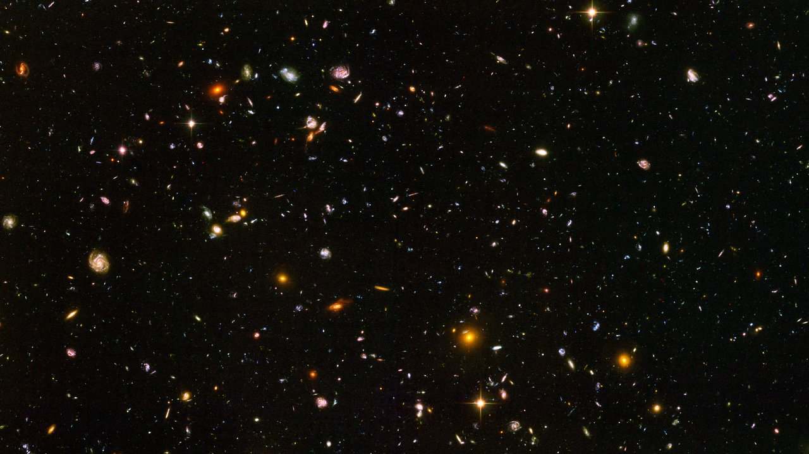
Can neutrinos explain everything?
(besides CMB photons)
Aart Heijboer - Nikhef
Topical lectures on flavour physics and CP violation, March 2022

Slide 2

outline
Lecture 1 : neutrinos and oscillations (+CP)
Lecture 2: neutrino masses & leptogenisis (1h)
Lecture 3: hand on computer exercise (1h)
References [heavily used and screenshotted]
[1] : P. Hernández, Lecture notes, arXiv:1708.01046v1
[2] : PDG: 14. Neutrino Masses, Mixing, and Oscillations
[3] : https://www.youtube.com/watch?v=Ml_6iNqU3HA (excellent talk on leptogenesis)
Broad overview
very loose on technicalities.

Slide 3


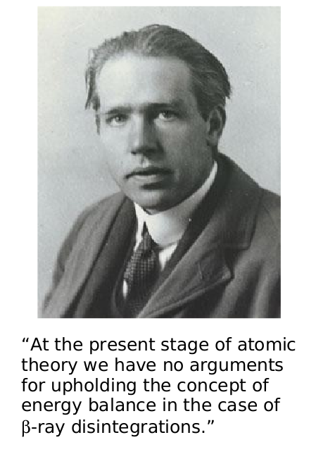
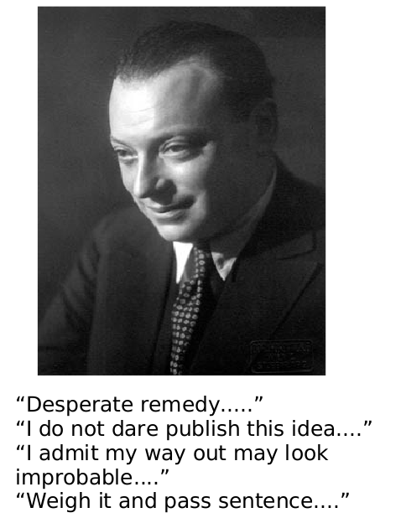
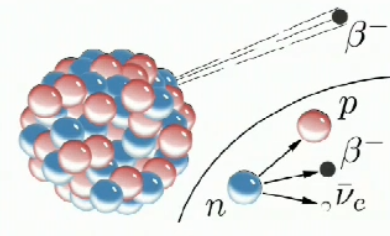
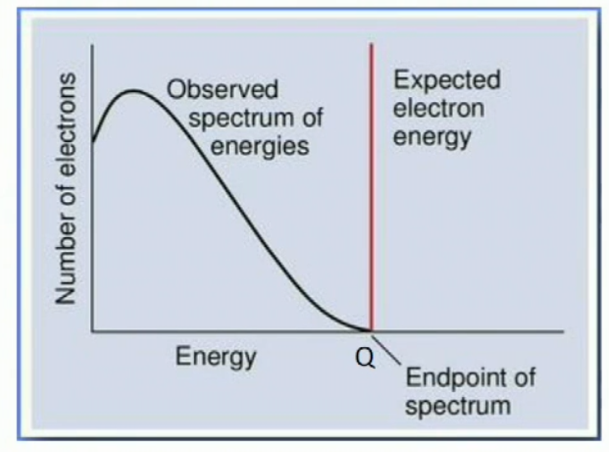

Slide 4
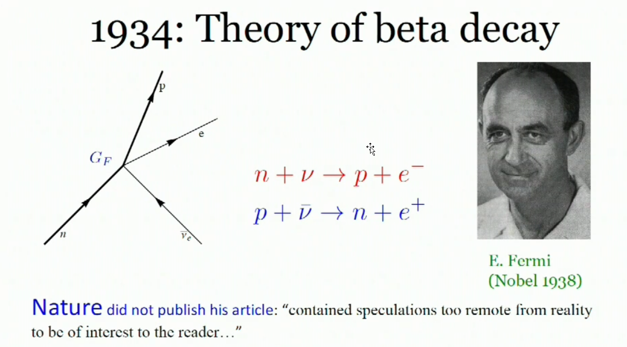

neutrinos

Slide 5
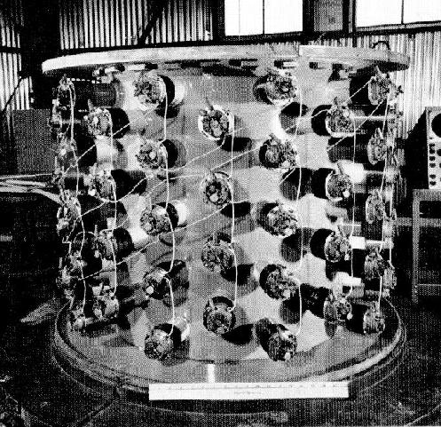
Reines & Cowan 1956

Slide 6
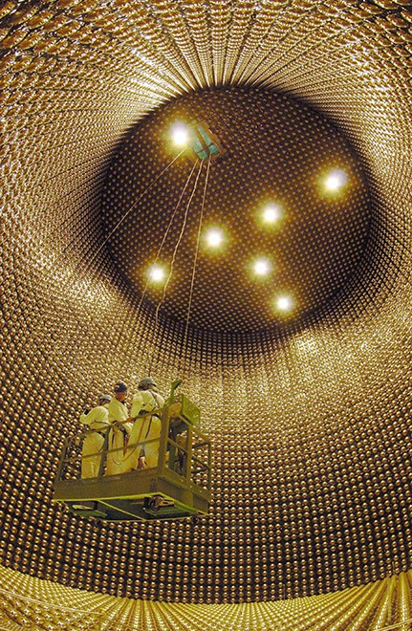
Not much has changed

Slide 7
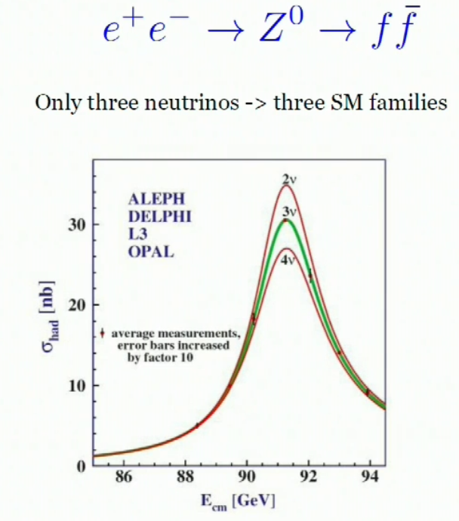
What we know..
There are 3 of them
They have mass (since ~2000)
They are everywhere.

Slide 8
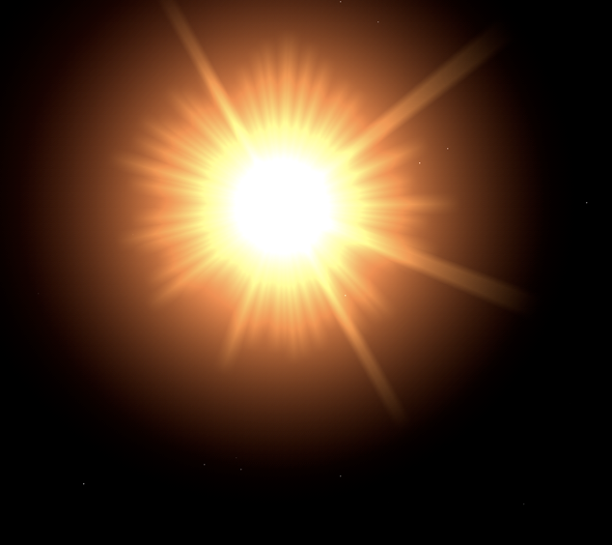
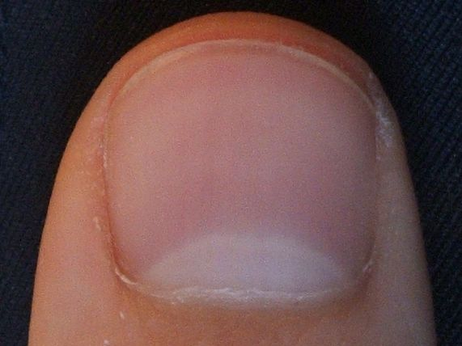
bron energie flux cm⁻² s⁻¹
big bang neutrino's 10⁻⁴ eV 5 10¹²
solar neutrinos MeV 6 10¹⁰
reactor @ 100 km MeV 3 10⁶
atmospheric GeV 0.1
cosmic TeV 10⁻¹⁰
60 000 000 000 neutrinos per cm² per second from the Sun

Slide 9
Block of lead:
1 in 10000 neutrinos absorbed
60 000 000 000 neutrinos per cm² per second from the Sun

Slide 10
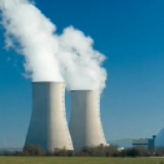
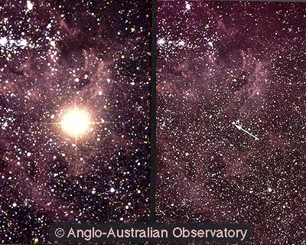
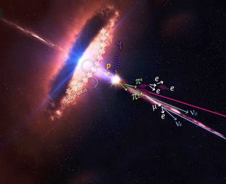
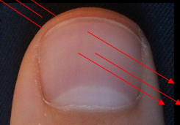
Atmospheric 0.2 /s
Sun 5 x 10¹⁰/s
Earth 10⁷/s
Reactor 10⁹/s (@100m)
Per cm²
Supernova 1987: ~10¹⁰/s
HE cosmic: 10⁻⁸/s
Big Bang: ~2 x 10¹⁰/s

Slide 11
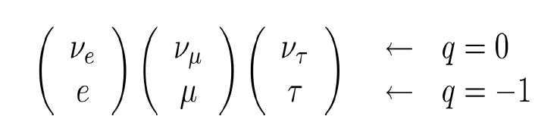
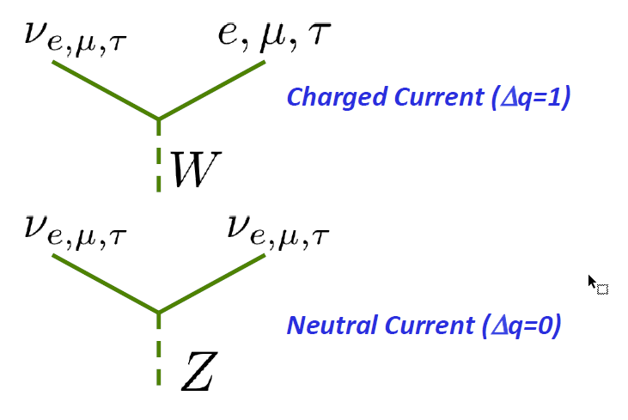
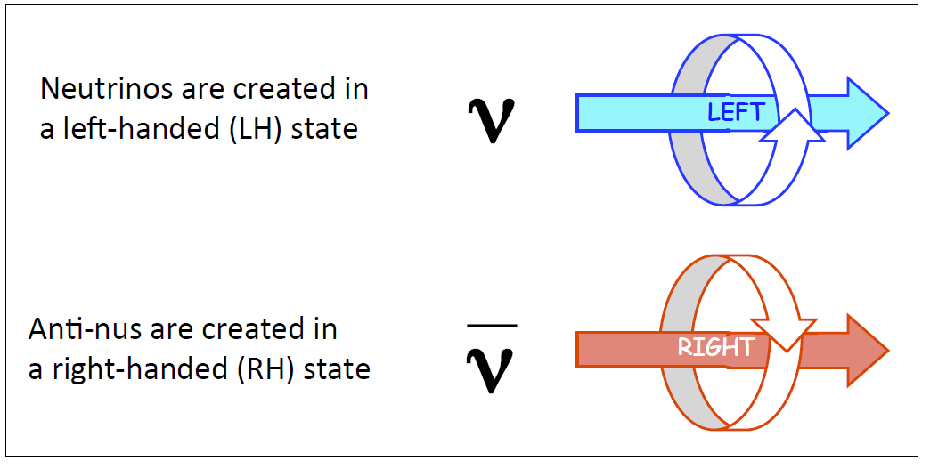
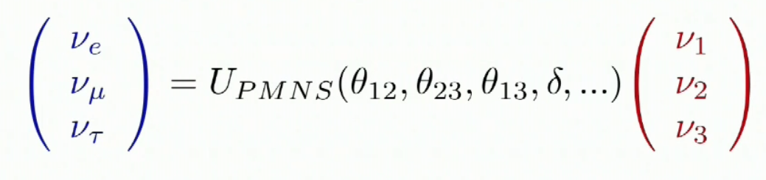
(so the P part of CP is pretty obvious)

Slide 12
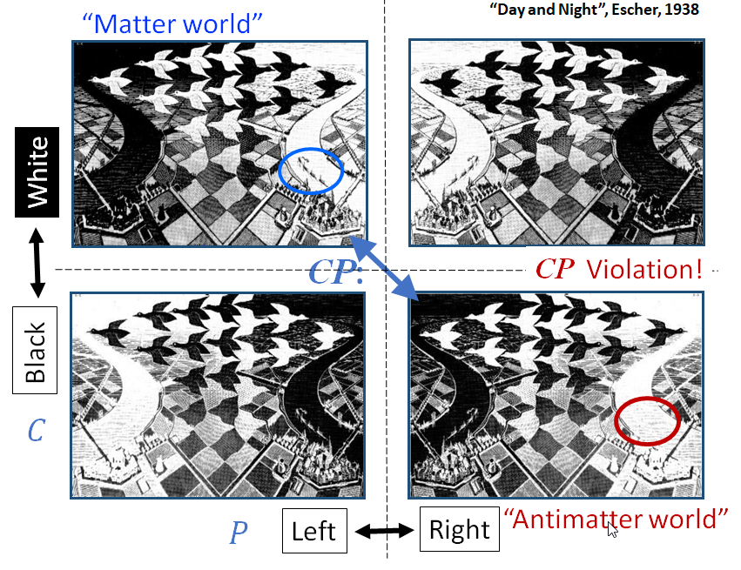
With neutrinos (only weak
interaction):
The P-mirrored version of a
neutrino does not exist.
The question if the CP-mirrored
Interactions are subtly different
remains…

Slide 13
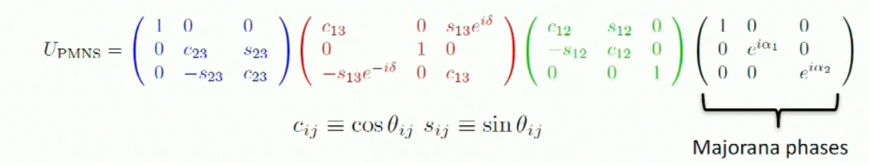
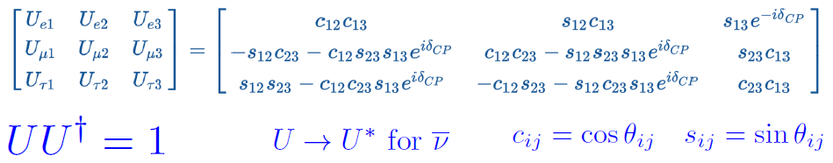
mixing

Slide 14
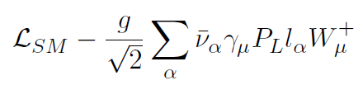
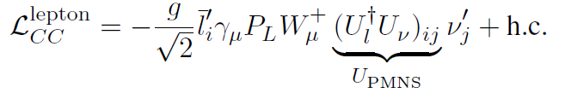
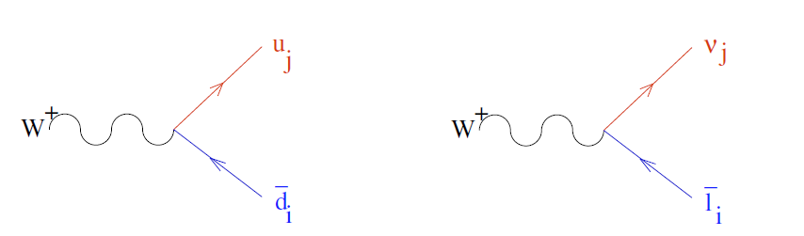
mixing
Expressed in mass-basis, the vertex
would look just like the quarks.
..and you could do neutrino physics
like that.
V_{CKM}
U_{PNMS}

Slide 15
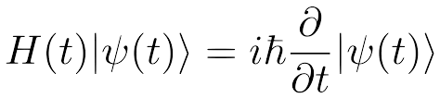

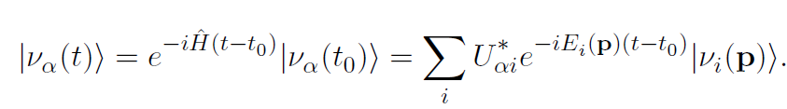
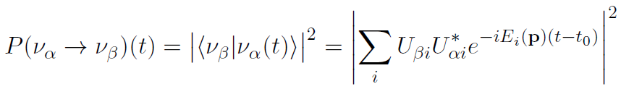
oscillations
Neutrinos are treated as plane
waves, with equal p.
More rigorous treatments
available [1]
l_{α}
ν_{α}
Decompose into mass eigenstates
W
True, but H
is hard here
easy for
mass eigenstates
Probability to find ν_{β}

Slide 16

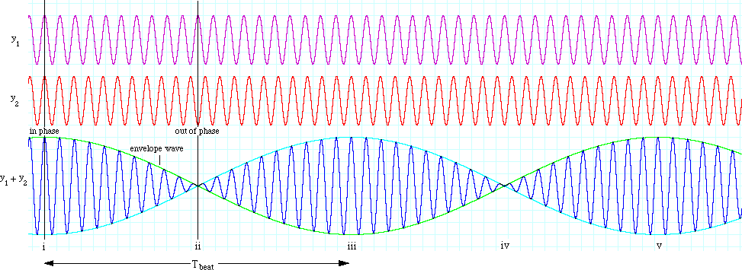
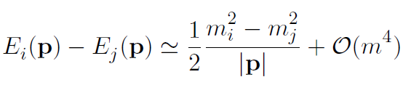
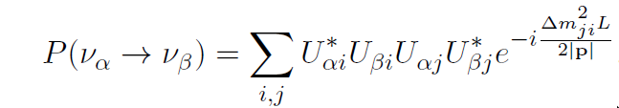
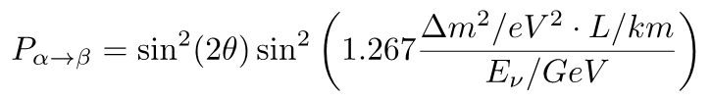
oscillations
In vacuum, at E>>m
Always some combination of mixing
angles, and oscillations with Δm² L/E
Two flavour case

Slide 17
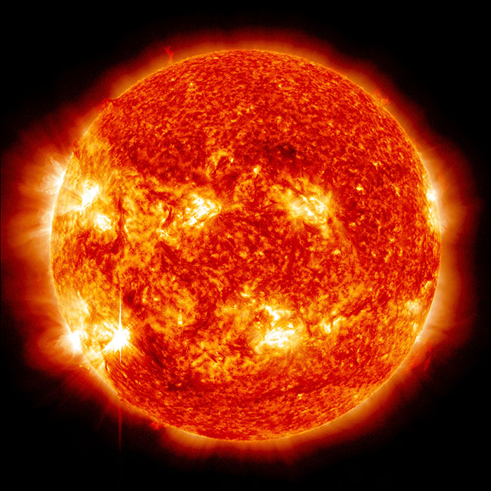

Slide 18
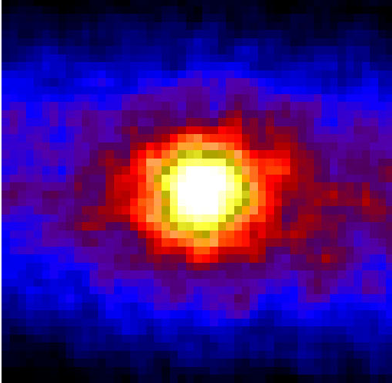
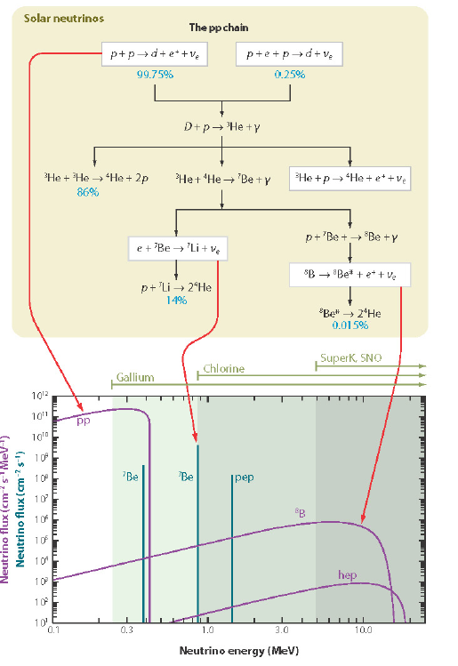
Why is the Sun hot?
Not enough, though

Slide 19
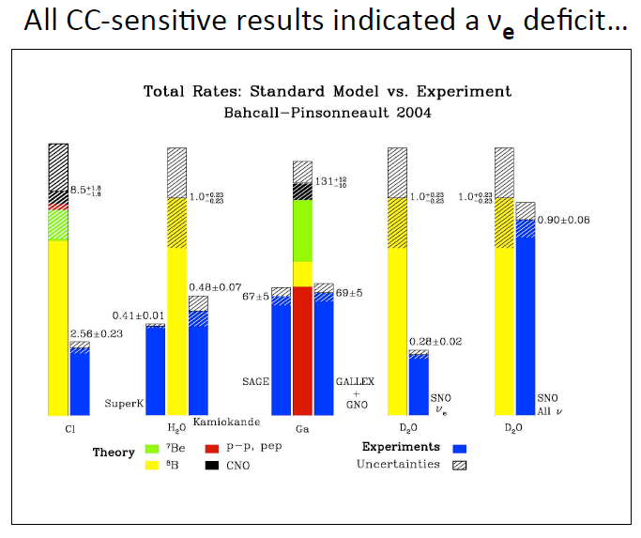
“Solar neutrino problem”
Only 30 to 50% of neutrinos from
the Sun are detected! (as ν_{e})
Okay, maybe neutrino oscillations,
but maybe the Solar model is
wrong.
No direct proof of oscillations
(also other exotic explanations)
Censored for
dramatic effect

Slide 20
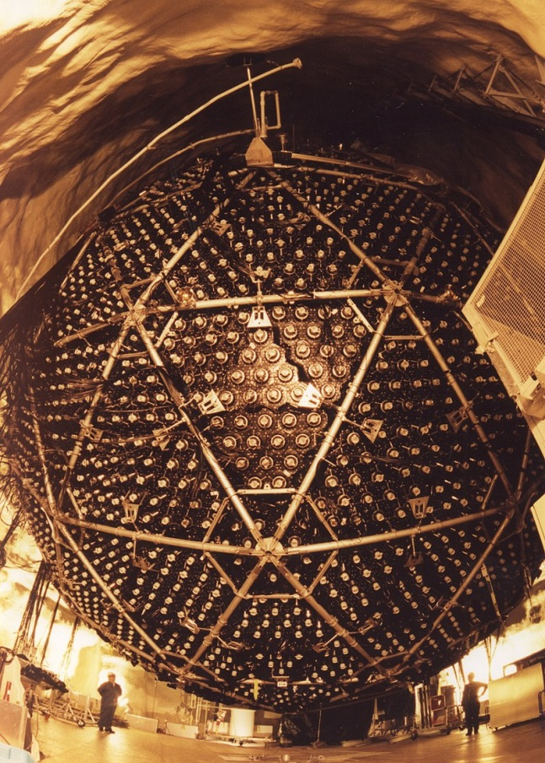

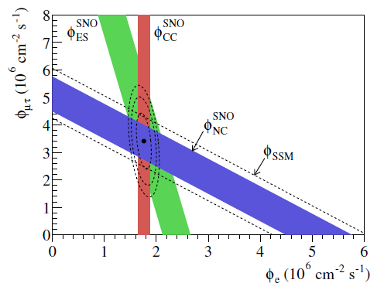
Solar neutrino problem (2001)

Slide 21
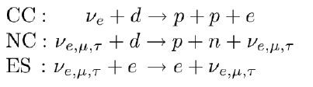
Solar neutrino problem (2001)
The sun shines in ν_{τ}
and/or ν_{μ}
Total flux in perfect agreement
with Solar model
Definite proof of flavour
change (oscillations)
But mostly ν_{e}

Slide 22
“Solar neutrino problem”
All understood now

Slide 23

Understood since 2001

Slide 24
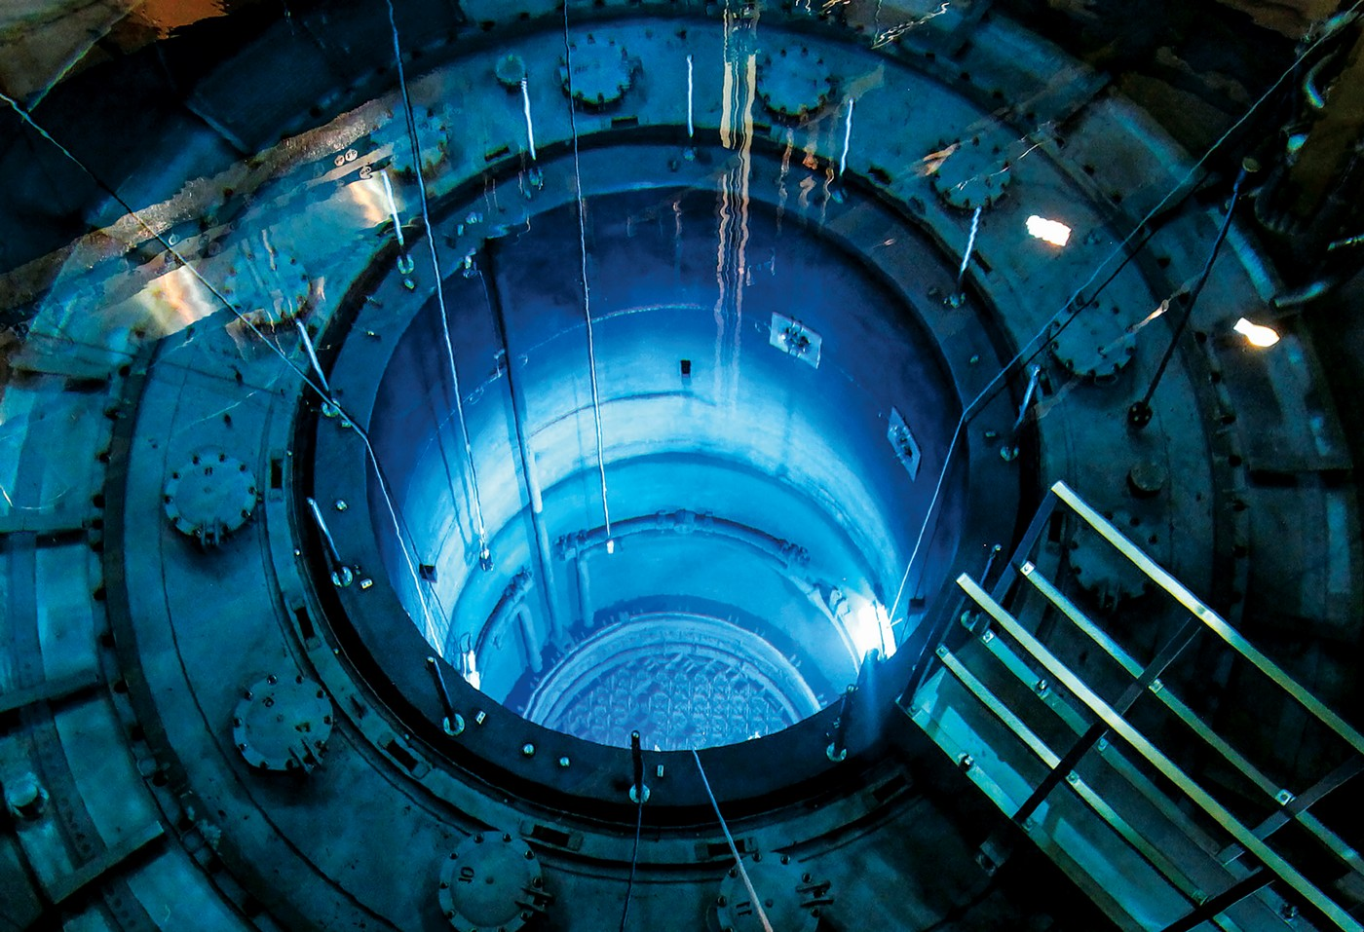

Slide 25

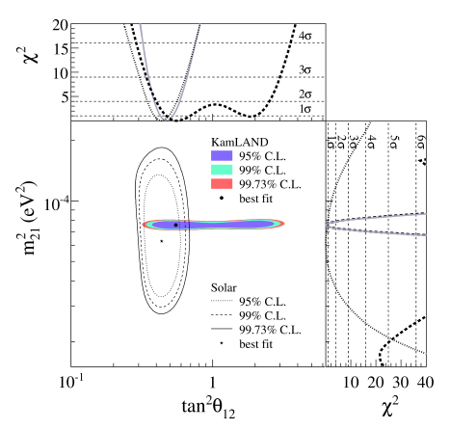
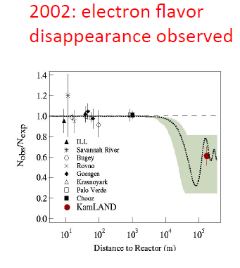
reactors
θ₁₃ is small
At large distnance 2nd term kicks in (α=0.03)
Kamland @ ~100 km

Slide 26
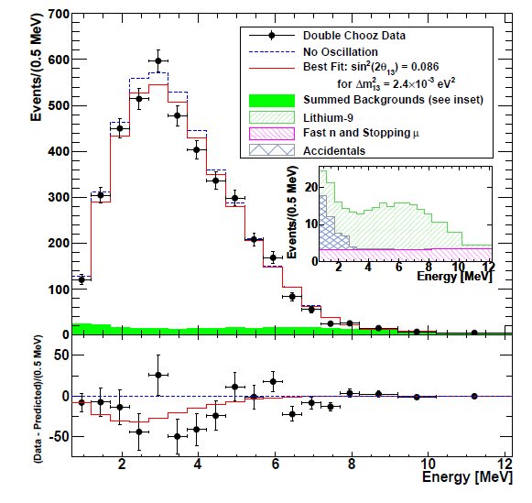

reactors
θ₁₃ is small
At large distnance 2nd term kicks in (α=0.03)
Kamland @ ~100 km
Double Chooz @ 1 km

Slide 27
At smaller distances..
(1st term dominant)

Slide 28
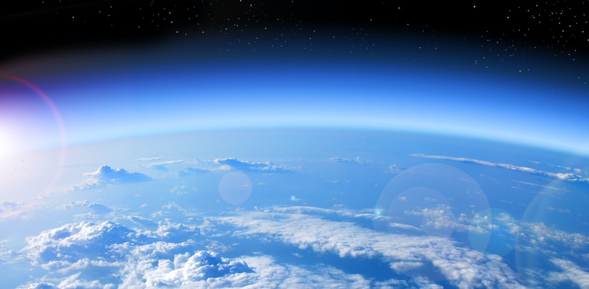

Slide 29
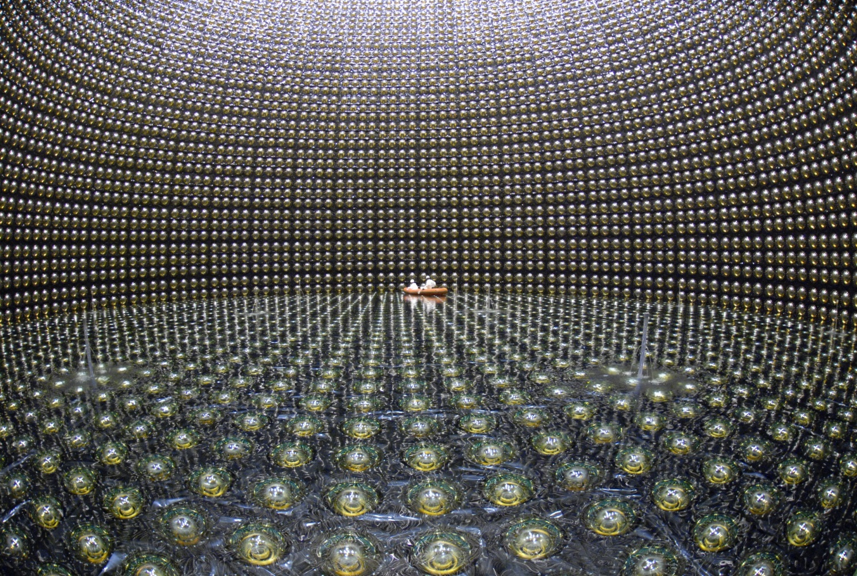
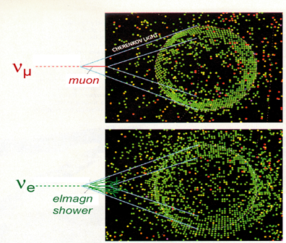

Slide 30
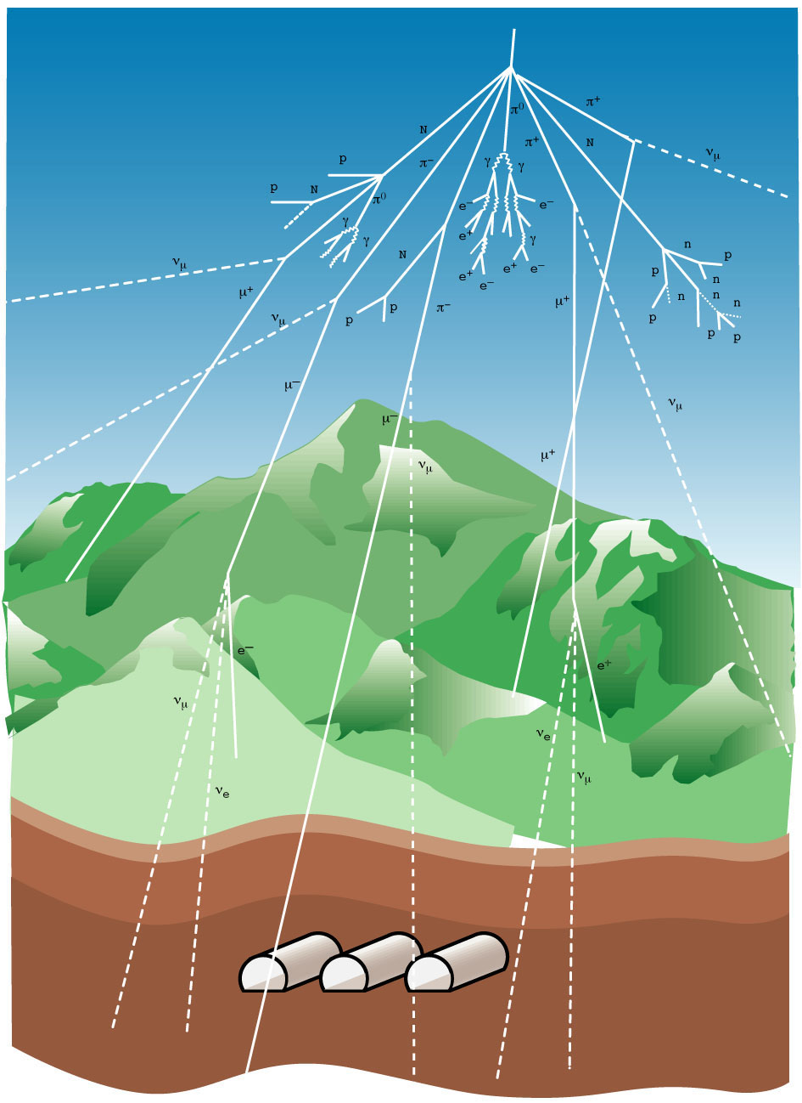
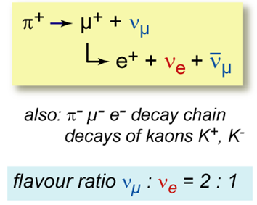
Atmospheric neutrinos

Slide 31
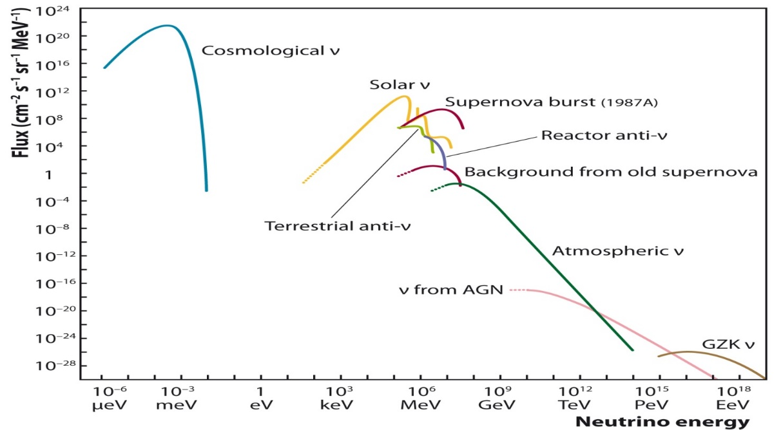
Atmospheric neutrinos

Slide 32
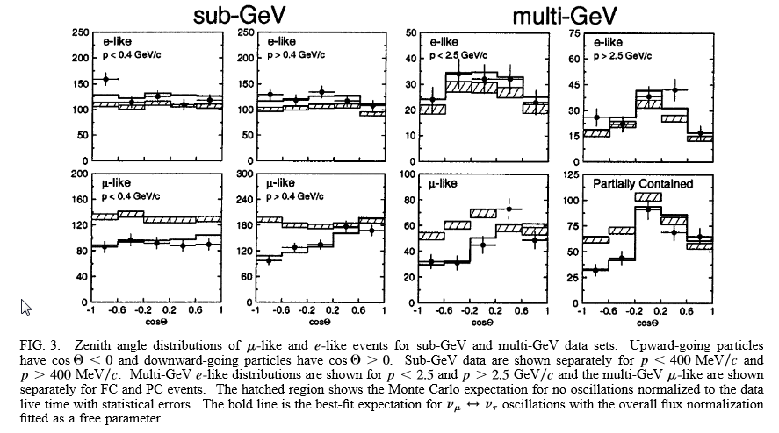

Evidence neutrino oscillations
Muon-neutrinos
are ‘disappearing’
At low energies.
Electron neutrinos
as expcted.

Slide 33

Evidence neutrino oscillations
Muon-neutrinos
are ‘disappearing’
At low energies.
Electron neutrinos
as expcted.

Slide 34


This is now called, ‘the large Δm^{2’,}
The atmospheric Δm² , or
Δm²₃₁ ≈Δm²₃₂
Corresponding mixing angle: atmospheric
mixing angle, or ϴ₂₃
Plot from 1998. Guess the current
Best-fit value… red, blue or green?

Slide 35



Oscillations

Slide 36

Confirming ‘atmospheric’ mixing
E. Lisi

Slide 37



Confirming ‘atmospheric’ mixing
NOvA
T2K
E. Lisi

Slide 38

… most recent to join the game I think
6 lines of the KM3NeT/ORCA detector running for 1 year
(completed detector will have 115 lines)

Slide 39

… most recent to join the game I think
6 lines of the KM3NeT/ORCA detector running for 1 year
(completed detector will have 115 lines)

Slide 40


Global fits..

Slide 41



Conclusions so far..
All mixing angles are non-zero
  Each flavour contributes to
  each mass eigenstate
  Very different from quarks
At least two of the masses
are non-zero. But tiny wrt quarks
We know the sign of Δm₁₂
What about CP?

Slide 42





What about CP? (i.e. the supposed topic of this lecture ;)
2nd term above flips sign.
Only CP if Im ≠ 0 -> δ≠0

Slide 43


What about CP? (i.e. the supposed topic of this lecture ;)
It was not a-priori obvious CP would be observable.
δ must not be zero*
(and not 180 deg)
ϴ₁₃ must not be zero
(okay since ~2012!)
..in fact no angle may be 0
And you need 3 generations, by the way!
must measure in both L/E
regimes.
(both Δm² must be non-zero)
It does not
depend on
the flavours.
* I guess that’s why they call it the cp-phase….

Slide 44



Interesting factoid
You can’t have CP violation in neutrino disappearance
experiments.
CP violation :
But CPT conservation says :
If β=α, this is a contradiction.
In other words : disappearance probability is the same when you run it backwards,
and therefore it must also be the same under CP.
To measure CP, look for appearance

Slide 45


Measure δ
As example, data from T2K.
(NOvA also in this game)

Slide 46


Global fit (nufit 5.0),
Hint for non-zero δ, and if IO, then hint for maximal CP.
..but significance limited… and would be nice to know the mass-ordering.

Slide 47



Mass ordering
Matter effects:
The Earth is full of
electrons (but no
muons or taus).
The electron-
Large effect on
oscillations
Nb: these matter effects must also
Be taken into account in the cp-measurements

Slide 48



How to compute
Exponentiate complex matrix…
Typically via diagonalization
(i.e. find the “effective-mass” eigenstates)
Or some other numerical tool.
Schrodinger equation for
the mass eigenstates
Free propogation easy in mass
basis. Matter contribution (density
dependent) simple in flavour basis
Propagate states through a
layer of constant densitity
(nb: matrix exponentiation)
Many small layers of constant
density. En transform to flavour
basis at beginning and end.
Earth density profile

Slide 49


KM3NeT/ORCA
May definitely measure the
mass ordering
(if we build it fast enough)

Slide 50
Neutrinos vs Quarks
Question for the audience
(during the break)
Is it reasonable to think neutrinos are massive for the same
reason as quarks & charged leptons?

Slide 51
Can neutrinos explain everything?
(besides CMB photons)

Slide 52
Neutrinos vs Quarks
Is it reasonable to think neutrinos are massive for the same reason as quarks & charged leptons?

Slide 53




Adding neutrino masses to SM
Yukawa
coupling
Higgs
Okay, but…
A right-handed neutrino that is a ‘singlet
under all the gauge groups’.
(theorist talk for: “it doesn’t ever do
anything”).
A ‘hierarchy’ problem:
why Yukawa couplings so small
for neutrinos?
After spontaneous symmetry breaking:

Slide 54






Adding neutrino masses to SM
After symmetry breaking
α has units of 1/mass
scale indicative of new physics
inside the blob
High mass scale -> low mass neutrinos
Majorana neutrinos violate L
Neutrinos are their own anti-particles

Slide 55

Interesting thought…
What if we did effective field theory, like our quark-minded colleagues?
The only possible d=5 operator
is the one for Majorana neutrino masses.
If one were to look for new physics in this way, the
first* thing one could hope to find is (majorana) neutrino masses.
Well….we did!

Slide 56


Majorana or not?
Best option: neutrinoless double Beta decay
Possible if, and only if, Majorana
Make a ν
change helicity
because he has
mass.
W wants to know:
- helicity correct?
- nu/nubar correct

Slide 57


Experiments looking for ββ0ν

Slide 58



Seesaw mechanism
Suppose the new physics is due
to a right-handed neutrino
Give it both a Yukawa coupling to the
left-handed leptons, and Majorana
mass term…
Type 1 seesaw
Type 2
Type 3

Slide 59




Seesaw mechanism
A Majorana mass for the
New, right handed neutrino.
A ‘normal’ Dirac mass
with λ ~ 1. generated by
Yukawa coupling.
mass
This is the 1-neutrino case.
For 3 generations
M are matrices that
can violate CP.
Eigenvalues
If M_{R} is large, then the left-handed mass-eigenstates are very small!

Slide 60

Seesaw mechanism
A Majorana mass for the
New, right handed neutrino.
A ‘normal’ Dirac mass
with λ ~ 1. generated by
Yukawa coupling.
mass
Eigenvalues
If M_{R} is large, then the left-handed mass-eigenstates are very small!
Boris Kayser

Slide 61





(Lepto)genesis
Baryon to photon ratio. Extremely well measured
From both CMB and Big Bang Nucleosynthesis.

Slide 62



Buzzword: “Sphalerons”
Non-pertubative SM process that
Conserves B-L
(but not B and not L)
These can convert a lepton asymmetry
into a Baryon one.

Slide 63

Buzzword: “sphalerons”
Non-pertubative SM process that
Conserves B-L
(but not B and not L)
Sphaleroneriamus!
These can convert a lepton asymmetry
into a baryon one.

Slide 64

Leptogenesis
Dynamically generate lepton asymmetry, by
producing N in the early universe
They decay into leptons
Lepton-asymmetry converted to Baryon
asymmetry by SM sphaleron process
All this while the Universe is cooling.
See if this yields the correct Bayon number
Can be made to work, with various variations,
for a huge mass-range for the right-handed
neutrinos.

Slide 65



Leptogenesis
N = right handed heavy neutrino, which
is its own anti-particle. M>T
L = (normal) Leptons
H = Higgs
Processes creating leptons…
Set of coupled differential
equations.
Starting with no N.
Evolve while T goes down.
See what happens
This may create
more L than anti-L
Competing with ‘destroying’ leptons …

Slide 66




leptogenesis
Net number or right handed neutrinos
Lepton
asymmetry
Compare with
Observed
Asymmetry η_{B}
(not order of magnitude,
But the actual, measured
number, within errors)
= Time, basically

Slide 67

leptogenesis
Okay, but we know nothing about these right handed neutrinos
18 parameters in total; of which 6 are known (low-E angles + masses)
One fun question: What if all the CPV is from the low-energy sector?

Slide 68


leptogenesis
Here, at PeV masses for the RHN
Assume two phases
Scan all other parameters (mixing angles
of the RHNs) to yield correct Baryon asy.
(while conserving CP there).
See for which region it can work
It works!
While there is absolutely no reason (afaik)
to suspect the CP conservation at high
scale, it is ‘nice’ to know it is not needed.
The low-scale CP phases can be measured(!)
Dirac phase
A Majorana phase
<- for inverse ordering, looks
different but same conclusion

Slide 69

leptogenesis
Can even do it with just the Dirac phase!
(which we are already measuring and which
will be measured by Dune).
And with just the Majorana phases it works too.
α₂₁ and α₃₁ = 0 or π

Slide 70

In conclusion
Leptogenesis, building on seesaw mechanism:
  Rather minimal assumptions
  Every theory of massive neutrinos need RHN and
  no reason not to write general mass terms…
  All the rest follows.
  Explains why the normal neutrinos are light
  Explains the matter-anti-matter asymmetry in the Universe
  predicts/assumes Majorana particles -> testable.
  Measuring CPV in normal neutrinos would lend a lot
  of, let’s say, “psychological support”

Slide 71


Slide 72



mixing
mass eigenstates
‘flavour’ eigenstates

Slide 73
Questions
Why do neutrino’s behave so differently from quarks?
(do they get mass the same way??)
(why do we not even know)
Which neutrino is the heaviest?
So what if neutrinos violate CP?
(Leptogenesis?)
Do neutrinos point to new Physics?

