Slide 1
Welcome
Charles Timmermans,
on behalf of Dorothea Samtleben and the CAN

Slide 2
APP in the Netherlands – the CAN
Established in 2004, the CAN represents the Dutch scientific community interested in astroparticle physics. It comprises members, representing the different sub-fields and the institutions involved in astroparticle physics in the Netherlands.
Objective of the committee is to strengthen and further develop the field of astroparticle physics in the Netherlands in research and teaching.
Members:
Chris Van Den Broeck (U Utrecht) Dorothea Samtleben (Nikhef & U Leiden)
Andreas Freise (VU Amsterdam) Charles Timmermans (RU Nijmegen)
Jason Hessels (ASTRON) Manuela Vecchi (RU Groningen)
Stefan Hild (U Maastricht) Jean in 't Zand (SRON)
Jörg Hörandel (RU Nijmegen) Jacco Vink (UvA Amsterdam)
Elena Rossi (U Leiden) Christoph Weniger (UvA Amsterdam)

Slide 3
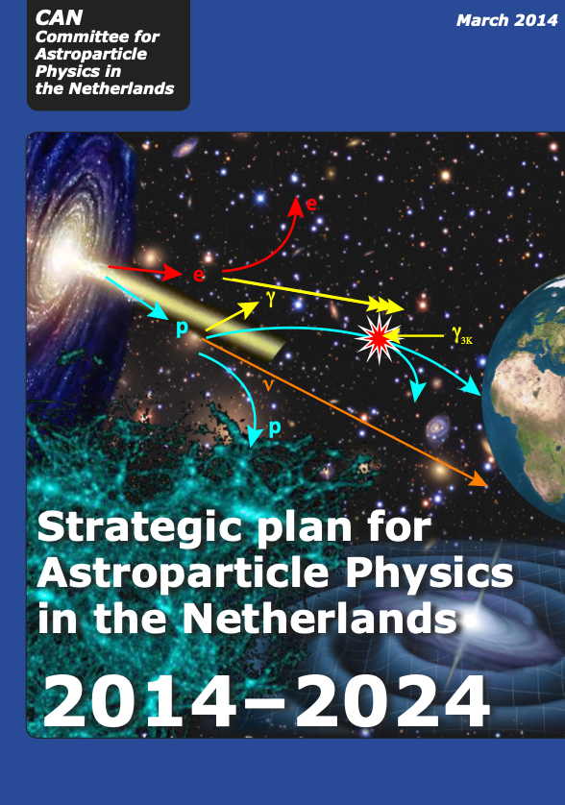
APP in the Netherlands - Strategy
The CAN produced a document on “The strategic plan for astroparticle physics in the Netherlands 2014-2024”
The main objectives are achieved!
APP through 5 different pillars:
Cosmic Rays
Neutrinos
Gamma Rays
Gravitational Waves
Dark Matter
A next version of this document is due
Aligned with APPEC
Aligned with Nikhef
Aligned with RvA/NOVA

Slide 4
APP in the Netherlands Organisation
The organisation was formalised in 2020 by creation of the AppSC (Astroparticle physics Strategic Committee)
Members: Nikhef Director, CAN Chair, RvdA Chair, NWO secretary
Task: Align particle physics and astronomy strategies with CAN strategy
AppSC appoints CAN members and chair and mandates its mission
Members: one for each APP group at Dutch University or Institute
Tasks:
Promote APP in the Netherlands
Provide strategy input to AppSC
Monitor implementation of strategy as agreed with AppSC

Slide 5
APP in the Netherlands
We will install a prize for the best PhD thesis in the field of astroparticle physics.
Details on this competition will be made available later this year

Slide 6
APP in the Netherlands –Participate!
Look at our web site
http://astroparticlephysics.nl/
Subscribe to the APP mailing list:
https://mailman.nikhef.nl/mailman/listinfo/astroparticlephysics
Participate in the events
Provide input

Slide 7
The 26th Symposium
A lot of thanks to Manuela, Andreas and Christoph for organizing!
Let’s have a great symposium!

