Slide 1




Pixel TPC testbeam results
B=0 data set
Yevgen Bilevych, Klaus Desch, Harry van der Graaf, Fred Hartjes, Jochen Kaminski, Peter Kluit, Naomi van der Kolk,
Cornelis Ligtenberg,
Gerhard Raven, and
Jan Timmermans
8 Quad Module
Lepton Collider 14 February 2022

Slide 2
DESY testbeam Module Analysis
Next calibration and alignment steps
The jitter in the trigger signal
  There is a clear issue with the z residuals (0.464 mm)-> time jitter ˜7.5 ns on the trigger signal (TLU)
The results for run 6917 and rotations vs z
Improving the z calibration and alignment and xy alignment
Resolution results and estimates of systematics

Slide 3
DESY testbeam Module Analysis
Comparing the fitted track in the Telescope (T) with the TPX3 (M) track in the middle of the module (with curvature)
There is a clear issue with the z residuals (0.464 mm)-> time jitter ˜7.5 ns on the trigger signal (TLU)
If we refit the TPX3 track in the two concentrators A & C fixing the T angle and curvature we find σ_{TPX3A-C z} = 93 μm
From 14 February
Gaussian fits:
σ_{T-M xy} = 37 μm (32 μm from T)
σ_{T-M z} = 464 μm (35 μm from T)
σ _{T-M dxdy} = 0.56 mrad (0.22 from T)
σ_{T-M dzdy} = 0.91 mrad (0.25 from T)

Slide 4
DESY testbeam Module Analysis
The jitter (˜7.5 ns) in the trigger signal
Looked into detail with Jan at the fToa correction (that is of same order as the jitter) for the pixel hits. Indeed it is subtracted (as it should).
The trigger time is decoded in the same way as the quad (and single chip) and should be fine
The trigger was not jittering in the Bonn quad test beam and in the Nikhef laser data tests of the (timing and performance) module
The internal fit of all the z hits DESY B=0 data gives a (measured) resolution of 93/2=47 μm (slide 3). This correspond to a time resolution of better than 0.5 ns. So more than a factor 10 better than the jitter
Unavoidable conclusion: the scintillators or the TLU system jitter

Slide 5
DESY testbeam Module Analysis
Run 6917 B=0
Comparing the Telescope and TPX3 track
There are clear rotation(s) that were not present in 6916
Need alignment of module (dx/dz was not aligned)
Telescope alignment remains prediction.
From 14 February

Slide 6
DESY testbeam Module Analysis
The results for run 6917 and rotations vs z
In the slides of last meeting it was shown that for run 6917 taken at a different mean z value, the distributions for the track angles in the module were shifted wrt the telescope angles.
To correct for the dependencies:
  positions: δxy, δz, z in mm (ylocal in pixels) angular corrections δdxdy δdzdy in mrads
δxy0 = -0.017- 0.00448 (z-4.2)
δdxdy0 = -0.227+ 0.0933 (z-4.2)
δxy = -δxy0 + 0.055 δdxdy0 (y_{local}-1436)/1000
δdzdy0 = 1.189 - 0.231 (z-4.2)
δz = -0.055*δdzdy0 (y_{local}-1436)/1000
Part of this correction is a (geometrical) rotation of the module; but the angular changes (δdxdy0, δdzdy0) indicate a drift field deformation, because the drift plane angles changes orientation as a function of z.
Note that Kees similarly had to realign the Quad detector for different z slices

Slide 7
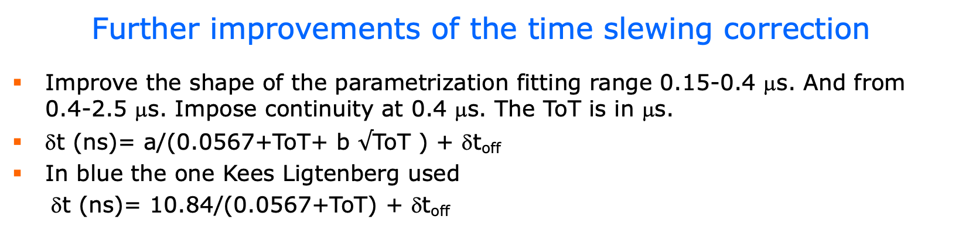
DESY testbeam Module Analysis
Further improvements of the time slewing correction
Improve the shape of the parametrization fitting range 0.15-0.4 μs. And from 0.4-2.5 μs. Impose continuity at 0.4 μs. The ToT is in μs.
δt (ns)= a/(0.0567+ToT+ b $√$ToT ) + δt_{off}
In blue the one Kees Ligtenberg used
δt (ns)= 10.84/(0.0567+ToT) + δt_{off}
The parametrization and magnitude of the correction is close to the one Kees used.
The new parametrization follows better the module data in the ‘knee’ (due to b term) and in particular at low ToT (fitting range splitted)

Slide 8
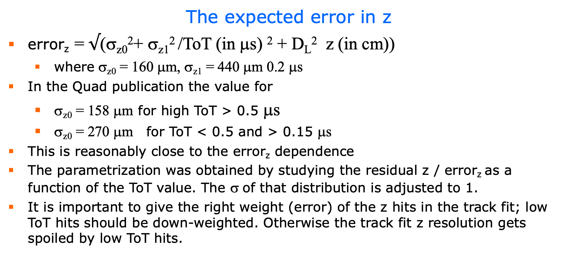
DESY testbeam Module Analysis
The expected error in z
error_{z} = $√$(σ_{z0}²+ σ_{z1}² /ToT (in μs) ² + D_{L}² z (in cm))
  where σ_{z0} = 160 μm, σ_{z1} = 440 μm 0.2 μs
In the Quad publication the value for
  σ_{z0} = 158 μm for high ToT > 0.5 μs
  σ_{z0} = 270 μm for ToT < 0.5 and > 0.15 μs
This is reasonably close to the error_{z} dependence
The parametrization was obtained by studying the residual z / error_{z} as a function of the ToT value. The σ of that distribution is adjusted to 1.
It is important to give the right weight (error) of the z hits in the track fit; low ToT hits should be down-weighted. Otherwise the track fit z resolution gets spoiled by low ToT hits.

Slide 9
DESY testbeam Module Analysis
Per chip alignment
To improve the quality of the reconstructed data the chips were realigned correcting in local module coordinates using runs 6916 and 6917 (B=0T)
  The mean position in xy and z (or t0)
  The dependence per row xy and z (angle dxdy and dzdy local)
  The dependence per column in z (angle dzdx)
The per chip dependence vs row (y local) in the z residuals can be clearly observed in the slide from 14 February
They are probably due to small z height differences of the individual chips
The magnitude of the corrections in xy is (as expected) smaller than for z

Slide 10
DESY testbeam Module Analysis
Mean unbiased residuals in xy
  Looks with this stat OK
Mean refitted TPX3 z residuals in the module
  Mean t0 per chip are about 0
  See t0 different pattern in chip plane vs local y
  Has impact on fitted σ
From 14 February

Slide 11
DESY testbeam Module Analysis
run 6916
Only Run 6916 B=0 T
Mean unbiased residuals in xy
  Looks with this stat OK
Mean refitted TPX3 z residuals in the module
  Looks much better than previous slide

Slide 12
DESY testbeam Module Analysis
run 6917
Only Run 6917 B=0 T
Mean unbiased residuals in xy
  Looks with this stat OK
Mean refitted TPX3 z residuals in the module
  Looks Okish
  z deformations in this chip?

Slide 13
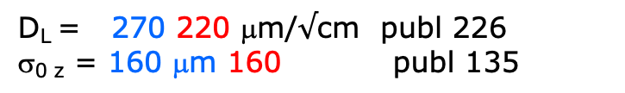
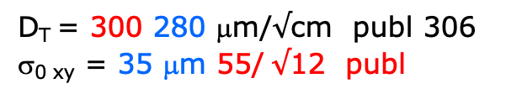
DESY testbeam Module Analysis
run 6916
Using the unbiased residuals in xy and the refitted TPX3 z residuals the resolution can be extracted as a function of the telescope z prediction.
Expected tracking contribution telescope xy
σ_{0 xy} = 32 μm
Expected TPX3 tracking contribution z
(σ_{TPX3A-C z} = 93 μm)
σ_{0 z} = 47 μm
The drift distance has a per track uncertainty of 464 μm (trigger time)
D_{T} = 300 280 μm/$√$cm publ 306
σ_{0 xy} = 35 μm 55/ $√$12 publ
D_{L} = 270 220 μm/$√$cm publ 226
σ_{0 z} = 160 μm 160 publ 135
ToT > 0.6 μs

Slide 14
DESY testbeam Module Analysis
runs 6917-18 B=0 T
xy z xy z
ToT > 0.6 μs
ToT > 0.6 μs

Slide 15
DESY testbeam Module Analysis
runs 6916 and 6917
A look into stability of the chip alignment
Extract the xy and z shifts and angles and plot them for the different runs
  δx_{shift} (2); δx_{shift} + δx_rot (row 128-64); δx_{shift} + δx_rot (row 128+64); δx_{shift} + δx_rot (row 128-128); δx_{shift} + δx_rot (row 128+128);
  Similarly for Δz_{shift} (2) for rot (row) (4) and rot(col) (4)
Run 6916
Run 6917
xy -15 μm
rms 30 μm
z 55 μm
rms 80 μm

Slide 16
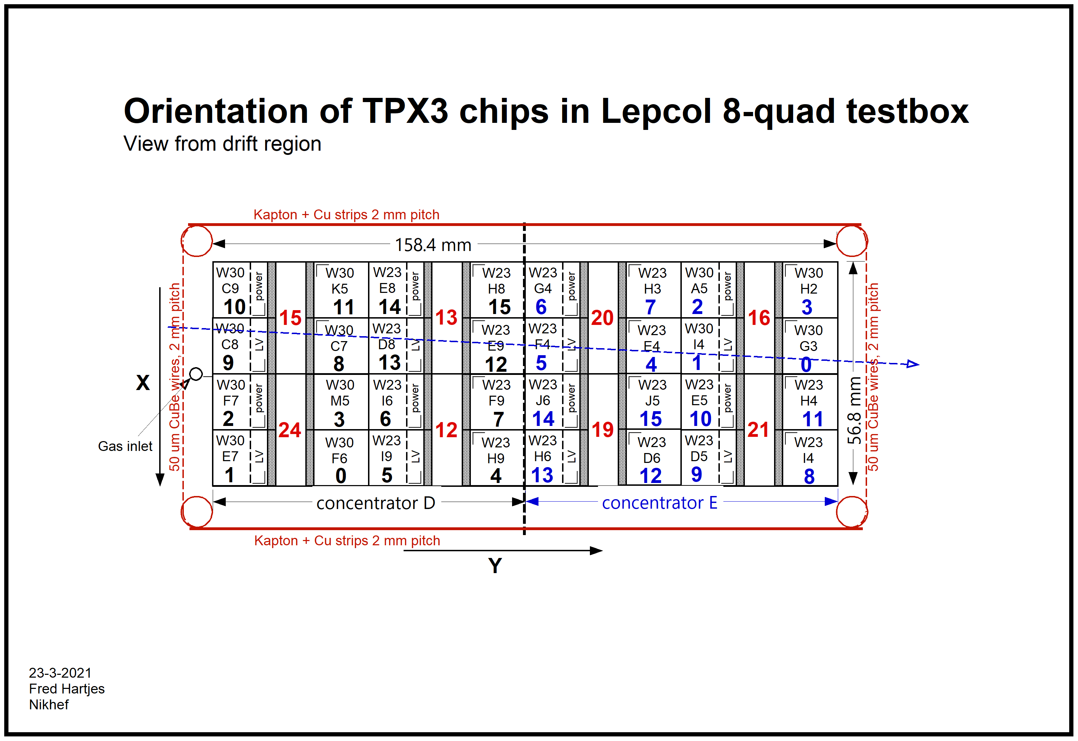
DESY testbeam Module Analysis

