Slide 1




Pixel TPC testbeam results
B=0 data set
Yevgen Bilevych, Klaus Desch, Harry van der Graaf, Fred Hartjes, Jochen Kaminski, Peter Kluit, Naomi van der Kolk,
Cornelis Ligtenberg,
Gerhard Raven, and
Jan Timmermans
8 Quad Module
Lepton Collider 14 February 2022

Slide 2
DESY testbeam Module Analysis
Detailed study of Run 6916 B=0 T p=6 GeV
Emphasis on the resolution results in z shown two weeks ago
  xy plane behaved quite nicely
Cross checked time slewing:
  δt (ns)= 18.6/ (0.0567+ToT(μs))
  In the actual code a different formula was used (bug fixed)
The drift velocity (E=280 V/cm) was just put at 78 μm/ns
  Internal fits to the z hits in the module can absorb z0 and t0 shifts and work well for any assumed drift velocity
Investigated in detail the tracks from the telescope
  Important because t0 and drift velocity measurement are best determined by an external measurement

Slide 3
DESY testbeam Module Analysis
Time slewing as used in the data
In red our parametrization
δt (ns)= 18.6/ (0.0567+ToT(μs))
In blue the one Kees used
δt (ns)= 10.84/ (0.0567+ToT(μs))
The curves for different chips look very very similar. So one parametrization is fine.
The extact amplitude (18.6 vs 10.84) depends on the chip settings, temperature etc.
Mean residual / v drift [ns]
Tot [μs]

Slide 4
DESY testbeam Module Analysis
Included the Mimosa clusters
Corrected geometry: Module in middle
There is sizeable a distance between nearest Si plane and the Module entrance/exit window
Track fits to Mimosa red; to TPX3 blue. We need curved fit in Mimosa to account for multiple scattering.
Blue cluster = on selected M track
green cluster = on other M tracks
small magenta = all other M clusters

Slide 5
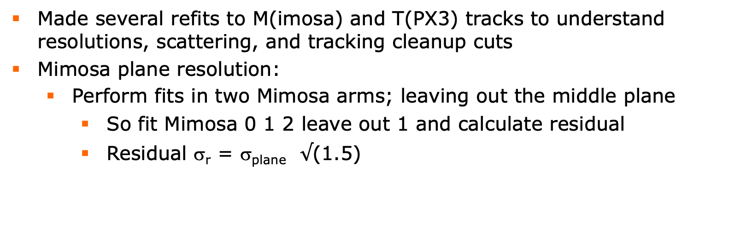
DESY testbeam Module Analysis
Made several refits to M(imosa) and T(PX3) tracks to understand resolutions, scattering, and tracking cleanup cuts
Mimosa plane resolution:
  Perform fits in two Mimosa arms; leaving out the middle plane
    So fit Mimosa 0 1 2 leave out 1 and calculate residual
    Residual σ_{r} = σ_{plane} $√$(1.5)
Gaus fit
σ_{res xy}= 5.1 μm
σ_{res z} = 5.1 μm

Slide 6
DESY testbeam Module Analysis
Here a SL refit to each arm 1/2 of the Mimosa (0-2 and 3-5)
Predictions are in the middle of the module
Gaussian fit
σ_{res1-2 xy} = 65 μm
σ_{res1-2 z} = 71 μm
σ_{res1-2 dxdy} = 0.43 mrad
σ_{res1-2 dzdy} = 0.50 mrad
Expected error assuming 5 μm point resolution 0.15 mrad

Slide 7
DESY testbeam Module Analysis
The fitted numbers imply the following
Comparing the expected σ_{res1-2 dxdy} (0.20 mrad) and measured (0.43 or 0.50 mrad) angles one can conclude that multiple scattering is pretty important.
The distance between middle module and Mimosa 1 is 105 mm so we expect a σ xy of 16 μm (per arm). In terms of σ_{res1-2 xy} one expects 21 μm while observation gives 65 μm. Indicating also the importance of multiple scattering.
All in all it means that the a fully fitted telescope track through both arms with free curvature/scattering would give in the middle of the module a σ _{xy} = 32 μm and σ _{z} = 35 μm with a large contribution from multiple scattering. The uncertainty on the angle σ _{dxdy} is 0.22 mrad and σ _{dzdy} is 0.25 mrad.

Slide 8
DESY testbeam Module Analysis
Comparing the fitted track in the Telescope (T) with the TPX3 (M) track in the middle of the module (with curvature)
There is a clear issue with the z residuals (0.464 mm)-> time jitter ˜7.5 ns on the trigger signal (TLU)
If we refit the TPX3 track in the two concentrators A & C fixing the T angle and curvature we find σ_{TPX3A-C z} = 93 μm
Gaussian fits:
σ_{T-M xy} = 37 μm (32 μm from T)
σ_{T-M z} = 464 μm (35 μm from T)
σ _{T-M dxdy} = 0.56 mrad (0.22 from T)
σ_{T-M dzdy} = 0.91 mrad (0.25 from T)

Slide 9
DESY testbeam Module Analysis
Track quality cuts based on the Telescope
Compare extrapolation of the SL fits in two arms in middle of module
  |distance xy | < 0.3 mm |distance z | < 0.3 mm
  Removes events with scattered tracks
Track selection cuts on Telescope and TPX3 Module fitted curved tracks
  |distance xy | < 0.3 mm |distance z | < 3 mm
  Refit TPX3 z track in the two concentrators |distance z A-C| < 0.3 mm
Unbiased residuals in z can be calculated using the Telescope only fit
But … to get a better precision (to measure the z resolution) we need to refit the full TPX3 z track fixing the angle and curvature from the telescope

Slide 10
DESY testbeam Module Analysis
With the unbiased residuals in z the drift velocity can be measured as the Telescope z measurement defines the scale.
By adjusting the residual vs z expected (Telescope) the drift velocity was measured to be 62 μm/ns
The t0 per chip and x per chip were corrected; the module aligned
The average assigned error xy is 370 μm and z 472 μm
After refit

Slide 11
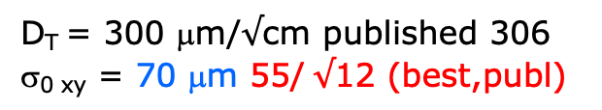
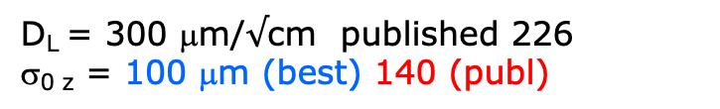
DESY testbeam Module Analysis
Using the unbiased residuals in xy and the refitted TPX3 z residuals the resolution can be extracted as a function of the telescope z prediction.
Expected tracking contribution telescope xy
σ_{0 xy} = 32 μm
Expected TPX3 tracking contribution z
(σ_{TPX3A-C z} = 93 μm)
σ_{0 z} = 47 μm
The drift distance has a per track uncertainty of 464 μm (trigger time)
D_{T} = 300 μm/$√$cm published 306
σ_{0 xy} = 70 μm 55/ $√$12 (best,publ)
D_{L} = 300 μm/$√$cm published 226
σ_{0 z} = 100 μm (best) 140 (publ)
ToT > 0.6 μs

Slide 12
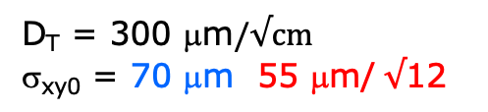
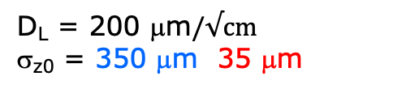
DESY testbeam Module Analysis
Run 6916-18 B=0 T p =6 GeV
D_{T} = 300 μm$/√cm$
σ_{xy0} = 70 μm 55 μm/ $√$12
D_{L} = 200 μm$/√cm$
σ_{z0} = 350 μm 35 μm
B=0 T
ToT > 0.6 μs
Results improved due to:
Track selection
Drift distance from Telesope
Procedure for z residuals
  Trigger time uncertainty
Re-calibrations of t0 and x chip shifts (xy has less syst)
OLD results 31 January

Slide 13
DESY testbeam Module Analysis
Mean unbiased residuals in xy
  Looks with this stat OK
Mean refitted TPX3 z residuals in the module
  Mean t0 per chip are about 0
  See t0 different pattern in chip plane vs local y
  Has impact on fitted σ

Slide 14
DESY testbeam Module Analysis
Using the unbiased residuals in xy and the refitted TPX3 z residuals the resolution can be extracted as a function of the telescope z prediction.
D_{T} = 300 μm/$√$cm published 306
σ_{0 xy} = 70 μm 55/ $√$12 (best,publ)
D_{L} = 300 μm/$√$cm published 226
σ_{0 z} = 100 μm (best) 140 (publ)
ToT > 0.6 μs
Run 6917 B=0
At different z

Slide 15
DESY testbeam Module Analysis
Using the unbiased residuals in xy and the refitted TPX3 z residuals the resolution can be extracted as a function of the telescope z prediction.
D_{T} = 300 μm/$√$cm published 306
σ_{0 xy} = 70 μm 55/ $√$12 (best,publ)
D_{L} = 300 μm/$√$cm published 226
σ_{0 z} = 100 μm (best) 140 (publ)
ToT > 0.6 μs
Run 6917 B=0
At different z

Slide 16
DESY testbeam Module Analysis
Run 6917 B=0
Comparing the Telescope and TPX3 track
There are clear rotation(s) that were not present in 6916
Need alignment of module (dx/dz was not aligned)
Telescope alignment remains prediction.

Slide 17
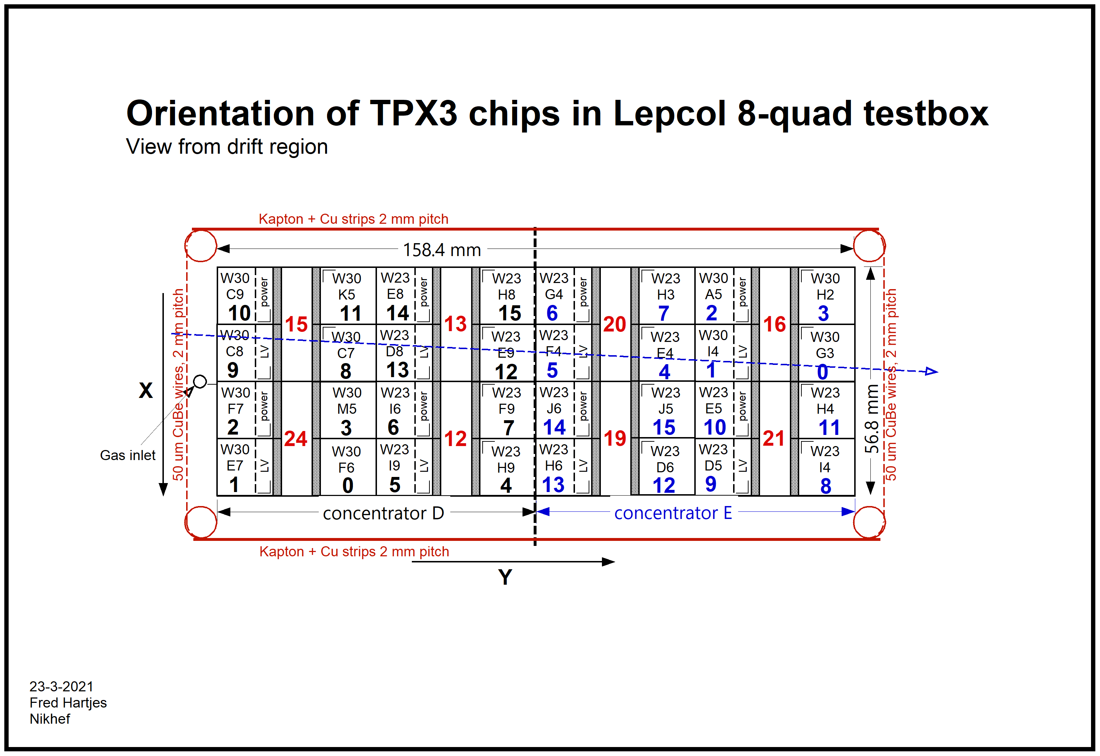
DESY testbeam Module Analysis

