Slide 1




Pixel TPC testbeam results
Yevgen Bilevych, Klaus Desch, Harry van der Graaf, Fred Hartjes, Jochen Kaminski, Peter Kluit, Naomi van der Kolk,
Cornelis Ligtenberg,
Gerhard Raven, and
Jan Timmermans
8 Quad Module
Lepton Collider 31 January 2022

Slide 2
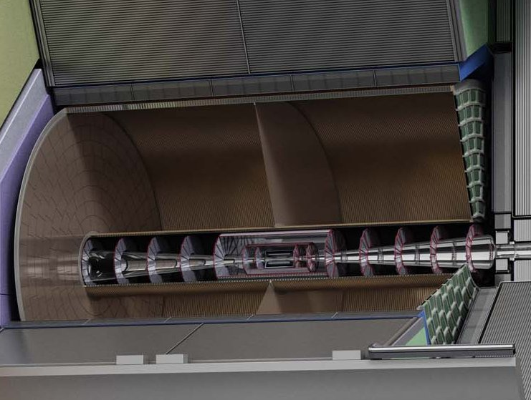


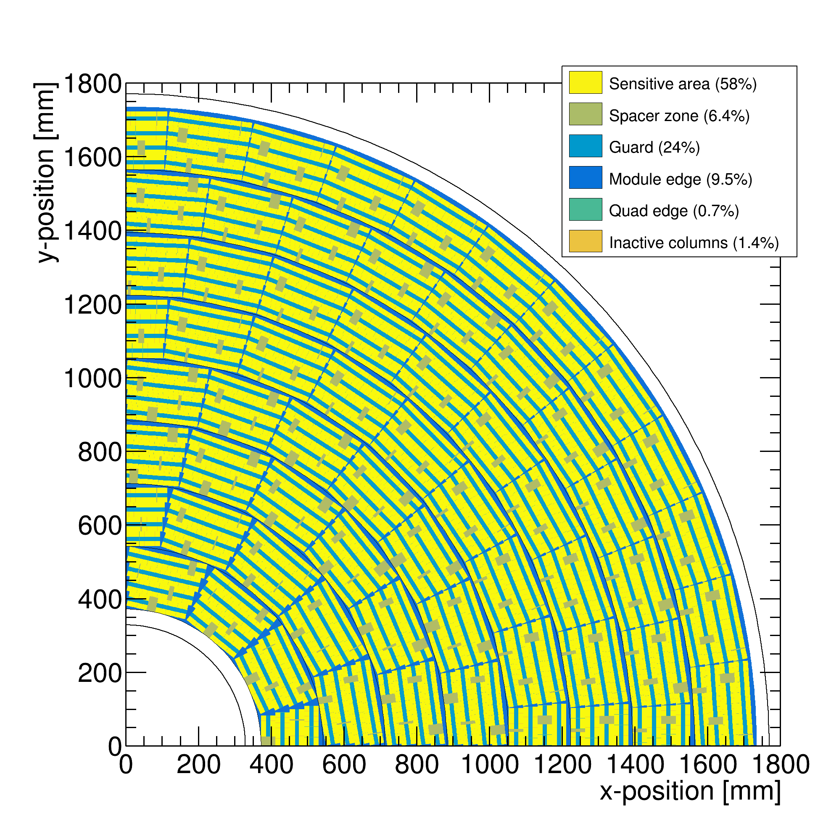

Pixel TPC
(Octopuce)
(TimePix1) TPX3 chip Quad Module TPC plane
(2007-14) 2017 2018 2019

Slide 3
DESY testbeam Module Analysis
Preliminary results for Run 6969-72 B=1 T p =6 GeV
Tracks are preselected using the Mimosa Telescope
Very loose matching with Telescope track
Alignment of the 8 quad module from B=0 run 6916:
  local frame xy and z (drift) positions; angles dx/dy and dz/dy
  Adjusted t0 and x per chip (no rotation inside module)
Time slewing applied using ToT:
  δt (ns)= 18.6/ (0.1577+ToT(μs))
Drift velocity (E=280 V/cm) 78 μm/ns
A local fit is performed to the track hits using errors:
  σ_{xy} = 180 μm and σ_{z} =450 μm (slight dependence on ToT)

Slide 4
DESY testbeam Module Analysis
Track fit with curvature q/p free
Track hits 657
χ²_{xy} = 315/654
χ²_{z} = 493/559
(with asymmetric tail and outlier removal applied)
x global
x local
z global
y local
z global
y global
z local drift
y local

Slide 5
DESY testbeam Module Analysis
Run 6969-72 B=1 T p =6 GeV
σ_{xy} = 180 μm and σ_{z} =450 μm (assigned error) 2.2 M hits
<mean> 4.9 mm

Slide 6
DESY testbeam Module Analysis
Run 6969-72 B=1 T p =6 GeV
One chip was disconnected
Neighbouring chip in x was masked. Can be recuperated but needs distortion correction.
Mix of 4 runs where the module was displaced in x (3) and z (1)
Beam has small angle wrt module

Slide 7
DESY testbeam Module Analysis
Run 6969-72 B=1 T p =6 GeV
Track selection:
more than 100 hits in concentrator 0 and 1
more than 50% of the hits should be on the tracks
outlier removal in xy applied
3694 selected tracks
large number 603 hits / track
module or tracklength 157.96 mm

Slide 8
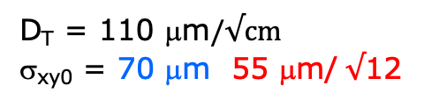
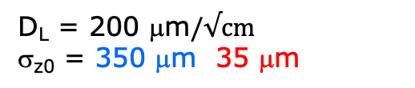
DESY testbeam Module Analysis
Run 6969-72 B=1 T p =6 GeV
D_{T} = 110 μm$/√cm$
σ_{xy0} = 70 μm 55 μm/ $√$12
D_{L} = 200 μm$/√cm$
σ_{z0} = 350 μm 35 μm
Fitted resolution in 1 mm slices with gaussian core
Not clear that the chip alignment inside the module in xy is (now) better than 50 μm.
NB we use all but two chips
The z resolution is larger than for the quad:
Could be due to the fact that we don’t use the silicon track
Or time jitter in the distribution of the clock; Or t0 calibration
B=1 T
ToT > 0.6 μs
z edges near 0 and 15 mm are biased in z (‘geometrical’ cuts)

Slide 9
DESY testbeam Module Analysis
Run 6969-72 B=1 T p =6 GeV
Tracking precision:
position 11 μm (xy) 20 μm (z)
angle 0.18 mrad (dx/dy) 0.43 mrad
module tracklength = 157.96 mm
The 1T B field reduces the diffusion and the tracking precision in xy is improved substantially

Slide 10
DESY testbeam Module Analysis
Run 6969-72 B=1 T p =6 GeV
Mean residuals xy over the module plane
Mean residuals z

Slide 11
DESY testbeam Module Analysis
Preliminary results for Run 6916-18 B=0T p =6 GeV
Tracks are preselected using the Mimosa Telescope
Very loose matching with Telescope track
Alignment of the 8 quad module from B=0 run 6916:
  local frame xy and z (drift) positions; angles dx/dy and dz/dy
  Adjusted t0 and x per chip (no rotation inside module)
Time slewing applied using ToT:
  δt (ns)= 18.6/ (0.1577+ToT(μs))
Drift velocity (E=280 V/cm) 78 μm/ns
A local fit is performed to the track hits using errors:
  σ_{xy} = 450 μm and σ_{z} =540 μm (slight dependence on ToT)

Slide 12
DESY testbeam Module Analysis
Track fit with curvature q/p free
Track hits 1046
χ²_{xy} = 412/1044
χ²_{z} = 687/979
(with asymmetric tail and outlier removal applied)
x global
x local
z global
y local
z global
y global
z local drift
y local

Slide 13
DESY testbeam Module Analysis
Run 6916-18 B=0 T p =6 GeV
σ_{xy} = 450 μm and σ_{z} =540 μm (assigned error) 2.5 M hits
<mean> 14 mm

Slide 14
DESY testbeam Module Analysis
Run 6916-18 B=0 T p =6 GeV
One chip was disconnected
Neighbouring chip in x was masked. Can be recuperated but needs distortion correction.
Mix of 3 runs where the module was displaced in z
Beam has small(er) angle wrt module

Slide 15
DESY testbeam Module Analysis
Run 6916-18 B=0 T p =6 GeV
Track selection:
more than 100 hits in concentrator 0 and 1
more than 50% of the hits should be on the tracks
outlier removal in xy applied
2853 selected tracks
large number 847 hits / track
module or tracklength 157.96 mm

Slide 16
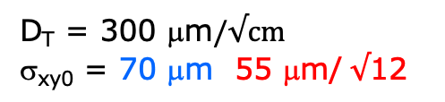

DESY testbeam Module Analysis
Run 6916-18 B=0 T p =6 GeV
D_{T} = 300 μm$/√cm$
σ_{xy0} = 70 μm 55 μm/ $√$12
D_{L} = 200 μm$/√cm$
σ_{z0} = 350 μm 35 μm
Fitted resolution in 1 mm slices with gaussian core
Not clear that the chip alignment inside the module in xy is (now) better than 50 μm.
NB we use all but two chips
The z resolution is larger than for the quad:
Could be due to the fact that we don’t use the silicon track
Or time jitter in the distribution of the clock; Or t0 calibration
B=0 T
ToT > 0.6 μs
z edges near 0,15,25,35 mm are biased in z (‘geometrical’ cuts)

Slide 17
DESY testbeam Module Analysis
Run 6916-18 B=0 T p =6 GeV
Tracking precision:
position 16 μm (xy) 20 μm (z)
angle 0.36 mrad (dx/dy) 0.43 mrad
module tracklength = 157.96 mm

Slide 18
DESY testbeam Module Analysis
Run 6916-18 B=0 T p =6 GeV
Mean residuals xy over the module plane
Mean residuals z

