Slide 1
Attribute Authority Operations Revisited
Completing the AARC G048bis process
David Groep
AARC Community Policy WG
EUGridPMA 54 meeting
2022-01-26

Slide 2
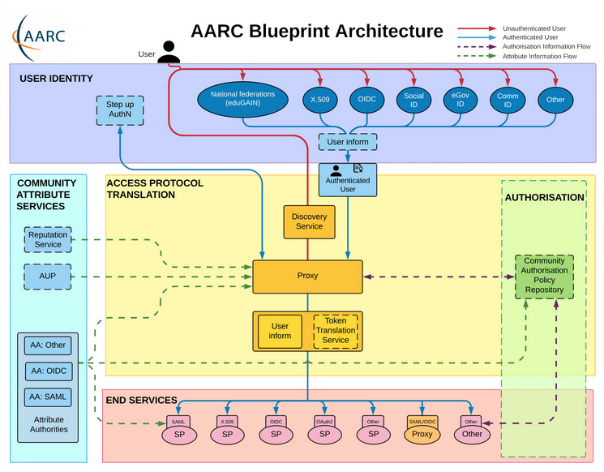
Operational guideline landscape for - proxy or source - AAI components
Authentication/identity sources
Sirtfi
(eduGAIN) baselining
IGTF AP Profiles
NIST SP800-63
eduGAIN sec. team workflow
MFA
RFC6238/4226
FIPS140
NISTSP800-53
Ephemeral credentials
trusted credential stores
protection at rest
Service provider operations
ISO27k
Sirtfi
Infrastructure response plans

Slide 3
Operational security focus in the BPA: beyond just the IdPs
Community membership management directories and attribute authorities
integrity of membership
identification, naming and traceability
site and service security
protection on the network
assertion integrity
Community membership management directories and attribute authorities
integrity of membership
identification, naming and traceability
site and service security
protection on the network
assertion integrity
Guidelines for Secure Operation of Attribute Authorities and other issuers of access-granting statements
(AARC-I048, in collaboration with IGTF AAOPS)

Slide 4
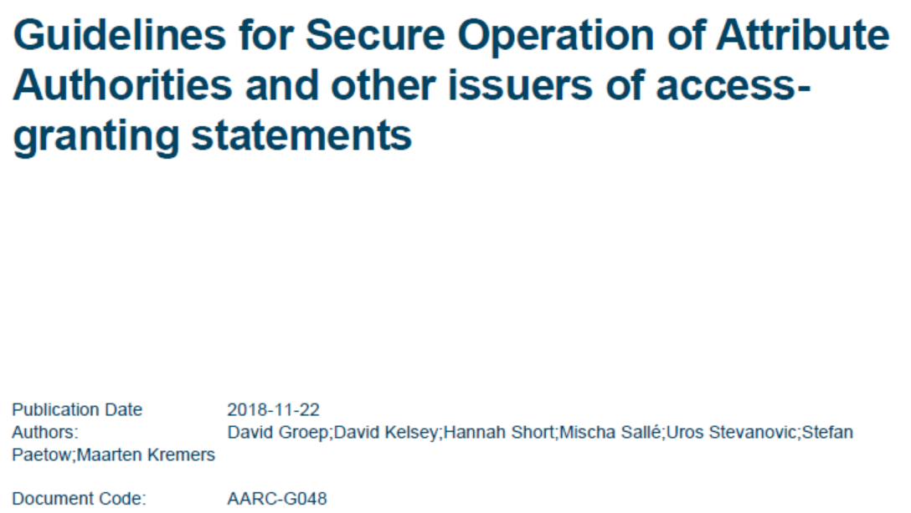
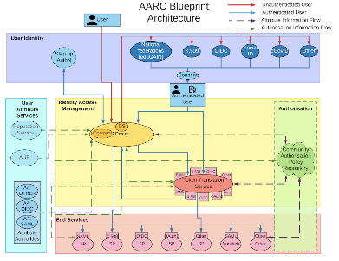
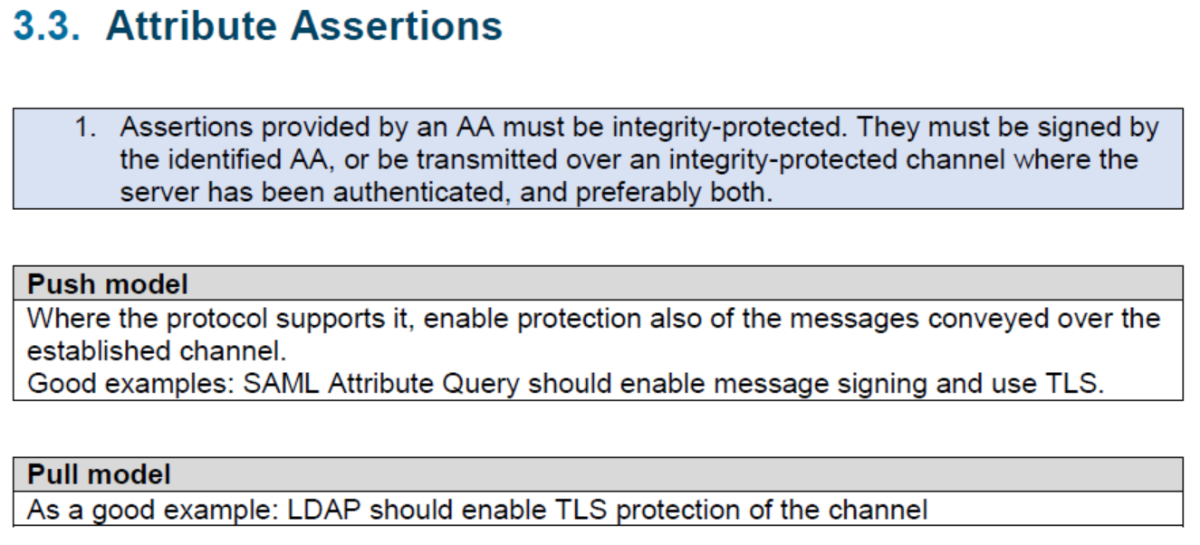
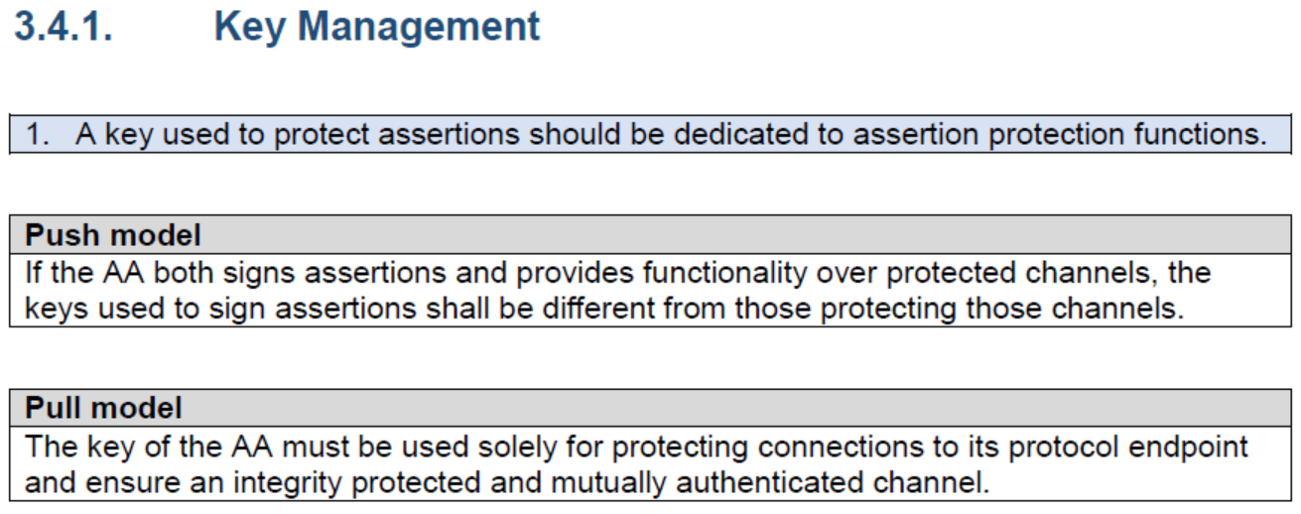
AARC-G048: keeping users & communities protected, moving across models
trusted delegation of response from communities to operators,
and from services to communities in recognizing their assertions
Structured around concept of “AA Operators”,
operating “Attribute Authorities” (technological entities),
on behalf of, one or more, Communities
`
https://www.igtf.net/guidelines/aaops/
https://aarc-community.org/guidelines/aarc-g048/
Notes:
And dwells also on naming since that is the unique hook for the service providers to actually track back persistently to the proper community as well as operator …

Slide 5
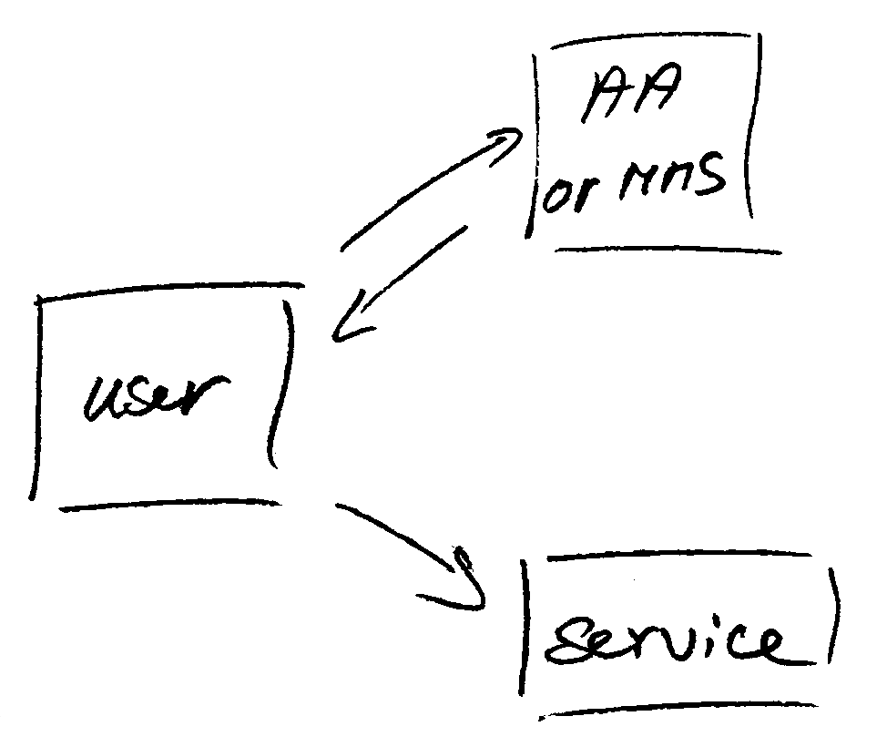
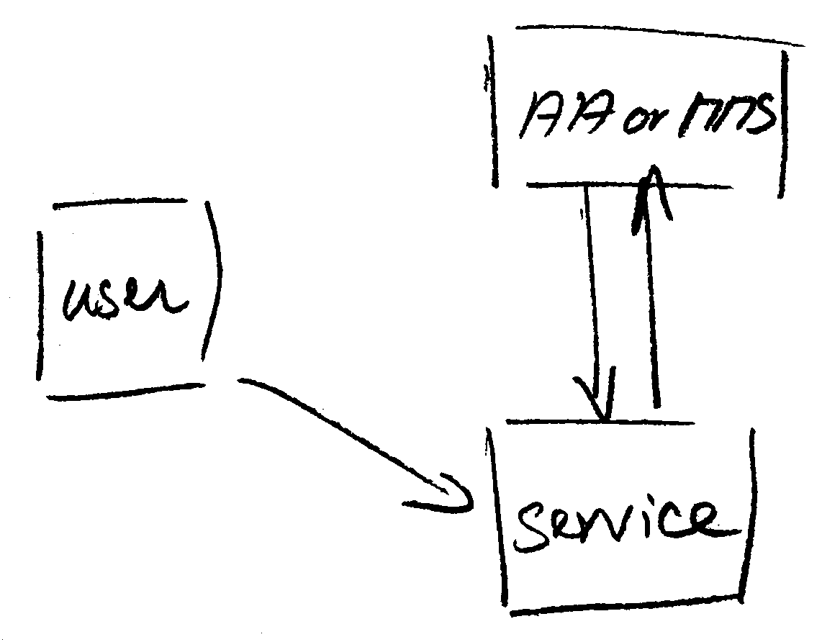
Protecting the community membership data and its proxy
Intentionally targeted broader than just BPA-style communities, since operational security spans data centres and infrastructures using other forms of AA membership management
push model – the common BPA method
(e.g. SAML AttributeStatement, VOMS AC)
pull model – common when using directories
(e.g. LDAP in PRACE, GUMS in OSG)
push and pull model diagrams as per RFC2904 – the 3rd (agent) model is uncommon in research/collaboration scenarios except for provisioning

Slide 6
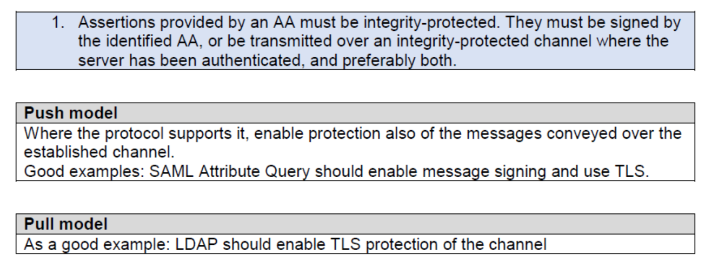
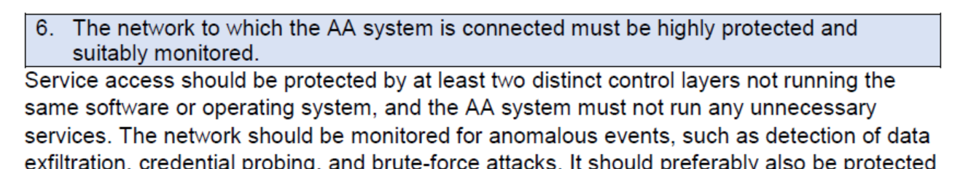
Deployment guidance included …

Slide 7
When the AA is in a managed environment …
Many of the recommendations are already implemented ‘implicitly’
because common software implements it: e.g. signing SAML assertions and JWTs
because a good data centre already has network monitoring and central logging in place
because you signed up to Sirtfi (didn’t you?) – so you collaborate in incident response
because you have trained IT operations personnel looking after the service
And some are intuitive best practice
like assigning a unique and lasting name to a group
because implemented controls follow ought to be those that have been documented
But some items contain specific values and recommendations that are good practice,
but where best practice varies among constituencies

Slide 8
Forward looking and specific requirements
Controls that are specific to AA operations and protect against current and future threats
minimum signing key length so that the community is not broken in the next few years (at least 112-bit symmetric, i.e. >=2048 bit RSA keys)
protect the key from data breaches, compromise, ransomware, and exfiltration by using HSM Hardware Security Modules or equivalent controls (and the HSMs you need are not that expensive, or you can even rent them in AWS…)
Or deal with commensurate incident response (you don’t want just a big red button):
re-issuance of attribute statement must be based on fresh data
release them only in accordance with the community’s policy and maximum life time
require appropriate client authentication before releasing attributes to prevent data breaches
for non-revocable tokens (like OAuth Access Tokens or PKIX 3820 proxies), limit life time <24hrs
(for OIDC, these are anyway typically 15 minutes)

Slide 9
Implementation of the AA Operations (“AAI proxy”) Security guidelines
AEGIS, major RPs, and Infrastructures reviewed it in light of their the
current (up-to-date) use cases and models
guideline should aim to fit both infrastructure and Community use cases, in any combination – independent of their ‘business relationships’
Useful input to the EOSC connected proxies as a good practice guideline
Our peer-review self-assessment model may be of specific value here
https://wiki.geant.org/x/-YVgBw
https://docs.google.com/document/d/1-hbqSpQegm7UaC_wupFzFMm19Q024UPkG-8Jwokkmzc
https://wiki.geant.org/display/AARC/Attribute+Authority+and+Proxy+operational+security

Slide 10
davidg@nikhef.nl

