Slide 1
GN4-3 - T&I - eScience Global Engagement
Maarten Kremers, SURF
EUGridPMA #52 / GN4-3 T&I EnCo / AARC Policy community
Virtual 26TH January 2022

Slide 2
GN 4-3 T&I Objectives
Expand the Reach of Federated Access
Operate T&I services
Develop and Enhance the T&I services
Explore new or disruptive ideas
Engage with the relevant stakeholders

Slide 3
Paul Dekkers
(SURF)
Davide Vaghetti
(GARR)
T&I Services
Christos Kanellopoulos (GÉANT)
Michelle Williams (GÉANT)

Slide 4
Incubator
Enabling Communities
T&I Services
Identity Feds
r/e-infras
EOSC
eGov
Operational Support

Slide 5
Enabling Communities

Slide 6
T&I Business Development Coordination
Facilitating of the AEGIS group
T&I eScience Global Engagement

Slide 7
AEGIS
The AARC Engagement Group for Infrastructures (AEGIS) brings together global representatives from AAI operators in research infrastructures and e-infrastructures, which are implementing authentication and authorisation services that support federated access, to discuss adoption of policy and technical best practices that facilitate interoperability across e-infrastructures ands e-infrastructures.

Slide 8
T&I eScience Global Engagement
The 'eScience Global Engagement' of EnCo in the GEANT project is there to support those developments in the policy and best practice areas that would benefit the community at large, and do that by means of supporting the work in the existing forums such as WISE, FIM4R, IGTF, REFEDS, AARC-community, and the research and e-Infra communities directly

Slide 9
T&I eScience Global Engagement
Full paper published
https://doi.org/10.22323/1.378.0029

Slide 10
T&I eScience Global Engagement
Guidance Doc
WISE SCI WG

Slide 11
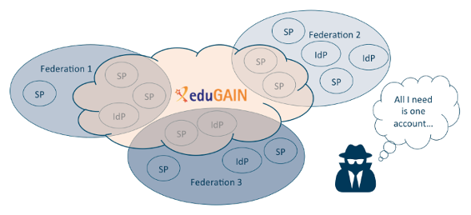
T&I eScience Global Engagement

Slide 12
T&I eScience Global Engagement
On the agenda
WISE SCI WG

Slide 13
T&I eScience Global Engagement
Work in Progress
On the agenda

Slide 14
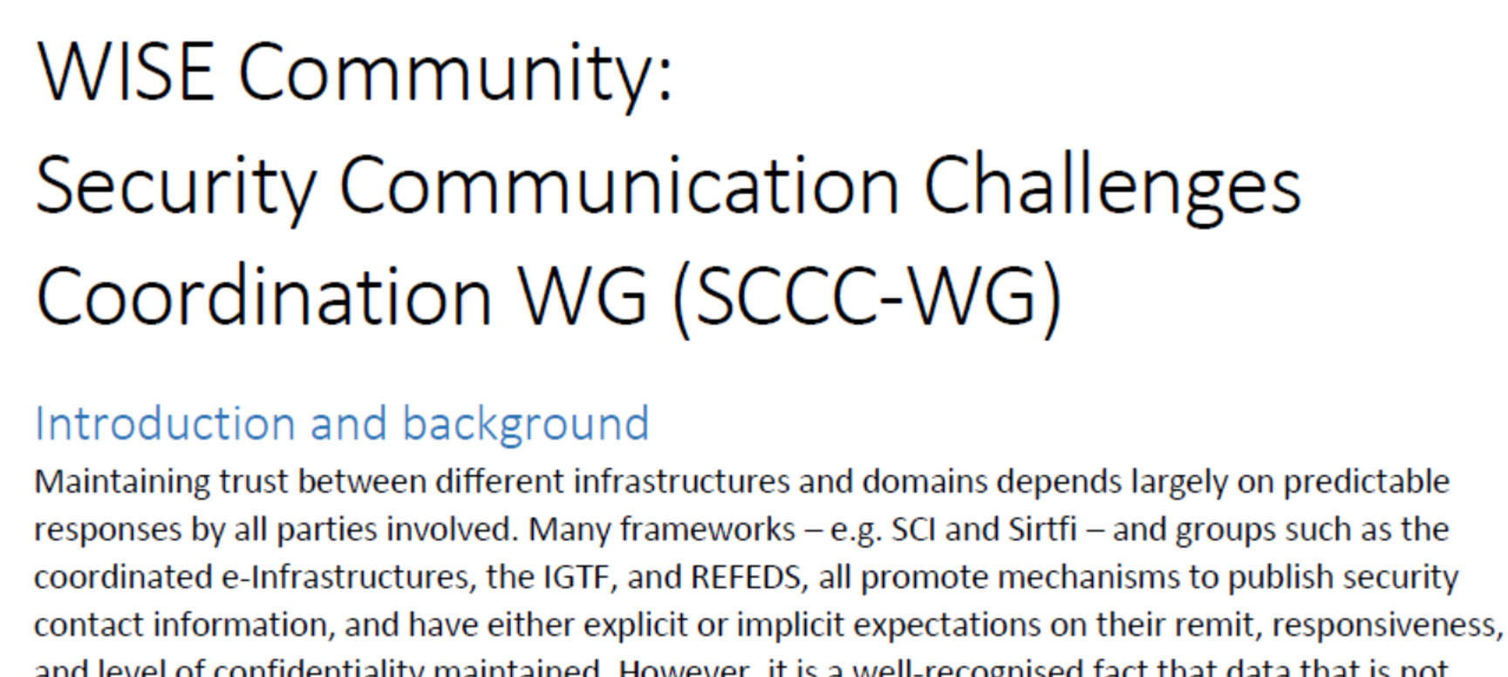
T&I eScience Global Engagement

Slide 15
T&I eScience Global Engagement

Slide 16
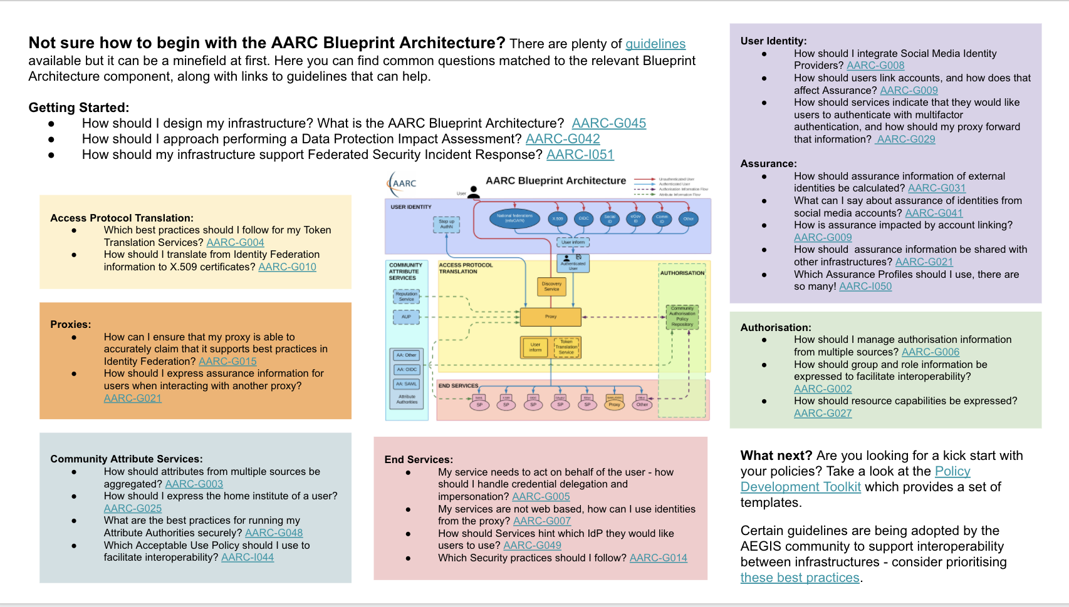
T&I Outreach
https://edu.nl/h3dm4

Slide 17
T&I eScience Global Engagement
GN4-3 Project Updates
EnCo Policy TNC22 Abstract got accepted!

Slide 18
T&I eScience Global Engagement
GN5-1 preparations

Slide 19
T&I eScience Global Engagement
Relevant meetings
TNC22 13^{th –} 16th June (Trieste, Italy)
REFEDS TBD
WISE & SIG ISM: Spring 2022 (date still to be defined)

Slide 20
T&I eScience Global Engagement
GN4-3 Project Updates
Review our own workplan
Activities that need or more less attention
New Activities
Activities to dropped
https://edu.nl/ctxxg

Slide 21
Thank you
Any questions?
maarten.kremers@surf.nl
As part of the GÉANT 2020 Framework Partnership Agreement (FPA), the project receives funding from the European Union's Horizon 2020 research and innovation programme under Grant Agreement No. 856726 (GN4-3).​​​

