Slide 1
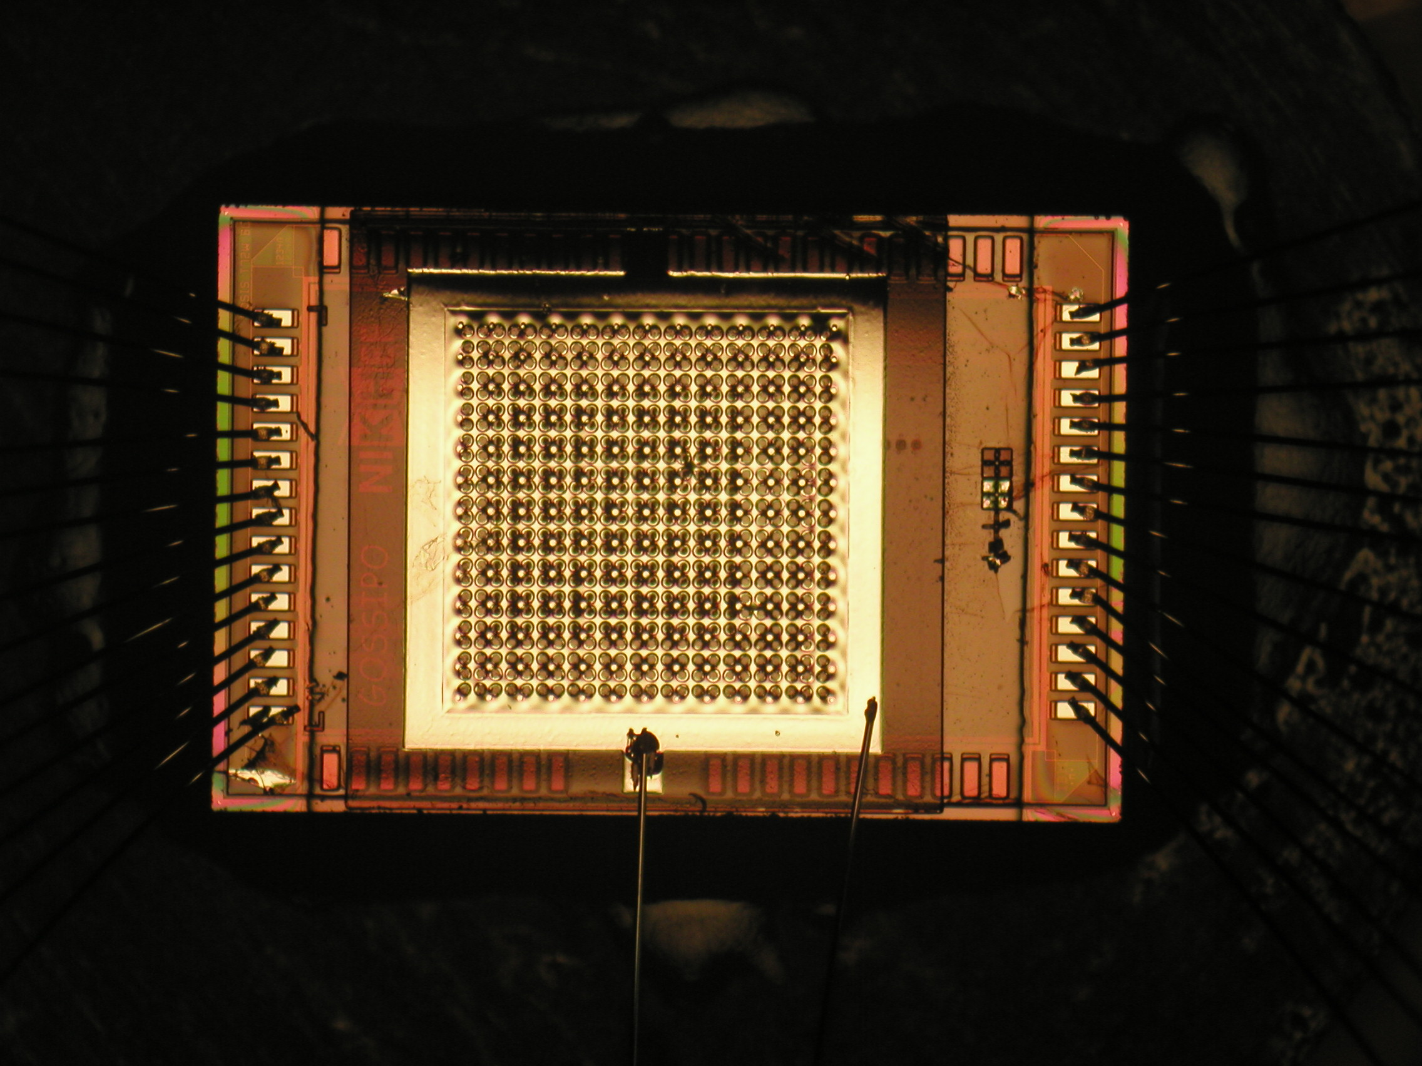
Gossipo-2 TPC gas volume of 1 µl

Slide 2
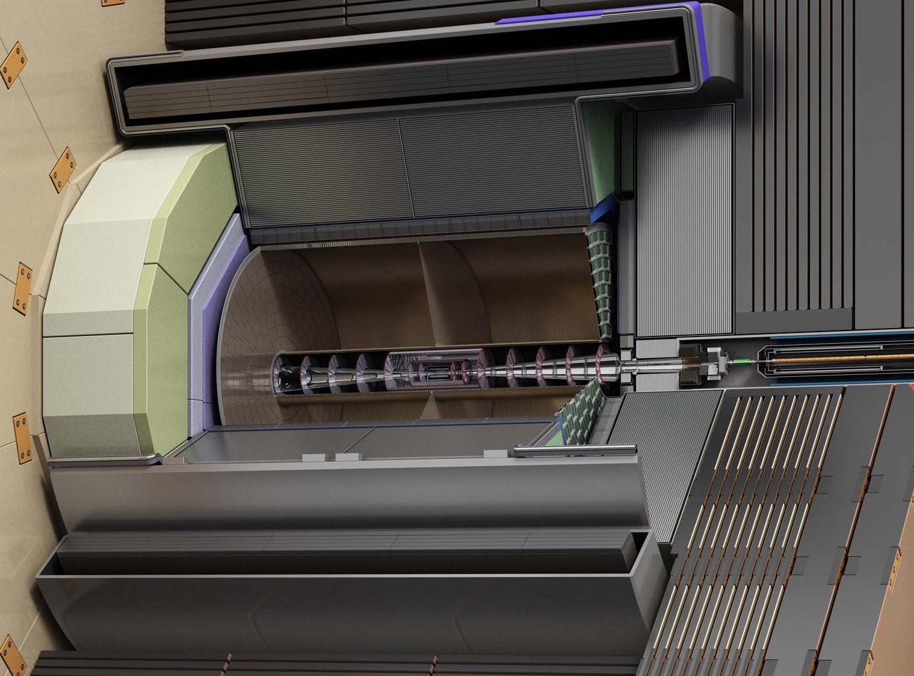
LepCol TPC gas volume of 2 x 14,000 l

Slide 3
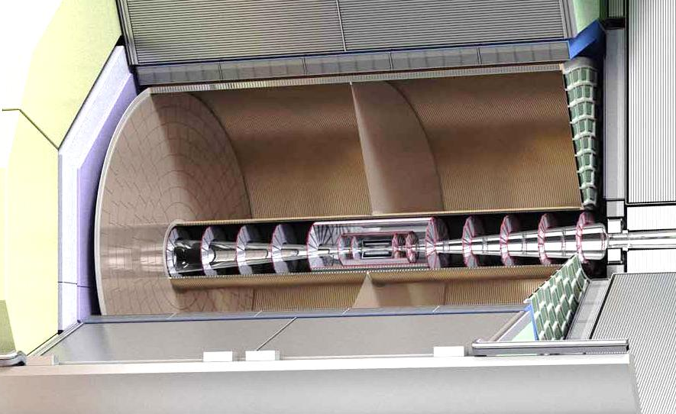
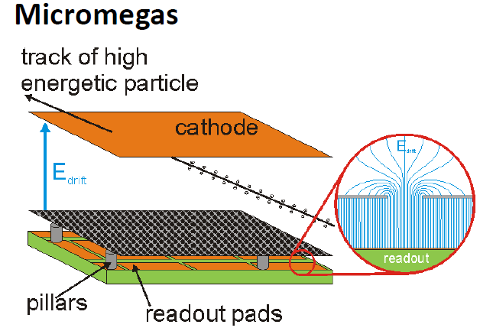
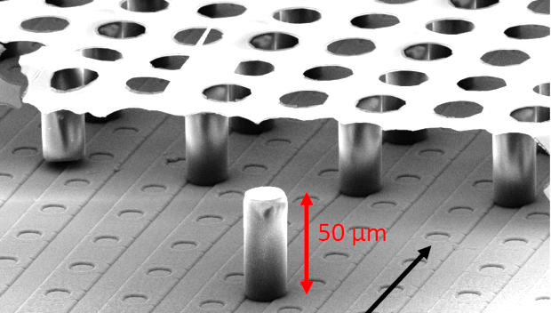


How to detect the particle trails?
4.5 m
X
3.0 m
Z
Y
Micromegas; GEMs; Micromegas/GEM
  Pickup pads 2 - 5 mm
  PCB technology
  GridPix technology - pickup pads 55 x 55 µm
  ASIC technology (pixel chip)
  Amplification grid (InGrid) produced by thin film technology
  Extremely fine granularity

Slide 4
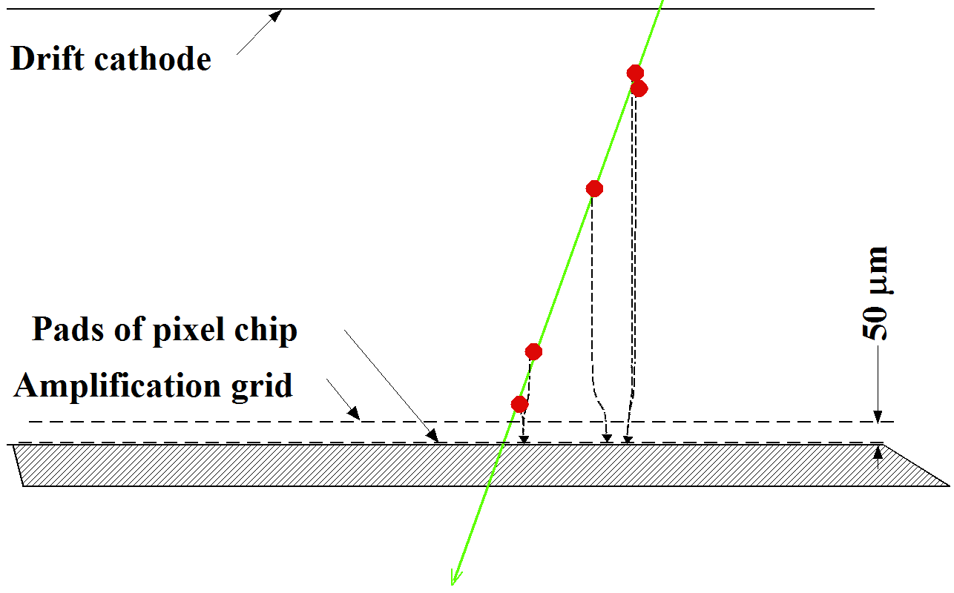
GridPix operation: detecting individual electrons
Reconstructing individual electrons in 3D
Ultimate position resolution for gaseous detectors
E
Pixel chip

Slide 5
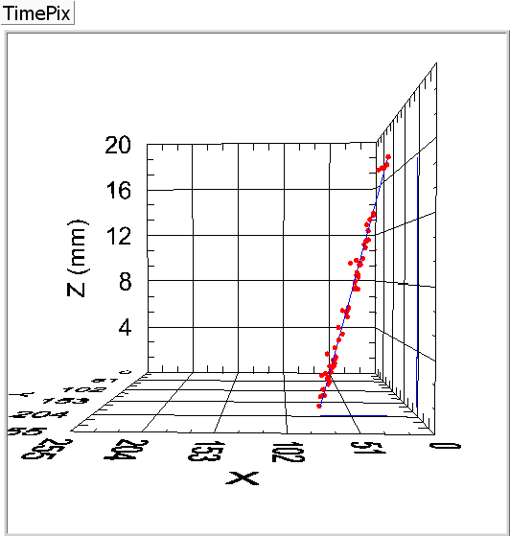
GridPix operation: example
Particle track

Slide 6
Precise tracking with GridPix in LepCol TPC
Reconstruction accuracy individual electron is limited
  40 – 400 µm @ 4 T
Position resolution of 60 cm long track
  ~6000 hits
  => extremely small statistical error
  => 0.5 - 5 µm in XY
  => in practise accuracy track segment will be dominated by systematics
4.5 m
X
B = 4T
3.6 m
Z
Y
Track

Slide 7
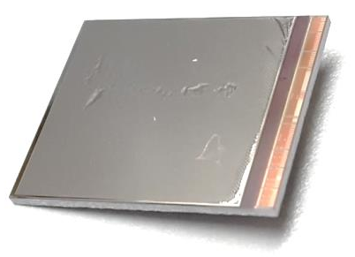
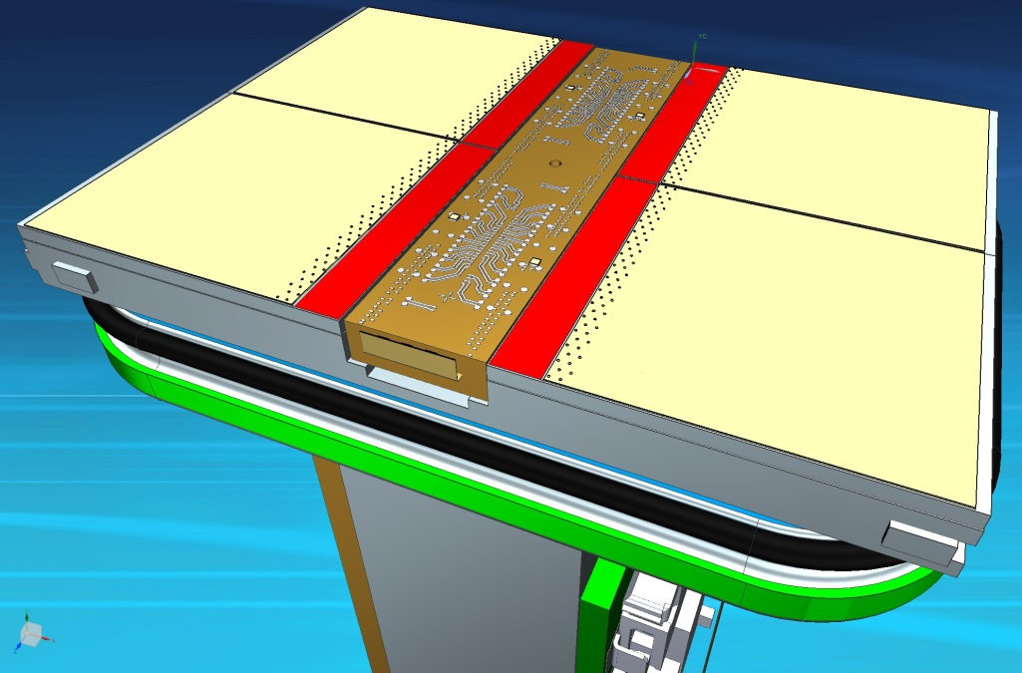
Realisation GridPix technology
GridPix chip
Designed at Nikhef in past 4 months
4 GridPix chips (TimePix-3) on one mechanical support
  Cooling and electrical connections
  28.38 x 39.6 mm²
All chips wire bonded to central interface board
QUAD building block

Slide 8
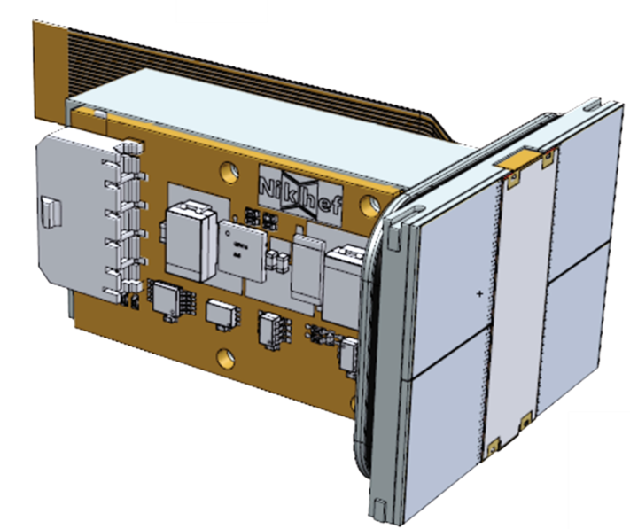
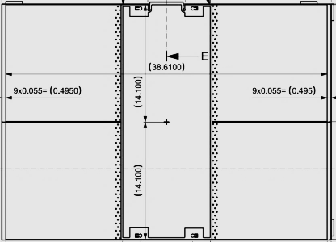

Building block
Unlimited surface may be covered
QUAD
Guard plate
Active area 69.1%

Slide 9
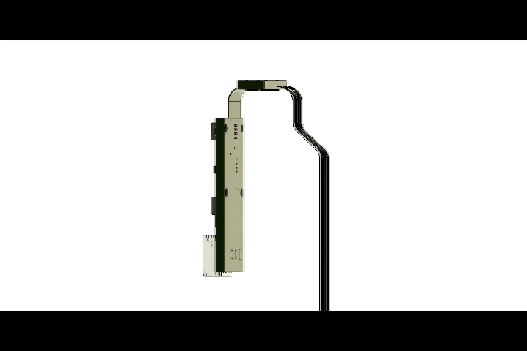
The heart of the QUAD
Two PCBs connected by flex
Fabricated as one item
No connectors

Slide 10
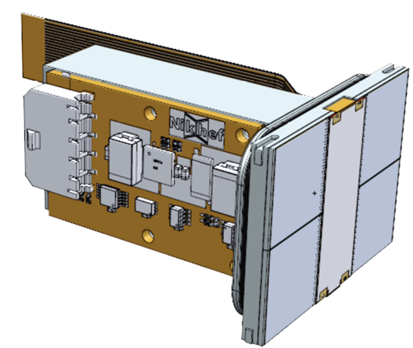
Conclusions/ summary
GridPix technology offers great benefits
  Detecting each individual electron
  Ultimate position resolution that can be achieved with a gaseous detector
  Much better dE/dx
After a long (almost) idle period the GridPix production is now successful
QUAD made from 4 TimePix-3 chips ready to make any size detector plane
  Hit rate up to 80 MHz can be achieved
Not only for LepCol
  Atlas L1 trigger layers
  Tracking for proton tomography
  …………
Generic
QUAD
Thank you!

