Slide 1
Vista25
Wouter Verkerke

Slide 2
Vista25/ATLAS - Big Picture questions
SM describes most of what we see – but leaves many open questions, as it doesn’t naturally explain all it describes
What is the origin of mass for fundamental particles?
Are there undiscovered principles of nature: new symmetries, new physical laws?
How can we solve the mystery of dark energy?
Are there extra dimensions of space?
Do all forces become one?
Why are there so many kinds of particles?
What is dark matter? How can we make it in the laboratory?
What are neutrinos telling us?
How did the universe come to be?
What happened to the antimatter?
From “The Quantum Universe”, HEPAP 2004
Many unsolved questions & puzzles → There surely is new physics! – But can we see & understand it?
1

Slide 3
Vista25/ATLAS - Big Picture questions
Two complementary approaches: Search for new fundamental particles, Measure properties of known particles
Measure
Search
Higgs, top
What is the origin of mass for fundamental particles?
Are there undiscovered principles of nature: new symmetries, new physical laws?
How can we solve the mystery of dark energy?
Are there extra dimensions of space?
Do all forces become one?
Why are there so many kinds of particles?
What is dark matter? How can we make it in the laboratory?
What are neutrinos telling us?
How did the universe come to be?
What happened to the antimatter?
H/A
SUSY/V’/Vlq
KK
Higgs
DM candidate
LFV decay
From “The Quantum Universe”, HEPAP 2004
Many unsolved questions & puzzles → There surely is new physics! – But can we see & understand it?
1

Slide 4
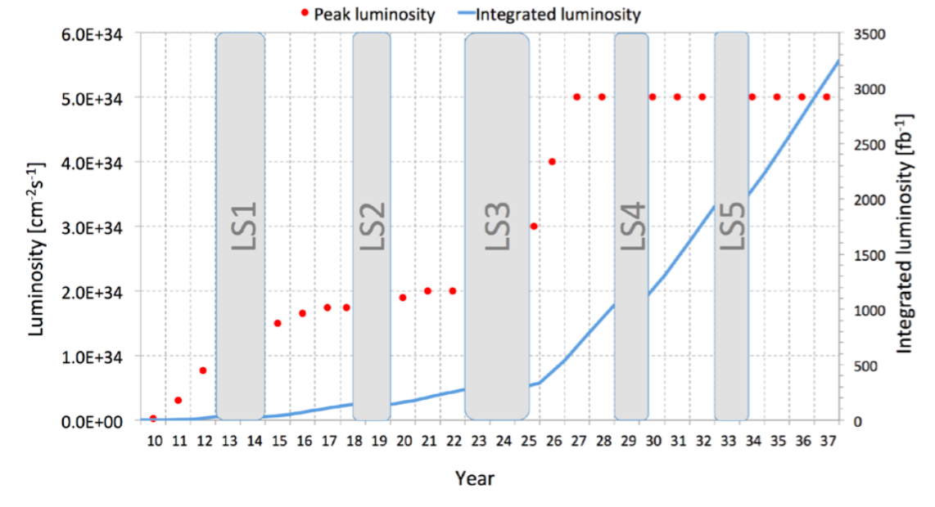
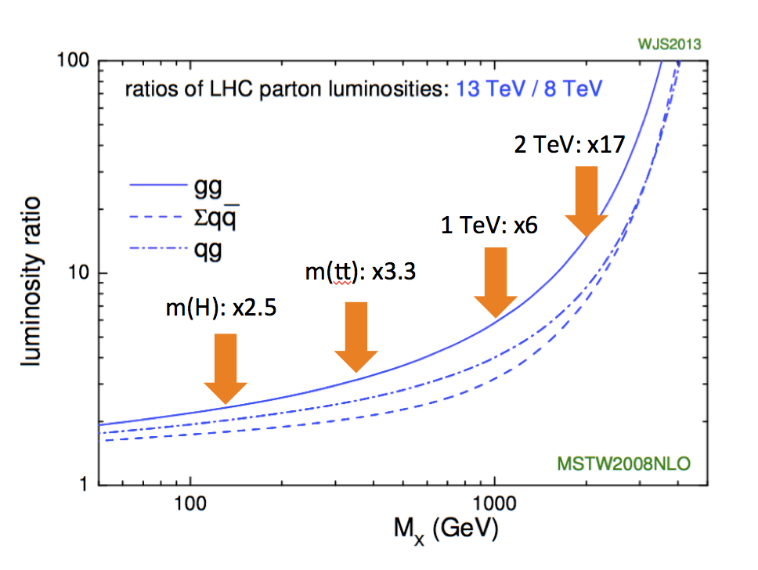
ATLAS and the LHC: now→2020→2025→2030
_
2020: 100 fb⁻¹ of 13 TeV data (#Higgs = 12x Run1, 80 million tt )
To address challenges at LHC: data rates, radiation, occupancy
2025: 300 fb⁻¹ of 13-14 TeV data (#Higgs = 37x Run1)
Contributions ATLAS upgrade New Muon Small wheels (LS2) New TDAQ system (LS2,3) New all-Si Inner tracker LS(3)
_
2030: 1000fb⁻¹ of 14 TeV data= (#Higgs = 125x Run1, 1 billion tt! )
2

Slide 5
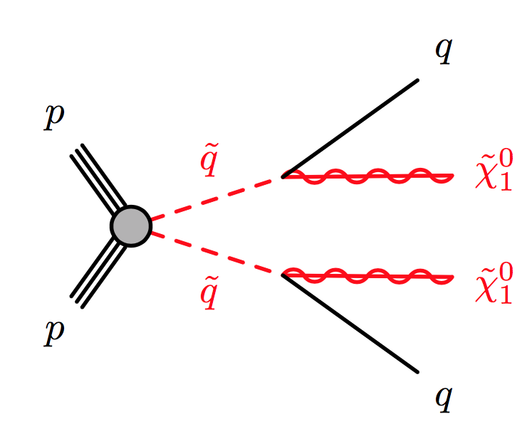
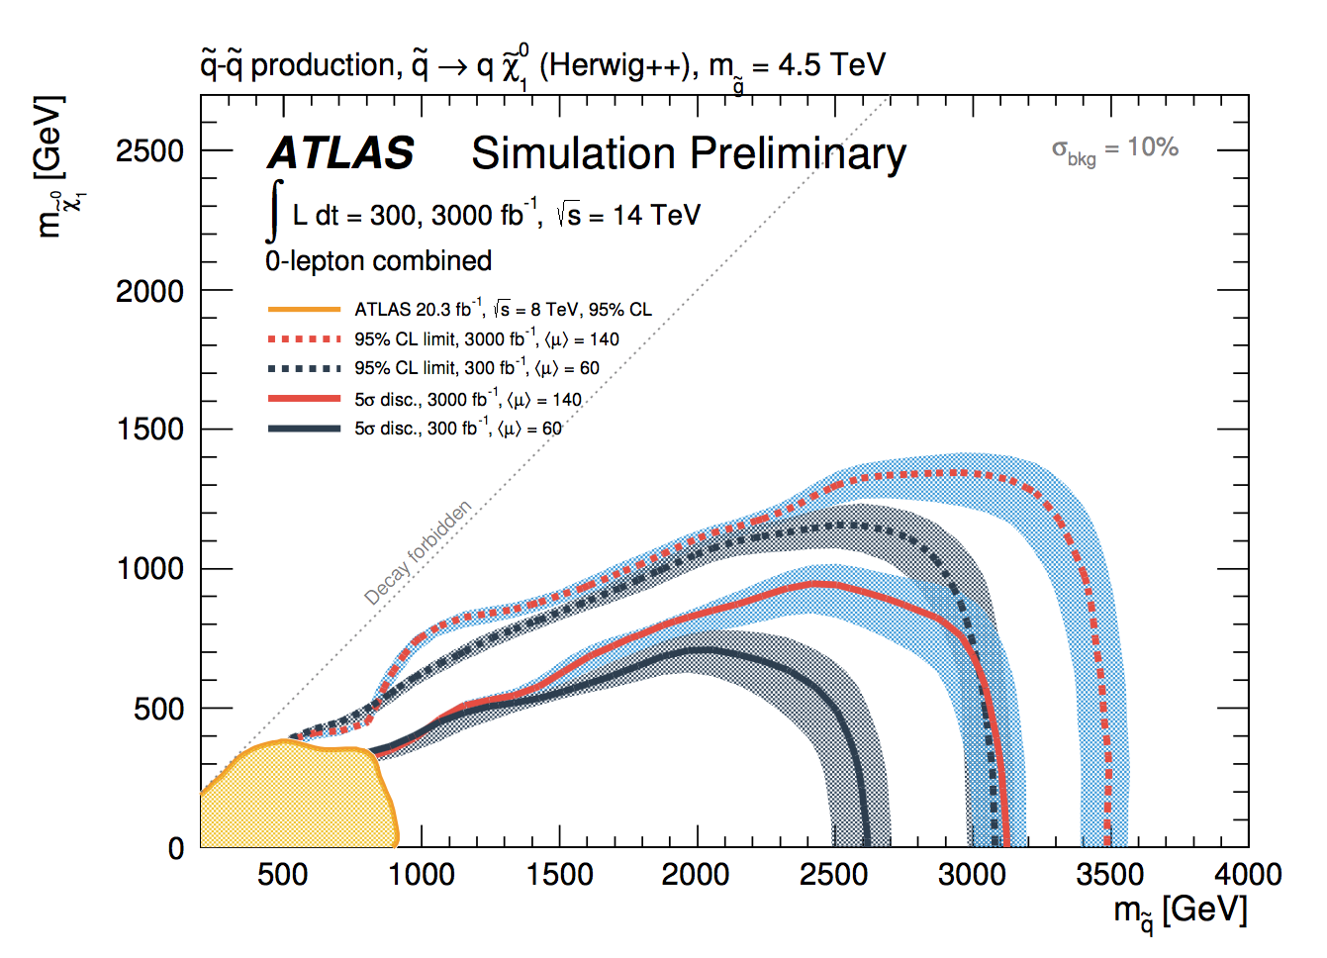
Searches 2020-2025-2030
Expertise in SuperSymmetry, Dark Matter Gen.Search
Establishing on-shell new fundamental particles is still the ‘holy grail’ of HEP experimental discoveries
Search for solution-motivated BSM theories: SUSY/DM/Higgs partners etc…
General searches for deviations in data (experimentally-driven)
What are most promising search strategies in 2020-2025-2030?
Strategy in early phase (now) – high-cross-section signatures
Discovery reach 2025
Discovery reach 2030
High cross-section → Early discovery
3

Slide 6
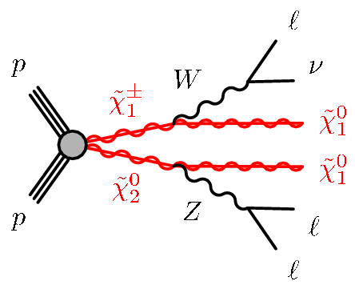
Searches 2020-2025-2030
Expertise in SuperSymmetry, Dark Matter Gen.Search
Establishing existing on-shell new fundamental particles is still the ‘holy grail’ of HEP experimental discoveries
Search for solution-motivated BSM theories: SUSY/DM/Higgs partners etc…
General searches for deviations in data (experimentally-driven)
What are most promising search strategies in 2020-2025-2030?
Strategy in later phase – low-section signatures
NB: Many BSM theories can realize NP (exclusively) in low cross-section processes w/o substantial fine-tuning
Example: electroweak SUSY production
Low cross-section → late discovery / late onset of limiting systematics
3

Slide 7
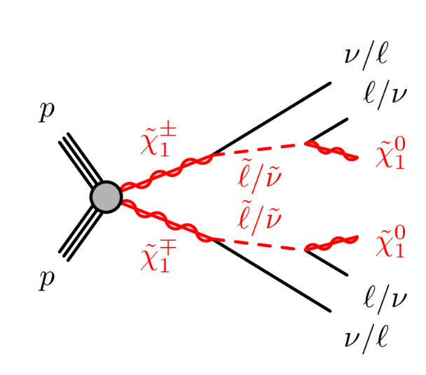
Searches 2020-2025-2030
Expertise in SuperSymmetry, Dark Matter Gen.Search
If no new (lower XS) signatures of BSM theories materialize searches will run ‘out of steam’ at some point
At some point exclusion limits preclude future discovery at 95% C.L
With current mix of high/low cross-section signatures for classical BSM searches for new particles (SUSY,DM,2HDM etc) will not run out of steam until about 2020
Moment of re-orientation around 2020 likely if nothing found.
However extremely low cross-section NP signatures not yet well investigated (since not very interesting right now).
May well extend life of meaningful searches for many years. Hard to say now
Expect theoretical progress on this in the next years.
New Physics may well (naturally) only manifest itself in low cross-section processes that we can’t see yet!
Aside from that – there is a whole world of visible but ‘difficult to reconstruct’ new physics signatures (long-lived particles, displaced vertices, R-parity violating SUSY)
Only investigated by a comparatively small community now
Establishing existing on-shell new fundamental particles is still the ‘holy grail’ of HEP experimental discoveries
Search for solution-motivated BSM theories: SUSY/DM/Higgs partners etc…
General searches for deviations in data (experimentally-driven)
What are most promising search strategies in 2020-2025-2030?
Strategy in later phase – low-section signatures
NB: Many BSM theories can realize NP (exclusively) in low cross-section processes w/o substantial fine-tuning
Example: electroweakly produced SUSY
Low cross-section = late discovery / late onset of limiting systematics
3

Slide 8
Precision measurements 2020-2025-2030
New physics can also manifest itself in other forms
Fundamental particles turn out to be composites (Higgs, leptons, quarks)
Very massive new particles can affect precision observables through loops
Properties of known particles are significantly different from SM (works best for particles with stringent SM predictions)
The Higgs sector of nature is both the most interesting and the least tested → The Higgs sector needs stress-testing
Is Higgs fundamental or composite?
If fundamental, is it minimal (or 2HDM, EWS etc…)?
Are Yukawa couplings responsible for masses of all generations?
Is the potential really φ⁴?
Is Higgs a portal to new physics?
4

Slide 9
Precision measurements 2020-2025-2030
New physics can also manifest itself in other forms
Fundamental particles turn out to be composites (Higgs, leptons, quarks)
Very massive new particles can affect precision observables through loops
Properties of known particles are significantly different from SM (works best for particles with stringent SM predictions)
The Higgs sector of nature is both the most interesting and the least tested → The Higgs sector is not yet well measured
Couplings to W,Z and 3rd gen fermions measured to 10-20%. We’re assuming SM kinematics and (mostly) measuring rate changes only. Top quark coupling effectively probed through loops only
But many Higgs couplings are experimentally accessible (now W,Z,t,b,τ,(γ,g) later μ,c,h). This is an unexpected treasure! (Life would very different at m(H)=160) → Theoretical framework for (precision) measurements still very much in development.
So far mostly probing Higgs rate deviations, not looking at distributions (i.e. assuming SM kinematic and SM tensor structure of Higgs couplings)
Goal: increasing precision in Higgs couplings → increase reach in scale Λ of new physics (1% precision probes Λ≈2.5 TeV)
4

Slide 10
Precision measurements 2020-2025-2030
Expertise in WW,ZZ,ttH combined fitting & EFT/BSM modeling
New physics can also manifest itself in other forms
Fundamental particles turn out to be composites (Higgs, leptons, quarks)
Properties of known particles are significantly different from SM (works best for particles with stringent SM predictions)
The Higgs sector of nature is both the most interesting and the least tested → The Higgs sector is not yet well measured
Couplings to W,Z and 3rd gen fermions measured to 10-20%. We’re assuming SM kinematics and (mostly) measuring rate changes only.
But many Higgs couplings are experimentally accessible (now W,Z,t,b,τ,(γ,g) later μ,c,h). This is an unexpected treasure! (Life would very different at m(H)=160) → Theoretical framework for potential (precision) measurements still very much in development.
So far mostly probing Higgs rate deviations, not looking at distributions (i.e. assuming SM kinematic and SM tensor structure of Higgs couplings)
Systematic uncertainties not (strongly) dominating for most Higgs couplings at 300 fb-1 (=year 2025), expect steady incremental improvements in the next years
New in Run-2: Yukawa couplings to 2nd generation (H→μμ) Tree-level access to top quark coupling (ttH)
I expect ATLAS will significantly outperform ‘official’ predictions because these assume current expt. systematics and assume Higgs rate measurement only.
Offshell and high-Q high production are very sensitive to NP (e.g. 15% precision at Q=1TeV also probes Λ=2.5 TeV)
Fit for tensor structure of couplings adds significant information e.g. single channel VBF → h → μμ can constrain 15 parameters of an Dim(6) EFT theory using shape info (vs. 3 params with rates)
Also watch for non-linear progress due to theory developments: E.g. Precision of Γ_{H} with off-shell technique at MeV level (vs GeV for direct)
4

Slide 11
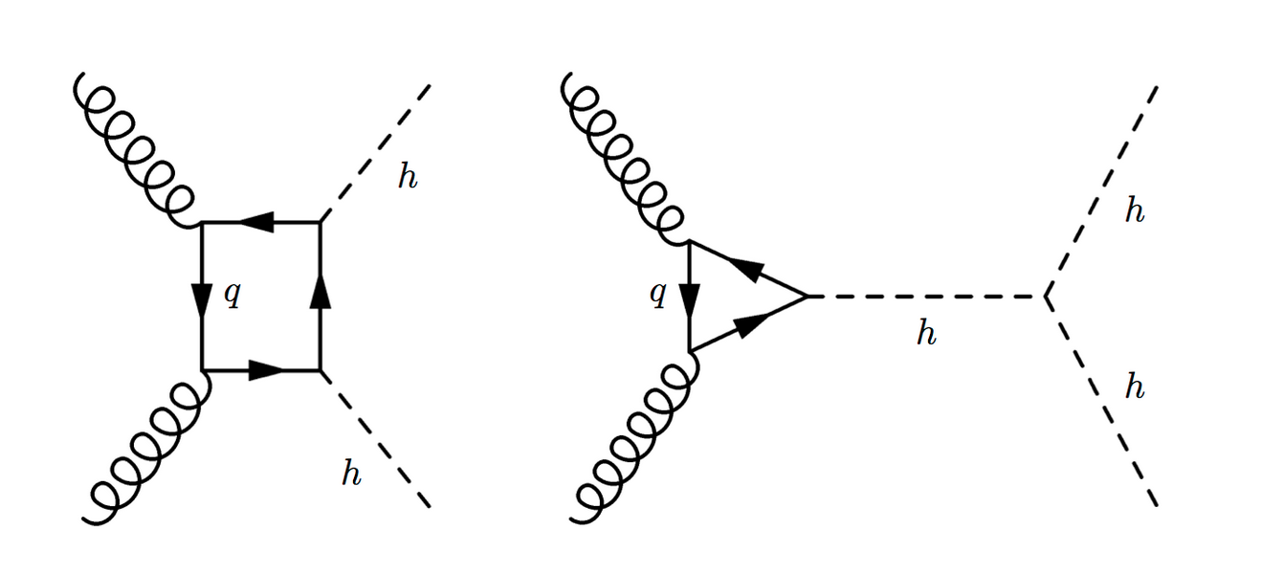
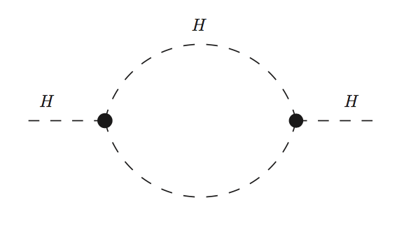
Precision measurements 2020-2025-2030
Expertise in diHiggs
New physics can also manifest itself in other forms
Fundamental particles turn out to be composites (Higgs, leptons, quarks)
Properties of known particles are significantly different from SM (works best for particles with stringent SM predictions)
The Higgs sector of nature is both the most interesting and the least tested → The Higgs sector is not yet well measured
Couplings to W,Z and 3rd gen fermions measured to 10-20%. We’re assuming SM kinematics and (mostly) measuring rate changes only.
But many Higgs couplings are experimentally accessible (now W,Z,t,b,τ,(γ,g) later μ,c,h). This is an unexpected treasure! (Life would very different at m(H)=160) → Theoretical framework for potential (precision) measurements still very much in development.
So far mostly probing Higgs rate deviations, not looking at distributions (i.e. assuming SM kinematic and SM tensor structure of Higgs couplings)
On the very long-term (3000 fb⁻¹) systematics will limit many Higgs coupling measurements. But situation may be different when considering Higgs distributions and offshell/high-Q Higgs.
Unknown at this point, requires more study
Ultimately constraints on Higgs self-coupling may become in reach of the LHC. Crucial tool to probe shape of Higgs potential. Very challenging, but also here many ideas that may improve situation
Traditional approach (di-Higgs production) hampered by tiny cross-section due to destructive interference
But Higgs-self coupling also affect all Higgs propagators in ‘vanilla’ single Higgs production → Improved analysis of single Higgs production may yield comparable sensitivity to di-Higgs approach
Also watch here for non-linear progress due to new analysis ideas
4

Slide 12
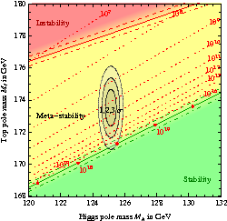
Precision measurements 2020-2025-2030
New physics can also manifest itself in other forms
Fundamental particles turn out to be composites (Higgs, leptons, quarks)
Very massive new particles can affect precision observables through loops
Properties of known particles are significantly different from SM (works best for particles with stringent SM predictions)
Ultra abundant top quarks provide other interesting measurement opportunities: expect 100M (2020) to 1B (2030) top quark pairs
Completely different analysis game → Even a selection of 0.1% of events gives sample for statistically ultra-precise measurement
‘Ultimate top quark mass measurement’ with precision of 200 MeV may be in reach
Higgs (mass) and top (mass) strongly connected in SM (vacuum stability of universe). Top mass precision is limiting factor
Can test top coupling tensor structure (Wtb vertex) at unprecedented precision
Can probe various FCNC top-quark decays at unprecedented precision
Expertise in top reconstruction top theory, LFV
4

