Slide 1
ALICE
Groningen 12 December 2016

Slide 2
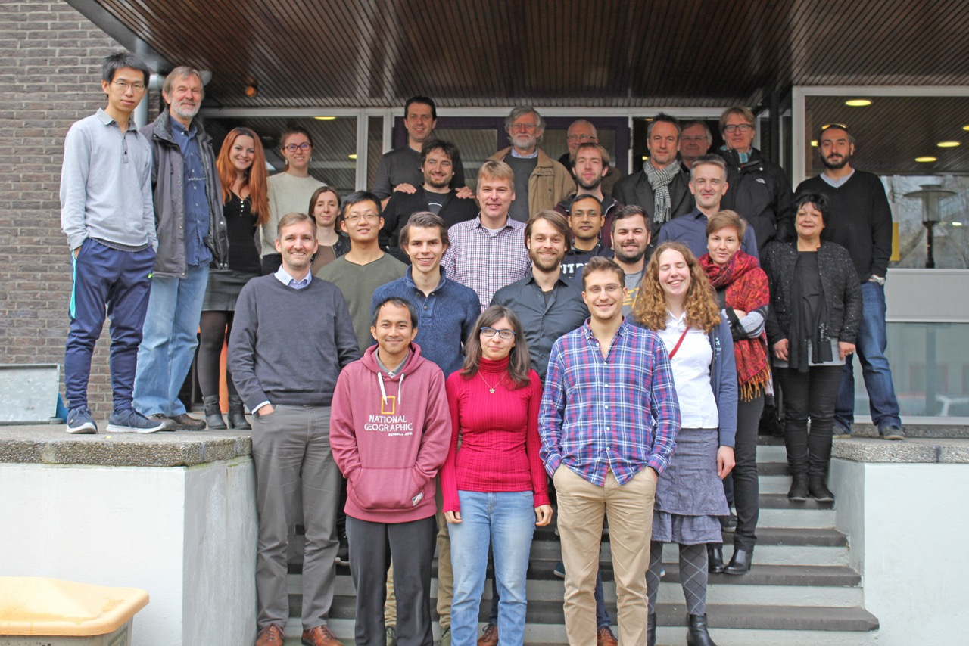
The Quark Gluon Plasma
ALICE
Group composition
  7 staff
  4 postdocs
  18 PhD students
  Visiting professor
  Humboldt fellow
Funding
  Nikhef
  UU
  CERN (doctoral programme)
  China (students)
  Collaborative grant with Nantes
  LHC FOM up to 2021 (since 2013)
  NWO BIG hardware (2014)
  2 VICI
  VIDI
  Collaboration with Sao Paulo (PhDs)
  COST network (EU)
  3 Projectruimte
Strong position in ALICE
  Management board
  (sub) detector project leader
  Physics coordinator
  Physics working group conveners
  Physics analysis group convenor
  Editorial board members
  Primary authors many papers
  ALICE thesis award

Slide 3

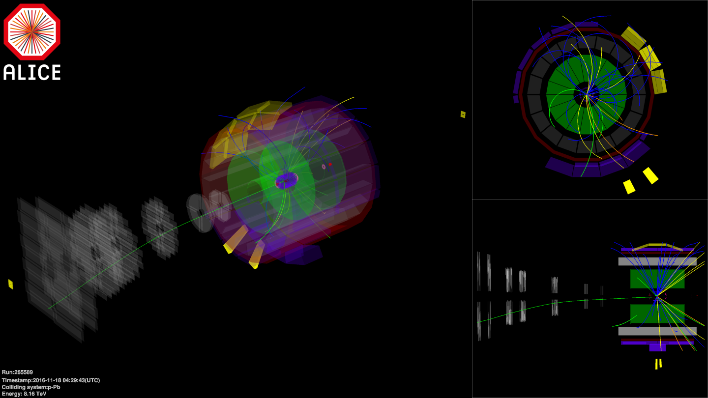
Run II 2016
pp
pPb @ 5.02 TeV
  Reference for 2015 PbPb
  765M events = 7x previous recorded
pPb @ 8.16 TeV high luminosity (rare triggers)
  Charmonia in forward direction
  Mostly ITS, PHOS and muon spectrometer
  12.4 nb⁻¹ pPb / Pbp

Slide 4
Physics
Study of nuclear matter under extreme conditions
Experiments require many observables
  Bulk observables (correlations, flow) – viscosity,…
  Jets and heavy quarks – penetrating the medium
  Electromagnetic probes – escape with little interaction
  Thermal di-leptons
Require different systems pp, pPb, PbPb
  Disentangle different processes
  Surprising similarities found also!
Calculations
  Numerical QCD (lattice QCD)
  AdS/CFT
  Needs many ingredients
    Initial state
    Hydrodynamics - evolution
    pQCD – energy loss
    hadronisation
Our contributions for today:
  Alberto Caliva
  Naghmeh Mohammadi
More on context and future
  Raimond Snellings

Slide 5
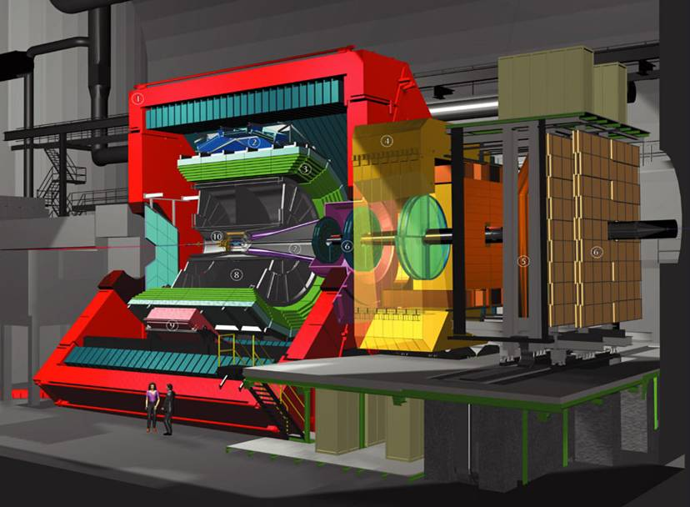
Precision (low p_{T}) and speed
Improve S/B → depends on ITS
  Beampipe with smaller diameter
  Smaller pixel size for inner layers ITS
  Less material in inner layers ITS
  Optimize number of layers ITS
Improve statistics → All tracking and PID faster
  Continuous read-out TPC
  Faster electronics TRD, TOF, PHOS, MUON
  Improve forward trigger detectors
  Faster ITS (replace SDD+SSD)

Slide 6
ITS hardware goals
All layers in MAPS technology
First layer at 22 mm from interaction
  now 39 mm
First layers material budget 0.3 %X0 (
  now 1.14 %X0
  Outer layers stay at ~0.8 %X0
First layer pixel size 20x20 um
  Now 50x200 um
  Outer layers could be larger but may use same chips
Integration time ~ 20 us continuous read-out
  Collision rates 50 kHz PbPb or 200 kHz pp
  Now limited by SDD (busy 1 ms) and SSD (busy 0.25 ms)

Slide 7
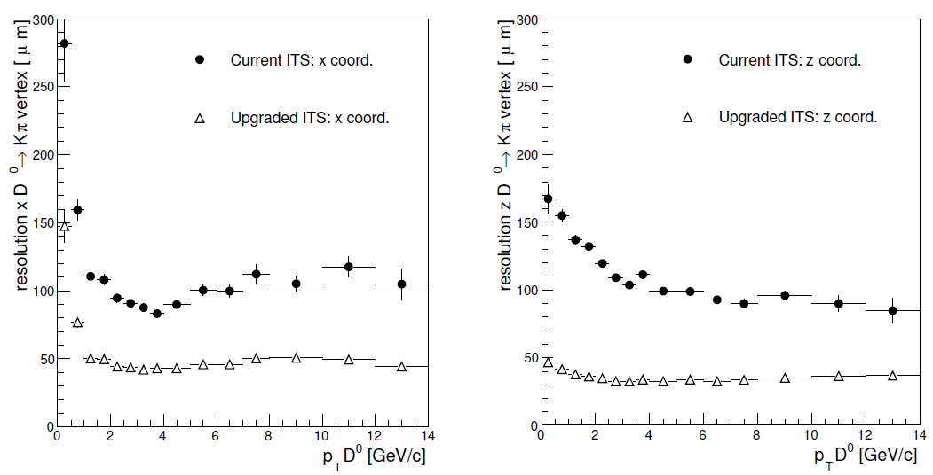
ITS upgrade
Improve spatial resolution on vertex by factor 2
Enable ALICE to get two orders of magnitude more data after LS2

Slide 8
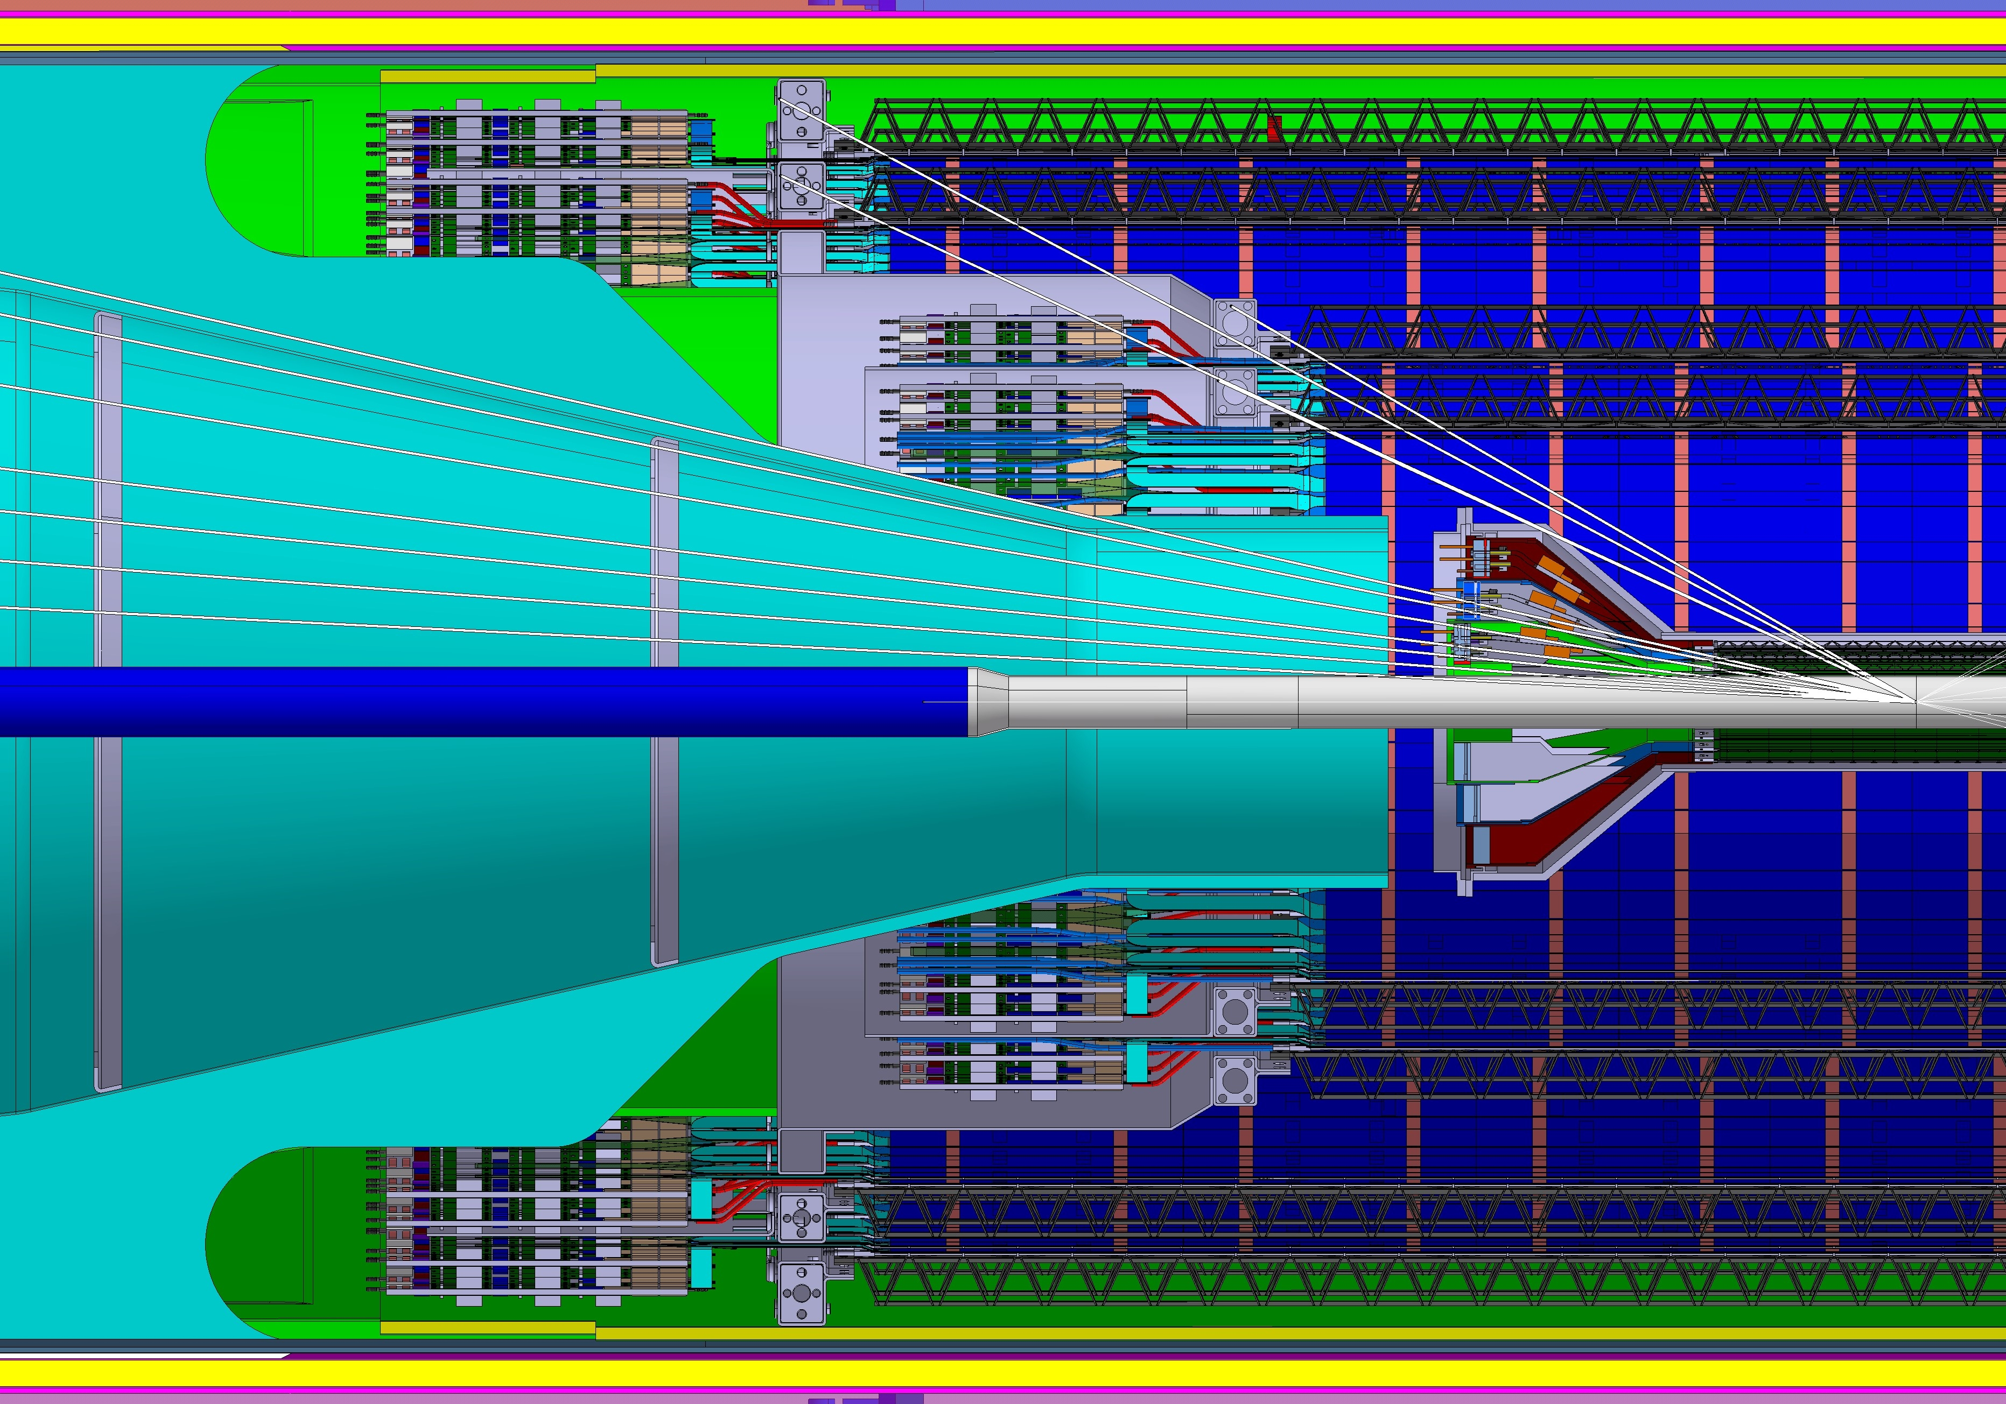
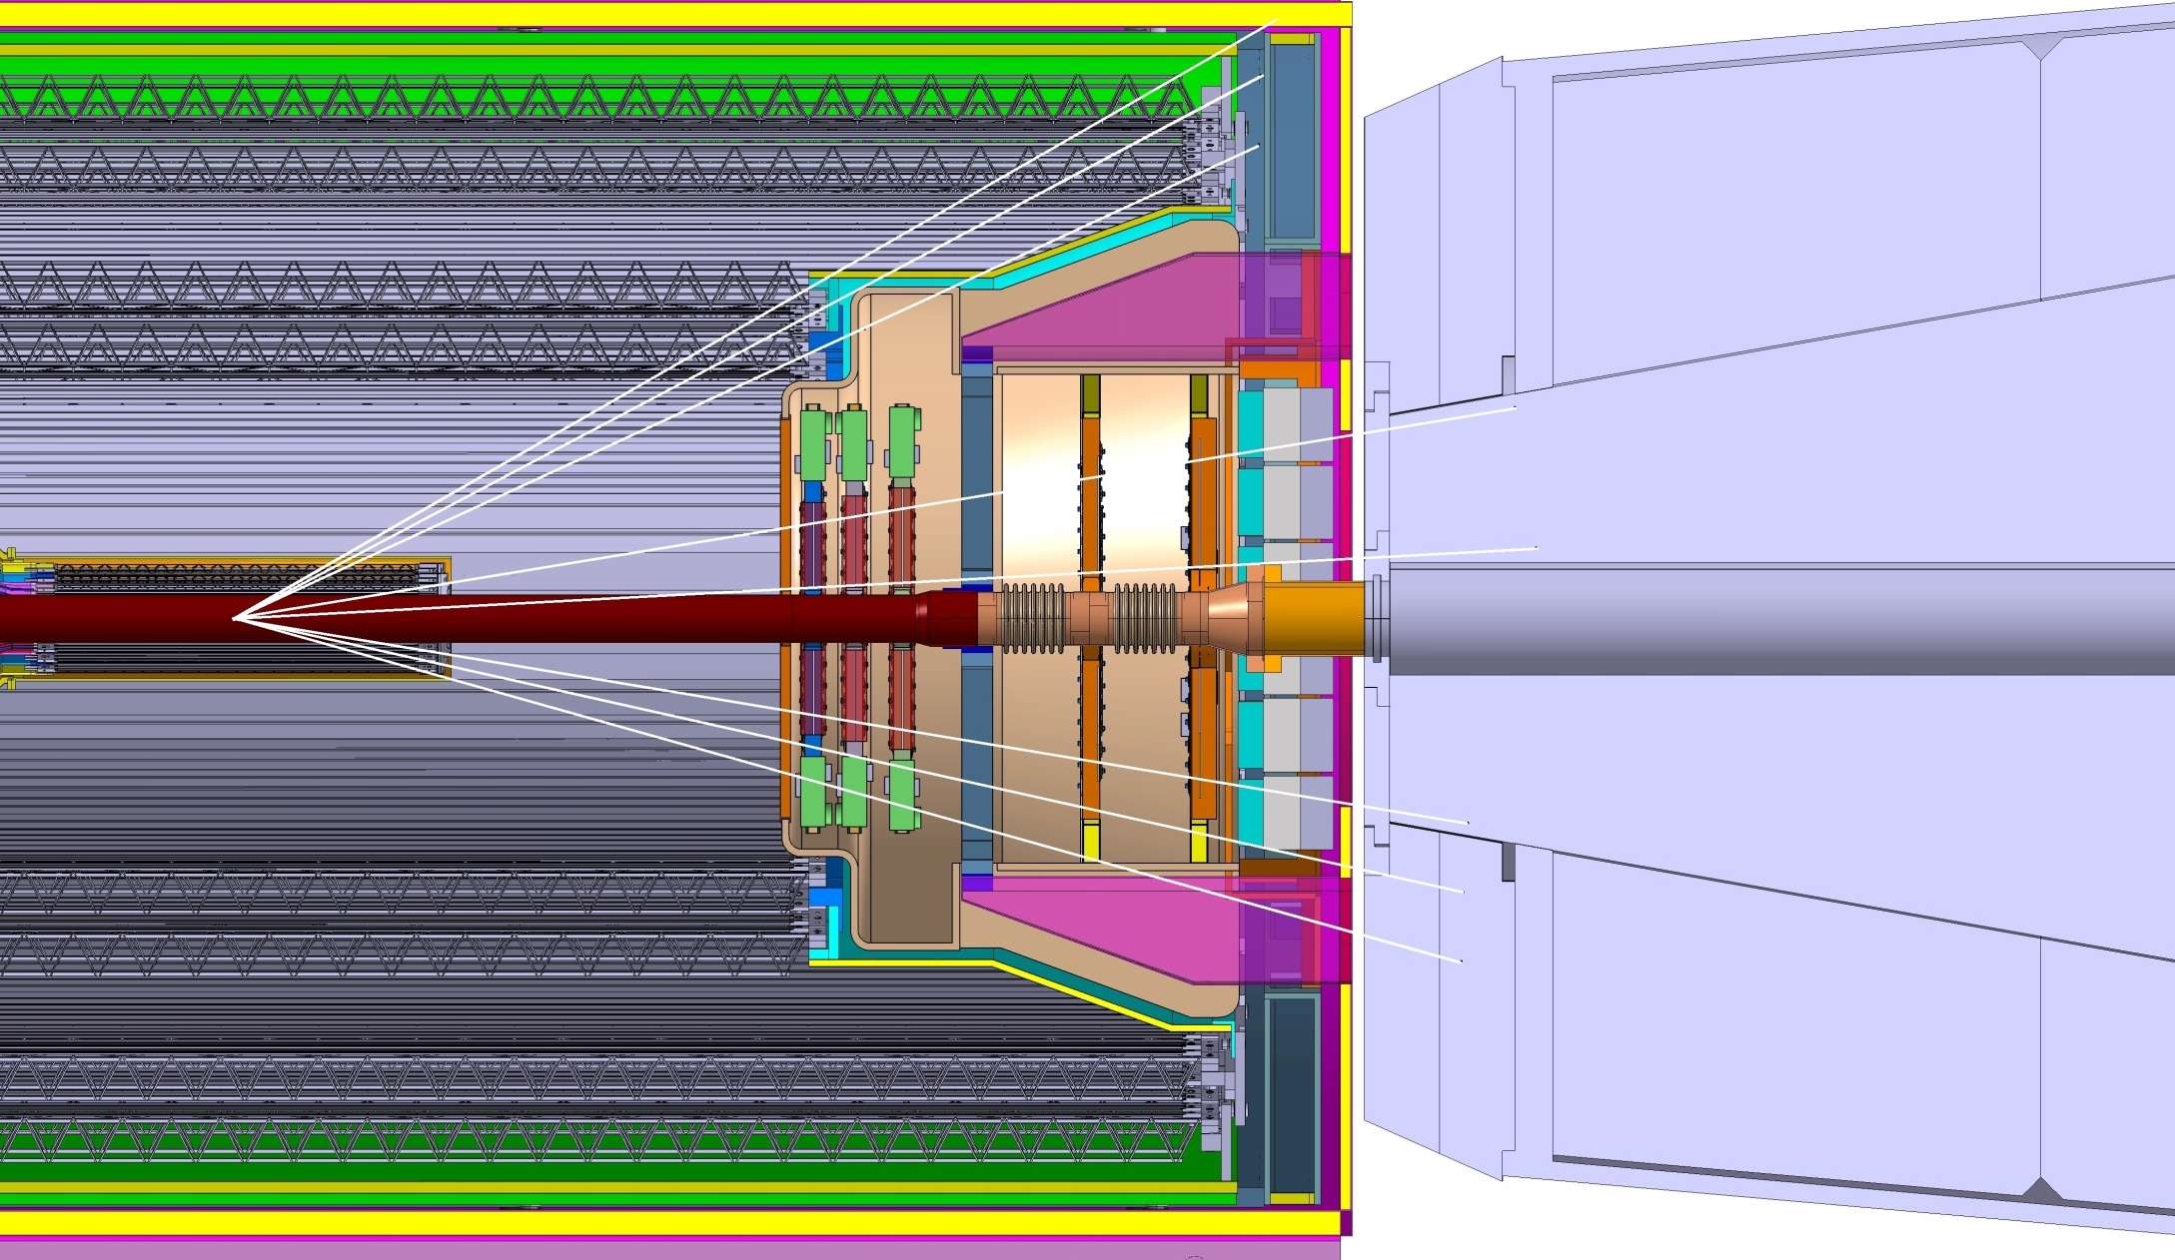
Upgrades

Slide 9
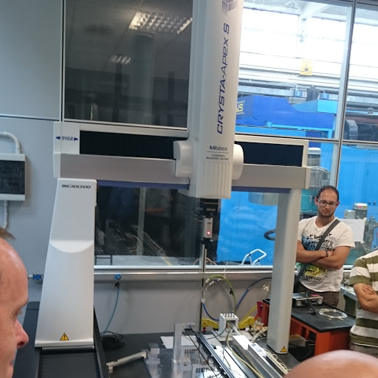
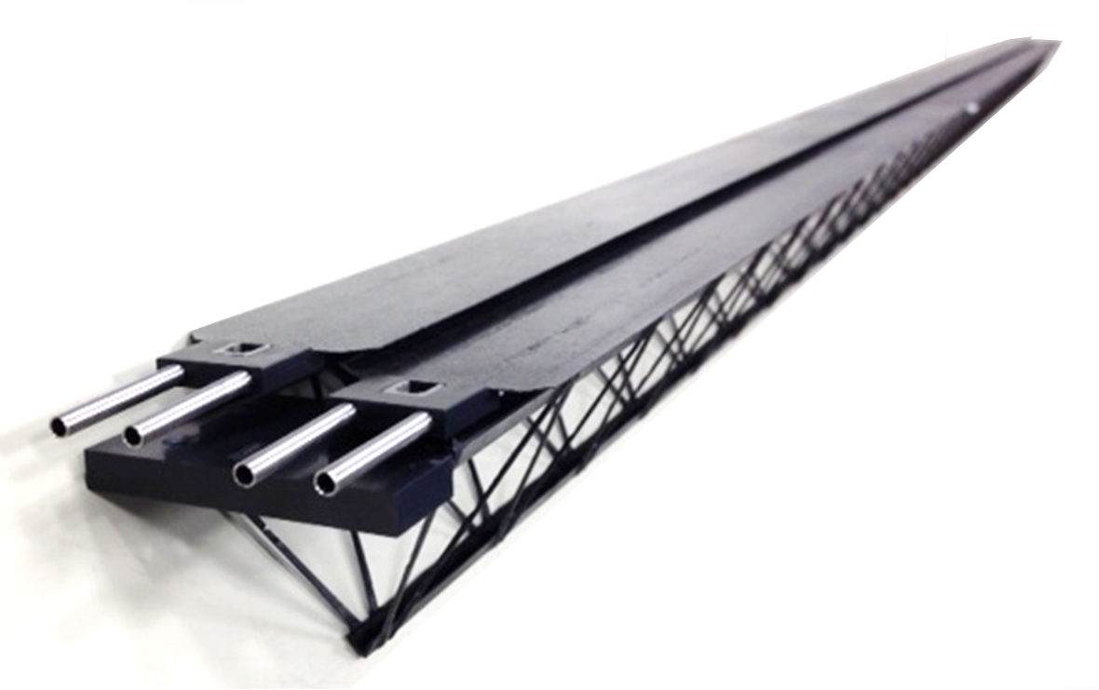
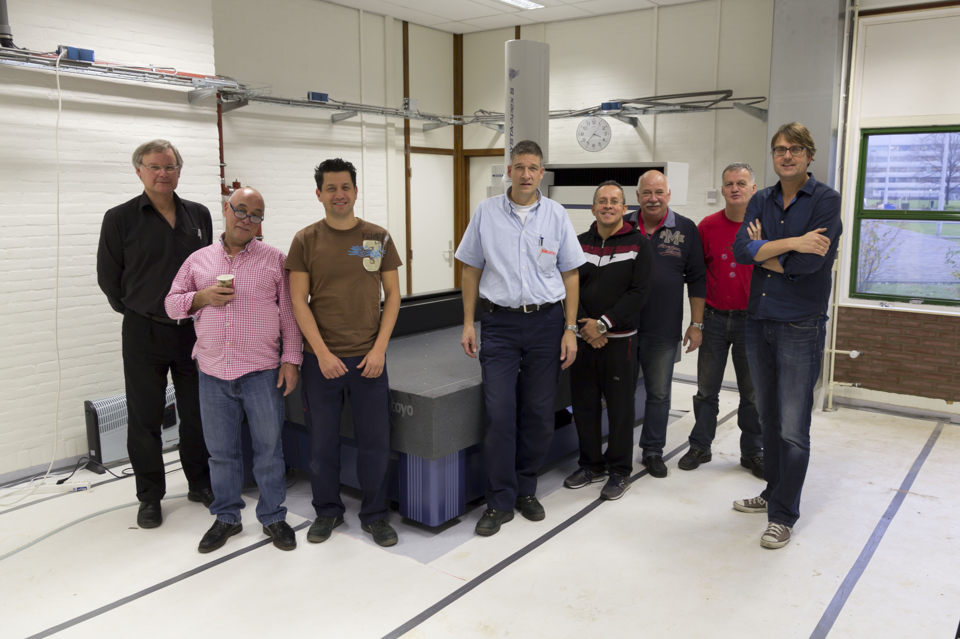
Stave assembly
Our main responsibility during production
Manual procedure with 3D measurement machine as reference
Tools (developed in Turin) ordered in Italy

Slide 10
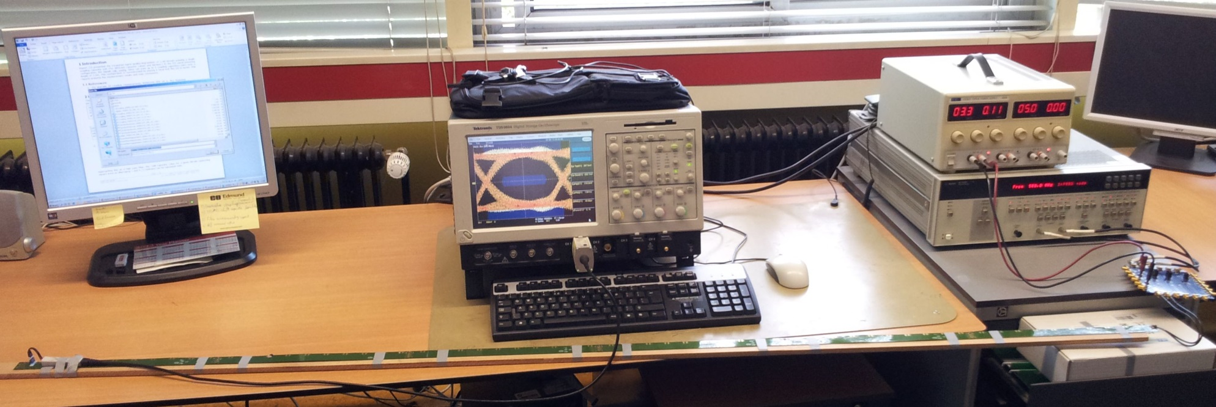
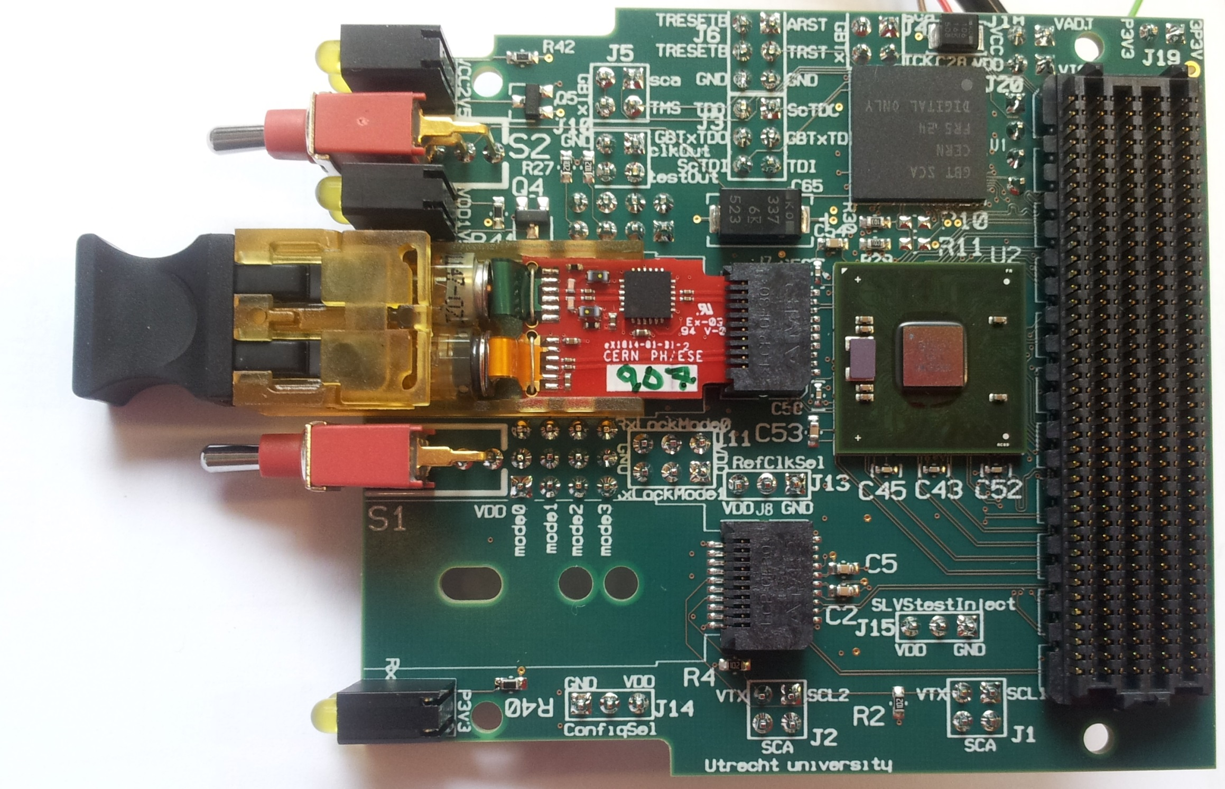
Read-out
Nikhef is responsible for integration of the read-out unit (between pixel modules and DAQ).
  Interface to local power supplies (Berkeley)
  Interface to pixel modules (CERN)
  GBT link to DAQ ()
Cabling
  UU+Nikhef tested data transport across (firefly) cables and between modules
Marcel Rossewij(UU)
Jan-David Schipper
Losses dominated by transport between modules

Slide 11
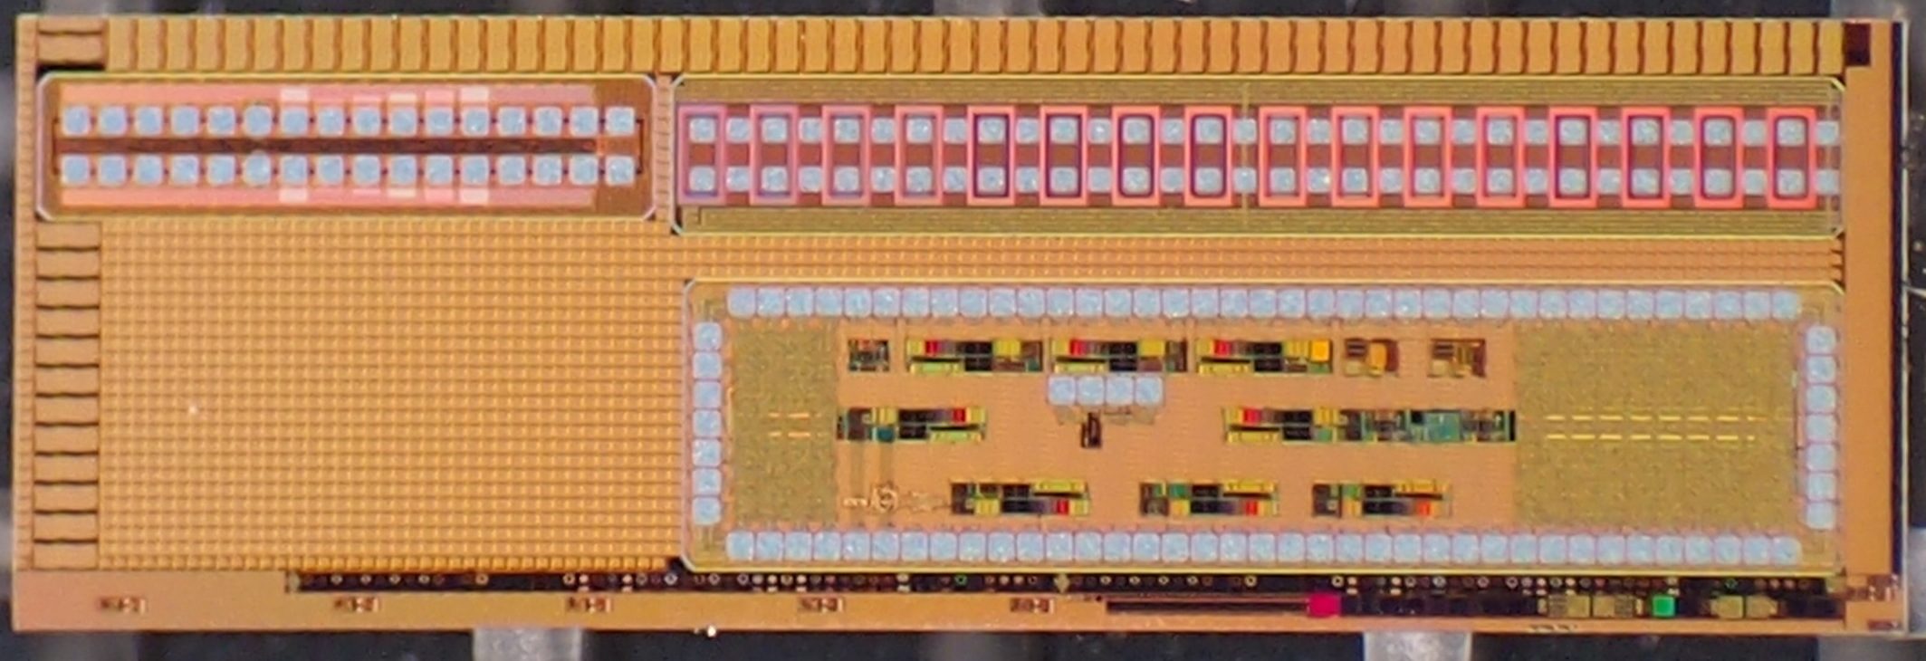
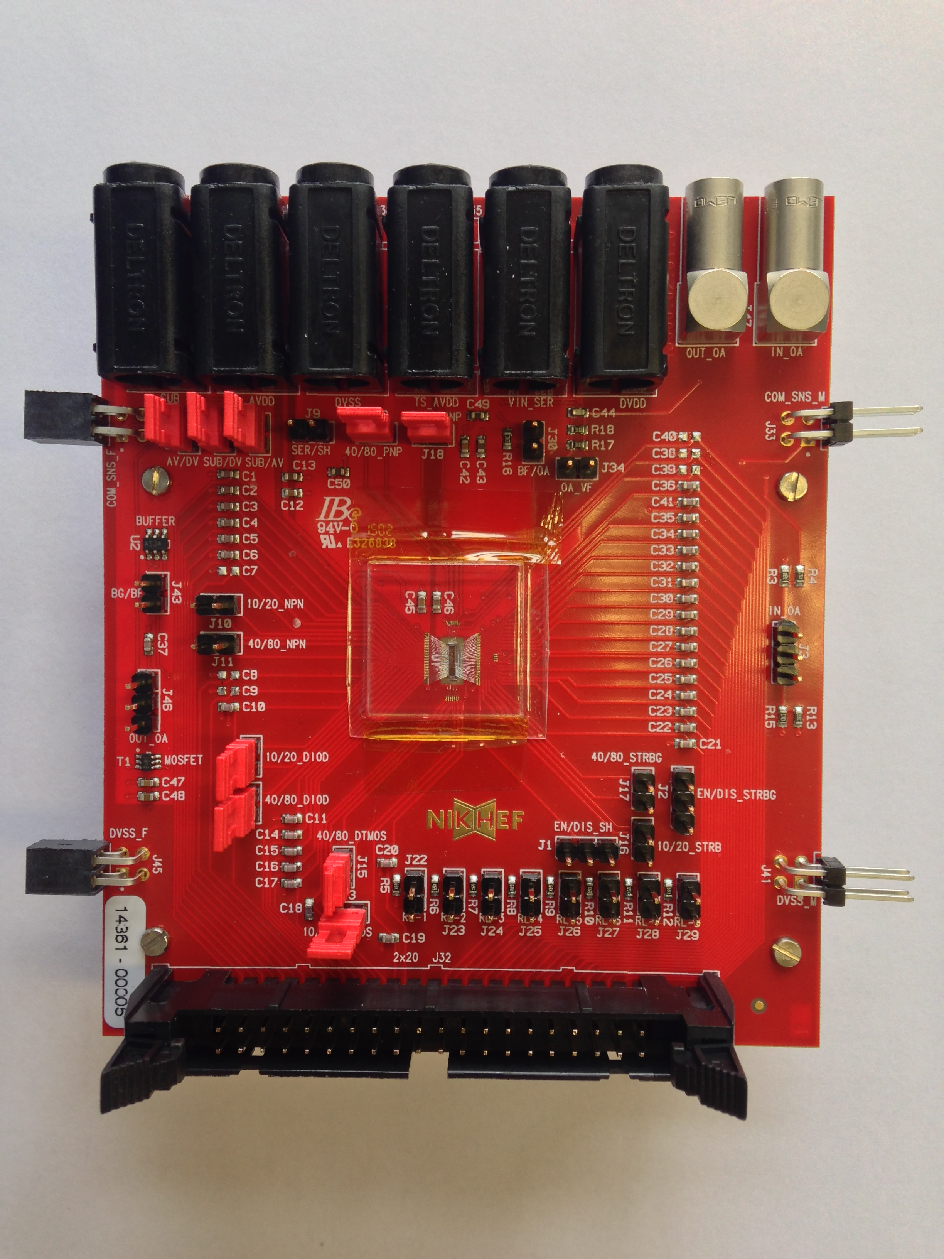
ASIC development
ALPOSE test chip
Produced and tested variants of band-gap and temperature sensor
Both circuits are confirmed to behave exactly as designed and simulated.
Both are included in ALPIDE
Deepak Gajanana
German Henao

Slide 12
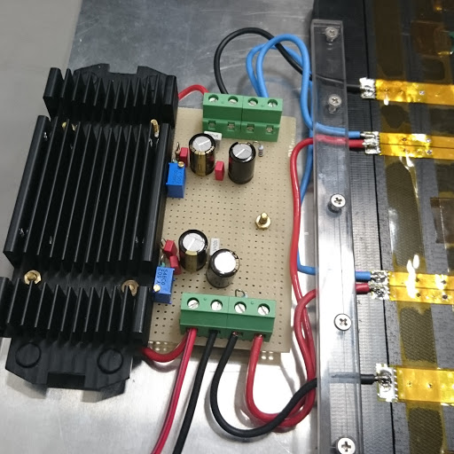
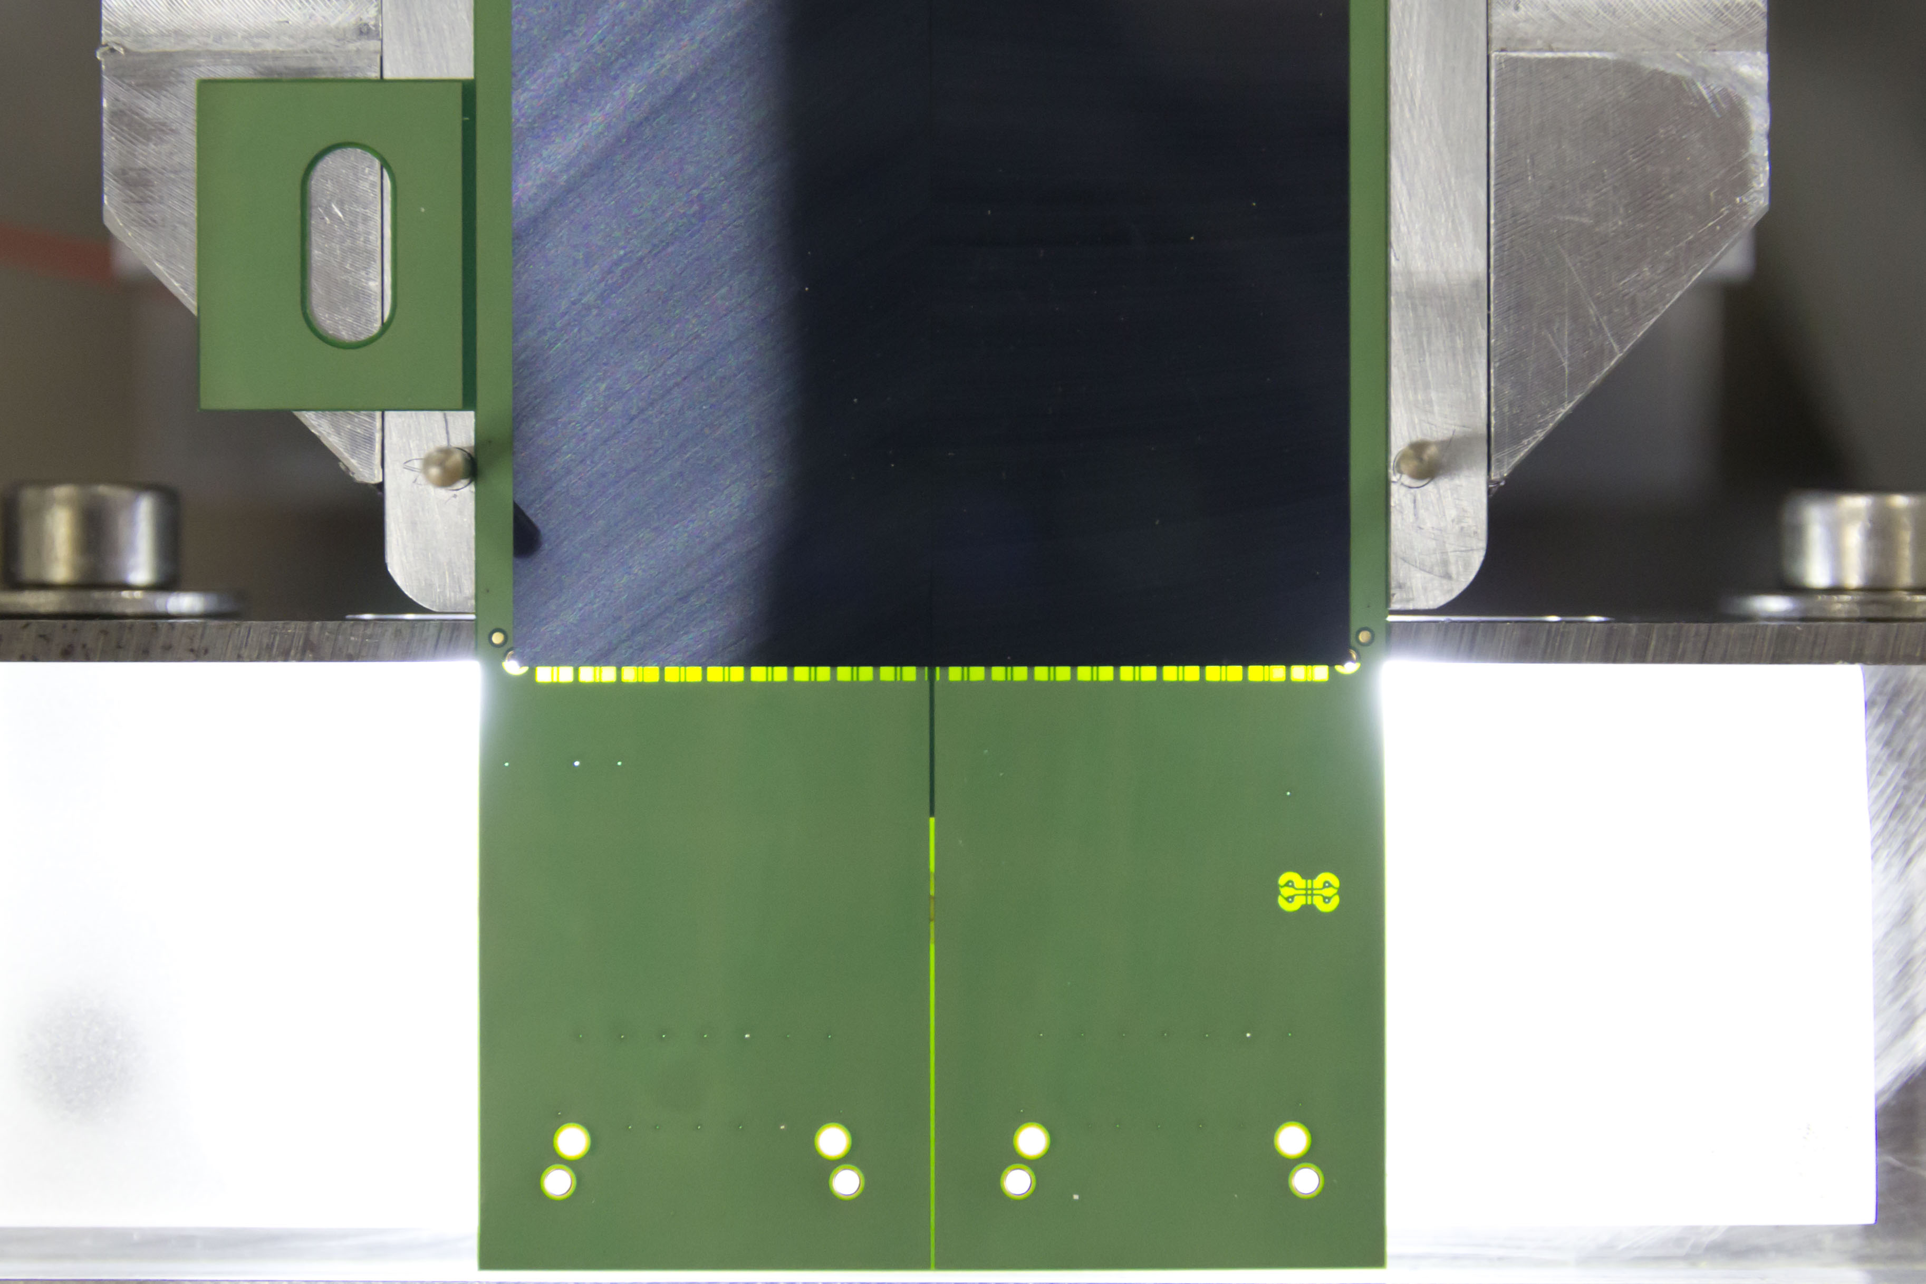
Module testing
Nikhef responsibility
To be distributed to all production labs
Burn-in test (few days)
Tests for transport and handling damage
Simple operation after minimal training
Dimitra Andreou
Software being developed
Interface to hardware (FPGA board)
Interface to database
Mechanics under development
Probes for power connections
Connectors for signal connections

Slide 13
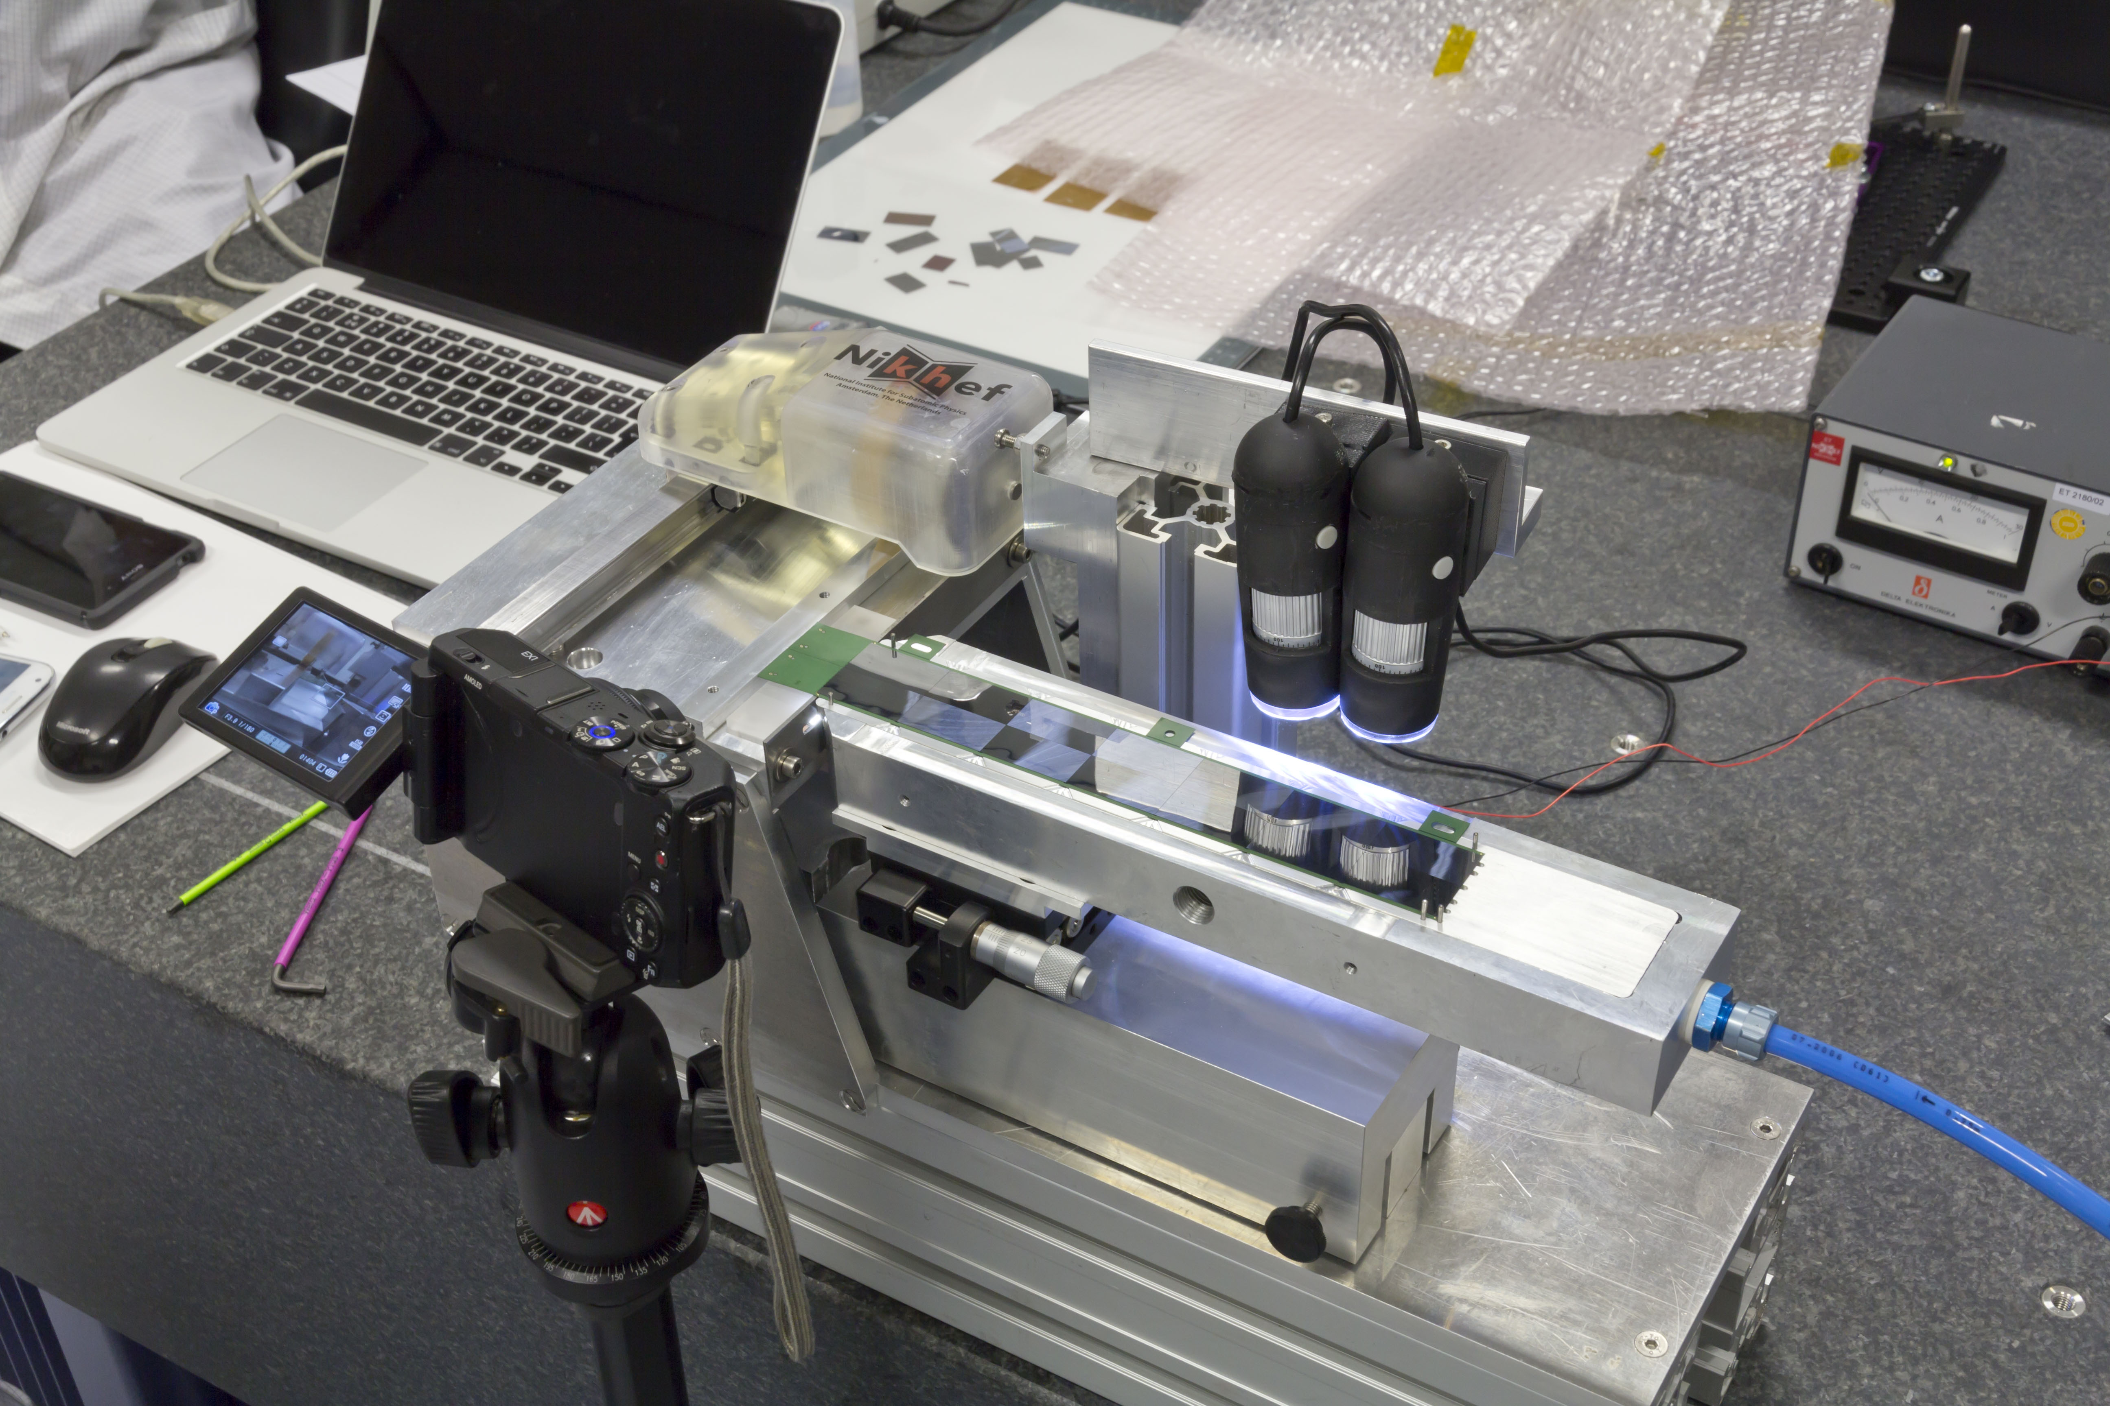
Test system → cutting
Considerations:
The cut has to be within 50 μm from the silicon
  Fine positioning needed
The FPC is flexible
  needs to be clamped close to the cut
A standard medical blade is 200 μm thick
Dimitra Andreou
Gerrit Brouwer
Marco Kraan
Straight edge defines position of cut
Spring loaded wheel follows straight edge
Movable cameras to view fine positioning of the FPC on the straight edge
Positioning mechanism
Vacuum table
(FPC side down)

Slide 14
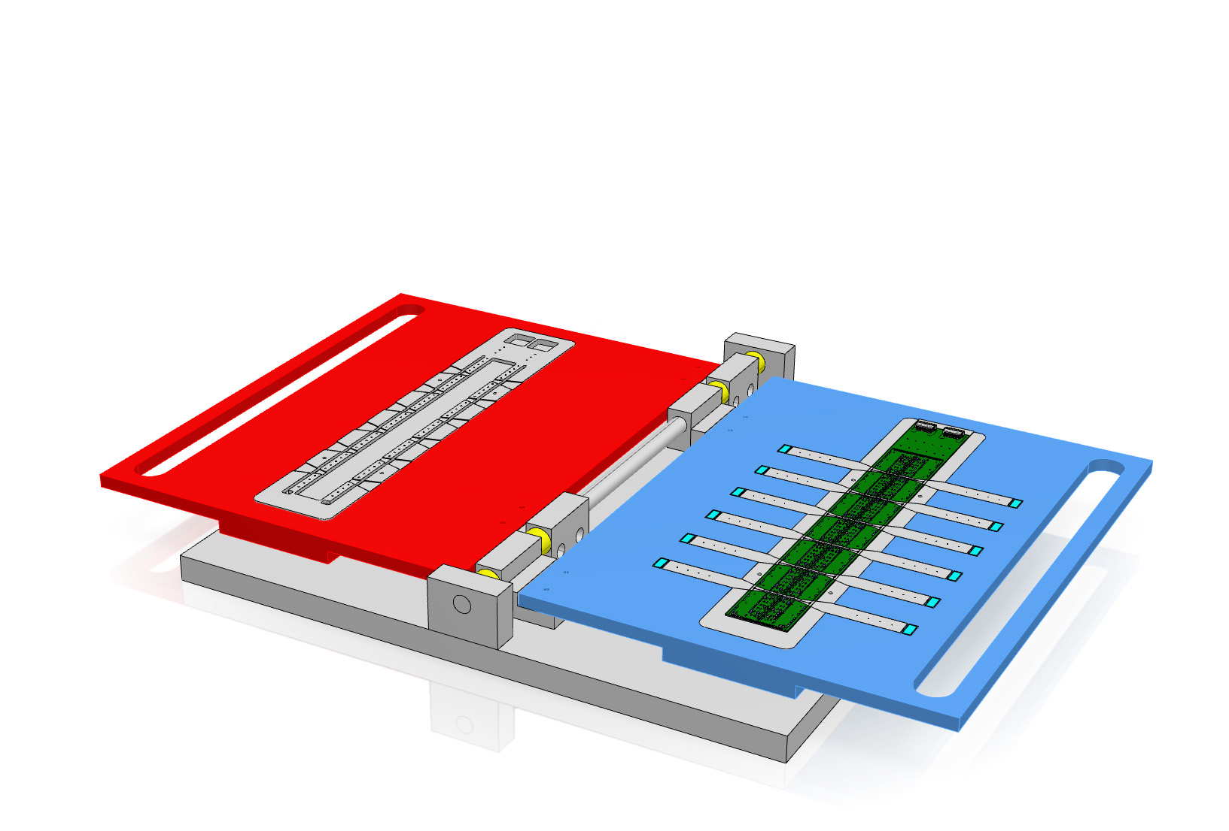
Module flipper
Cutting off the connectors with this precision requires placing the module on the FPC side
Need to flip it over between transport/testing and cutting
‘flip tool’ under development
  ‘Book like structure

Slide 15
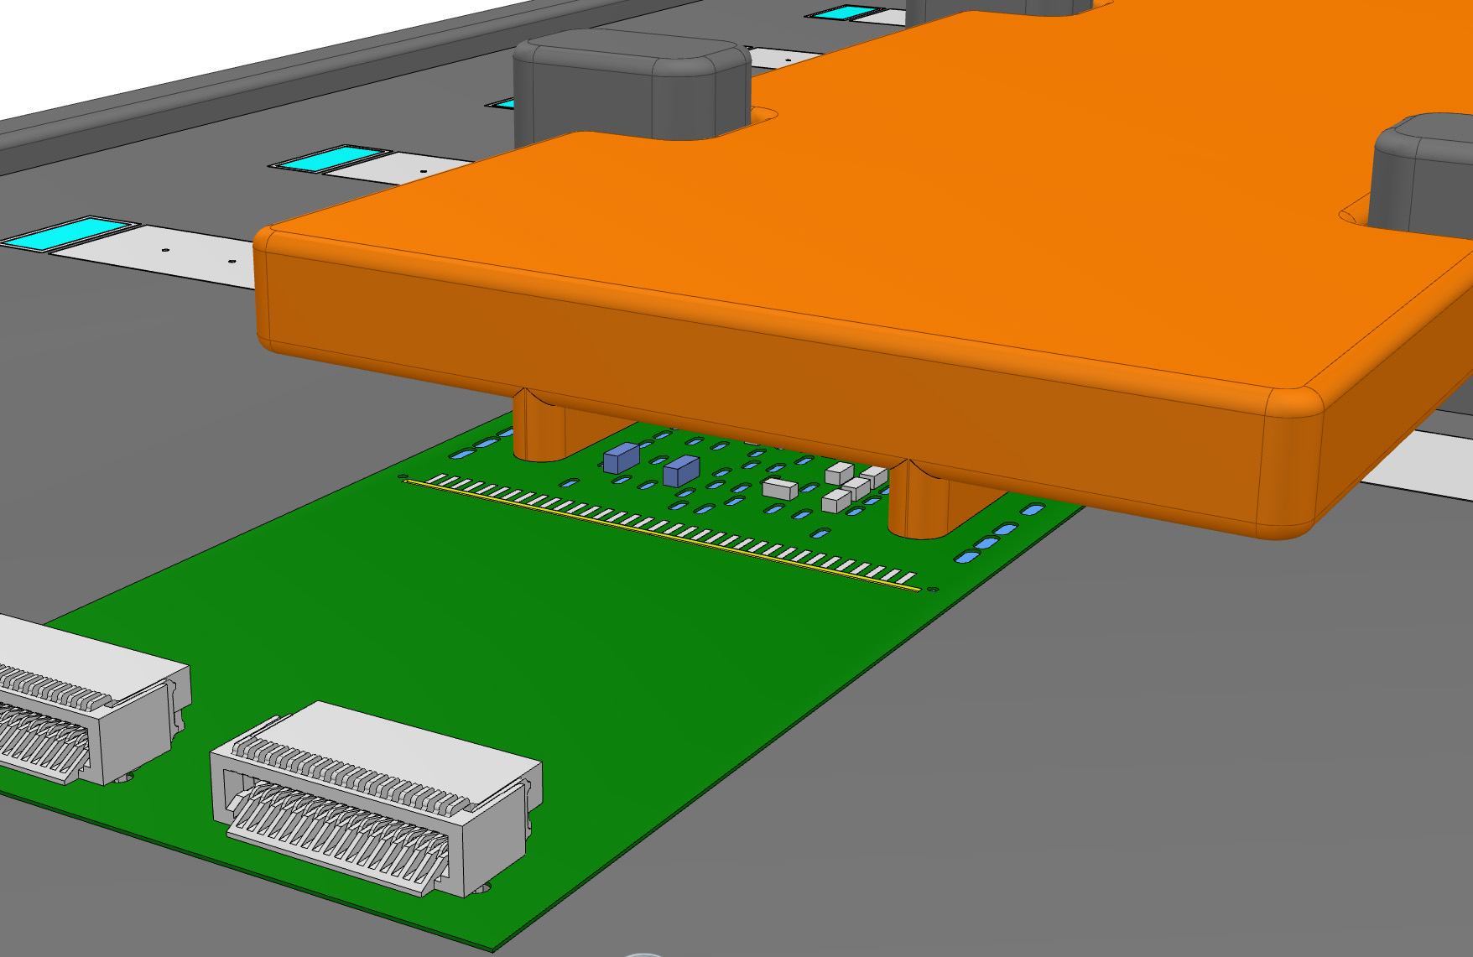
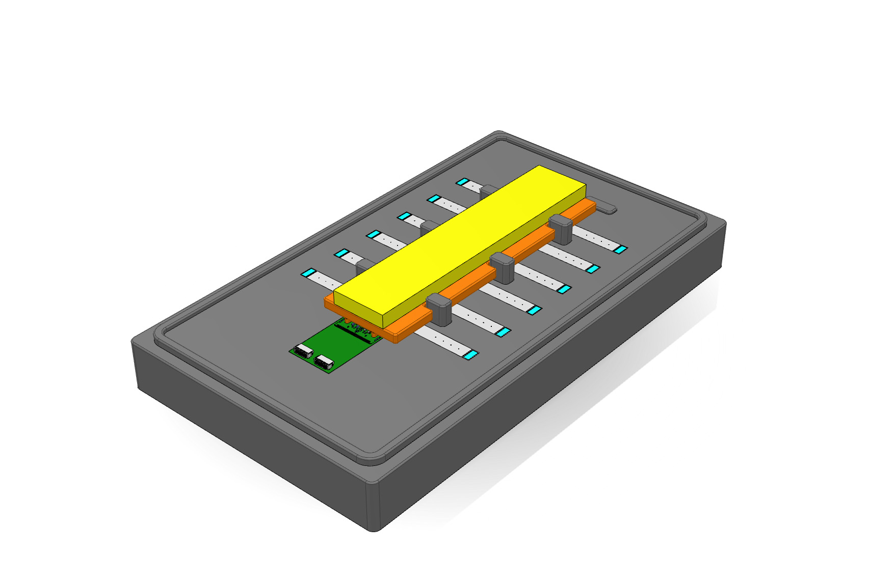
Module transport and storage
Full surface covered with silicon
FPC side has many bond-wires
First ideas:
  Cheap foam box → one time use / one for each module
  Perhaps metal plate insert

Slide 16
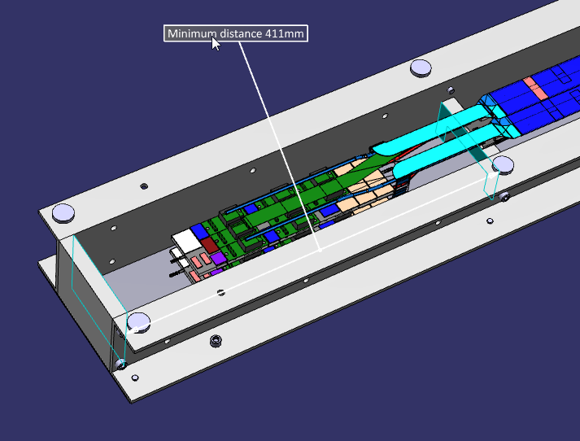
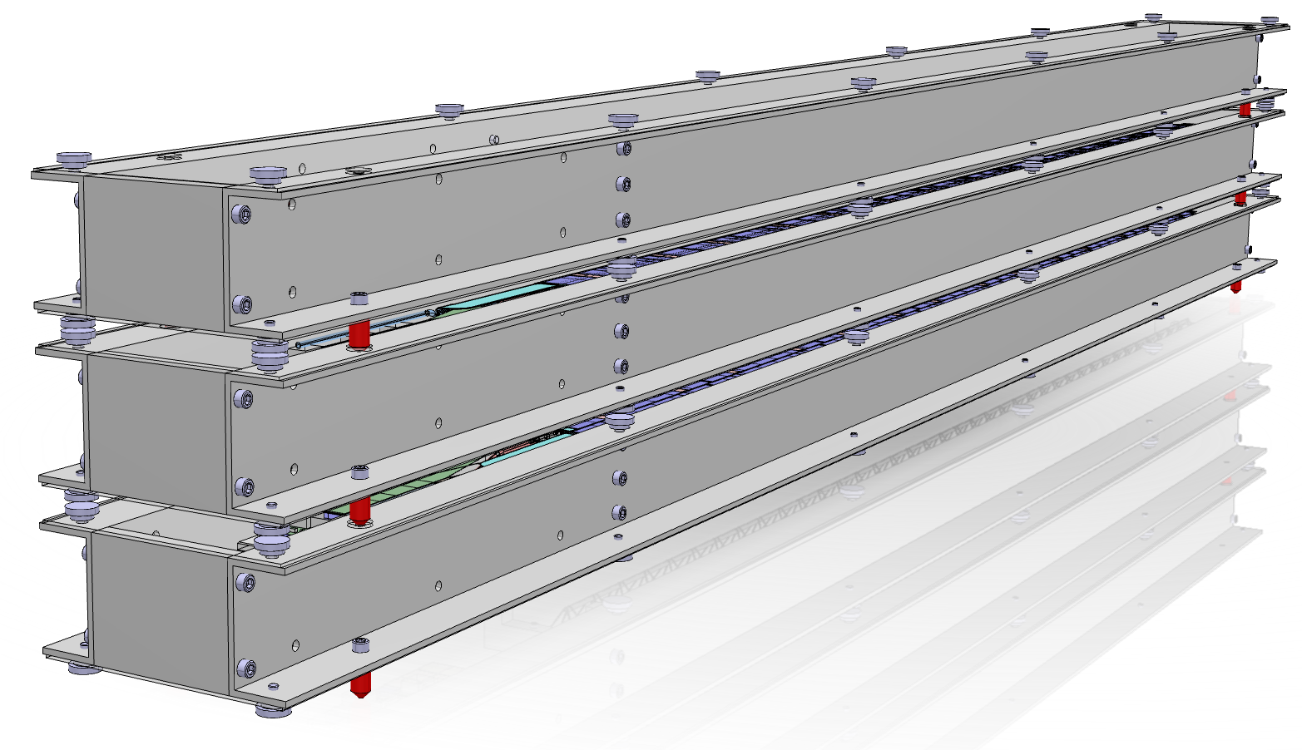
Stave storage and transport
Considerations for the single stave container:
  Protection, stave completely fixed but little stress
  Stackable
  protection against humidity
  temperature range
  Synergy with pick-up tools (stave assy)
  Few extra boxes to allow buffering between assembly steps
Currently investigating:
Large transport container container
  Containing few staveboxes
  Dessicant to stabilize humidity
  Protection against shocks
  Transport standard size
Contact with IPS
  ISTA certification for transport

Slide 17
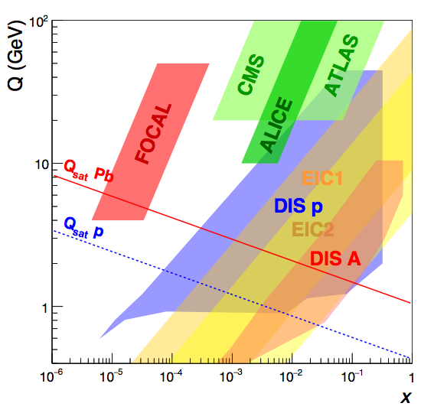

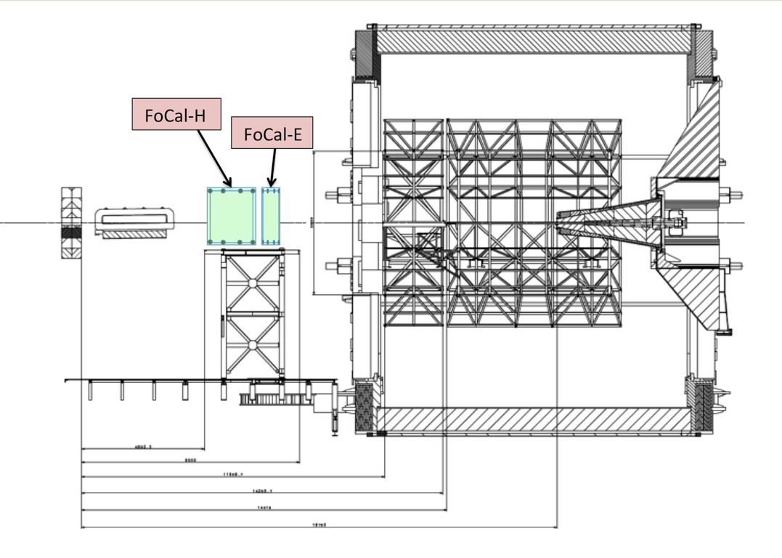
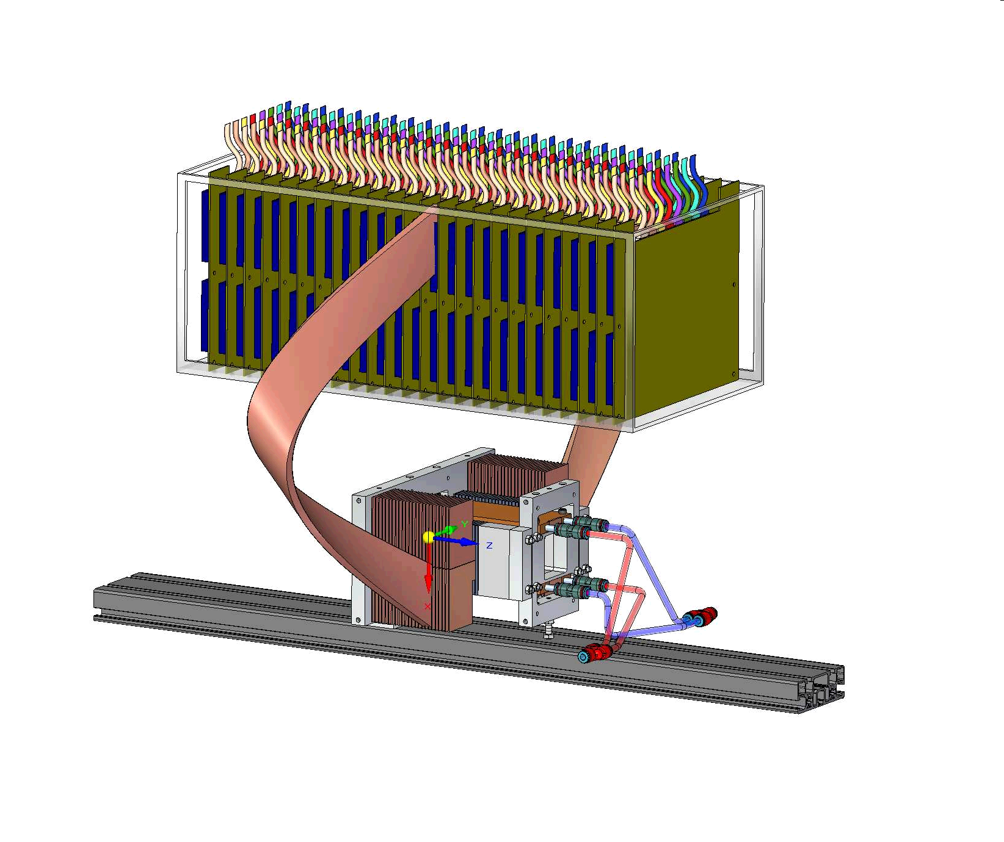
Beyond LS3: FoCal?
x-Q² coverage for EM probes
New ideas
proposal to measure forward direct photons to study low-x gluon distributions/gluon saturation (under discussion for LS3)
  main challenge: separate γ/π⁰ at high energy
  need small Molière radius, high-granularity read-out
R&D with full MAPS SiW calorimeter prototype
24 layers
  3mm W
  1mm sensor layer
    120µm sensor (2x2 chips) + PCB, glue, air, ...
39 M pixels in 4x4x10 cm³ !

Slide 18
Energy Linearity – Energy Resolution
good linearity
  no strong effect of saturation
resolution slightly worse than simulation
  sensor quality/calibration can be improved
  note to simulation:
    ideal detector: no dead/bad sensors
    real detector: including dead/bad sensors
Chunhui Zhang, Hongkai Wang

Slide 19
R&D Results: Lateral Profiles of EM Showers
“world records”:
  highest granularity calorimeter
  smallest Moliere radius
    R_{M} ≈ 11mm
allows shower measurements with unprecedented detail
good overall agreement with simulations
  GEANT4 + charge diffusion
should allow to tune details of shower description in GEANT4
preliminary
layer 8 → z ≈ 8 X₀
extremely narrow showers and high granularity make this technology useful for FoCal and other future calorimeters
(ideal for particle flow)

Slide 20
Shower Position Resolution
distribution of residuals of shower position relative to electron beam
excellent position resolution
includes uncertainty on beam position

Slide 22
Backup

Slide 23
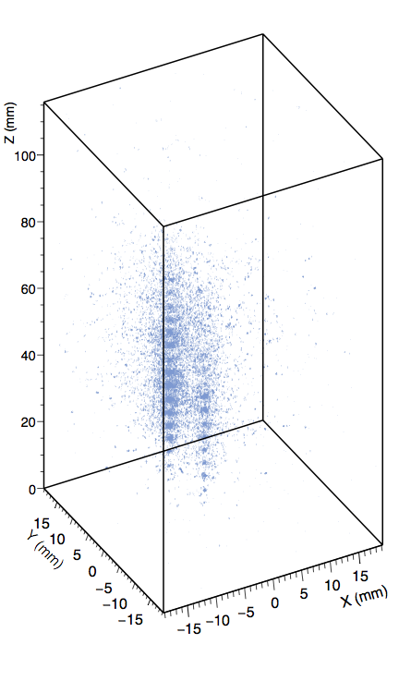
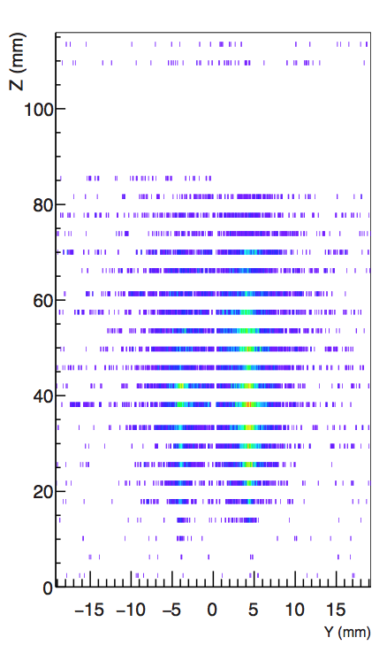
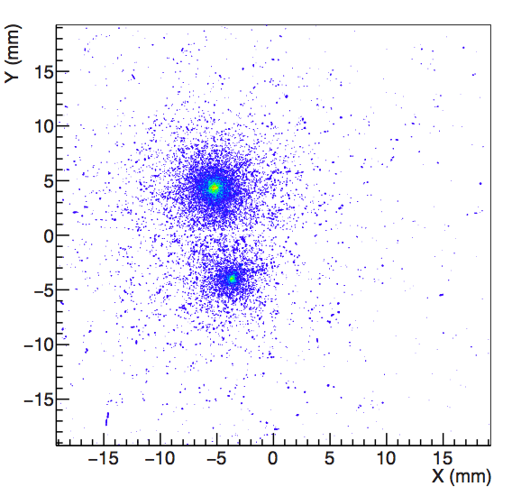
Two Shower Separation
display of single event (with pile-up) from 244 GeV mixed beam
colour code = pixel hit density

