Slide 1
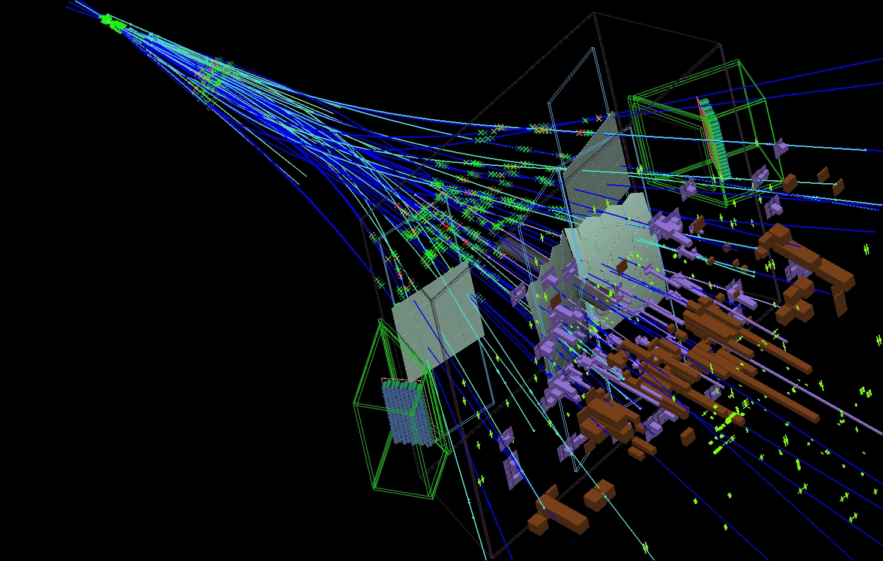
B-physics: LHCb
Jamboree 2016:
M.M. – 15’:
“Introduction and Vista25”
Flavio Archilli - 15’:
“Very Rare B-decays”
Jacco de Vries – 15’:
“CP Violation Measurements”:
Elena Dall’Occo – 20’:
“VeloPix Beam tests”

Slide 2
The Mass and Flavour Puzzle .
i) Origin of the 3 generations CKM structure of CC

Slide 3
The Mass and Flavour Puzzle .
i) Origin of the 3 generations CKM structure of CC
What is the origin of the hierarchy of particle masses and weak couplings?
ii) The absence of FCNC

Slide 4
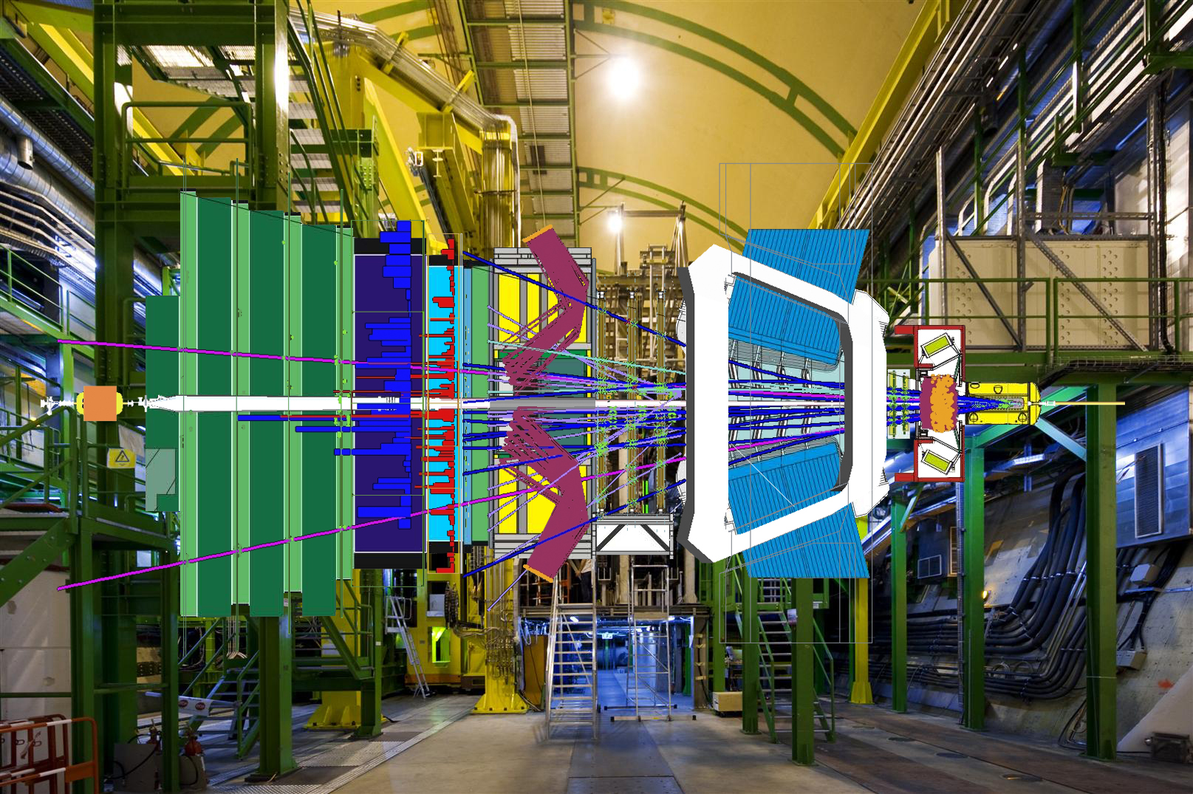
LHCb
Precision measurements on fundamental (complex) couplings,
Searches for New Physics through quantum corrections.

Slide 5
Flavour and BSM Physics
Many physics channels sensitive to a broad spectrum of BSM physics:
Z’ and W’, lepto-quarks, 2HDM, Little Higgs, Randall Sundrum, vector-like fermions, axions, Majorana neutrino’s…
Theoretical cleanliness
Current observations or “hints” :
Zoltan Ligeti CKM2016
Significance (σ)
Two examples of sensitivities for NP:
(Very) Rare Decays: the b→s transition
CP Violation and B⁰_{(s)} - B⁰_{(s)} Mixing

Slide 6
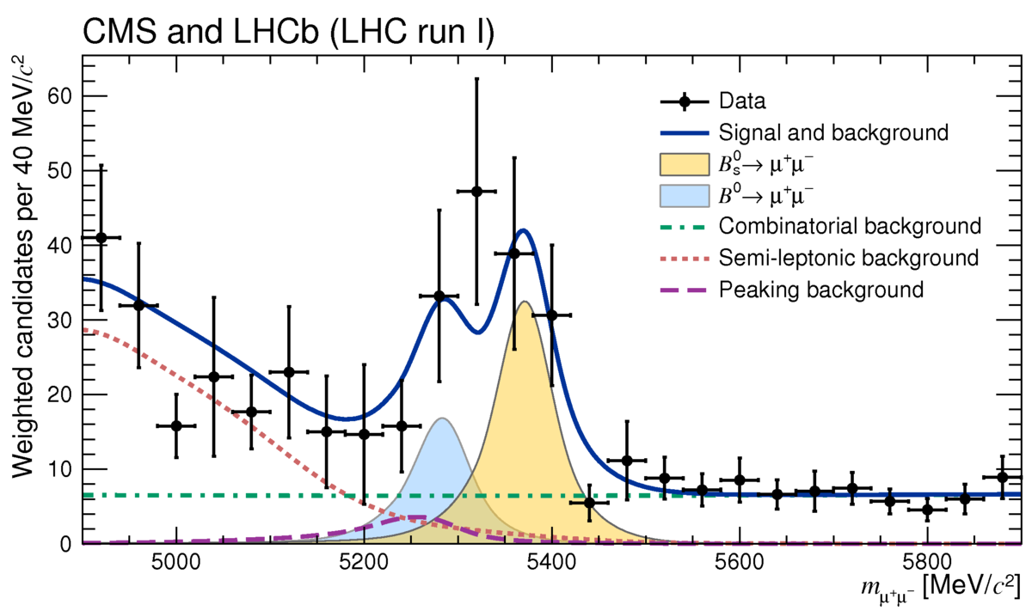
1) Rare Decays: b→s transition (i) B⁰_{(s)}→μ⁺μ⁻
B⁰_{s}→μ⁺μ⁻ : Discovered in 2015:
“Golden channel for SUSY”
NP Sensitivity
U. Haisch, Heavy Flavours
at HL-LHC, 2016, Cern
“Anarchic” tree:
Currently (3 fb⁻¹): Λ ≈ 40 TeV
B⁰→μ⁺μ⁻ : first evidence
2.3 σ above
SM prediction
MFV loop:
Currently (3 fb⁻¹): Λ ≈ 0.5 TeV

Slide 7
1) Rare Decays: b→s transition (i) B⁰_{(s)}→μ⁺μ⁻
B⁰_{s}→μ⁺μ⁻ : Discovered in 2015:
“Golden channel for SUSY”
NP Sensitivity
U. Haisch, Heavy Flavours
at HL-LHC, 2016, Cern
“Anarchic” tree:
Upgrade (50 fb⁻¹): Λ ≈ 200 TeV
B⁰→μ⁺μ⁻ : first evidence
2.3 σ above
SM prediction
MFV loop:
Upgrade (50 fb⁻¹): Λ ≈ 3 TeV

Slide 8
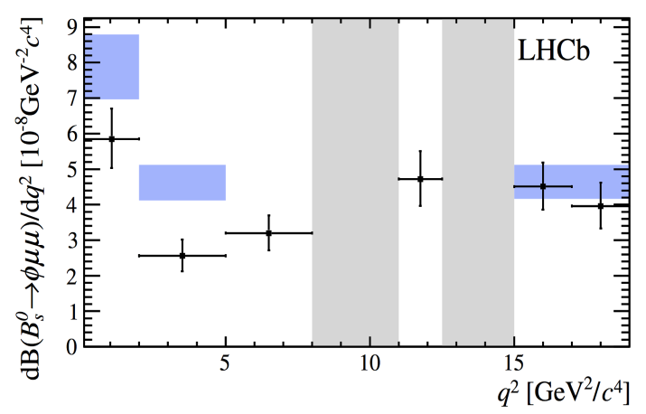
1) Rare Decays: b→s transition (ii) b→s l⁺l⁻
FCNC b→s : Standard Model
EW-penguin
Eg.: B→K*μμ
B→K*μμ
P₅’
3.4 σ
LHCb, JHEP 1602 (2016) 104
B→φμμ
Interesting anomalies are observed.
If correct they would suggest NP at:
Generic tree : Λ_{NP} ≈ 35 TeV
MFV tree : Λ_{NP} ≈ 7 TeV
Generic loop : Λ_{NP} ≈ 3 TeV
MFV loop : Λ_{NP} ≈ 0.6 TeV
3.1 σ
LHCb, JHEP 1509 (2015) 179

Slide 9
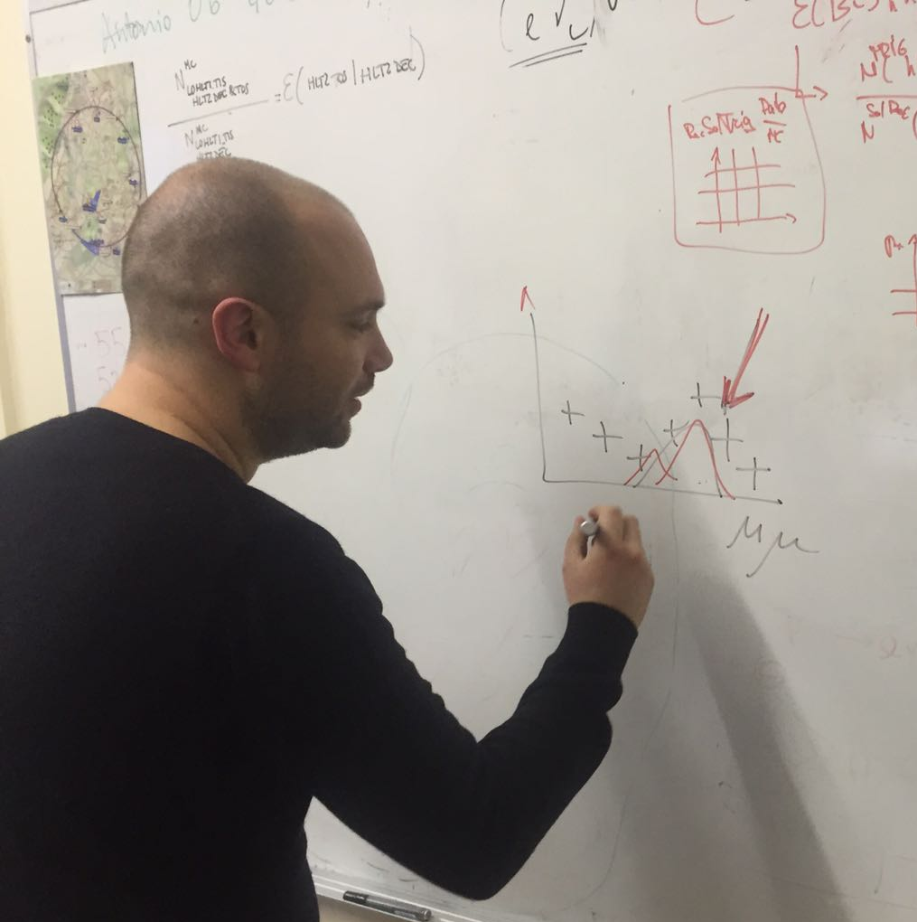
Talk-1: Flavio Archilli – “Very Rare Decays”
MFV
Little Higgs model with T parity
[Blanke et al., 1507.06316]
Randall-Sundrum model without
custodial protection
[Bauer et al., 0912.1625]
New LHCb results this week!

Slide 10
2) B-B Mixing and CP Violation
Phase space for NP:
Charles et. al., 1309.2293
“now”
Currently:
After Upgrade (50 fb⁻¹):

Slide 11
2) B-B Mixing and CP Violation
“now”
LHCb 50 fb⁻¹ & Belle 50 ab⁻¹
Charles et. al., 1309.2293
CP Violation measurements:
Many channels (e.g. “trees”, “boxes” en “penguins”) and CKM tests
Measurements statistically limited, also in upgrade.

Slide 12
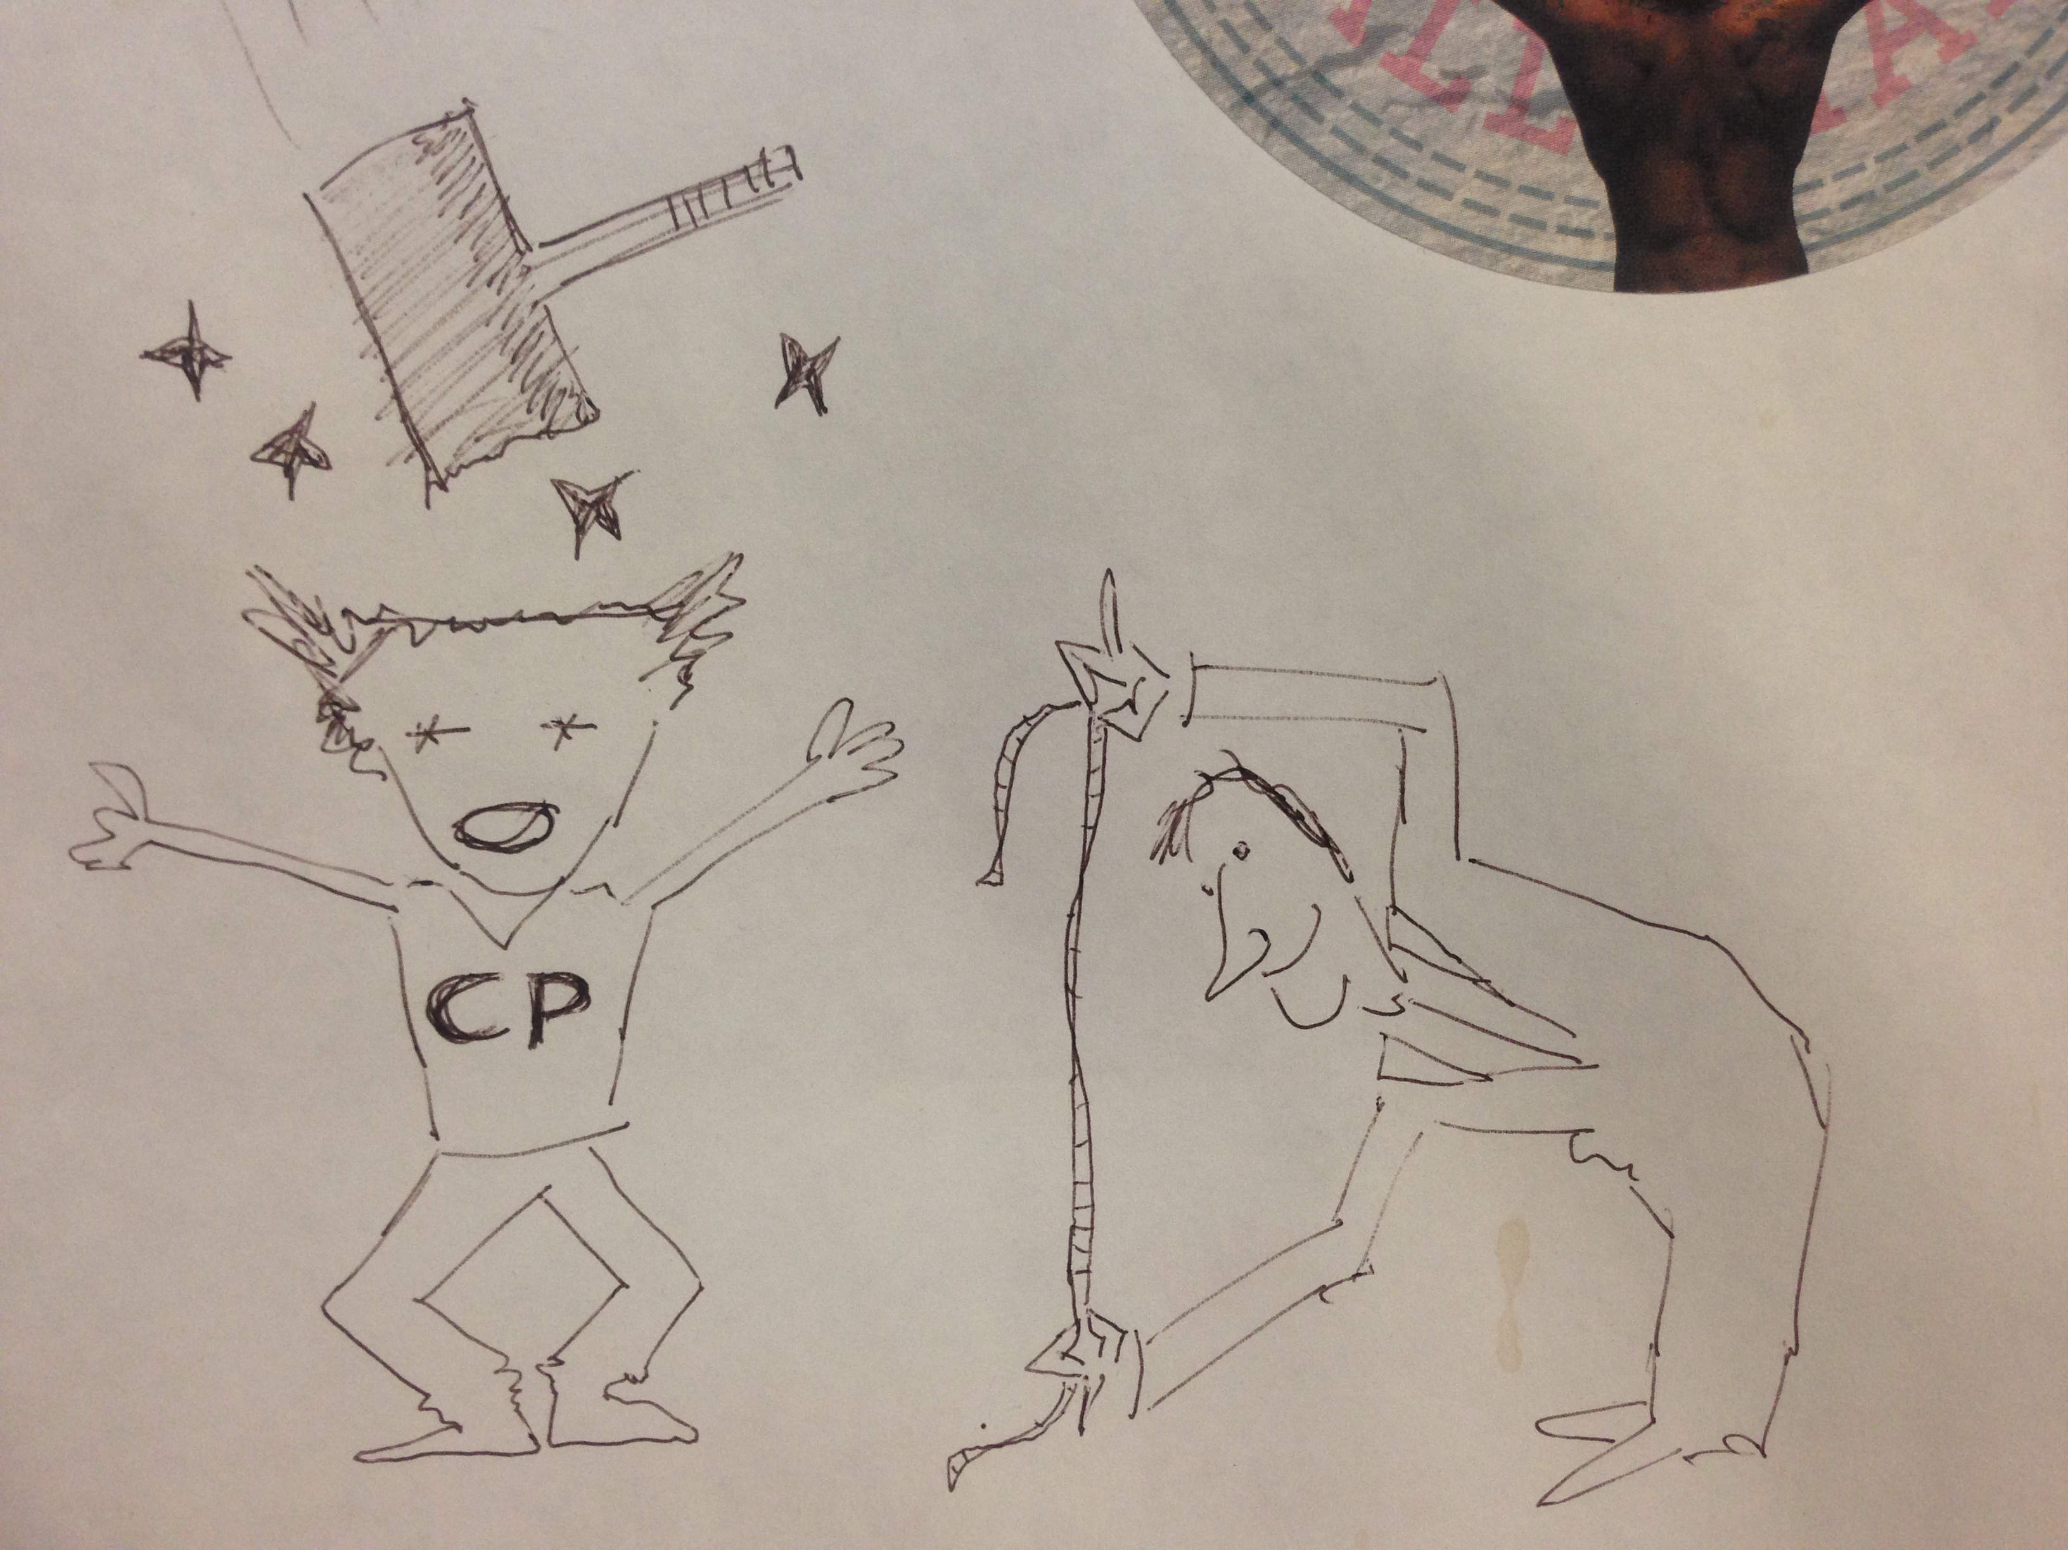
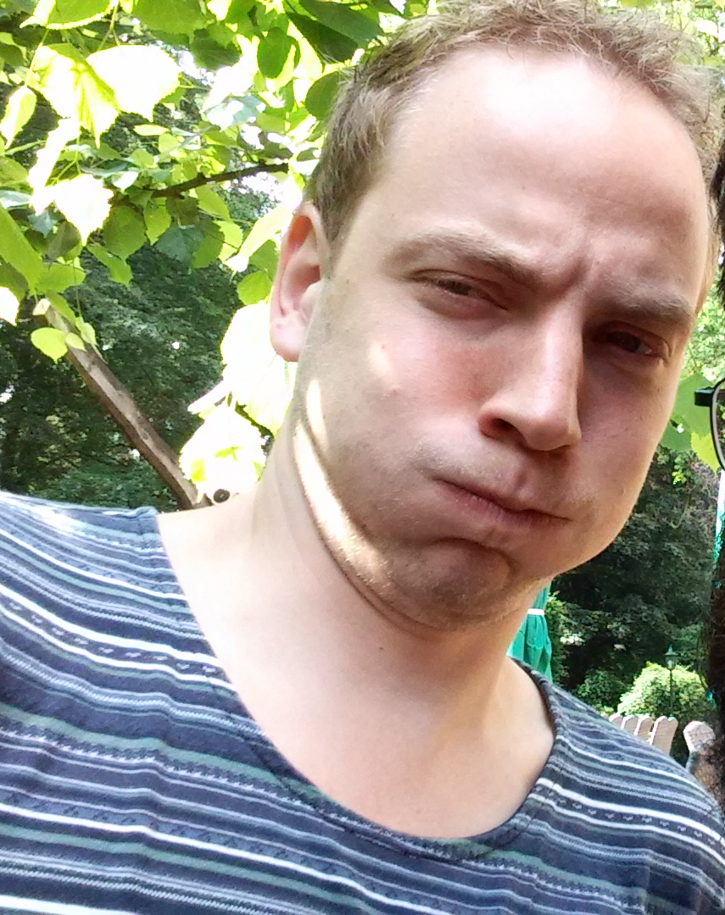
Talk-2: Jacco de Vries - “Measurements of CP Violation”
Erwin Agasi, 1999

Slide 13
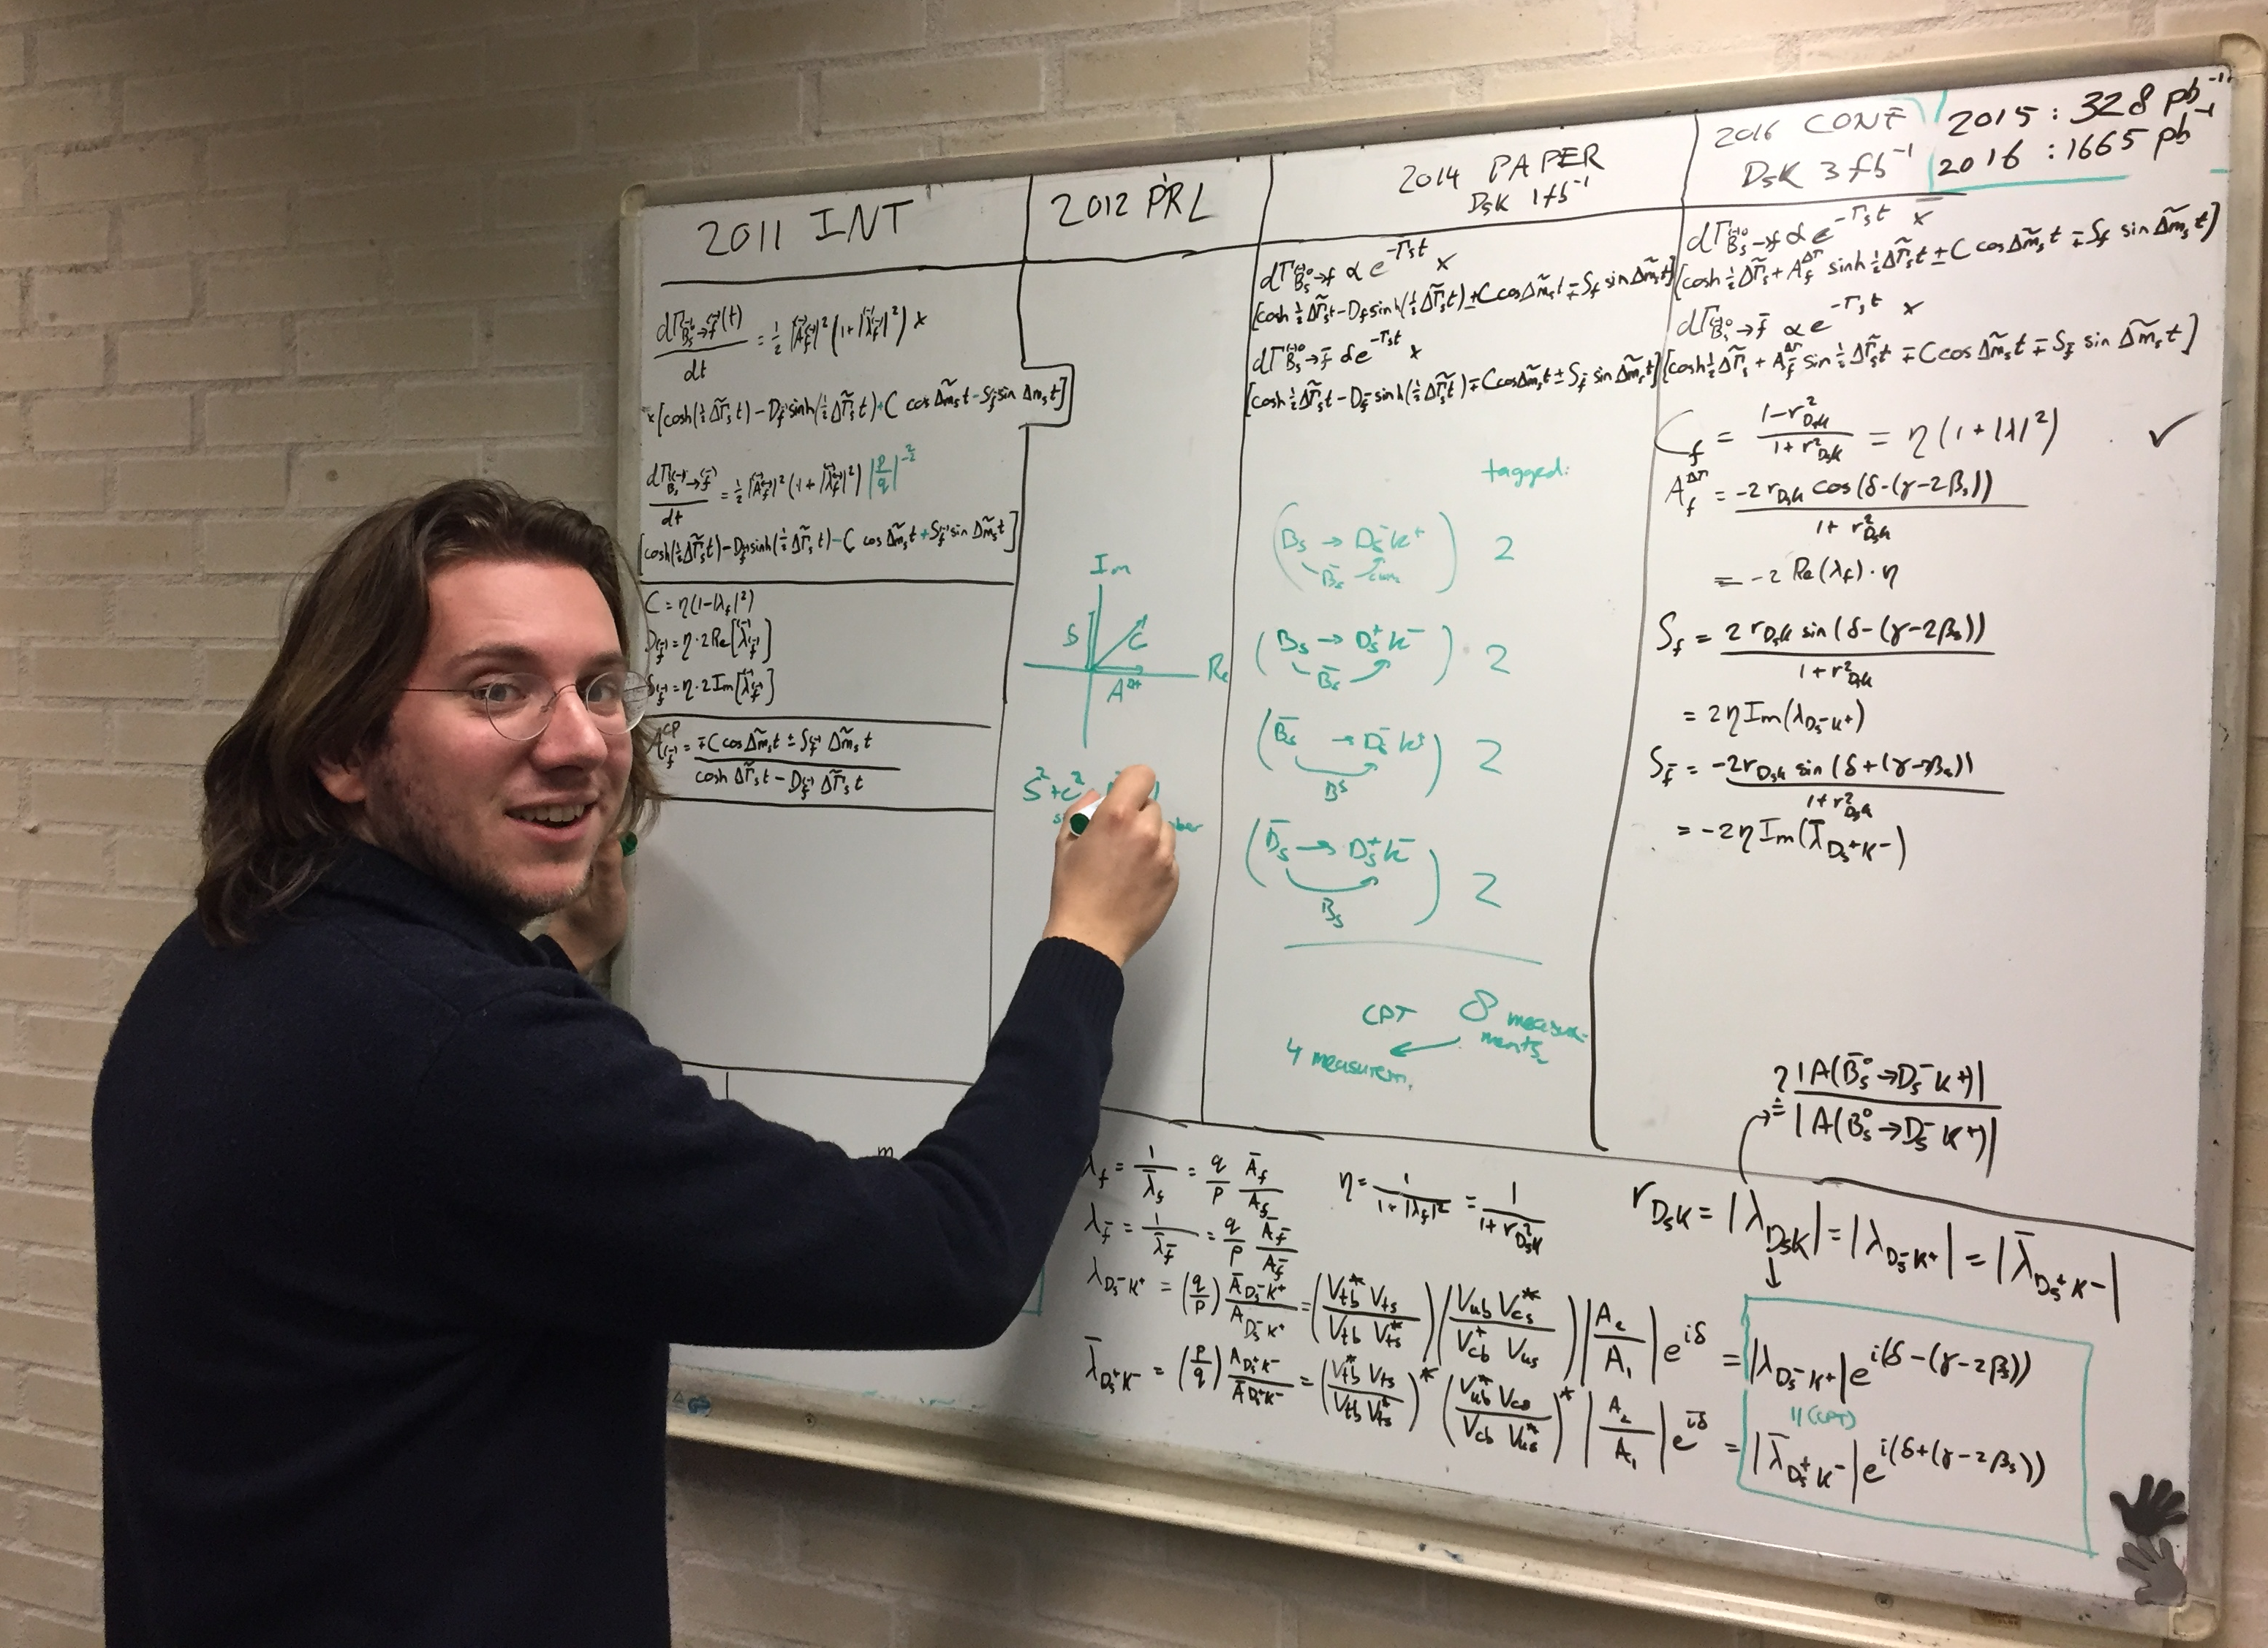
…including a new B_{s}→D_{s}K measurement of angle γ …
Lennaert double checking the equations and sign conventions…

Slide 14
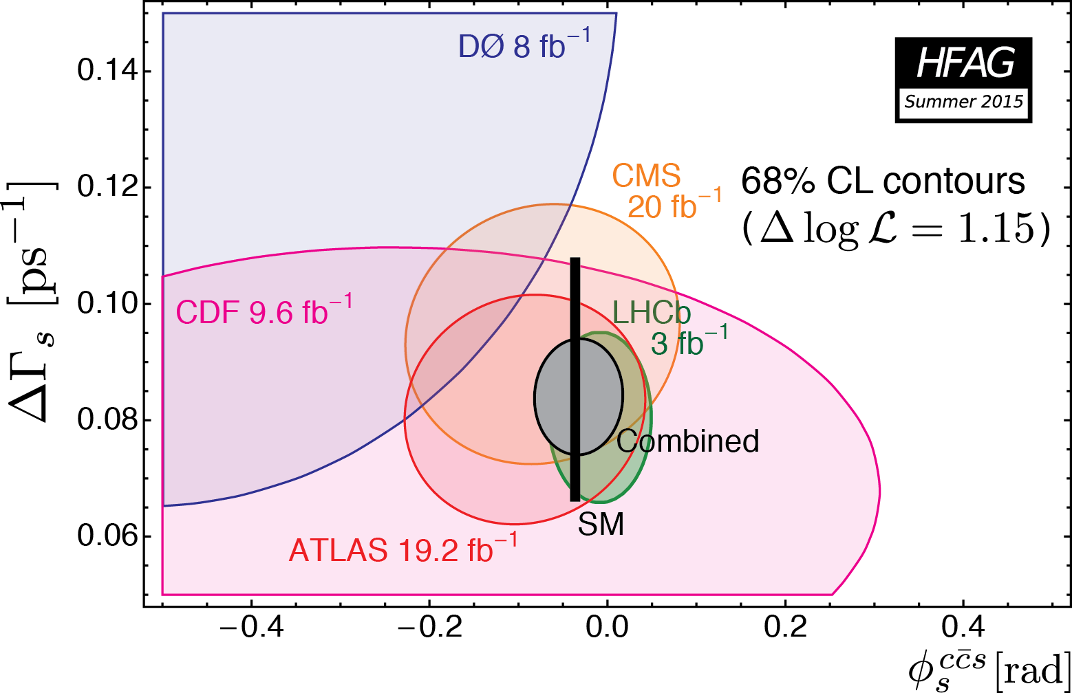
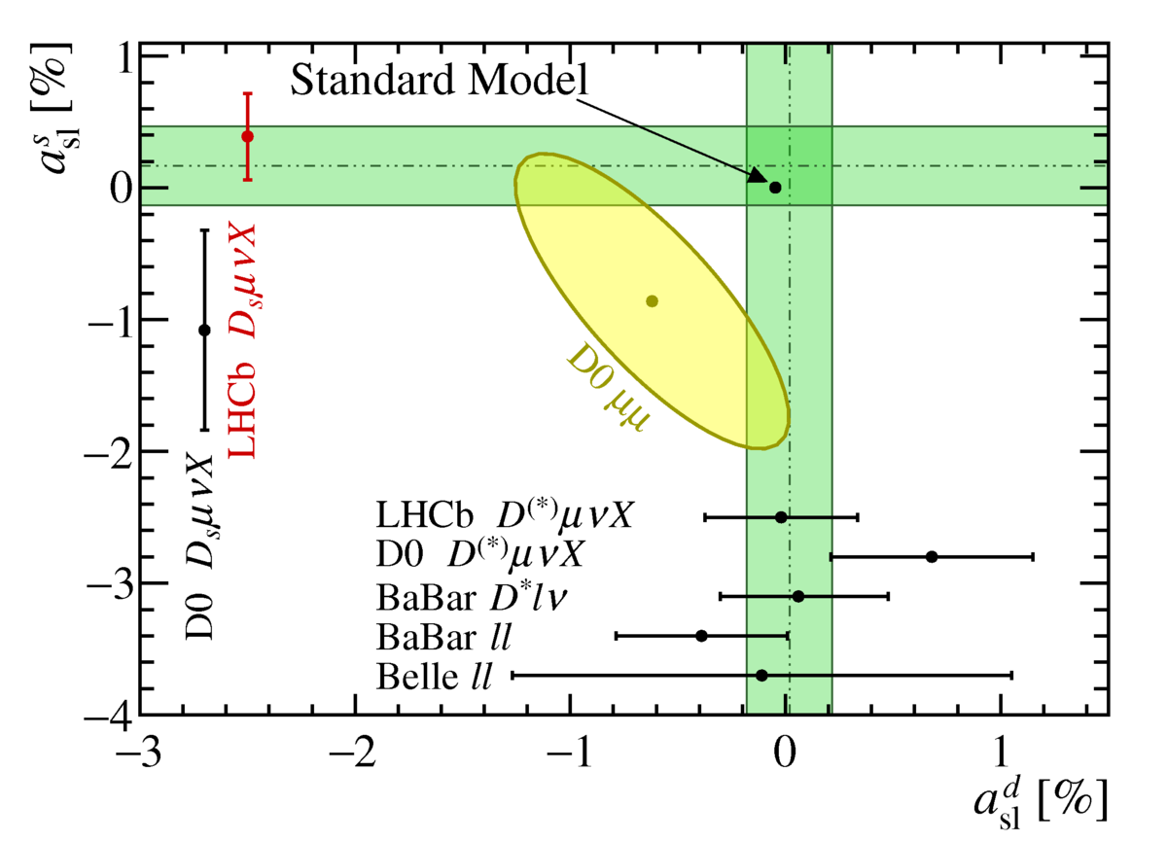
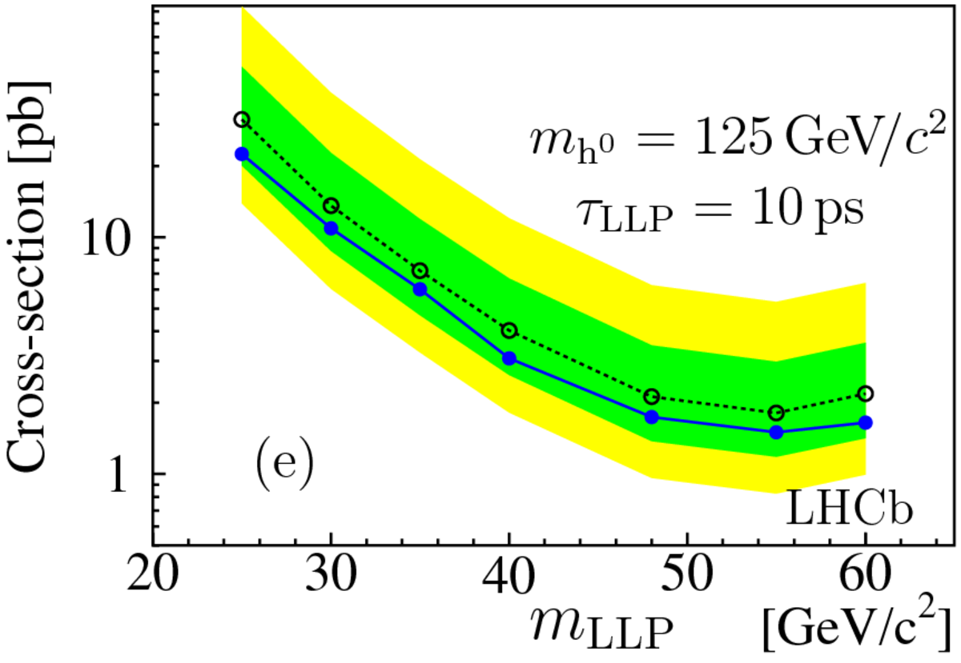
Nikhef Group Activities
Rare Decays: B_{s,d}→μμ, LFV:
A. Pellegrino, G. Onderwater, F. Archilli,
M. Mulder, M. v. Veghel
b to ccs (angle φ_{s}): B_{s}→J/ψφ, J/ψK_{s} , φφ:
G. Raven, P. Koppenburg, S. Benson,
V. Syropoulos, K. Govorkova
B to open charm (angle γ): B→D_{s}K/π:
N. Tuning, M. Merk, L. Bel
Semi-leptonic decays: a_{sl}^{d}, a_{sl}^{s} :
J. v. Tilburg, H. Wilschut, G. Ciezarek, J. de Vries, L. Dufour
Long-lived particles:
W. Hulsbergen, E. Dall’Occo
Vertex Detector:
W. Hulsbergen, M. v. Beuzekom, E. Jans, l. Bel, E. Dall’Occo
Main Tracker:
A. Pellegrino, N.Tuning, J. v. Tilburg, G.Ciezarek, J. de Vries, L. Dufour, L Bel, M. Mulder
High Level Trigger:
G.Raven, S. Benson, V. Syropoulos, M.v.Veghel
4σ

Slide 15
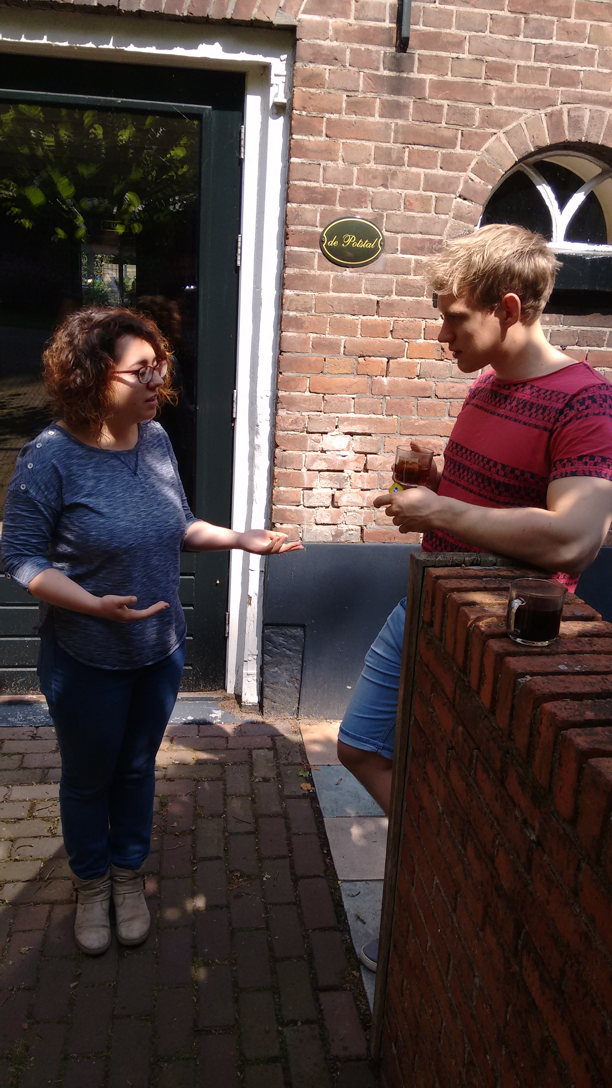
Talk-3: Elena Dall’Occo – “VeloPix Beam Tests”

Slide 16
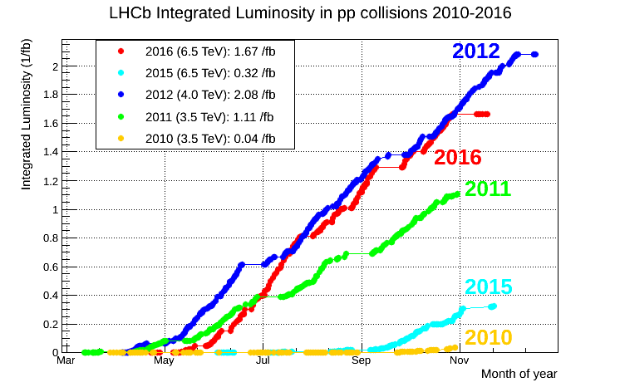
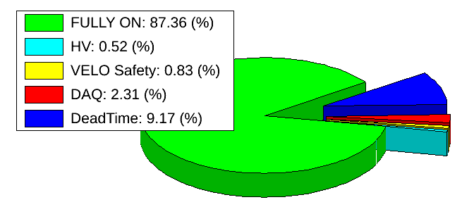
LHCb Status: “Dashboards”
Collected in total 5 fb⁻¹
- 7, 8, 13 TeV
Published 350 papers
- Excluding conf notes

Slide 17
Directly from the p-Pb run!
“Heavy Flavour in Heavy Ion”
Experiment is in excellent shape,
Many analyses underway.

Slide 18
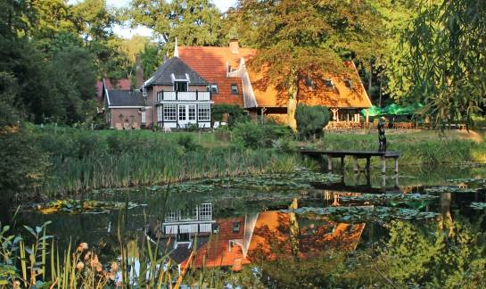
Bfys Workshop
“Horizons”
June 1 – 3, 2016, Erve Hulsbeek

Slide 19

“Horizons”
Think of a new idea (measurement, detector, technique) for LHCb and present scientifically.
Advertize the idea to a broad audience.
General discussion of the idea. Suggestions etc.

Slide 20
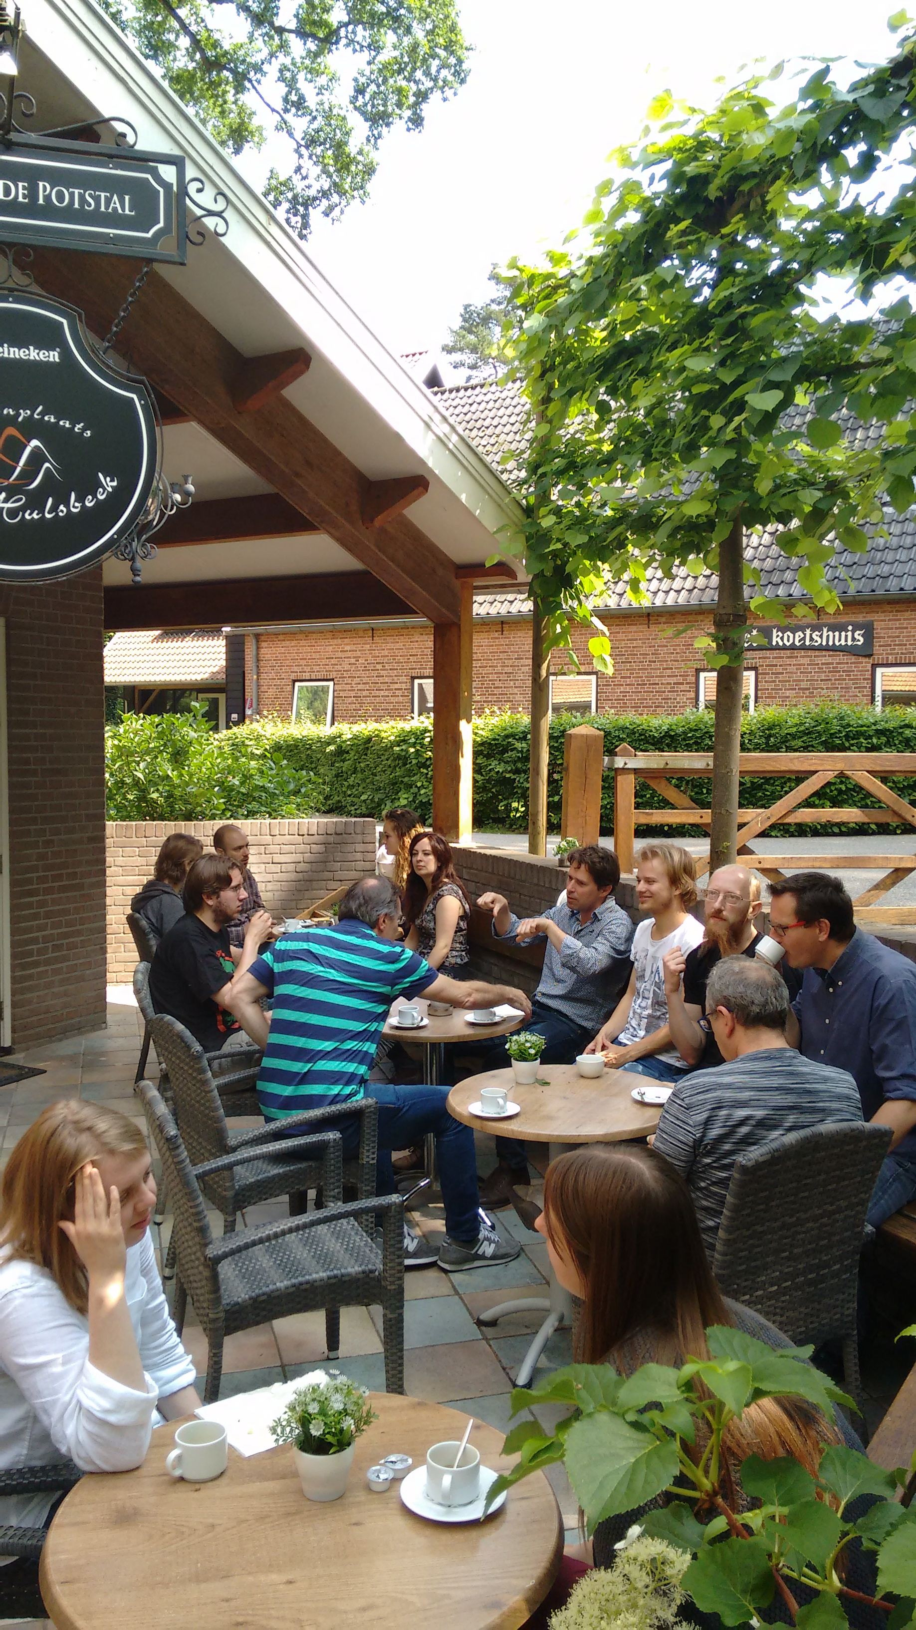
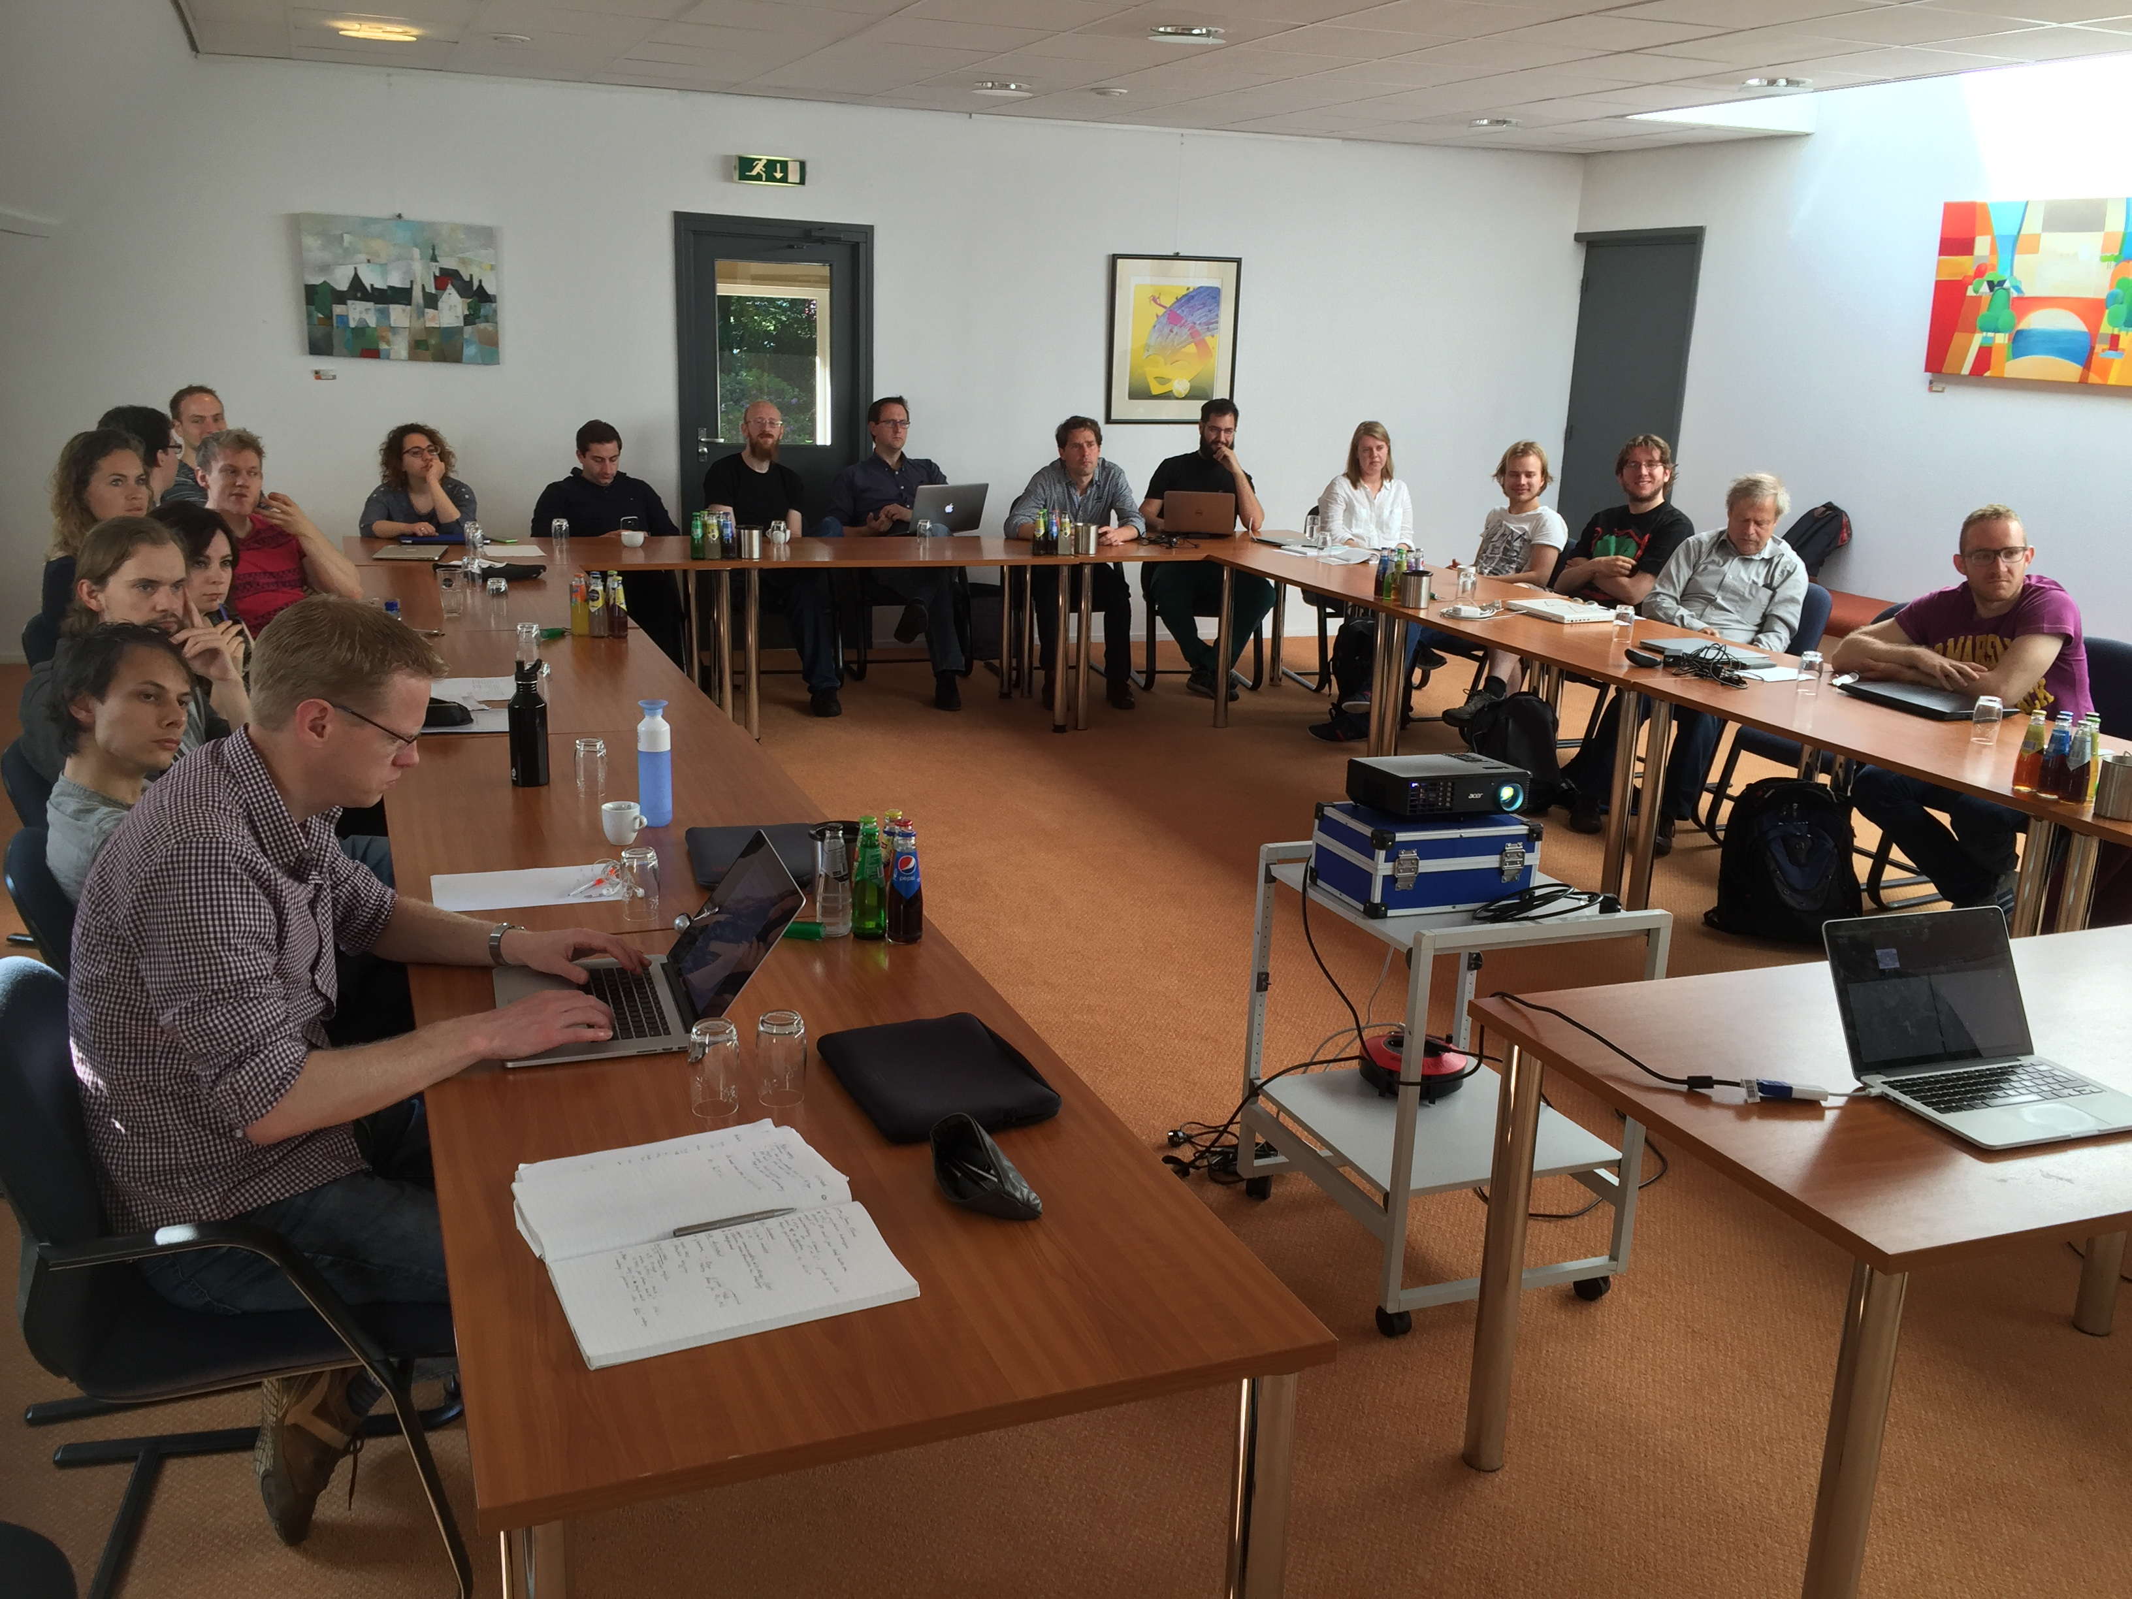
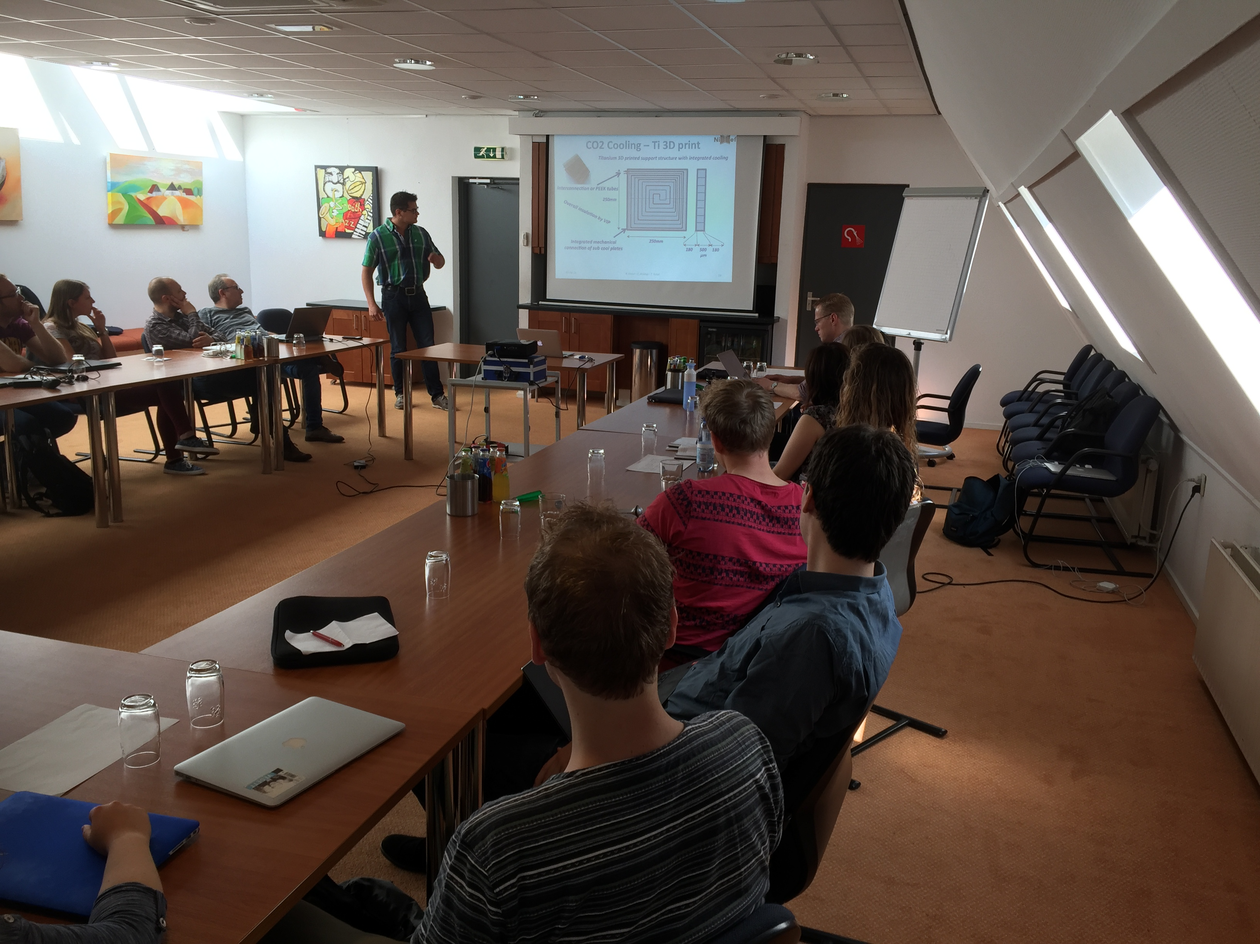

Hard work!

Slide 21
LHCb Schedule and long term plans
2019 | 2020 |  | 2021 | 2022 | 2023 | 2024 | 2025 | 2026 |  | 2027 | 2028 | 2029 | 2030 | 2031 | 2032 | 203+
 |  |  | Run III |  |  |  |  |  | Run IV |  |  |  |  |  | Run V
LS2 |  |  |  |  |  |  | LS3 |  |  |  |  |  | LS4
LHCb 40 MHz UPGRADE |  |  | L = 2 x 10³³ |  |  | LHCb Consolidation |  |  |  | L = 2 x 10³³ 50 fb⁻¹ |  |  | LHCb Ph II UPGRADE |  | L = 2 x 10³⁴ 300 fb⁻¹
ATLAS Phase I Upgr |  |  | L = 2 x 10³⁴ |  |  | ATLAS Phase II UPGRADE |  |  |  | HL-LHC L = 5 x 10³⁴ |  |  | ATLAS |  | HL-LHC L = 5 x 10³⁴
CMS Phase I Upgr |  |  | 300 fb⁻¹ |  |  | CMS Phase II UPGRADE |  |  |  |  |  |  | CMS |  | 3000 fb⁻¹
Belle II |  |  | 5 ab⁻¹ | L = 8 x 10³⁵ |  | 50 ab⁻¹
LHC schedule: Frederick Bordry, Jun 2015
Long Term Plan: make large steps in Lumi:
Run I + II : L = 4 x 10³² cm⁻² s⁻¹ : collect 3+5 fb⁻¹
On schedule
Run III + IV : L = 2 x 10³³ cm⁻² s⁻¹ : collect 50 fb⁻¹
Phase-1 Upgrade fully funded
Consolidation plans becoming concrete
Run V : L = 2 x 10³⁴ cm⁻² s⁻¹ : collect 300 fb⁻¹
Phase-2 upgrade “EoI” prepared for next LHCC

Slide 22
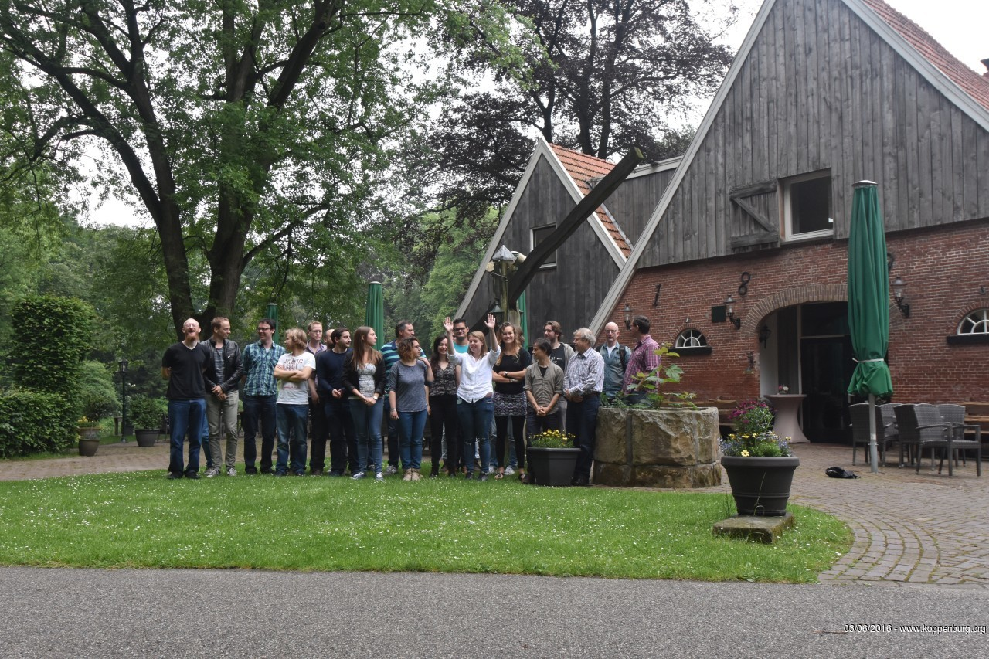
Katya is excited about LHCb…

Slide 23
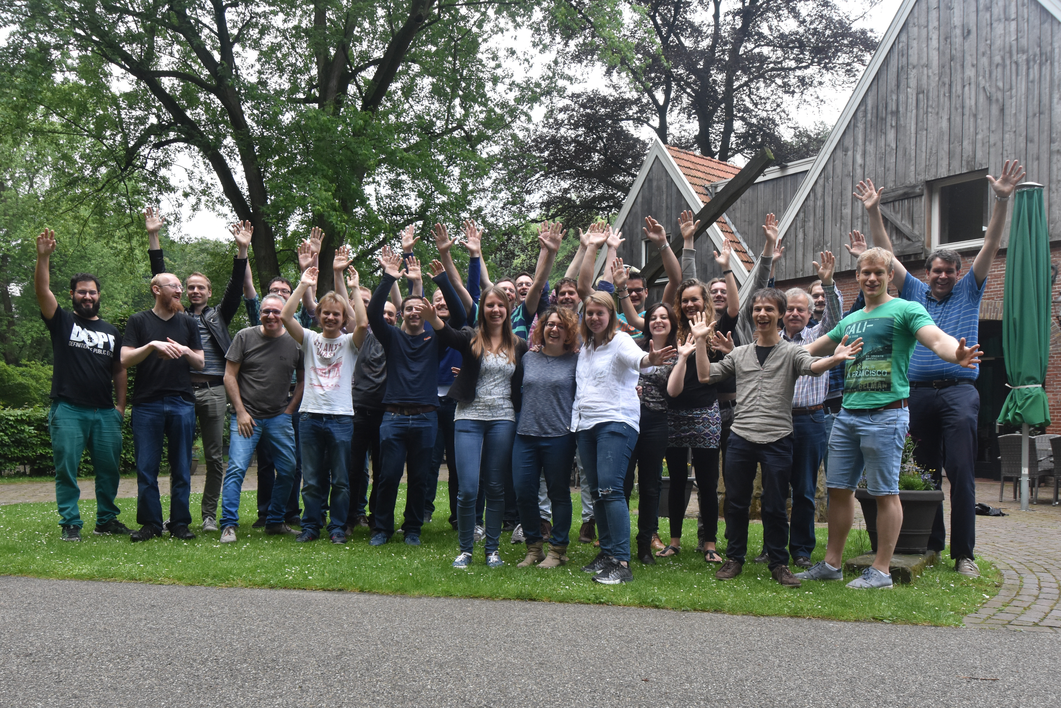
…and so are we!

Slide 24
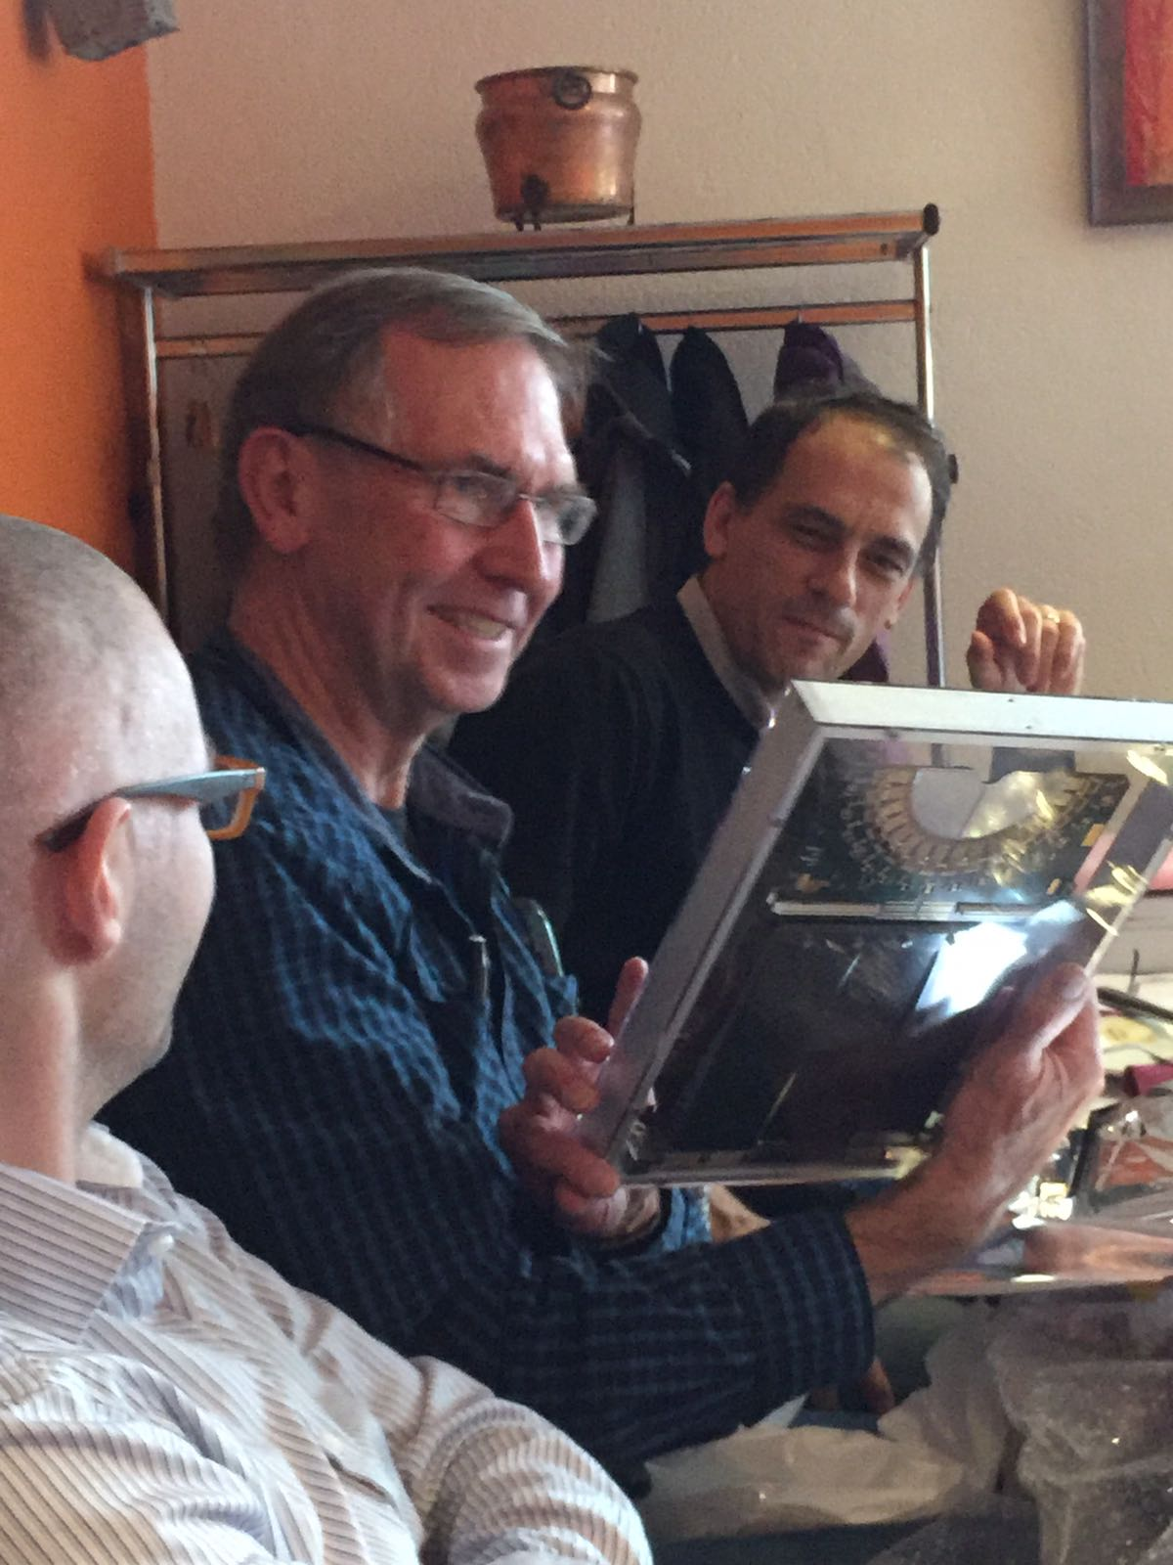

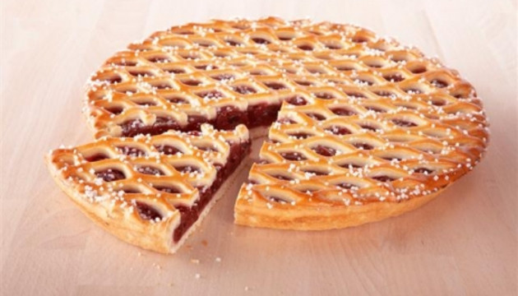
Congratulations Eddy!
On Thursday Dec 15 at 10h00
You are welcome to join Eddy for a…

Slide 25
LHCb and Vista25

Slide 26
Flavour Physics
Flavour Puzzles:
• Why are there three particle generations?
• What explains masses and interaction strengths?
• New particles and sources of CP Violation?
➔LHCb: Studies physics beyond TeV scale.
Track record of indirect discoveries:
K⁰→μμ: charm prediction GIM
CPV K_{L}⁰→ππ: 3rd generation
B-mixing: large top-mass
EW Z-physics: H mass prediction

Slide 27
The Precision Frontier
Large potential to study Beyond SM physics: B-physics, Charm, EDM’s, Kaons, g-2, …
W. Altmannshofer
Coll. Aspen, 2014
Nikhef + VU + RuG have unique opportunity for coherent precision flavour program!

Slide 28
LHCb’s “No-lose Theorem” for Future
LHCb will provide order of magnitude improvements in:
Precision measurements on fundamental couplings,
Mass range for searches for new particles or forces beyond LHC energy scale.
LHCb complements B-physics with:
Charm and Strange physics
Electroweak (W,Z physics)
Central Exclusion Production physics
Spectroscopy and Quarkonia (tetra-q/penta-q)
Heavy Ion Physics
LHCb will:
Publish 50++ publications/year
Give high visibility for students: ~ 2 publications+conf’s for our PhD students.
LHCb will continue to develop state-of-the-art technology
Upgrade: 40 MHz event-rec, VeloPix μ-channel cooling, SciFi with SiPM at -40ºC,
Allowing students to work on challenging hardware and analysis.

Slide 29
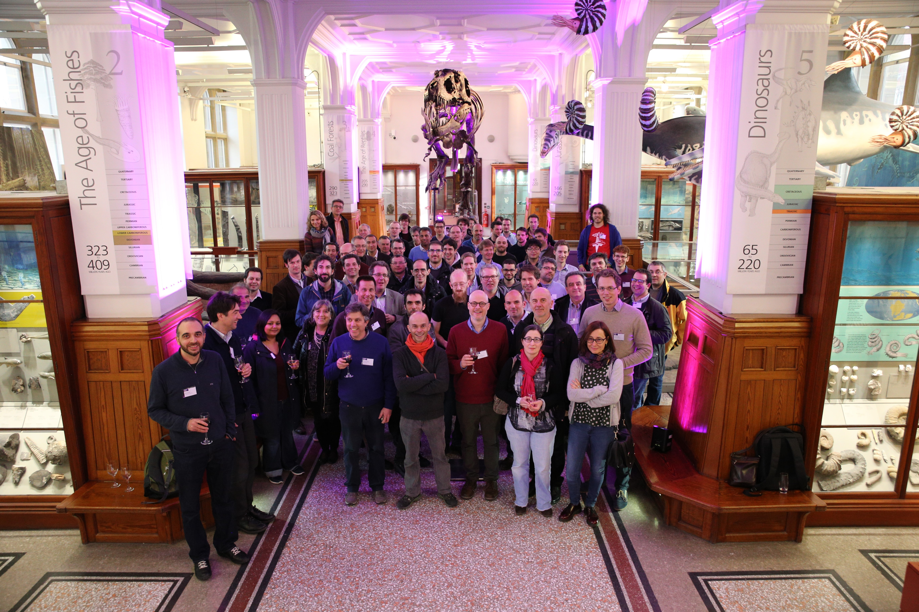
LHCb “Think Tank for Future Upgrades”
Physics Proposal: “LHCb Expression of Interest for phase-II” being prepared.
To be presented to LHCC in early 2017.
LHCb will have an exciting future beyond 2025:
We propose to play a leading role in that future.

Slide 30
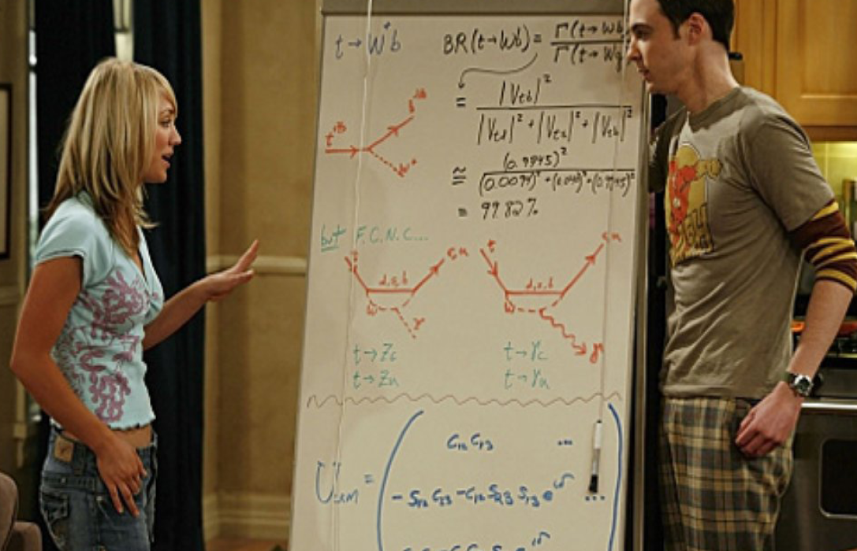
Flavour Physics as seen by Sheldon…

Slide 31
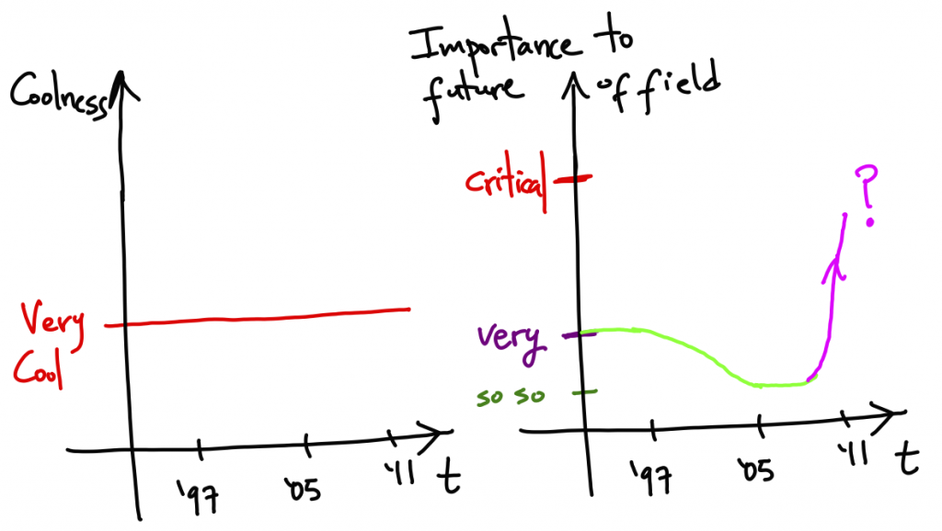
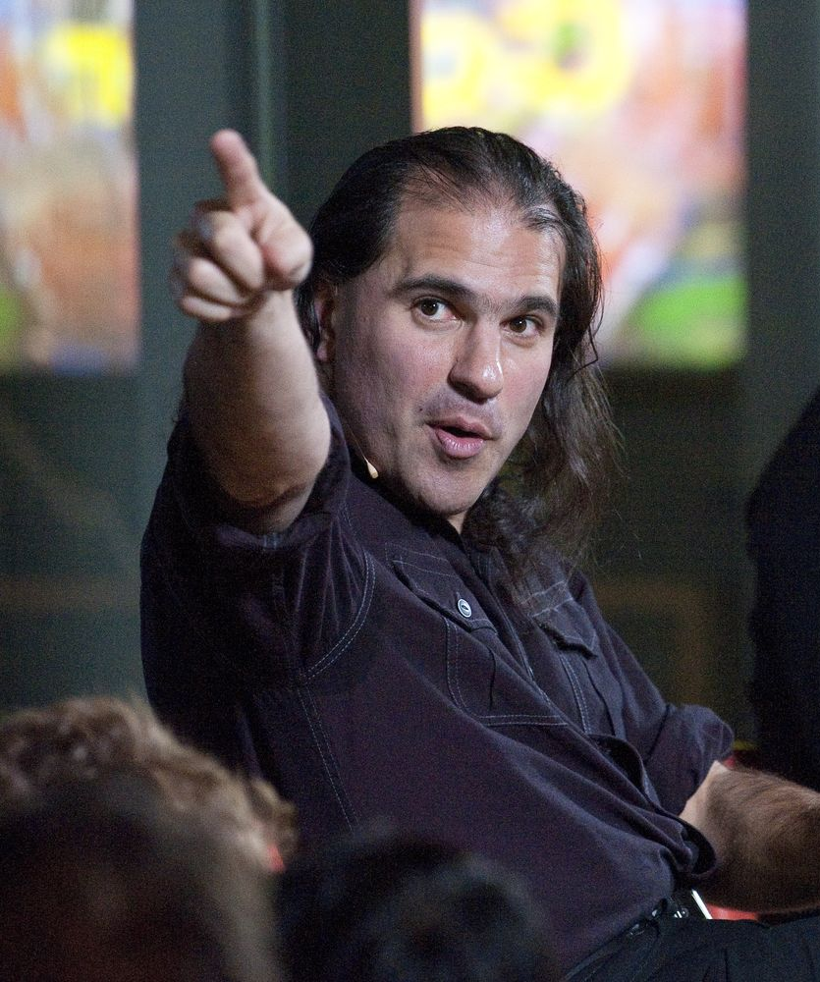
Flavour Physics as seen by Sheldon…
and Nima...
Very cool and of critical importance!

Slide 32
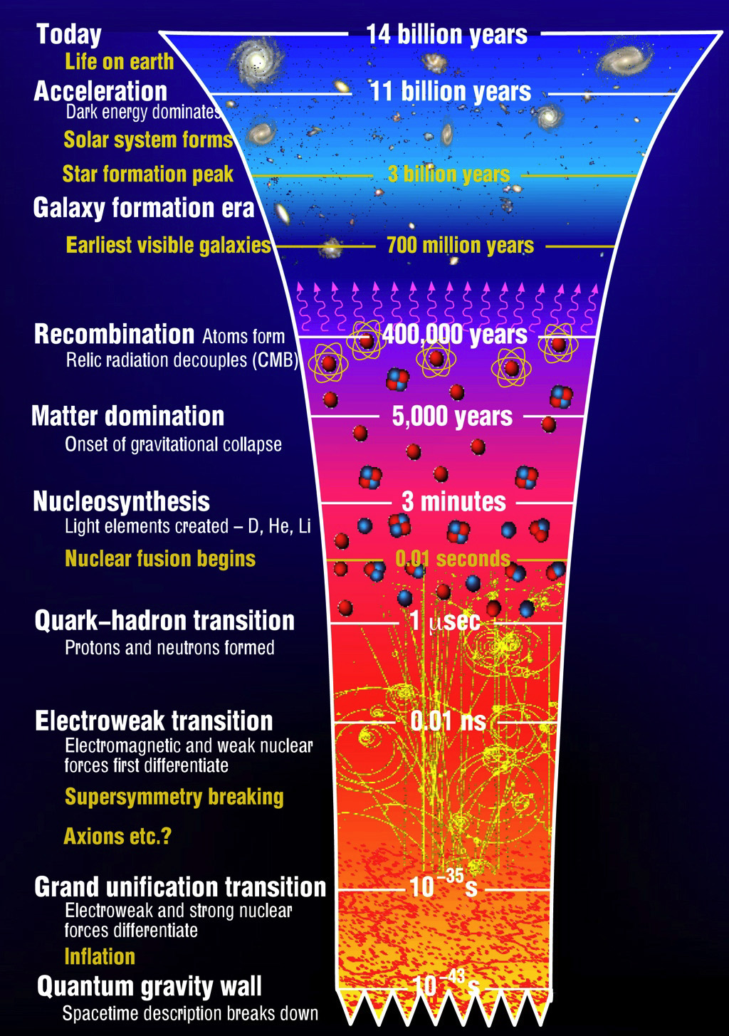
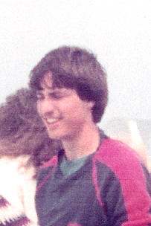
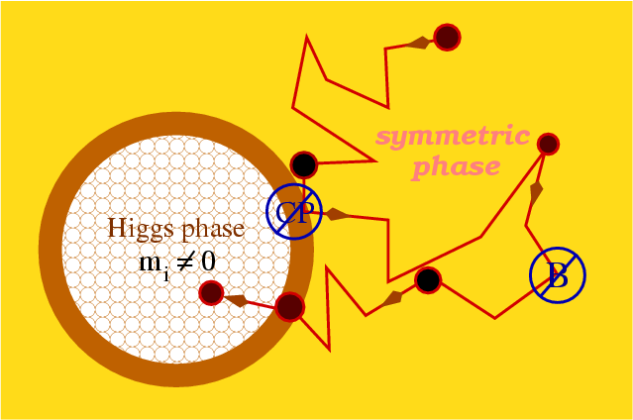
Finally: my personal view…
?
Do all matter-antimatter asymmetries originate from Higgs-Yukawa coupling?
Since adolescence a dream for me to do science on fundaments of nature,
These days of LHC physics are the highlight of my scientific life,
Each day I learn from science at the LHC, future is even more exciting!
EW Symmetry Breaking (mass)

