Slide 1
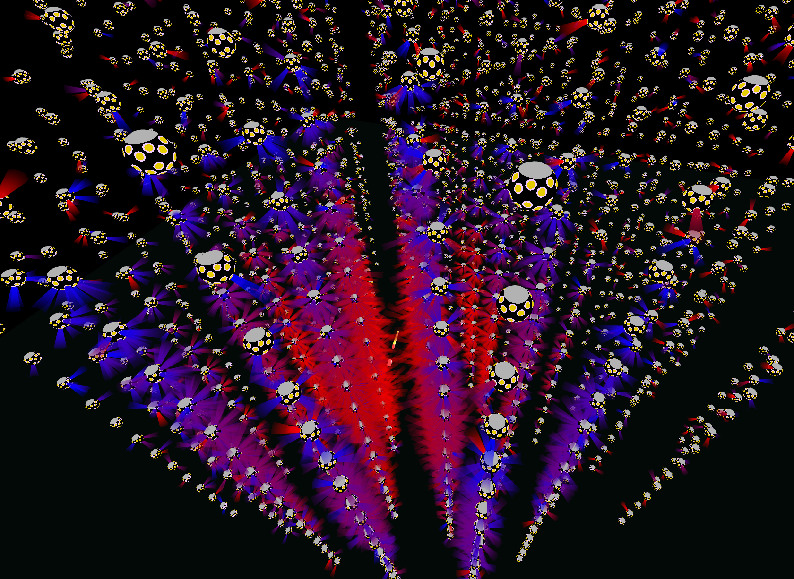
Elevotor Pitch
(nikhef elevator to 3rd floor)

Slide 2
The birth of neutrino astronomy
IceCube discovery is
(just)
the dawn of neutrino
astronomy
Julia Tjus

Slide 3
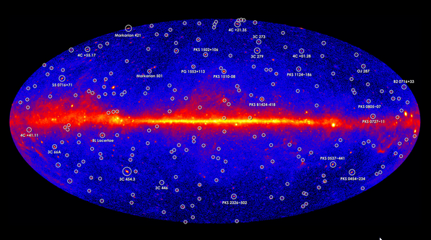
The birth of neutrino astronomy
IceCube discovery is
(just)
the dawn of neutrino
astronomy
Gamma ray sky now
… neutrino sky in 2030.
Julia Tjus

Slide 4
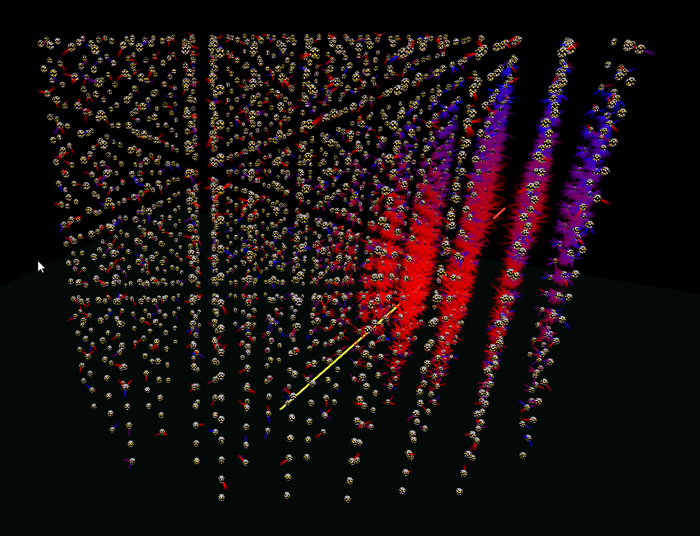
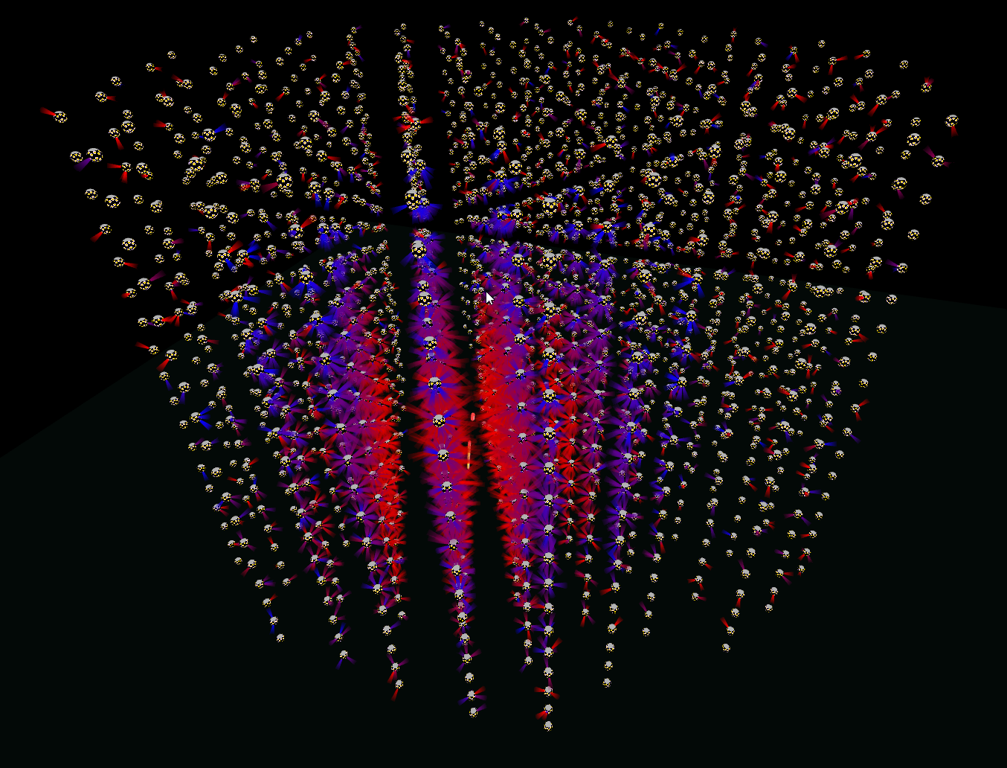
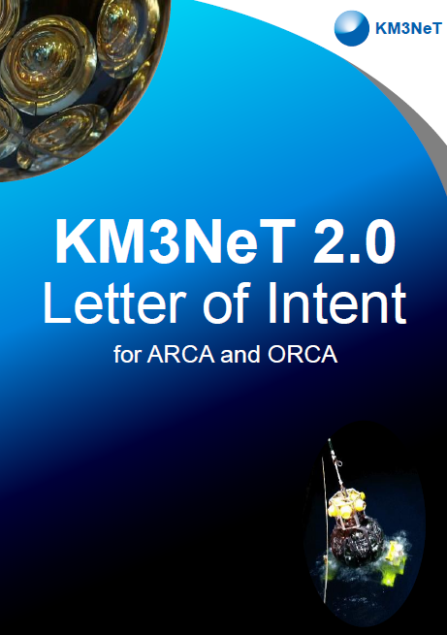
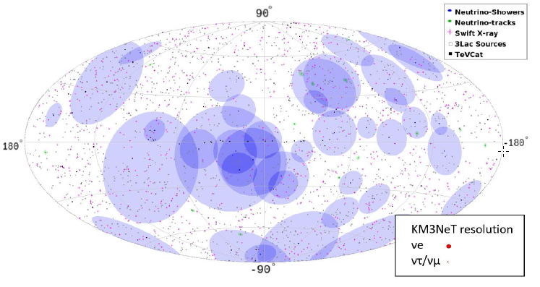
Expect by 2020…
Completion of ARCA and ORCA
Establish neutrino mass hierarchy (+ many other parameters)
Identify the sources of high energy cosmic neutrinos observed by IceCube
Firmly establish water as ideal detection medium
All-flavor neutrino studies

Slide 5
Expect by 2020…
Completion of ARCA and ORCA
Establish neutrino mass hierarchy (+ many other parameters)
Identify the sources of high energy cosmic neutrinos observed by IceCube
Firmly establish water as ideal detection medium
All-flavor neutrino studies
#daaromKM3NeT
Establish sources
Use source knowledge to find more neutrinos

Slide 6
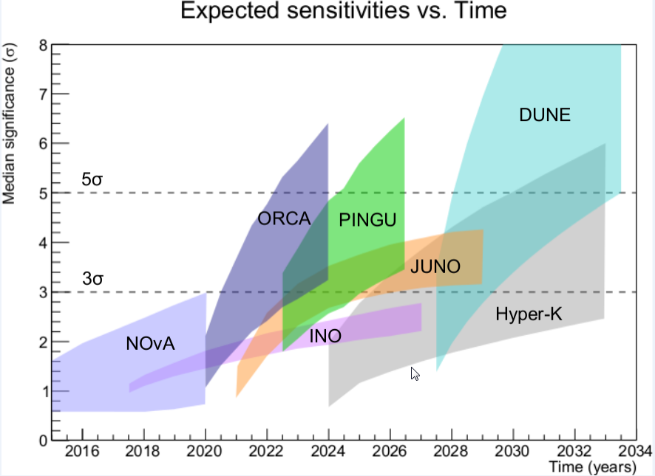
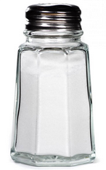
competition
Grains
of salt
ORCA can be very competitieve
First lines 2016 + good prospects for more funding
Fast deployment possible (no accelerator, no polar logistics)
Community starts to take note.

Slide 7
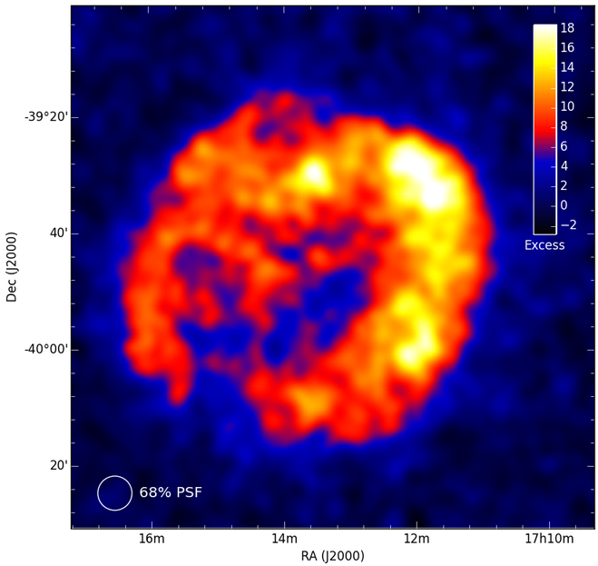
Beyond KM3NeT 2.0
Next phase: concept already exists
6 building blocks of (115 lines)
Include Greek site
Galactic sources (supernova remnants)
but I want to talk about:
High energy neutrino physics (with KM3NeT 2.0)
Big questions: How do neutrinos get Mass? Do they violate CP? Leptogensis?
Cosmic neutrinos :
A, now, guaranteed source of very high energy (up to >PeV) neutrinos
ν telescopes : Only place to study neutrinos at this energy scale.
They travel for very long times though the Universe
Galactic (also guaranteed) : 10000 years
Extra-galactic 10⁸ yr or more.
If we identify the sources, we know the baseline
Probe whole new class of extremely rare processes, unobservable in Earth-size baselines

Slide 8
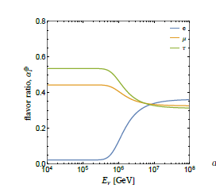
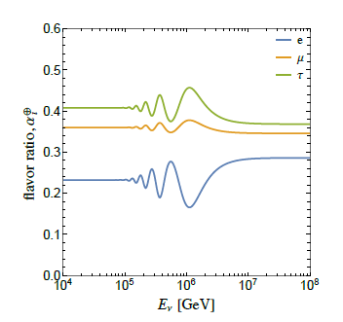
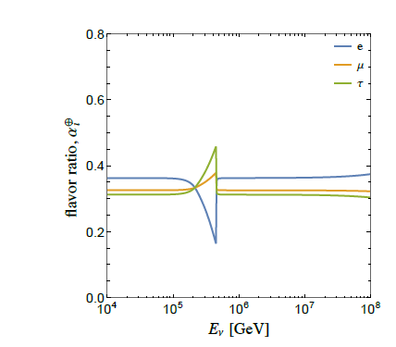
Physics at a PeV
Once we have a collection of cosmic neutrinos, with identified source objects:
Know the beamline
Understand source physics (= initial flavor composition)
Flavour composition on Earth probes (exotic) neutrino oscillations.
Neutrino decay
(majoron induced)
Pseudo-dirac neutrinos:
See-saw with very light Majorana
mass -> right handed neutrinos
have tiiiny mass difference with left handed neutrinos.
Oscillations over huge lengths
Scattering on CνB
(new interaction)
 | arXiv:1512.07228

Slide 9
Physics at a PeV
Once we have a collection of cosmic neutrinos, with identified source objects:
Know the beamline
Understand source physics (= initial flavor composition)
Flavour composition on Earth probes (exotic) neutrino oscillations.
Neutrino decay
(majoron induced)
Pseudo-dirac neutrinos:
See-saw with very light Majorana
mass -> right handed neutrinos
have tiiiny mass difference with left handed neutrinos.
Oscillations over huge lengths
Common denominator of models:
Mechanisms for neutrino mass generation
Scattering on CνB
(new interaction)
 | arXiv:1512.07228

Slide 10
Conclusion
2020:
ORCA: mass hierarchy + broad oscillations program
ARCA: Identify IceCube-flux sources -> neutrino physics at PeV
2025++:
Still Running ARCA+ORCA
(hopefully global) effort to build next generation:
Study any sources, Galactic + extra-galactic
δ_{cp} together with Dune, hyperK?

Slide 11
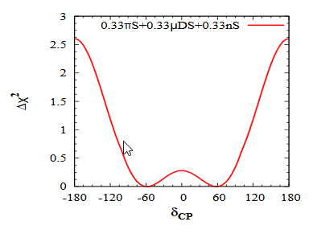
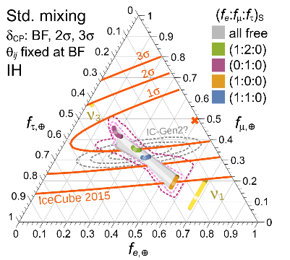
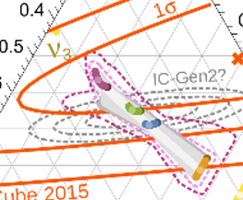
CP at a PeV
IC data already
Some sensitivity
IF you assume the
Initial flavor mix
Value of dcp influences flavor ratio’s (not much, but still…)
Need to know source fluxes
Measure flavor ratios with %-level accuracy

Slide 12
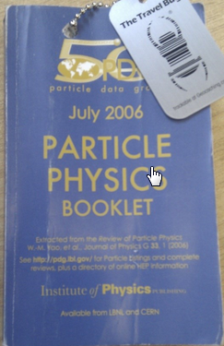
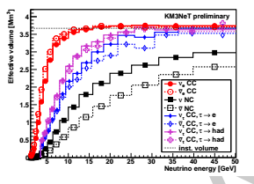
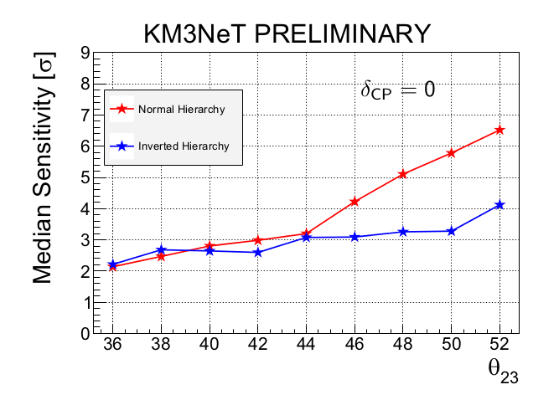
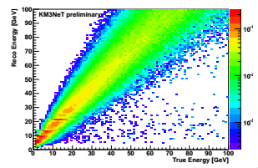
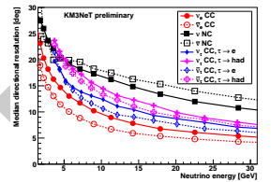
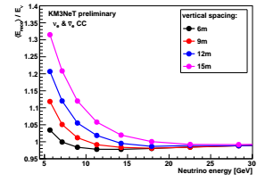
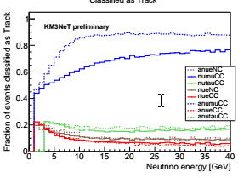
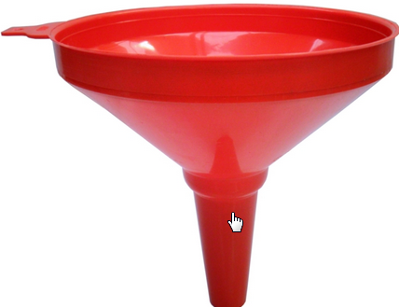
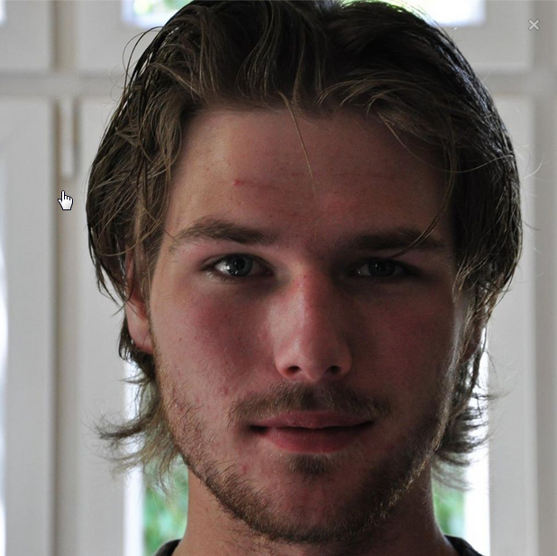
Sensitivity calculation
~3 sigma in 3 years
Depending on nature
Measure Δm² & θ₂₃ precisely

Slide 13
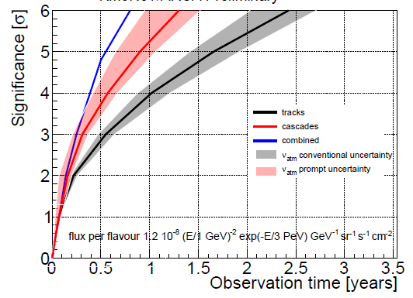
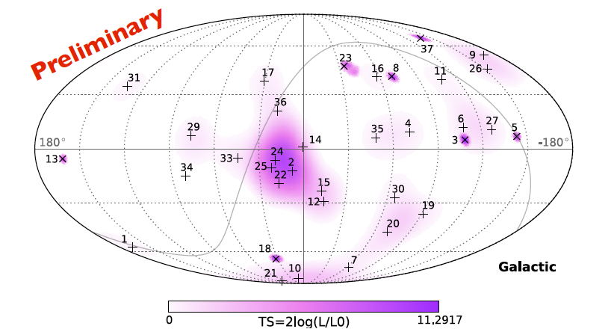
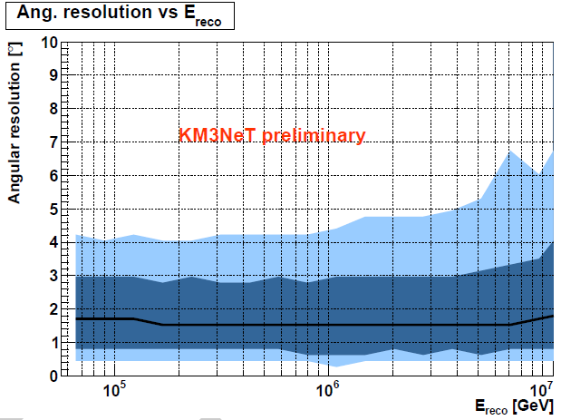
Neutrino astronomy
IceCube
Evidence for cosmic neutrinos increasing - IC sees it in several samples
Sources not identified
Soft spectrum/cut-off
Hints of Galactic Component
Flavour ratios carry physics
KM3NeT/ARCA can see the signal within 1 year, and do high-resolution all-flavour follow-ups
Angular resolution for cascades factor >5 better than IceCube
Now demonstrated in
Antares data too
Stronger
Case for
KM3NeT

Slide 14
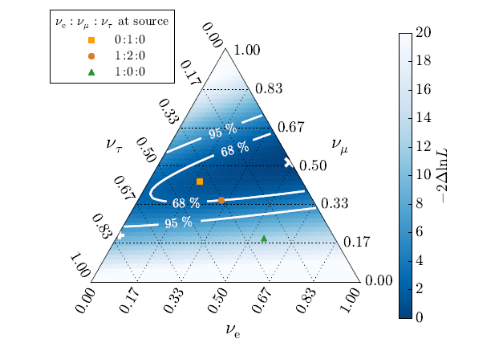
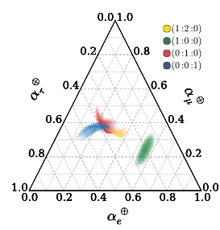
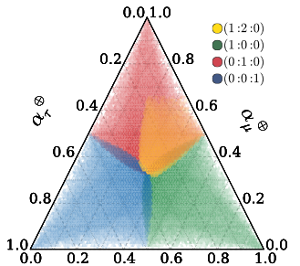
Flavour ratios => physics
Phys.Rev.Lett. 115 (2015) 161303
IceCube flavour ratio fit
ν_{μ}
SM
NP
ν_{τ}
ν_{e}
New physics affects flavour ratios of cosmic neutrinos.
non-standard interaction, Lorentz-invariance violation, ν-decay, steriles…
Works better when sources are understood
(and then, can also probe δ_{cp})
KM3NeT will contribute a lot here
Fit to IceCube data consistent
with 1:1:1

