Slide 1
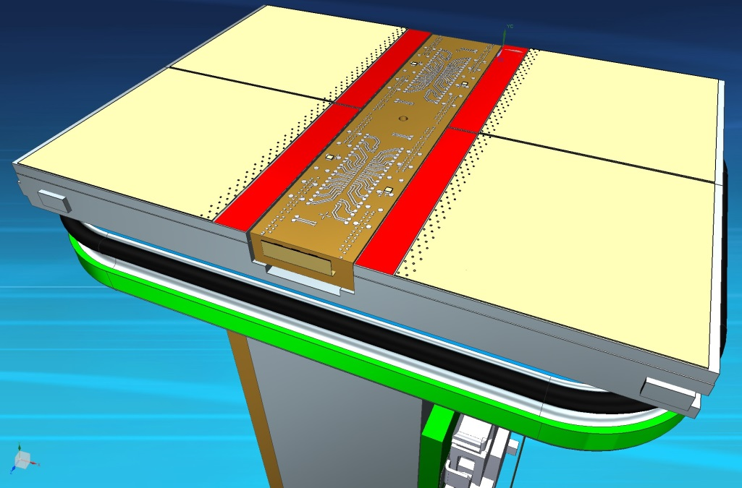
Lepton Collider program
Peter Kluit
Nikhef Annual meeting 15 December 2016

Slide 2
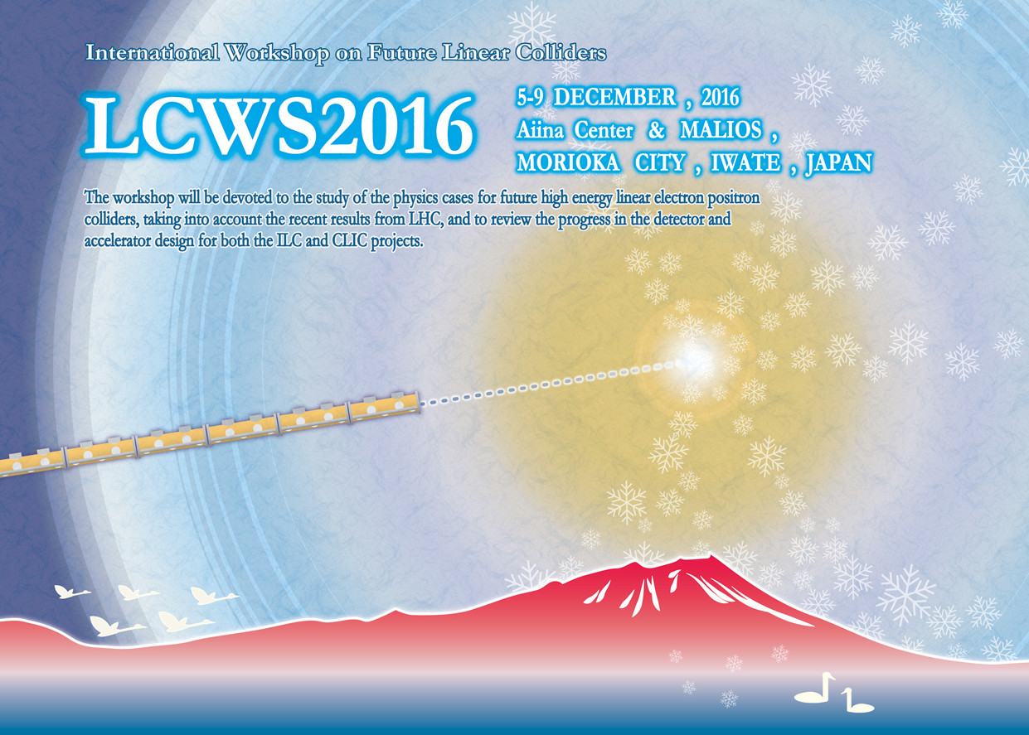
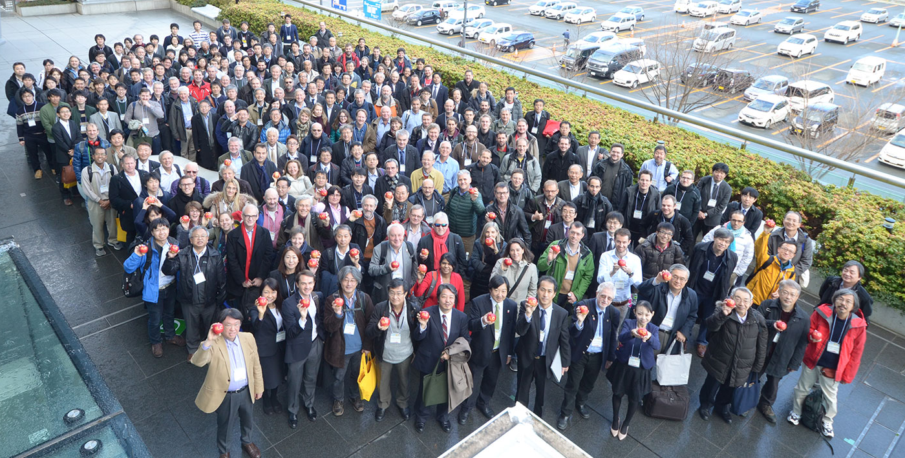
The International Linear Collider
The physics case will be discussed at vista 25

Slide 3
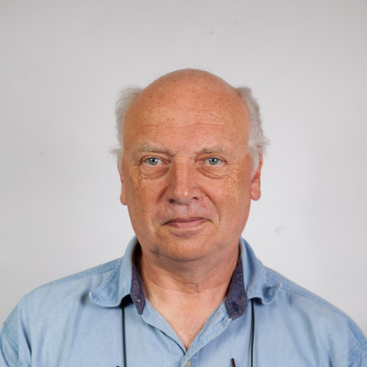
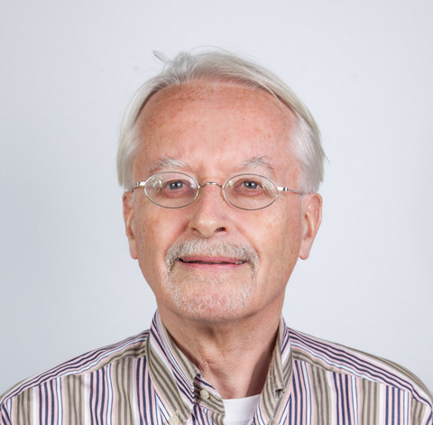
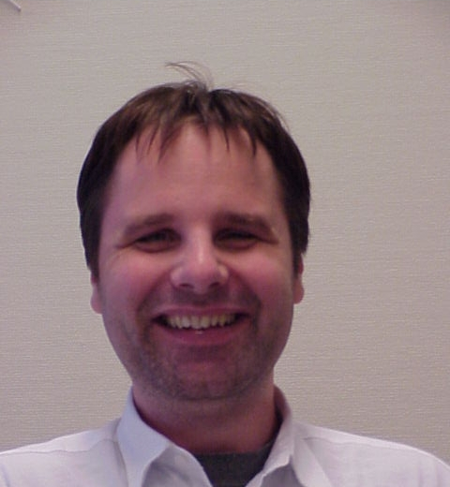
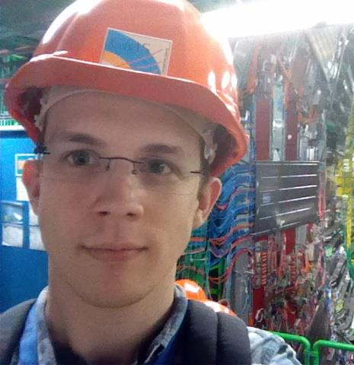
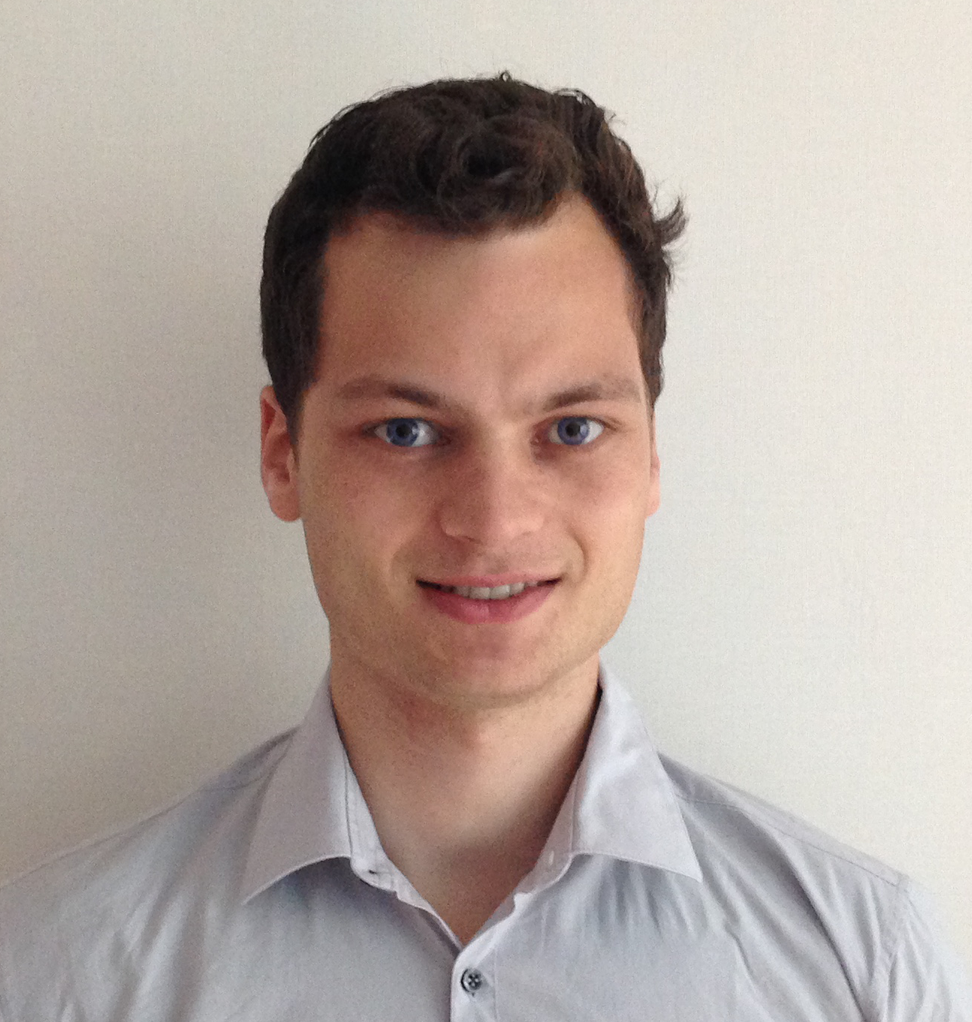
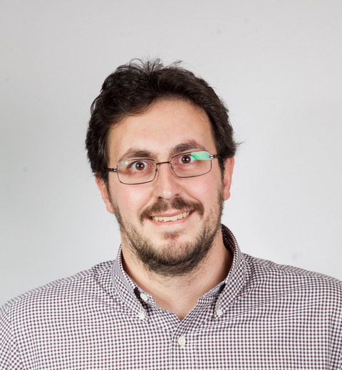
Lepton Collider program
the people involved…
Harry van der Graaf
Fred Hartjes
Jan Timmermans
Gerhard Raven
Stergios Tsigaridas
Peter Kluit
Wouter Bos Master student
Kevin Heijhoff PhD
oct 2016 pixel TPC Bonn/Nikhef
Kees Ligtenberg PhD
sep 2016 ILC simulations

Slide 4
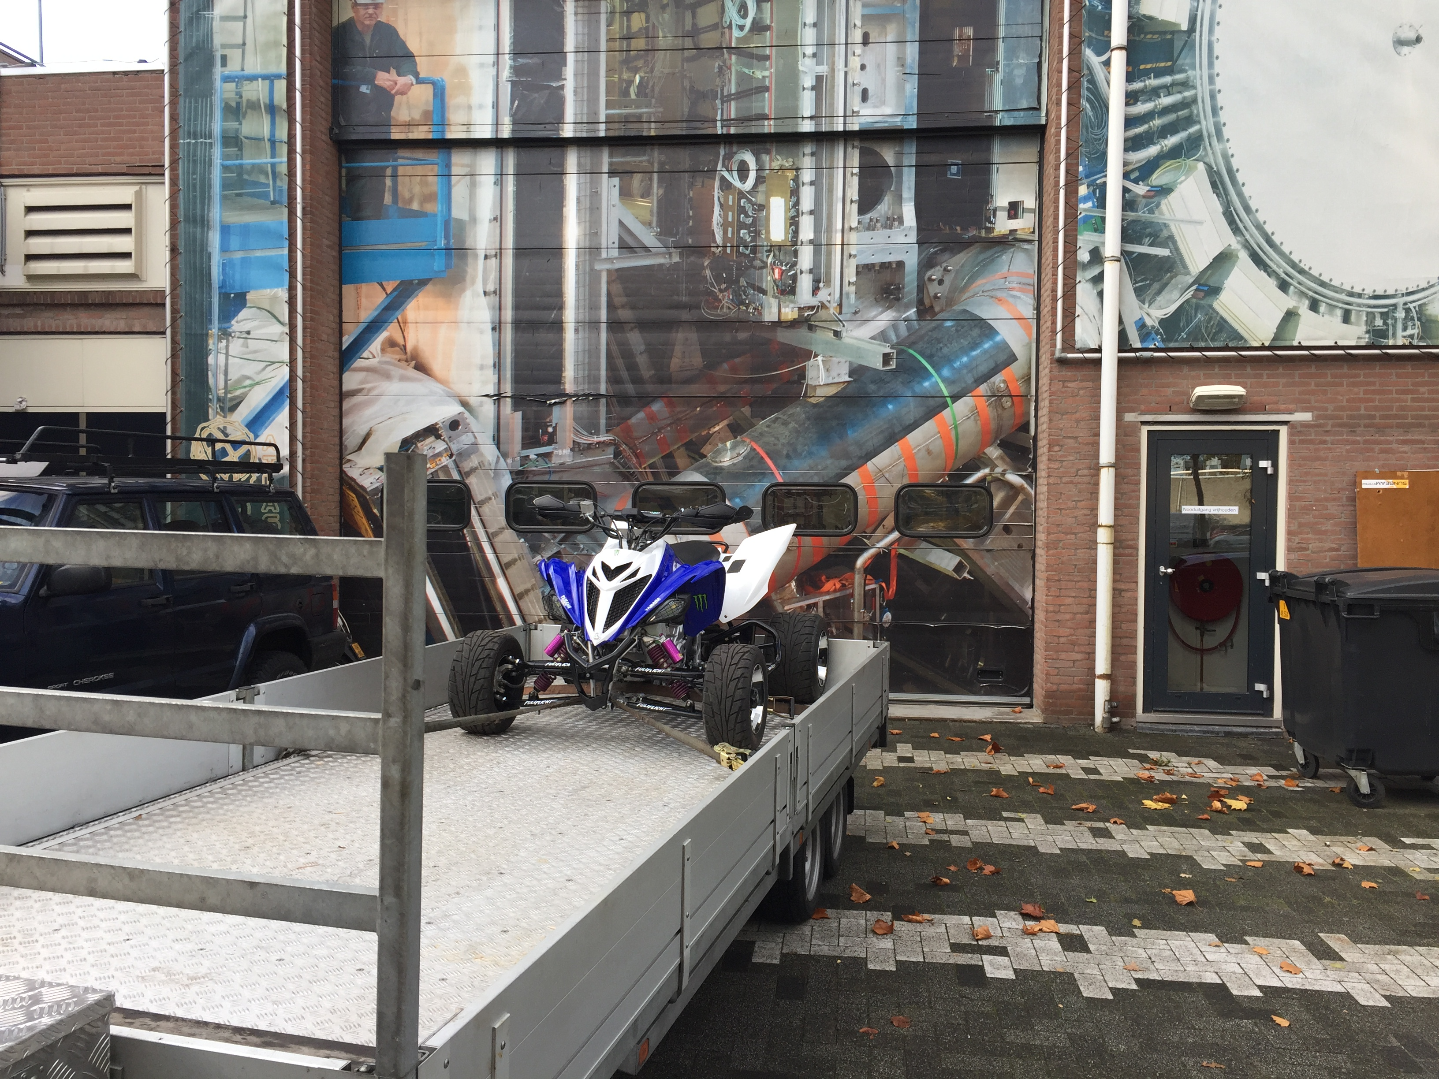
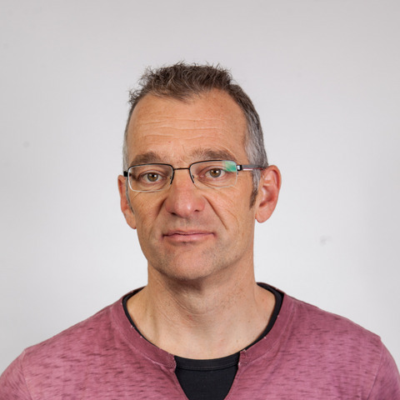
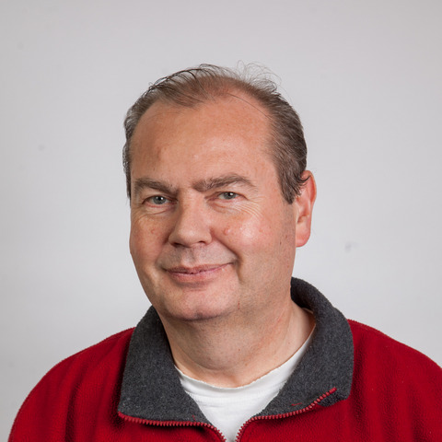
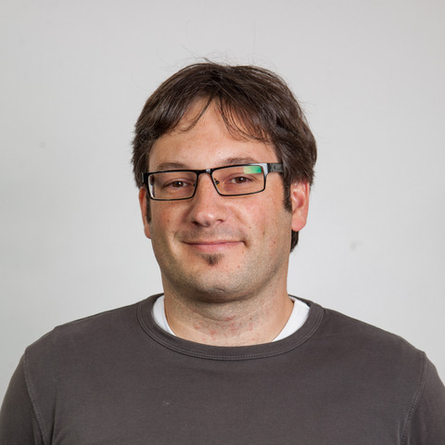
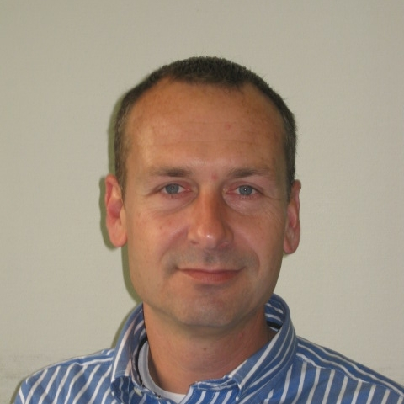
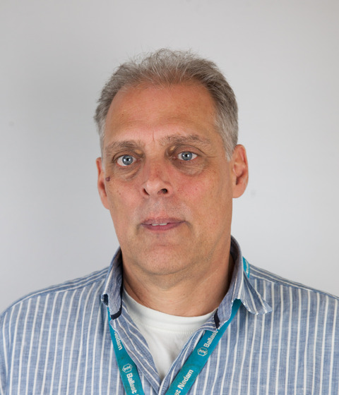
Lepton Collider program
the Quad team & Bonn…
Ruud Kluit, Auke Korporaal,
Patrick Werneke,
Charles Ietswaard,
Bas van der Heijden et al
University of Bonn group
Yevgen Bilevych, Klaus Desch, Jochen Kaminiski, Kevin Heijhoff, Tobias Schiffer,
Lucian Scharenberg, Christof Krieger, Sebastian Schmidt, Andrea Fürstenberg

Slide 5
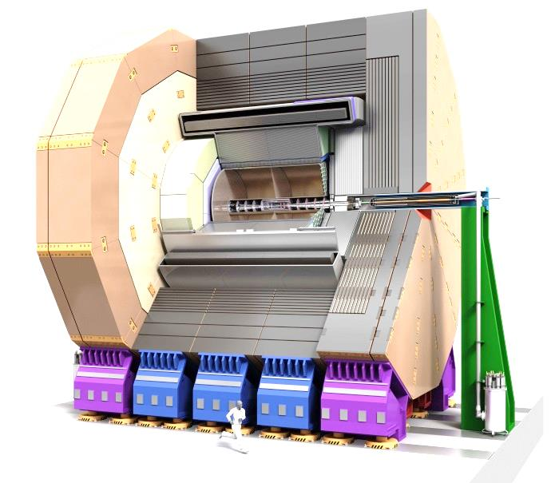
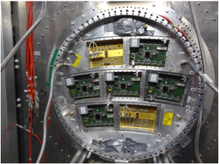
What happened @ Nikhef?
Made in 2015 proposal for a Lepton Collider
program to the WAR:
we currently don’t know which machine will be built (and when)
most interested physicists will only work part time
focus the R&D on the pixel readout of the TPC in ILC/ILD
modest resources for TPC module
request 2 PhD students
The director has given follow up on this and launched an “initiatief programma”
close Collaboration with Bonn
2 PhD students (one shared with Bonn)
Made an OPP proposal that was granted to build a quad (4 chips)
a first step towards a TPC module (100 chips)
ILD detector
TPC end plate
modules DESY

Slide 6
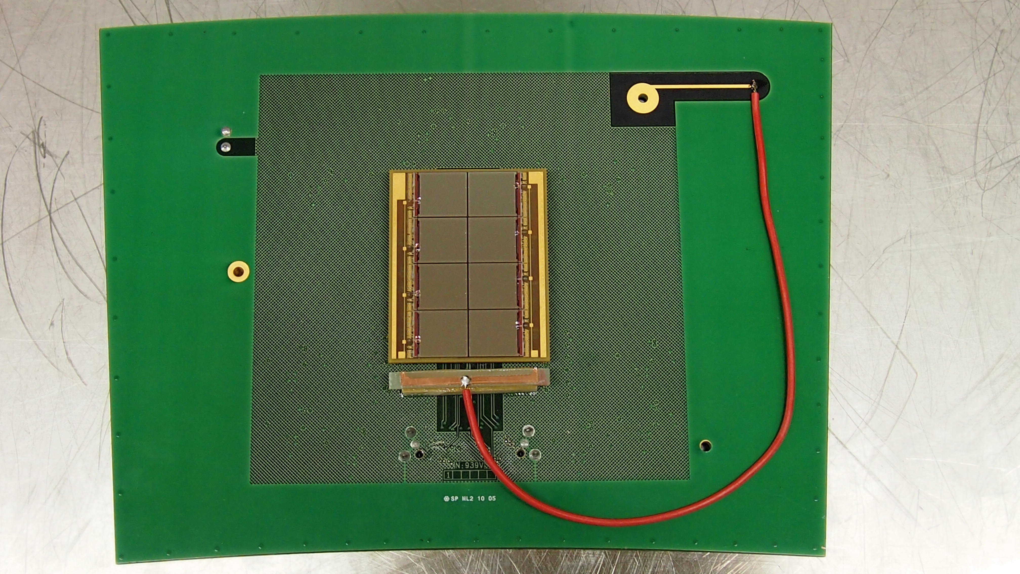
Nikhef-Saclay Octopuce GridPix
GridPix chip (1x1) 14 x 14 mm
Octopuce (2x4) 28 x 56
Module (≈100)
2nd generation of chip
Since 2015/2016 we have a TimePix 3 chip

Slide 7
Test beam DESY performance
Module 1 is in great shape
320 V and B=1 T z = 1cm
all
100 μm
about 40 hits per fully crossed chip
Resolution 100 μm per hit. (ExB) Deformations at the edges of the board are under control and systematics per chip less than 20 μm. This is good enough for a TPC (Jan & Peter).

Slide 8
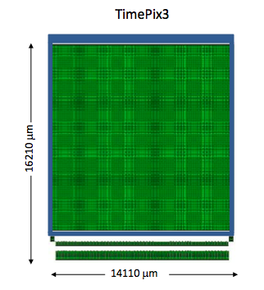
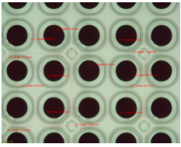
TimePix 3 single chip with Bonn/IZM InGrid
zoom on grid
with InGrid
Sparking and the protection layer 4 μm Si_{x}N_{y}
- Origin of sparks and detector failure was tracked down to cracks in protection layer. A careful cleaning and monitoring process was developed at IZM.
Extensive sparks tests have been done at Bonn taking more than a million sparks without detector failure.
At CERN also sparking tests in a hadron beam have beam successfully performed (Stergios, Kevin & Fred)

Slide 9
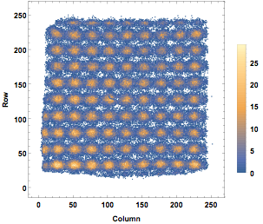
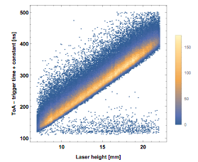
TimePix 3 single chip laser tests
Kevin, Fred @ Nikhef
Laser spots each ≈1 mm scan the single chip detector
Deformations at the edges are due to the not yet optimally matched Guard potential
TimePix 3 allows for a precise time of arrival measurement

Slide 10
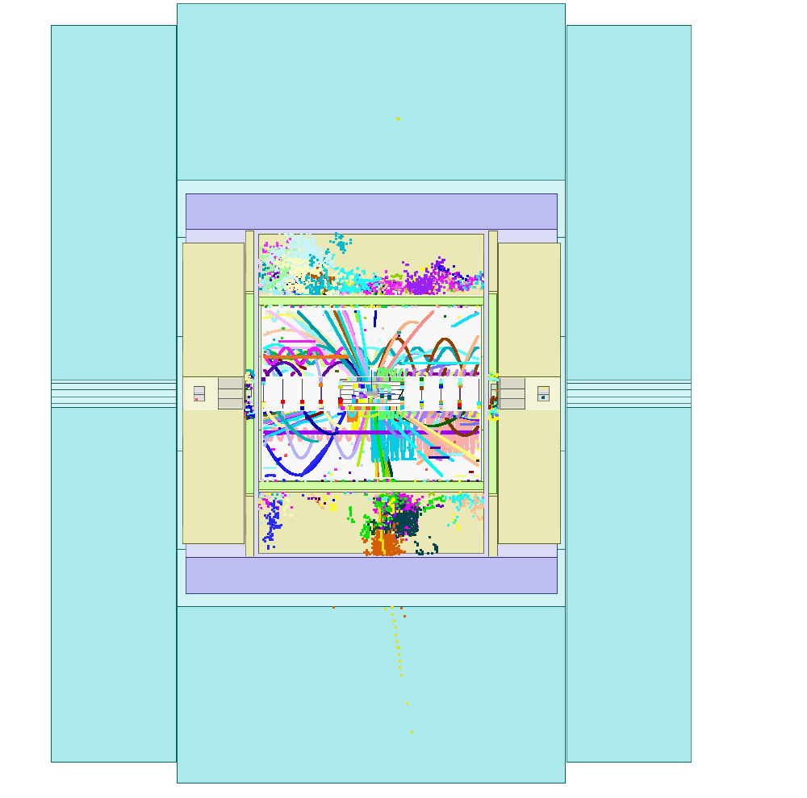
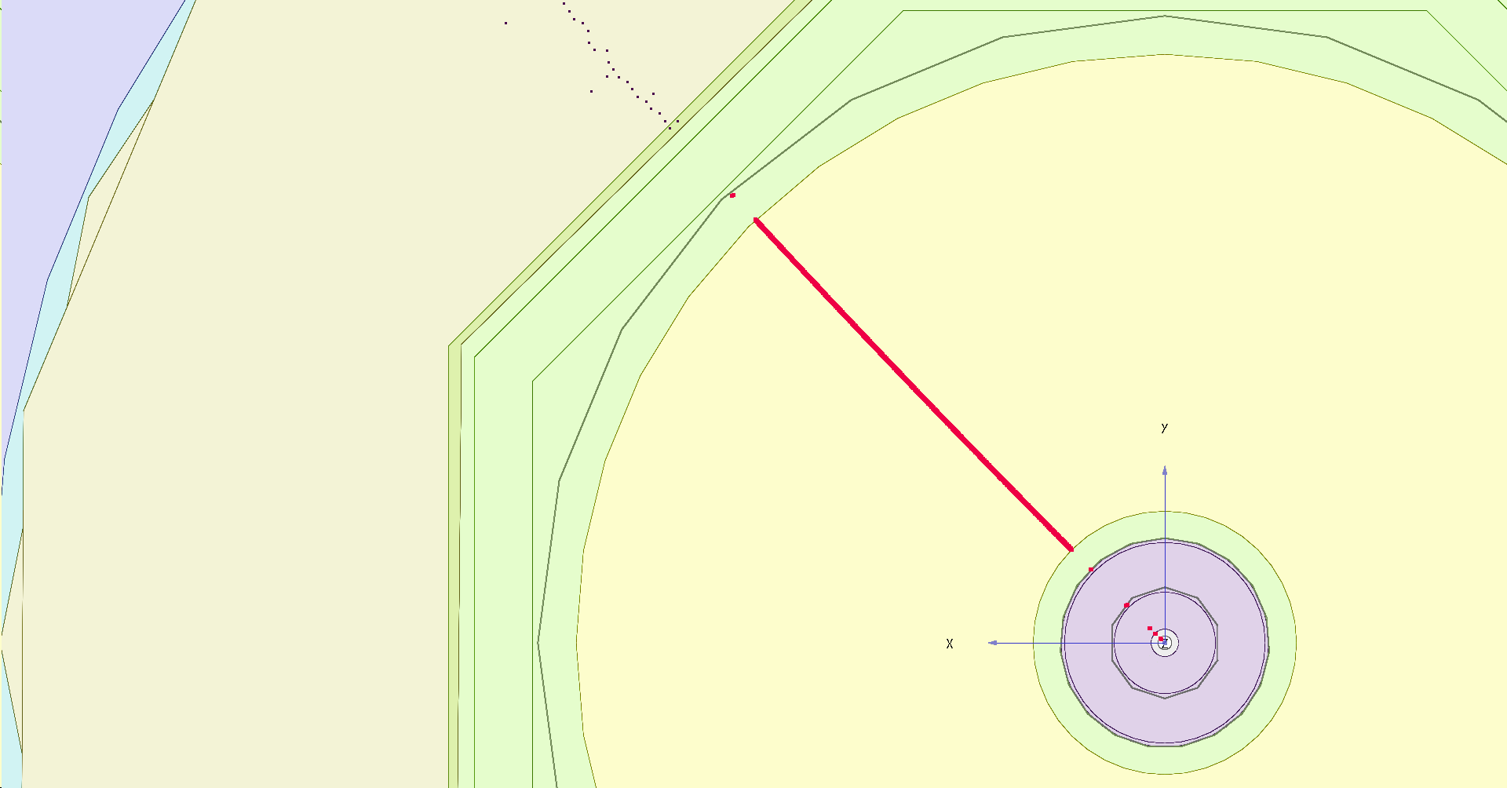
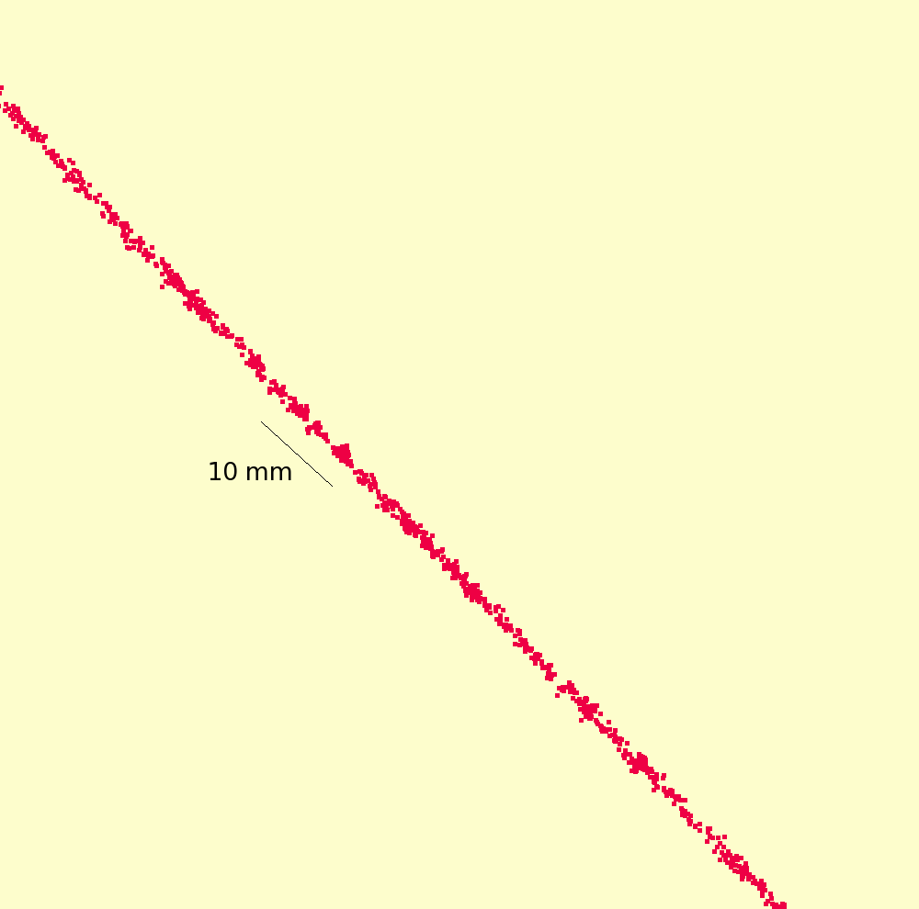
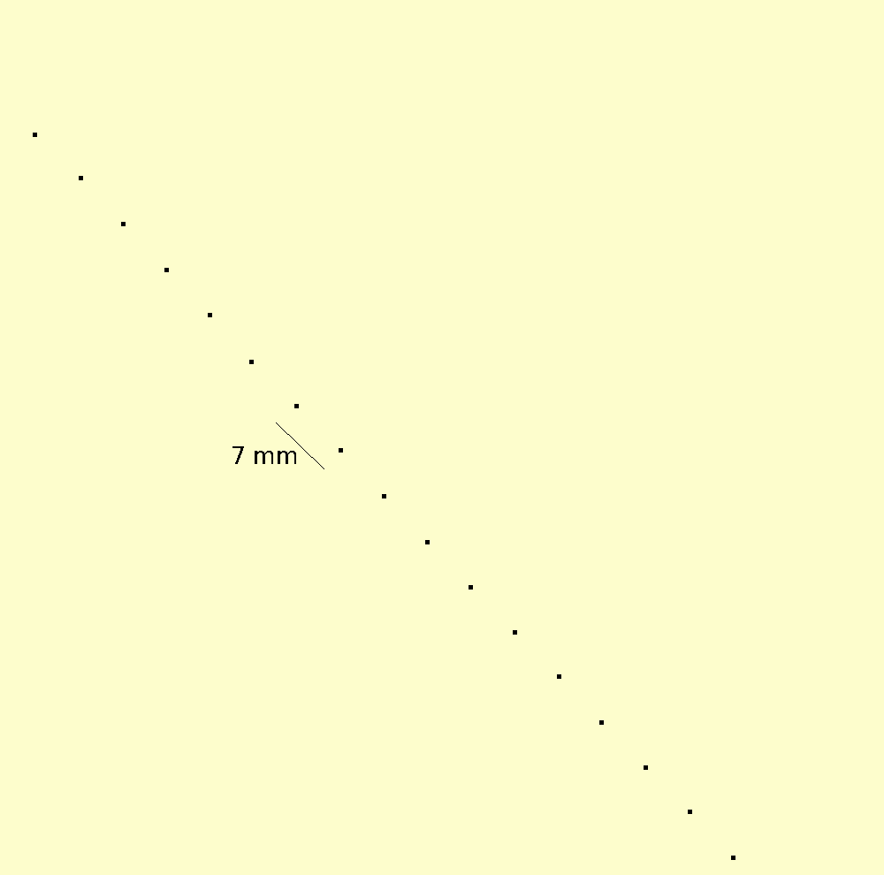
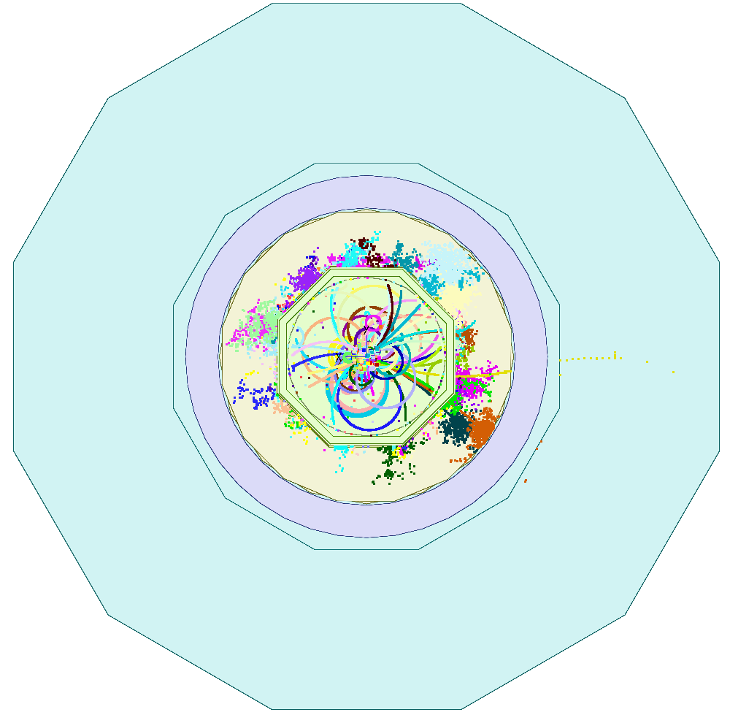
Pixel TPC simulations
Full ILD simulation using DD4HEP and fast pixel digitization
Kees, Peter
ttbar event display
single muon event
On the way to
e.g. H ττ
physics studies
Pixel read out ≈15 000 hits
pad read out ≈250 space points

