Slide 1
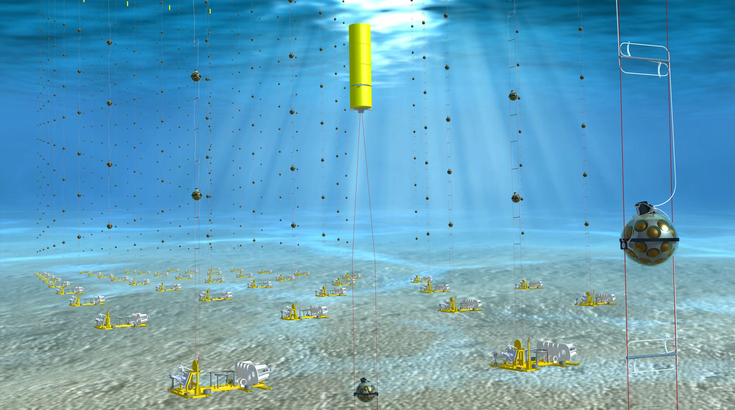
KM³ν_{e}T
Astro-particle and Oscillation Research
with Cosmics in the Abyss
(ARCA & ORCA)
Nikhef annual meeting
12−13 December 2016
Maarten de Jong
E. Berbee

Slide 3
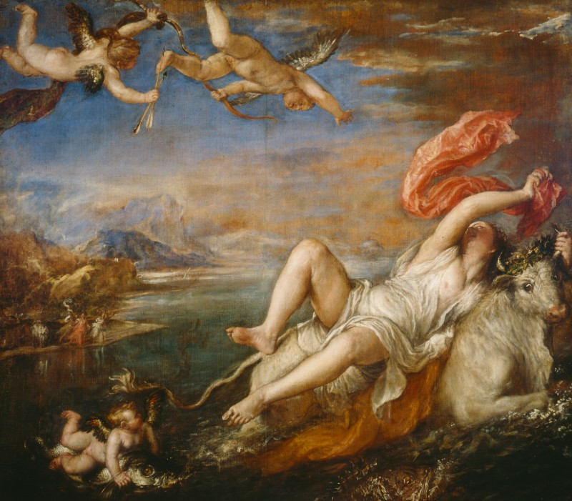
Heaven or Hell
Heaven in Europe
  English are the policemen
  French are the cooks
  German are the mechanics
  Italian are the lovers
  the Swiss organize everything
Hell in Europe
  German are the policemen
  English are the cooks
  French are the mechanics
  Swiss are the lovers
  the Italians organize everything

Slide 4
Heaven or Hell
2013−2016
  spokesperson Maarten de Jong (NL)
  deputy spokesperson P. Coyle (FR)
  technical coordinator M. Circella (I)
  physics coordinator U. Katz (DE)
2017−2018
  spokesperson M. Taiuti (I)
  deputy spokesperson Aart Heijboer (NL)
  technical coordinator Els Koffeman (NL)
  physics coordinator P. Coyle (FR)

Slide 5
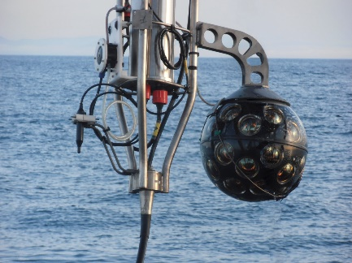
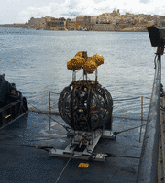
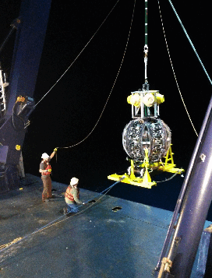
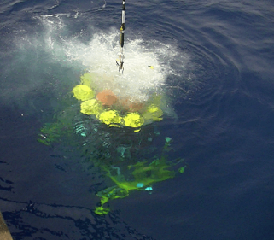
2013−2016
prototype module
prototype string
infrastructure in France
infrastructure in Italy
1st string
string 2 & 3

Slide 6
Optical module
Key features?
  it is expensive
  it is complicated
  it is expensive and complicated
  none of the above

Slide 7
Optical module
Key features?
  it is expensive
  it is complicated
  it is expensive and complicated
  none of the above
Interest from Hyper-K, NUPRISM, CHIPS,
IceCube-Gen2, Juno…

Slide 8
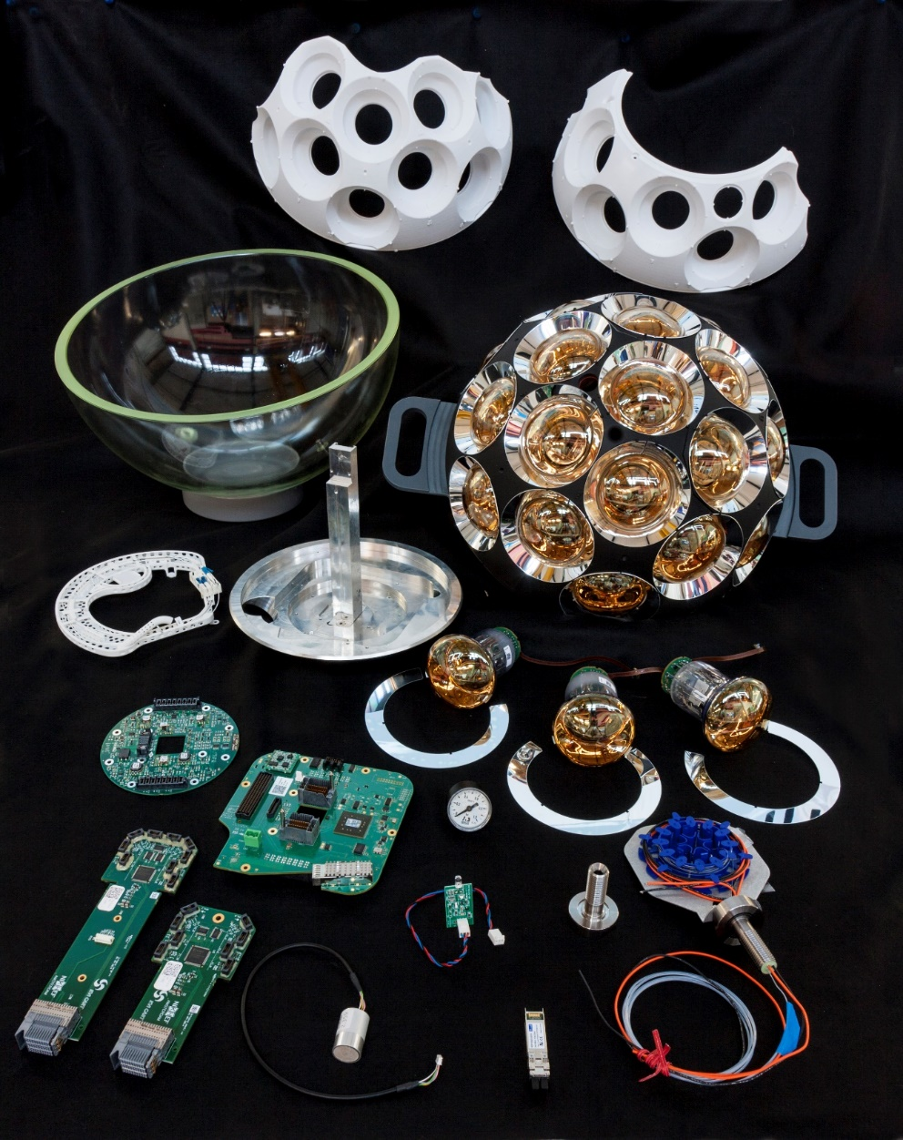
Optical module building kit
External review 14 December 2016

Slide 9
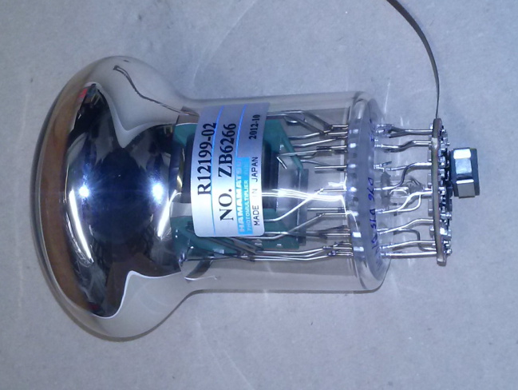
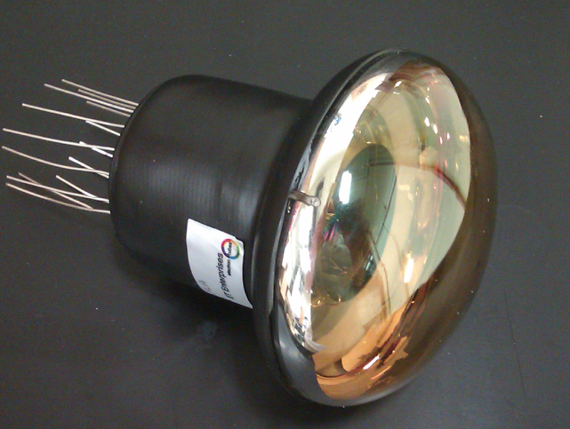
3-inch PMTs
Key specifications:
  timing 2 ns (RMS)
  QE(λ = 400 nm) 25−30%
  collection efficiency 90−95%
  photon counting purity 100% (by hits, no ADC)
  price/cm² ≤ 10” PMT
ETEL
ETEL D792
Hamamatsu R12199
HZC XP82B20

Slide 10
3-inch PMTs
Key specifications:
  timing 2 ns (RMS)
  QE(λ = 400 nm) 25−30%
  collection efficiency 90−95%
  photon counting purity 100% (by hits, no ADC)
  price/cm² ≤ 10” PMT
ETEL
ETEL D792
Hamamatsu R12199
HZC XP82B20

Slide 11
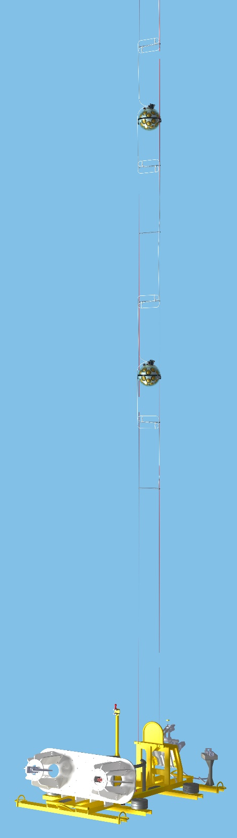
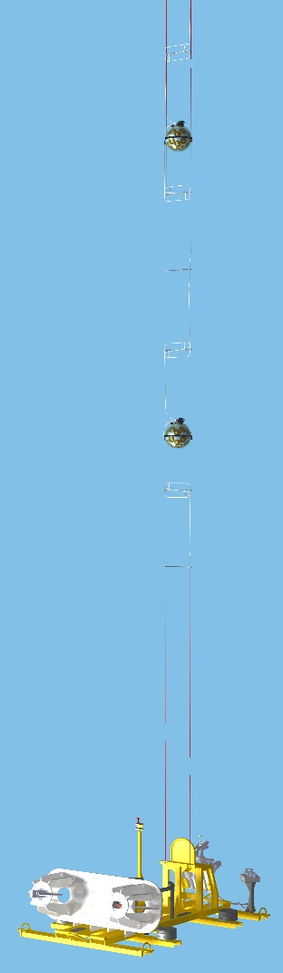
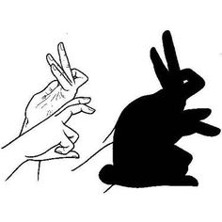


Time synchronisation
White Rabbit & broadcast
full synchronisation
passive optical network
standard Ethernet switches
for data processing
1 km
100 km
1 km

Slide 12


2016
May
Two more detection units deployed
A problem developed after unfurling of detection unit DU-3
July
DU-3 safely recovered
August
Problem understood
December
External review of solutions

Slide 13
2013−2016
Global Neutrino Network set up 2013
  Antares, GVD (Baikal), IceCube, KM3NeT
CERN recognised experiment 2014
MoU KM3NeT Phase-1 signed 2014
ASTERICS joint proposal (SKA, CTA, E-ELT, KM3NeT, …)
approved 2015
MoU with Hyper-K signed 2016
MoU with MWA (Australia) signed 2016
KM3NeT H2020 proposal approved 2016
convention between Morocco & KM3NeT
signed 2016

Slide 14
2013−2016
New web site 2016
Letter of Intent published in J. Phys. G. 2016
    This Enormous Telescope Will Study Neutrinos From The Depths Of The Ocean Floor
    KM3NeT Unveils Detailed Plans for Largest Neutrino Telescope in the World
    Detailed plans for largest neutrino telescope in the world -- ScienceDaily
    KM3NeT unveils detailed plans for largest neutrino telescope in the world
    World’s Largest Neutrino Telescope May Be Built Soon In The Depths Of The Mediterranean Sea
    From phys.org: "KM3NeT unveils detailed plans for largest neutrino telescope in the world"
    Komt er echt een onderwatertelescoop?
    This Enormous Telescope Will Study Neutrinos From The Depths Of The Ocean Floor
    KM3Net a caccia di neutrini cosmici
    World’s Largest Neutrino Telescope is in the Pipeline
    3Novices:KM3NeT unveils detailed plans for largest neutrino telescope in the world
    KM3NeT unveils detailed plans for largest neutrino telescope in the world|Healthy Space
    KM3NeT unveils detailed plans for largest neutrino telescope in the world|Health Consumer

Slide 15
2013−2016
ESFRI 2013
  “KM3NeT has clearly not yet reached maturity particularly with regard to funding of the full instrument and the AEG believes the chances for achieving maturity by 2015 to be minimal.”
ESFRI 2016
  “Its scientific case is evaluated `very high` and its maturity `high`.”

Slide 16
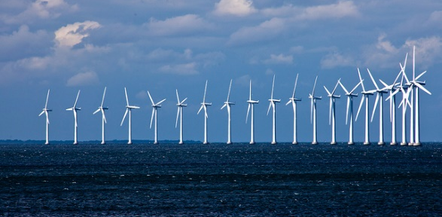
H2020
EU funded preparatory phase project
  budget 3.8 M€
  NL coordinator
  set up legal entity in NL
  prepare open data access
  study possibility of CO₂ neutral facility

Slide 17
Funding prospects
Common fund approved
  annual fee 5 k€ per author
Italian funding request
  new PON call (25 M€ + 25 M€) early 2017
French funding request
  partly secured (7.85 M€), remainder still pending
  option for further funding (10 M€)
Dutch funding request
  call June 2017, decision end 2017
  envisaged budget request 13 M€
Greek funding request
  submitted July 2016, decision pending

Slide 18
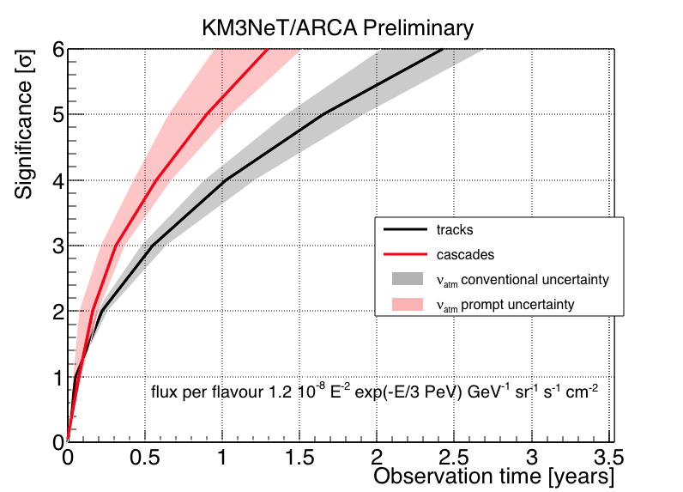
Timelines ARCA
IceCube signal
Supernova remnants
6
5
4
3
2
1
0
5
4
3
2
1
0
KM3NeT
KM3NeT
significance [σ]
tracks
cascades
RXJ1713
Vela X
0
1
2
3
0
2
4
6
8
10
12
observation time [y]
observation time [y]

Slide 19
Timelines ORCA
APPEC Town meeting, 6-7 April 2016, Paris
KM3NeT Letter of Intent

Slide 20
What I learned so far…
Things to know
  OECD report on large research infrastructures
Things to do
  involve policy makers (through ESFRI, APPEC, …)
Things to remember
  science comes first
Things to improve
  science / €

Slide 21
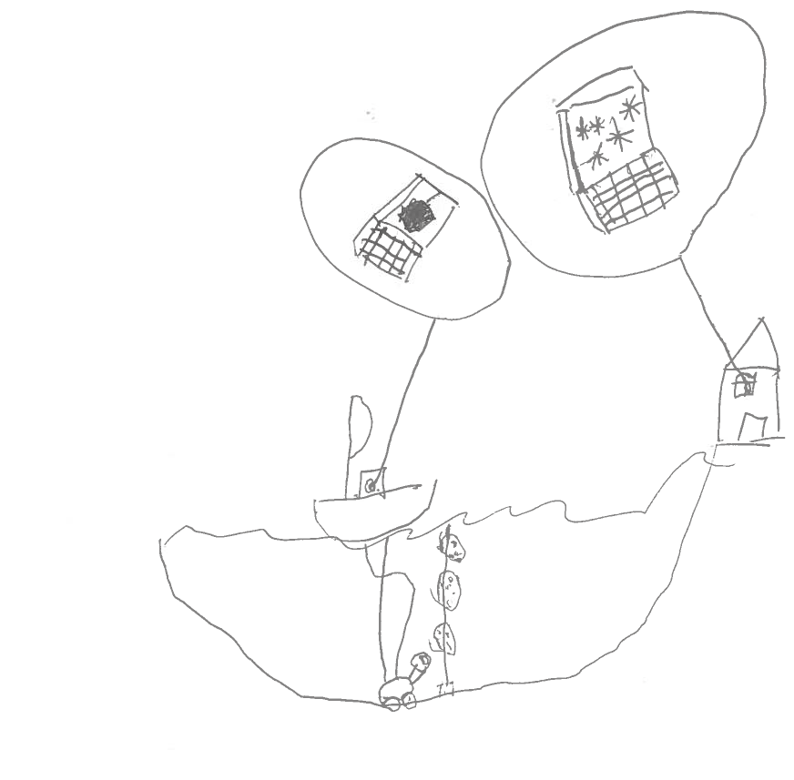
Things to look forward
Tim de Jong

