Slide 1
WISE, SCI & PDK (at EUGridPMA meeting 28-30 Sep) David Kelsey (STFC-RAL, UK Research and Innovation) 30 Sep 2021
Wise Information Security for collaborating e-Infrastructures
In collaboration with and co-supported by EU H2020 EOSC-HUB, GN4-3 & EGI-ACE
https://wise-community.org

Slide 2
WISE/SCI in 2021 (SCI-WG 10 May 2021)
SCI-WG
Complete the HowTo Guidance on maturity assessment
& encourage Infrastructures to perform self-assessment
Include feedback from USA SLATE policy work
Does this mean SCI version 3?
Produce updated policy templates from AARC PDK

Slide 3
Development of AARC PDK by WISE SCI-WG
Involve the widest experience from many Infrastructures and policy groups
Infrastructures using/considering the AARC PDK include
EOSC-hub, EOSC Future, IRIS(UK), EGI, ELIXIR, WLCG, SLATE(USA), FZJ, …
Policy templates are useful to new Infrastructures and help build trust and interoperability (compliant with SCI Trust Framework)
WISE SCI will collect feedback from Infrastructures
And use this if/when a new version of a template is required
Unlike AUP, new templates may contain optional components
Infrastructures just use the components that work for them
Or indeed have several different templates (loosely coupled, tighter, …)

Slide 4
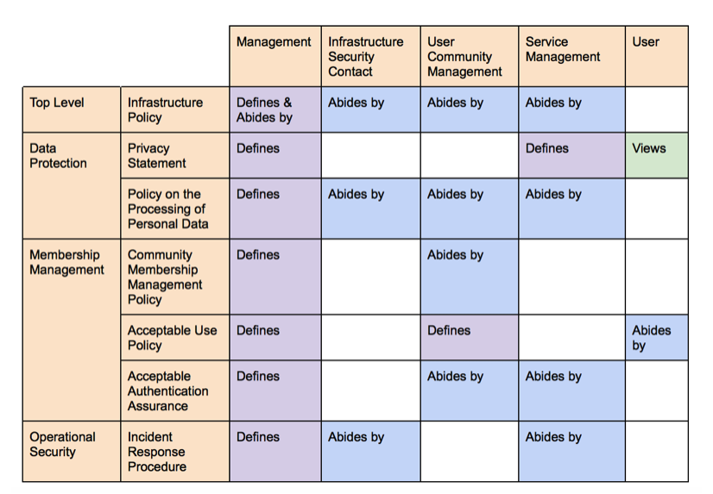
Building on AARC PDK in WISE SCI-WG
Policy Area | New Template | Lead Participants
Top Level | Infrastructure Policy | IRIS (UK), EOSC-hub
Data Protection | Privacy Statement | WLCG, IRIS
Data Protection | Policy on the Processing of Personal Data | EGI, WLCG
Membership | Community Policy | IRIS, EOSC, GN4-3, IGTF
Membership | Acceptable Authentication Assurance | GN4-3, IGTF
Operational Security | Incident Response | eduGAIN, Sirtfi, GN4-3, EOSC & many opsec groups
Operational Security | Service Operations | EOSC-hub, IRIS
https://aarc-project.eu/policies/policy-development-kit/
And ELIXIR too

Slide 5
Which policies to work on first?
Security of Service Operations
And EOSC Baseline security
Community Operations
Top-level Security Policy?
Update the WISE Baseline AUP (a version 2)
Include input from Trusted CI
Data Privacy (GDPR etc)
Identity Management/Assurance

Slide 6
Discussion
Where and how to store and publish documents?
How to organize work
Just one SCI thread of meetings?
Or one per policy document?
Hannah S will report to the WISE meeting on 26/27 Oct 2021
Q&A – and discussion

