Slide 1

Theoretical study of radioactive molecules
A. Kiuberis, A. Borschevsky and Lukáš F. Pašteka
NNV Annual meeting 2022, Lunteren
4th of November, 2022

Slide 2
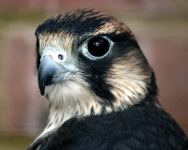


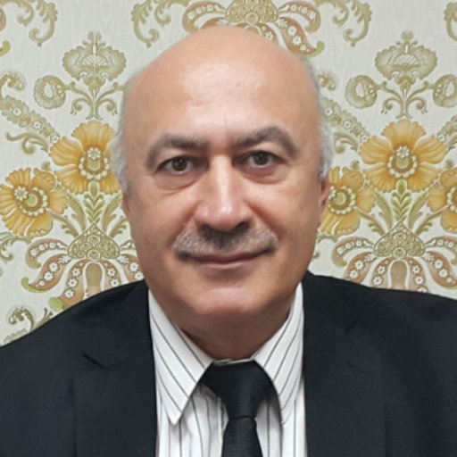







My Dream Team
Lukáš Félix Pašteka
Anastasia Borschevsky
Ephraim Eliav

Slide 3


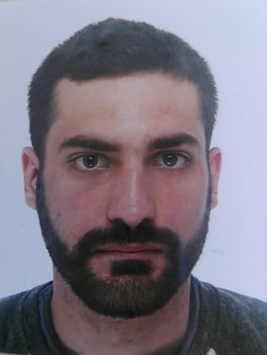
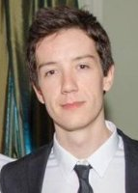



Experimental Side:
Shane Wilkins
Michail Athanasakis
Holly Perrett
Silviu-Marian Udrescu
Ronald Fernando Garcia Ruiz

Slide 4
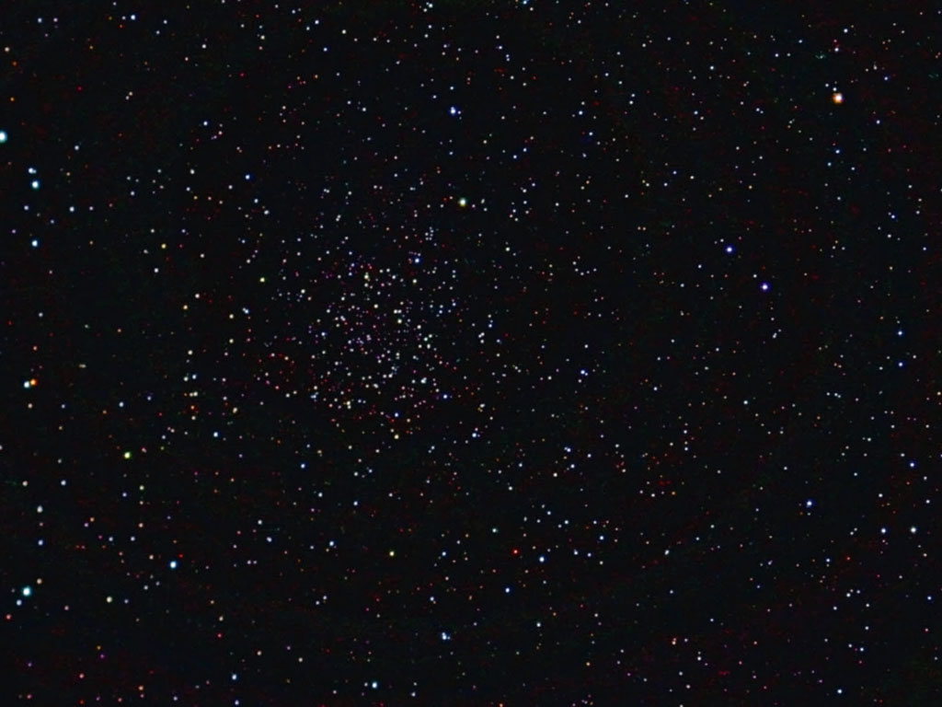
Outline
Motivation + Theory
“Wish list” +
Experiment
(Spectroscopy of short-lived
radioactive molecules.
R.F. Garcia Ruiz and et al.
Nature, 581, 396 (2020))
Theoretical approach
and results

Slide 5
























































Slide 6
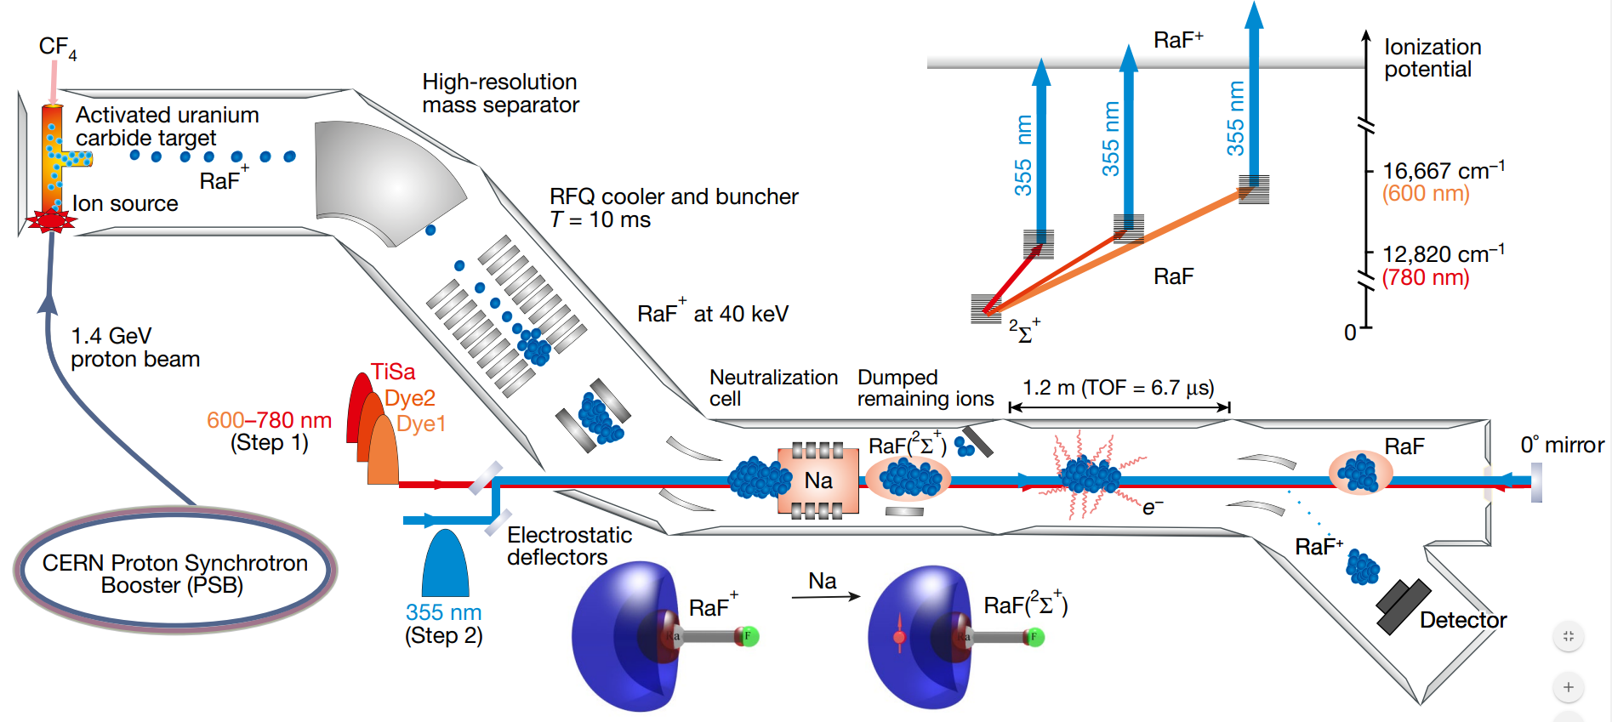





Experiment
Part I
Spectroscopy of short-lived radioactive molecules. R.F. Garcia Ruiz and et al. Nature, 581, 396 (2020)

Slide 7

































Slide 8
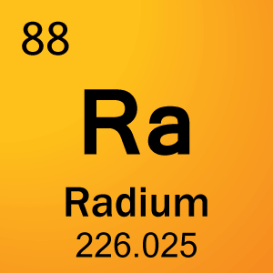














Heavy diatomic molecules are currently considered to be the most sensitive systems used in the search for the electron electric dipole moment (eEDM).

Slide 9
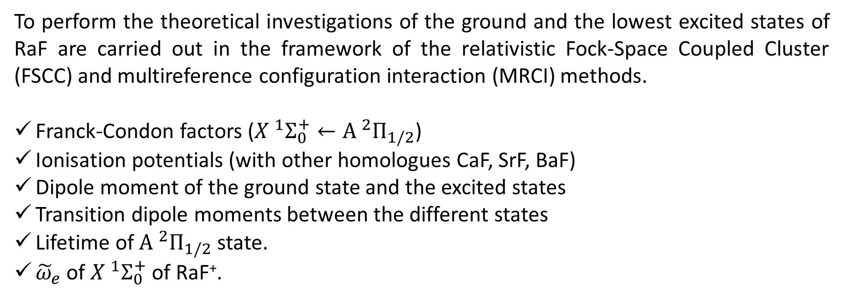
“Wish List”
To perform the theoretical investigations of the ground and the lowest excited states of RaF are carried out in the framework of the relativistic Fock-Space Coupled Cluster (FSCC) and multireference configuration interaction (MRCI) methods.
Franck-Condon factors (${X }^{1}Σ_{0}^{+}←{A }^{2}Π_{1/2}$)
Ionisation potentials (with other homologues CaF, SrF, BaF)
Dipole moment of the ground state and the excited states
Transition dipole moments between the different states
Lifetime of ${A }^{2}Π_{1/2}$ state.
${\tilde{ω}}_{e}$ of ${X }^{1}Σ_{0}^{+}$ of RaF⁺.

Slide 10
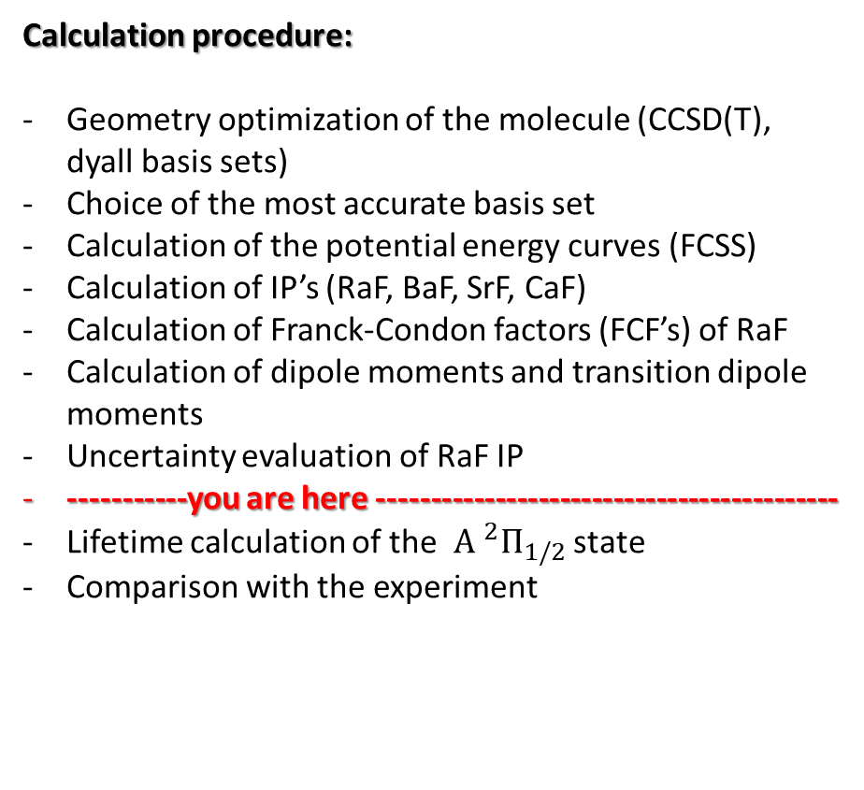
Part II. A
Theory
Calculation procedure:
Geometry optimization of the molecule (CCSD(T), dyall basis sets)
Choice of the most accurate basis set
Calculation of the potential energy curves (FCSS)
Calculation of IP’s (RaF, BaF, SrF, CaF)
Calculation of Franck-Condon factors (FCF’s) of RaF
Calculation of dipole moments and transition dipole moments
Uncertainty evaluation of RaF IP
-----------you are here -------------------------------------------
Lifetime calculation of the ${A }^{2}Π_{1/2}$ state
Comparison with the experiment

Slide 11
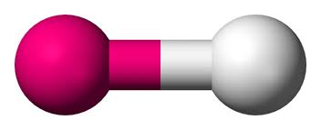


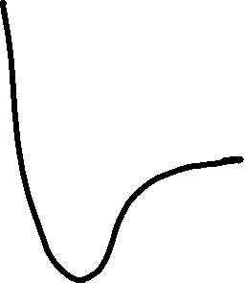
Geometry optimization
Equilibrium distance of RaF
Method | Basis set | Re, Å
SCF | dyall.v3z | 2.2546
CCSD(T) | dyall.v2z | 2.2708
CCSD(T) | dyall.v3z | 2.2597
CCSD(T) | dyall.cv3z | 2.2578
CCSD(T) | dyall.cv4z | 2.2451

Slide 12
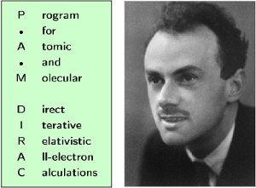


 | FSCC, eV | FSCC, eV | CCSD, eV | CCSD(T), eV
 | Old | This work | This work | This work
CaF | 5.88 | 5.88 | 5.846 | 5.867
SrF | 5.442 | 5.449 | 5.419 | 5.447
BaF | 4.839 | 4.842 | 4.834 | 4.797
RaF | - | 4.996 | 4.937 | 4.986
IP
Part II. Theory
s-aug-dyall.cvqz, X2Cmmf, correlated electrons -20 to 30 a.u.

Slide 13



























Basis set
Electron correlation
Uncertainty evaluation of XF IP
Relativistic effects
Virtual cut-off

Slide 14













IP of RaF: Error budget
Basis set
  Cardinality (CBS - s-aug-dyall.cv4z)
  Augmentation (d-aug-dyall.v4z - s-aug-dyall.v4z)
  AE.vs.CV (dyall.ae3z-dyall.cv3z, all electron correlated)
Relativistic effects
  Breit for Ra⁺
  QED for Ra⁺
Correlation
  Correlated electrons and virtuals
  Beyond (T) – CCSDT (MRCC)
Correction | Uncertainty of RaF, meV
1.1 1.2 1.3 | 2.8 0.5 4.6
2.1 | -2.0
2.2 3.1 3.2 | -12.7 2.0 0.9

Slide 15
































IP of XF: Error budget (X=Ca, Sr, Ba)
Basis set
  Cardinality (CBS - s-aug-dyall.cv4z)
  Augmentation (d-aug-dyall.v4z - s-aug-dyall.v4z)
  AE.vs.CV (dyall.ae3z-dyall.cv3z, all electron correlated)
Relativistic effects
  Breit for X⁺
  QED for X⁺
Correlation
  Correlated electrons and virtuals
  Beyond (T) – CCSDT (MRCC)
Correction | Uncertainty, meV |  | Uncertainty, meV
1.1 1.2 1.3 | 19.5 0.2 0 | 16.2 0.4 -1.0 | 17.5 1.0 -3.0
2.1 2.2
3.1 3.2 | 0.3 0.5 | -1.0 0.8 | 1.0 1.0

Slide 16
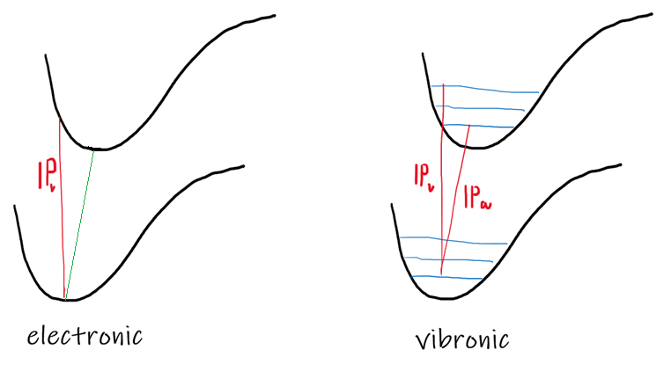
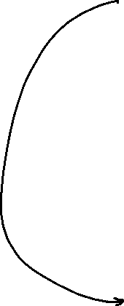

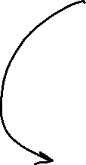
Approach | Final IP, eV
IP_{a} | 4.97516
Vibronic IP_{a} | 4.98016
IP_{v} | 4.98916
Final CBS Results for RaF IP:

Slide 17
Final CBS Results for XF IP
(X=Ca, Sr, Ba)
Approach | CaF | SrF | BaF
IP_{a} | 5.824 | 5.417 | 4.804
Vibronic IP_{a} | 5.817 | 5.412 | 4.799
IP_{v} | 5.891 | 5.476 | 4.849

Slide 18
Part II. A
FCFs
Potential Energy Curves
FSCC, s-aug-dyall.cvqz, X2Cmmf, correlated electrons -20 to 30 a.u.

Slide 19











Franck-Condon Factors
$${X }^{2}Σ_{1/2}^{+}−{A }^{2}Π_{1/2}$$

Slide 20


Slide 21
“Wish List”
To perform the theoretical investigations of the ground and the lowest excited states of AcF are carried out in the framework of the relativistic Fock-Space Coupled Cluster (FSCC) and multireference configuration interaction (MRCI) methods.
Ionisation potentials (with lighter homologue LaF)
Transition energies of AcF
Dissociation energies of AcF and LaF
Franck-Condon factors
Dipole moment of the ground state and the excited states
Transition dipole moments between the different states

Slide 22











Part II.B
Theory
Calculation procedure:
Geometry optimization of the molecule (CCSD(T), dyall basis sets)
Calculation of IP’s (AcF, LaF)
Uncertainty evaluation of AcF IP (and LaF IP)
Calculation of the potential energy curves (FCSS)
-----------we are here -------------------------------------------
Calculation of Franck-Condon factors (FCF’s) of AcF
Comparison with the experiment

Slide 23



Geometry optimization
Part II. Theory
Equilibrium distance of Ac, La - F
Method | Basis set | Re, Å | Re, Å
SCF | dyall.v3z | 2.1444 | 2.0740
CCSD(T) | dyall.v3z | 2.1366 | 2.0683
CCSD(T) | s-aug-dyall.cv3z | 2.1326 | 2.0467
CCSD(T) | s-aug-dyall.cv4z | 2.1118 | 2.0300
CCSD(T) | CBS | 2.1029 | 2.0225

Slide 24
IP
Part II. Theory
 | CCSD - IP, eV | CCSD(T) - IP, eV
AcF | 5.907 | 6.020
LaF | 5.806 | 5.898
Dyall.cvqz, X2Cmmf, correlating all electrons

Slide 25


Basis set
Electron correlation
Uncertainty evaluation of XF IP (X=Ac, La)
Relativistic effects
Virtual cut-off

Slide 26


IP of Ac/La - F: Error budget
Basis set
  Cardinality (CBS - s-aug-dyall.cv4z)
  Augmentation (d-aug-dyall.v4z - s-aug-dyall.v4z)
  AE.vs.CV (dyall.ae3z-dyall.cv3z, all electron correlated)
Relativistic effects
  Breit for Ac⁺ / La⁺
  QED for Ac⁺ / La⁺
Correlation
  Correlated electrons and virtuals
  Beyond (T) – CCSDT (MRCC)
Correction | Uncertainty of AcF, meV | Uncertainty of LaF, meV
1.1 1.2 1.3 | 7.36 0.1 4.3 | -12.4 -0.81 -25.95
2.1 2.2 | In progress | In progress
3.1 3.2 | 1.4 | 0.82

Slide 27
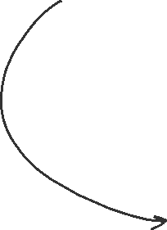


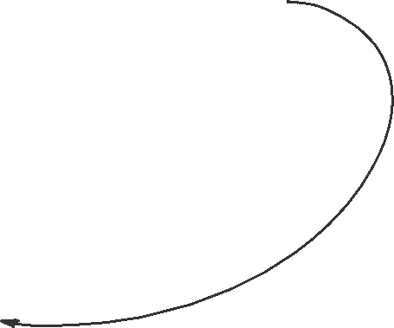
Approach | Final IP, eV
IP_{a} | 6.047
Vibronic IP_{a} | 6.051
Final CBS Results for AcF IP:

Slide 28
Approach | Final IP, eV
IP_{a} | 5.929
Vibronic IP_{a} | 5.933
Final CBS Results for LaF IP:

Slide 29
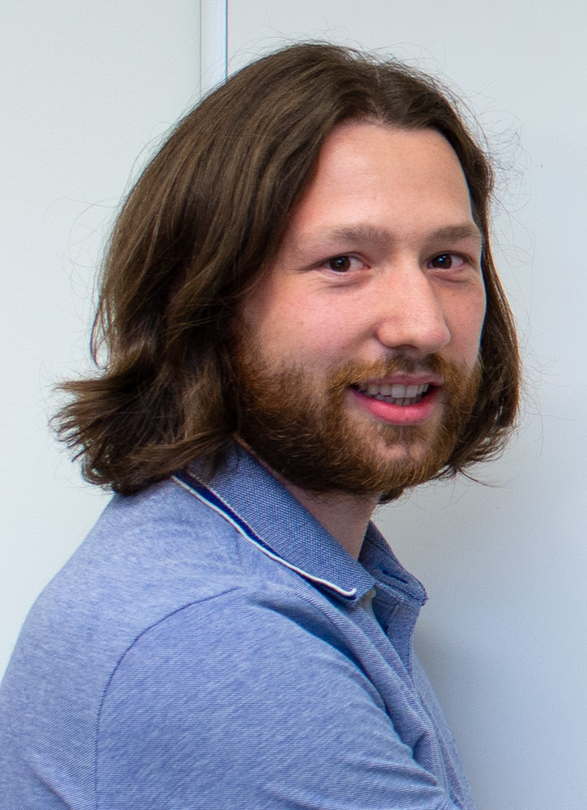


























































8396.366
9006.650
10066.105
11209.242
11622.590
12248.069
13616.495
14527.347
16053.582
16688.870
17334.320
18873.923
20887.571
20921.105
Konstantin Gaul
Method | Basis set | Ws, e/a₀⁴
SCF(expectation value) | Dyall.v2z | -5129.158
SCF(expectation value) | Dyall.cv3z | -7720.689
SCF(expectation value) | Dyall.cv3z_developed | -8378.539
CCSD (10⁻¹⁰) | Dyall.cv3z | -7884.0003

