Slide 1





New test of Lepton Flavour Universality with rare ${\text{Λ}}_{b}^{0}→\text{Λ}$ℓℓ decays at LHCb
Jan de Boer
NNV Annual Meeting
4 November 2022
Conseil Européen pour la Recherche Nucléaire
University of Groningen
National Institute for Subatomic Physics

Slide 2
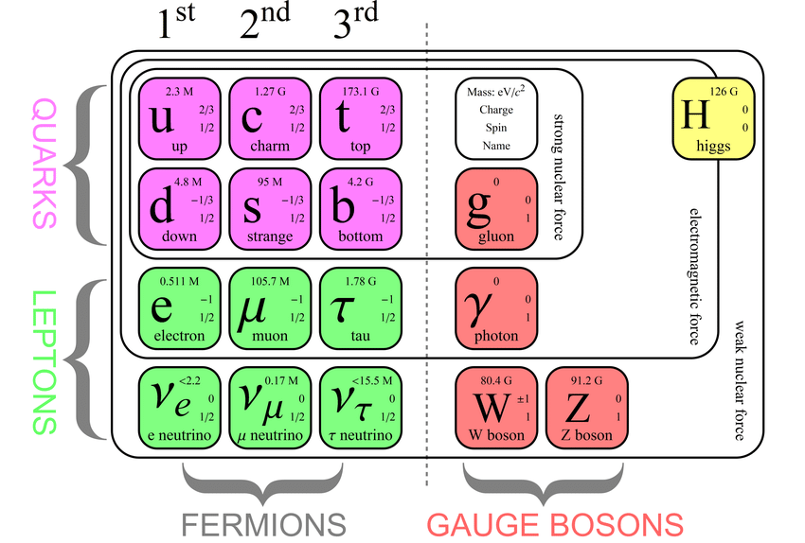
Our playground: the Standard Model
Fermions (matter):
  Why 3 generations of Quarks?
  Why 3 generations of Leptons?
Bosons (interactions):
  Strong, Weak, Electromagnetic forces have identical coupling constants to the generations of fermions
  Higgs field introduces distinction among the generations of fermions

Slide 3
Lepton Flavour Universality (LFU)
Standard Model couplings of leptons to v. vector bosons are flavour-independent
Precision measurements to:
  Carefully examine LFU prediction by the Standard Model
  Search for New Physics effects
Experimentally measured as Ratio: counting µ/e decays

Slide 4
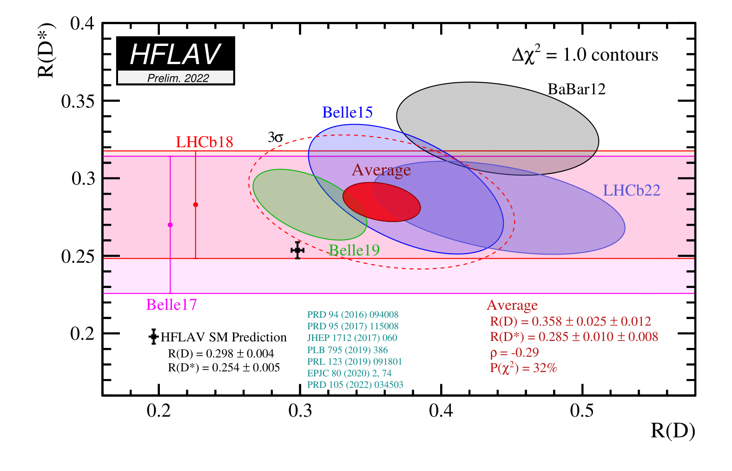
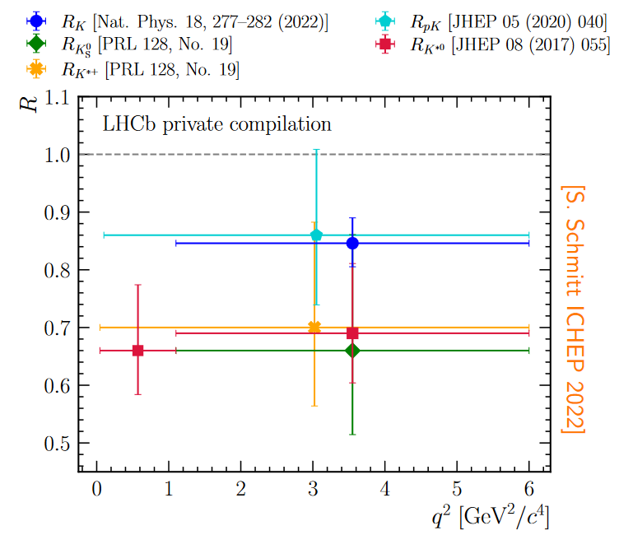
Anomalies in LFU tests at LHCb
b → c ℓν decays:
b → s ℓℓ decays:

Slide 5

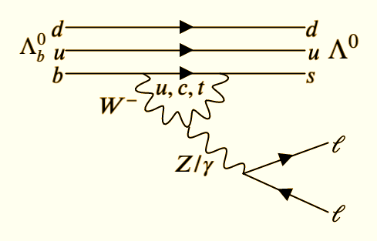
b→sℓℓ transitions (ℓ=lepton)
Part of the anomalies
Electroweak
Flavour Changing Neutral Current
In SM forbidden at tree level, only possible via higher order diagrams and thus highly suppressed
A rare decay that is sensitive to new physics effects.

Slide 6
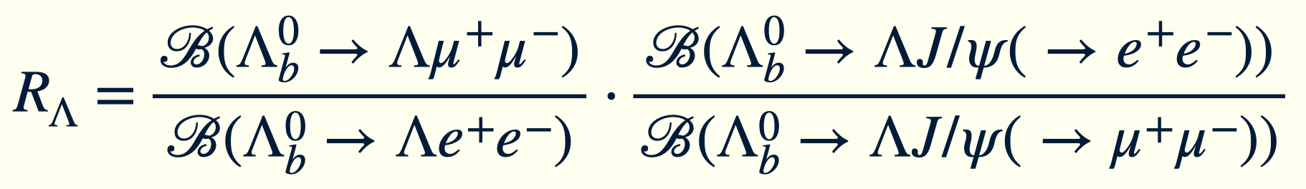

Motivation for using ${\text{Λ}}_{b}^{0}$decays
Baryonic decay to be measured:
- complementary to mesons
- different form factors
- different spin structure
Measured as a double ratio:
1 in SM!

Slide 7
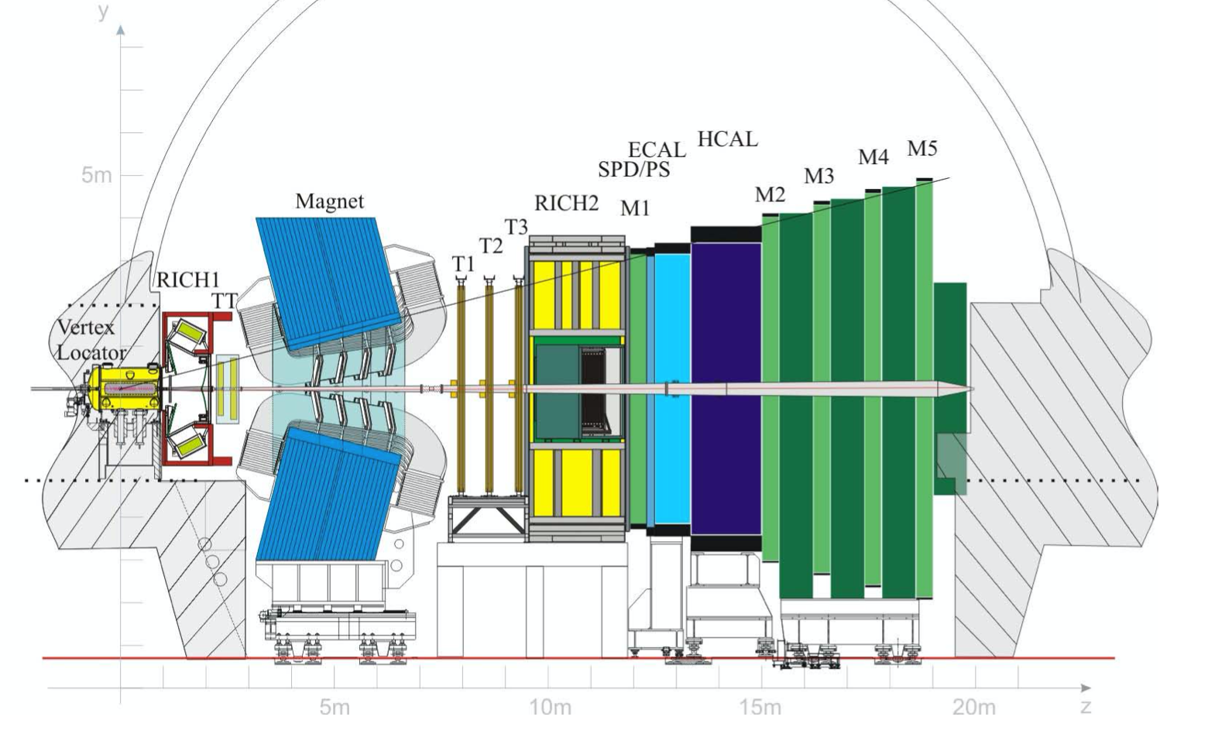
The LHCb detector ^{☠️ 2018}
Tracking
ECAL
Muon

Slide 8
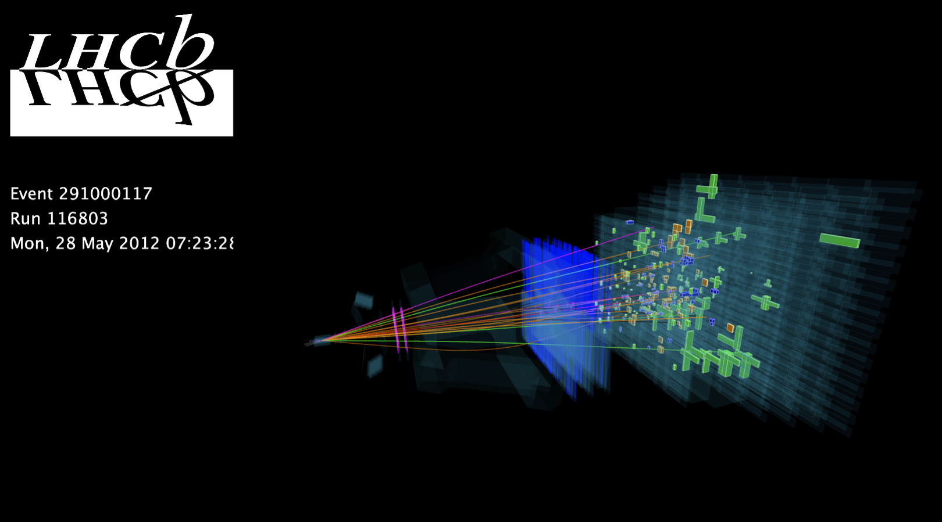

Slide 9
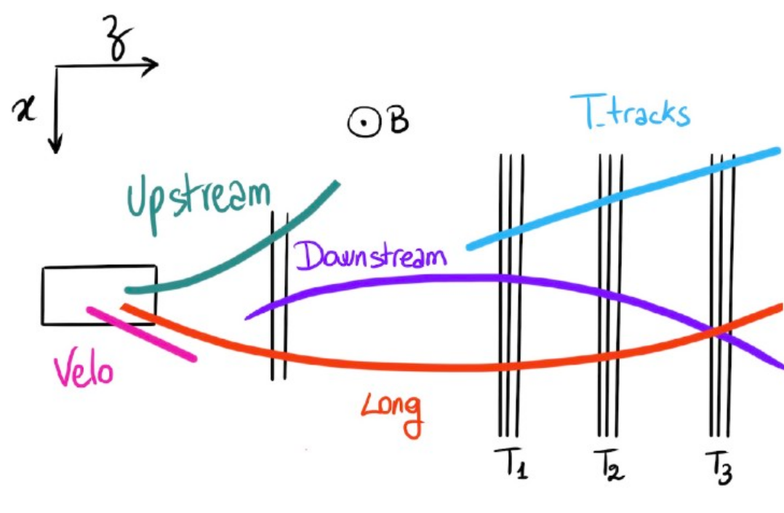





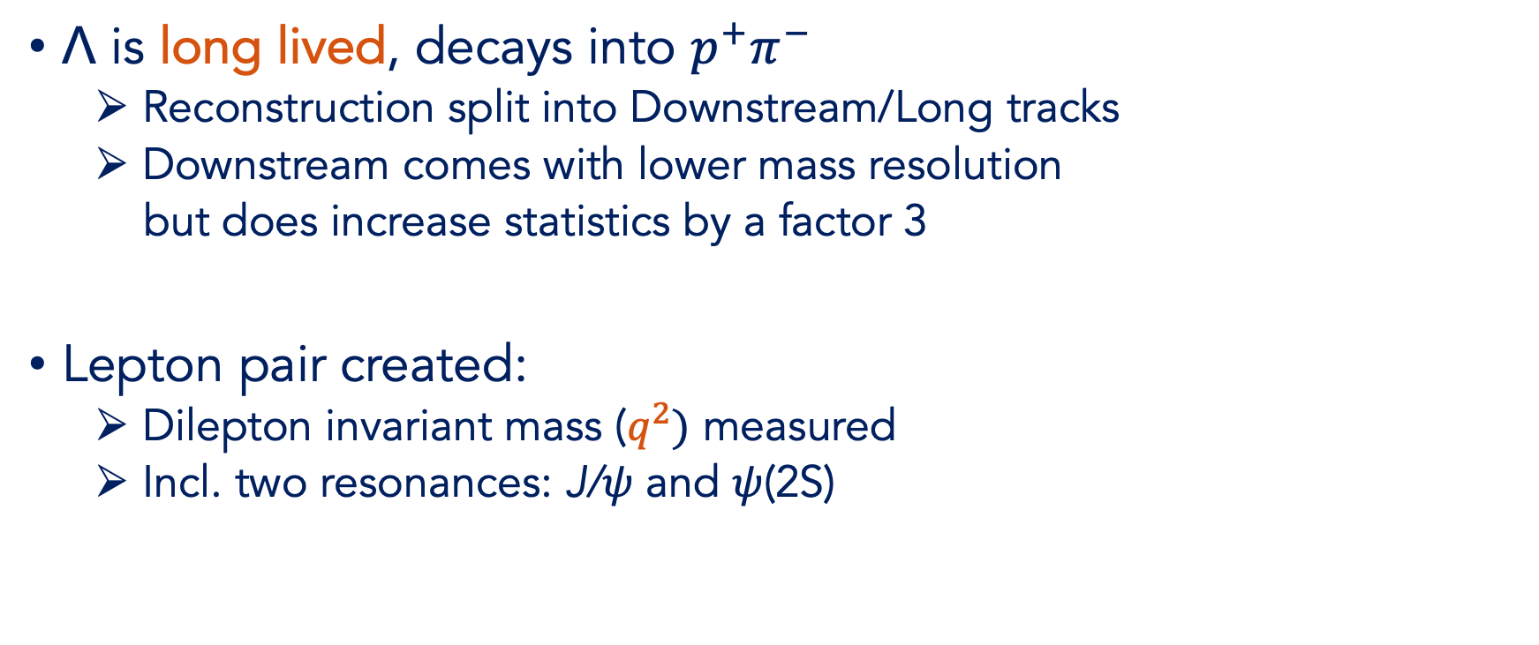

Event reconstruction
decay length ≈ 1 m (𝛾=15-25)
$\text{Λ}$ is long lived, decays into $p^{+}π^{−}$
  Reconstruction split into Downstream/Long tracks
  Downstream comes with lower mass resolution
  but does increase statistics by a factor 3
Lepton pair created:
  Dilepton invariant mass ($q^{2})$ measured
  Incl. two resonances: J/𝜓 and 𝜓(2S)
$${\text{p}}^{+}$$
$$π^{−}$$
$${\text{Λ}}^{0}$$
$${\text{Λ}}_{b}^{0}$$
$${\text{ℓ}}^{+}$$
$${\text{ℓ}}^{−}$$
PV
Notes:
DD and LL difference, does Lambda decay in velo or also outside? Lb always decays in velo?

Slide 10

Samples
${\text{Λ}}_{b}^{0}\text{→} \text{Λ}{\text{µ}}^{+}{\text{µ}}^{−}$ and ${\text{Λ}}_{b}^{0}\text{→ }\text{Λ}{\text{e}}^{+}{\text{e}}^{−}$ decays
Cross-checks via resonances:
${\text{Λ}}_{b}^{0}\text{→} \text{Λ}\text{J}\text{/}\text{ψ}\text{(}\text{→}{\text{µ}}^{+}{\text{µ}}^{−})$and ${\text{Λ}}_{b}^{0}\text{→ }\text{Λ}\text{ψ}\text{(2}\text{s}\text{)(}\text{→}{\text{µ}}^{+}{\text{µ}}^{−})$
${\text{Λ}}_{b}^{0}\text{→} \text{Λ}\text{J}\text{/}\text{ψ}\text{(}\text{→}e^{+}{\text{e}}^{−})$and ${\text{Λ}}_{b}^{0}\text{→ }\text{Λ}\text{ψ}\text{(2}\text{s}\text{)(}\text{→}e^{+}{\text{e}}^{−})$
Split over periods: LHC Run1, Run2
$${\text{p}}^{+}$$
q²-range: | J/𝜓 | 𝜓(2S) | Rare
Downstream
Long
$$π^{−}$$
Blinded!
$${\text{Λ}}^{0}$$
Cross-checks
Cross-checks
$${\text{Λ}}_{b}^{0}$$
$${\text{ℓ}}^{+}$$
$${\text{ℓ}}^{−}$$
PV
Notes:
DD and LL difference, does Lambda decay in velo or also outside? Lb always decays in velo?

Slide 11
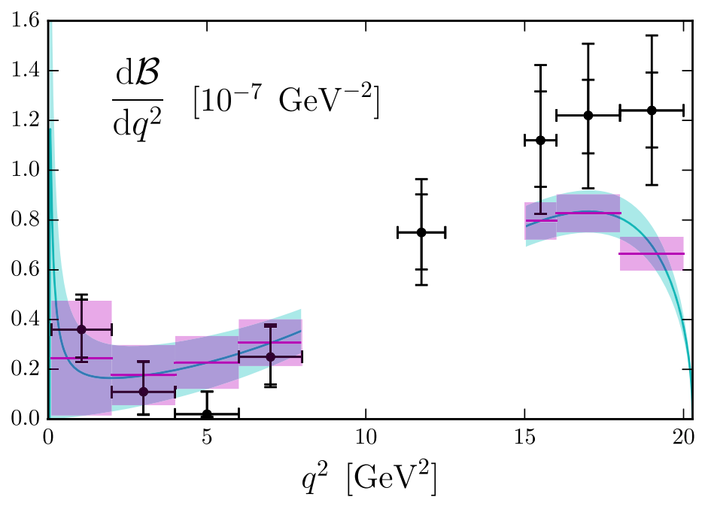
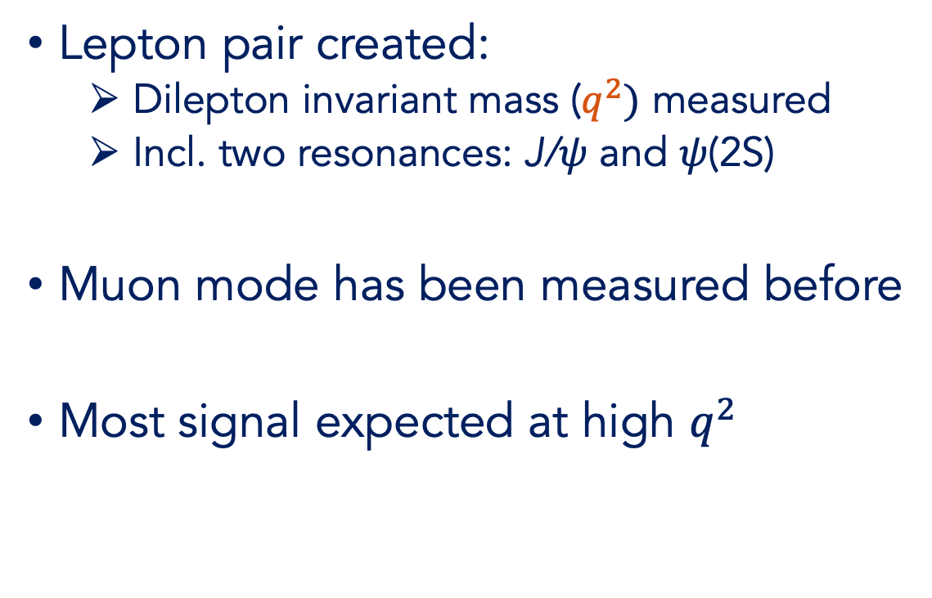

What about ${\text{Λ}}_{b}^{0}\text{→} \text{Λ}{\text{µ}}^{+}{\text{µ}}^{−}$decays?
Lepton pair created:
  Dilepton invariant mass ($q^{2})$ measured
  Incl. two resonances: J/𝜓 and 𝜓(2S)
Muon mode has been measured before
Most signal expected at high $q^{2}$
PHYSICAL REVIEW D 93, 074501 (2016)
J/𝜓
𝜓(2S)
𝓑 (J/𝜓) also being re-measured
muon mode

Slide 12
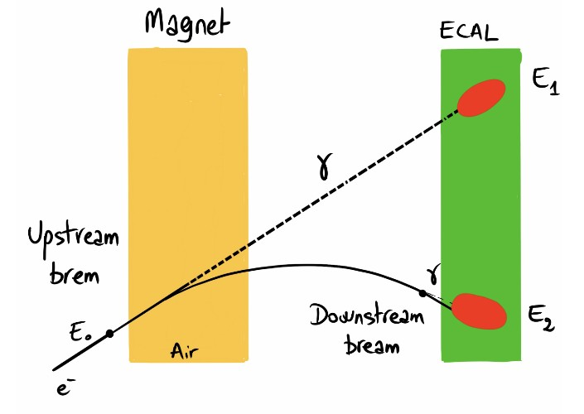
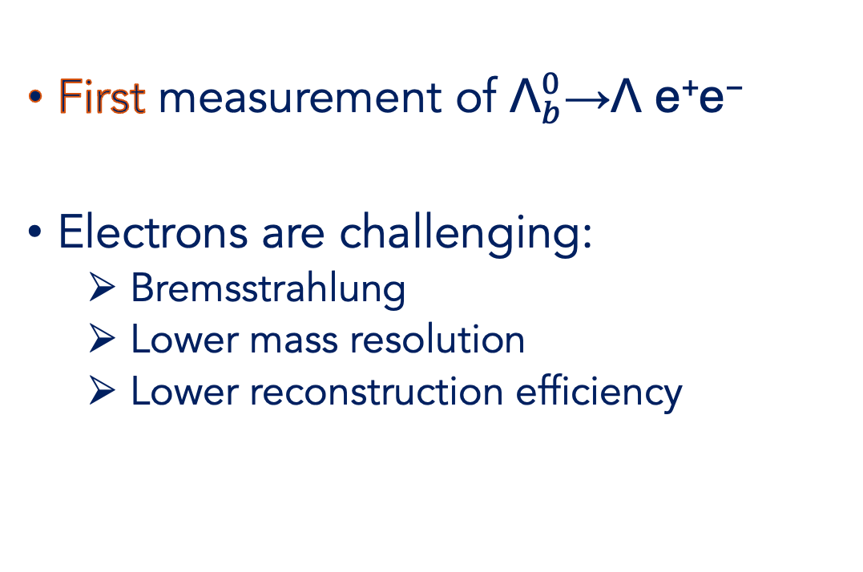

What about ${\text{Λ}}_{b}^{0}\text{→} \text{Λ}{\text{e}}^{+}{\text{e}}^{−}$decays?
First measurement of ${\text{Λ}}_{b}^{0}\text{→}\text{Λ} \text{e}\text{+}\text{e}\text{−}$
Electrons are challenging:
  Bremsstrahlung
  Lower mass resolution
  Lower reconstruction efficiency

Slide 13
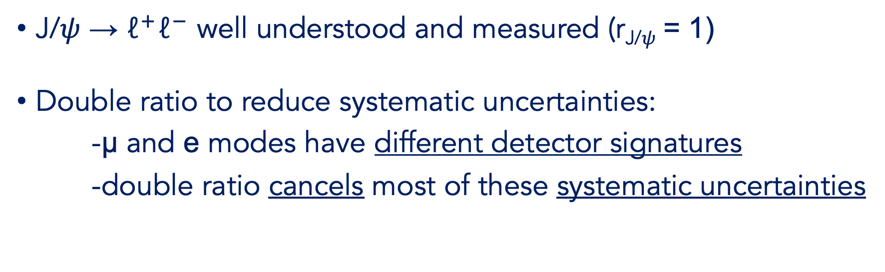

Lepton Flavour Universality in $\text{Λ}$_{b} decays
1 in SM!
J/𝜓 $\text{→} {\text{ℓ}}^{+}{\text{ℓ}}^{−}$ well understood and measured (r_{J/𝜓} = 1)
Double ratio to reduce systematic uncertainties:
-μ and e modes have different detector signatures
-double ratio cancels most of these systematic uncertainties

Slide 14
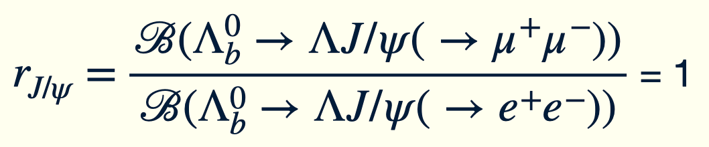
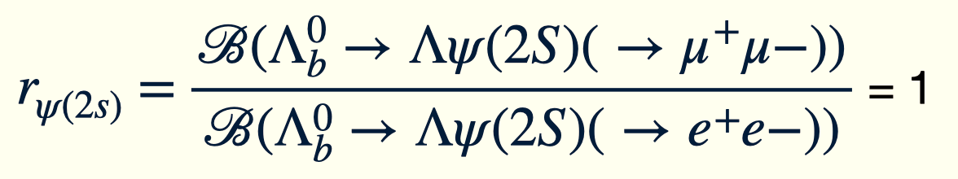
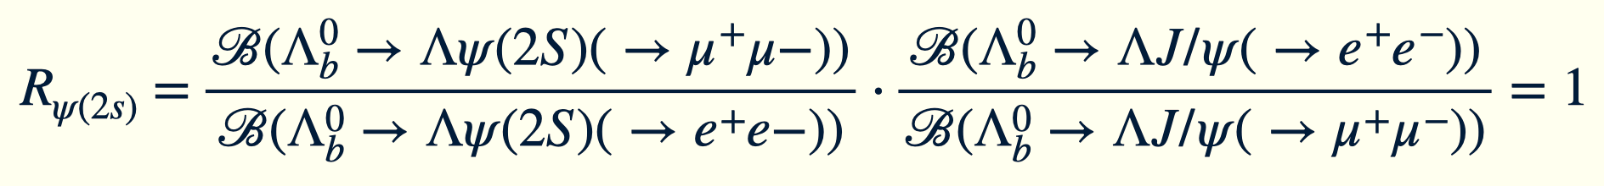
Cross-checks: J/𝜓 and 𝜓(2S)
Two cross-checks before measuring R_{Λ}:
1. single ratios r_{J/𝜓}, r_{𝜓(2s)}:
2. double ratio R_{𝜓(2s)}:

Slide 15





Mass fits: ${\text{Λ}}_{b}^{0}\text{→} \text{Λ}\text{J}\text{/}\text{ψ}\text{(}\text{→}{\text{ℓ}}^{+}{\text{ℓ}}^{−})$
x10³
LHCb Unofficial
LHCb Unofficial
MisID K_{s}($π^{+}π^{−})$
MisID K_{s}($π^{+}π^{−})$
N_{sig} = 1425 ± 48
N_{sig} = 4781 ± 71
electron mode: ${\text{Λ}}_{b}^{0}\text{→} \text{Λ}\text{J}\text{/}\text{ψ}\text{(}\text{→}{\text{e}}^{+}{\text{e}}^{−})$
muon mode: ${\text{Λ}}_{b}^{0}\text{→} \text{Λ}\text{J}\text{/}\text{ψ}\text{(}\text{→}{\text{µ}}^{+}{\text{µ}}^{−})$

Slide 16





Mass fits: ${\text{Λ}}_{b}^{0}\text{→} \text{Λ}\text{ψ}\text{(2}\text{S}\text{)(}\text{→}{\text{ℓ}}^{+}{\text{ℓ}}^{−})$
LHCb Unofficial
LHCb Unofficial
MisID K_{s}($π^{+}π^{−})$
MisID K_{s}($π^{+}π^{−})$
N_{sig} = 130 ± 14
N_{sig} = 491 ± 23
electron mode: ${\text{Λ}}_{b}^{0}\text{→} \text{Λ}\text{ψ}\text{(2}\text{S}\text{)(→}{\text{e}}^{+}{\text{e}}^{−})$
muon mode: ${\text{Λ}}_{b}^{0}\text{→} \text{Λ}\text{ψ}\text{(2}\text{S}\text{)(→}{\text{µ}}^{+}{\text{µ}}^{−})$

Slide 17
Ratio plots
Single ratios
Double ratio is a powerful method:
→ systematic biases cancel
Promising step for the analysis!
Work to be done on trigger efficiency
LHCb Unofficial
LHCb Unofficial

Slide 18
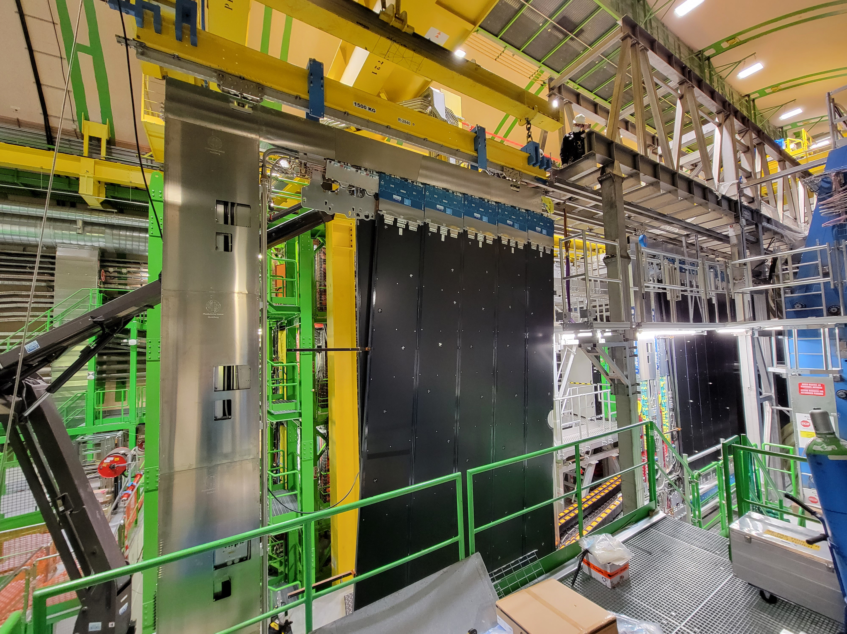
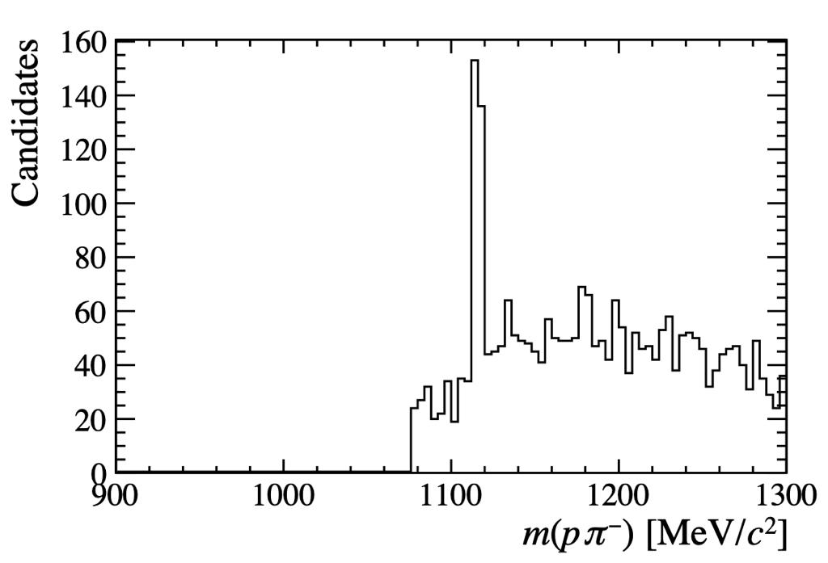

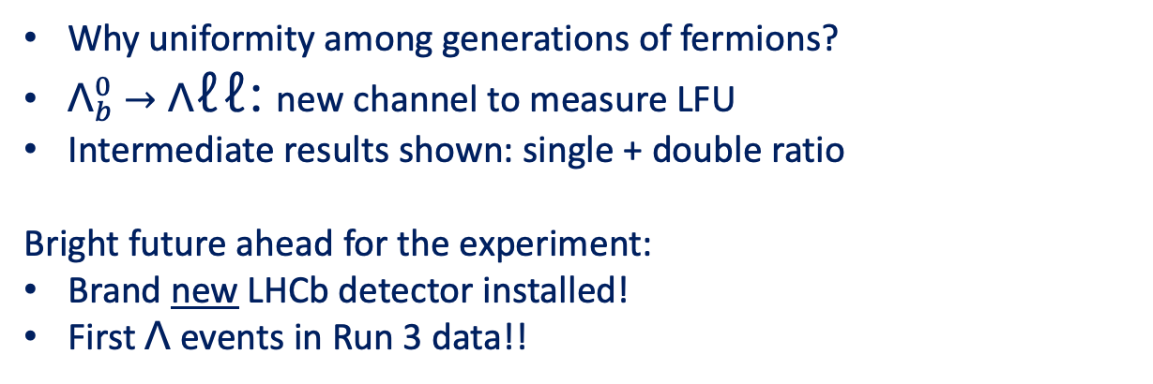

Final remarks
Why uniformity among generations of fermions?
${\text{Λ}}_{b}^{0}→\text{Λ}$ℓℓ: new channel to measure LFU
Intermediate results shown: single + double ratio
Bright future ahead for the experiment:
Brand new LHCb detector installed!
First $\text{Λ}$ events in Run 3 data!!
LHCb Run 3
Unofficial
$$\text{Λ}$$

Slide 19
Thank you for listening! Questions?

