Slide 1
VULCAN Studying the fluorescence response of PTFE to incident VUV light in cryogenic conditions
Emily Jayne Brookes

Slide 2
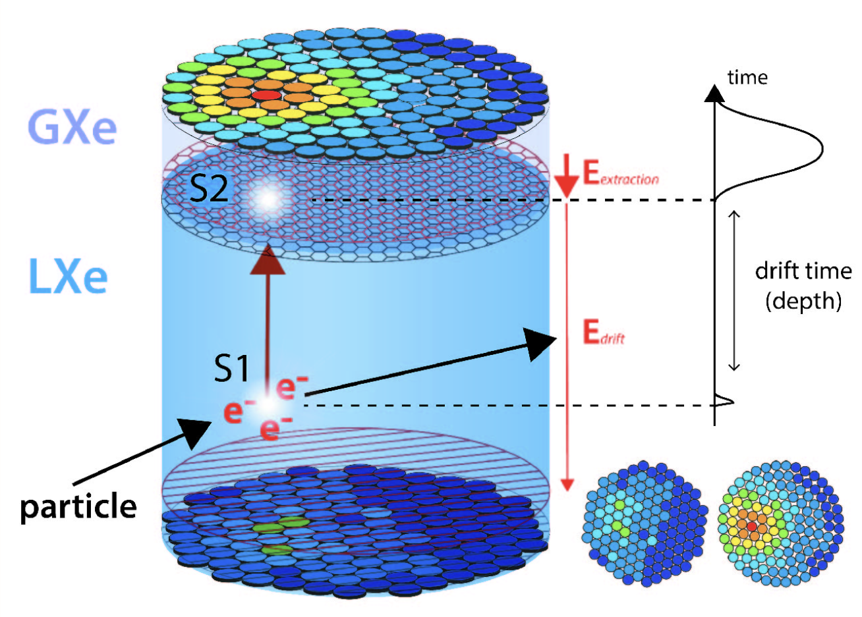
XENONnT relies on accurate characterisation of light signals
Scintillation light and electrons from ionisation are detected by arrays of PMTs at the top and bottom of the detector
The detector is constructed from polytetrafluoroethylene (PTFE)
It has been suggested that fluorescence from PTFE in the detector could be the cause for some backgrounds

Slide 3
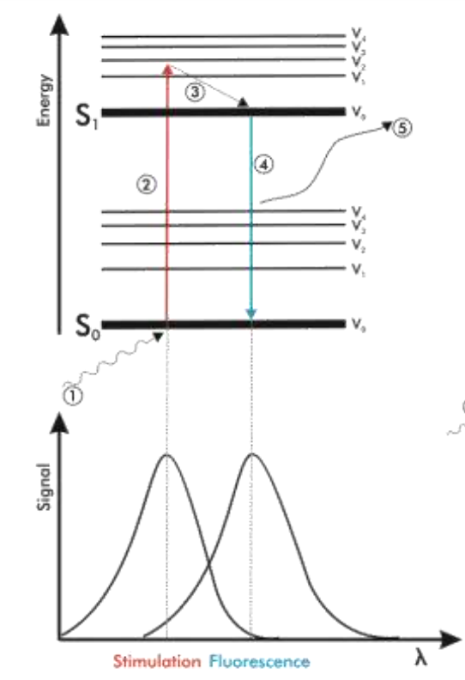
Impurities in the PTFE fluoresce
Fluorine atoms surrounding structure provide good resistance to heat, chemical reactions, weathering etc
PTFE does not fluoresce, the introduction of impurities, contaminants or defects create colour centres
Fluorescence depends on temperature, manufacturer, cleaning techniques, impurities and excitation wavelength
VUV light is not very penetrating so surface treatment is very important

Slide 4
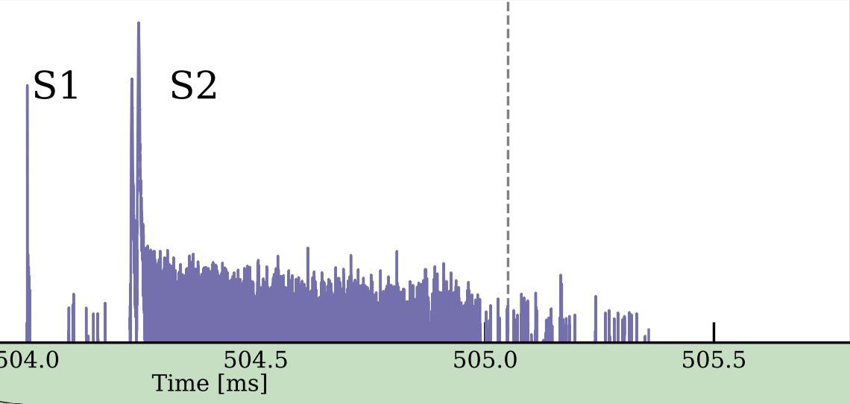
Fluorescence may contribute to electron train backgrounds
Fluoresced light can ionise detector impurities and introduce excess single electron signals following larger events
Electrons from large events can be trapped on electronegative impurities in the detector
Fluoresced photons can ionise these trapped electrons which are drifted and extracted to the gas phase of the detector, and detected as single electron signals

Slide 5
Few-electron signals are a background for light dark matter signals
Small S2 backgrounds can originate from light dark matter interactions, which are searched for in S2-only analyses
These signals can be paired with previous, uncorrelated small S1 signals to create a fake event, these are accidental coincidences
Building larger detectors will increase the exposure of these experiments, but the accidental coincidence background will also increase

Slide 6
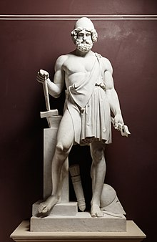
VULCAN will study this fluorescence under pseudo-LXe conditions
VULCAN – Vacuum ULtraviolet Characterisation At Nikhef
LXe conditions: 178nm excitation wavelength, 170K liquid xenon temperature
Vulcan: Roman god of flames and lightning
How much can PTFE fluorescence contribute to these single electron backgrounds?
Can we recommend effective surface treatments?

Slide 7
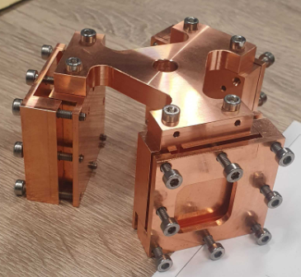
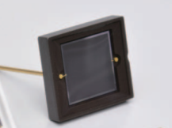
The VULCAN setup
+
LN2 reservoir
Lamp
Monochromator
VUV light provided by deuterium lamp + monochromator
Vacuum required to remove oxygen, reducing attenuation
Three samples can be mounted in Cu holder to be cooled
Fluorescence detected by SiPMs sensitive to visible light
Vacuum chamber
Pump (under table)

Slide 8
The VULCAN setup
+
LN2 reservoir
Lamp
Monochromator
VUV light provided by deuterium lamp + monochromator
Vacuum required to remove oxygen, reducing attenuation
Three samples can be mounted in Cu holder to be cooled
Fluorescence detected by SiPMs sensitive to visible light
Vacuum chamber
Pump (under table)

Slide 9
Conclusions – putting everything together
PTFE used in construction of the XENON experiment can fluoresce
Fluorescence from PTFE introduces electron train backgrounds and negatively impacts the limits we are able to set on dark matter
VULCAN will test the fluorescence of PTFE at LXe scintillation wavelength and temperature
Does PTFE fluoresce? Can it contribute to electron trains? Can we minimise this?

Slide 10
Other future measurements
Reflectivity and transmission of samples
SiPM efficiencies
Materials/cleaning techniques used in other detectors
Longevity of samples under incident radiation
Hydrocarbon formation on different optical components

Slide 11
Thank you for listening!

