Slide 1
KamLAND-Zen
Neutrinoless double-beta decay 0𝝂𝛽𝛽
NNV symposium lunteren | Kelly Weerman | 04-10-2022

Slide 2
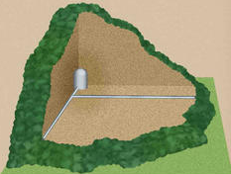
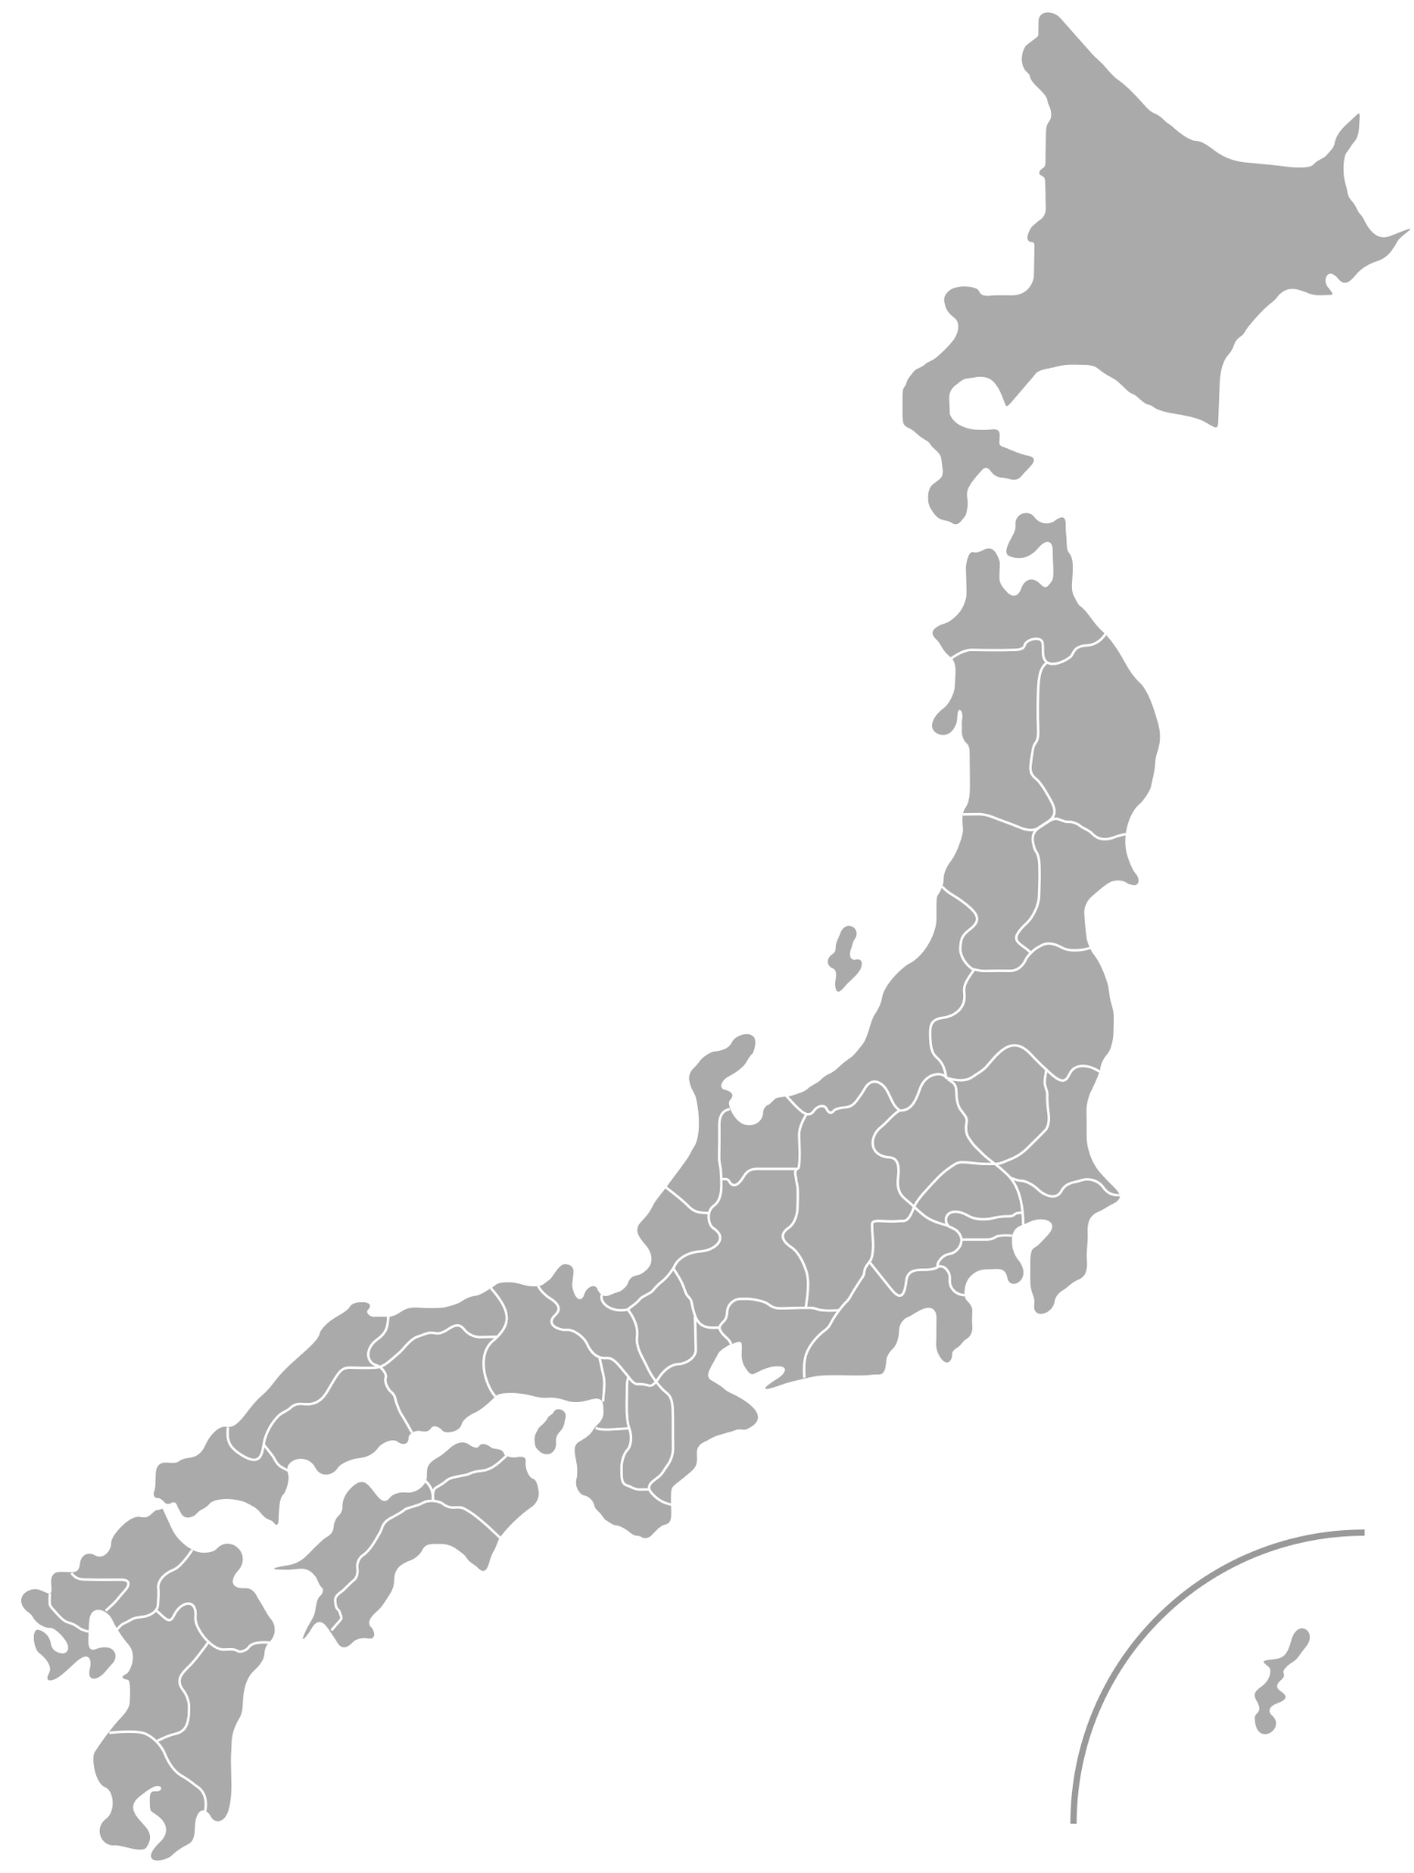
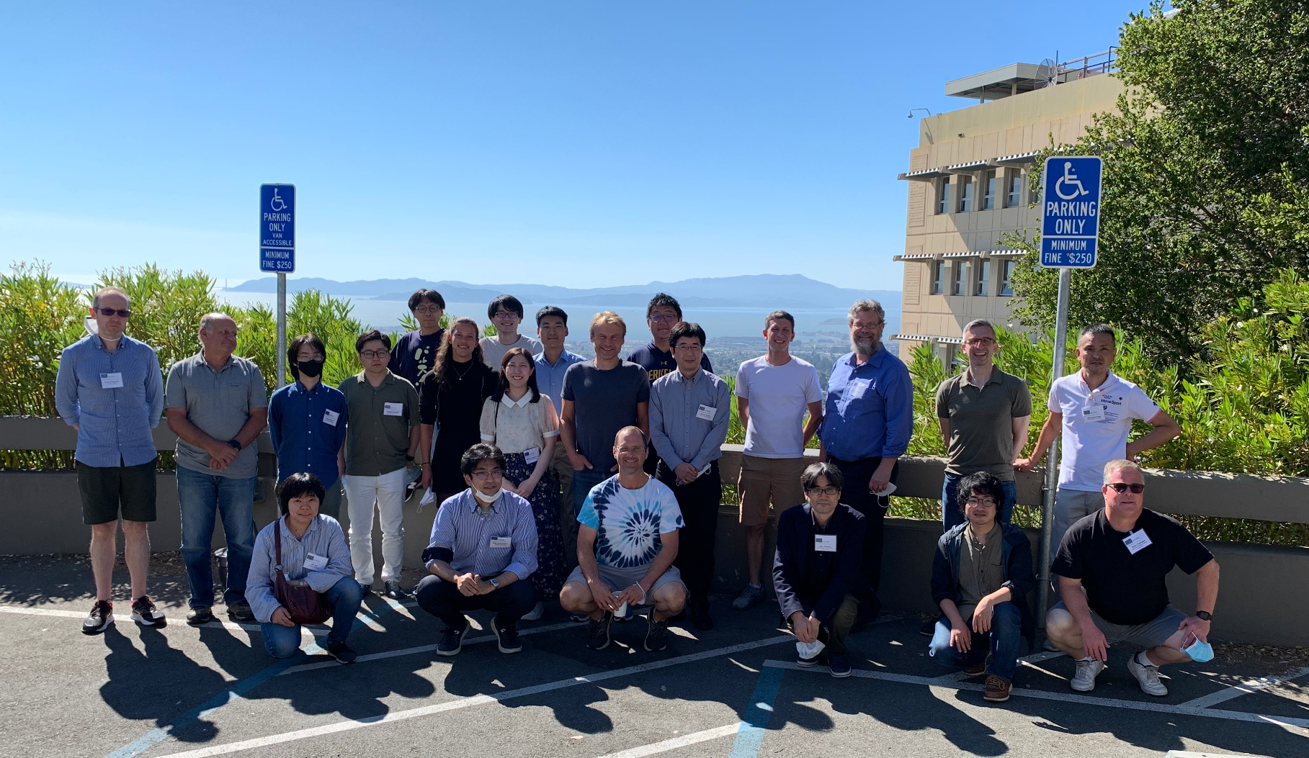
KamLAND Collaboration
Notes:
first of all tell you why this experiment is so important, many properties still not yet known because they are so hard to observe (background problem). For my research concentrate on majorana nature, why? Bc leptogenesis property
Show on whiteboard what exactly happens with majorana things

Slide 3
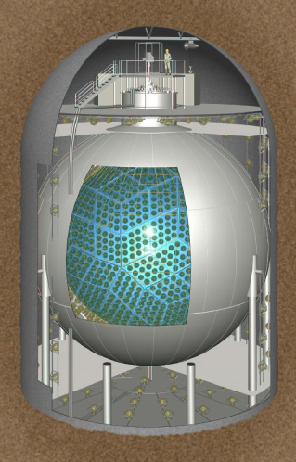
General purpose detector
Solar neutrinos
Geo and reactor neutrinos
Accelerator neutrinos
Astrophysical neutrinos
Neutrinoless double beta decay
Notes:
first of all tell you why this experiment is so important, many properties still not yet known because they are so hard to observe (background problem). For my research concentrate on majorana nature, why? Bc leptogenesis property
Show on whiteboard what exactly happens with majorana things

Slide 4
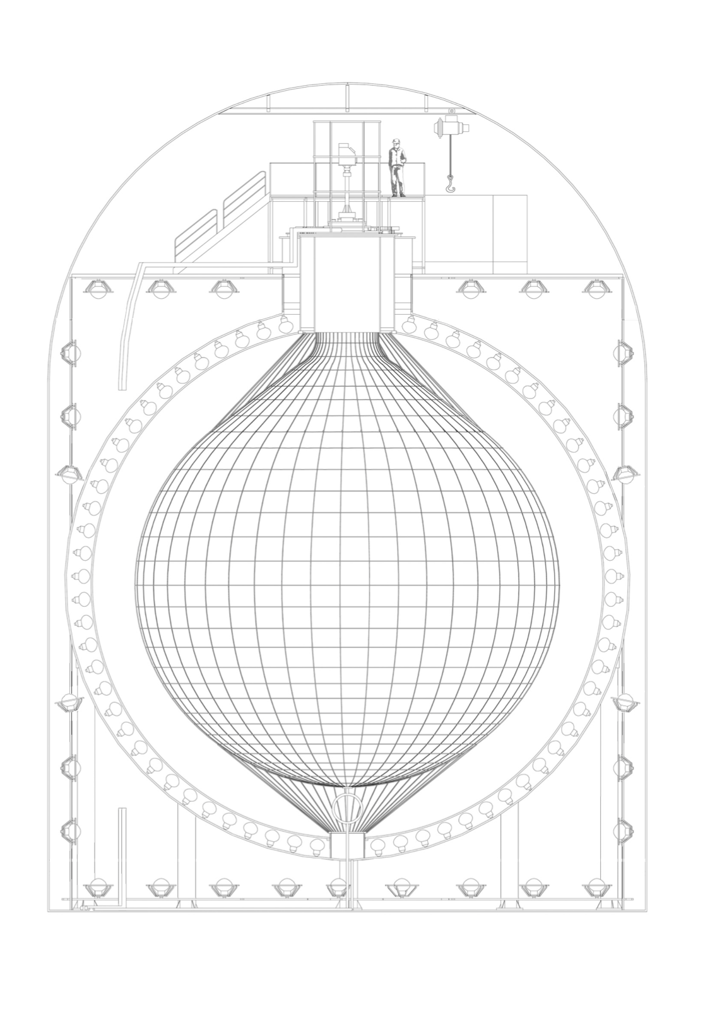
Kamioka Liquid Scintillator Antineutrino Detector
Spherical tank, ⌀18m
3.2kt pure water
Outer Cherenkov detector
Inner Scintillation detector
KamLAND detector | Majorana neutrinos | 0𝝂𝛽𝛽 KamLAND-Zen | Backgrounds & Analysis | Results
Notes:
stainless steel containment tank
shield for gamma-rays and fast neutrons. Used for cosmic-ray detection
18m diameter stainless steel spherical tank, contains 1000ton of ultra pure LS in a balloon of 13m diameter, viewed through transparent buffer oil of 1.8m thickness by 1879 17-inch and 20-inc PMT . Outside the tank there is 3200 ton water Cherenkov detector for muon identification which serves as a radiation shield from the surrounding rock.

Slide 5
Kamioka Liquid Scintillator Antineutrino Detector
Charge & Timing Energy & Vertex
Spherical tank, ⌀18m
3.2kt pure water
Outer Cherenkov detector
Outer PMTs
~1800 17- & 20-inch PMTs
Inner PMTs
Non-scintillation oil 1.8m
Buffer oil
KamLAND-LS, ⌀13m, 1.2kt
Dodecane 80.2%
Pseudocumene 19.8%
PPO 1.36g/L
Liquid Scintillator balloon
Inner Scintillation detector
KamLAND detector | Majorana neutrinos | 0𝝂𝛽𝛽 KamLAND-Zen | Backgrounds & Analysis | Results

Slide 6
Observation of 0𝝂𝛽𝛽 to confirm neutrinos majorana nature
2𝝂𝛽𝛽 :
0𝝂𝛽𝛽
M(A,Z)
(A,Z+1)
(A,Z)
0𝝂 𝛽𝛽
(A,Z+2)
even-even
Majorana nature: particle is its own antiparticle → leptogenesis
KamLAND detector | Majorana neutrinos | 0𝝂𝛽𝛽 KamLAND-Zen | Backgrounds & Analysis | Results
Notes:
(A,Z) \to (A,Z+2) + 2e^- + 2\overline{\nu}_e
Maybe here show lifetime dependent on majorana mass so nice new physics!!

Slide 8
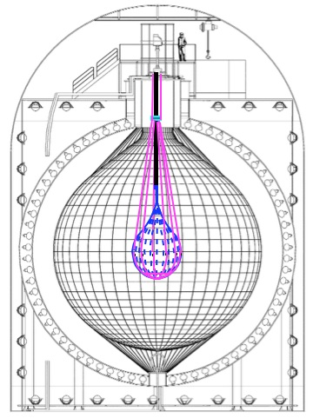
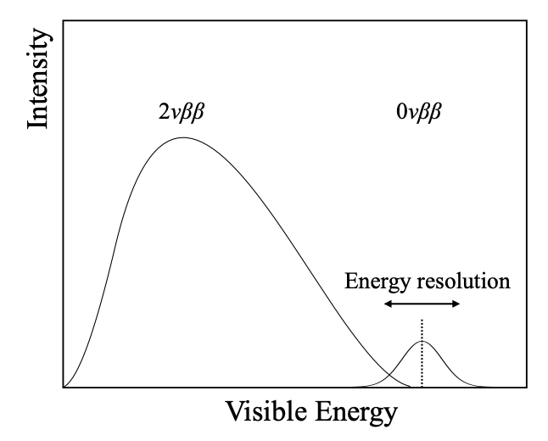
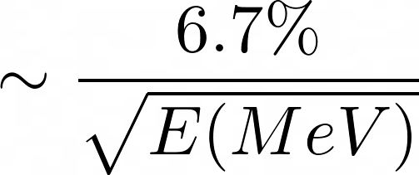
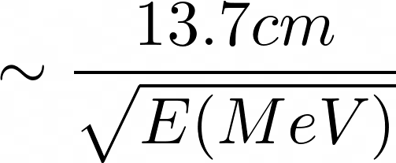
KamLAND-Zen: Zero Neutrino Double Beta
Xe-LS balloon, ⌀3.8m, 24t
3.13% enriched xenon
Inner Balloon Xe-LS
745 kg ¹³⁶Xe
970 kg yr Exposure
Q_{𝛽𝛽} = 2.458 MeV
Energy & position resolution
Important background!
KamLAND detector | Majorana neutrinos | 0𝝂𝛽𝛽 KamLAND-Zen | Backgrounds & Analysis | Results
Notes:
inner balloon in center of detector. Made of transparent clean nylon film of 25/mu m thick and 3.08 in diameter filled with enriched Xe (91% 136-Xe) dissolved in decane-based LS (Xe-LS).
Ask Patrick: is it 0.1 MeV?
8.6cm op diameter 13m outer one?

Slide 9
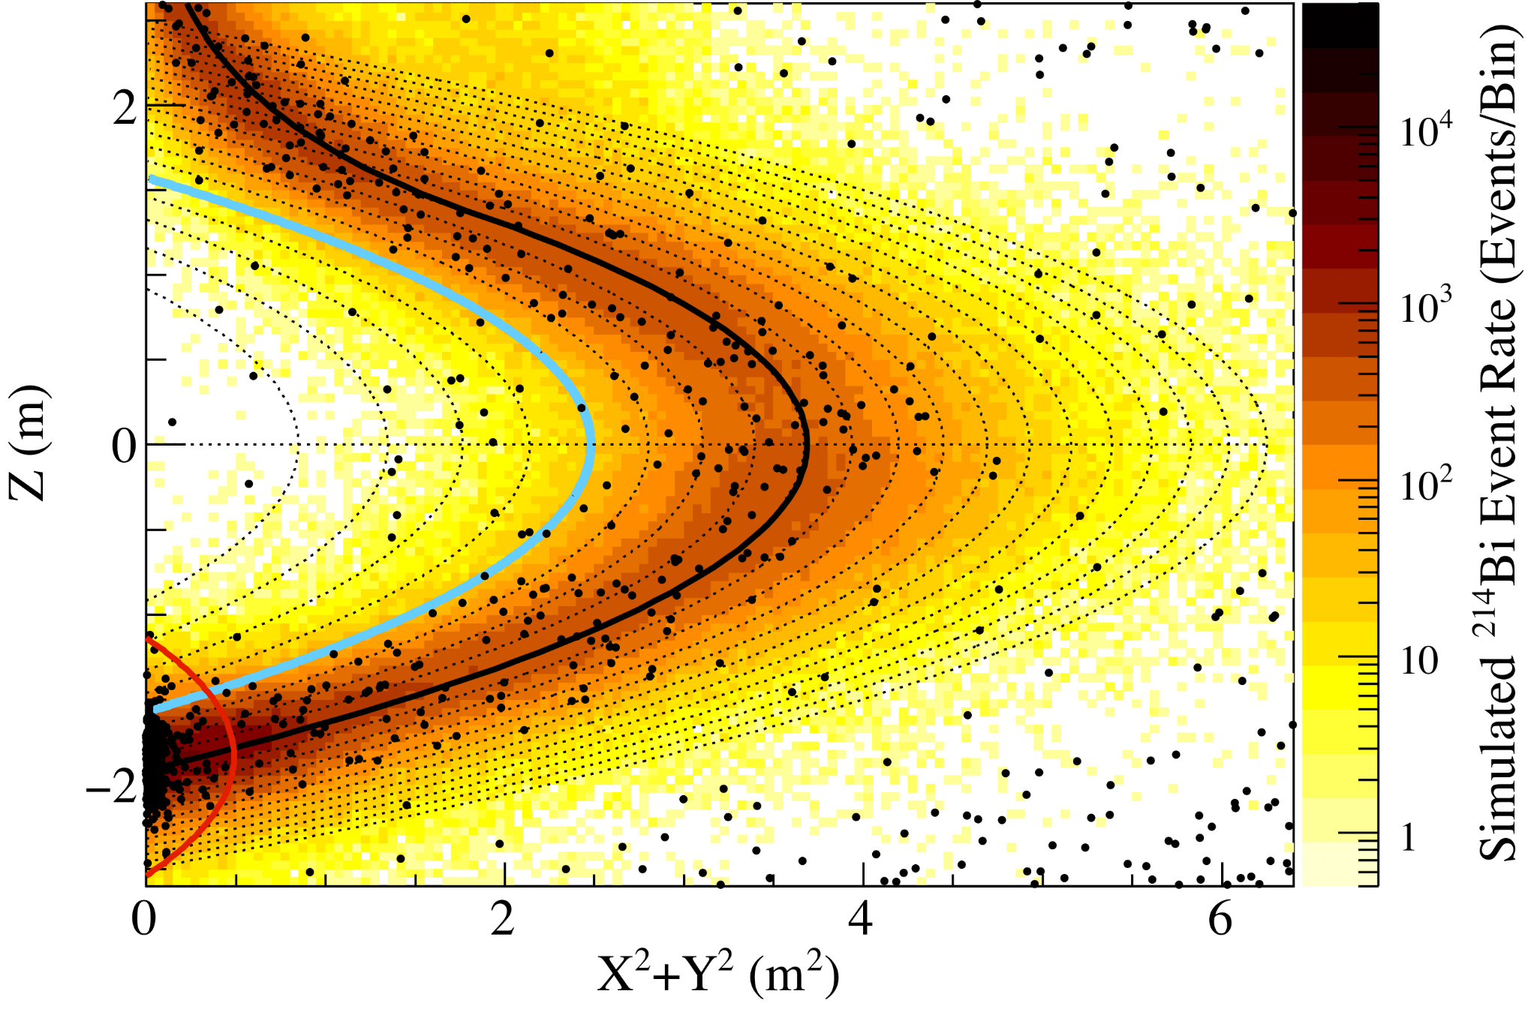
Primary backgrounds and analysis cuts
2𝝂𝛽𝛽 decay
Cosmogenic spallation products
Solar neutrino interactions
Radioactive contamination
Short-lived: triple coincidence tagging
Long-lived: problem
Xe-LS Inner balloon
Fiducial Volume
2.35 < E < 2.70 MeV
In Xe-LS
External to Xe-LS: IB material
Notes:
Null measurement outside of balloon!!!
214Bi: radon decay chain
2vbb, muons, other neutrino things
short-lived carbon spallation, long-lived spallation products of 136-Xe
Main backgrounds and coincidence tagging
Large life-time→low background experiment

Slide 10
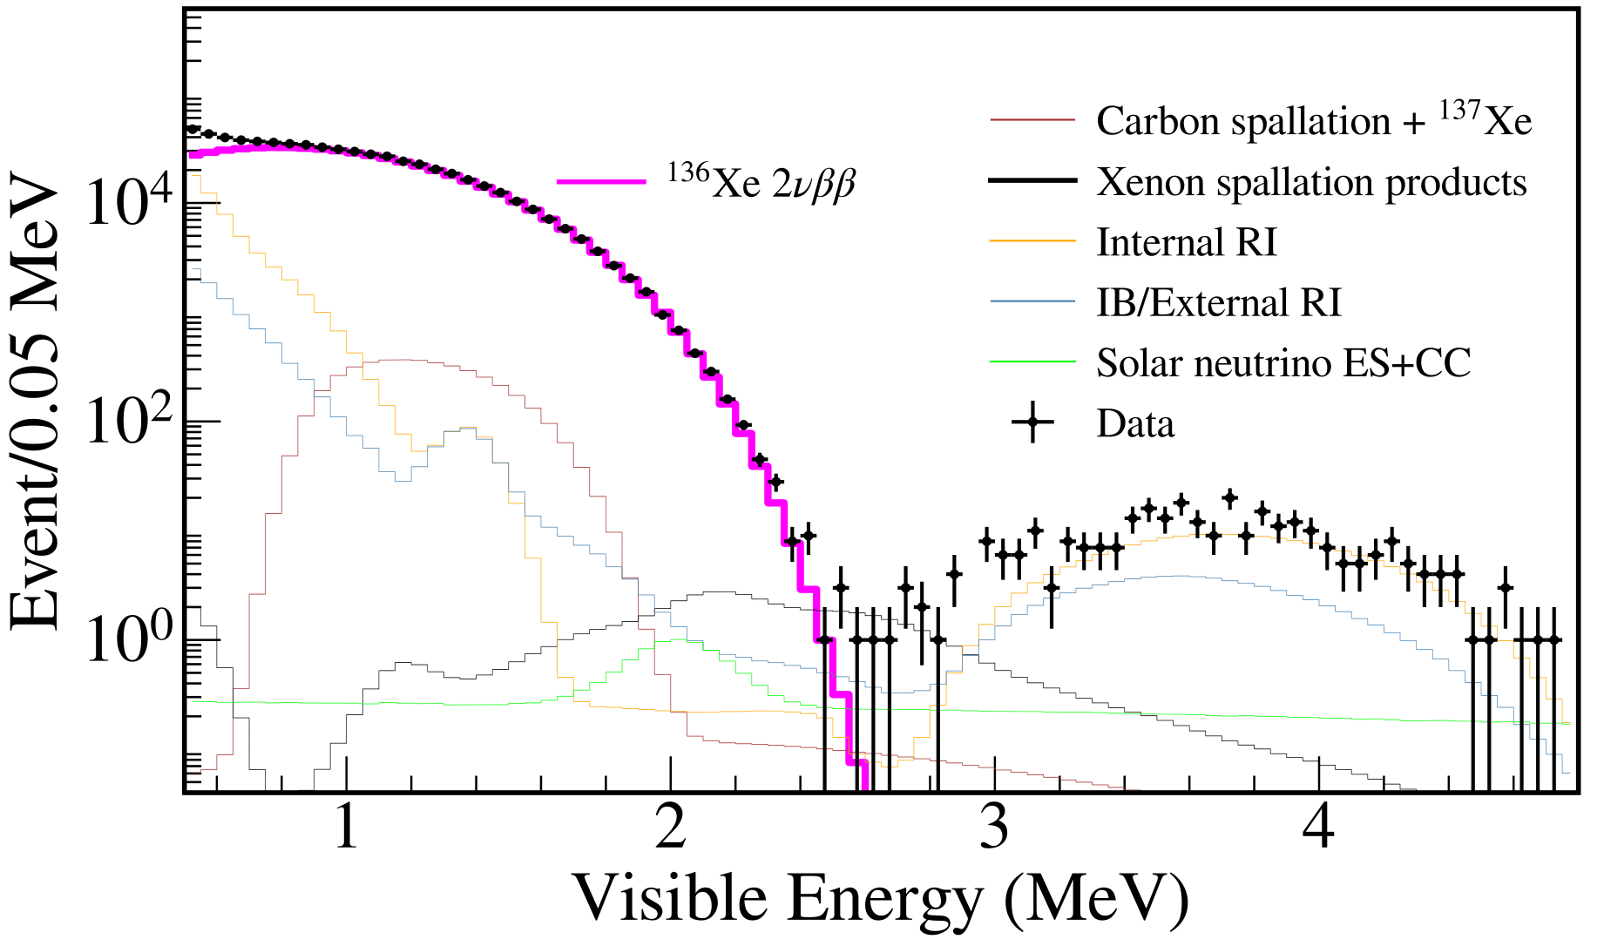
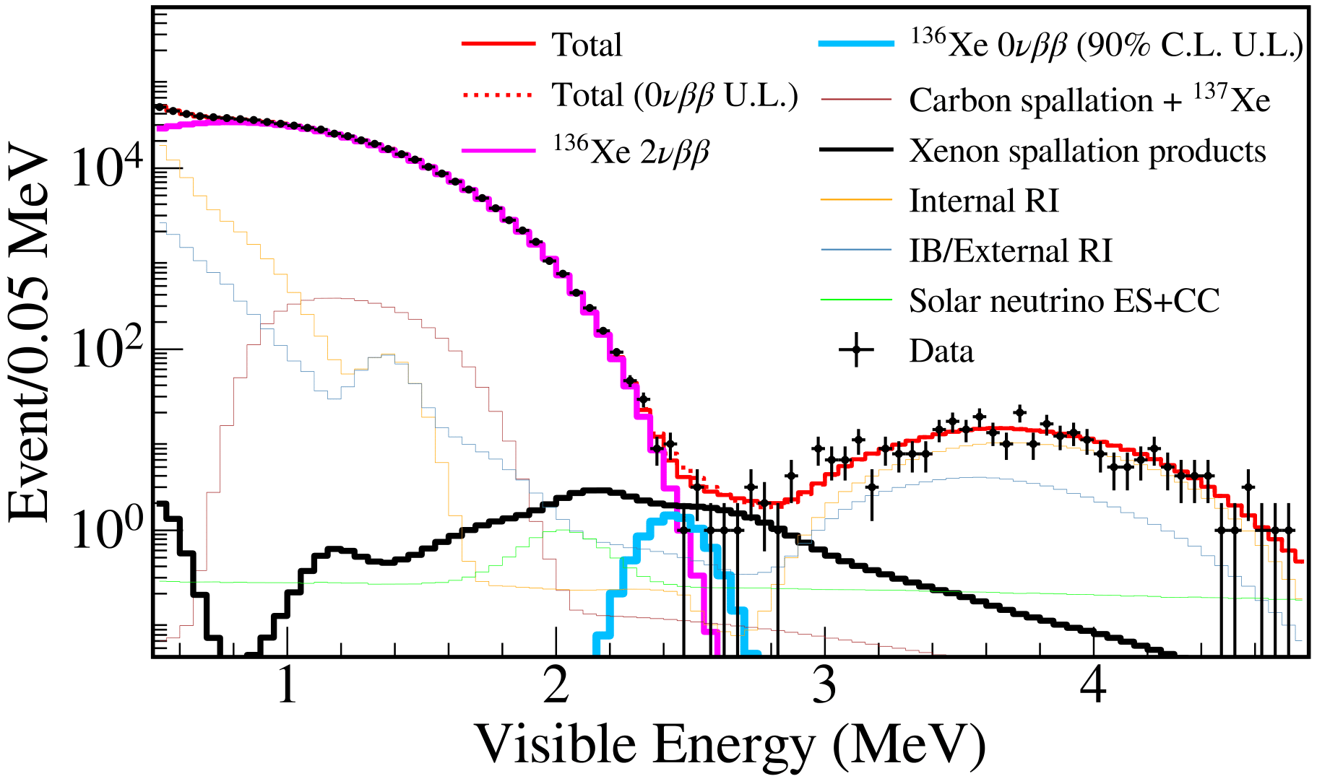
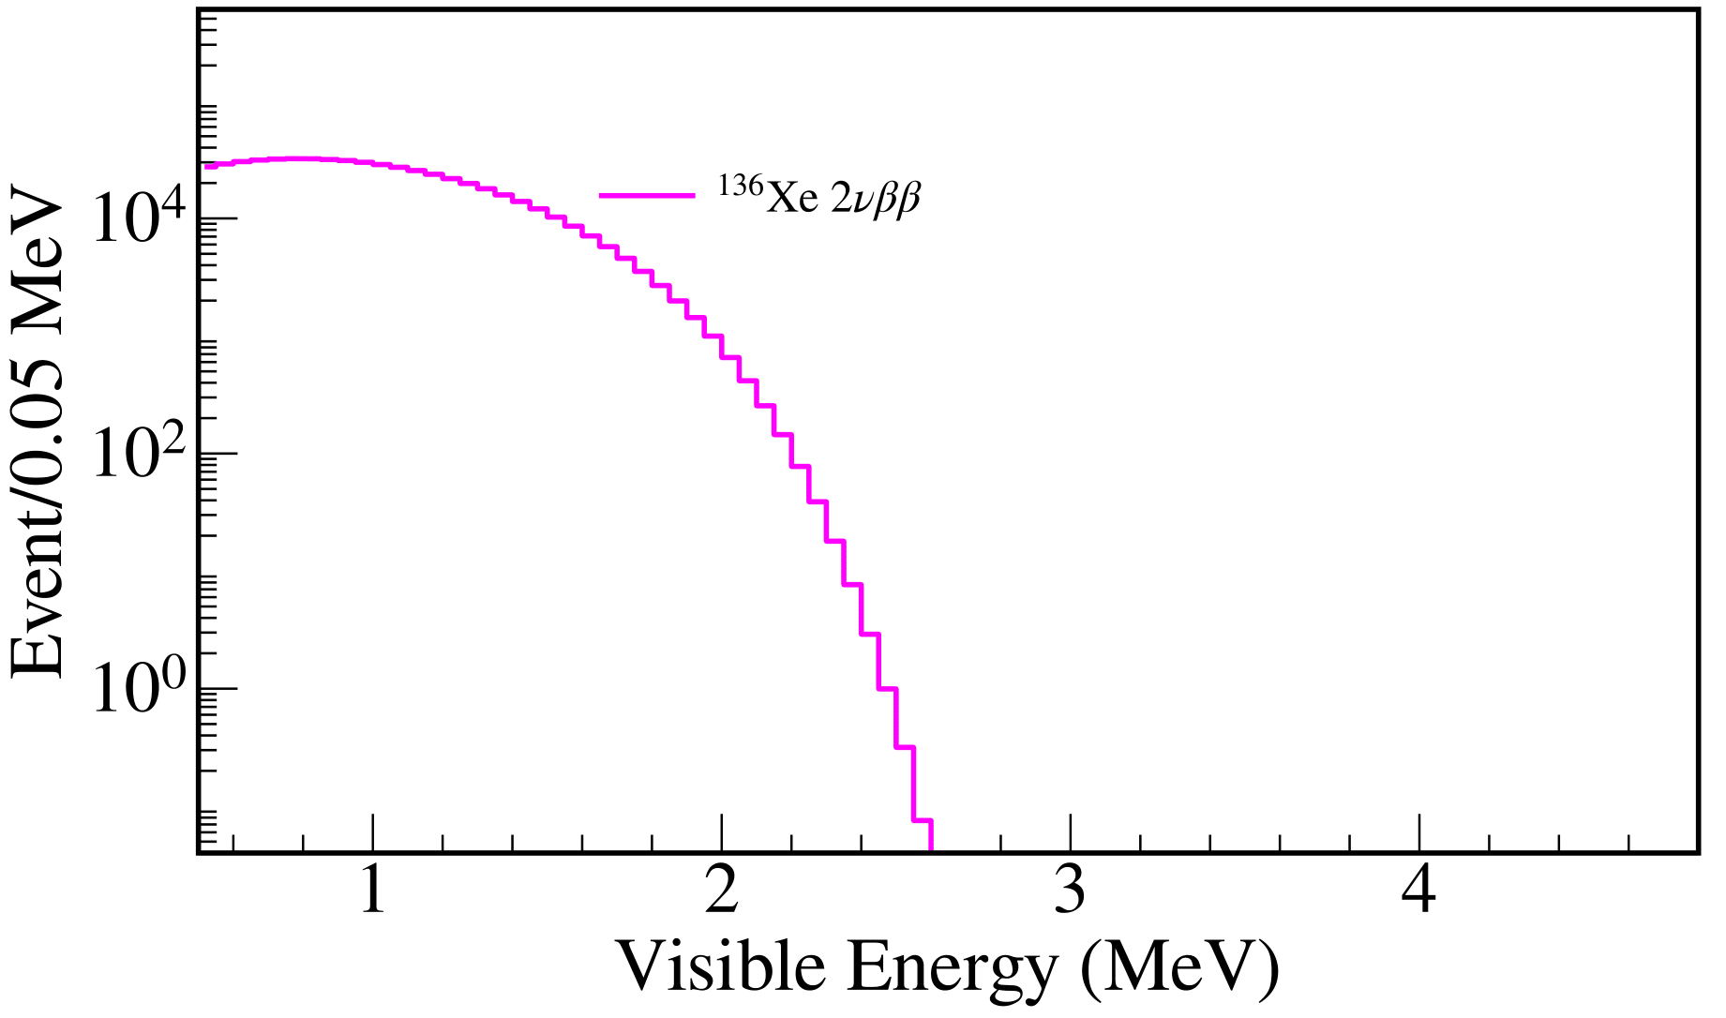
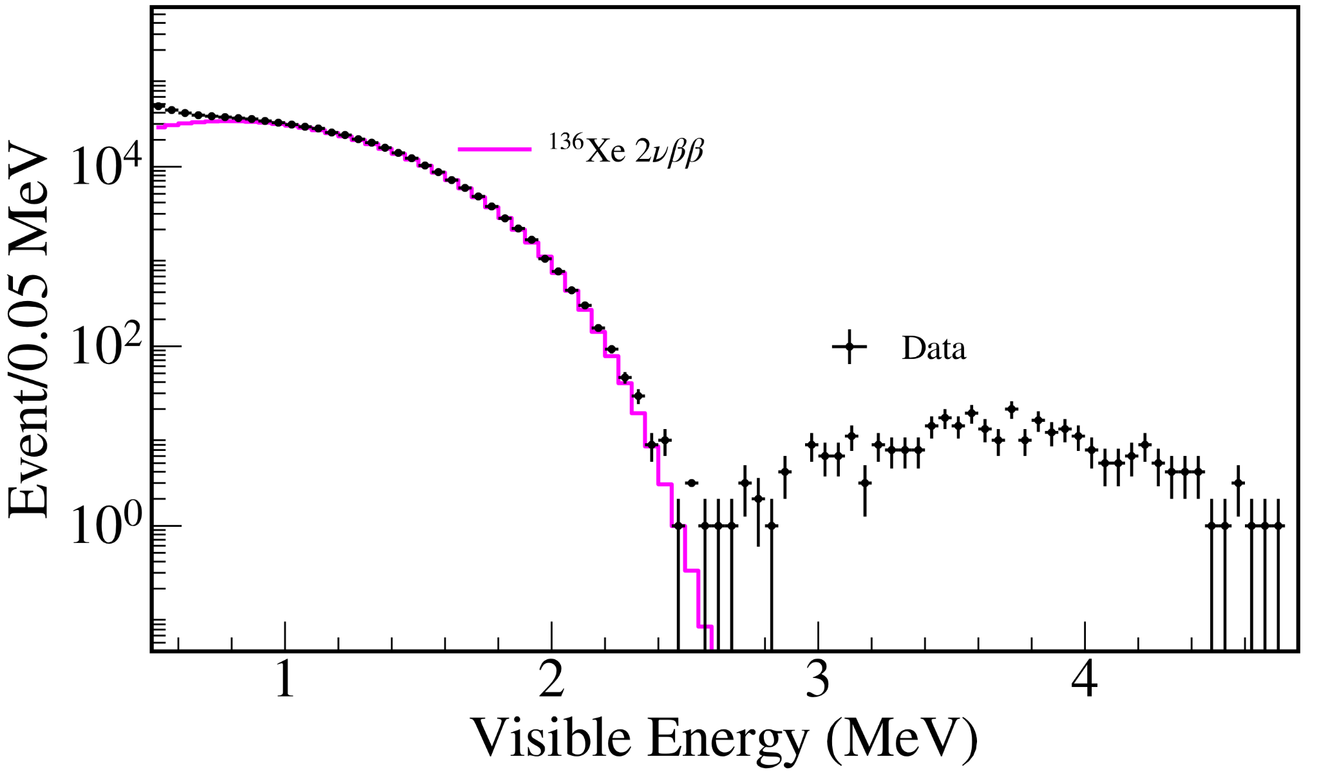
Most stringent limit on the half-life of 0𝝂𝛽𝛽
Zen Collaboration. (2022). First Search for the Majorana Nature of Neutrinos in the Inverted Mass Ordering Region with KamLAND-Zen. arXiv preprint arXiv:2203.02139.
Energy resolution
Q_{𝛽𝛽} = 2.458 MeV
KamLAND detector | Majorana neutrinos | 0𝝂𝛽𝛽 KamLAND-Zen | Backgrounds & Analysis | Results
Notes:
Write with arrows the backgrounds

Slide 11
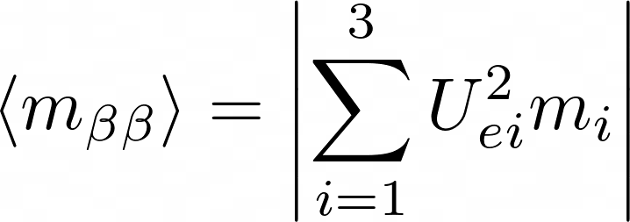
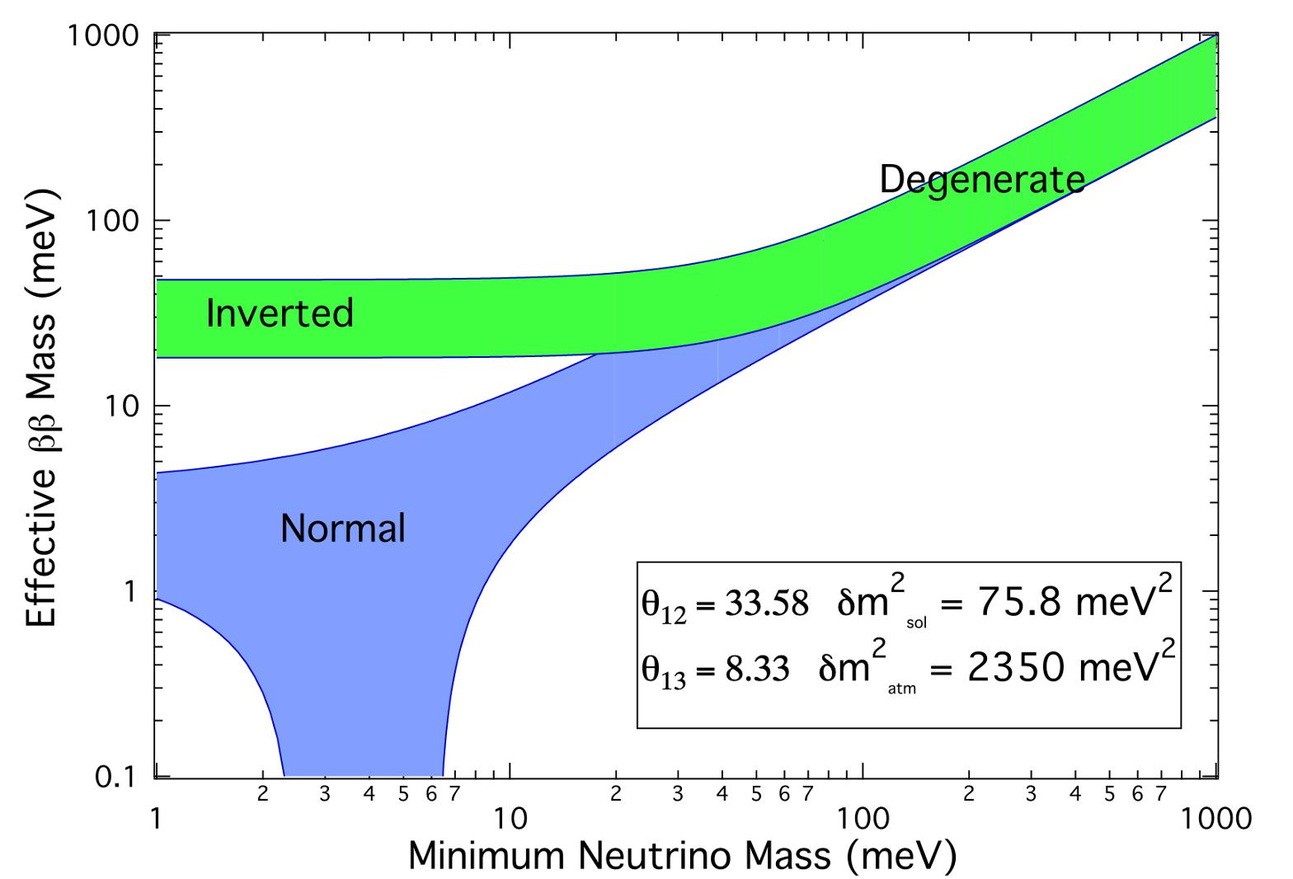
First test of the Majorana nature in the IO region
Nuclear Matrix Element
S. Elliot, Mod. Phys. Lett. A 27, 1230009 (2012)
KamLAND detector | Majorana neutrinos | 0𝝂𝛽𝛽 KamLAND-Zen | Backgrounds & Analysis | Results
Notes:
Inverted ordering: mv1 > mv3, normal ordering mv3 > mv1

Slide 12
Research overview and detector upgrade
Simulation of xenon isotopes with Monte Carlo code FLUKA
KamLAND2-Zen
1000 kg enriched Xenon
Improved energy resolution: 2𝝂𝛽𝛽 background reduced
Scintillating inner balloon
Notes:
2vbb, muons, other neutrino things
short-lived carbon spallation, long-lived spallation products of 136-Xe

Slide 13
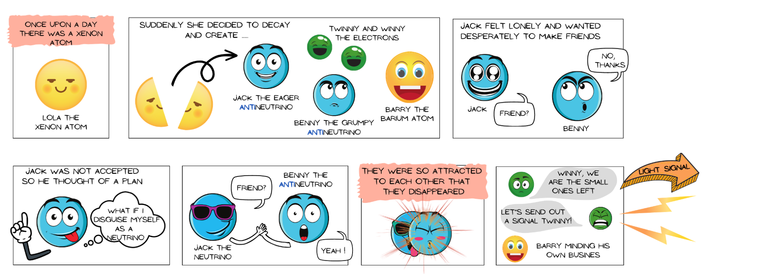
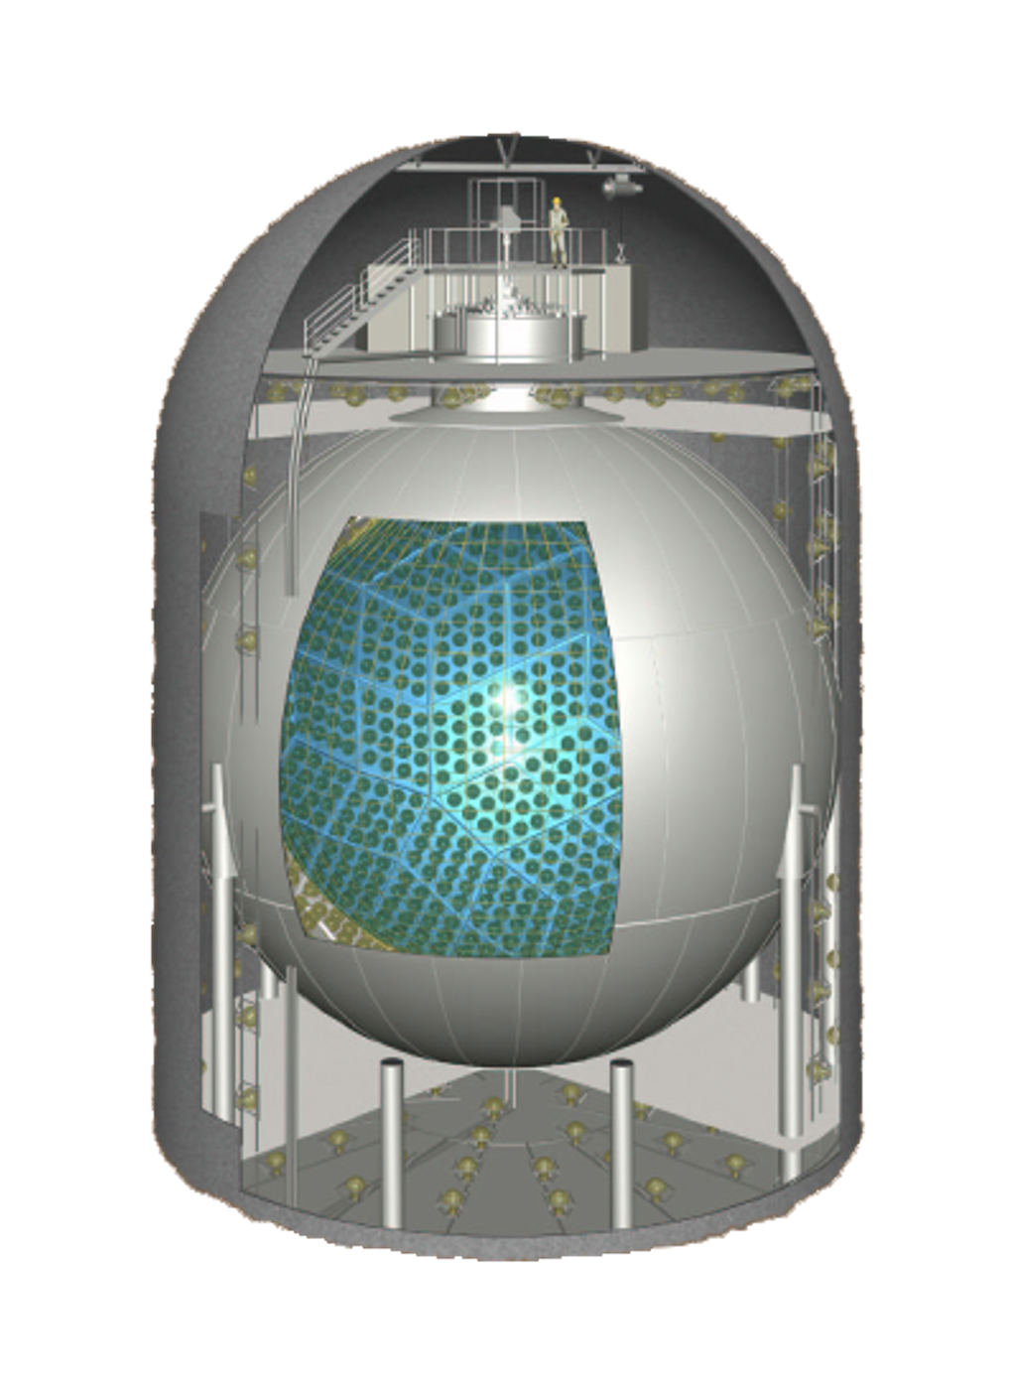
Thank you for your attention!
Notes:
2vbb, muons, other neutrino things
short-lived carbon spallation, long-lived spallation products of 136-Xe

Slide 14
Backup slides
Notes:
2vbb, muons, other neutrino things
short-lived carbon spallation, long-lived spallation products of 136-Xe

Slide 15
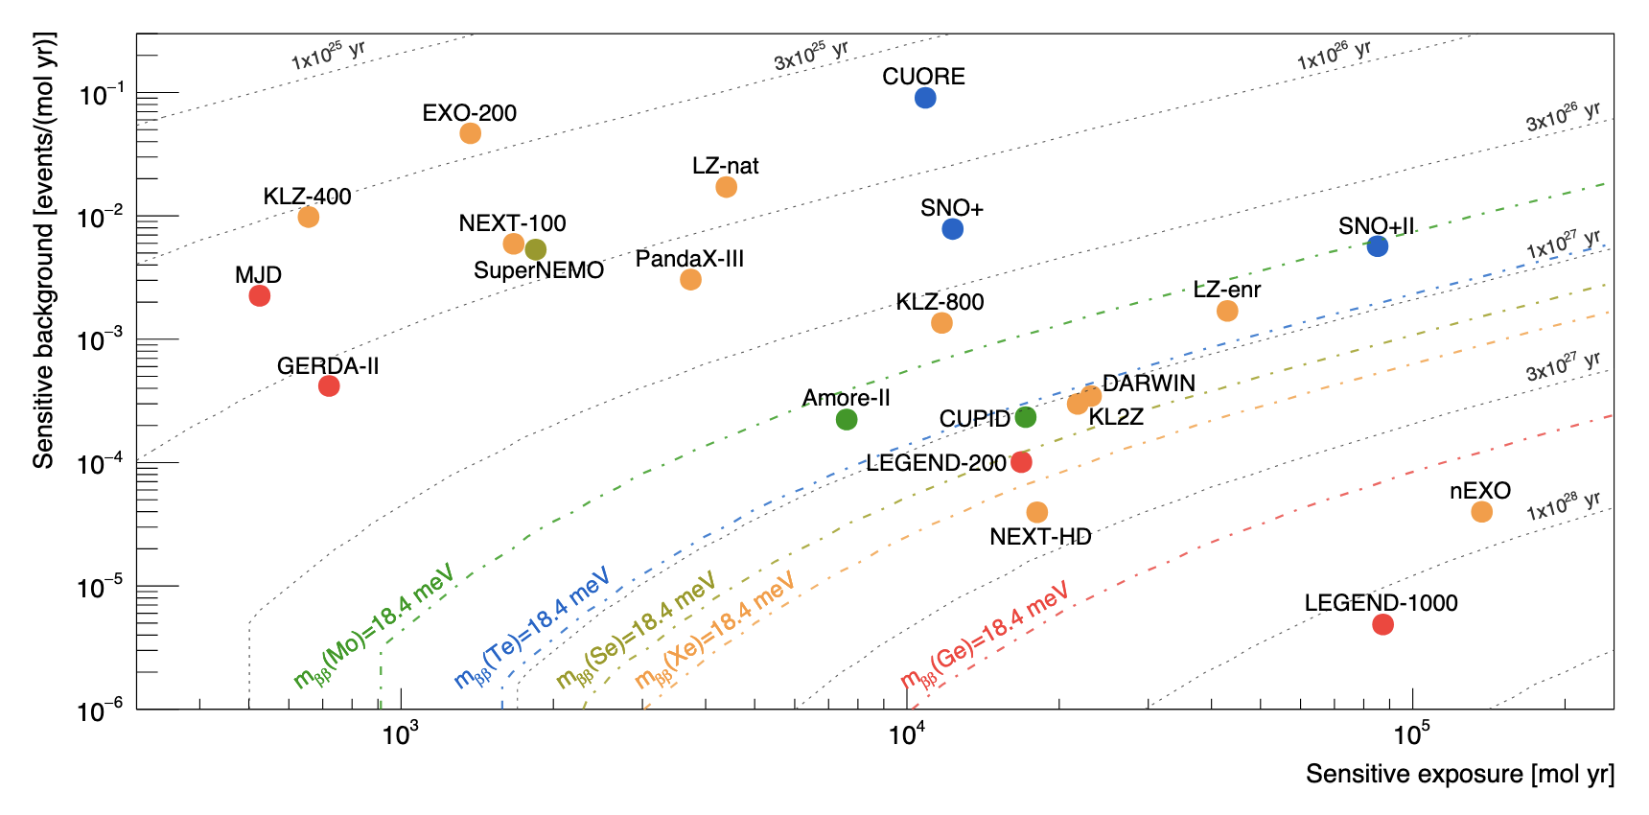
Sensitive background and exposure for recent and future experiments
Agostini, Matteo, et al. "Toward the discovery of matter creation with neutrinoless double-beta decay." arXiv preprint arXiv:2202.01787 (2022)
Notes:
Nuclear pairing force. Nucleons in nuclei: have spin and so magnetic moments. Maximally energetically favorable nucleons pair up with spins opposing each-other in equivalent spatial orbitals: maximizes wave-function overlap and the stabilizing effect of the attractive spin-opposite spin interaction. So nuclei with even numbers of protons, or neutrons, nearly always slightly more tightly bound than odd number of both. Special even-even nuclei: nucleons pair up in this especially harmonious stabalizing way.

Slide 16
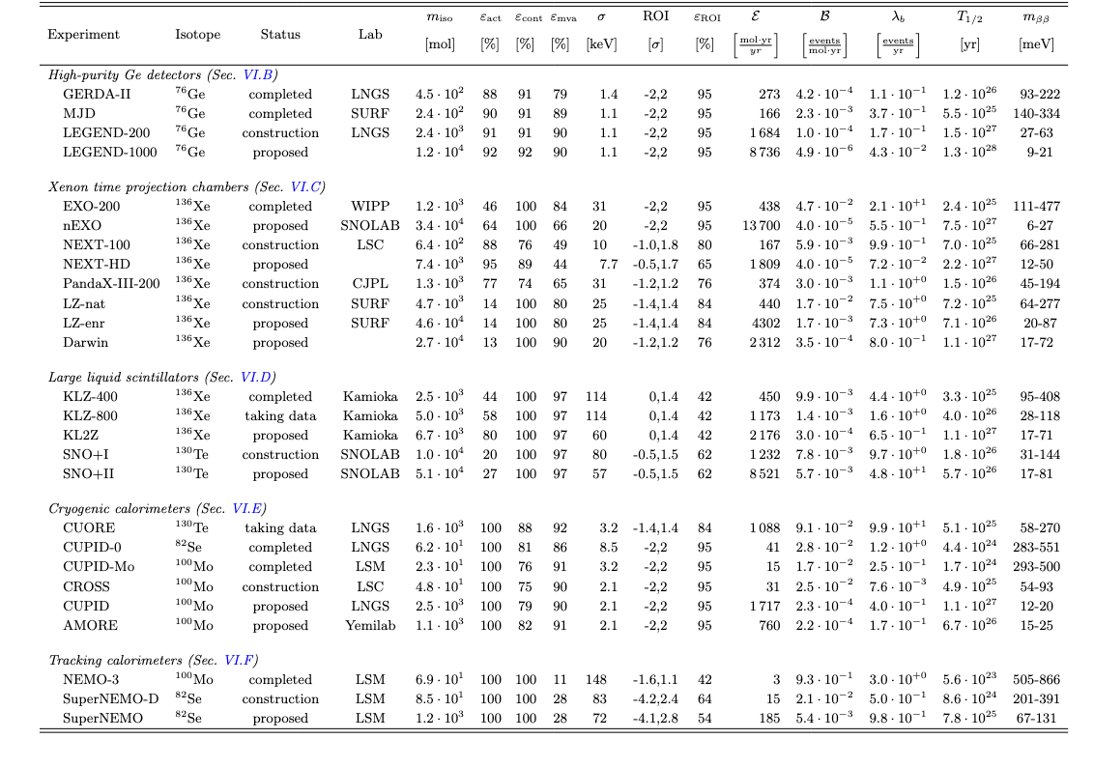
Agostini, Matteo, et al. "Toward the discovery of matter creation with neutrinoless double-beta decay." arXiv preprint arXiv:2202.01787 (2022)
Notes:
Nuclear pairing force. Nucleons in nuclei: have spin and so magnetic moments. Maximally energetically favorable nucleons pair up with spins opposing each-other in equivalent spatial orbitals: maximizes wave-function overlap and the stabilizing effect of the attractive spin-opposite spin interaction. So nuclei with even numbers of protons, or neutrons, nearly always slightly more tightly bound than odd number of both. Special even-even nuclei: nucleons pair up in this especially harmonious stabalizing way.

Slide 17
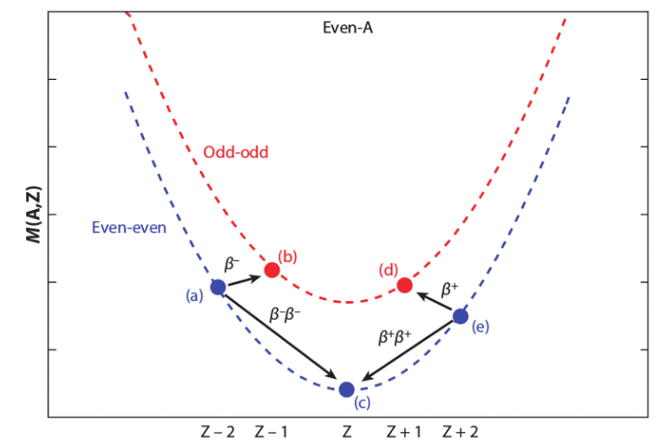
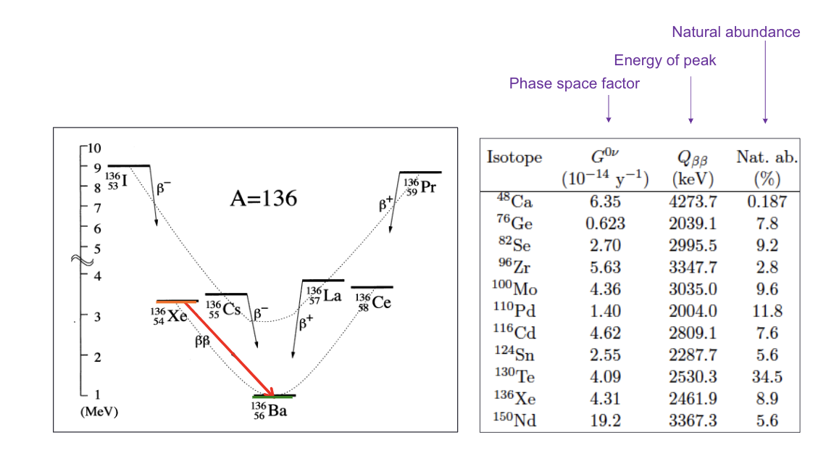
Which isotope is the best choice for detecting 0𝝂𝛽𝛽
Majorana neutrinos | KamLAND-Zen experiment | muon spallation | FLUKA
Notes:
Nuclear pairing force. Nucleons in nuclei: have spin and so magnetic moments. Maximally energetically favorable nucleons pair up with spins opposing each-other in equivalent spatial orbitals: maximizes wave-function overlap and the stabilizing effect of the attractive spin-opposite spin interaction. So nuclei with even numbers of protons, or neutrons, nearly always slightly more tightly bound than odd number of both. Special even-even nuclei: nucleons pair up in this especially harmonious stabalizing way.

Slide 18
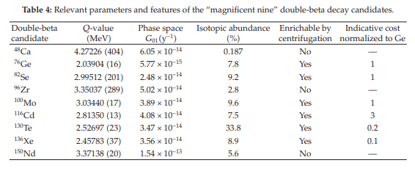
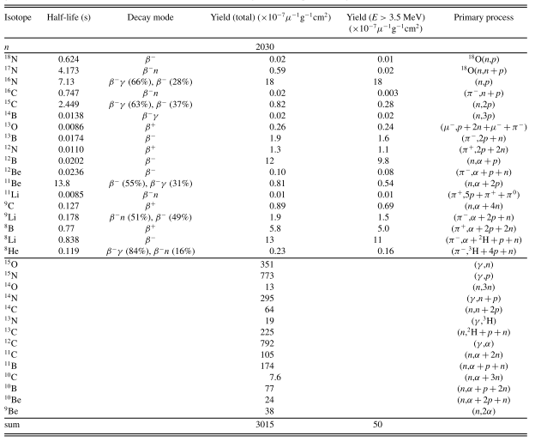
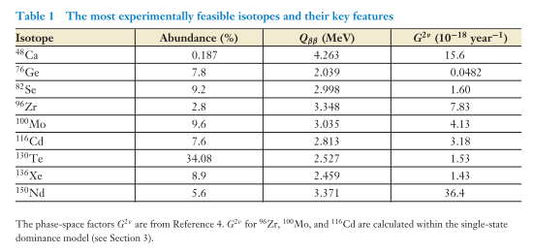
Other isotopes and muon spallation products
Backup slides
Notes:
FLUKA to find what isotopes are created
muon induced spallation products in Xe-LS predicted using FLUKA. Written in gfortran and c++ nightmare, but works really nicely.
Interaction of hadrons, heavy ions, electromagnetic particles in arbritary materials

Slide 19
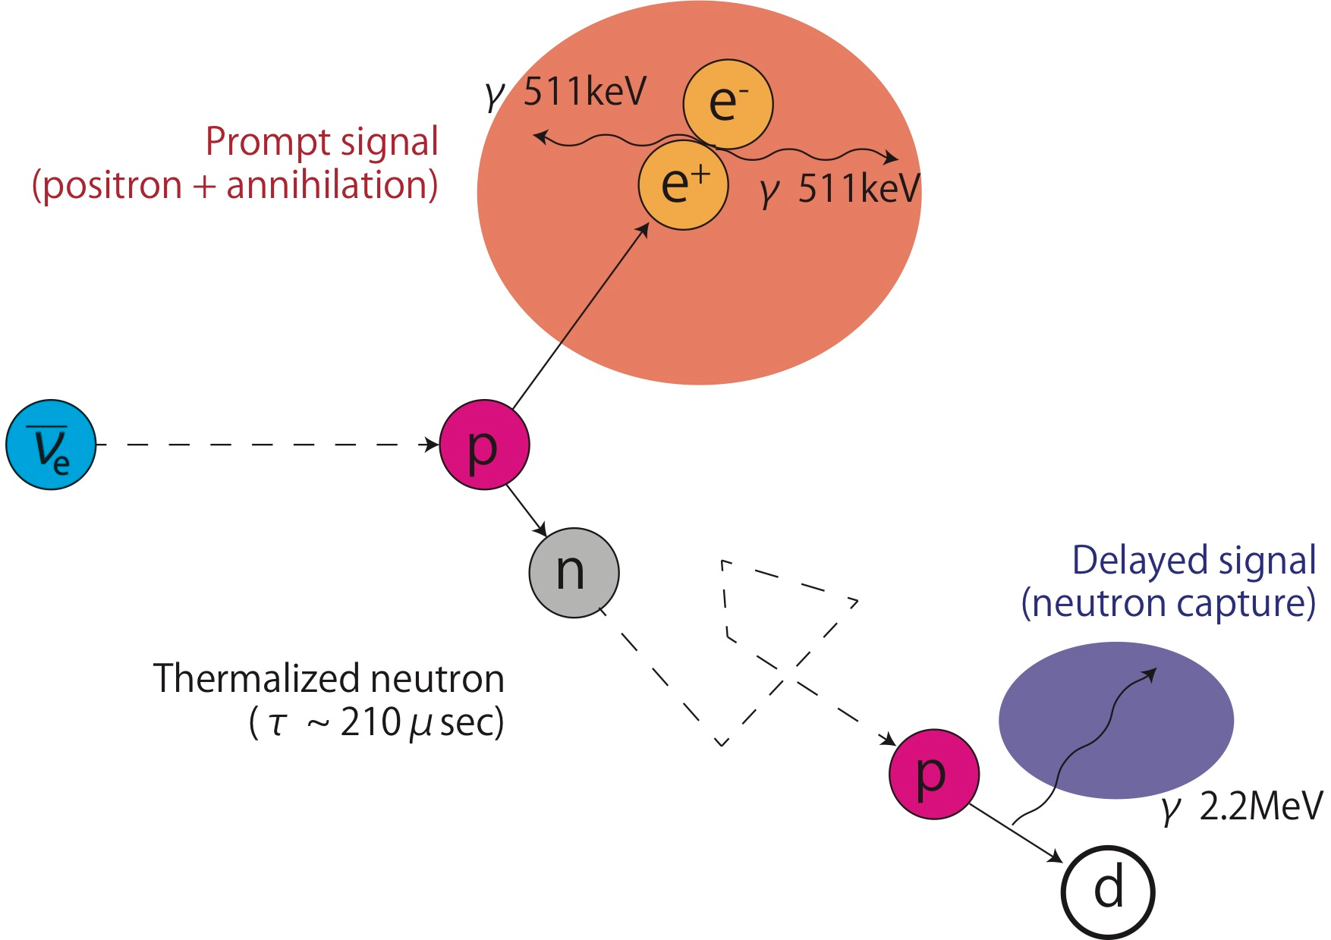
Kamioka Liquid Scintillator Antineutrino Detector
Majorana neutrinos | KamLAND-Zen experiment | muon spallation | FLUKA

Slide 20
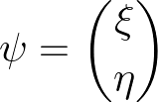
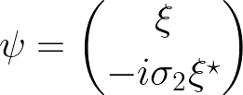
Why does the Majorana spinor lead to rare decays?
“They are both particle and antiparticle at the same time”
Left chiral field
Right chiral field
Chirality is not a conserved quantity, however helicity is
RH
LH
Majorana neutrinos | KamLAND-Zen experiment | muon spallation | FLUKA
Notes:
Some more introduction of majorana nature. Particles: left-chiral anti-particles: right-chiral. Start with right-chiral part, also right-helicity, go to left-chiral part, with small right-helicity there.

Slide 21
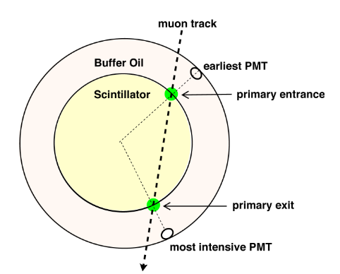
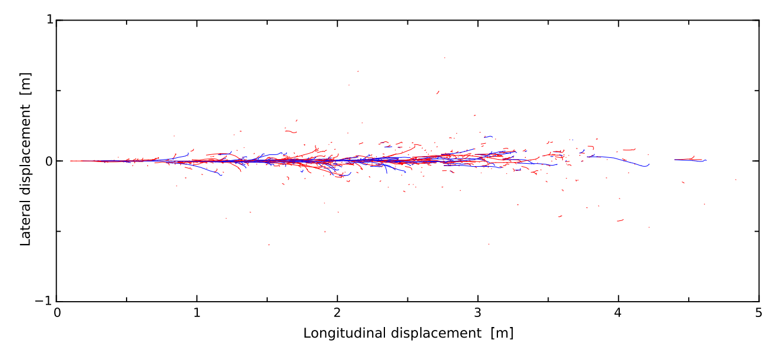
High energetic muons flying through the detector
Muon track reconstruction and induced showers
O. Hideyoshi, High Sensitivity Search for Neutrinoless Double-Beta Decay in KamLAND-Zen with Double Amount of 136Xe. PhD thesis, Tohoku University, 2020.
S. W. Li and J. F. Beacom, “Spallation backgrounds in super-kamiokande are made in muon-induced showers,” Physical Review D, vol. 91, no. 10, p. 105005, 2015
Majorana neutrinos | KamLAND-Zen experiment | muon spallation | FLUKA
Notes:
2vbb, muons, other neutrino things
short-lived carbon spallation, long-lived spallation products of 136-Xe

Slide 22
High energetic muons flying through the detector
Triple coincidence tagging of muon spallation products
O. Hideyoshi, High Sensitivity Search for Neutrinoless Double-Beta Decay in KamLAND-Zen with Double Amount of 136Xe. PhD thesis, Tohoku University, 2020.
Majorana neutrinos | KamLAND-Zen experiment | muon spallation | FLUKA
Notes:
2vbb, muons, other neutrino things
short-lived carbon spallation, long-lived spallation products of 136-Xe

Slide 23
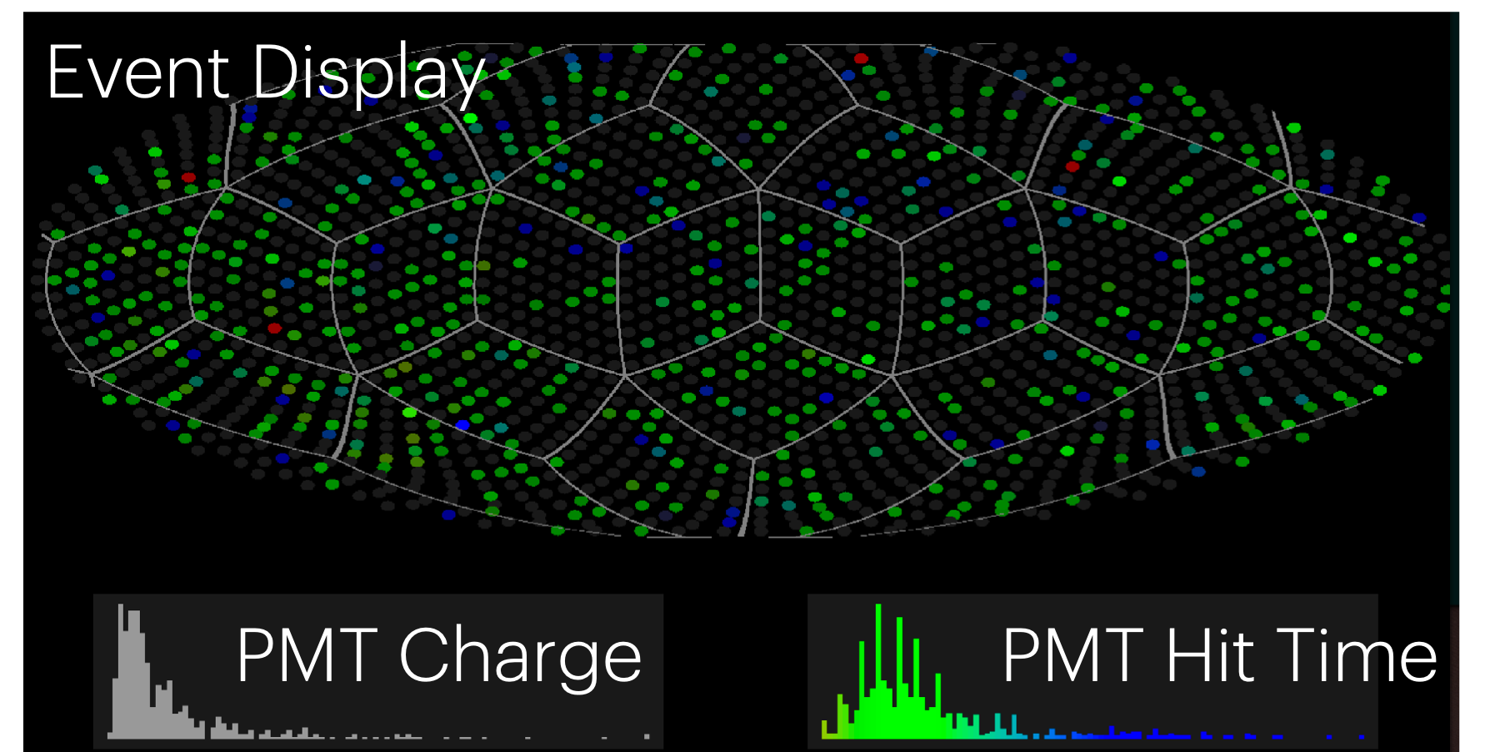
Kamioka Liquid Scintillator Antineutrino Detector
Inner detector
~ 1300 17-inch PMTs
~ 550 20-inch PMTs
Energy resolution
Position resolution
Charge & Timing
Energy & Vertex
KamLAND detector | Majorana neutrinos | 0𝝂𝛽𝛽 KamLAND-Zen | Backgrounds & Analysis | Results
Notes:
Decane based liquid scintillator: background reduction, visible light. PMT receive visible light: doped-LS send out visible light that are detected by PMTs.

Slide 24
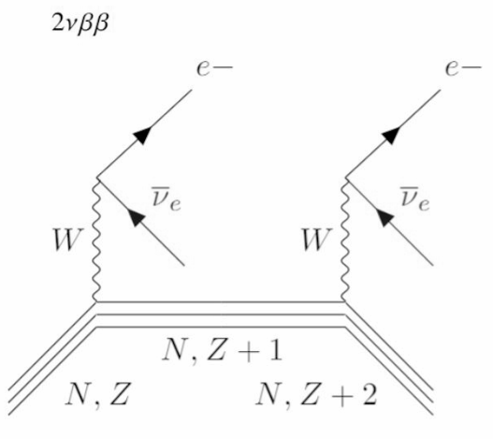
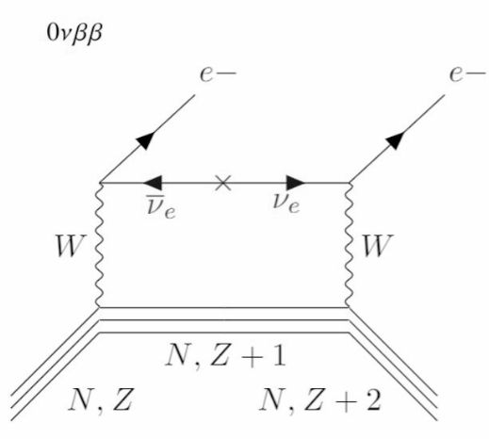
Observation of 0𝝂𝛽𝛽 to confirm neutrinos majorana nature
2𝝂𝛽𝛽 :
0𝝂𝛽𝛽
KamLAND detector | Majorana neutrinos | 0𝝂𝛽𝛽 KamLAND-Zen | Backgrounds & Analysis | Results
Notes:
(A,Z) \to (A,Z+2) + 2e^- + 2\overline{\nu}_e
Maybe here show lifetime dependent on majorana mass so nice new physics!!

Slide 25
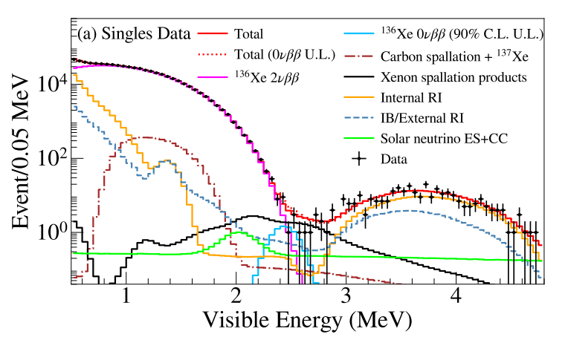
Recent KamLAND-Zen results
Zen Collaboration. (2022). First Search for the Majorana Nature of Neutrinos in the Inverted Mass Ordering Region with KamLAND-Zen. arXiv preprint arXiv:2203.02139.
2𝝂𝛽𝛽 decay
²¹⁴Bi from ²²²Rn
Carbon spallation
Xe spallation
KamLAND detector | Majorana neutrinos | 0𝝂𝛽𝛽 KamLAND-Zen | Backgrounds & Analysis | Results
Notes:
Write with arrows the backgrounds

