Slide 1
Introduction and history
Charles Timmermans

Slide 2
Why study cosmic rays?
Initially: What do we actually observe??

Slide 3
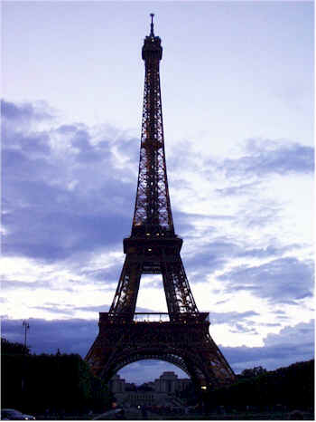
1909 Taking his ionization chamber
first to the top of the Eiffel Tower
(275 m)
Wulf observed a drop in the discharge rate.
Familiar with the penetrability of radioactive α, β, γ rays,
Wulf expected any ionizing effects due to natural radiation
from the ground, would have been heavily absorbed by the
“shielding” layers of air.

Slide 4
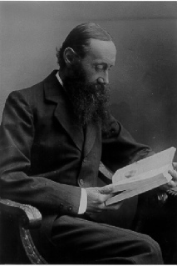
Albert Gockel (Switzerland) 1910
First Balloon Measurements (that I know)

Slide 5
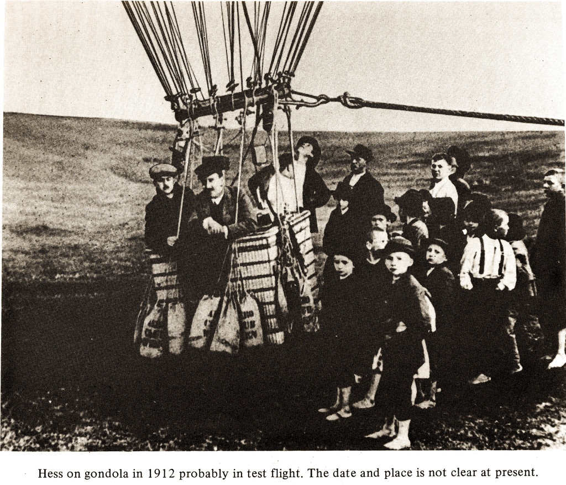
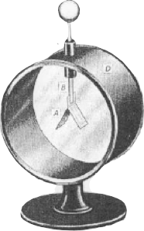

Slide 6
Physik Zeitschrift 13, 1912

Slide 7
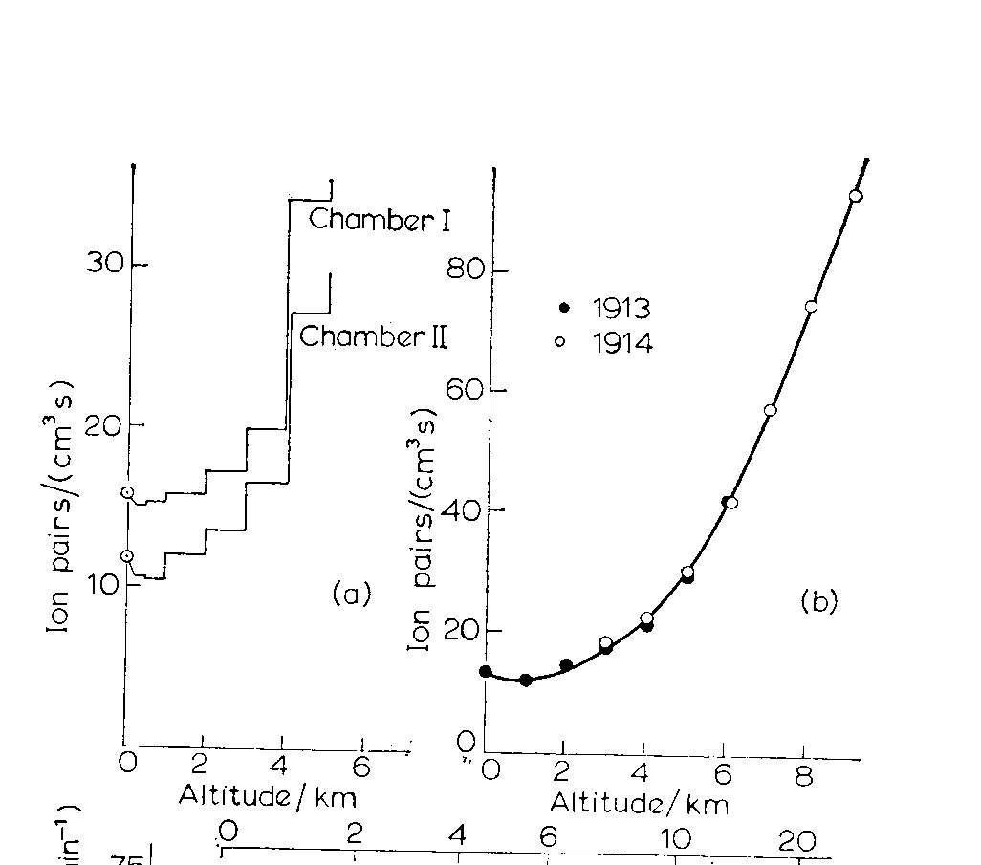
1913-14 Werner Kolhörster of Berlin’s
Physikalisch-Technische Reichsanstalt
    ascends to 9300 m (height of Mount Everest,
    cruising altitude of a passenger jet!)
    ionization rate 50 times that at sea level!
Hess
Kolhorster

Slide 8
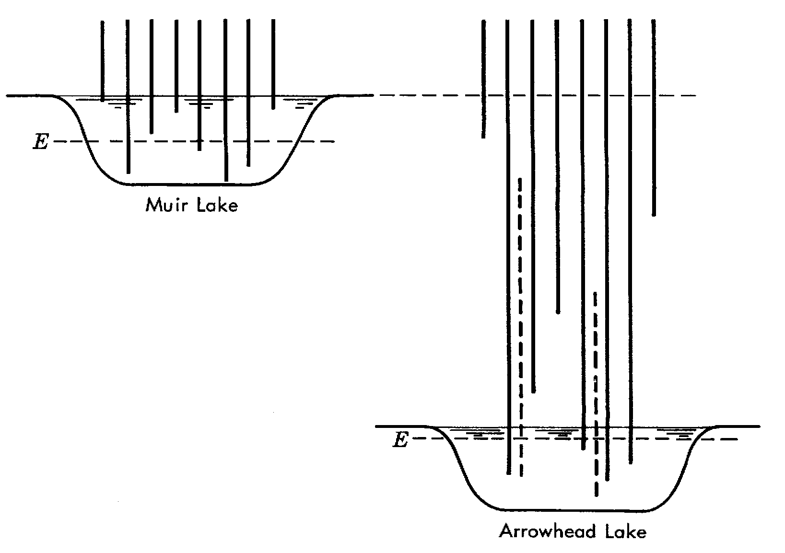
1926 Robert Millikan
Measures the intensity of rays in water. Altitude difference of the lakes is 200 meters, which corresponds to the mass of 2 meters of water.
Radiation 2 meters below surface of Muir-lake is the same as arrowhead lake!
Cosmic Rays!

Slide 9
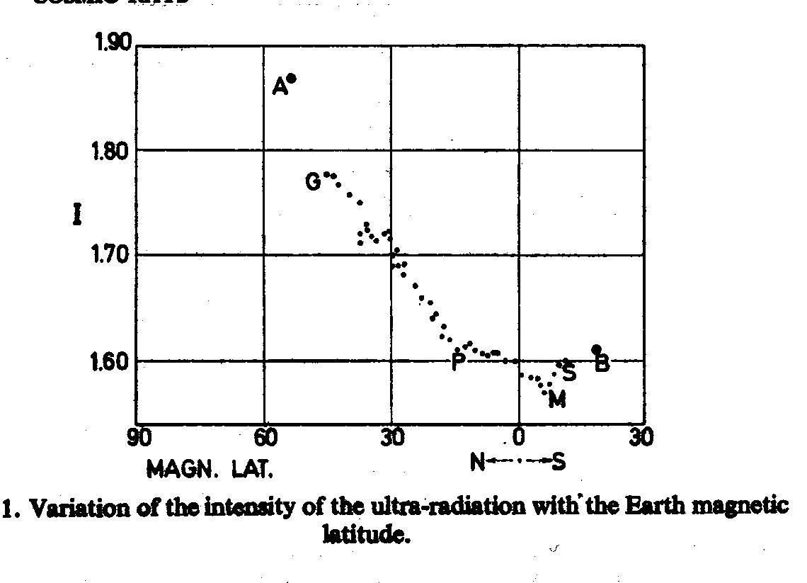
1927-28 Jacob Clay
from Genoa to the Dutch colony of Java
ionization intensity drops ~6%
minimum at magnetic equator
        Clays Results:
1929 Bothe & Kolhörster
  suggest Clay’s Lattitude Effect was due to
  deflection by earth’s magnetic field
  primaries are charged

Slide 11
Why study cosmic rays?
Initially: What do we actually observe??
Afterwards: Observing new particles in air showers!

Slide 12
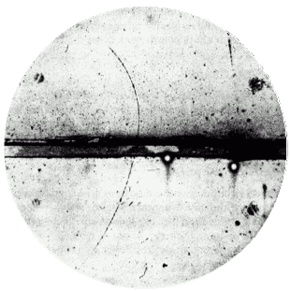
Discovery of new particles in air showers
Discovery of the positron by Anderson in 1933

Slide 13
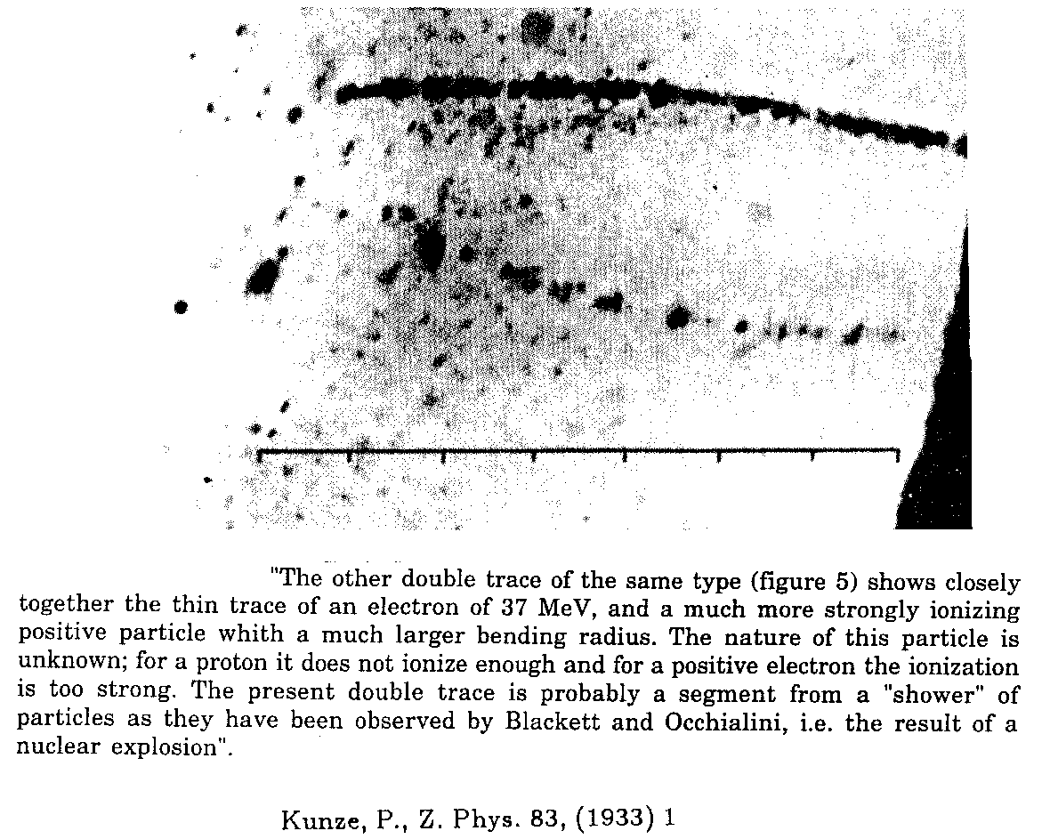
Discovery of new particles in air showers
Kunze (1933) first observation of a muon in cosmic rays
Properly interpreted by Anderson en Neddermeyer in 1936

Slide 14
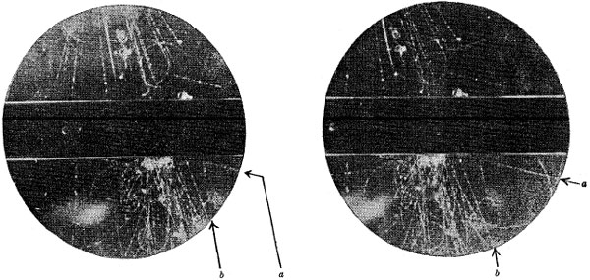
Discovery of new particles in air showers
Among some fifty counter-controlled cloud-chamber photographs of penetrating showers which we have obtained during the past year as part of an investigation of the nature of penetrating particles occurring in cosmic ray showers under lead, there are two photographs containing forked tracks of a very striking character. These photographs have been selected from five thousand photographs taken in an effective time of operation of 1500 hours. On the basis of the analysis given below we believe that one of the forked tracks represents the spontaneous transformation in the gas of the chamber of a new type of uncharged elementary particle into lighter charged particles, and that the other represents similarly the transformation of a new type of charged particle into two light particles, one of which is charged and the other uncharged
Discovery of the Kaon, a particle with a mass about 1000 times the mass of the electron (Rochester en Butler, 1947). First particle with a strange quark

Slide 15
Why study cosmic rays?
Initially: What do we actually observe??
Afterwards: Observing new particles in air showers!
Now: Going beyond accelerators

Slide 16
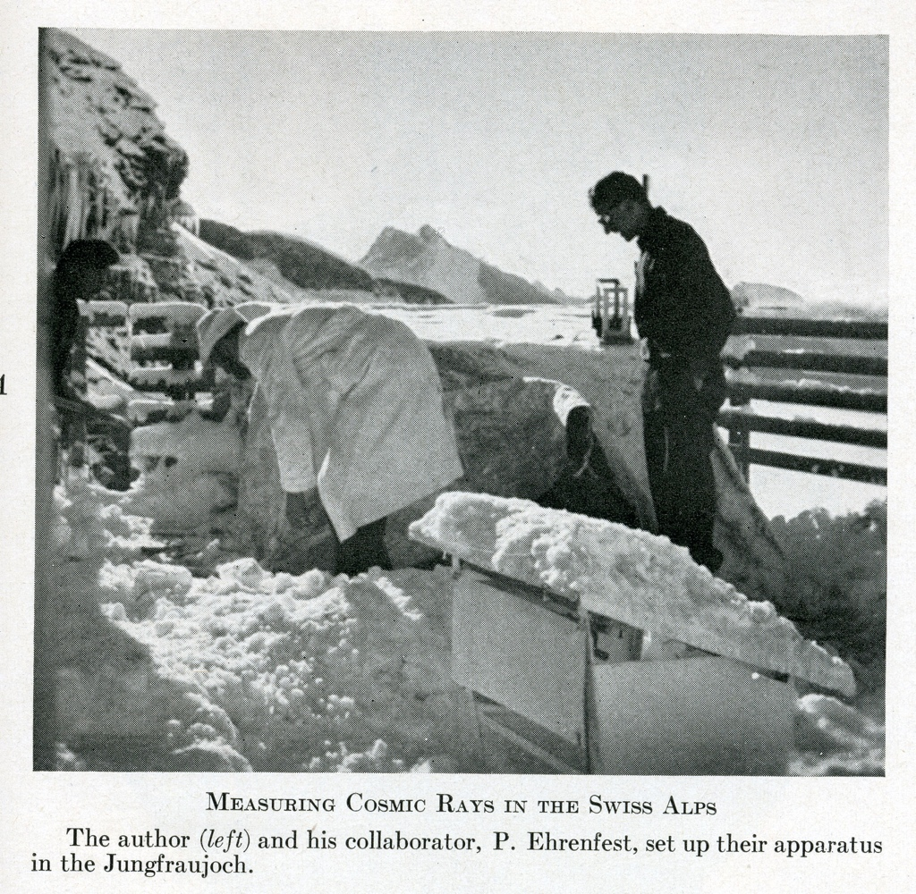
Rev mod phys 1939
Pierre Auger☛

Slide 17
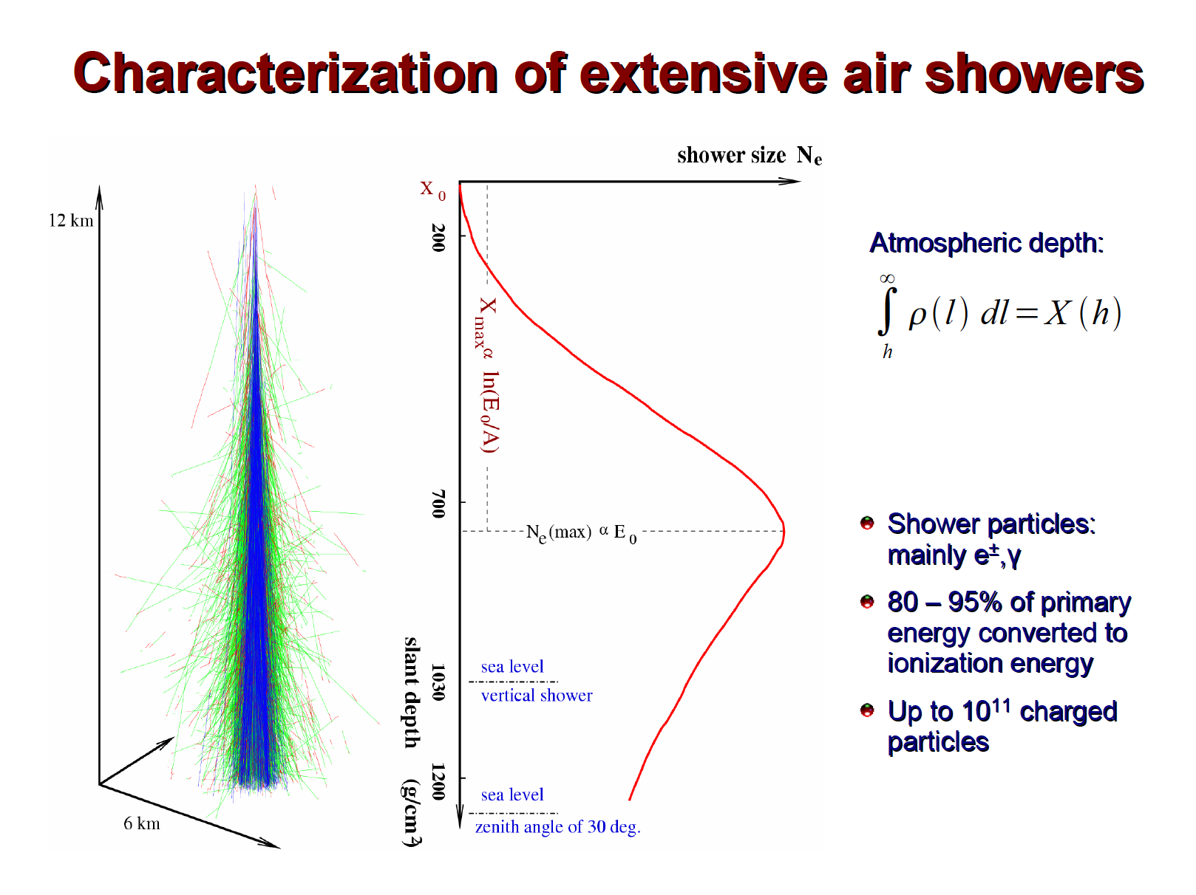

Slide 18
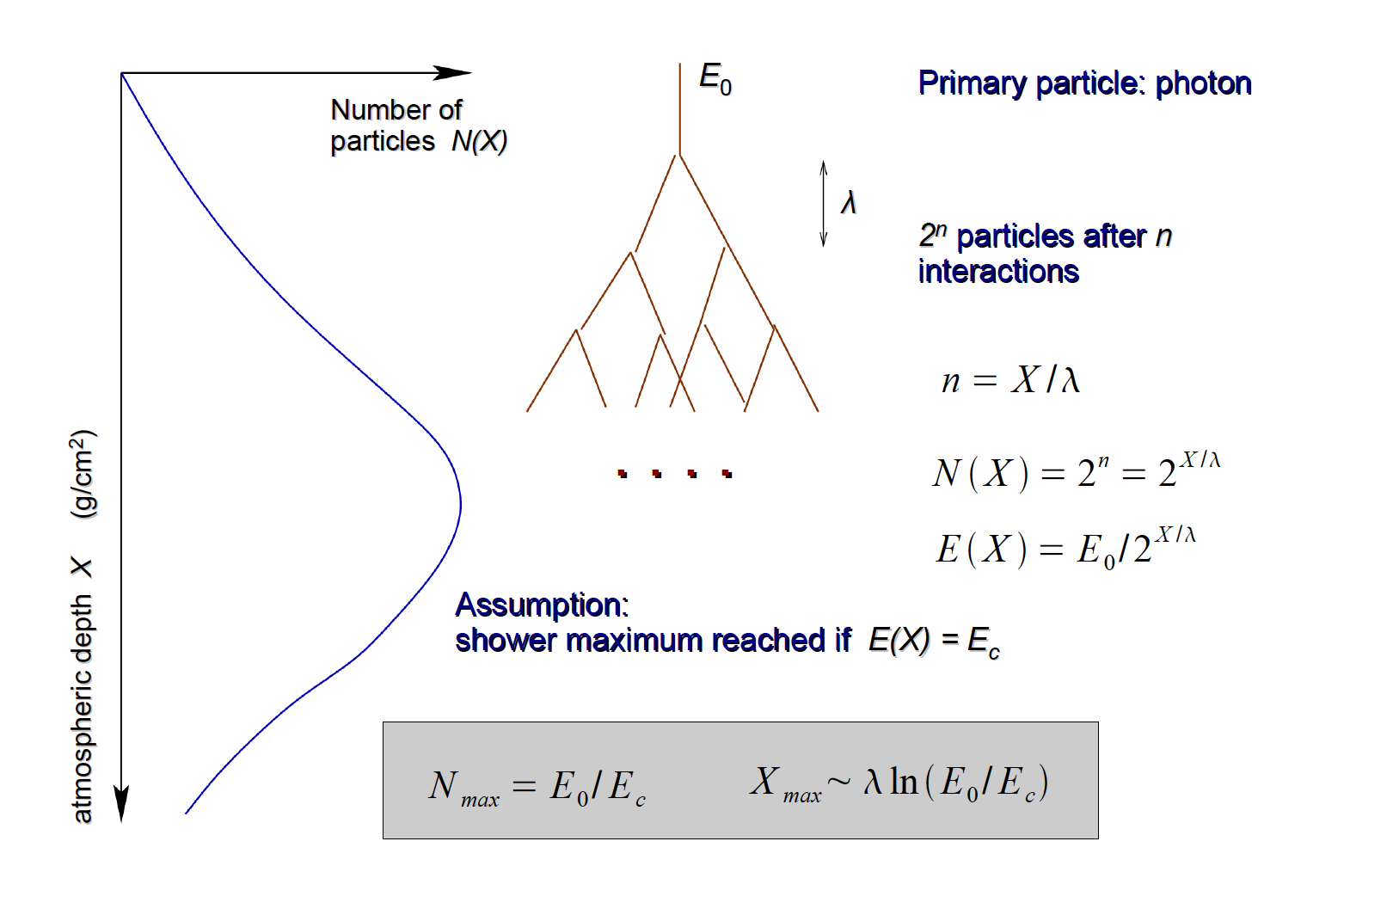
Heitlers Model of EM shower
Critical energy:
Loss in Bremsstrahlung == Loss in ionization

Slide 19
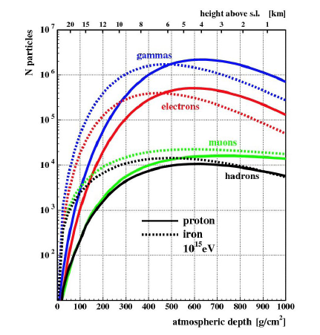
Longitudinal Development of Air Showers
Note:
Many more electrons and photons than muons and hadrons

Slide 20
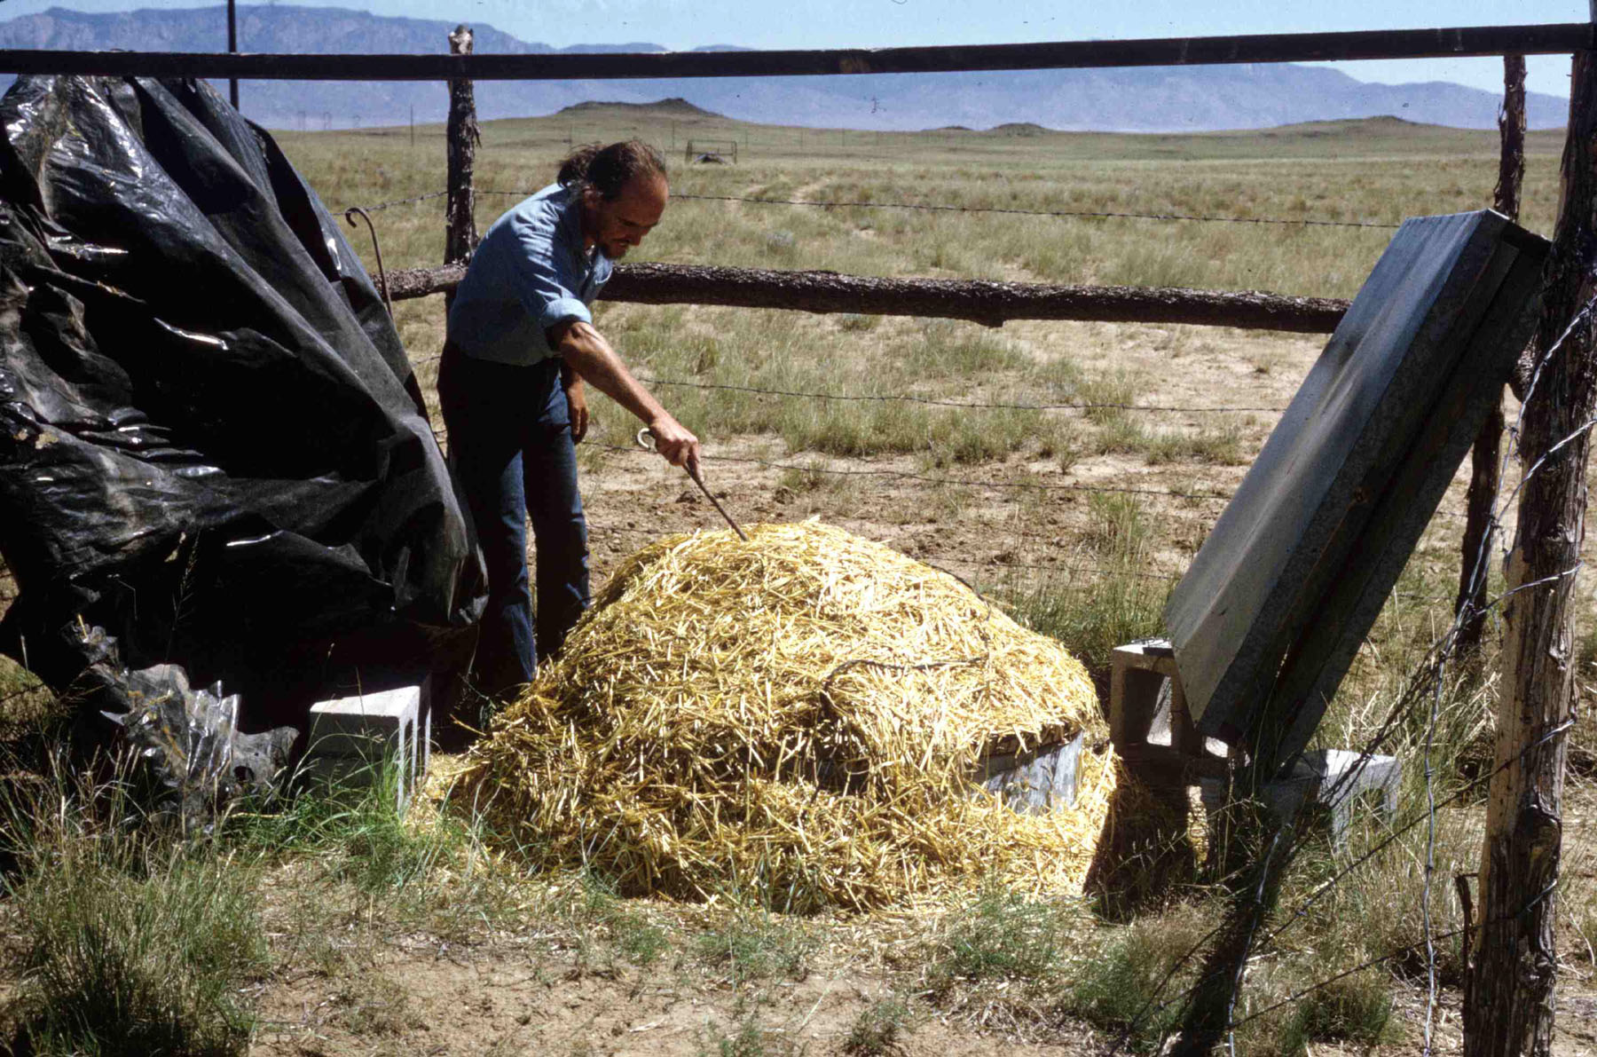
John Linsley Volcano Ranch NM 1960++

Slide 21
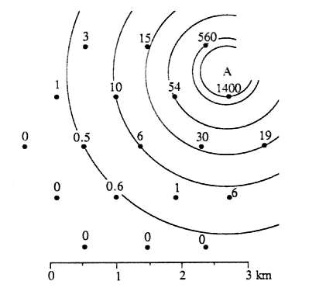

Linsley's event: >10²⁰ eV
detector positions and number of particles
footprint of a particle shower

Slide 22
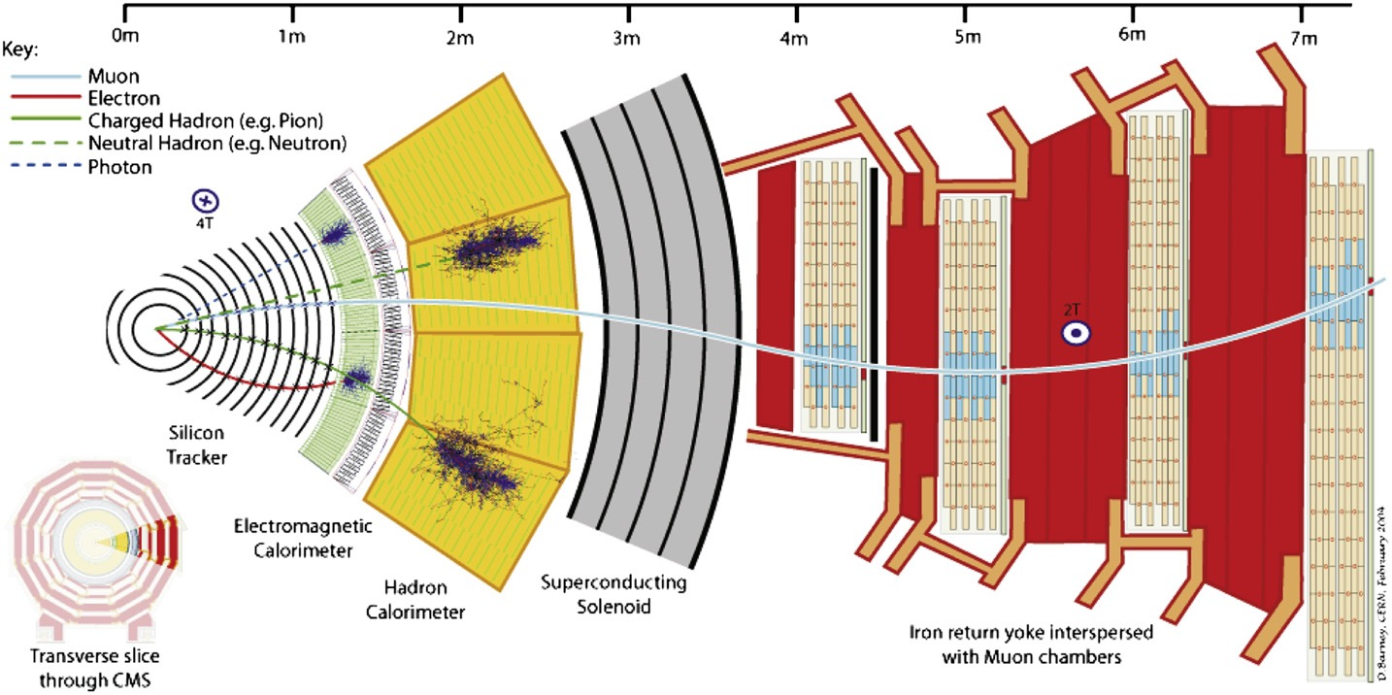
Analogy to Accelerator based physics

Slide 23
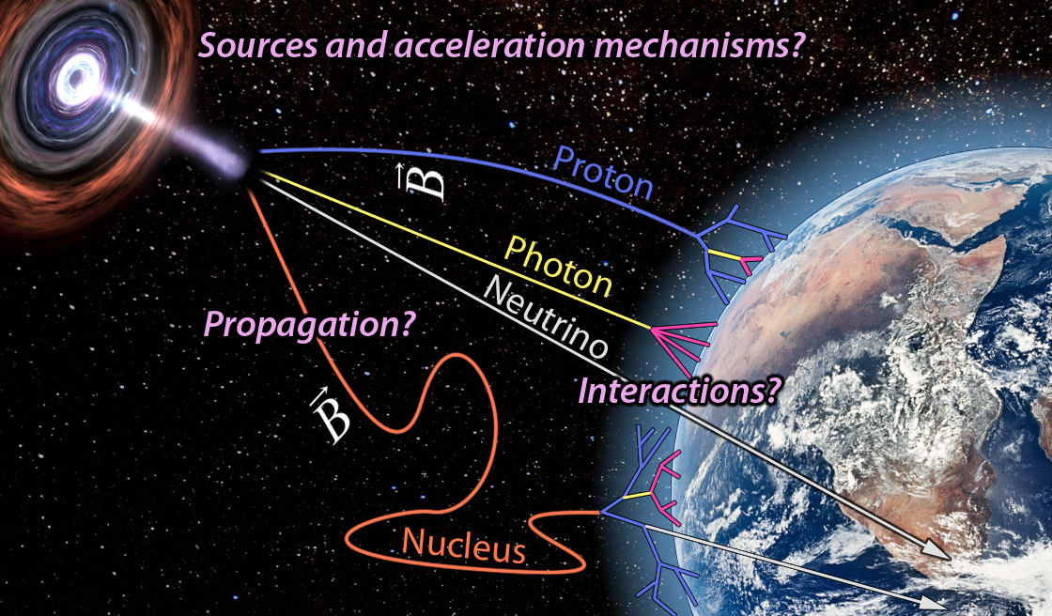
Analogy to Accelerator based physics
Andrew Taylor!
Particles from cosmic accelerator
Collision in Beampipe producing particles

Slide 24
Analogy to Accelerator based physics
Universe as spectrometer; huge distances small fields
Inner tracker as spectrometer, measures E/q
~ 100M LY

Slide 25
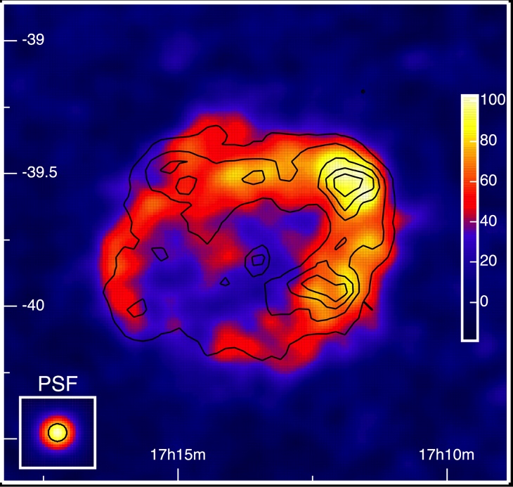
Finding Acceleration sites of UHECR or: finding the primary vertex
Find light cosmic rays(p) from nearby sites (AugerPrime)
Find neutral particles as tracers from these sites (at low energy: ACT)
Need for multi-messenger astroparticle physics!

Slide 26
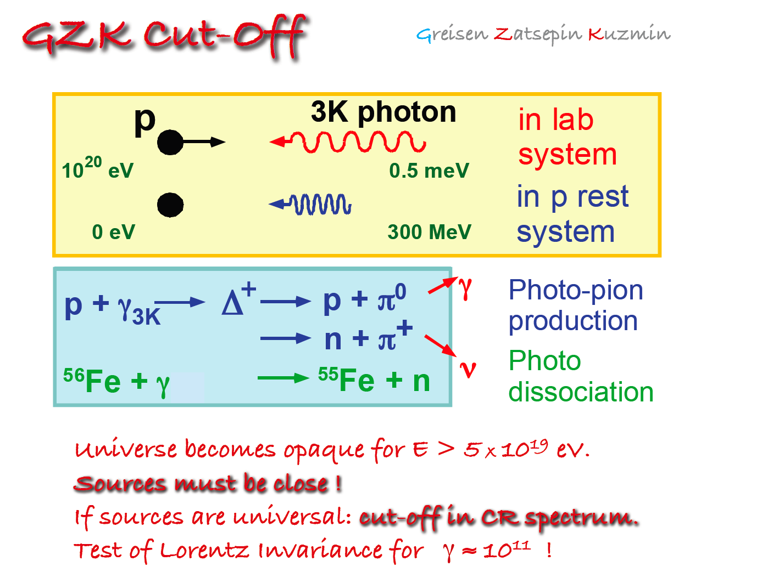

Slide 27
Greisen 1966
Phys rev letters 1966

Slide 28
Nuclei and the CMB
Binding energy:
  E_{b} = ΔM_{A} = Zm_{p} + N m_{n} - MA
Using semi-emperical mass formula (Weizsäcker)
  E_{b}(A) = A[15.8 – 18.3A^{-1/3} – 0.18 A^{2/3} +1.3 10⁻³A^{4/3} – 6.4 10⁻⁶A²]
This is about 20 MeV/nucleon
The 20 MeV could be obtained from the photon in the frame in which the nucleus is at rest
  photon energy is boosted by a factor of (1+βcos(ϕ))γ

Slide 29
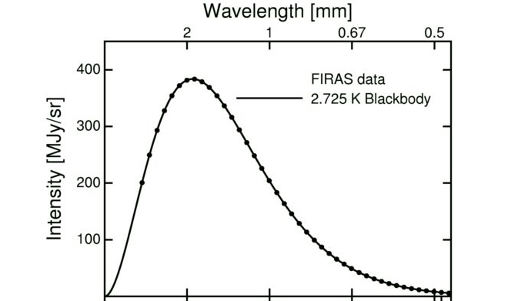
Nuclei and the CMB
At 55 EeV, iron travels approximately as far as protons, but lighter nuclei lose energy rapidly by photodisintegration.
At 55 EeV, the CMB photon energy needed for photodisintegrating a nucleus depends on the Lorentz gamma factor, hence on the nuclear mass.
The minimum CMB photon energies are shown for He, CNO, and Fe
frequency (1/cm) 5 10 15 20
He CNO Fe

Slide 30
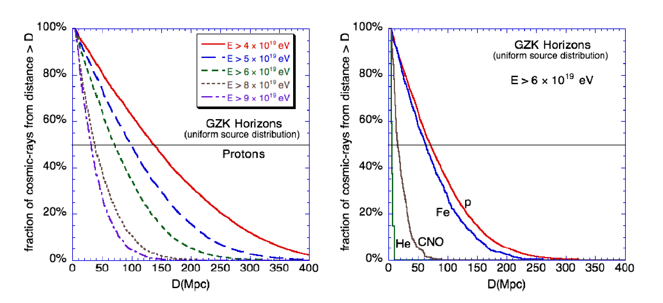
The GZK-distances
P. Gorham, SSI 2007
D. Allard et al., JCAP 0810 (2008)

Slide 31






Origin of neutrinos and photons or: Interactions in the spectrometer and primary vertex
Source production
Cosmogenic
$$p+γ_{CMB}→p+π^{0}$$
$π^{0}→γ+γ$
$$p+γ_{CMB}→n+π^{+}$$
$π^{+}→μ^{+}+ν_{μ}$
$μ^{+}→e^{+}+{\overline{ν}}_{μ}+ν_{e}$
$n→p+e^{−}+{\overline{ν}}_{e}$
$$A+γ→A^{′}+p$$
$p+γ→ν^{′}s$
$p+γ→γ^{′}s$
$$E_{γ}\sim 0.1 E_{p}$$
$$E_{ν}\sim 0.05 E_{p}$$
$$E_{ν}\sim {10}^{−3}E_{p}$$
$$E_{ν}\sim 0.05 E_{nucleus}/A$$
$$E_{γ}\sim 0.1 E_{nucleus}/A$$

Slide 32
The Particle multi-messenger landscape or: secondaries that help particle identification

Slide 33
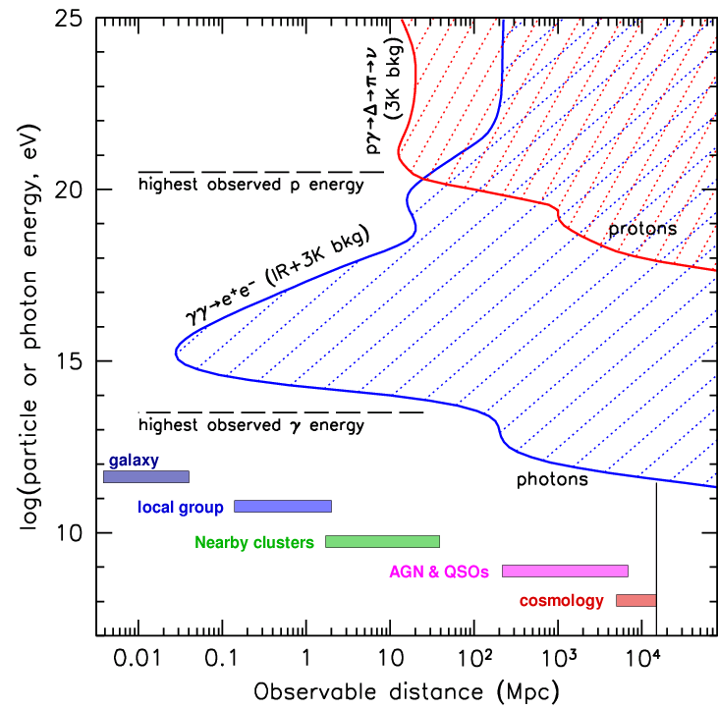
Cosmic Horizons or: size of the spectrometer
Photons have to be produced nearby (pair production)
UHECR have to be produced nearby (GZK)
Neutrinos may come from anywhere!

Slide 34
Analogy to Accelerator based physics
Atmosphere acts as EM+hadronic calorimeter. Shower size (energy) and shower depth (particle id) are commonly used.
Tanguy Pierog!
Energy from shower size in calorimeter.
Excellent 3D-readout with fluorescence detection!
~40 km ~1000 g/cm²
Particle physics from interactions with the atmosphere (calorimeter)

Slide 35
Analogy to Accelerator based physics tail catcher

Slide 36
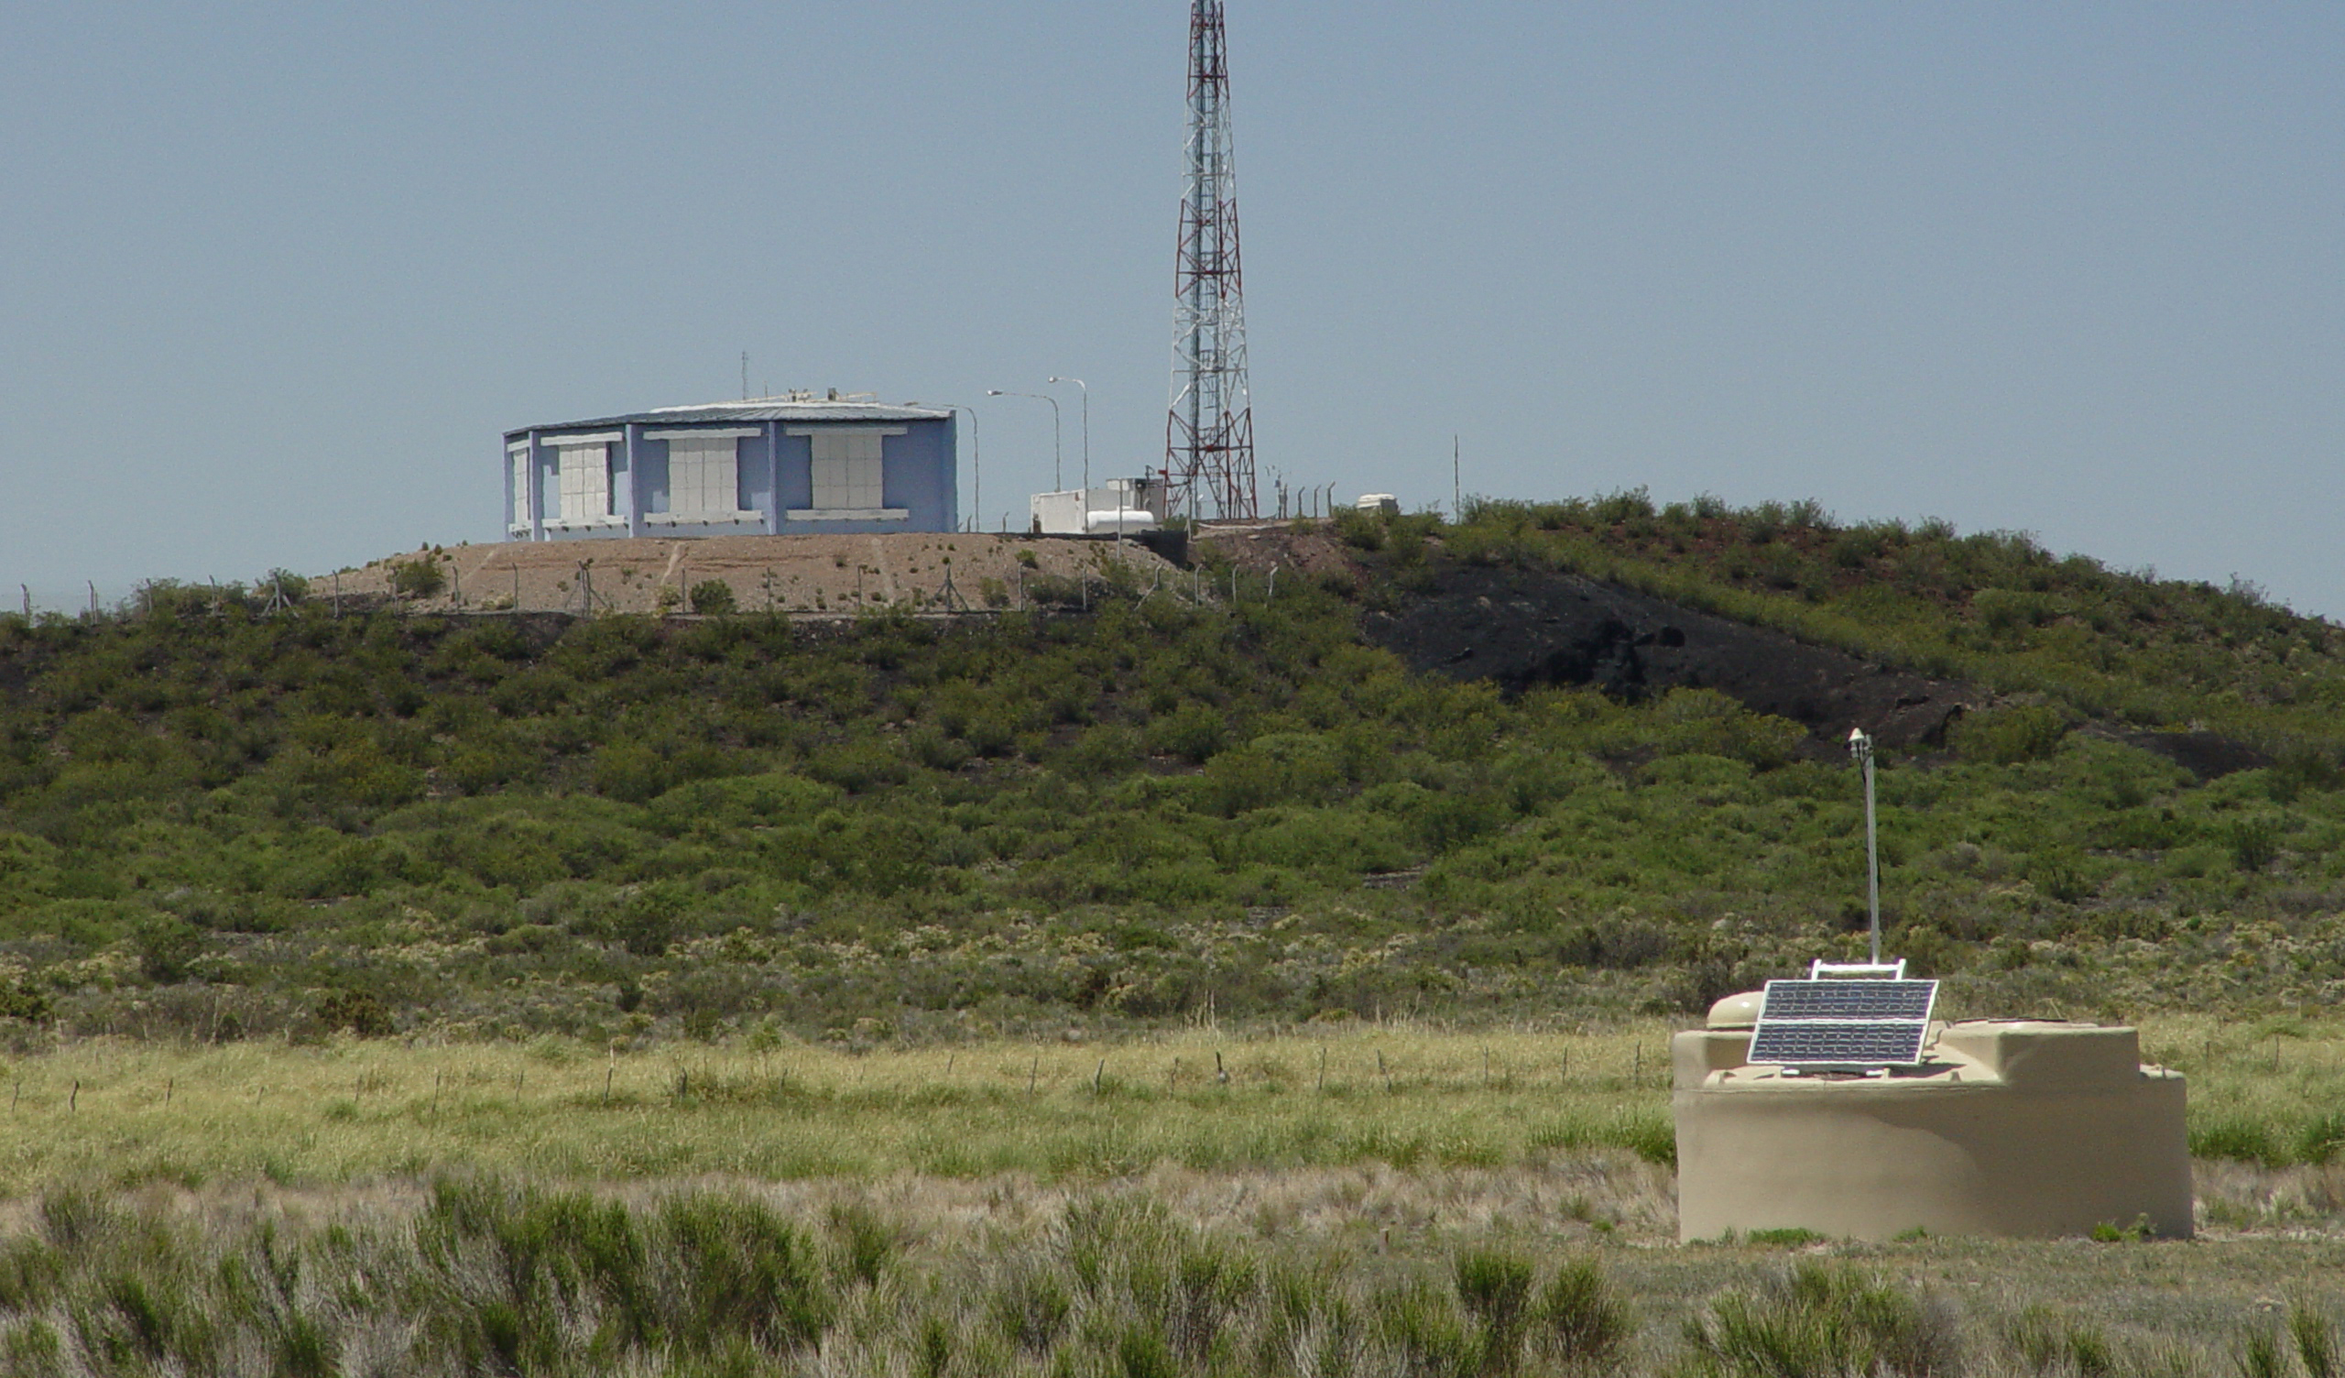

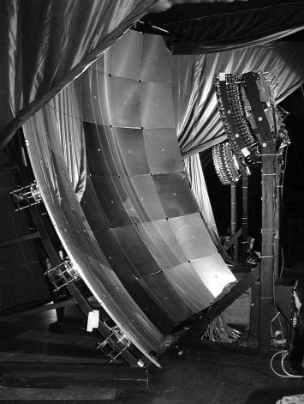
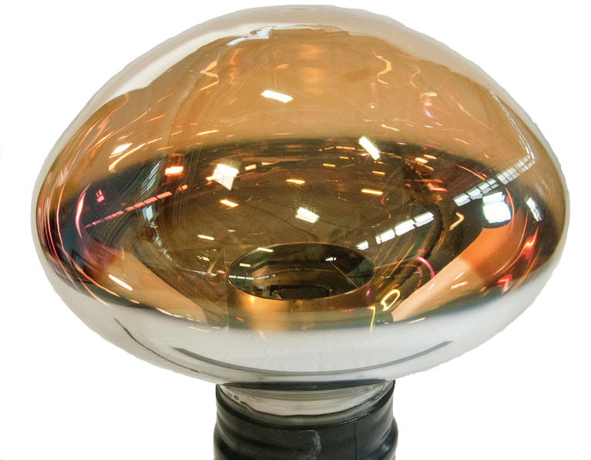
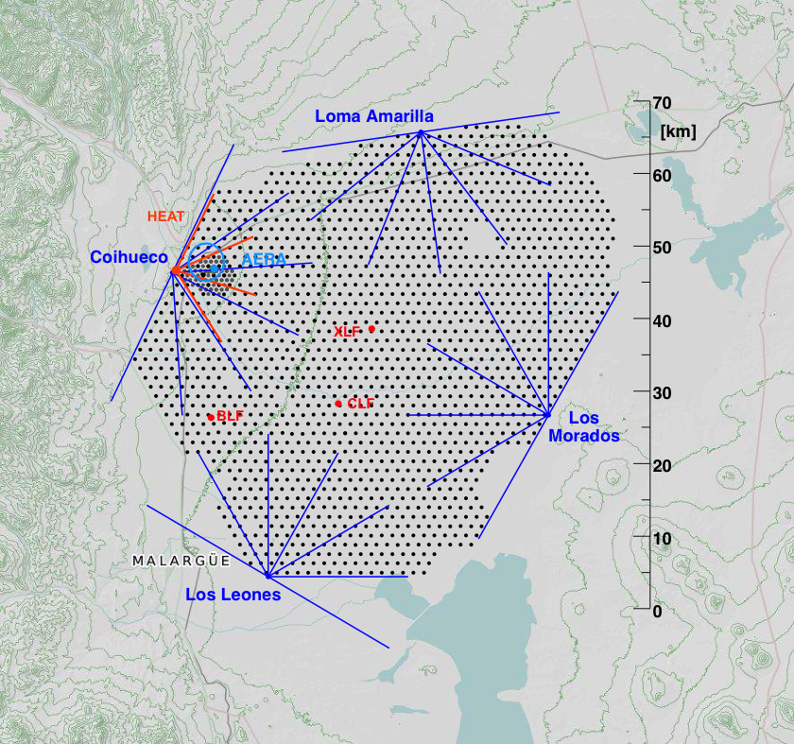
The Pierre Auger Observatory
Auger 3000 km²

Slide 37
The Fluorescence measurement
v. de Souza, Vulcano 2018

Slide 38
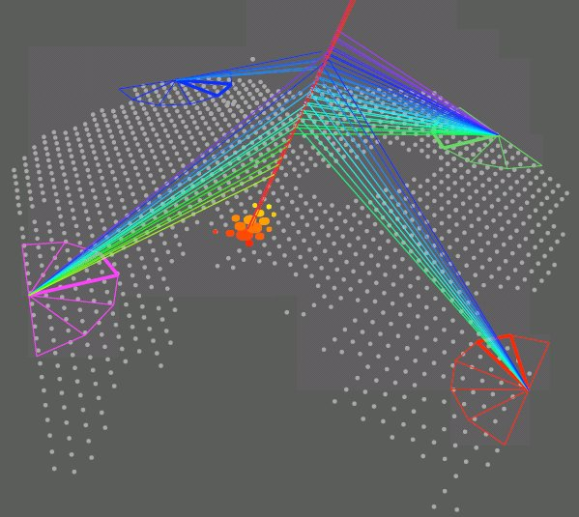
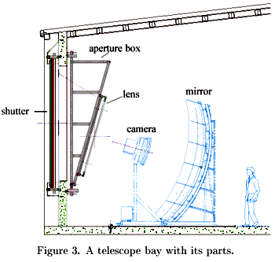
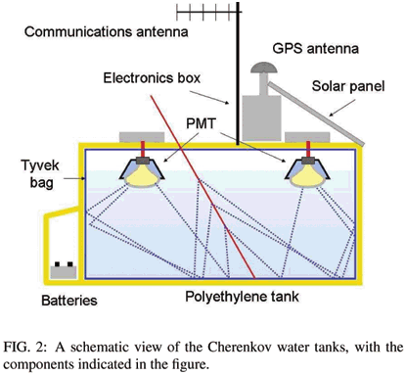
Hybrid detection with baseline Auger
State-of-the-art: FD
X_{max} using fluorescence light
σ (X_{max}) = 20 g/cm²
Only in dark nights
~10% duty cycle
SD measures only 24/7
tail of shower 100% Duty Cycle
X_{max}
fluorescence
mirror
camera
# particles

Slide 39
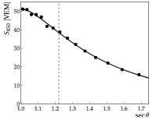
SD Energy Calibration
particle density at 1000 m
Infill: particle density at 400 m
Horizontal showers: Compare to expected muon profile at 10 EeV
M. Unger, SuGAR 2018

Slide 40
The energy spectrum

Slide 41
What is the nature of the beam?

Slide 42
Combining flux and shower development

Slide 43
Conclusion
Initially, the phenomenon of ionizing radiation led to the study of cosmic rays
Pre-accelerator
  Images of interactions showed new particles
  Air showers showed particles of immense energies at Earth
From the 1960s: UHE particles were discovered
  Can we study those to learn more about fundamental particles?
Nowadays: Modern experiments start to really unravel the nature of cosmic rays: The key to learn more about particle physics and astronomy!

