Slide 1
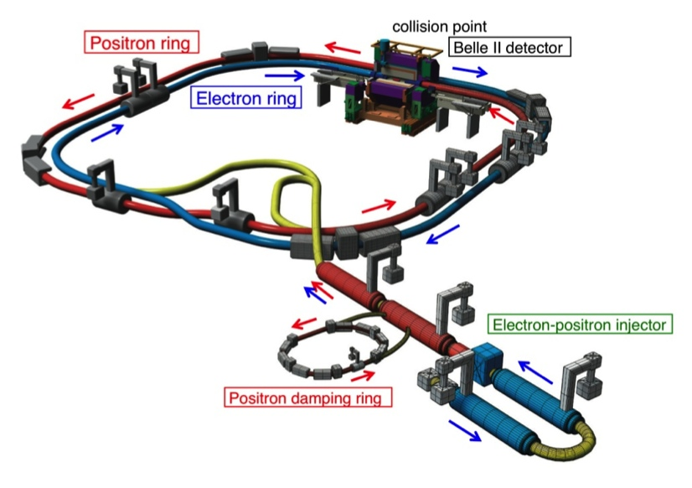
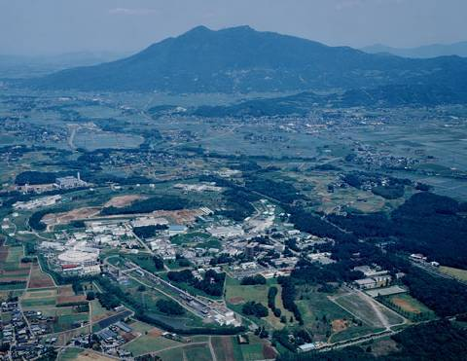
B Physics: New Physics and The Next Generation
Tom Browder (University of Hawai’i at Manoa)
Complex phases in the weak interaction: V_{td} and V_{ts} and associated CPV asymmetries
Excitement in Flavor Physics:
-Connections to the charged Higgs
-Rare B Decays + NP
Flavor Physics, The Next Generation:
Belle II and the LHCb upgrade
Apologies: I have borrowed slides from many excellent physicists and will aim for the “big picture” but skip most details.
KEK in Tsukuba, Japan

Slide 2
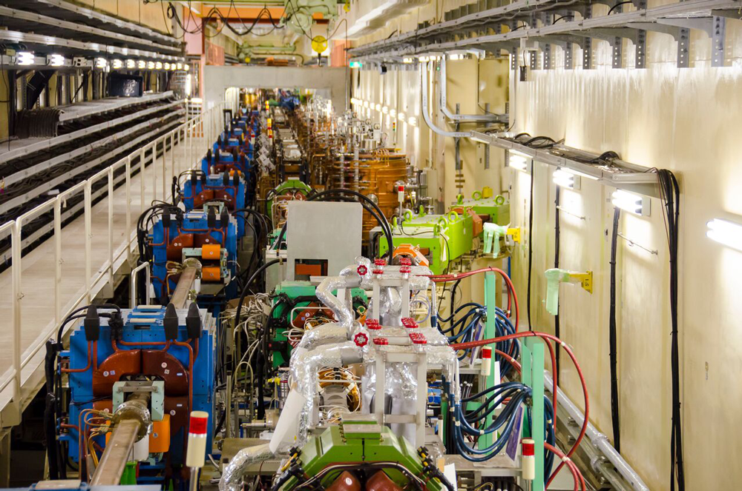
Feb 2016 News: First Turns at SuperKEKB (4 GeV e+’s and 7 GeV e-’s)
April 14, 2016 (LER beam current at 460 mA, HER at 420 mA)
First new particle collider since the LHC (intensity frontier rather than energy frontier; e⁺ e⁻ rather than p p)

Slide 3

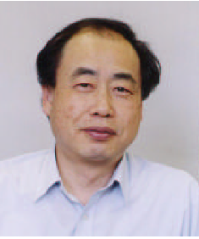
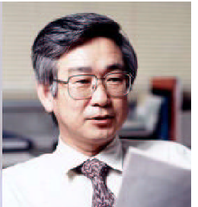
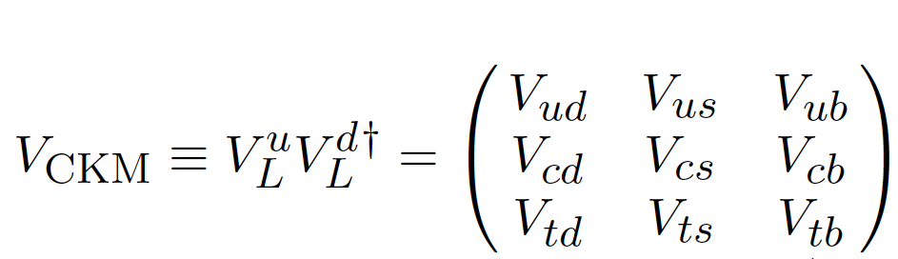
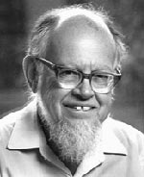
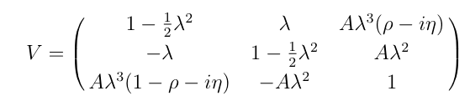
N. Cabibbo
M.Kobayashi
T.Maskawa
Amplitudes and Phases in the Weak Interaction
to O(λ³)
L. Wolfenstein (1923-2015)
Notes:
Let’s now discuss amplitudes and phases in the weak interaction. Weak interaction eigenstates are rotated versions of flavor eigenstates. Cabibbo et al realized that upper left portion of the mixing matrix is a rotation matrix. However, to accommodate CP violation, which was first observed 50 years ago,
Kobayashi and Maskawa realized that one needed three generations of quarks (only two were known at the time).
Wolfenstein provided a phenomenological parameterization of the mixing matrix. His version makes it crystal clear that the complex parts, which give raise to CP violation are in the corners (V_td and V_ub). N.B. that V_ts does NOT have a complex phase.

Slide 4
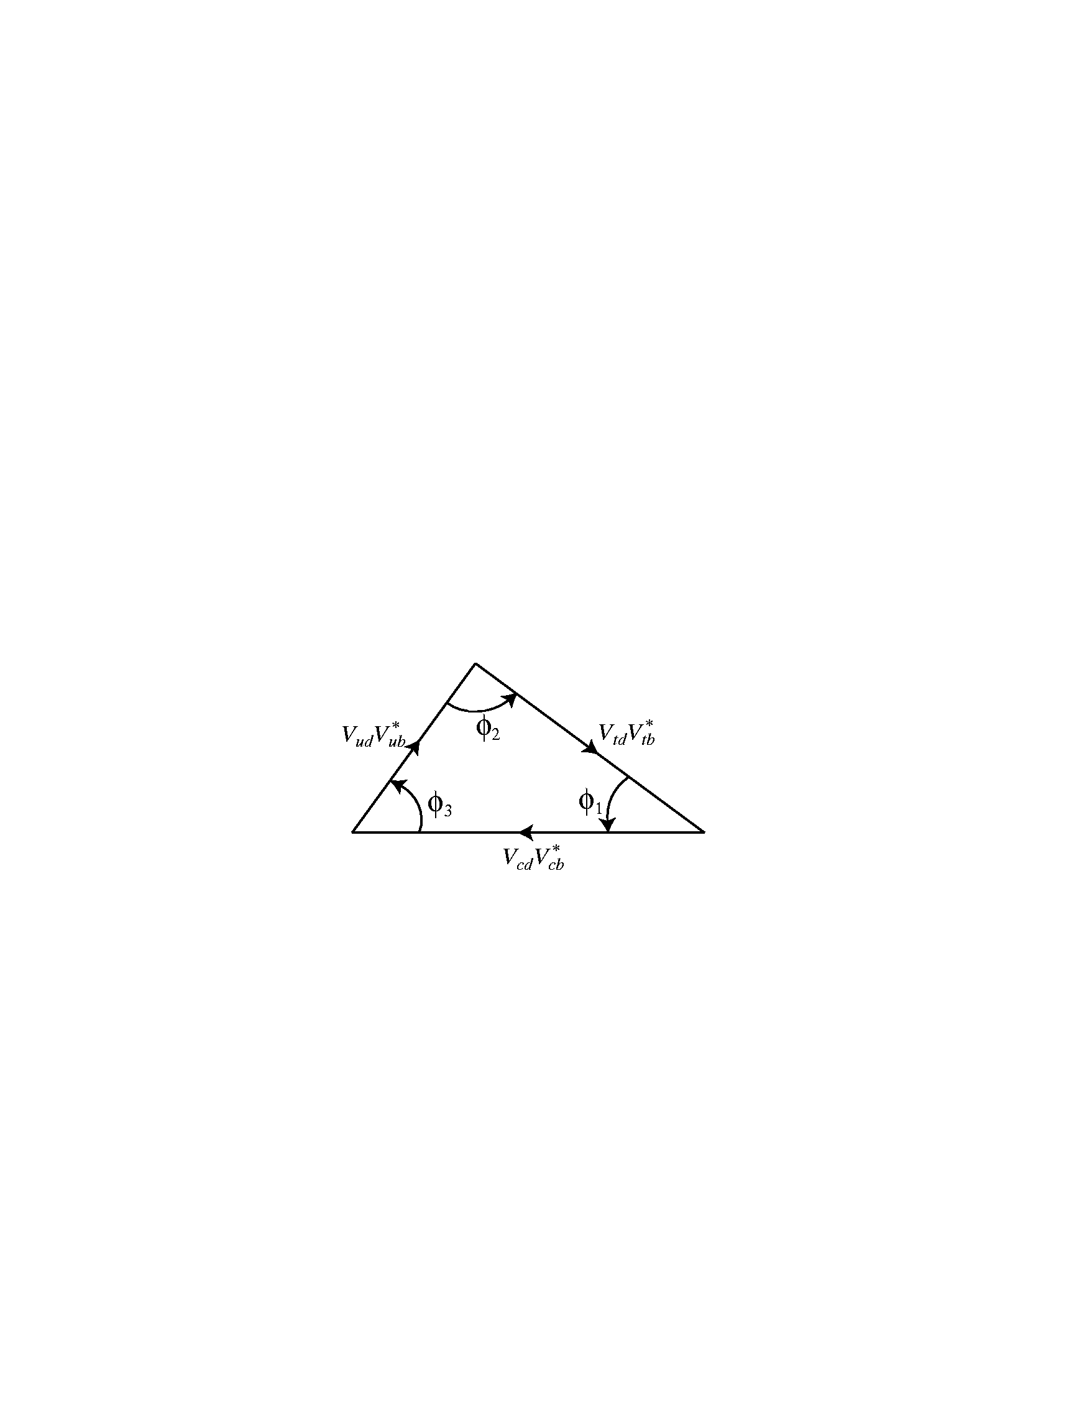
Three Angles: (φ₁,φ₂,φ₃) or (β, α, γ)
Recent Belle result on B→ρ⁺ ρ⁻
B⁰ → π⁻ π⁺
Unitarity implies that the weak couplings and phases form a triangle in the complex plane.
B⁰→Ψ K_{s},Ψ K_{L},
B⁰→D^{(*)0} h⁰
Recent LHCb results on CPV in B_{s}→D_{S}^{-(*)} K⁺
B⁻ →D_{CP} K⁻
Big Questions: Are determinations of angles consistent with determinations of the sides of the triangle ? Are angle determinations from loop and tree decays consistent ?
Notes:
Check order of animations

Slide 5
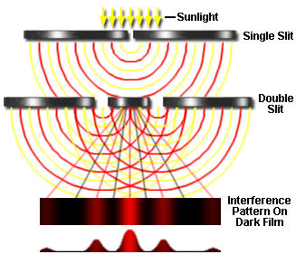
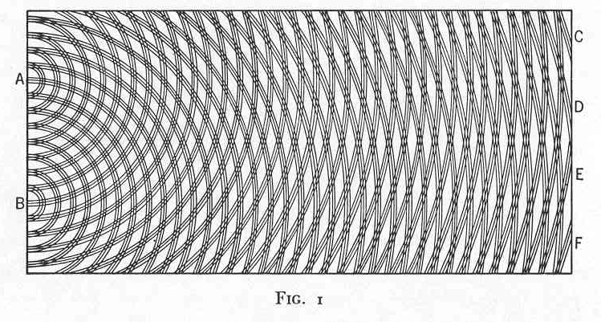
Time-dependent CP violation is
“A Double-Slit experiment” with particles and antiparticles
QM interference between two diagrams
box diagram + tree diagram
tree diagram
V_{td}
b
c
J/ψ
b
t
d
d
K_{S}
c
+
s
s
K_{S}
c
J/ψ
d
d
d
t
b
c
V_{td}
Measures the phase of V_{td} or equivalently the phase of
B_{d} –anti B_{d} mixing.
Notes:
Sometimes HEP physicists outside of our sub-field become lost in the formalism. What are we really doing ?

Slide 6
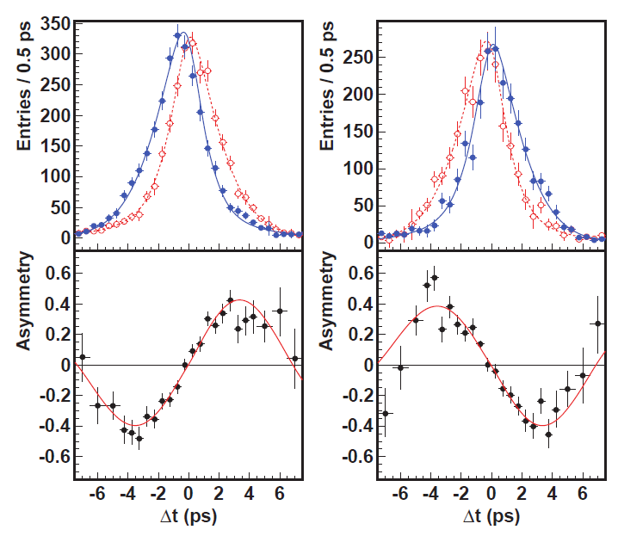
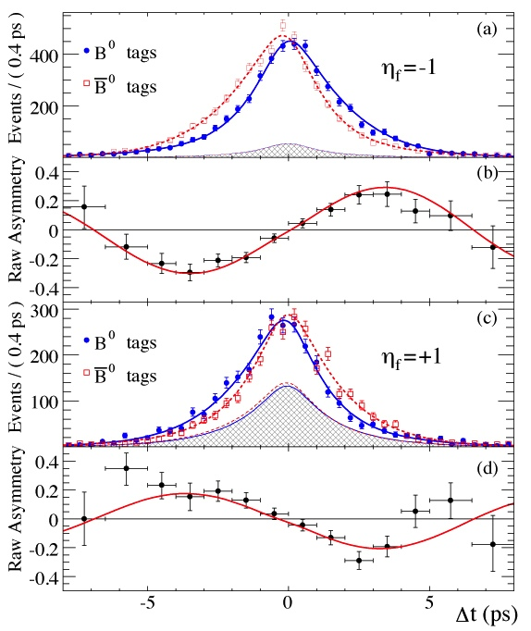

Measurement of sin(2φ₁)/sin(2β) in B→Charmonium K⁰ modes
(cc)K_{S}
J/ψK_{S}
J/ψK_{L}
J/ψK_{L}
sin2φ ₁=0.667±0.023±0.012
A_{f}=0.006±0.016±0.012
PRL108,171802 (2012)
sin2φ₁=0.687±0.028±0.012
A_{f}=-0.024±0.020±0.016
PRD79,072009 (2009)
Overpowering evidence for CP violation (matter-antimatter asymmetries). >>>> The phase of V_{td} is in good agreement with Standard Model expectations. This is the phase of B_{d} mixing.

Slide 7
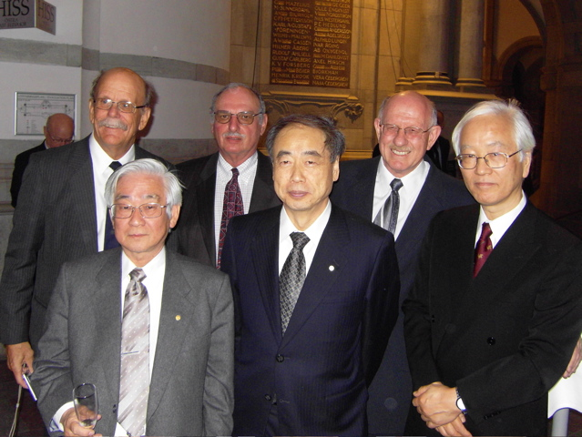
News from Utah: April 2016 APS Panofsky Prize for Experimental Particle Physics Awarded to
Steve Olsen, Dave Hitlin, Jonathan Dorfan, and Fumihiko Takasaki
A scene in Stockholm, Sweden 2008
Front row 2008 Physics Nobelists: T. Maskawa, M. Kobayashi

Slide 8
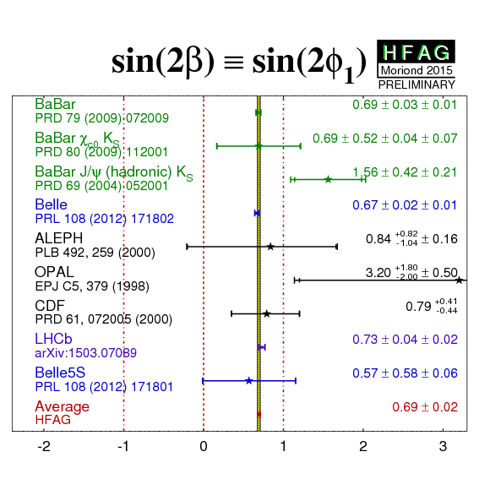
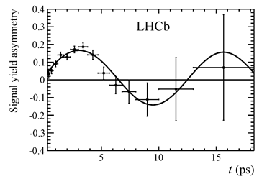

B factories: High precision CPV measurement and a calibration for NP.
2013: LHCb joins the game [±0.07(stat)]
2015: Latest LHCb measurement is comparable in precision to B factories (now uses same-side B tagging)

Slide 9
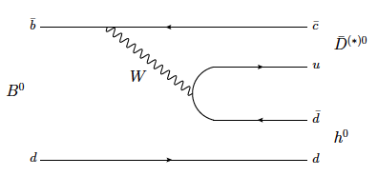
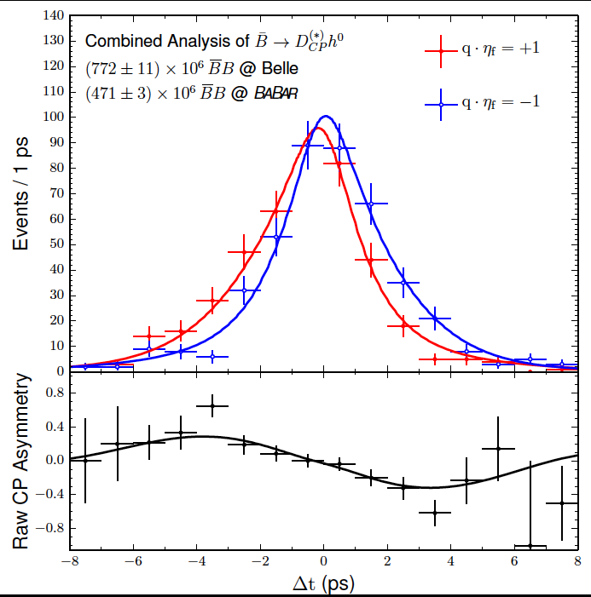

B factories: Check CP violation in b→c [ubar d] processes
2015: First joint BaBar-Belle data analysis
M. Rohrken et al
“Color-suppressed” B→D h
where D⁰ is a CP eigenstate and h⁰=π⁰, η, ω
Combining Belle and BaBar datasets, ~1260 signal events, obtain a 5.4σ CP violation signal➔First observation
sin(2β_{eff})=0.66±0.10(stat)±0.06(sys)
Phys. Rev. Lett. 115, 121604 (2015)
Phase of V_{td} again
Conclusion: CP violation in b→c ubar d modes is the same as in b→c cbar s modes (e.g. B→J/ψ K_{S})
Notes:
V_ud and V_cb do not have complex phases.

Slide 10
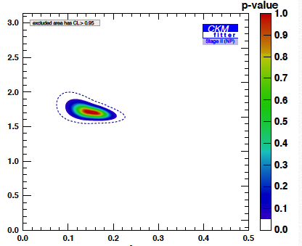
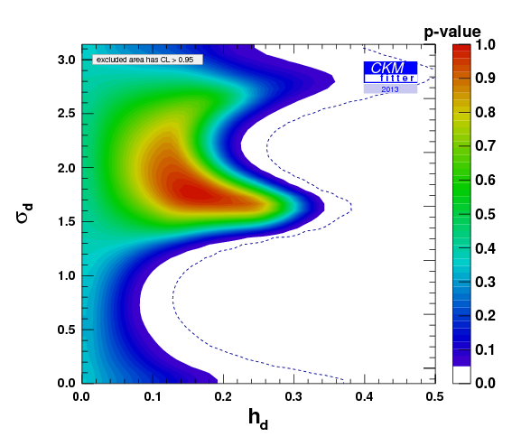
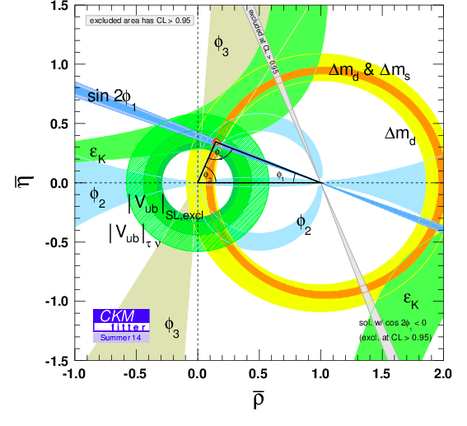
Results from Global Fits to Data (CKMFitter Group)
Great progress on ϕ₃ or γ (first from B factories and now in the last two years from LHCb). These measure the phase of V_{ub} [CKM2014, K. Trabelsi’s review: ±7⁰]
Similar results from UTFIT as well from G. Eigen et al.
NP Phase
Extrapolation to 50 ab⁻¹
NP/SM amplitude ratio
But a 10-20% NP amplitude in B_{d} mixing is perfectly compatible with all current data.
Looks good
(except for an issue with |V_{ub} |)
Notes:
So what does this triangle mean ? Is NP completely ruled out ? The picture on the left is often wildly misinterpreted. Perhaps it is the most misinterpreted plot in the field of high energy physics.

Slide 11
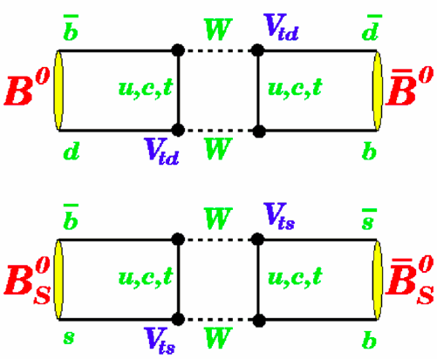

Boxes
Although B factories can run on the Upsilon(5S), LHCb dominates here
No phase expected from SM but possible from NP particles

Slide 12

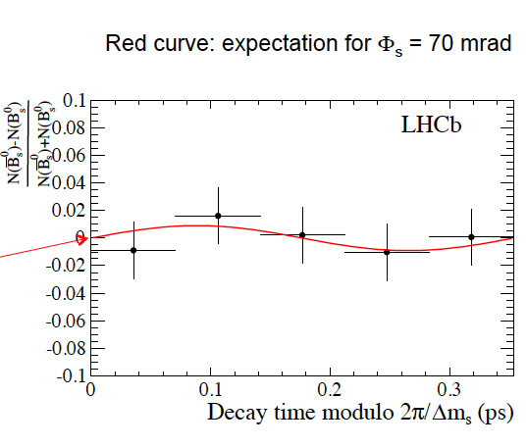
B_{s}→J/ψϕ, a pseudoscalar to vector-vector mode, is usually used. However, B_{s} →J/ψ f₀(980) is a pure CP eigenstate since the
f₀ (980) is a scalar.
Stone & Zhang pointed out that this mode provides more statistics and a more straightforward analysis. Phys. Rev. D79 (2009) 074024.
Asymmetry
R. Aaij et al., PLB 736, (2014) 186
Notes:
Amplitude of asymmetry consistent with zero.

Slide 13
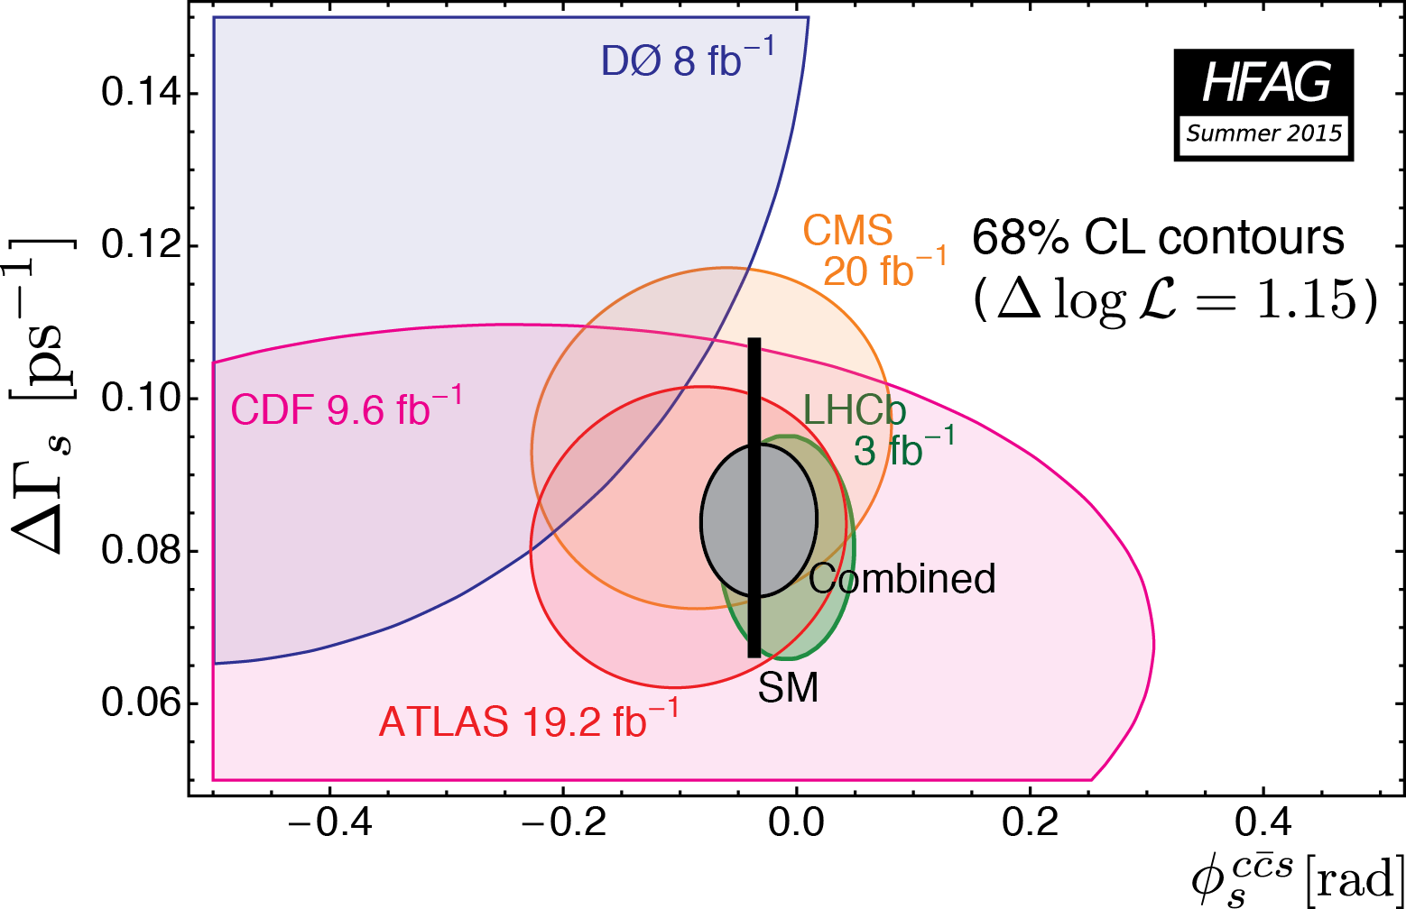
Results on the phase of B_{s}-anti B_{s} mixing (i.e. phase of V_{ts}) [use B_{s}→J/ψϕ; J/ψππ modes]
Width difference
Mixing Phase
(Includes the most recent LHCb prelim result, gives WA of -36 ±13 mrad)
Notes:
Note that the SM black bar is slightly displaced from zero

Slide 14
Boxes
No phase expected from SM but possible from NP particles

Slide 15
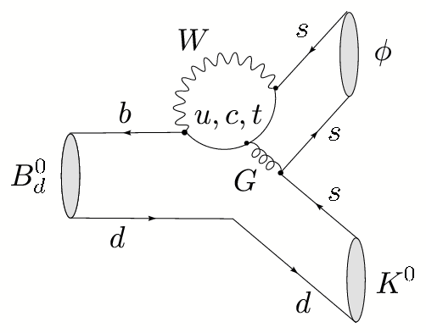
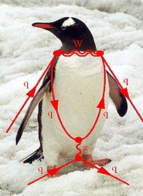
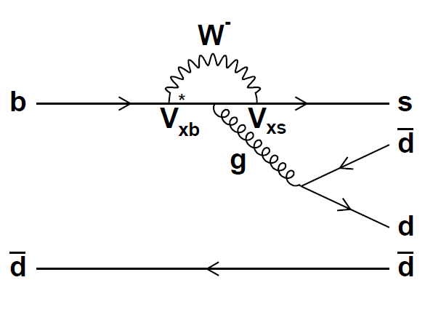
Phase of V_{ts}
Recent Belle results on B→ω K_{S},
B→η’ K_{S}
Notes:
In the loop, NP particles can contribute to the phase.

Slide 16
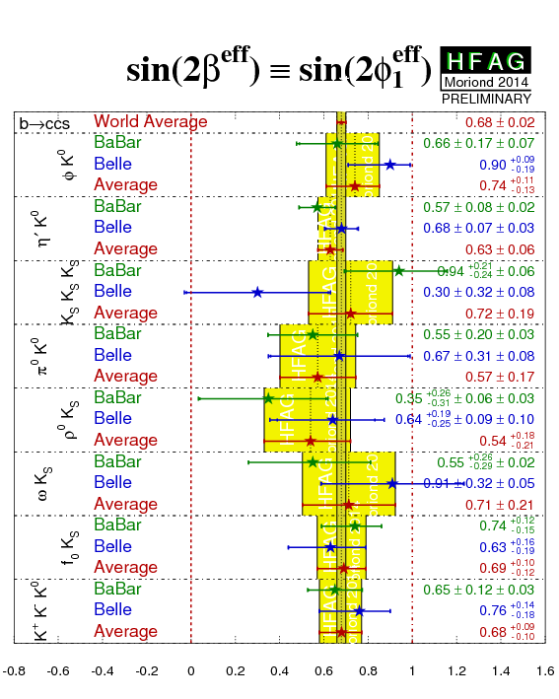
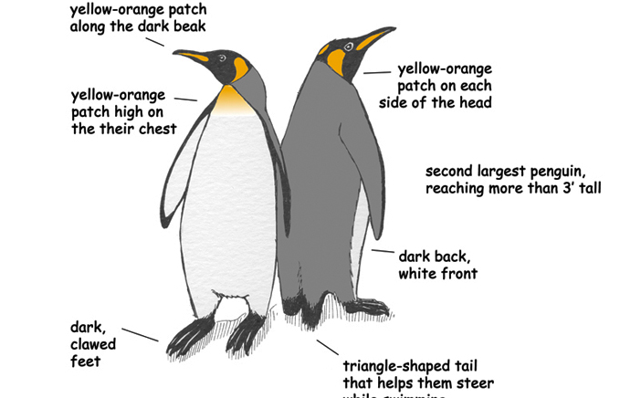
New Physics Phases in Penguin b→s decays
No evidence for NP at current level of sensitivity
LHCb is absent from this game (lower K_{S} eff and flavor tagging eff) but contributes in B_{S} modes.
Notes:
Here we compare the phase to the phase of b->c cbar s decays. If the effective value of sin(2 beta) agrees with that of J/psi K_S decays,
Then we conclude there is no phase from New Physics.

Slide 17
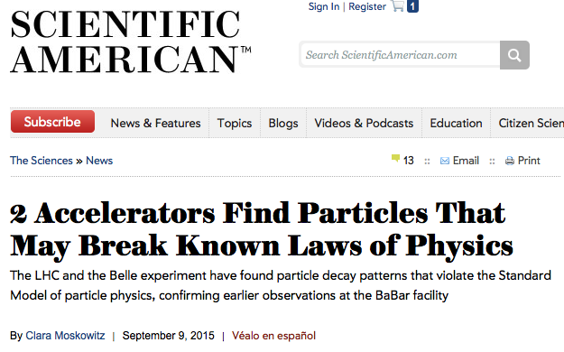

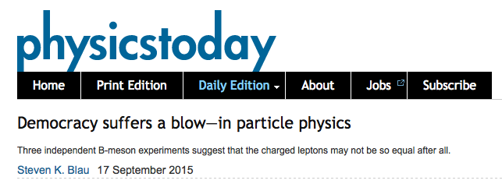
“Missing Energy” Decays
Notes:
Let’s now discuss “missing energy decays” and the excitement in this area.

Slide 18
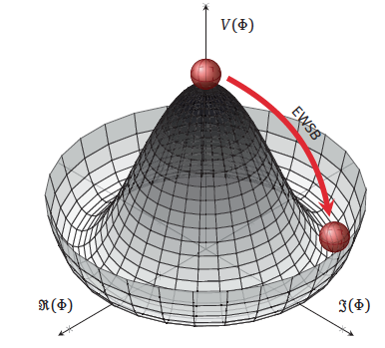

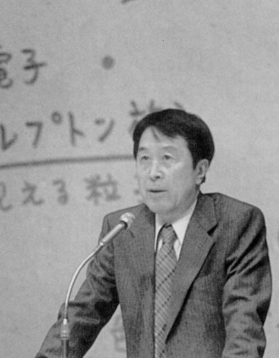
The BEH boson is now firmly established by experimental results from ATLAS and CMS. Now planning for future Higgs flavor factory facilities
(e.g ILC, FCC, CEPC, H-LHC).
.
Does the GP (Brout-Englert-Higgs particle) have a “brother” i.e. the charged Higgs ?
Y. Nambu, 1921-2015
Measurements at Belle II and direct searches at hadron colliders take complementary approaches to this important question.
Notes:
This prompted Leon Lederman to write a new book entitled “Beyond the God Particle”.
Sensitivity from tau nu, D(*) tau nu decays and b→s gamma.
Hadron colliders directly search for H+ →tau nu.

Slide 19
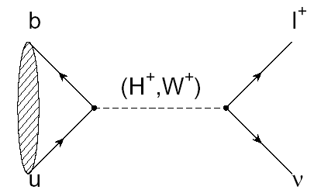
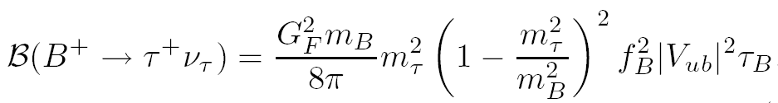

B→τ ν
(Decay with Large Missing Energy)
Sensitivity to new physics from a charged Higgs
W.S.Hou,. PRD 48, 2342 (1993)
The B meson decay constant, determined by the B wavefunction at the origin
(|V_{ub}| taken from indep. measurements.)
Notes:
In the SM this is mediated by a charged W. In addition there is a NP contribution from the charged Higgs.

Slide 20
Consumer’s guide to charged Higgs
Higgs doublet of type I (φ₁ couples to upper (u-type) and lower (d-type) generations. No fermions couple to φ₂)
Higgs doublet of type II (φ_{u} couples to u type quarks, φ_{d} couples to d-type quarks, u and d couplings are different; tan(β) = v_{u}/v_{d}) [favored NP scenario e.g. MSSM, generic SUSY]
Higgs doublet of type III (not type I or type II; anything goes. “FCNC hell”→many FCNC signatures)
Thanks to theorist Xerxes Tata
Notes:
Thanks to Xerxes Tata for corrections. Remaining mistakes are my own.

Slide 21
Why measuring B⁺→τ⁺ν is non-trivial
e⁺
ϒ(4S)
B⁻
B⁺
Most of the sensitivity is from tau modes with 1-prongs.
ν_{e}
B⁻→X
ν_{e}
The experimental signature is rather difficult: B decays to a single charged track + nothing
(This may be hard at a hadron collider)

Slide 22
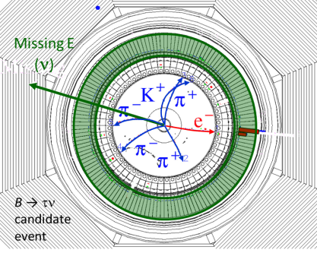

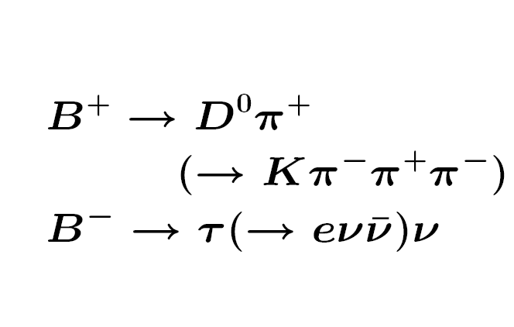
Example of a Missing Energy Decay (B→τν) in Data
The clean e+e- environment makes this possible

Slide 23
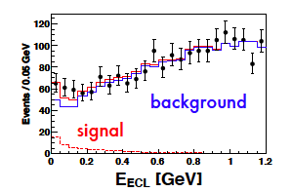
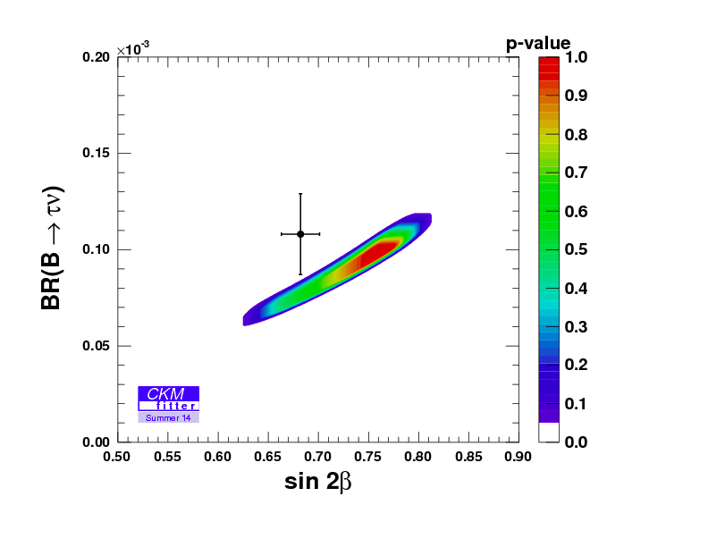
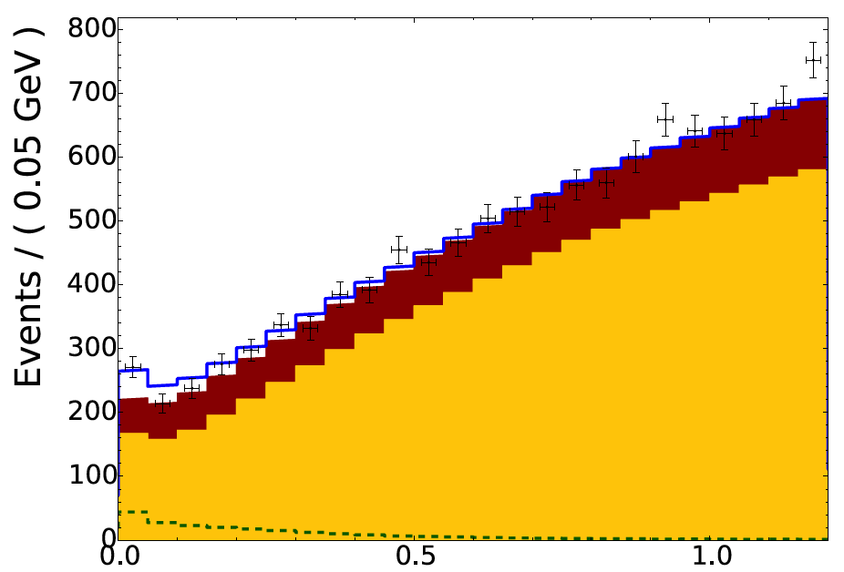
Example: Belle B→τν results with full reprocessed data sample and either hadronic or semileptonic tags (arXiv: 1409.5269→PRD)
Hadronic tags: 63±22.5 (3σ)
Idea: With the “single B meson beam”, we look for a single track from a τ, missing energy/momentun and extra calorimeter energy close to zero.
Semileptonic tags:
222±50 (3.8σ)
With the full B factory statistics only “evidence”. No single observation from either Belle or BaBar.
The horizontal axis is the “Extra Calorimeter Energy”
Notes:
The signal peaks at zero

Slide 24
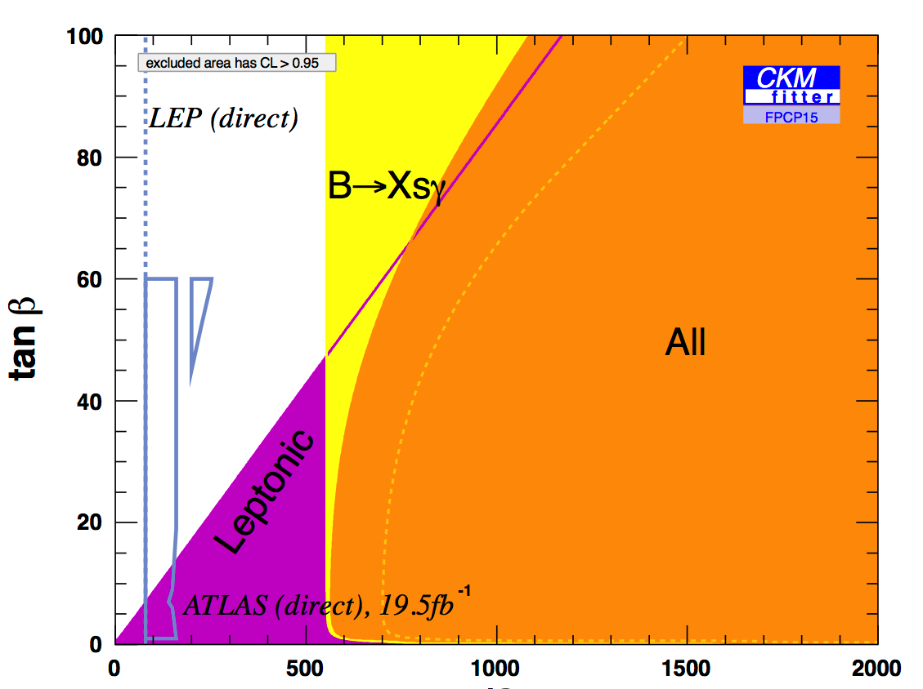
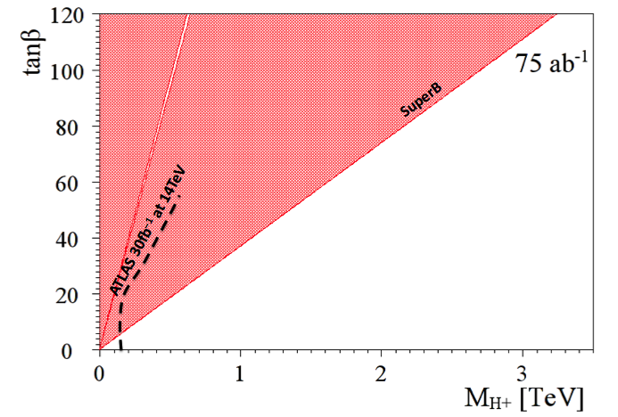
Complementarity of e+ e- factories and LHC
(Slide adapted from A. Bevan)
The current combined B→τυ limit places a stronger constraint than direct searches from LHC exps. for the next few years.
1 ab⁻¹
Belle II
Currently inclusive b→sγ rules out m_{H+} below ~480 GeV/c² range at 95% CL (independent of tanβ), M. Misiak et al. (assuming no other NP)
This region is allowed
http://arxiv.org/abs/1503.01789

Slide 25
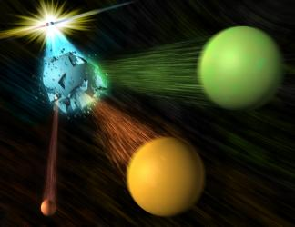
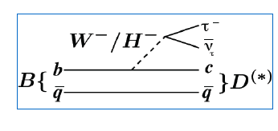
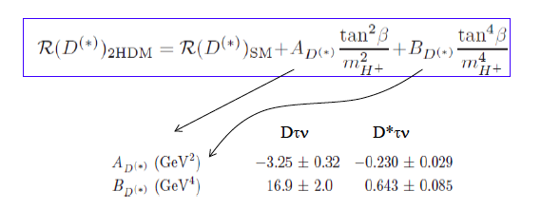

A three-body tale
Slide adapted from A. Soffer
Notes:
Let me tell you a fascinating three-body story

Slide 26
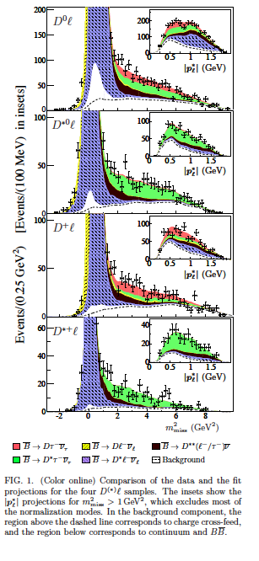
Example from a BaBar paper
Signals in B→D^{(*)} τν (489±63, 888±63)
Missing mass variable:
m_{miss}² =p_{miss}²=(p[e⁺e⁻]-p_{tag}-p_{D(*)}-p_{l})²
P_{l}* = momentum of lepton in B rest frame
But wait !!! Now possible at LHCb.
Production of B meson pairs at threshold is critical to the separation of backgrounds from the missing energy/ momentum signal.

Slide 27
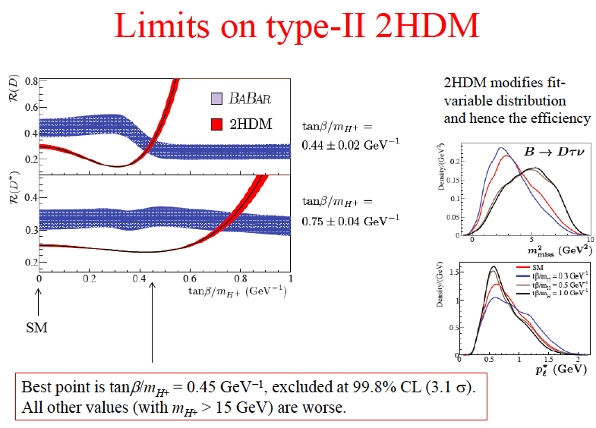
Too technical
Notes:
The two best points disagree with each other. But this slide may be too technical.

Slide 28
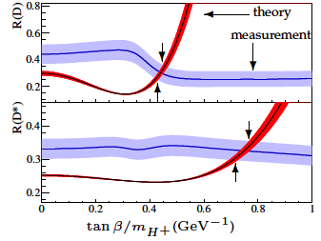
BaBar collaboration, Phys. Rev. Lett. 109, 101802 (2012)
“However, the combination of R(D) and R(D*) excludes the type II 2HDM charged Higgs boson with a 99.8% confidence level for any value of tan(β)/m_{H+}”
In other words, found NP but killed the 2HDM NP model.
Notes:
Shocking – who ordered that ?

Slide 29
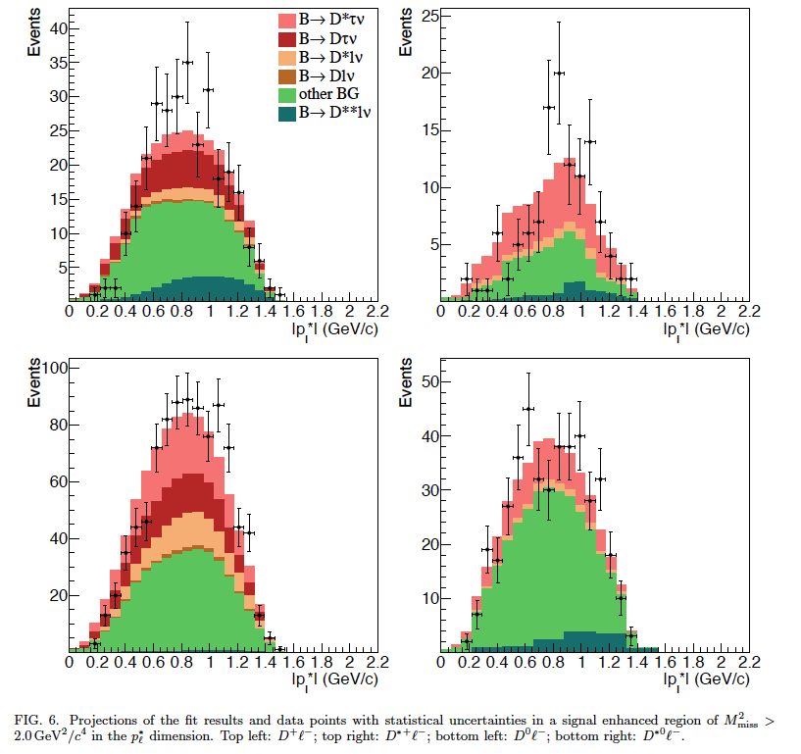
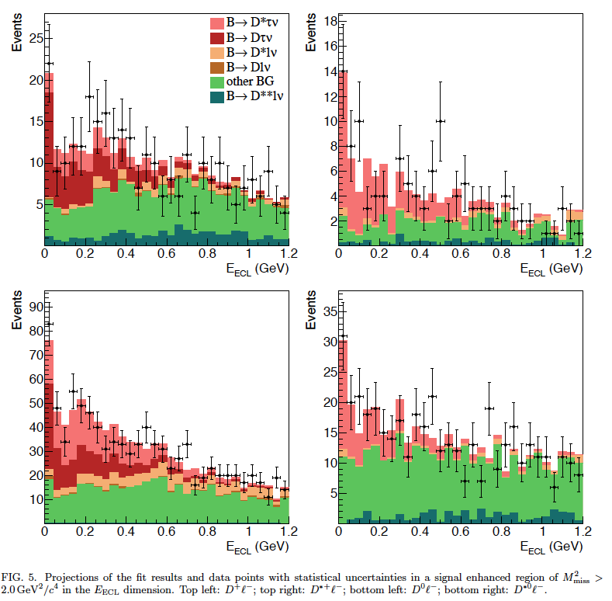
Latest Belle result with hadronic tags
May 25 2015, Nagoya FPCP
T. Kuhr
http://xxx.lanl.gov/abs/1507.03233; Phys Rev D 92, 072014(2015)
Warning: color-coding different from BaBar
Signal enhanced projections of lepton momenta in the high M²_{miss} region
Signal enhanced projections of extra calorimeter energy in the high M²_{miss} region
Notes:
Add the R picture again

Slide 30

Latest Belle result with hadronic tags
May 25 2015, Nagoya FPCP
http://xxx.lanl.gov/abs/1507.03233; Phys Rev D 92, 072014(2015)
Compatible with both BaBar and the 2HDM model (and SM !).
Need more data
Notes:
Add the R picture again

Slide 31

New LHCb result
May 25 2015, Nagoya FPCP
Compatible with BaBar D*τυ BF (B→Dτυ in the pipeline)
Published in Phys. Rev. Lett. 115, 111803 (2015)
Mass resolution is poor but vertex isolation is very powerful
Oui, c’est possible !
G. Ciezarek
Notes:
Add the R picture again

Slide 32


Apres Nagoya: World Averages for R(D) and R(D*)
July 23, 2015
Now 3.9σ from SM
It is obvious that we need two orders of magnitude of data to solve these issues related to the charged Higgs.
Notes:
New HFAG plot for R_D and R_D*. Belle will try to squeeze a little more out of its data. LHCb will try to do D tau nu..

Slide 33


One more Belle update, March 2016 (Moriond)
Uses semileptonic tagging
Talk by P. Goldenzweig (Karlsruhe)
SM discrepancy of WA is now 4.0σ from the SM
arXIv: 1603.06711

Slide 34

Last Belle update, March 2016 (Moriond)
Try to distinguish SM and charged Higgs in kinematic distributions.
Both fit well.
Can also constrain other types of NP couplings (e.g. leptoquarks) , but need much more data

Slide 35


Credit: Djouadi
Simple message from the world’s flavor physicists:
WE NEED MORE DATA !!!
With apologies to Herodotus, Thucydides, Sparta, Persia…
Initial Belle II projections for charged Higgs sensitivity

Slide 36


Rare B Decays
Two event displays
Goa, India
J. Albrecht
Notes:
Flavor physics has become spicier with the latest breakthrough.

Slide 37


LHC found the rarest B decay; B_{s}→μ+ μ-
BF ~O( 10⁻⁹)
N. B. Here and in b→s l⁺ l⁻ all the heavy particles of the SM enter as virtual particles in the Feynman diagrams
Notes:
Will focus on only a handful of rare decays.

Slide 38

LHCb
CMS

Slide 39

arXiv:1411.4413
Published in Nature: June 4, 2015

Slide 40



?
Combining evidence from two LHC experiments (LHCb and CMS), B_{s}→μ⁺ μ⁻ is observed with 6.2σ significance. The corresponding B_{d} decay is not clearly seen yet.
D. Dutta et al (Belle)
Phys. Rev. D 91, 011101(R), 2015
BF (B_{s}→γγ) <3.1 x 10⁻⁶
Complementarity [uses and requires Upsilon(5S) data]

Slide 41

Red Hot Flavor Physics
Notes:
Now let me briefly turn to the most important and surprising result in flavor physics. First some pedagogical introduction.

Slide 42



High Energy Physics History: finding NP in A_{FB} (using interference)
Conclusion: There is a Z boson at higher energy even though colliders of the time did not have enough to produce it
Notes:
Gargamelle discovered weak neutral currents in 1973; SLAC found parity violation in e N scattering in 1978. This set the stage for the discovery of the Z⁰ boson by UA1 and UA2.

Slide 43

A_{FB}(B→K*l⁺l⁻)(q²)
Forward
Backward
The SM forward-backward asymmetry in b→s l⁺ l⁻ arises from the interference between γ and Z⁰ contributions.
l⁻
l⁺
B
B
θ
K*
θ
K*
l⁺
l⁻
Ali, Mannel, Morozumi, PLB273, 505 (1991)
Note that all the heavy particles of the SM (W, Z, top) enter in this decay.

Slide 44

More on A_{FB}(B→K*l⁺l⁻)(q²)
Can in effect vary √s for NP
A_{FB} depends on q²= M²(l⁺l⁻)
Ali, Mannel, Morozumi, PLB273, 505 (1991)
The “zero-crossing” of A_{FB} depends only on a ratio of form factors and is a clean observable.

Slide 45

B→K* l l angular variables
K* and l⁺ l⁻ helicity angles
Angle between the normals to the two decay planes.
N.B. Recent LHCb measurements include φ angle data
From the 2013 LHCb paper

Slide 46

B→K*l⁺l⁻(q²) bootcamp (skip today)
Angular dependence
F_{L} is the longitudinal polarization fraction.
(-) means the term is only in
Introduce P_{4,5}’= S_{4,5}/sqrt[F_{L} (1-F_{L})] to reduce dependence on form factors
Thanks to Rahul Sinha
Notes:
A little technical but may help with understanding the issues…..Thanks to Rahul Sinha for tutoring and debugging. All remaining mistakes are my own.

Slide 47


LHCb 3fb⁻¹ results on B→K* μ⁺μ⁻ (q²)
Angular Asymmetries based on 2398±57 signal events
“The P₅’ measurements are only compatible with the SM prediction at a level of 3.7σ…..A mild tension can also be seen in the A_{FB} distribution, where the measurements are systematically <=1σ below the SM prediction in the region 1.1<q²< 6.0 GeV²”
Blank regions are the J/ψ and ψ’ vetos
Theory from http://arxiv.org/abs/1510.04329
R. Aaij et al., JHEP 1602, 104 (2016)

Slide 48


Recent LHCb results on B→K* μ⁺μ⁻ (q²)
Is HEP History repeating itself ? [But be sure this is not a tricky SM form factor effect.]
Why does NP appear first in this mode
(and not others) ?
Possible answer: All the heavy particles of the SM (t, W, Z) and maybe NP (except the Higgs) appear here. Sensitive to NP via interference (linear effects and many types of couplings).
Notes:
Let’s think about this (along with Auguste Rodin).
However, there must be other signatures !

Slide 49



NP could mean “new particles” (bump in some mass spectrum at the LHC) or “new couplings” (flavor physics)
We would be happy to break the Standard Model.
Places where we might find New couplings
Right-handed currents:1- γ₅➔1+ γ₅
Notes:
We would he happy to break the Standard Model. Paradigm shift (find new couplings instead of new particles). But wait new couplings are due to new particles. This might be just beyond the reach of the LHC direct production

Slide 50

Some examples of NP Fits to B→K*l l data
Not complete: many theorists are trying this

Slide 51

Recent example of NP Fits to B→s l l data
L. Hofer et al., Moriond March 2016
Fits use LCSR at low q² and lattice form factors at high q² and all data on b→s l l
These plots mean there are NP coupling(s) in the weak interaction
Notes:
What does this mean ?

Slide 52

Theory issues on B→K* μ⁺μ⁻ (q²)
➔Check dependence on light-cone form factors (some checks already done by Lattice QCD groups)
Major concern
➔Can tails of large B→K* [c-cbar] or non-factorizable effects produce the anomalies found in the angular distributions ? (If all non-perturbative effects float with arbitrary normalization in the fit then the data can explained)
→ Use data near q² =q²_{max} (K* at rest), where basic symmetry works (Heavy Quark Effective Theory) and constrains ratio of form factors.➔Still find NP
Notes:
In addition to the K* helicity angle and lepton-nu helicity angle, the angle between the two vector meson decay planes called phi is very useful. Mandal et al introduce a new observable A_4, which is sensitive to NP and appears to show a 3.5\sigma NP effect.

Slide 53


A. Karan et al. (arXiv: 1603.04355) [R.Sinha group]
Fit LHCb angular data at q²_{max} (HQET limit)
5σ signal for NP, requires right-handed currents
Still confirmation and more data is needed to close the case
Notes:
In addition to the K* helicity angle and lepton-nu helicity angle, the angle between the two vector meson decay planes called phi is very useful. Mandal et al introduce a new observable A_4, which is sensitive to NP and appears to show a 3.5\sigma NP effect.

Slide 54


A_{FB}(q²) for Inclusive b→s l⁺ l⁻
No form factors
~301 b→s l⁺l⁻ signal events
Where is the zero crossing ?
Precise result useful for NP diagnosis
http://arxiv.org/abs/1402.7134
To appear in PRD.

Slide 55



How can we establish NP in B→K* l⁻l⁺ ?
Ans: Observe and measure the rate for
and thus isolate the Z’ penguin (C₉) at Belle II
Answer from Buras et al.
Ans: Verify hint of lepton universality breakdown at Belle II (good electron eff)
R. Aaij et al. (LHCb collab); PRL 113, 151601 (2014)

Slide 56




“We need more data !!”
Apologies to Director Akira Kurosawa
To find out whether there are NP coulings in the weak interaction
Signal of ~187 events
Belle I data S. Wehle, DESY
Notes:
To find out whether there are new physics couplings in the weak interaction

Slide 57



The Next Generation
Belle II and the LHCb upgrade
2014 was the 50th anniversary of the discovery of CP violation in the kaon sector [see http://pprc.qmul.ac.uk/research/50-years-cp-violation
US P5 report (p. v): “Explore the unknown: new particles, interactions, and physical principles”

Slide 58




Physics Reach of Belle II and the LHCb upgrade
Competition and complementarity
Gelato flavors in Asakusa
Tofu Gelato ?

Slide 59

Tight race
Belle II ahead
Belle II dominates here
Tight race
Notes:
And full funding of operations is needed !

Slide 60

Latest SuperKEKB Luminosity Profile
Belle/KEKB recorded ~1000 fb⁻¹ . Now change units on y-axis to ab⁻¹
N.B. To realize this steep turn-on, requires close cooperation between Belle II and SuperKEKB [and international collaboration on the accelerator].
This plot assumes full and stable operation funding profile.
Notes:
And full funding of operations is needed !

Slide 61
Compare the Parameters for KEKB and SuperKEKB
 | KEKB Design | KEKB Achieved : with crab | SuperKEKB Nano-Beam
Energy (GeV) (LER/HER) | 3.5/8.0 | 3.5/8.0 | 4.0/7.0
β_{y} * (mm) | 10/10 | 5.9/5.9 | 0.27/0.30
β_{x} * (mm) | 330/330 | 1200/1200 | 32/25
ε_{x} (nm) | 18/18 | 18/24 | 3.2/5.3
ε_{y} /ε_{x} (%) | 1 | 0.85/0.64 | 0.27/0.24
σ_{y}(mm) | 1.9 | 0.94 | 0.048/0.062
σ_{y} | 0.052 | 0.129/0.090 | 0.09/0.081
σ_{z} (mm) | 4 | 6 - 7 | 6/5
I_{beam} (A) | 2.6/1.1 | 1.64/1.19 | 3.6/2.6
N_{bunches} | 5000 | 1584 | 2500
Luminosity (10³⁴ cm⁻² s⁻¹) | 1 | 2.11 | 80
Nano-beams are the key (vertical spot size is ~50nm !!)
This is not a typo
Notes:
The jump from CESR to the B factories (PEP-II, KEKB) was not significant in per bunch parameters. However, the number of bunches and the beam currents were much larger. There is greater than an order of magnitude reduction in beam size and emittance.

Slide 62











2016: Basic hardware (except final focus) now in place
New superconducting final focusing magnets near the IP
e⁺ 3.6A
e⁻ 2.6A
KEKB to SuperKEKB
Redesign the lattice to reduce the emittance (replace short dipoles with longer ones, increase wiggler cycles) (being tuned)
Nano-Beam scheme
extremely small β_{y}*
low emittance
Beam current X 2
Reinforce RF systems for
higher beam currents
40 times higher luminosity
2.1x10³⁴ → 8x10³⁵ cm⁻²s⁻¹
Replace beam pipes with TiN-coated beam pipes with antechambers (works well)
Improve monitors and control system
Injector Linac upgrade
Upgrade positron capture section
DR tunnel
Low emittance
RF electron gun
New e+ Damping Ring
constructed
Notes:
Construction is nearly complete. Commissioning of SuperKEKB will start in 2016.

Slide 63
Belle II Detector
German contribution
BEAST (Background commissioning detector)
KL and muon detector:
Resistive Plate Counter (barrel outer layers)
Scintillator + WLSF + MPPC (end-caps , inner 2 barrel layers)
EM Calorimeter:
CsI(Tl), waveform sampling (barrel)
Pure CsI + waveform sampling (end-caps)
Particle Identification
Time-of-Propagation counter (barrel)
Prox. focusing Aerogel RICH (fwd)
electrons (7GeV)
Beryllium beam pipe
2cm diameter
Vertex Detector
2 layers DEPFET + 4 layers DSSD
positrons (4GeV)
Central Drift Chamber
He(50%):C2H6(50%), small cells, long lever arm, fast electronics
Notes:
Reuses the structure, solenoid and CsI(Tl) crystals and part of the barrel RPCs. Most other components are new.
We must prepare for backgrounds a factor of 10-20 higher. Hence the use of DEPFET pixels for inner vertexing and a new silicon vertex detector with the APV2.5 readout chip from CMS. The PID is based on Cherenkov counters. For the barrel, the Cerenkov light is totally internally reflected to an array of pixelated PMTs. High precision timing and position information is used to distinguish kaons from pions.

Slide 64


Barrel Particle Identification
A GEANT4 event display of a 2 GeV pion and kaon interacting in a TOP quartz bar. (Japan, US, Slovenia, Italy)
Incoming track
Vertexing/Inner Tracking
Beampipe r= 10 mm
DEPFET pixels (Germany, Czech Republic, Spain…)
Layer 1 r=14 mm
Layer 2 r= 22 mm
DSSD (double sided silicon detectors)
Layer 3 r=38 mm (Australia)
Layer 4 r=80 mm (India)
Layer 5 r=115 mm (Austria)
Layer 6 r=140 mm (Japan)
FWD/BWD Italy
+Poland, Korea
Notes:
Pion is green and kaon is red

Slide 65



TOP detector at Tsukuba Hall
April 2016: Belle II structure
First TOP module arriving at Tsukuba Hall
Update: April 15, 2016 7/16 TOP modules were installed into the Belle II structure. Magnetic field mapping then CDC installation in the summer.
CDC (Central Drift Chamber)
Notes:
Central drift chamber is partially instrumented and taking cosmic ray data.

Slide 66


In e+e- scattering at 10-11 GeV, a critical issue for vertexing is multiple scattering.
Reduce the multiple scattering lever arm; reduce X₀
s[mm]
Belle
Belle II’
Belle II
Belle: r(beampipe) 2 cm→1.5 cm
Belle II: r(beampipe) 1cm
Improved resolution and nano-beams will open new possibilities for vertex analysis
0
1.0
2.0
pβsin(θ)^{5/2} [GeV/c]
Large improvement in ΔS(B→K_{S}π⁰ γ)
Ks track
π⁺ π⁻
γ
γ
B vertex
IP profile
γ
Larger radial coverage of SVD
B decay point reconstruction
from the K_{S} vertex, used in searches
for NP right handed currents.

Slide 67

“Full sized” pixel detector module 0
75 μm thick
Pixel detector group from many institutes and universities in Germany
Notes:
Note locations of the ASICs, switchers on the side, SMDs in between the switchers, thinned area on the backside.

Slide 68

“Full sized” pixel detector module 0
PXD9 illuminated through a mask
MPI and HLL are among the leading groups of this large detector collaboration.
Notes:
Note locations of the ASICs, switchers on the side, SMDs in between the switchers, thinned area on the backside.

Slide 69


Full speed PXD readout – laser scan
:- laser spot at 1 pixel in each of the 24 regions, signal about 4 mip
:- taken at full read-out speed (frame time 20µs)
noise (laser system): 1-2 ADU
Laser signals are working well
→ First batch of final sensor production started

Slide 70

April 2016: Belle II VXD beam test at DESY
Incident DESY e- test beam

Slide 71


April 2016: Two full-sized Belle II DEPFET pixel detector
modules at DESY (beam test in progress)
Working examples of L3, L4, L5, L6 SVD ladders
Test the integrated PXD-SVD system. This includes ROI (region of interest) extrapolation from the SVD tracker to the PXD, which is needed to reduce the large data volume.
Test full-sized PXD modules in a beam. [Measure efficiency and S/N].

Slide 72


“Missing Energy Decay” in a Belle II GEANT4 MC simulation
Signal B→K ν ν tag mode: B→Dπ; D→Kπ
Zoomed view of the vertex region in r--phi
View in r-z
➔Belle II Software is in a fairly advanced state (T. Kuhr (LMU) is the Belle II software coordinator)

Slide 73

Some Belle II jargon
BEAST PHASE I: Simple background commissioning detector (diodes, TPCs, crystals). No final focus. Only single beam background studies possible [started in Feb 2016].
BEAST PHASE II: More elaborate inner background commissioning detector. Full Belle II outer detector. Full superconducting final focus. No vertex detectors.

Slide 74


SuperKEKB vacuum scrubbing to reduce beam gas backgrounds in Belle II
LER integrated beam dose > 100 A-h
BEAST background in the LER vs time

Slide 75

“Cool” (low-emittance) and flat beams in SuperKEKB
HER to be remeasured soon after optics tuning.
Improved calibration of X-ray monitor beam size monitor will be done shortly.

Slide 76

April 2016: Large Touschek background observed in the LER
Bkg in BEAST
Vertical beam size from size monitor (not measured at IP)
→Will need excellent collimators to handle nano-beam backgounds.

Slide 77


Belle II Schedule
When do we start Belle II ?
BEAST PHASE I: Started in Feb 2016 (Belle II roll-in at the end of the year)
BEAST PHASE II: Starts in Nov 2017 [first collisions, limited physics without vertex detectors]
Belle II Physics Running: Fall 2018 [vertex detectors in]
QCSL at KEK, Dec 2015

Slide 78
Conclusion/Next Generation
Flavor physics is exciting and fundamental. Did we just find NP via new weak couplings ?
Flavor could be the path for the future of HEP but we need much more data.
Time for a Paradigm Shift ?
SuperKEKB commissioning started in February. Belle II rolls in at the end of the year. First collisions in fall 2017. Belle II physics runs in 2018 and the LHCb upgrade in ~2020. These facilities will inaugurate a new era of flavor physics and the study of CP violation.
Notes:
2014 was the 50th anniversary of the discovery of CP violation. We are now entering the 2nd generation. Time for a paradigm shift ?

Slide 79
Backup slides

Slide 80

Feb 2016 News: First Turns at SuperKEKB (4 GeV e+’s and 7 GeV e-’s)
First detection of “first turns” in BEAST background detector by F. Simon et al (MPI) using CLAWs (scintillators with SiPM’s).

Slide 81

DESY contributions to SuperKEKB
An important piece of SuperKEKB

Slide 82

DESY contributions to Belle II
Thermal mockup of the vertex detectors
Precise mapping of the B field of the Belle II superconducting solenoid
Software Alignment of Belle II detectors
Collaborative Computing Services for Belle II

Slide 83



Innovative Technologies in Belle II
Pixelated photo-sensors play a central role
MCP-PMTs in the iTOP
HAPDs in the ARICH
SiPMs in the KLM, DEPFET pixels
Waveform sampling with precise timing is “saving our butts”. Front-end custom ASICs (Application Specific Integrated Circuits) for all subsystems ➔a 21st century HEP experiment.
Pixel detector [3 custom German ASICs: DCD, DHP, Switcher]
KL/muon detector (TARGETX ASIC)
Electromagnetic calorimeter
(New waveform sampling backend with good timing)
iTOP particle identification (IRSX ASIC)
Aerogel RICH (KEK custom ASIC)
Central Drift Chamber (KEK custom ASIC)
SVD (APV2.5 readout chip adapted from CMS)
Notes:
But readout integration is hard. Since all these technologies are fairly new, we need education and training. These technologies will be discussed further at this school.

Slide 84





Highlights of Belle II construction
SuperKEKB hardware is being finalized.
BEAST PHASE I beampipe installed
S/N
Hits
Final Belle II SVD ladder in CERN beam in June (working well !)
(a) CDC arriving at Tsukuba Hall; (b) first cosmics with partly instrumented electronics (6 layers)

Slide 85


Slide 86

Belle II construction status
“Tensions are high, tempers are short.”

Slide 87




BEAST Phase 1 Installation Sequence
4.
1.
Install IP bridge: Completed
Install support structure and sensors: Aug 17- Sep 22
2.
Install 6km cables:
Completed June 25-28
5.
IP1 chamber for Phase 1.
3.
Install IP chamber: Completed June 29th
Add IP shield wall w/ crane

Slide 88

Updated projections for B→K(*) nu nubar modes
P. Urquijo et al.

Slide 89

Mixing and CP violation in the D system
However, x signal is marginal
There is a very strong y signal
Notes:
Belle and BaBar discovered D mixing in 2007. Next job is to disentangle x and y. So far there is a strong y signal but the x signal is 2\sigma, quite marginal. Clearly establishing x would be very important.

Slide 90

D mixing: Another new physics phase !
CPV in D system negligible in SM
CPV in interf. mix./decay:
The existence of D mixing (if x is non-zero) allows us to look for another poorly constrained new physics phase but this time from up-type quarks.
(c.f. CPV in B_{s} mixing)
Current WA sensitivity ~±20⁰, 50 ab⁻¹ go below 2⁰

Slide 91

Belle I Drift Chamber and Vertex Detector in the Ueno Science Museum in Tokyo

Slide 92


Tau Lepton Flavor Violation
Example of the decay topology
Belle II will push many limits below 10⁻⁹ ; LHCb has very limited capabilities.
Notes:
Belle and BaBar pushed many limits far beyond CLEO. Belle II will move below 10^-9

Slide 93


CPV in the charged lepton sector
There is mixing in the neutrino (neutral lepton) sector. CP violation is possible too.
BaBar rate anomaly ??
Can we explore at Belle II ?
M. Bischofberger et al, Phys. Rev. Lett. 107, 131801 (2011)

Slide 94


Slide 95


“Missing Energy Decay” in a Belle II GEANT4 MC simulation
B→τν, τ→eνν B→Dπ, D→Kπππ
Zoomed view of the vertex region
e

Slide 96




Beast Phase II & New Triggers
Update to First-physics report: BELLE2-NOTE-PH-2015-003 Y(2S), Y(3S), Y(6S), Scan proposals
Beast Phase II Physics Task Force formed to study physics with this configuration (B. Fulsom).
Belle Y(1S) decay data used for Pythia 8 MC tuning in Belle II (U. Tamponi).
C. Hearty
C-H. Li
HLT & L1 Trigger Menu under design. Evolving Trigger Menu (Link).

Slide 97


Slide 98

Belle II

Slide 99

Discussion Topic: What additional Theoretical Work is required to determine whether NP is present in B decays ?
Participants: Wolfgang Altmannshofer, Christoph Bobeth, Jorge Martin Camalich, Robert Fleischer, Zoltan Ligeti, Rahul Sinha
Nagoya FPCP15 roundtable
鵜飼
“ukai”
Cormorant Fishing on the Nagara River during the Edo Period
Notes:
Experimentalists have restrictive neck rings while theorists retrieve the juicy data and determine whether it contains NP.

Slide 100

Discussed in Nakada-san’s talk

Slide 101

LHCb Upgrade: Key Feature is Trigger-less readout
Notes:
N.B. Trigger-less read-out !!

Slide 102

LHCb upgrade timeline
Run at ~4 x 10³² /cm² /sec
Expect (1-2) x 10³³ /cm² /sec
Upgraded trigger and DAQ is the key feature

Slide 103




Belle II at IPMU in 柏の葉, Japan
Constructing two layers of the Belle II SVD detector in the clean room on the 1st floor. Dr T. Higuchi is the leader.
Test Production by late Sept;
Detector production starts ~ Nov 2015
Japan (Layer 6) and India/Tata Institute (Layer 4)
L4 mechanical prototype

Slide 104
New Reference for the Next Generation
The Physics of the B Factories
http://arxiv.org/abs/1406.6311
This work is on the Physics of the B Factories. Part A of this book contains a brief description of the SLAC and KEK B Factories as well as their detectors, BaBar and Belle, and data taking related issues. Part B discusses tools and methods used by the experiments in order to obtain results. The results themselves can be found in Part C.
Comments: 928 pages
Subjects: High Energy Physics - Experiment (hep-ex); High Energy Physics - Phenomenology (hep-ph)
Report number: SLAC-PUB-15968, KEK Preprint 2014-3

Slide 105


Slide 106

B factories: Check CP violation in b→c [ubar d] processes
2015: First joint BaBar-Belle data analysis
M. Rohrken et al
“Color-suppressed” B→D h
where D⁰ is a CP eigenstate and h⁰=π⁰, η, ω
Combining Belle and BaBar datasets, ~1260 signal events, obtain a 5.4σ CP violation signal➔First observation
sin(2β_{eff})=0.66±0.10(stat)±0.06(sys)
Phase of V_{td} again
Conclusion: CP violation in b→c ubar d modes is the same as in b→c cbar s modes (e.g. B→J/ψ K_{S})

Slide 107
More backup

Slide 108


M.Needham@ICHEP2014
But LHCb dominates on these B_{S} modes

Slide 109


Slide 110

CKMFitter with LHCb sin(2β) included

Slide 111


SuperKEKB complex

Slide 112

ATF2 nanobeams

Slide 113


“Missing Energy” Decays
Tsutentaku tower, Osaka
Tokyo Sky Tree

Slide 114



B→K* l⁺ l⁻ form factor ratios determined from data
disagree with theory
SKIP TODAY
Three form factors here
R. Mandal, R.Sinha, arXiv 1506:04535
Notes:
In addition to the K* helicity angle and lepton-nu helicity angle, the angle between the two vector meson decay planes called phi is very useful. Mandal et al introduce a new observable A_4, which is sensitive to NP and appears to show a 3.5\sigma NP effect.

Slide 115

Initial Belle II projections for charged Higgs sensitivity
Yutaro Sato, R. Itoh et al
Charged Higgs: A strong case at Belle II

Slide 116



Belle II iTOP at Fuji Hall/Hawaii
Module 01 assembly at Fuji Hall
Module 04 assembly at Fuji Hall
Production testing of readout with single photo-electron laser pulses in Hawaii; electronics resolution ~35ps
All quartz and electronics in hand; now testing and assembling.

Slide 117


Vacuum scrubbing
LER Beam dose > 100 Ah
HER Beam dose > 60 Ah

Slide 118
BEAST Phase 1 Installation Sequence
4.
1.
Install IP bridge: Completed
Install support structure and sensors: Aug 17- Sep 22
2.
Install 6km cables:
Completed June 25-28
5.
IP1 chamber for Phase 1.
3.
Install IP chamber: Completed June 29th
Add IP shield wall w/ crane

Slide 119
Conclusion/Next Generation
The e+ e- B factories confirmed that the KM phase is responsible for most of the observed CPV [Physics Nobel Prize 2008]
Nevertheless, 10-20% NP effects are consistent with all current flavor data.
LHCb has ruled out large CPV phases from NP in the B_{s} sector.
“Missing energy B decays” provide important high—mass sensitivity to the charged Higgs in the multi-TeV range.⁻
Angular anomalies in B→K*l⁺l⁻ from LHCb with 3 fb⁻¹
Belle II will soon join the game.
Flavor physics is exciting and fundamental. (Did we just find NP ? New Couplings; Flavor may be the path for the future of HEP but we need more data.)
SuperKEKB commissioning started in February. Belle II rolls in at the end of the year. Belle II physics runs in 2018 and the LHCb upgrade in ~2020. These facilities will inaugurate a new era of flavor physics and the study of CP violation.
Notes:
2014 was the 50th anniversary of the discovery of CP violation. We are now entering the 2nd generation. Time for a paradigm shift ?

