Slide 1

Track Finding @ HL-LHC
QC Workshop
Marcel Merk LHCb/Nikhef/UM

Slide 2

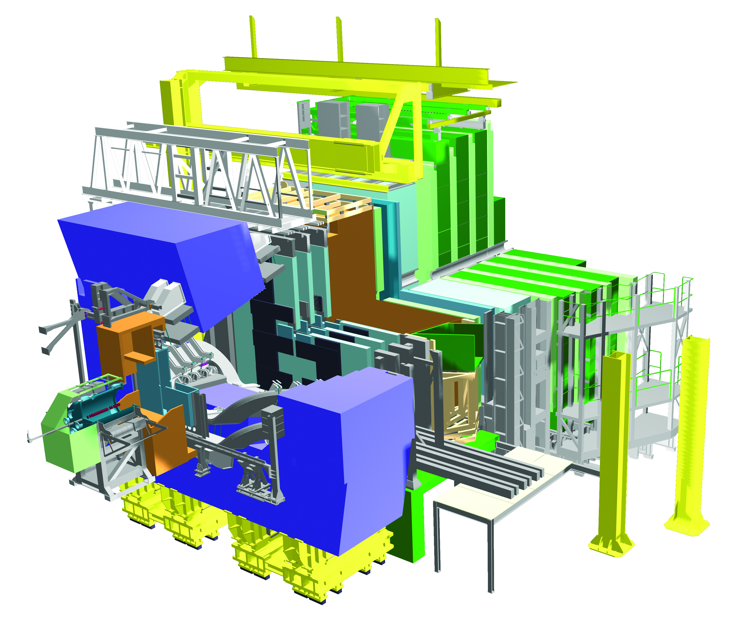
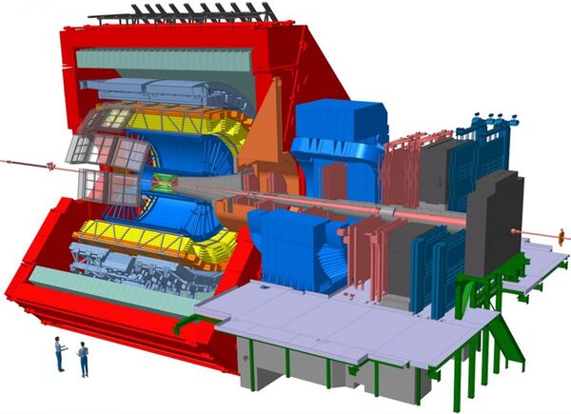
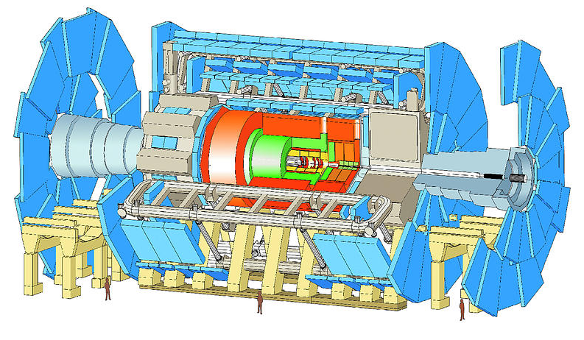
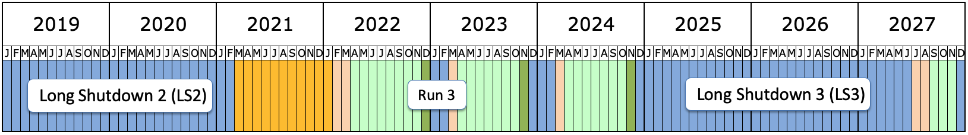
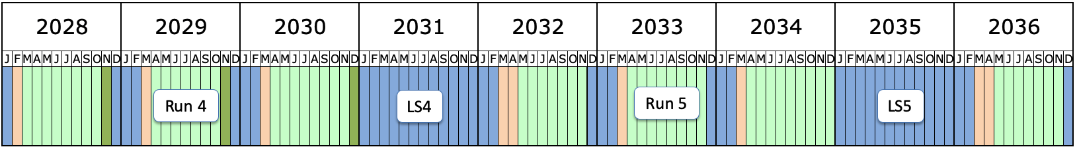
Timeline HL-LHC at Nikhef
Atlas
LHCb
Alice

Slide 3
1) Tracking: Finding lines from individual hits

Slide 4
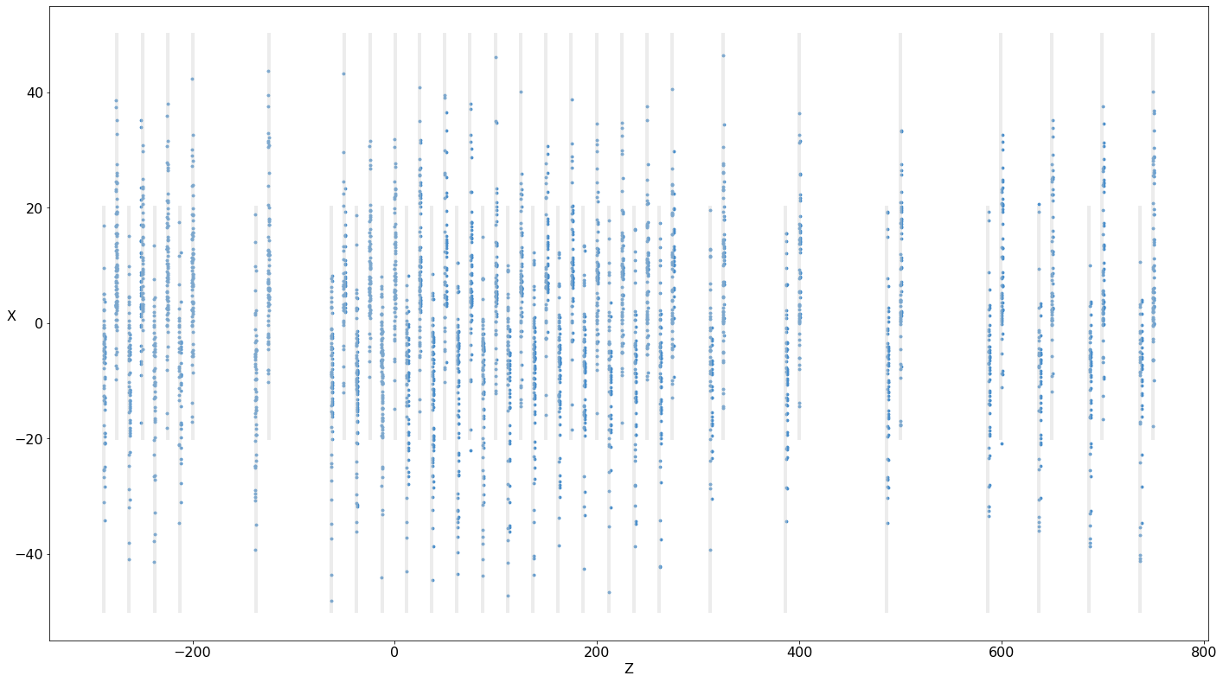
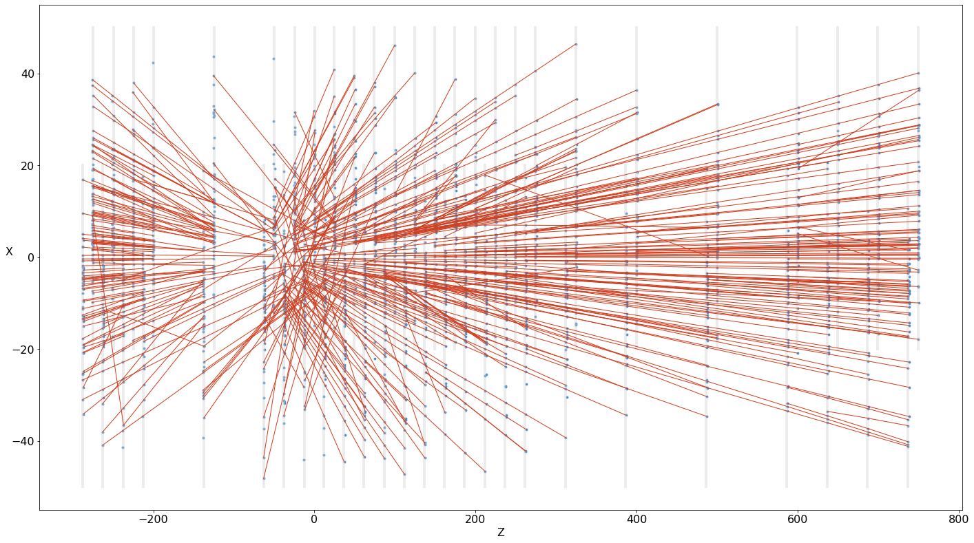
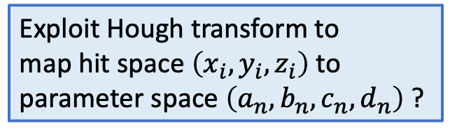
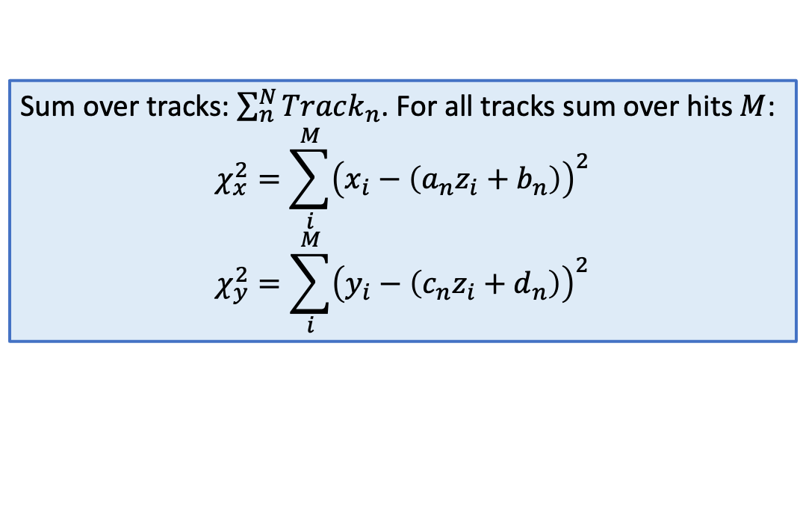
Solve as simultaneous hit combinatorics?
Sum over tracks: $\sum_{n}^{N}{Track_{n}}$. For all tracks sum over hits $M$:
$$χ_{x}^{2}=\sum_{i}^{M}{{\left(x_{i}−\left(a_{n}z_{i}+b_{n}\right)\right)}^{2}}$$
$$χ_{y}^{2}=\sum_{i}^{M}{{\left(y_{i}−\left(c_{n}z_{i}+d_{n}\right)\right)}^{2}}$$
Exploit Hough transform to
map hit space $\left(x_{i},y_{i},z_{i}\right)$ to parameter space $\left(a_{n},b_{n},c_{n},d_{n}\right)$ ?

Slide 5
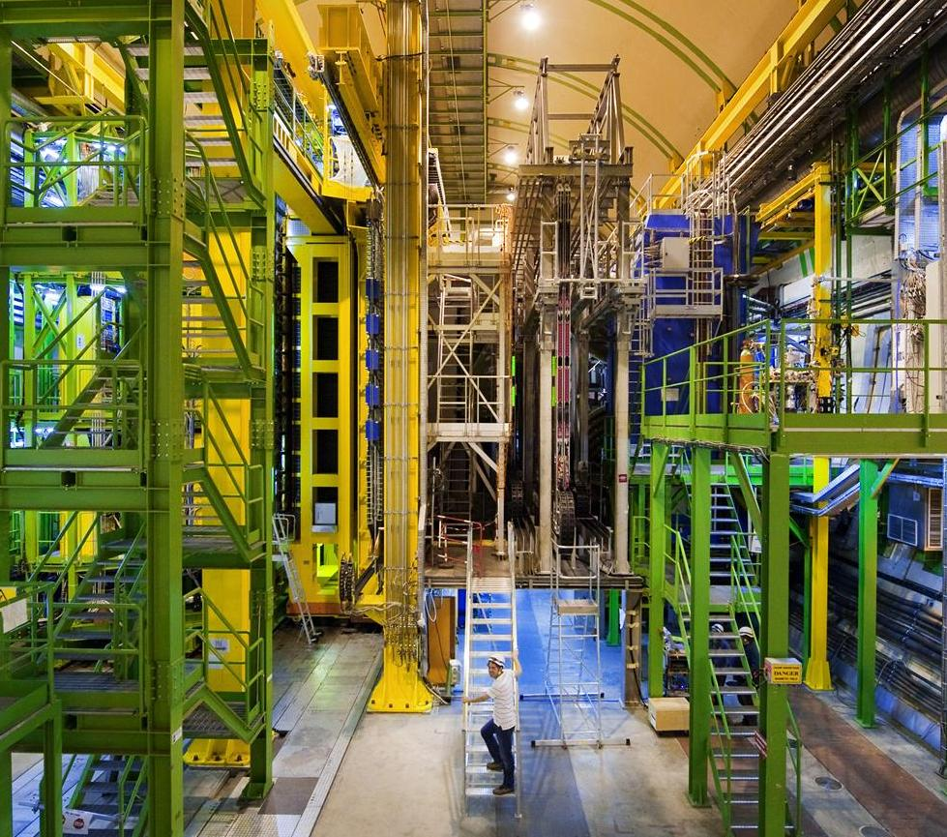
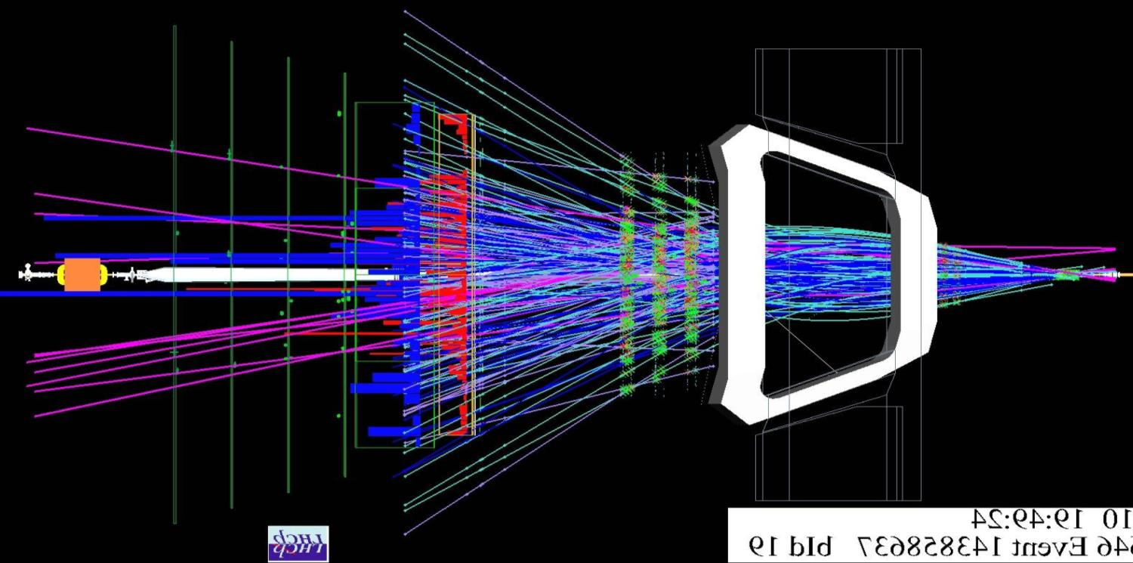
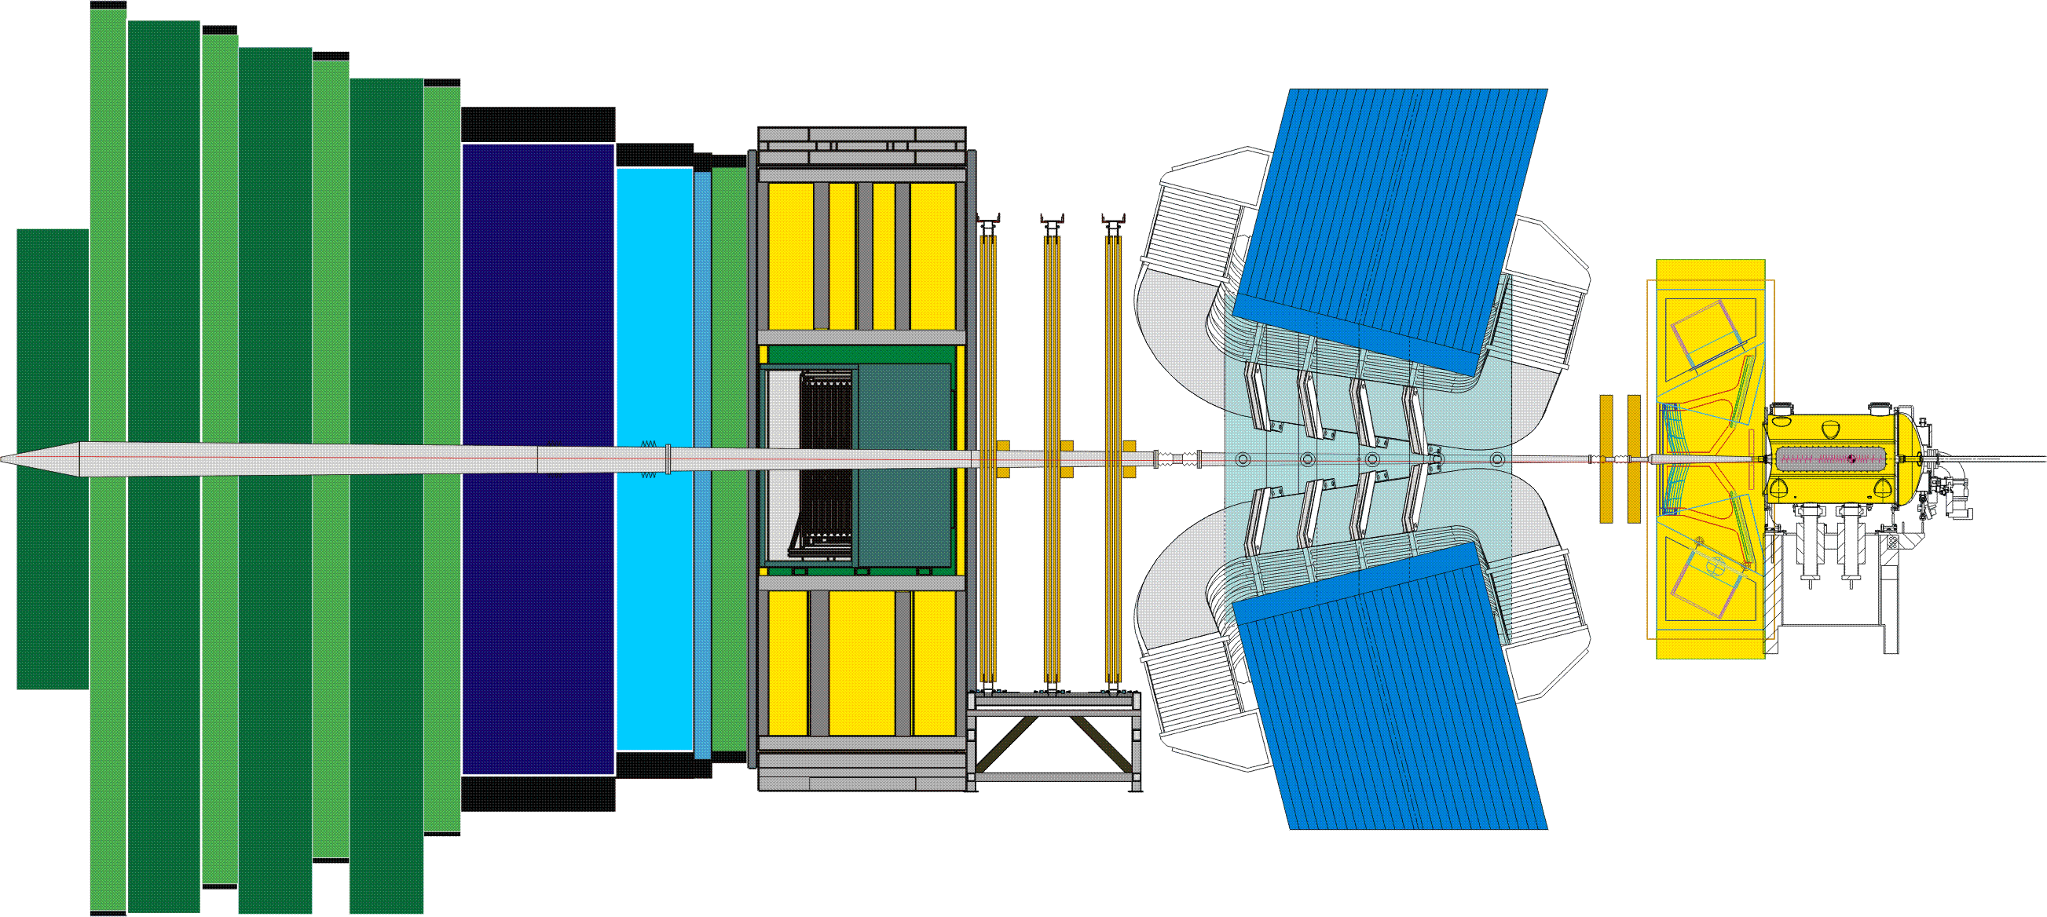
2) Direct extraction B-decay from event?
23 sep 2010 19:49:24
Run 79646 Event 143858637

