Slide 1
Software structure at Nikhef
DATA STORAGE:
/data/lepcol/common/BonnTelescopeTestJune17
/testbeam_bonn_october18
Prepared /testbeam_DESY_june21
Arawana DAQ and monitoring TPX3 software:
/project/lepcol/common/arawana/
Firmwares laser_setup_software localSPIDR2 sophy1.4.6 user
gastpx3home localSPIDR localstore2localSPIDR spidr3-software
Analysis software Kees /project/lepcol/users/cligtenb
Peter /project/lepcol/users/s01/arawanaSoftware

Slide 2
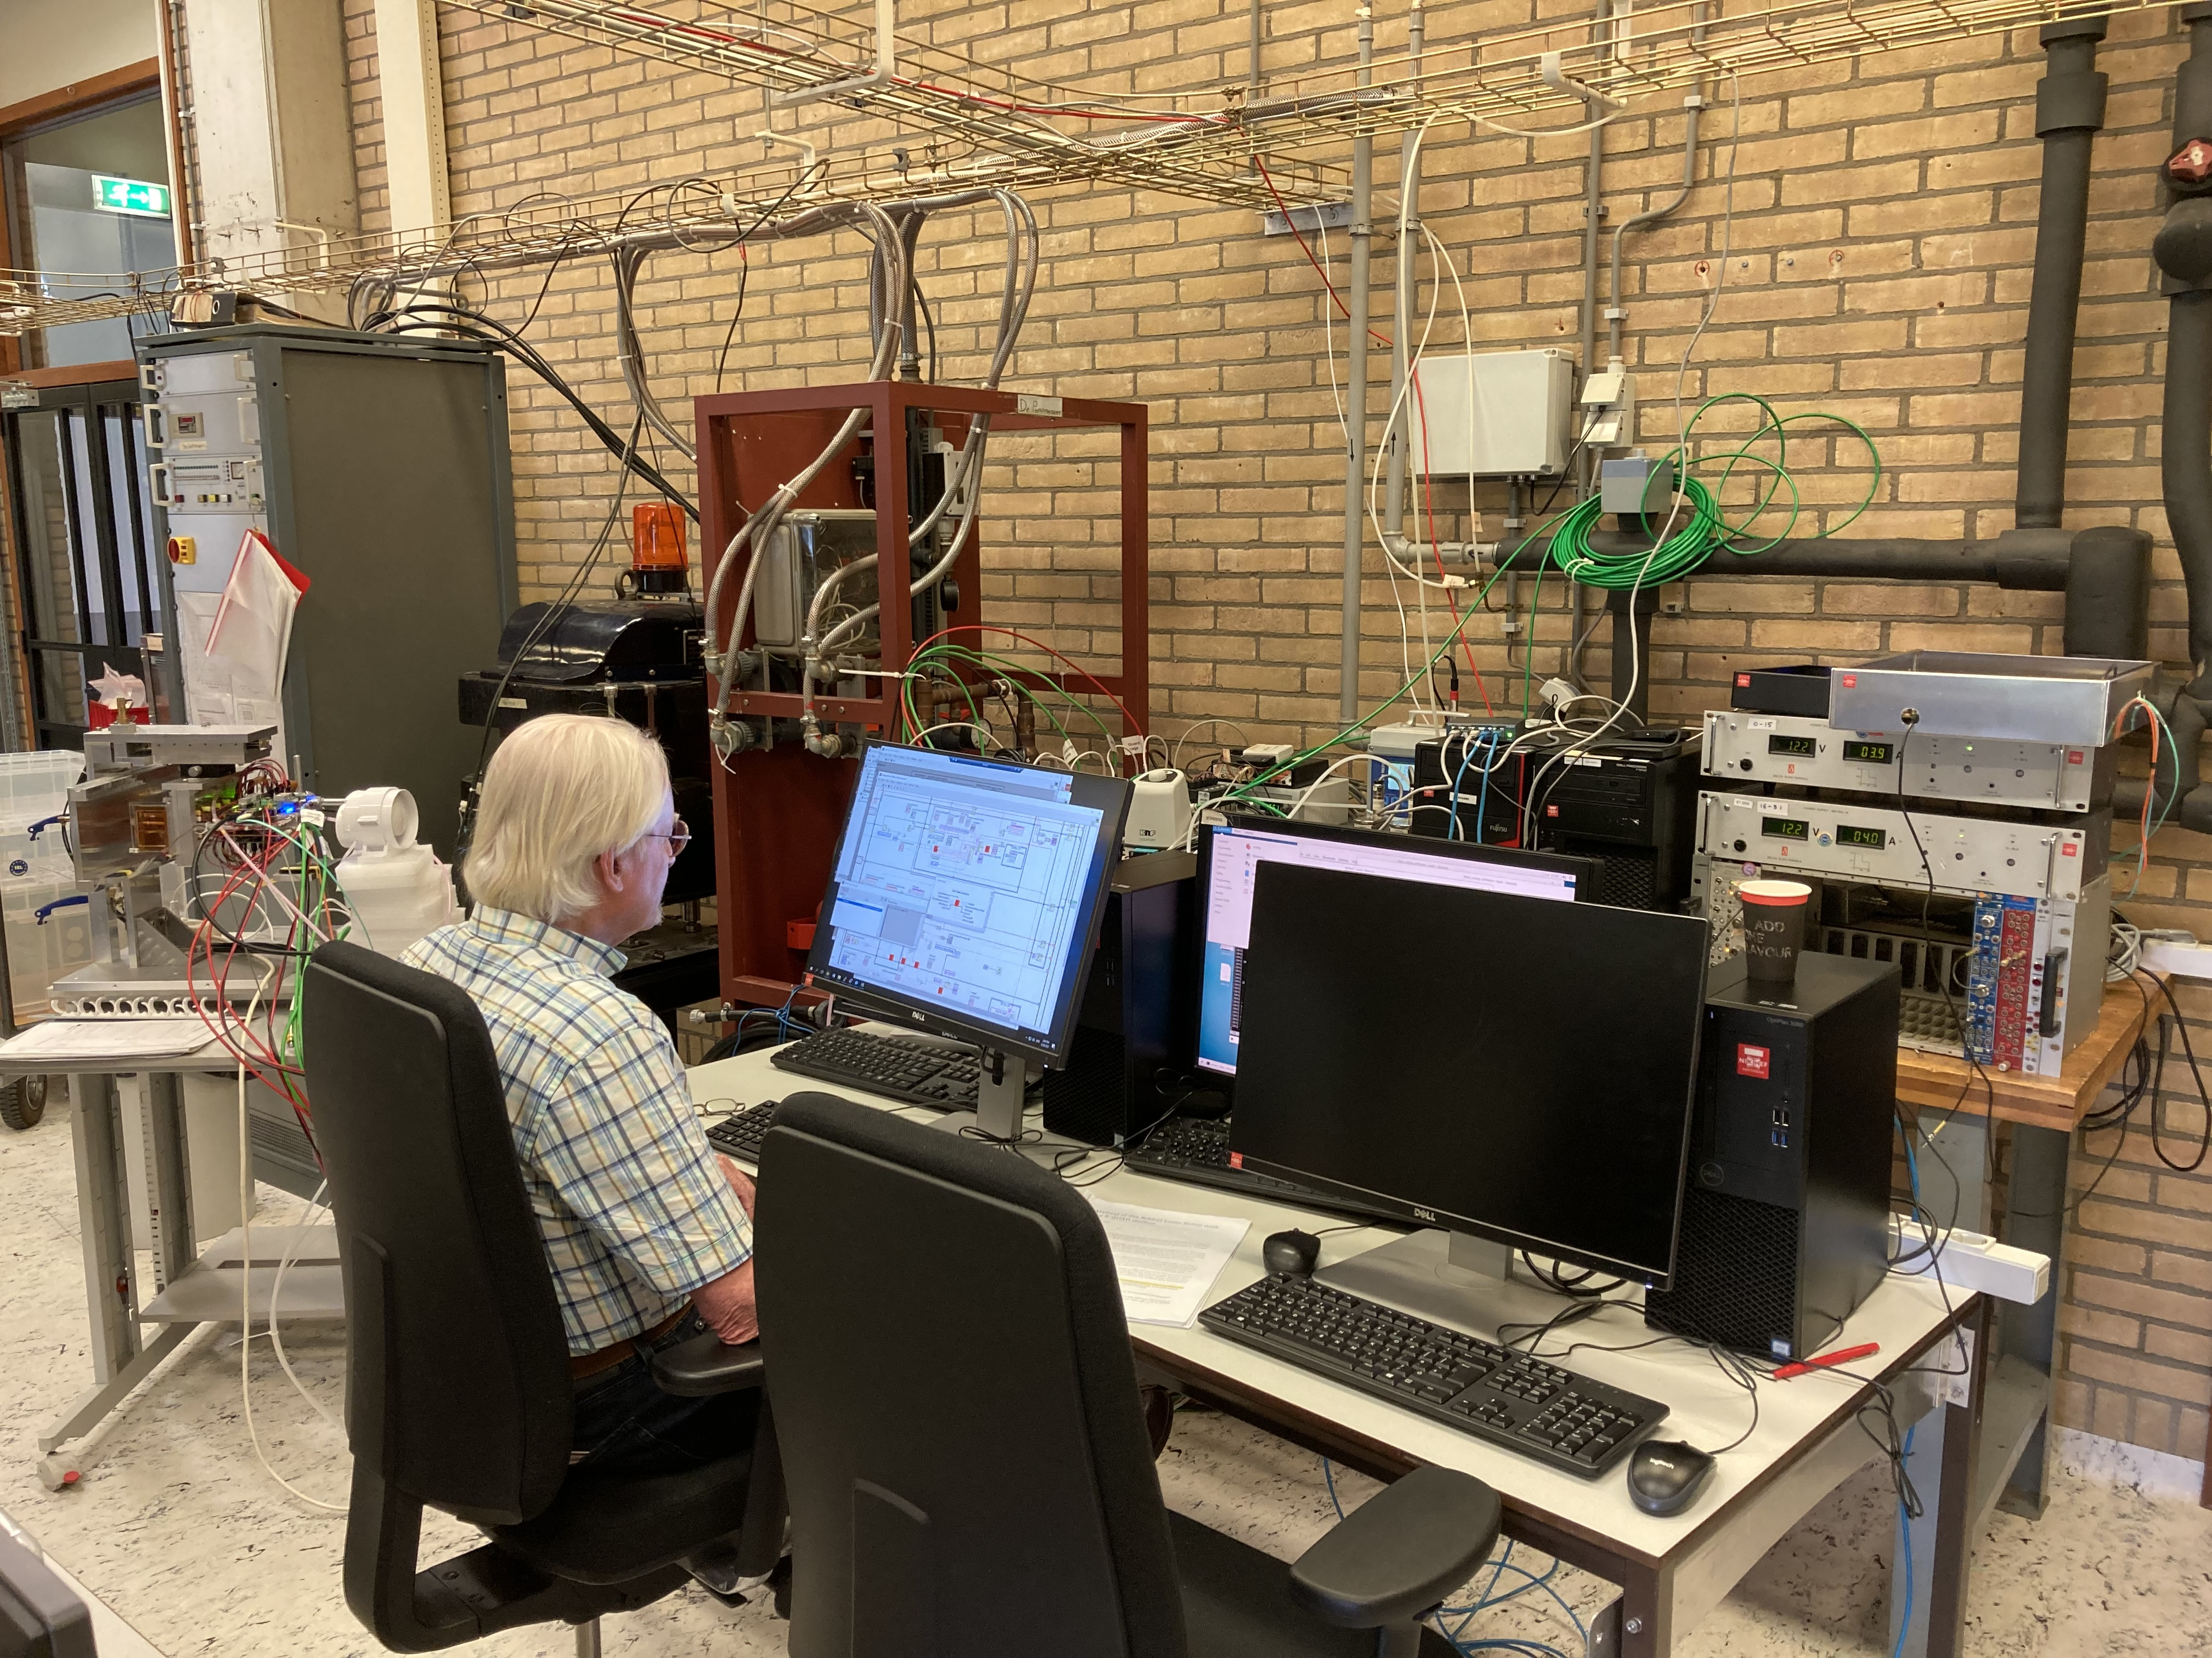
Remote desktop and data taking
SLOW CONTROLS
Windows
DAQ TPX3
Linux
DAQ Si
Linux
In hall
outside magnet
Si telescope
Levaard
arawana
Switch
Control room
Remote hut
PC-19-023
Elrits
Windows
Linux
HV, Gas, stager and
run control (tunnel to arawana)
SPDR controls (2)
DAQ running
root file production

Slide 3
Levaard Slow controls
Gas system: Measures and controls gas flow temperature of the 8-quad and O2 meter
HV system: controls the HV on the grid, guard etc. measures currents
Run control is used to start a run
- first start PUTTY and tunnel to arawana
- on arawana ./rundaq.sh (starts the daq in run control mode)
it should give a binding socket (if not ˆC and redo)
check on arawana chips: spidrchipids 192.168.1.10
if not 32 chips do: spidrreset 192.168.1.10
- from the panel Connect (to arawana) and then Configure
check the arawana PUTTY window to check that you are connected
after configure still have 32 chips in the readout
- if OK give run number and Start run
- After (e.g.) 60 s Stop run
- the bytestream is now closed and we can decode it (next slides)

Slide 4
Software on elrits
On Elrits we open a remote desktop on arawana
1) We can see on arawana the LOGFILES
DATA files
2) And observe/monitor the USB outputs from the two SPDR systems
3) Start standalone test runs an arawana (commissioning)
4) start the program to produce a ROOT file for a given run and link
Elrits is also used to store - transfer from arawana - locally the data that we took on arawana:
elrits /localstore/TPX3/DATA
/ROOT

Slide 5
Data and Software on arawana
Data structure on arawana:
/localstore2/TPX3/DATA/LOGFILES/arawana*.log
TPX3/DATA/LINK0/Runxxxx/*.dat
TPX3/DATA/LINK1/Runxxxx/*.dat
TPX3/DATA/TIMESTAMP/Runxxxx/*.dat
DAQ program on arawana:
/localstore/TPX3/spidr3-software/Telescope/DAQ_Concentrator
Running DAQ program standalone test for 10 secs
// cd /localstore2/TPX3/DATA/LOGFILES
Tpx3daq_concentrator -s "" -i 1 -p 2 -m -t 10
NB: This will create a dummy run number 1111 and write data
For a real run we will use run control from levaard

Slide 6
Data and Software on arawana
Bytestream decoding program
/home/gastpx3/source init_laser_setup_software.sh
/localstore/TPX3/laser_setup_software/make_concentrator_tree.*
It produces a root file with histograms and ntuple (tree) on arawana:
/localstore2/TPX3/ROOT
Produce root file for run 1801 and link (concentrator) 0
cd /localstore/TPX3/laser_setup_software
./make_concentrator_tree -r 1801 -l 0 >&1 | tee out_1801_0.log
// name of the root file: run1801_0.root
This root file should be transferred to elrits, where it can be further analysed

Slide 7
Analysis/Monitoring Software on elrits
elrits /localstore/TPX3/ROOT
/software
MaskAndTrim.C and .h
- runs over one root file and analyses the histograms in the root file
- Noise level per chip (and per pixel)
- Can be ran to produce files per chip with masked pixels
that are input to the DAQ maskPixels()
/localstore/TPX3/localCONFIGS/Module/ W0023_J09_dacs.txt W0023_D06_trimdacs.txt
root –l <return> > .L MaskAndTrim.C++ <return> > MaskAndTrim t <return> > t.LoopM() <return>
rootCommands.mes
- open root file root –l ../ROOT/filename
- one can browse the histograms TBrowser t
- or analyse the ntuple hits (use commands in file) and make selections
In the directory /software/detailedSoftware more detailed software is kept but this needs updating to be useful for testbeam monitoring

