Slide 1
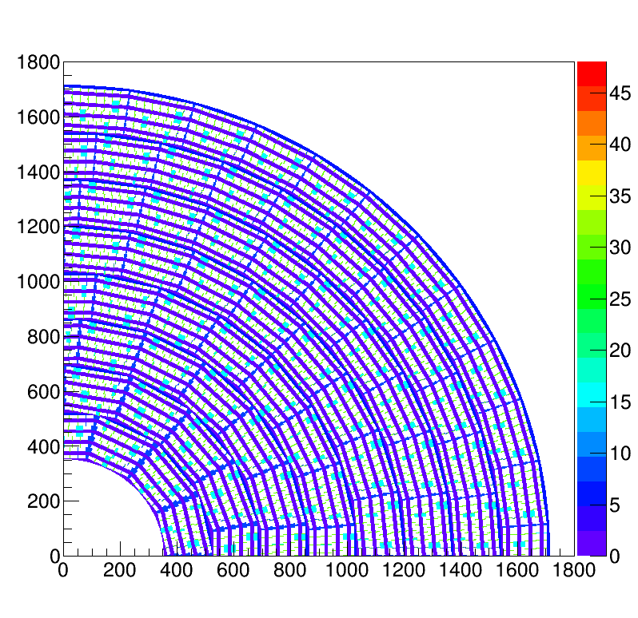
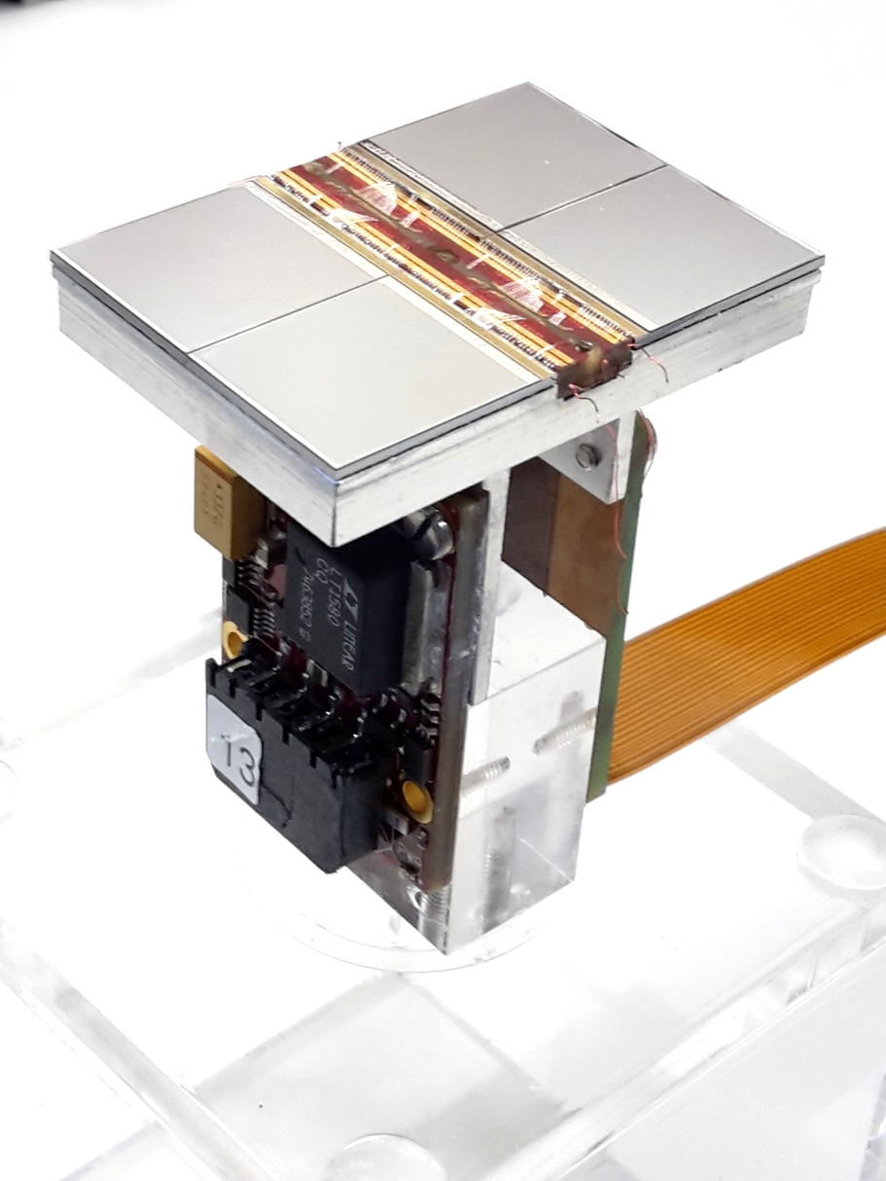
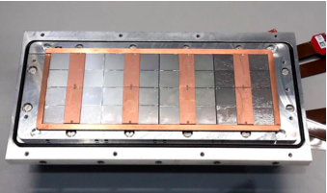
Pixel TPC
Single chip Quad Module TPC plane
2017 2018 2019

Slide 2
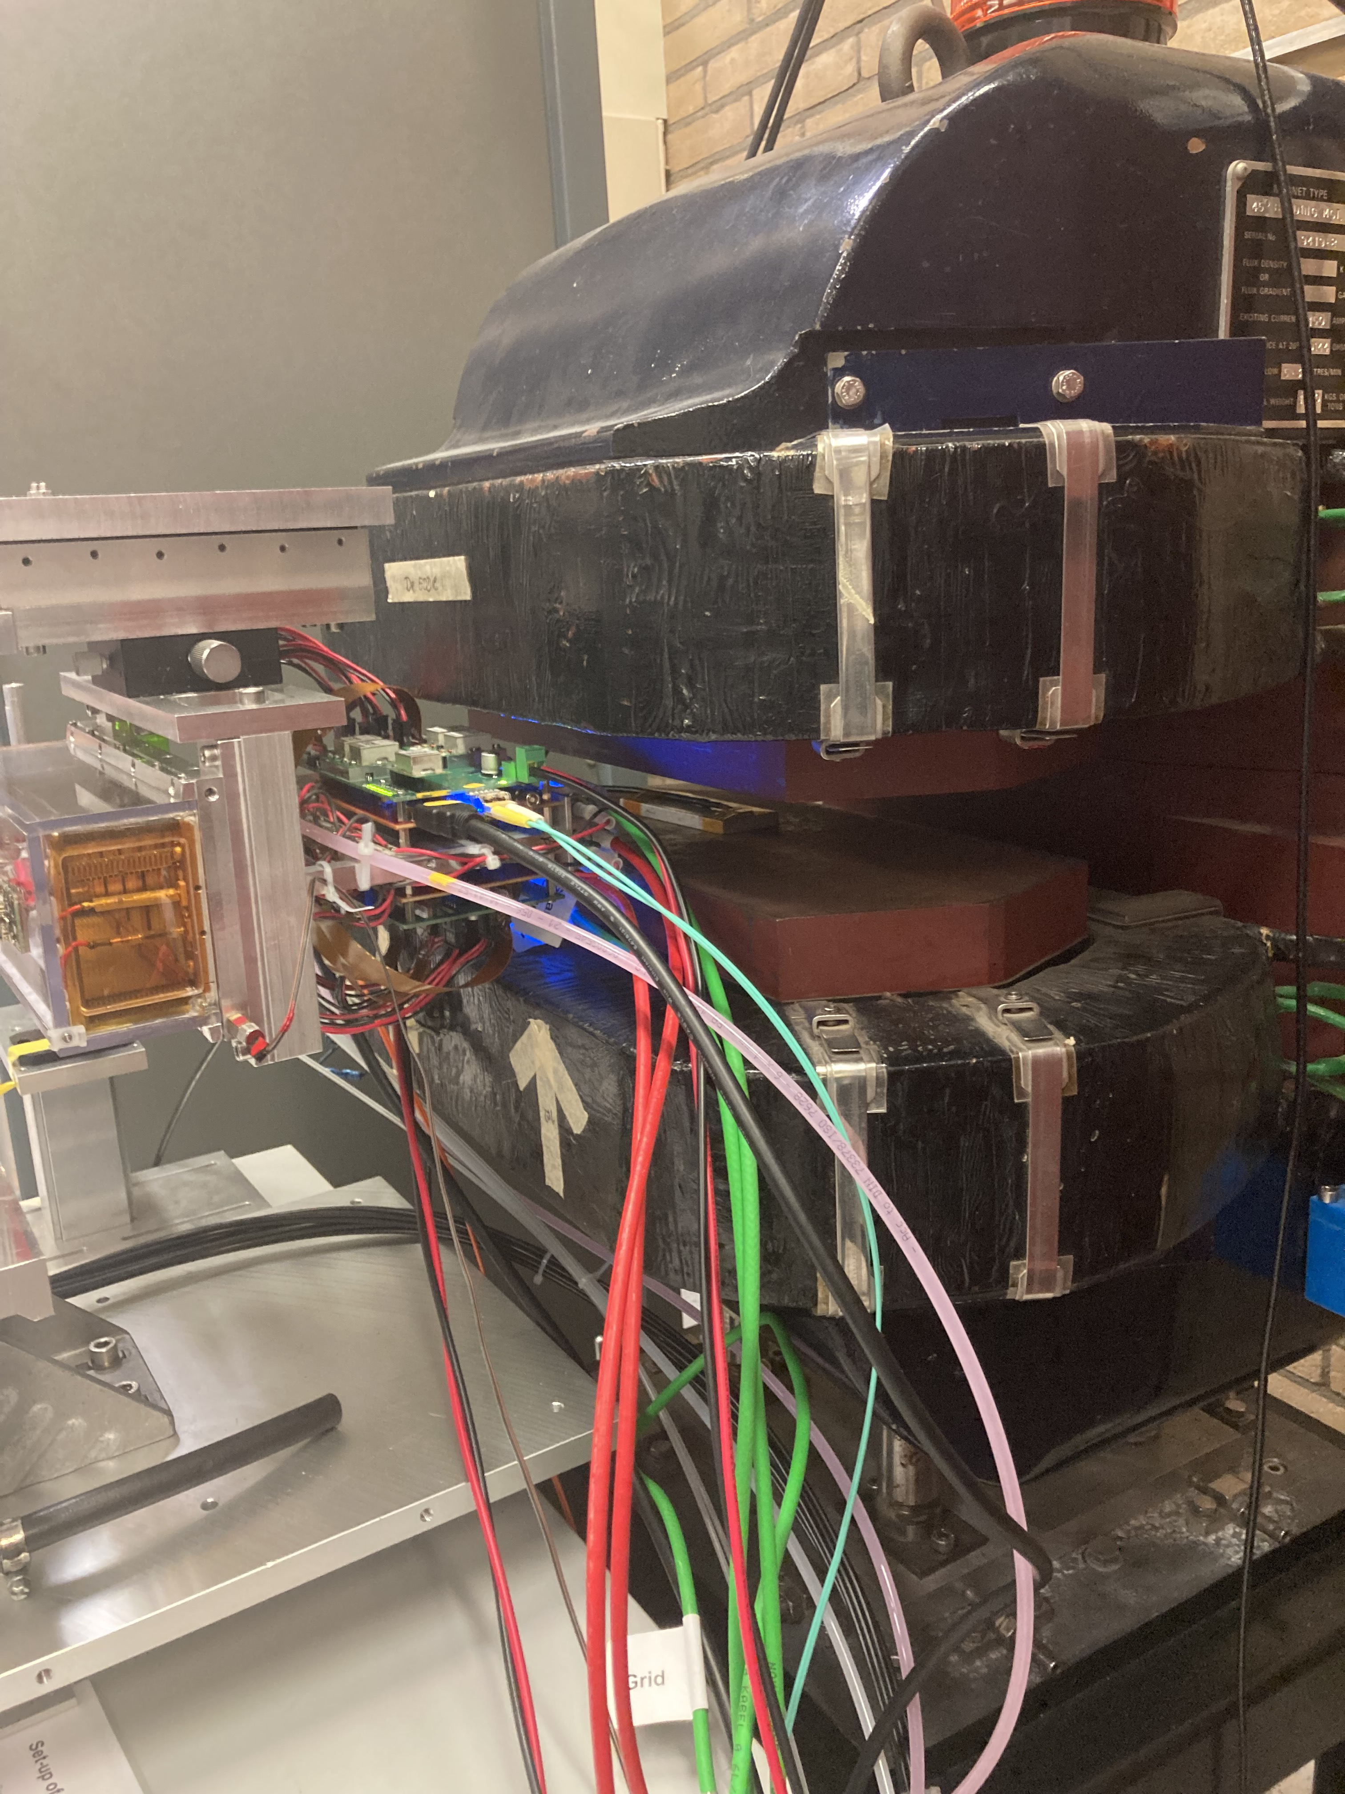
B field test of the concentrator
The magnet was powered with the help of Martin van Beuzekom. With Sander and Peter we took noise data at different field values.
First points was 0.25 T. All 32 chips could be read out, but the colling of the concentrators with the ventilator was ciritical to get all chips in the readout.
A final test was done at 1 T. There were no problems in the readout of the chips.
We concluded that the concentrators work properly in a magnetic field.

Slide 3
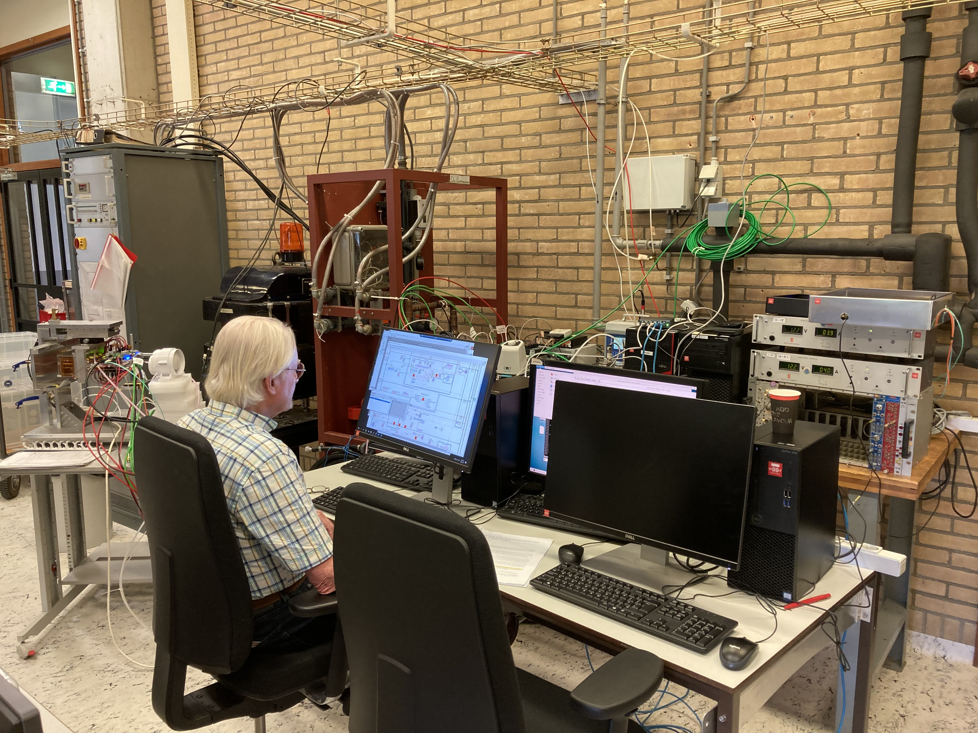
Remote desktop and data taking tests
SLOW CONTROLS
Windows
DAQ TPX3
Linux
DAQ Si
Linux
In hall
outside magnet
Si telescope
Levaard
arawana
Switch
Control room
Remote hut
PC-19-023
Elrits
Windows
Linux
HV, Gas, stager and
run control (tunnel to arawana)
SPDR controls (2)
DAQ running
root file production

Slide 4
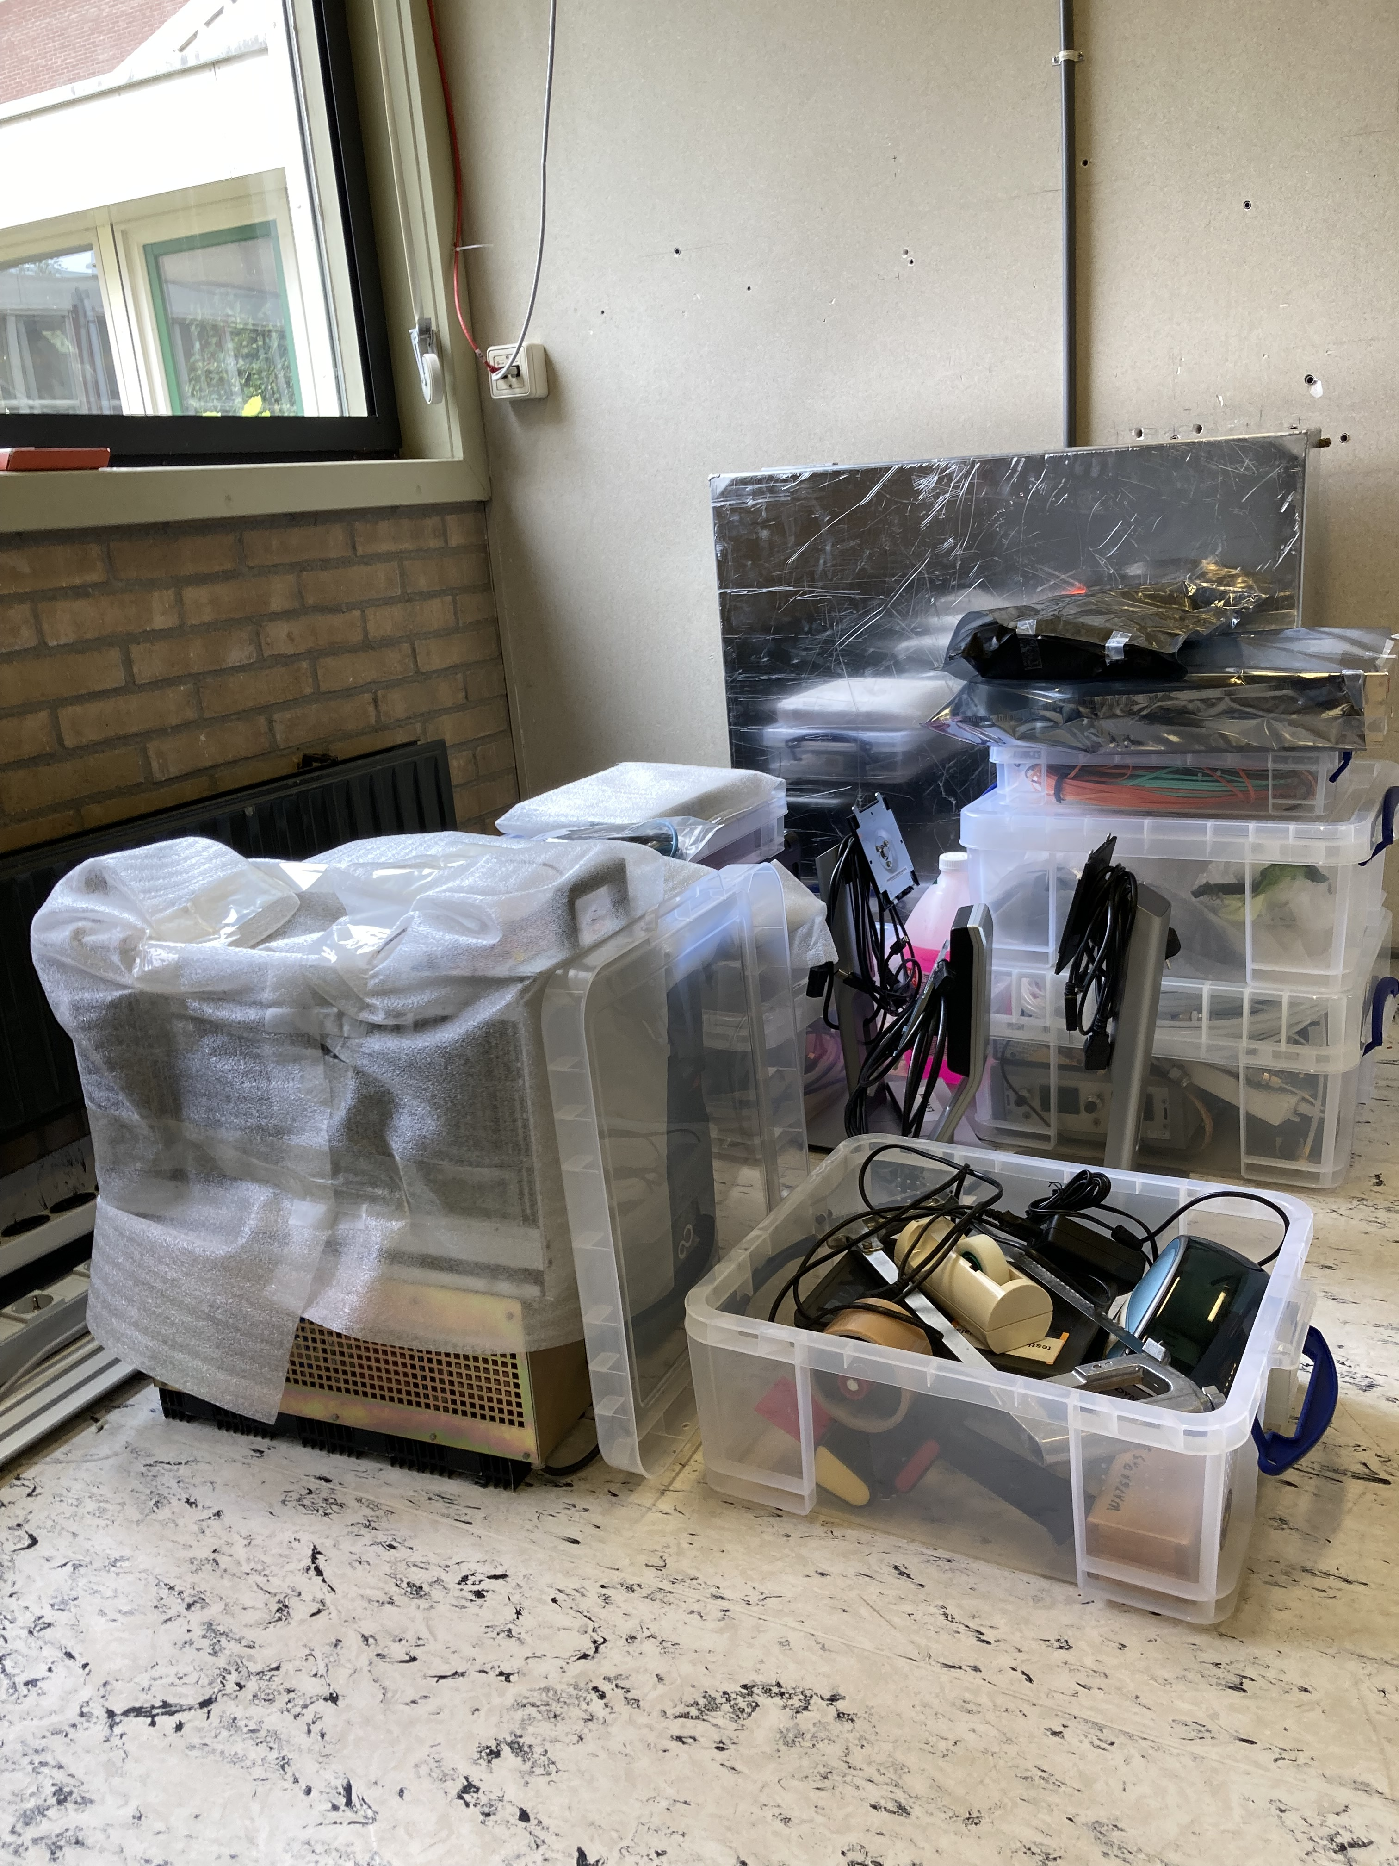
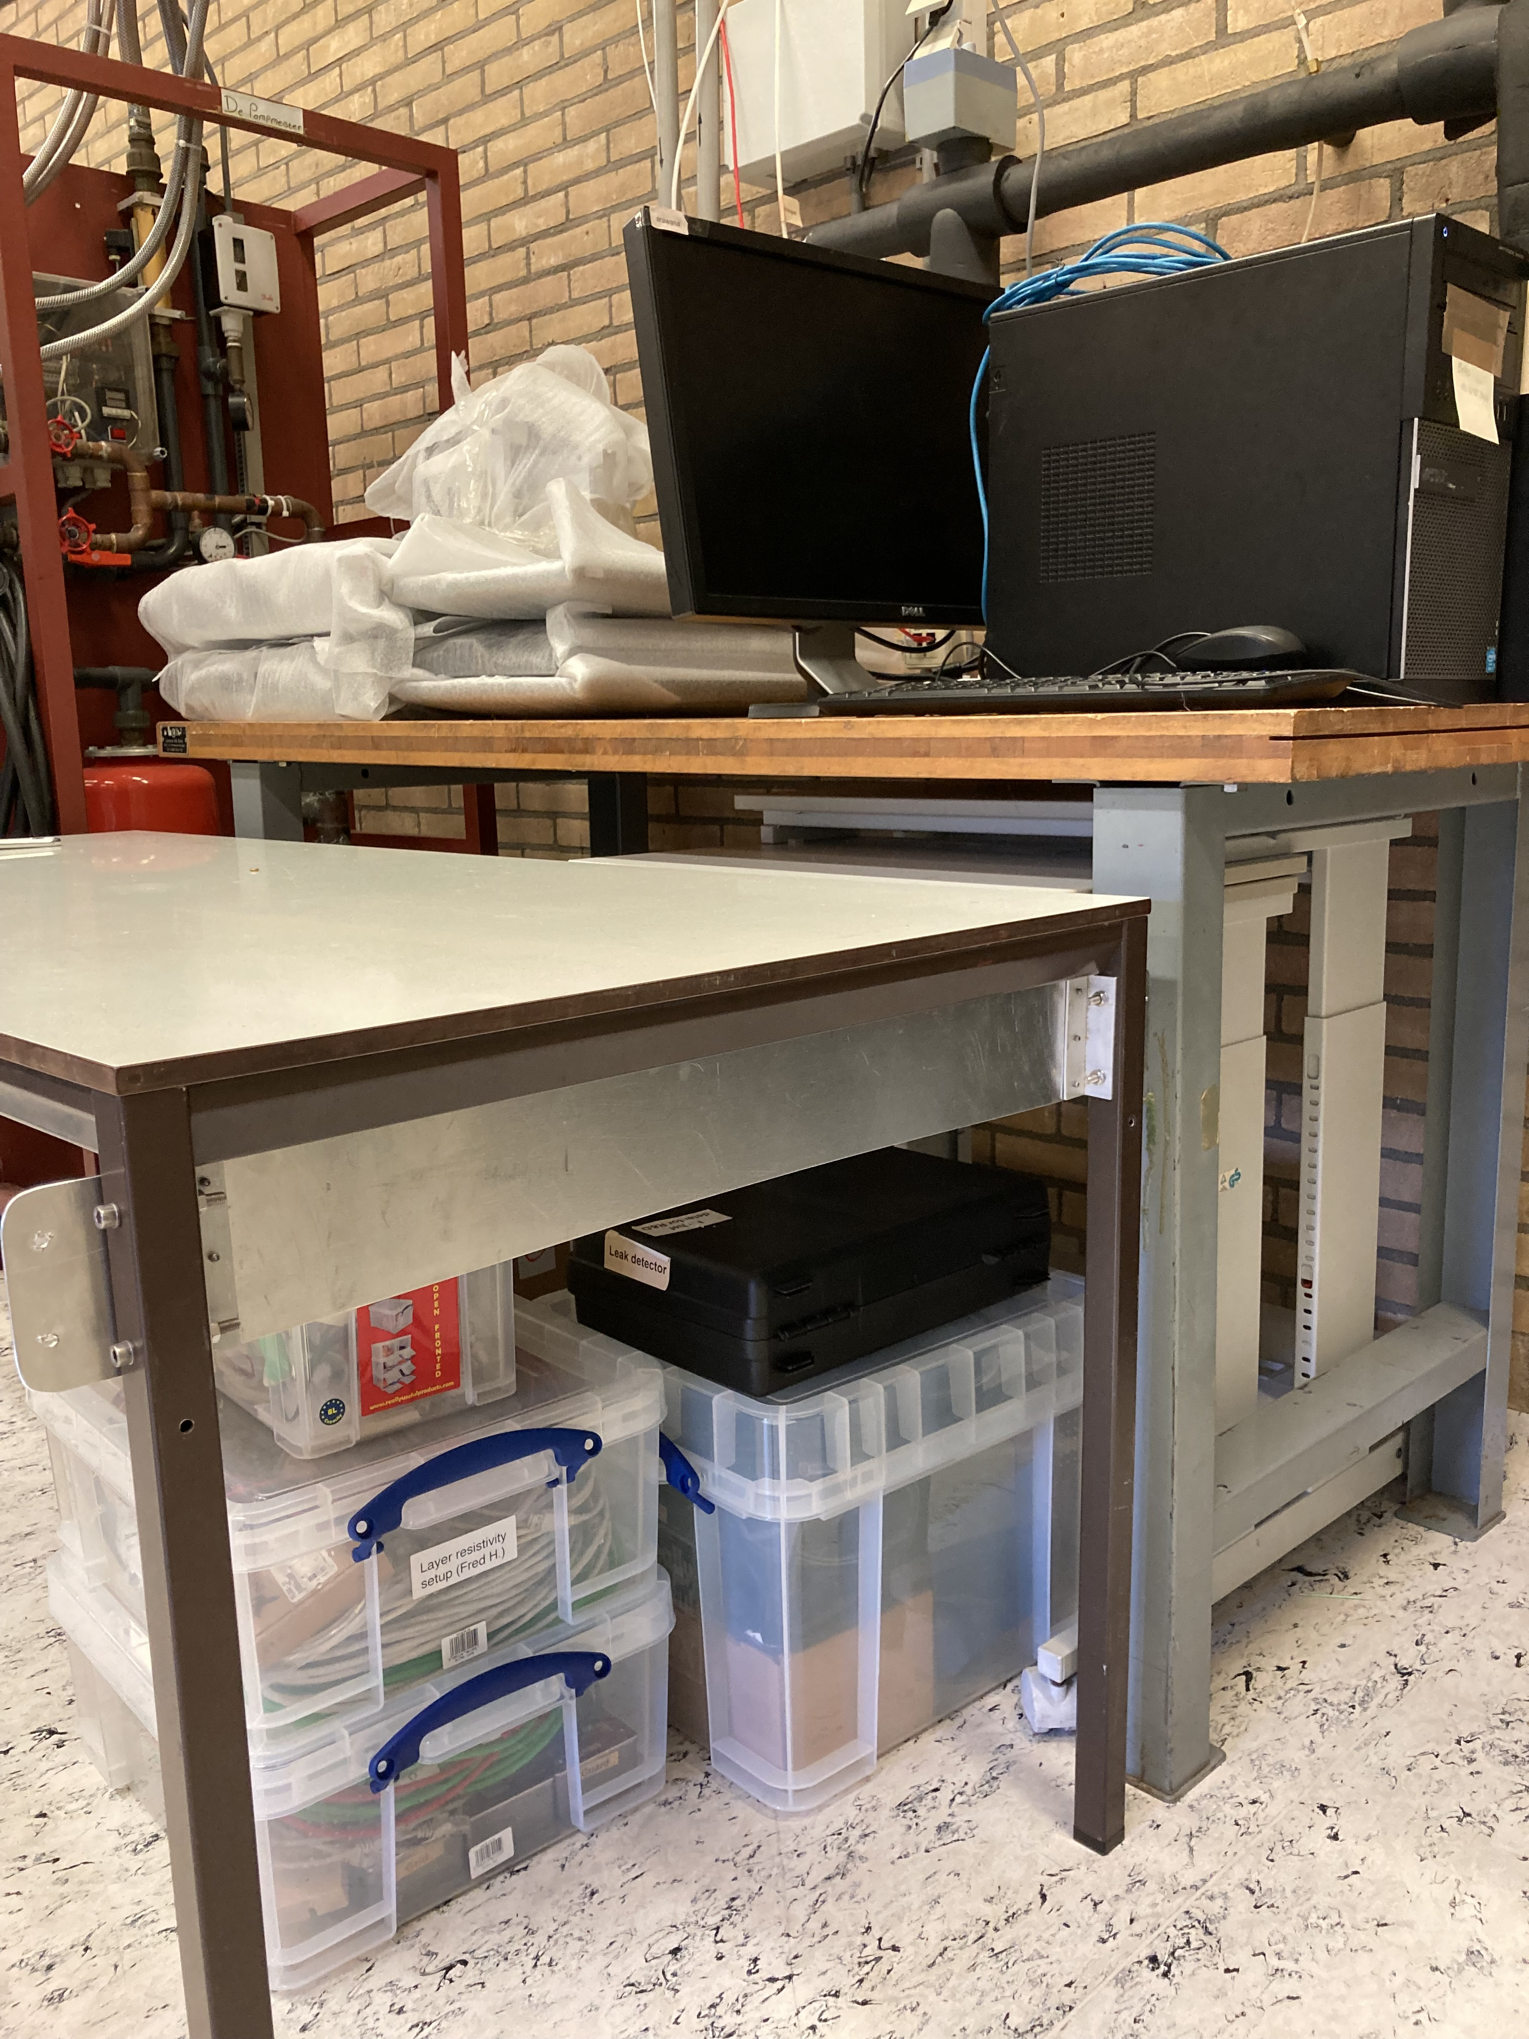
Packing of the equipment 5 & 12 June
All the equipment including detector, cables and computers are packed, assembled in boxes and wrapped in protective plastic.
Also spares and tools are packed. Elrits and arawana are still connected to the network and running and not yet packed.
The loading of the car (station wagen) will be done on 12 June.
Need to take with us the cooling (concentrator).

