Slide 1
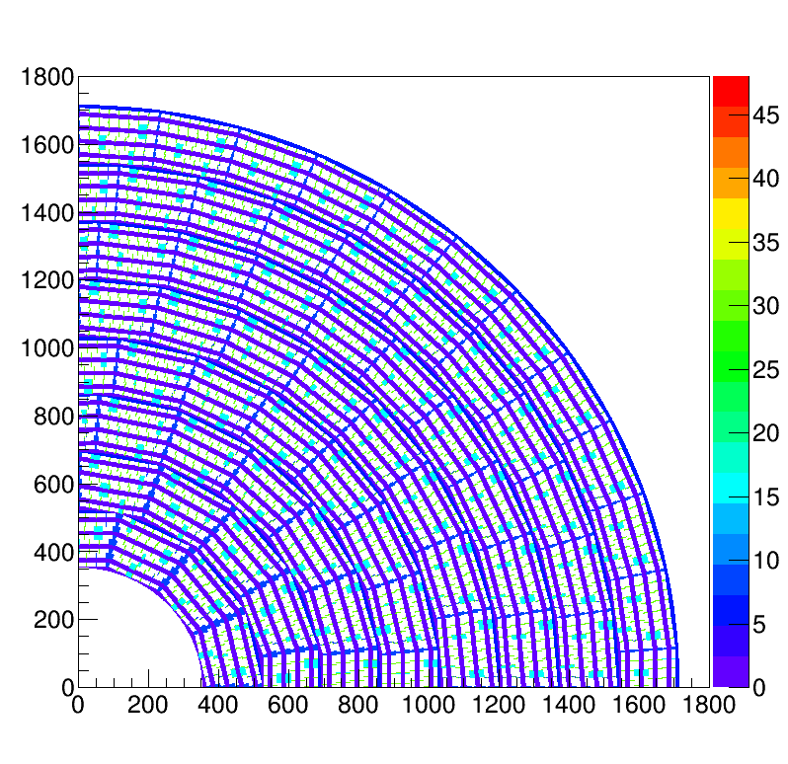
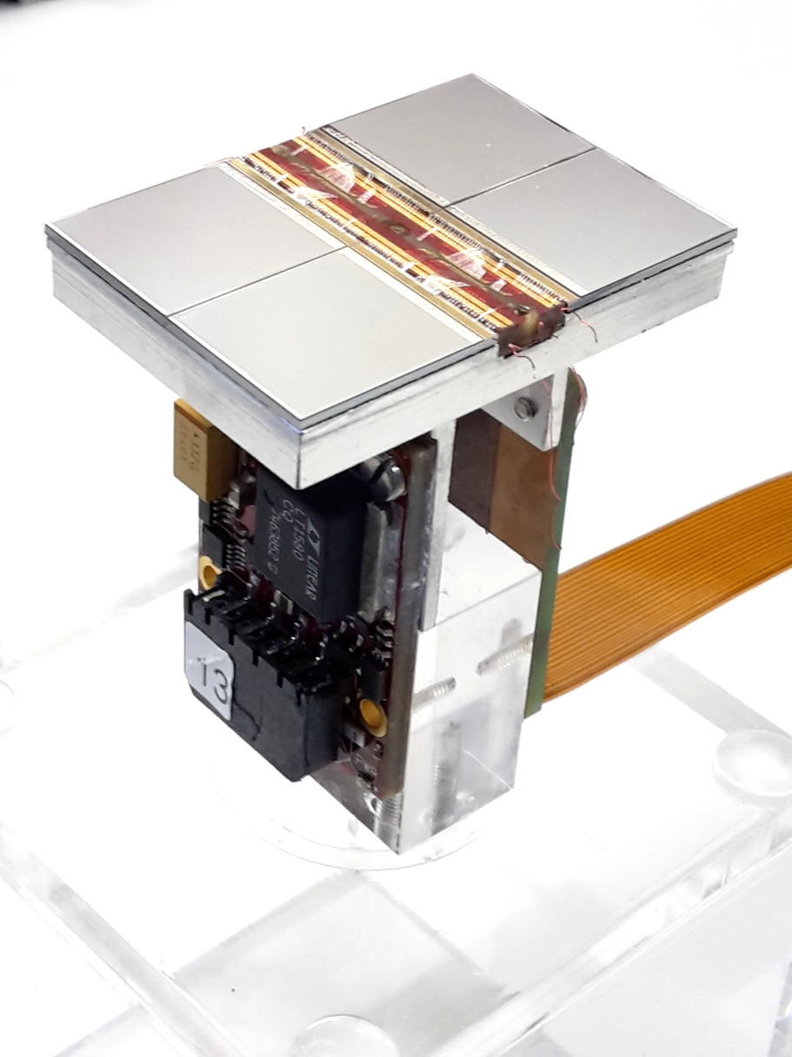
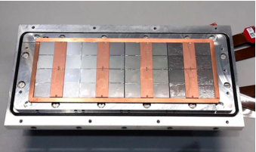
Pixel TPC
Single chip Quad Module TPC plane
2017 2018 2019

Slide 2
Organisation Test Beam DESY 13 – 28 June
- Assume that the Netherlands remains a risc zone.
For DESY a negative PCR test is sufficient.
If on Friday 11 June it changes to a high risc zone,
we must unfortunately cancel the test beam.
- Gerhard Raven, Peter Kluit, Jan Timmermans, Fred Hartjes, Harry van de Graaf
from Sunday 13 - 28 June
- Sander van Doesburg 13 - 21 June
Saturday 12 juni: negative PCR test with proof for DESY access
Sunday: arrival at DESY
Monday: @DESY 13h safety course, to get access to TestBeam area
9h fill in corona forms
Monday-Wednesday: building up of the experiment
Thursday and following days: commissioning, test and data taking
Bonn: Jochen Kaminsky from Sunday 13 June onwards

Slide 3
Update: Organisation Test Beam DESY 13 – 28 June
- We got permission for the Test beam at DESY from the Nikhef Director
- Each of us fills in a travel request
- Nikhef hires a car to transport the equipment (done)
- Peter has booked the DESY hostel for the LEPCOL Nikhef group LCTPC-PIX beam
- Saturday 12 juni: negative PCR test
- We have to register at: https://www.einreiseanmeldung.de/
and upload the negative PCR test (to avoid quarantine)
- We need a letter from Nikhef to state that this is necessary travel for work
- The safety course on Monday at 13h is booked for the Test beam
- Monday 9h we have to fill in the DESY corona forms

