Slide 1




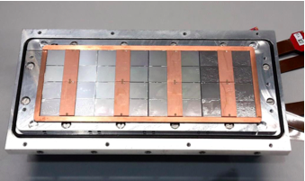



Pixel TPC
Single chip Quad Module TPC plane
2017 2018 2019

Slide 2
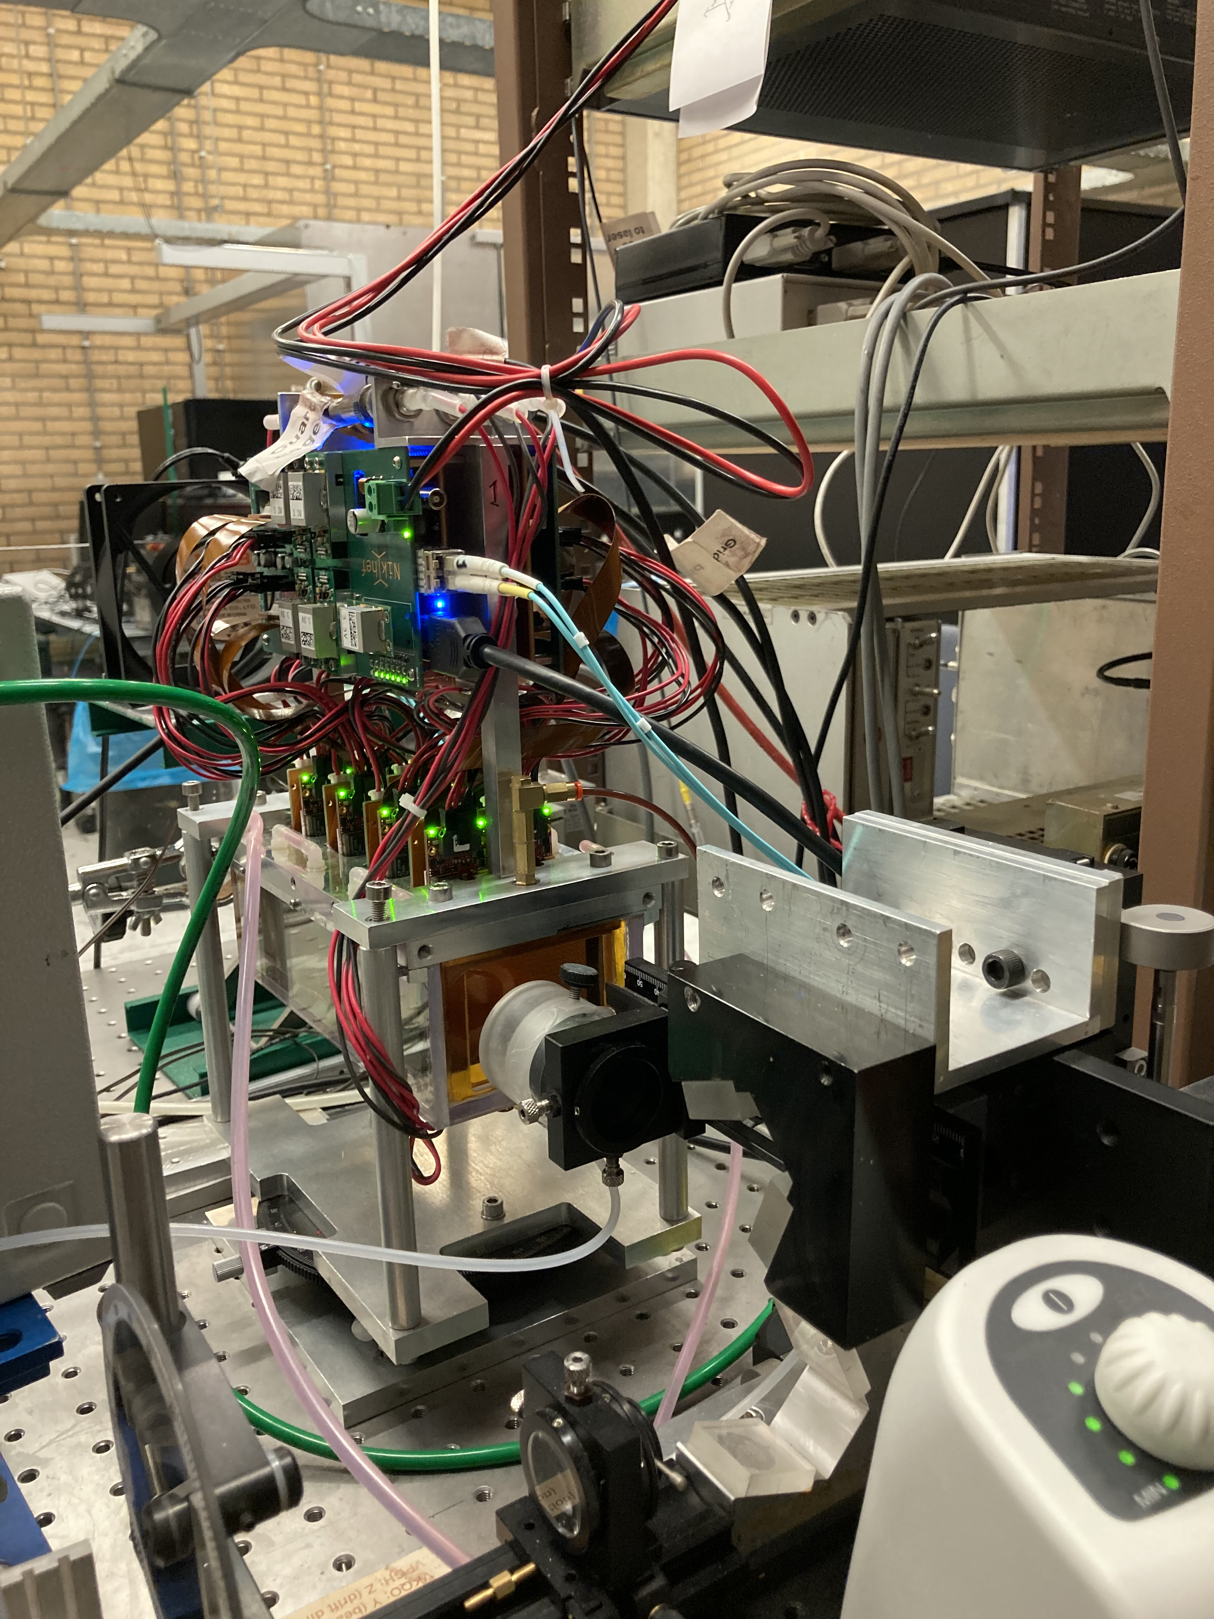
New Gas envelop
Here the 32 chip module in the new gas envelop
The entrance windows are 50 microns capton
The leak rate T2K is 1.3 ml/min: slightly better than the old box (2.5 ml/min).
The O2 level plateaus at 2 per mille. A bit higher than the old box.
A Sr is mounted on the stager
This allows to compare the Sr data taken 13 May with the old envelop with the new envelop
Runs 1831 V grid -340 V and 1832 at -346 V were
Scan of 7 mm steps

Slide 3
New Gas envelop
Old gas box
New gas box
Mean ToT
Concentrator 0 chip nr

Slide 4
New Gas envelop
Old gas box
New gas box
Mean ToT
Concentrator 1 chip nr

Slide 5
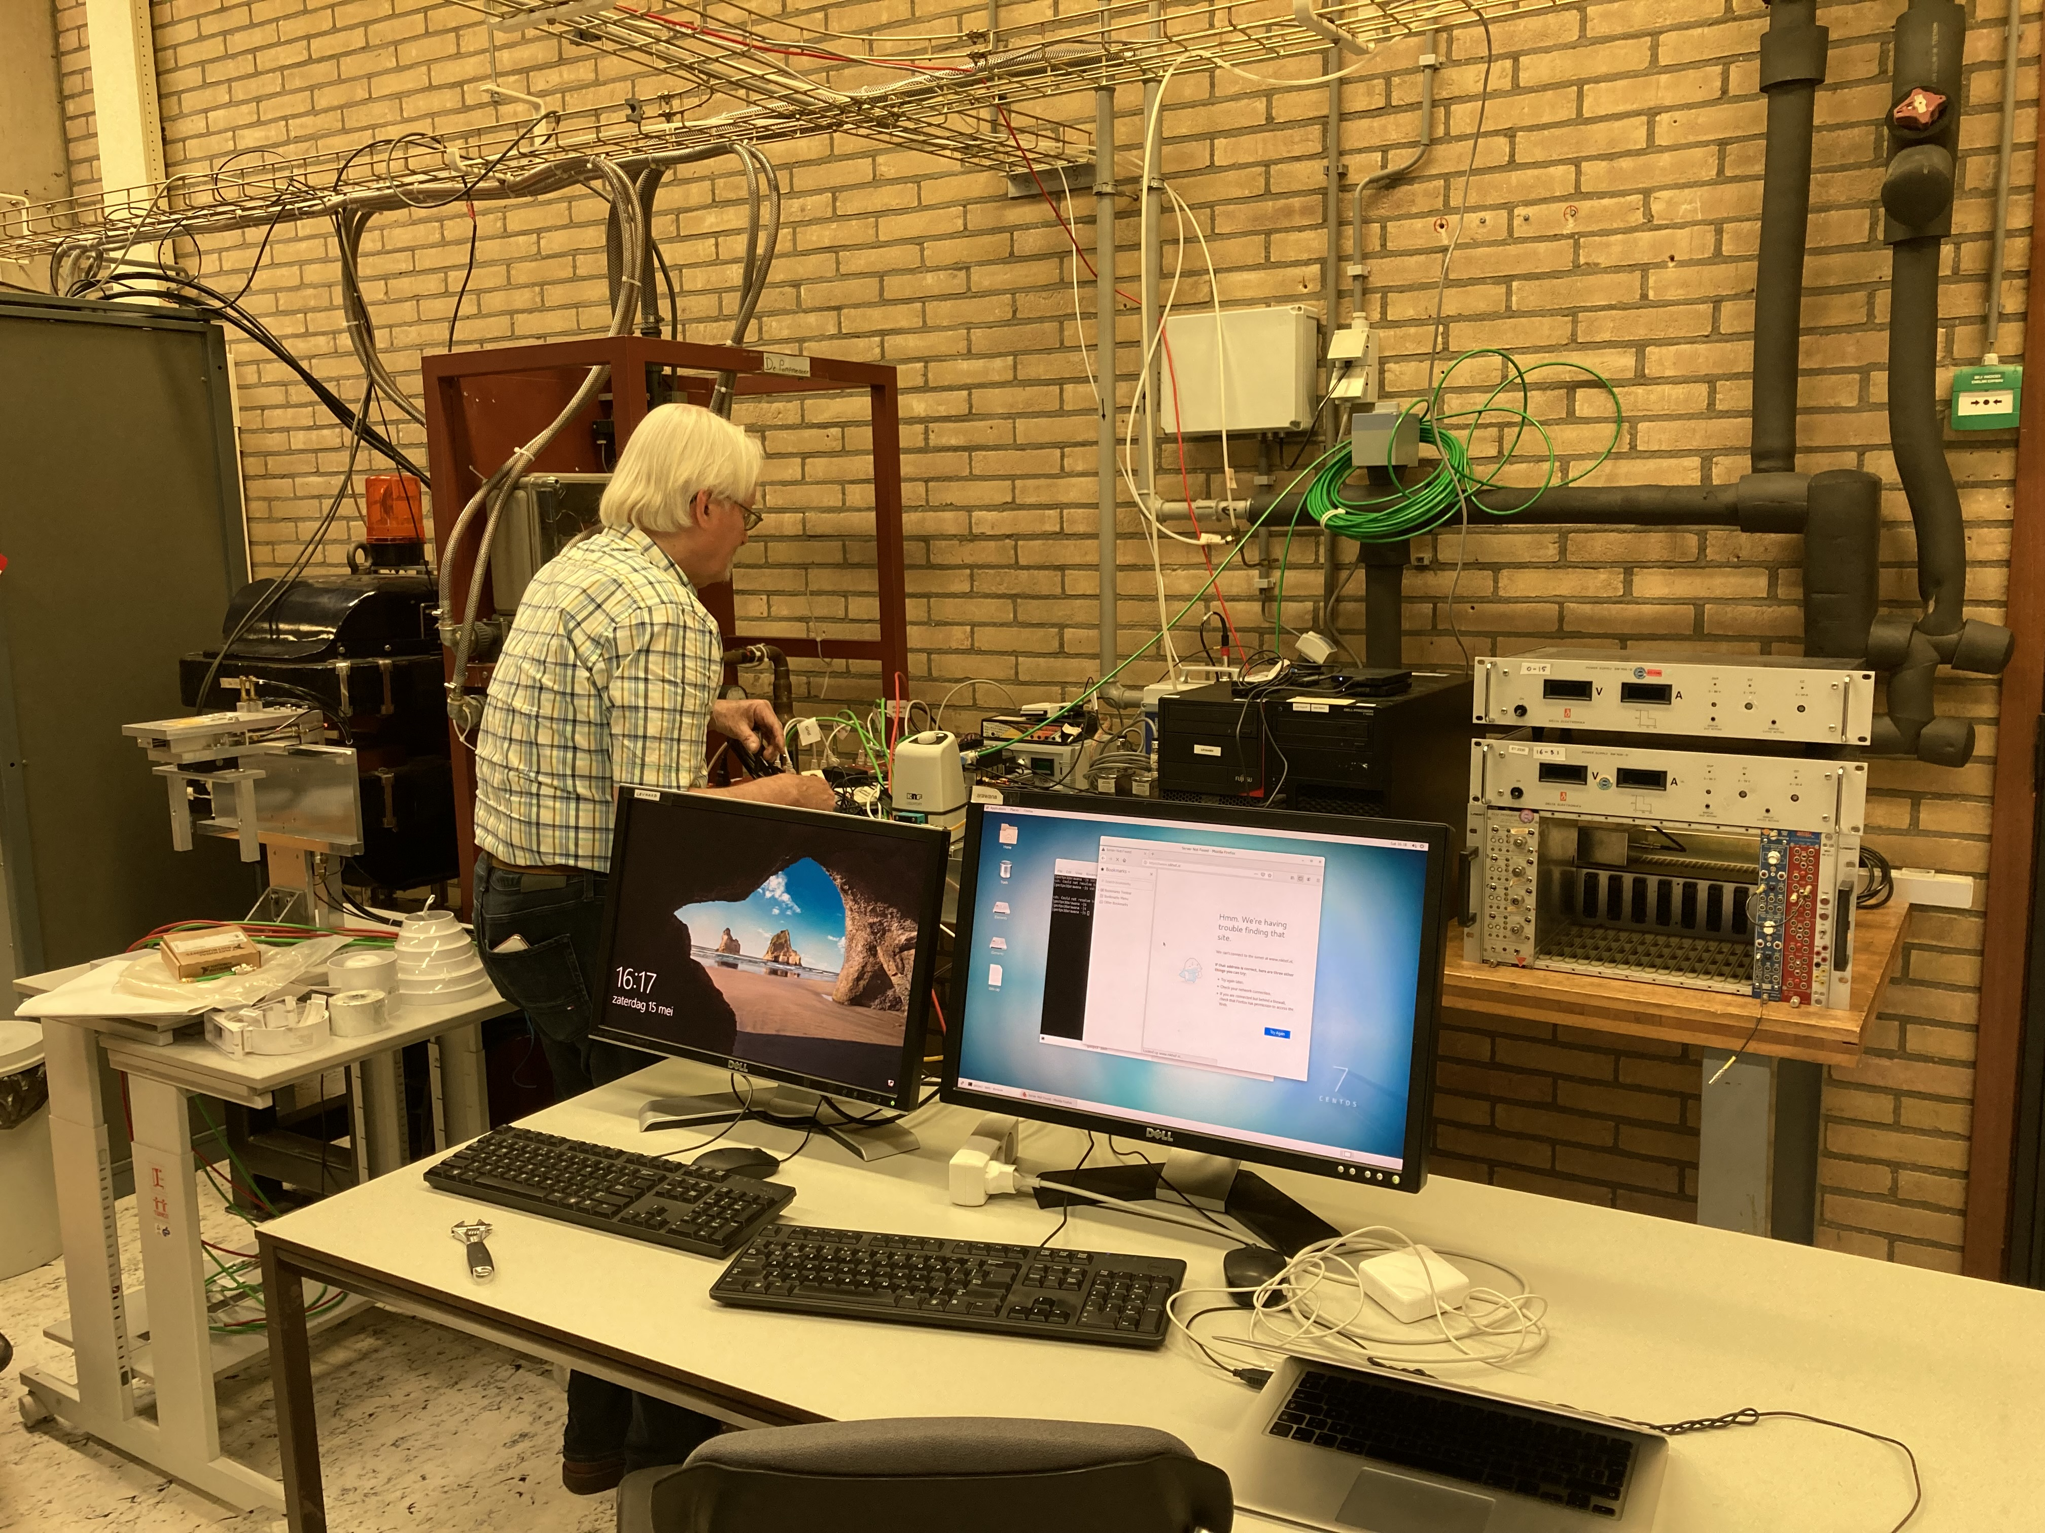
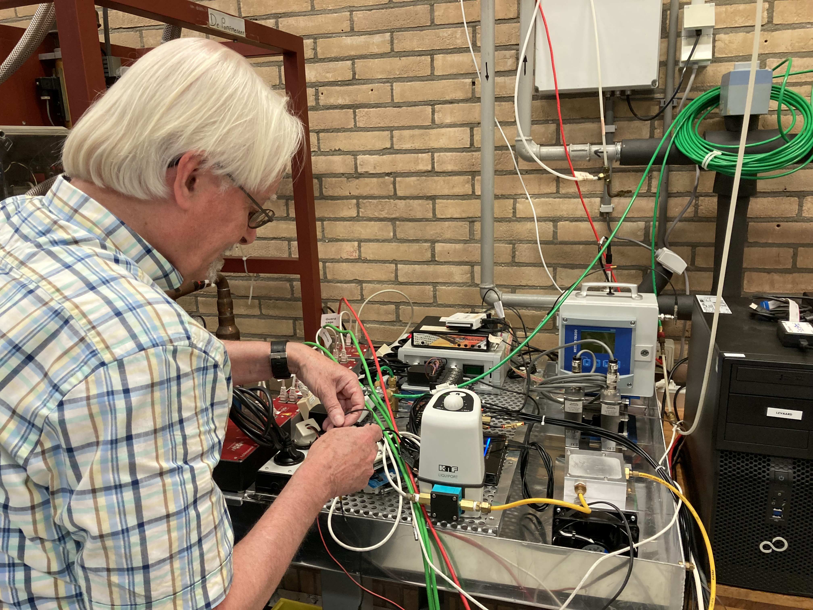
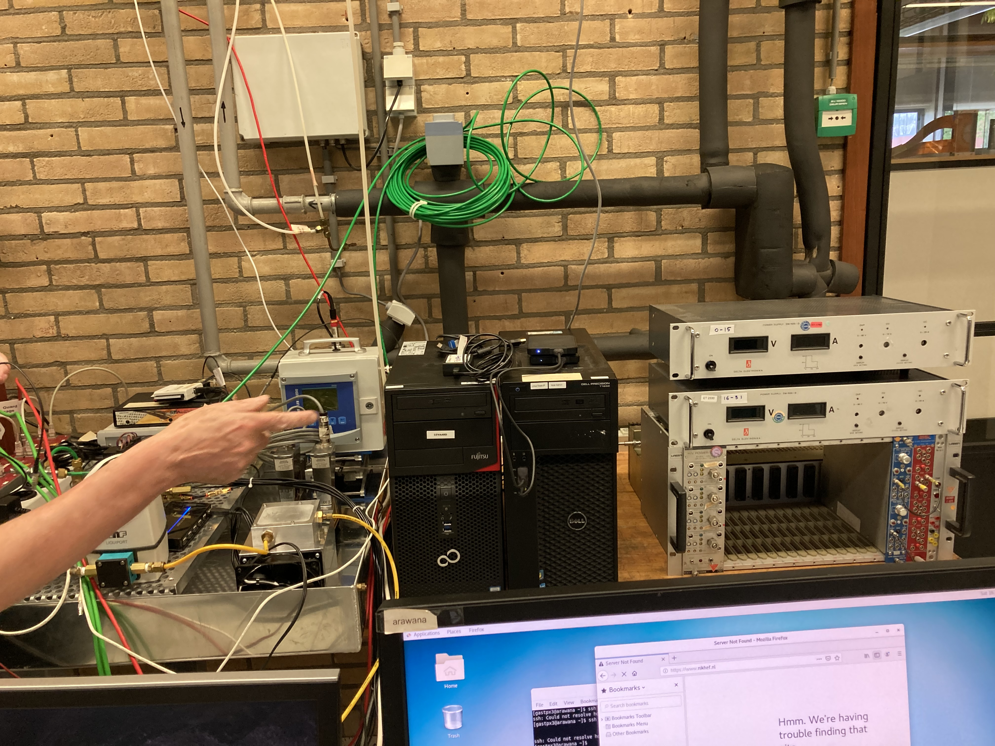
Mock up preparations 15 May
Most of the equipment from the laser set up is now moved to H039
The computers levaard, arawana, cooling, power suplies, NIM crates

Slide 6
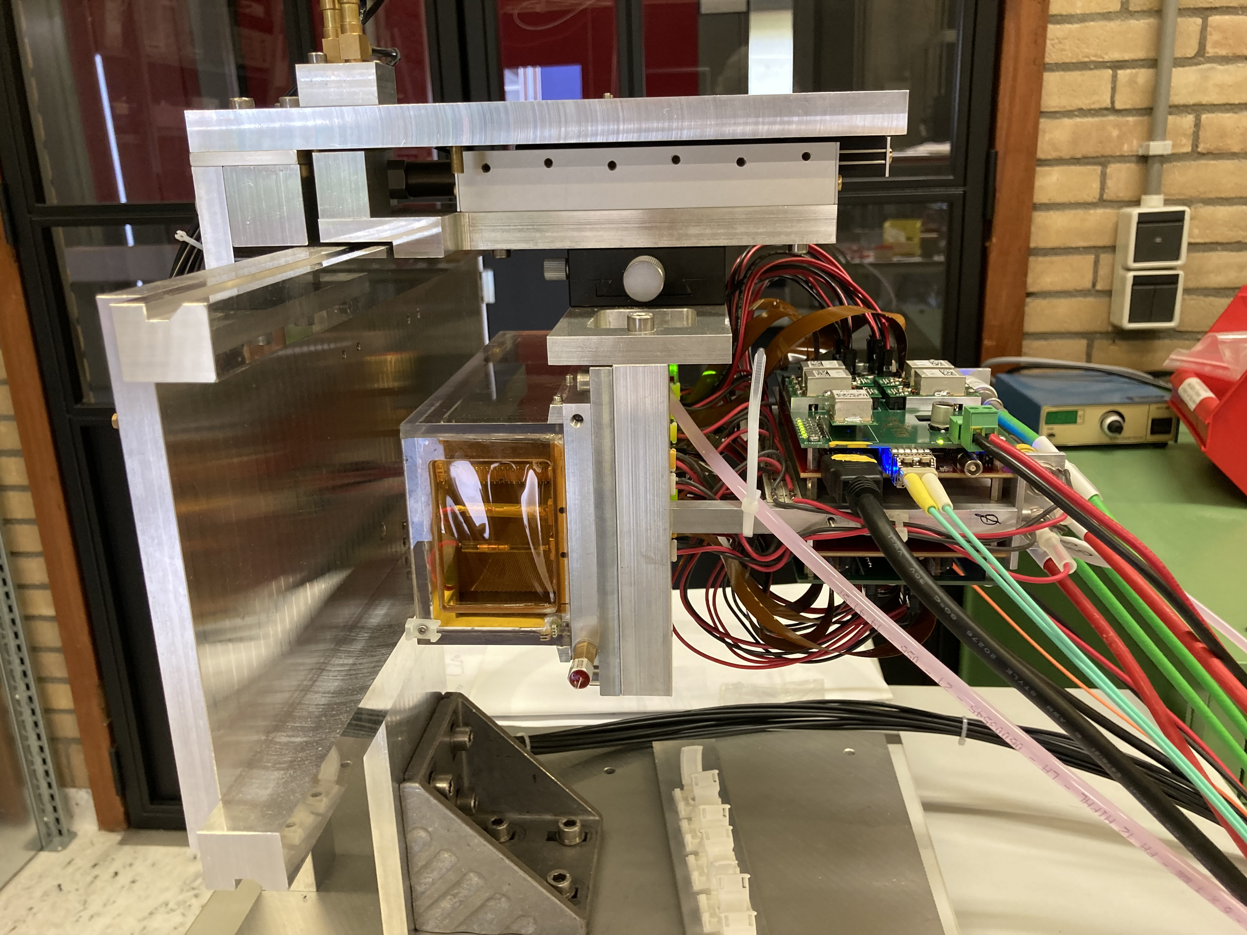
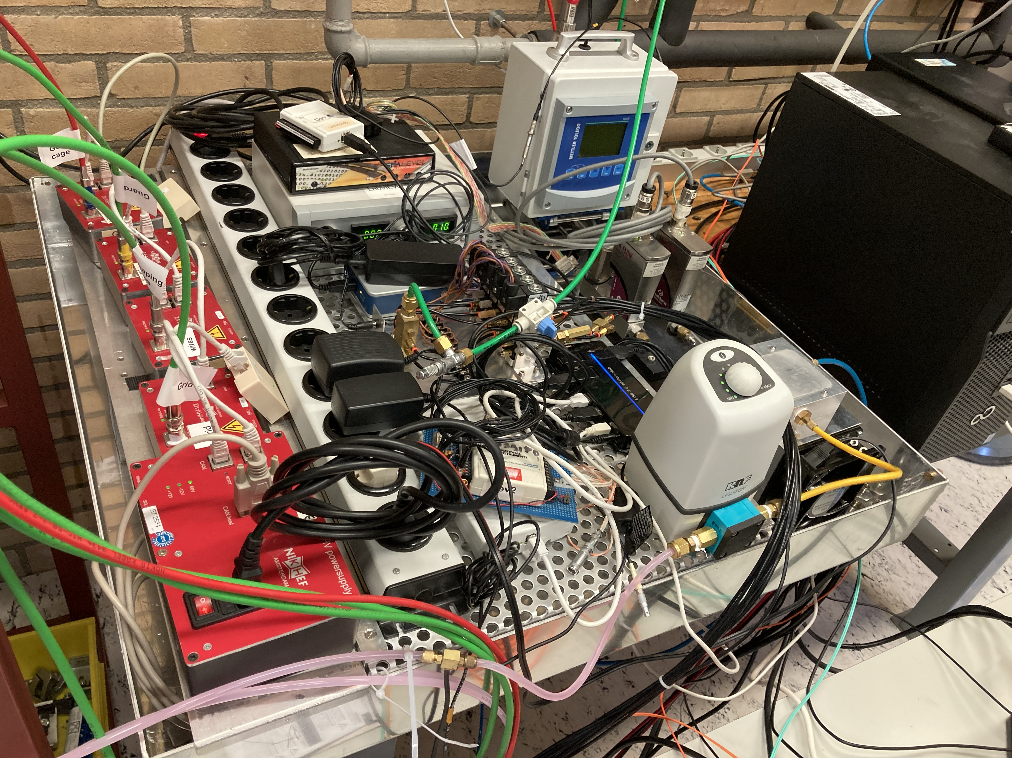
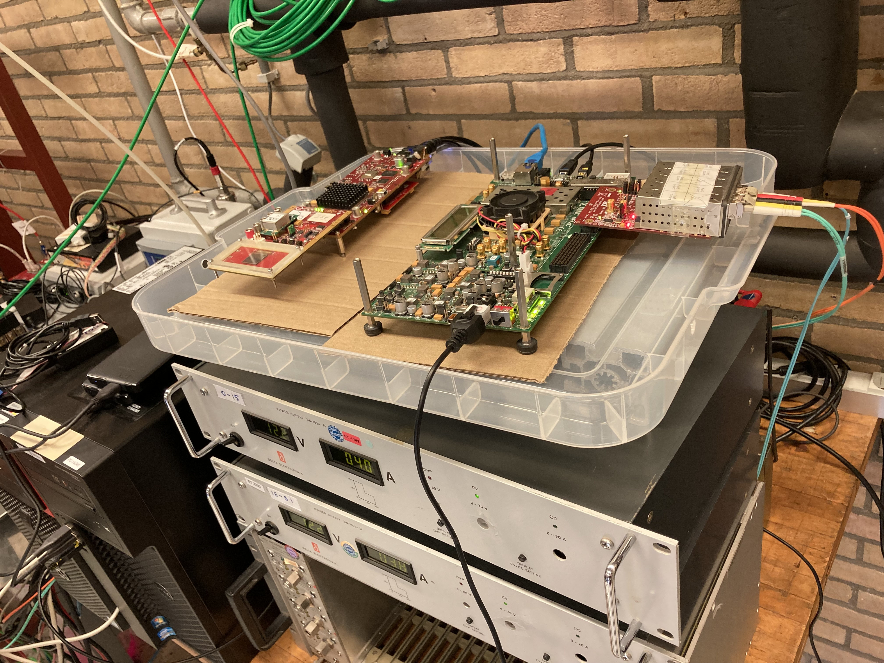
Mock up preparations 22-23 May
The detector is connected with 8 m long cables and mounted.
The detector cooling is installed and works; HV is connected.
The SPDR systems are powered and connected and the chips can
be read out.

Slide 7
Mock up preparations 25-27 May
The gas system also works. And we have taken succesfully data with a Sr 90 source.
The SPDR still have to be put in boxes and the cooling ventilator is now adhoc put near the concentrator.
The Levaard and arawana computers are connected to Gbit ethernet switch. Run control from levaard (to tunnel to the DAQ computer arawana) works. External hard disks 6 TB are ordered.

Slide 8
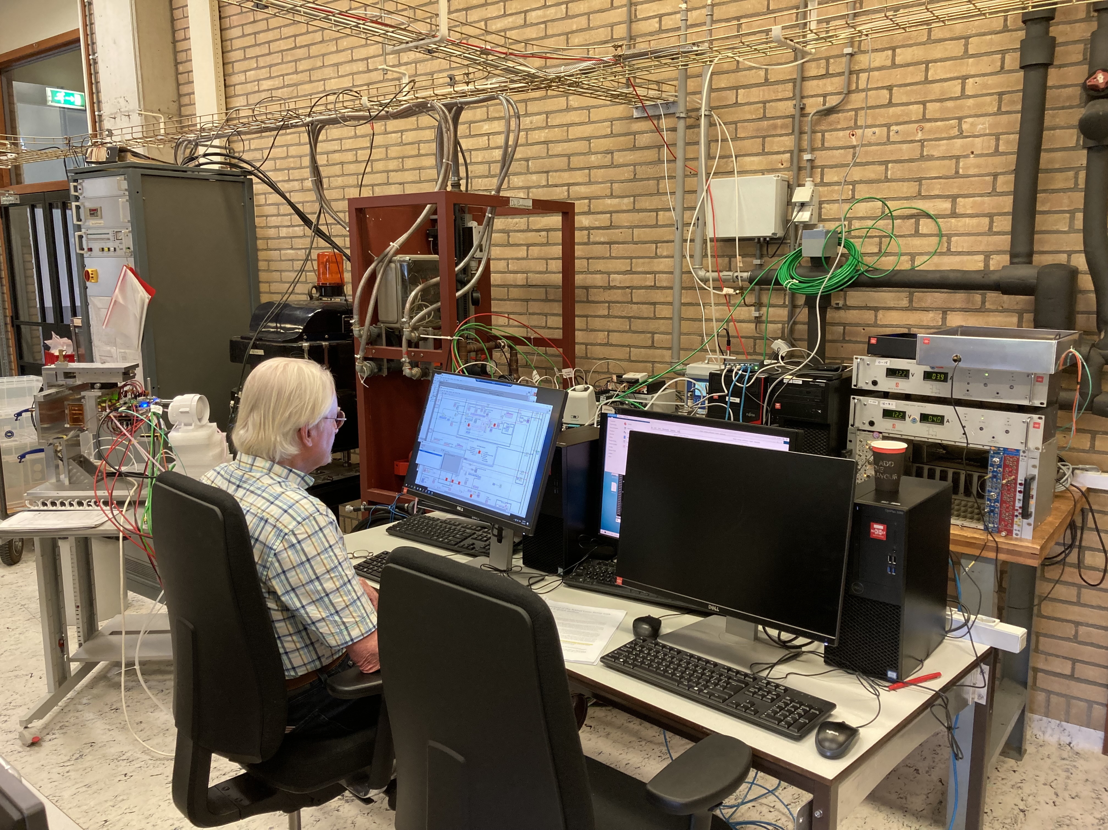
Mock up preparations 29 May
Remote desktop control (2 computers) and logging of the stage positions was tested on Saturday.
Next week we will then also switch on the magnetic field to check the operation of the concentrators.

