Slide 1
The WISE SCI Working Group David Kelsey (STFC-RAL, UK Research and Innovation) 25 May 2021
Wise Information Security for collaborating e-Infrastructures
In collaboration with and co-supported by EU H2020 EOSC-HUB, GN4-3 & EGI-ACE
https://wise-community.org

Slide 2
A Trust Framework: Security Collaboration among Infrastructures (SCI)
Infrastructures are subject to many of the same threats
Shared technology, middleware, applications and users
User communities use multiple e-Infrastructures
Often using same federated identity credentials
Security incidents often spread by following the user
compromised credentials
e-Infrastructure security teams need to collaborate
Trust is required

Slide 3
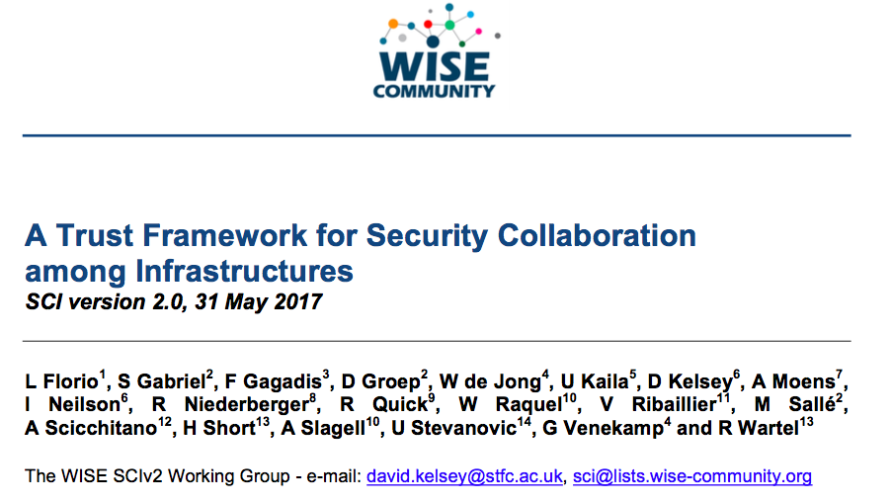
SCI Version 2 – published 31 May 2017

Slide 4
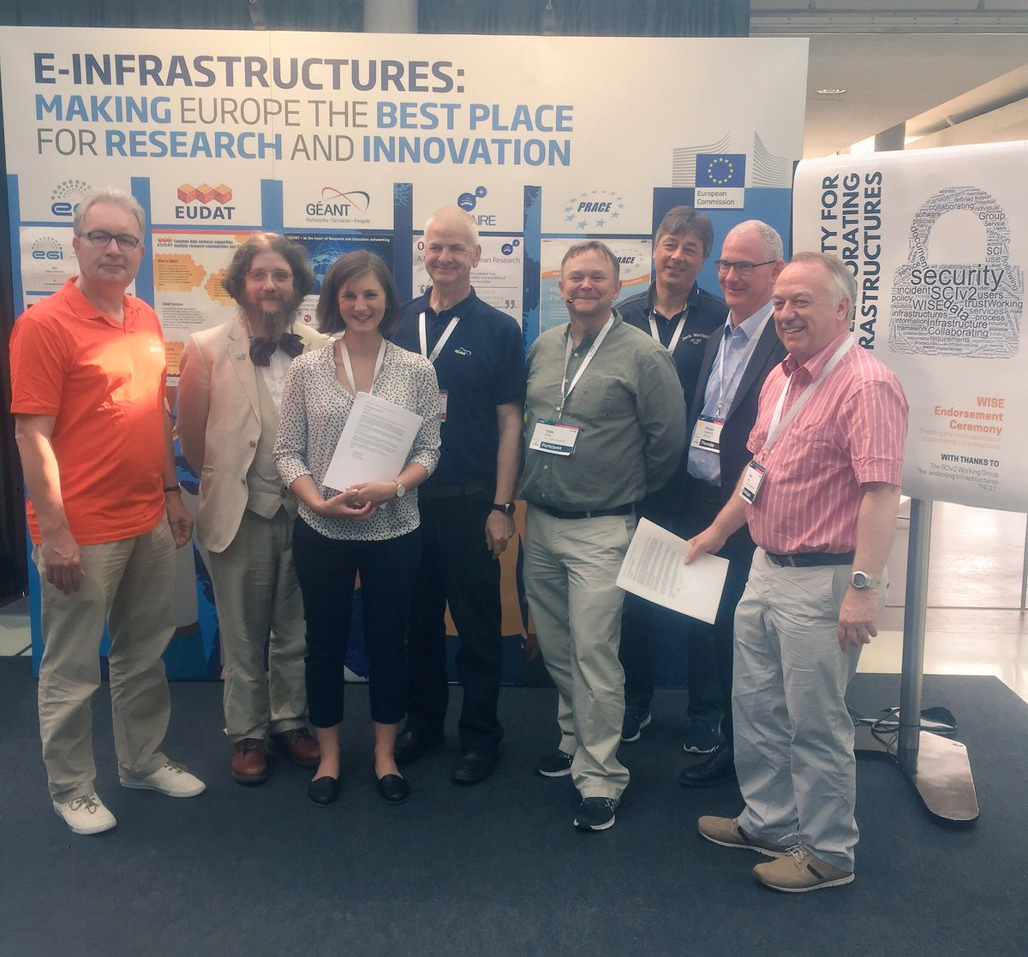
Endorsement of SCI Version 2 at TNC17 (Linz)
1st June 2017
Infrastructures endorse the governing principles and approach of SCI, as produced by WISE, as a medium of building trust between infrastructures, to facilitate the exchange of security information in the event of a cross-infrastructure incident, and the collaboration of e-Infrastructures to support the process. These Infrastructures welcome the development of an information security community for the Infrastructures, and underline that the present activities by the research and e-Infrastructures should be continued and reinforced
Endorsements have been received from the following infrastructures; EGI, EUDAT, GEANT, GridPP, MYREN, PRACE, SURF, WLCG, XSEDE, HBP
https://www.geant.org/News_and_Events/Pages/supporting-security-for-collaborating-infrastructures.aspx

Slide 5
WISE/SCI in 2021 (presented Oct 2020 WISE)
3 active SCI-WG sub-tasks
Policies and procedures developed by SLATE (Edge services)
Complete the HowTo Guidance on maturity assessment
& encourage Infrastructures to perform self-assessment
Produce updated policy templates from the AARC Policy Development Kit
Since Oct 2020, work has continued on all 3
But within the projects leading activity
SCI-WG met again on 10-May-2021
Today we will hear an update from the 3 sub-tasks
Then take the work forward in the SCI-WG

