Slide 1
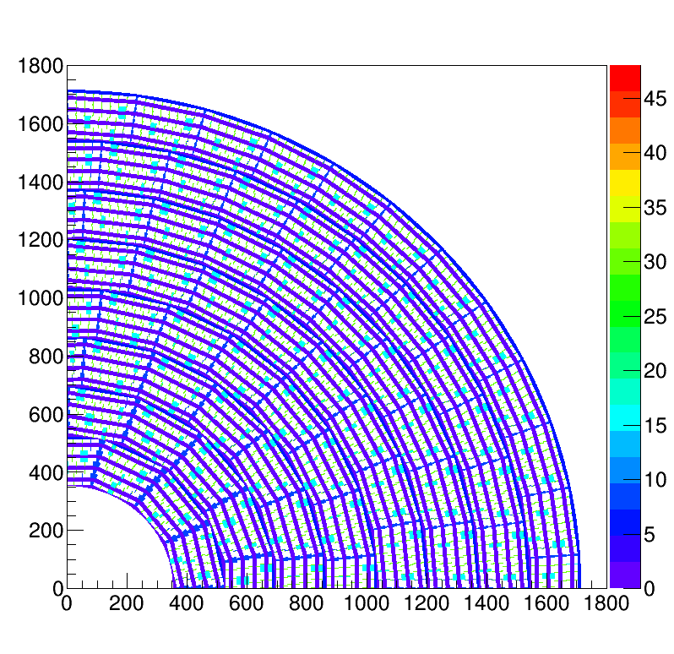
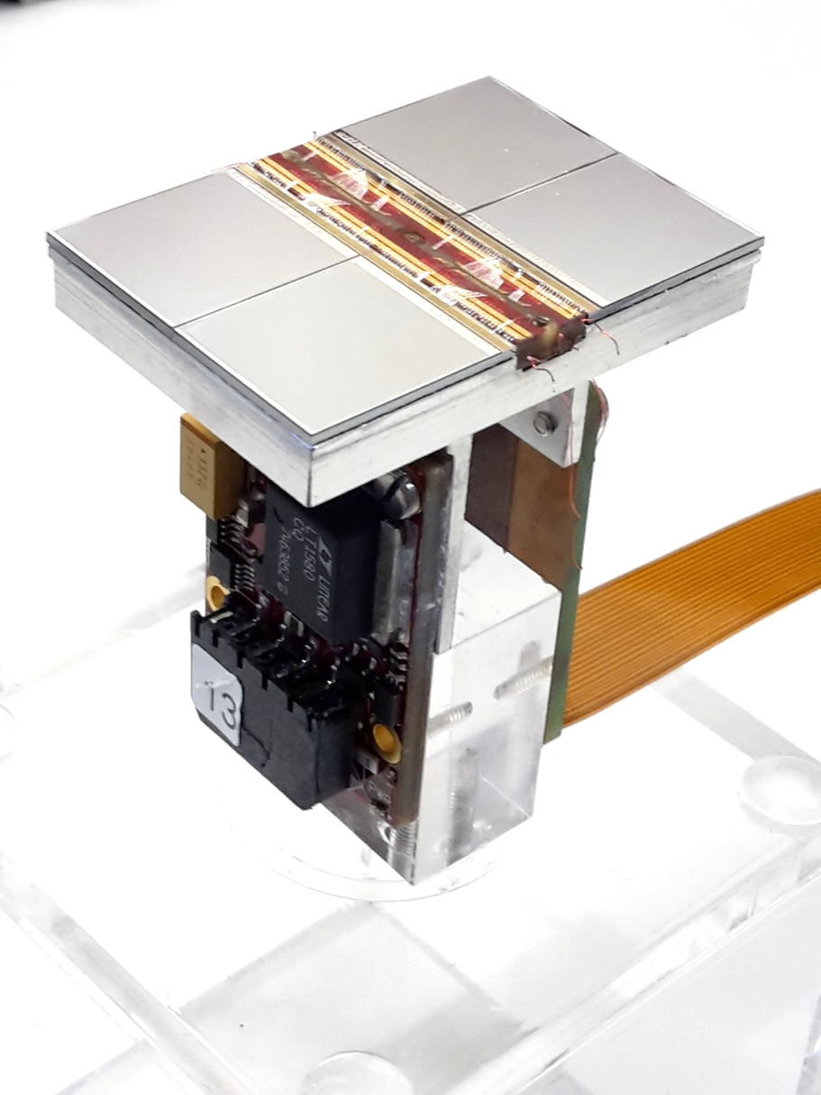
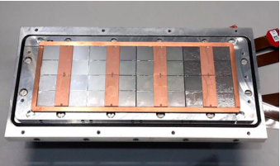
Pixel TPC
Single chip Quad Module TPC plane
2017 2018 2019

Slide 2
The full module with 32 chips
The problem of noise/not good data.
After many trails seaching for a noise/background source, we concluded that gas bottle had been exchanged since 2 April and that since then we had noise, backgrounds en no good laser data.
Fred changed the gas bottle on 5 May and we carefully studied the grid and field potentials. Now we can successfully run with the new gas bottle and run with V grid 340 V and V drift of 350 V/cm.
One problem is still with us: chip 15 from concentrator 1.
It often falls out of the readout or is in the readout but produces huge datafiles with header 0. On 8 May we had to mask this chip (ALL Pixels) because it did not produce sensible data and flooded the data stream.
It is very likely that the timing of the concentrator for this channel is problematic. All the symptoms are similar as for the channels that were fixed by a timing adjustment (see Sander his presentation two weeks ago).

Slide 3
The full module with 32 chips
We studied the mean ToT values for the different chips. And lowered the threshold by 5 (3) cnts on the chips with low ToT on concentrator 1 (0). This helped a bit the ToT increased with 1 unit (25 ns).
This is not sufficient. The noise level in these chips increases.
Link0 Chip nrs 8 10 11 with -3 DACs
Link1 Chip nrs 12 13 14 15 with -5 DACs
On the 8 May we studied the impact of a higher grid voltage (350 in stead of 340 at 1015 mbar)and this really helped significantly.
There were some spikes in the grid current 5 nA each 10 minutes, but after a few hours of running this calmed down.
Due to the higher gain, the mean ToT values have increased.

Slide 4
The full module with 32 chips
On the 8 May we took 1 mm step scans without chip 31:
With a 25 mm moved detector
run 1811 at z = 37 mm (near the grid)
run 1812 at z = 7 mm (near cathode)
With the standard position
run 1820 at z = 37 mm (near the grid)
run 1821 at z = 7 mm (near cathode)
These data will allow to make a (deformation) “3D” field map of the detector.
The data taken with standard position near the grid or not OK for link 0 because the laser was below grid (run1820_0).
For data taken with moved detector near cathode the laser spots are not visible
Ouside the sensitive region (run 1812_0).
As a consequence only part of the laser scan is usefull.

Slide 5
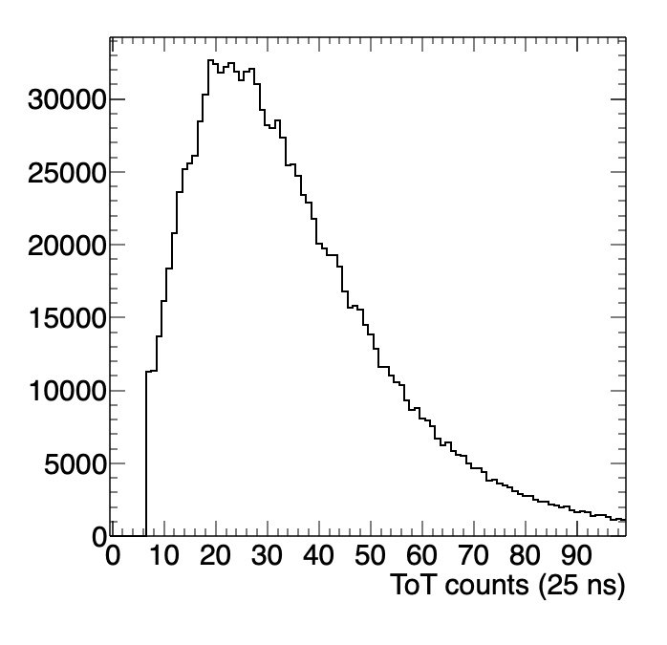
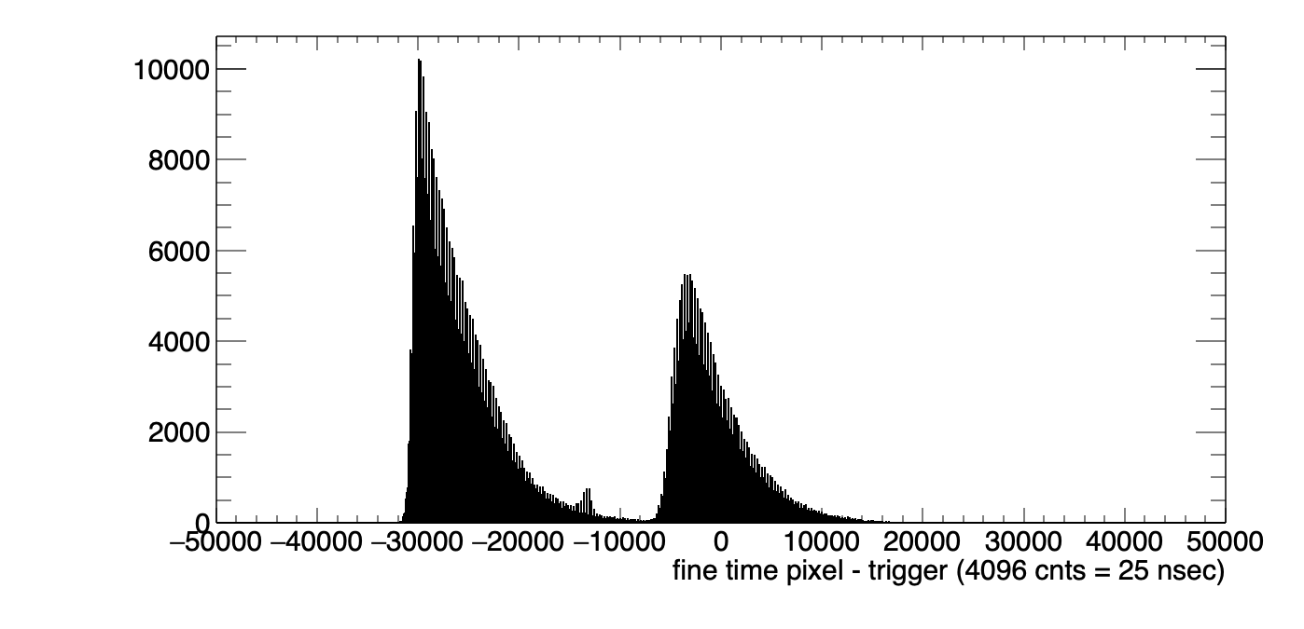
The module with 31 chips
Runs 1811-1821
Two peaks from cathode and grid

Slide 6
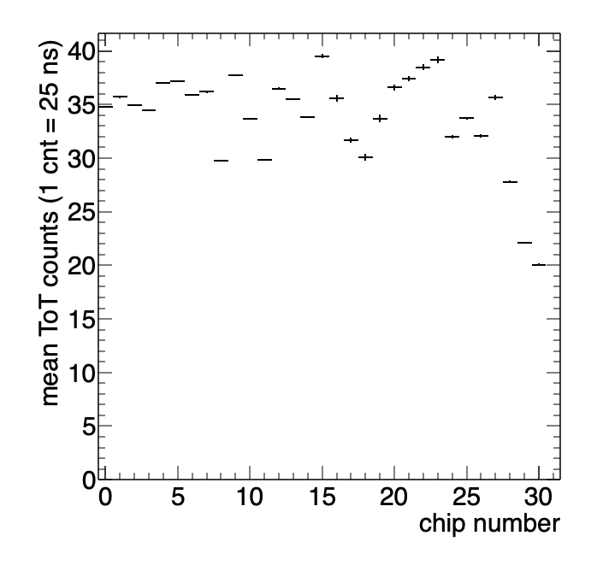
The module with 31 chips
chip 31 is missing
Chips 29 and 30 have a lower ToT

Slide 7
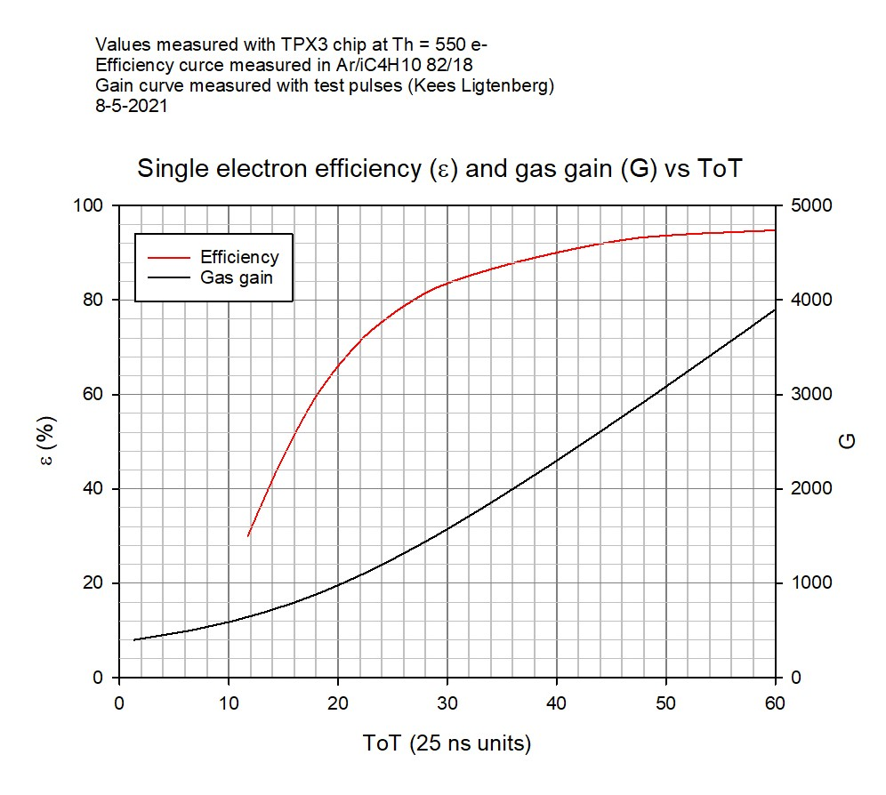
The Tot and efficiency
NB Tot = 20 ε = 65%
30 ε = 80%
40 ε = 90%
So single electron efficiencies for the module vary between 65 and 90%.

Slide 8
Preparations DESY testbeam 16 June 2021
With Fred we gathered several pieces of equipment needed for the mock up and put it on the tables in H039. We did this outside working days 27 April, 5 and 8 of May.
An inventory of missing about 10 items was.
These items were ordered for LEPCOL by Peter (through Muzaffer from the FA department). A few other items should be ordered.
There was a new gas tight housing made by the MT; it has thin entrance and exit window in order to minimize multiple scattering. These windows would absorb the laser light.
Fred and I inspected the cleanroom, where asap the new housing will be put on after we are ready with the laser studies. This is planned on Thursday 13 May. We have to do this before 20 May to have access to the clean room.
After the new housing is put on we can test the detector in the laser setup and with a Sr source.
After that we will start taking parts from the laser setup and make a start with the installation of the mock up.

