Slide 1
Nikhef PhD council
BND school 2022

Slide 2
Agenda
New member recruitment
Education survey

Slide 3
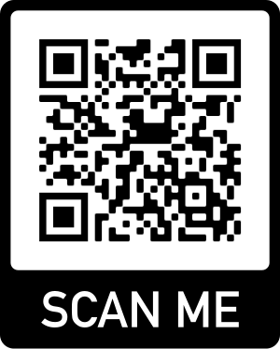
https://www.survio.com/survey/d/F8I3T6C7N5R3H7K9T

