Slide 1




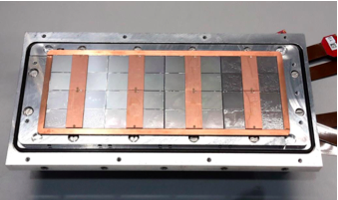



Pixel TPC
Single chip Quad Module TPC plane
2017 2018 2019

Slide 2
The full module with 32 chips
We have now a procedure of running 32 chips:
First the module is powered and one makes sure that the 8 quads have power.
This can be verified by checking the number of chips that the SPDR detects.
In the DAQ it is now possible to recover chips that are not in the device list.
Because we now their chip name and location.
In the end one restarts the SPDR with the dip-switch or the on-off switch and configures the module untill we have all 32 chips.
First it is important to take a noise run; configure the chips and check carefully the outputs/ noise histograms of all the chips. Sometimes chips are noisy, while they should not (all chips are excellent). It this case one 1) re-configures; resets the SPDR with the 2) dip-switch or the 3) on-off switch (in this order).
If the noise run is good we can start to take data with the laser.
Currently, the arawana computer still has a small internal memory: a larger memory is ordered by the CT group at Nikhef.

Slide 3
Next steps in laser data taking
The DAQ itself is far more stable due to fixes in the general program by Henk Boterenbrood: threads are now properly initiated and terminated.
One re-occuring proble are error messages for the getTimer command. This makes that sometimes the time of the laser is not logged;
The heartbeats in both streams are also injected by the getTimer command; the streams do contain a proper heartbeat. It would be great if Sander could fix this problem.
We also want to read out the temperature of the chip and Sander will look into that.
Thursday we installed an additional cooling block in the setup, but the device was blocked. It is now repaired by Oscar and we will install it on Tuesday.
The timing/synchrnisation problem was fixed in the decoding.

Slide 4
Laser data taking runs
We took 4 good long runs: V_{grid} = -330 V and V_{drift} = -280 V
Run 1389 full scan 1 mm steps over the module
Run 1396 full scan 1 mm steps after moving the detector 25 mm
Run 1390 3.5 mm scan diagonal (down wards)
Run 1391 3.5 mm scan (upwards)
Runs 1389 and 1396 to characterize the module measure deformations over the whole module.
Runs 1390-1391 to check the geometry with diagonal tracks.

Slide 5
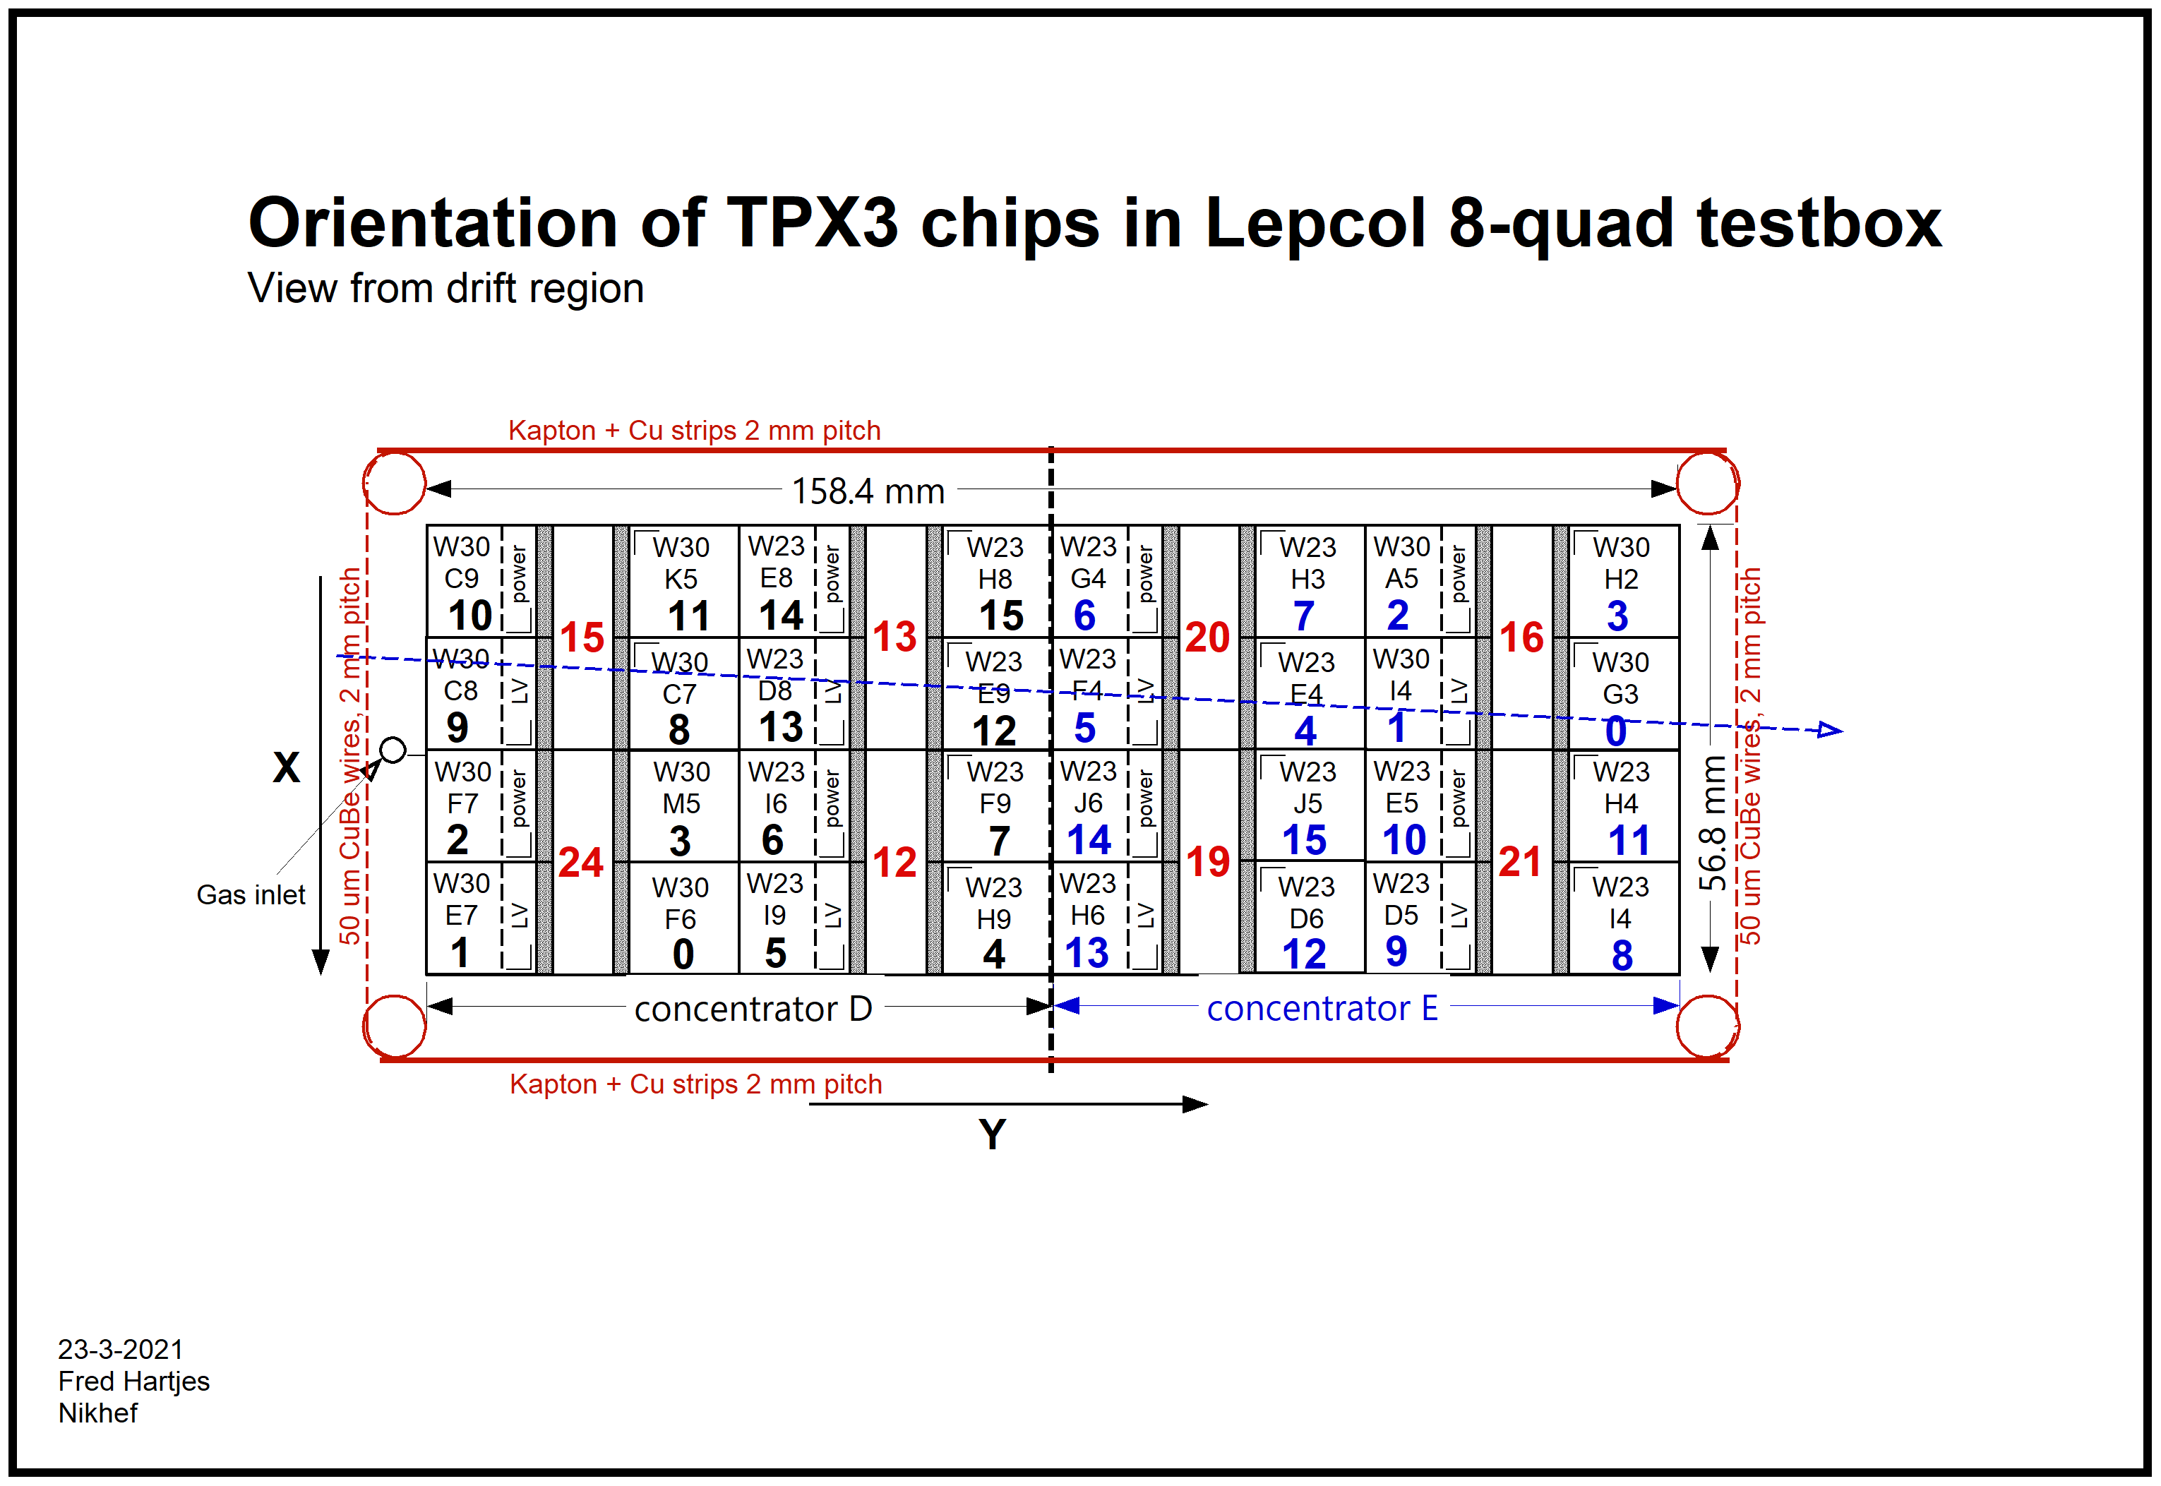
Geometry from Fred
The offline geometry follows this picure and has 0,0 in the lower bottom corner and x runs upwards
The laser x (indicated with the arrow) starts scanning at high offline x values
off line x = - laser x

Slide 6
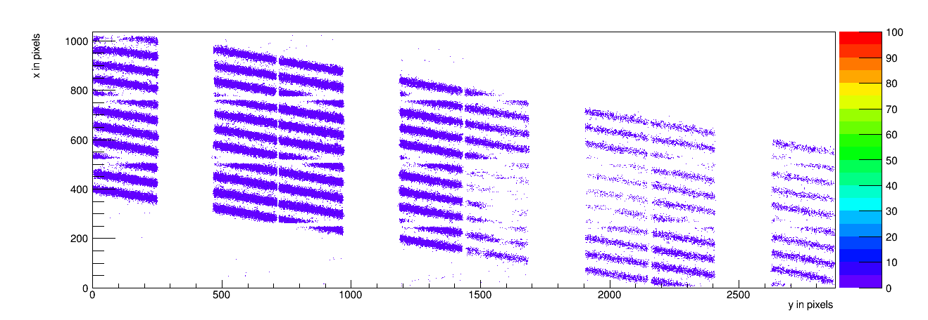
Laser data run 1390
x offline (pixels)

Slide 7
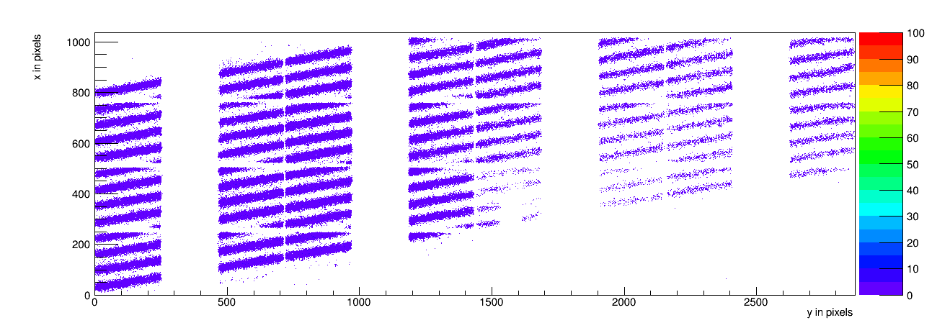
Laser data run 1391

Slide 8
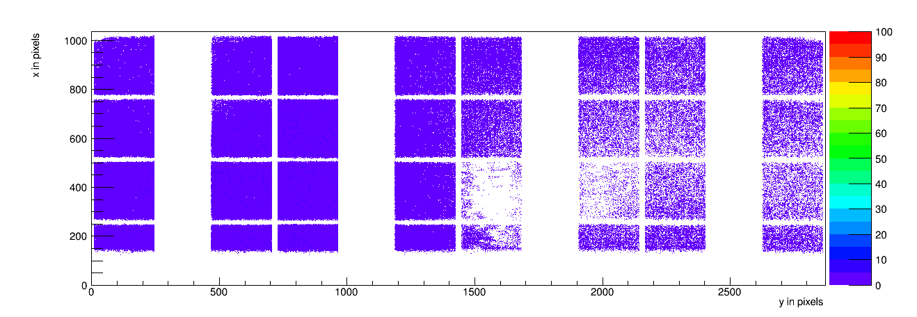
Laser data run 1389 1 mm scan

Slide 9
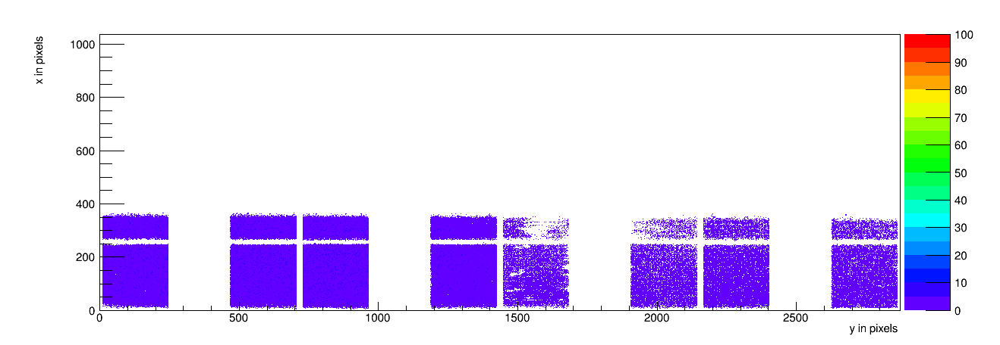
Laser data run 1396 1 mm scan

Slide 10
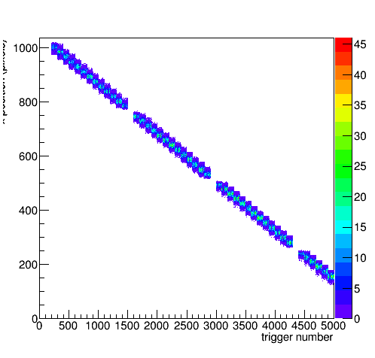
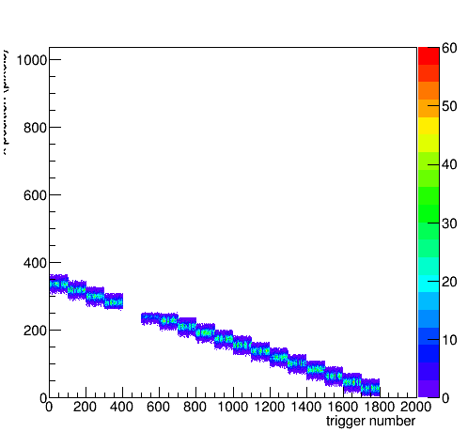
Laser data run 1389 and 1396 scan
x offline (pixels)
Conclusion geometry is (finally) excellently described

Slide 11
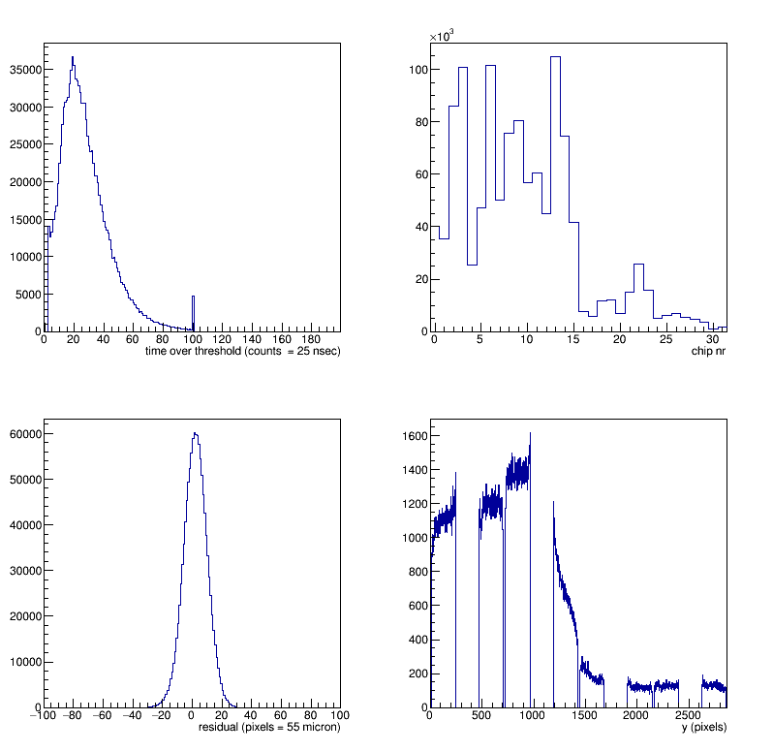
Laser data run 1389
Residuals look OK:
- can look for details
Nr hits varies over chip
- Trends due to primaries
Single electron efficiencies vary per chip (next slide)

Slide 12
Detailed averages per chip run 1389
chip 0 entries 40267 residual 6.8371 tot 26.6781 time 1375.64
chip 1 entries 75461 residual 6.88514 tot 26.8796 time 1179.82
chip 2 entries 121319 residual 5.01678 tot 26.547 time 870.689
chip 3 entries 186811 residual 4.2144 tot 26.291 time 1059.94
chip 4 entries 126219 residual 4.51026 tot 27.0806 time 1410.34
chip 5 entries 72694 residual 5.34781 tot 30.6911 time 1836.93
chip 6 entries 148657 residual 3.90946 tot 29.4256 time 1762.79
chip 7 entries 151683 residual 3.65729 tot 28.5235 time 1907.53
chip 8 entries 125760 residual 2.2497 tot 26.0875 time 1812.86
chip 9 entries 156129 residual 1.32164 tot 27.4273 time 1404.81
chip 10 entries 137354 residual 0.0701618 tot 28.0657 time 1224.59
chip 11 entries 117270 residual -1.02164 tot 25.3051 time 1522.98
chip 12 entries 105603 residual 0.272478 tot 26.5345 time 1974.42
chip 13 entries 149950 residual 1.15307 tot 28.9628 time 1840.73
chip 14 entries 179400 residual 1.11788 tot 28.5017 time 1698.15
chip 15 entries 116104 residual 0.32855 tot 28.9868 time 1954.17
chip 16 entries 49111 residual -0.852263 tot 31.3971 time 2754.82
chip 17 entries 13526 residual -2.86012 tot 28.2344 time 4232.52
chip 18 entries 17601 residual -1.00565 tot 24.6401 time 3610.02
chip 19 entries 23615 residual -3.14535 tot 26.0245 time 3995.26
chip 20 entries 18945 residual -3.77575 tot 28.8897 time 3904.35
chip 21 entries 22002 residual -0.459004 tot 29.9239 time 2614.1
chip 22 entries 40691 residual -0.336696 tot 30.6688 time 2543.34
chip 23 entries 41333 residual -0.965996 tot 31.1058 time 2841.19
chip 24 entries 20658 residual -1.27278 tot 29.5579 time 3520.16
chip 25 entries 11275 residual 2.86044 tot 26.0113 time 3857.57
chip 26 entries 13023 residual 4.13979 tot 26.1657 time 3431.27
chip 27 entries 12111 residual 1.79568 tot 26.7572 time 3855.51
chip 28 entries 9986 residual 1.72512 tot 24.9169 time 3915.82
chip 29 entries 8074 residual 4.35645 tot 18.2374 time 3379.94
chip 30 entries 4448 residual 4.64838 tot 13.9773 time 3565.67
chip 31 entries 2624 residual 2.82279 tot 13.005 time 6500.42
link/concentrator 0 entries 1026102 residual 2.48313 tot 27.7317 time 1569.77
link/concentrator 1 entries 176083 residual -0.424422 tot 28.7167 time 3188.3
Low ToT (13-18) for chips 29, 30 and 31
Average 28 cnts
Need to run at higher grid voltage
Drift Times in counts 4096 cnts = 25 ns
Concentrator dt = 1500 cnt or 10 nsec
Per chip varations of 1000-1500 cnts
Residuals now -5 till 8 pixels +-500 μm
No track angle correction applied
No per chip alignment

Slide 13
Detailed averages per chip run 1396
chip 0 entries 111779 residual 5.0696 tot 27.0414 time 1292.92
chip 1 entries 207094 residual 5.89146 tot 27.1039 time 1034.06
chip 2 entries 127224 residual 6.27964 tot 26.9425 time 654.236
chip 3 entries 70396 residual 3.84701 tot 26.7888 time 652.627
chip 4 entries 114386 residual 2.53351 tot 28.2157 time 1533.5
chip 5 entries 198134 residual 2.50713 tot 29.5456 time 1689.85
chip 6 entries 159865 residual 2.48143 tot 29.5728 time 1511.35
chip 7 entries 61392 residual 1.36586 tot 28.1958 time 1493.6
chip 8 entries 23762 residual 0.817019 tot 28.548 time 1760.17
chip 24 entries 21602 residual -6.82108 tot 23.9631 time 3834.51
chip 25 entries 50112 residual -3.26046 tot 25.6267 time 3333.88
chip 26 entries 33269 residual -0.718191 tot 26.645 time 2931.49
chip 27 entries 8425 residual -3.60303 tot 26.5991 time 3166.63
chip 28 entries 21039 residual -1.93015 tot 21.4689 time 3201.74
chip 29 entries 33591 residual 0.0132327 tot 17.5859 time 2986.27
chip 30 entries 17797 residual 1.07425 tot 14.7045 time 2892.39
chip 31 entries 2919 residual -0.317403 tot 13.4858 time 4979.63
link/concentrator 0 entries 537016 residual 3.85743 tot 28.0883 time 1278.55
link/concentrator 1 entries 95047 residual -2.04347 tot 22.4983 time 3246.74
Same picture and conclusions:
Low ToT (13-18) for chips 29, 30 and 31
Average 28 cnts
Need to run at higher grid voltage
Drift times in counts 4096 cnts = 25 ns
Concentrator Δt = 1500 cnt or 10 nsec
Per chip variations of 1000-1500 cnts
Residuals now -5 till 8 pixels +-500 μm
No track angle correction applied
Without per chip alignment

Slide 14
ToT and efficiency
These runs V_{grid} = -330 V
Low ToT (13-18) for chips 29, 30 and 31
Average 28 cnts
NB: average ToT (28) = 0.7 ms
lowest = 0.3 ms
Need a dV of 20-30 Volt to reach also >90% efficiency
Thesis from Kees Ligtenberg

Slide 15
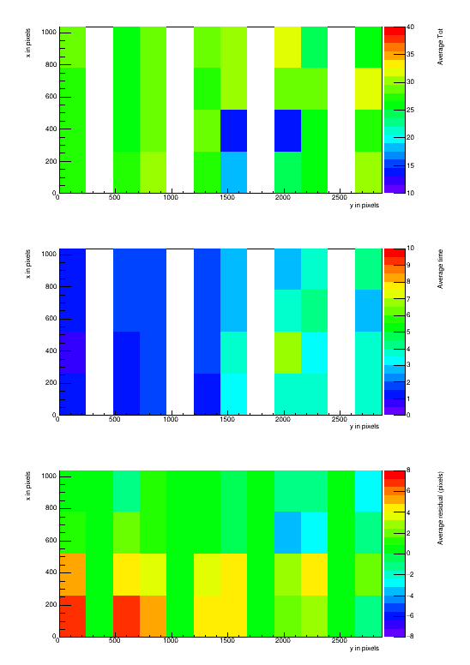
Laser data run 1389
ToT
Time
Residual
Colored representation of the per chip measurements ToT, Time and Residual of slide 12
In the module x-y plane
x pixels
y pixels

Slide 16
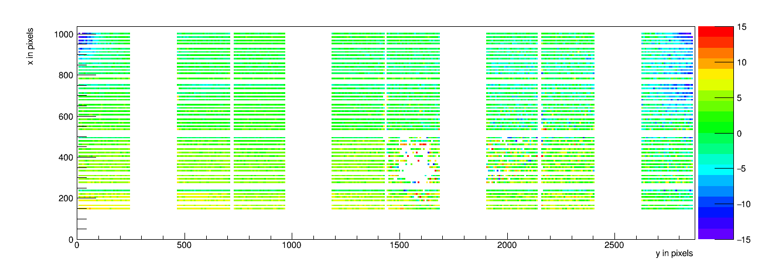
Mean residuals for laser data run 1389
Observe deformations of the E field left top and right top corners
Affects 50% of the pixels of the chips

Slide 17
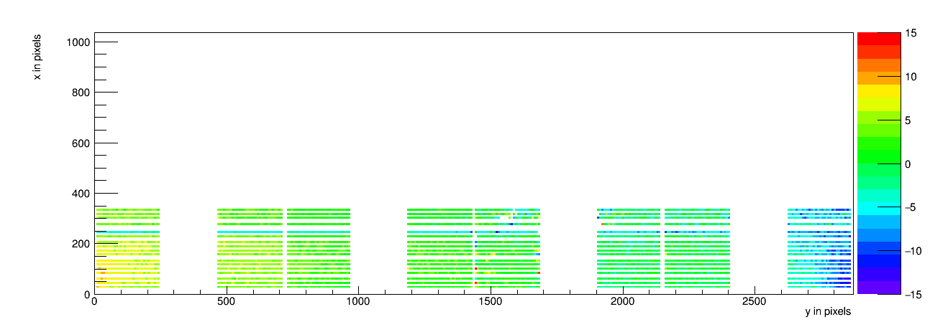
Mean residuals for laser data run 1389
Deformations of the E field left bottom and right bottom chips corner
Affects ˜50% of the pixels of the chips

Slide 18
Conclusions
Large steps forward have been made:
- Data taking procedure has been optimized
- Excellent data has been taken
Need to follow up on chips 29, 30 and 31 that have a low ToT
Further analysis of the data could bring:
calibrated time offsets per chip
Alignment corrections for the module
Measurement of the distortions
  Might need more statistics
Take data at higher grid voltage setting
1 May will start with the mock-up test

