Slide 1
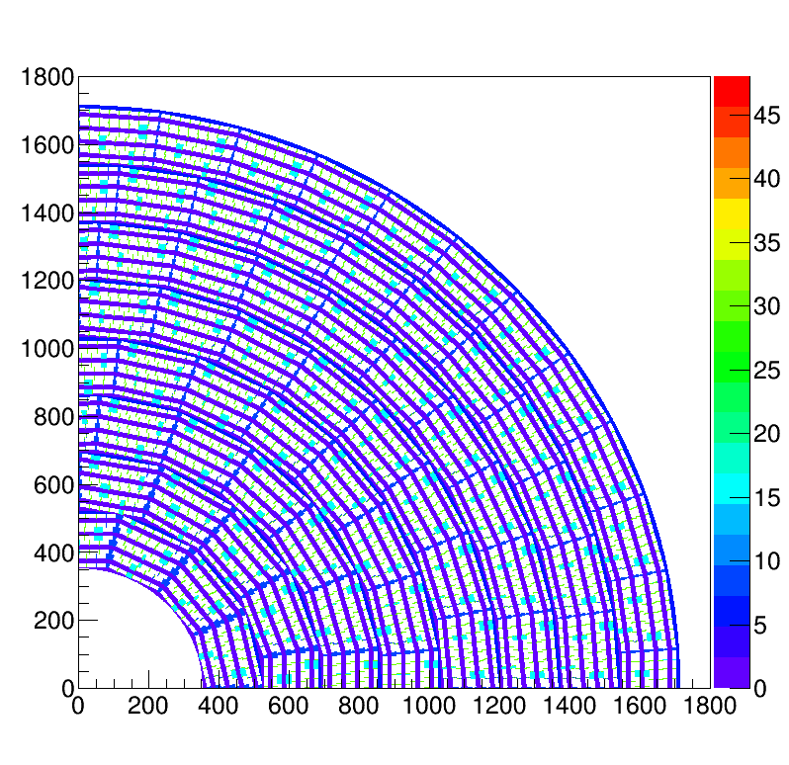
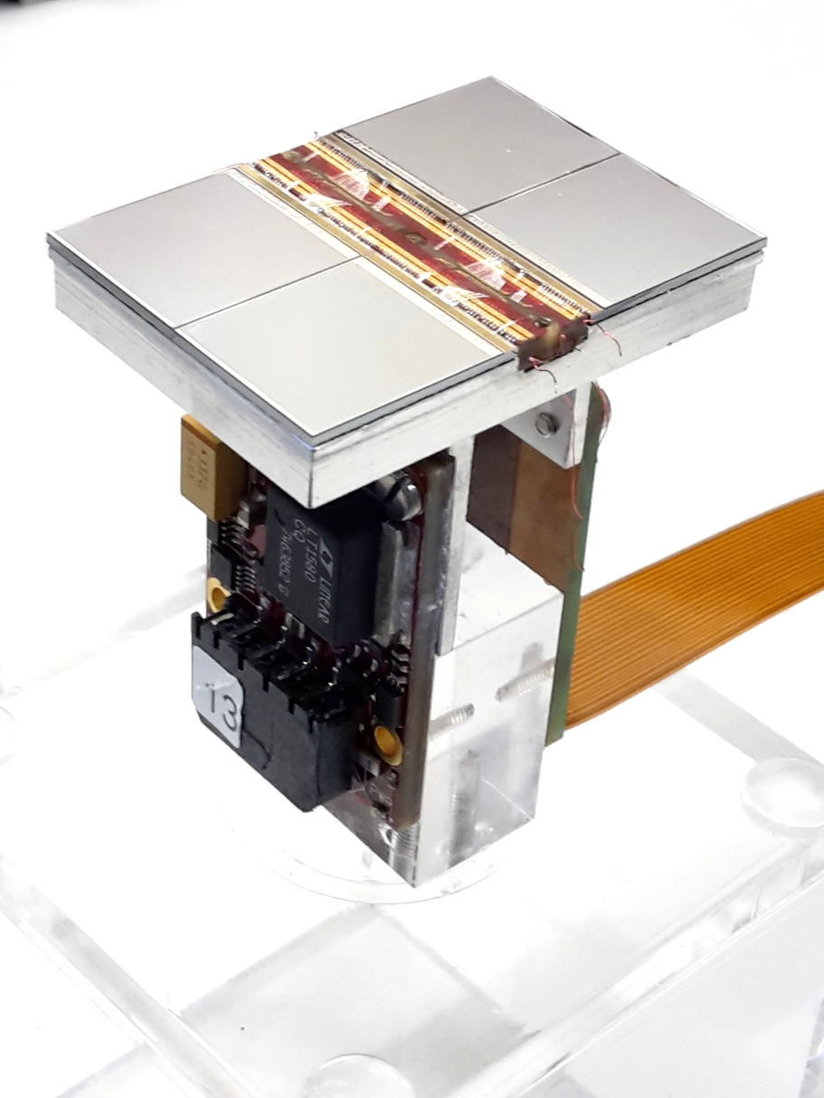
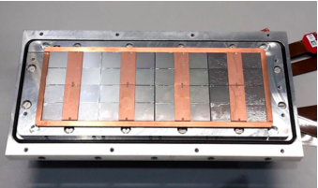
Pixel TPC
Single chip Quad Module TPC plane
2017 2018 2019

Slide 2
The full module with 32 chips
Sander van Doesburg succeeded to get all 32 chips in the read out.
Optimistically, I thought we just read them out and take a laser run.
We quickly found out that huge amounts of data were taken, with noisy pixels that were flushing the datastream. The real signal hist from the laser track were not recorded.
This meant that we should
First equalise the 4 new chips in the readout:determining the trim dac values by a threshold scan over de chips
Secondly mask the noisy pixels, thus that the stream is not flooded by noise hits.
The equalisation procedure for the full module turned out to be not that trivial.
One of the issues is that the arawana computer has a small internal memory: to keep the per pixel histograms (256x256) for the threshold scan for all 32 chips is not possible. So this has to be done in per concentrator of 16 chips.
We requested that the CT group at Nikhef enlarges the memory.

Slide 3
The full module with 32 chips
The equalisation procedure for the full module turned out to be not that trivial.
The second issue is the stability of the DAQ system at start up and during the scanning and masking procedure.
Current wisdom for the start up is that: power the modules, switch on the SPDR.
If the SPDR doesnot find 32 chips -> repower the modules
If there are 32 chips but errors appear in the loading of default values -> reset the SPDR. If this does not work -> switch of the SPDR and put it on again.
If this is OK, one can run the equalisation procedure for one concentrator (one chip or odd/even chips).
The equalisation procedure itself is very critical to communication errors that occur in the loading of the trimdac values and in the setting of the thresholds.
In the code for the equalisation there are several commands that are there to ensure that the SPDR system is read to accept the trimdac values by introducing a sleep time and wait for replies using the getDAC() getGenConf() commands.

Slide 4
The full module with 32 chips
If the setting and getting is too fast, the system produces errors and sometimes ends up in a time-out state.
In the last case one has to switch on and off the SPDR.
It took quite sometime to get a proper equalisation run.
Last week we succeeded to extract the trim values for the new chips.
See plots next page.
The masking procedure is more straightforward. One has to take a noise run and analyse the per chip hitmap. Also here we ran into the memory problem; the ntuple was becoming too big (due to the noise). This is overcome by using histograms and switching off the ntuple.
By iterating 6 times the noisy channels are masked and the ntuple can be switched on again.

Slide 5
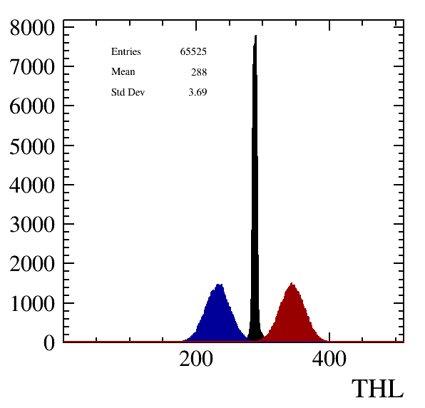
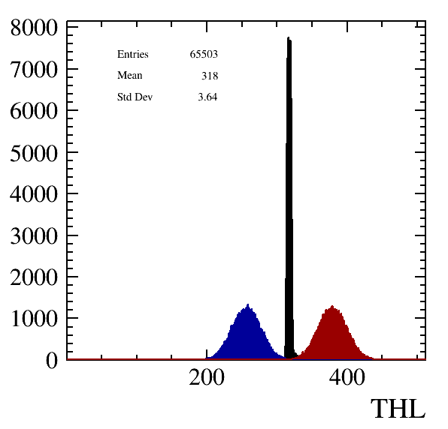
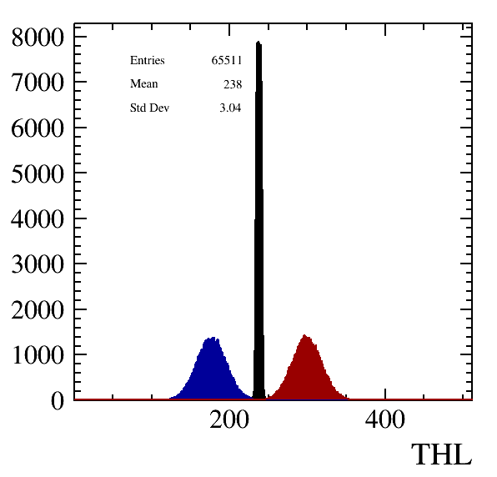
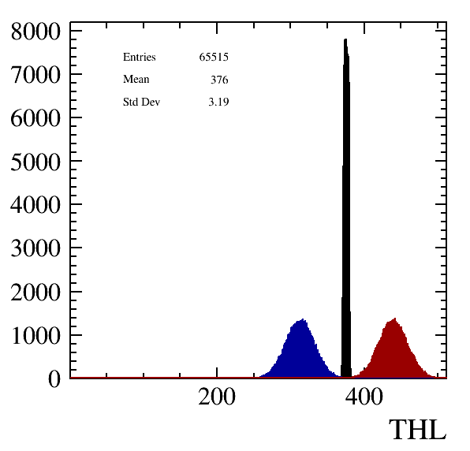
Equalisation results for the four remaining chips
Chip 7
Chip 24
Chip 25
Chip 31

Slide 6
Next steps in laser data taking
Friday we did some attemps to take laser data.
A problem occurred that was already there in October: many laser runs do not finish properly. Sometimes the laser stops around trigger 100 and the data is still flushed. Sometimes the job ends with a crash and the file with the laser positions is not closed properly.
Also here the origin lies in the SPDR communication that gets stuck; in this case it is due to the getTimer command: at the end of 100 laser shots the time is asked from one of the devices in the SPDR. This often returns an “error”.
The current workaround is NOT to request the time. The system then ran smoothly.
This I just changed to request the Time from the TIMESTAMP stream, after enabling the tdc in that stream. This works, but is not very stable.
Adding some usleep helps. And resetting both SPDRs before running too.

Slide 7
Next steps in laser data taking
Looking at the data that did finalize properly, it was found out that the synchronisation of the trigger and SPDR was not working. So this has to be sorted out again (it worked in december as I showed). Just found out that in the code the hearbeats were not properly configured.
On our to do list is: laser tracks with 32 chips and diagonal tracks to sort out the geometry.

