Slide 1




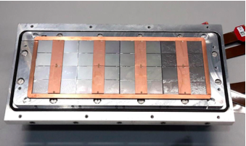



Pixel TPC - Geometry
Single chip Quad Module TPC plane
2017 2018 2019

Slide 2
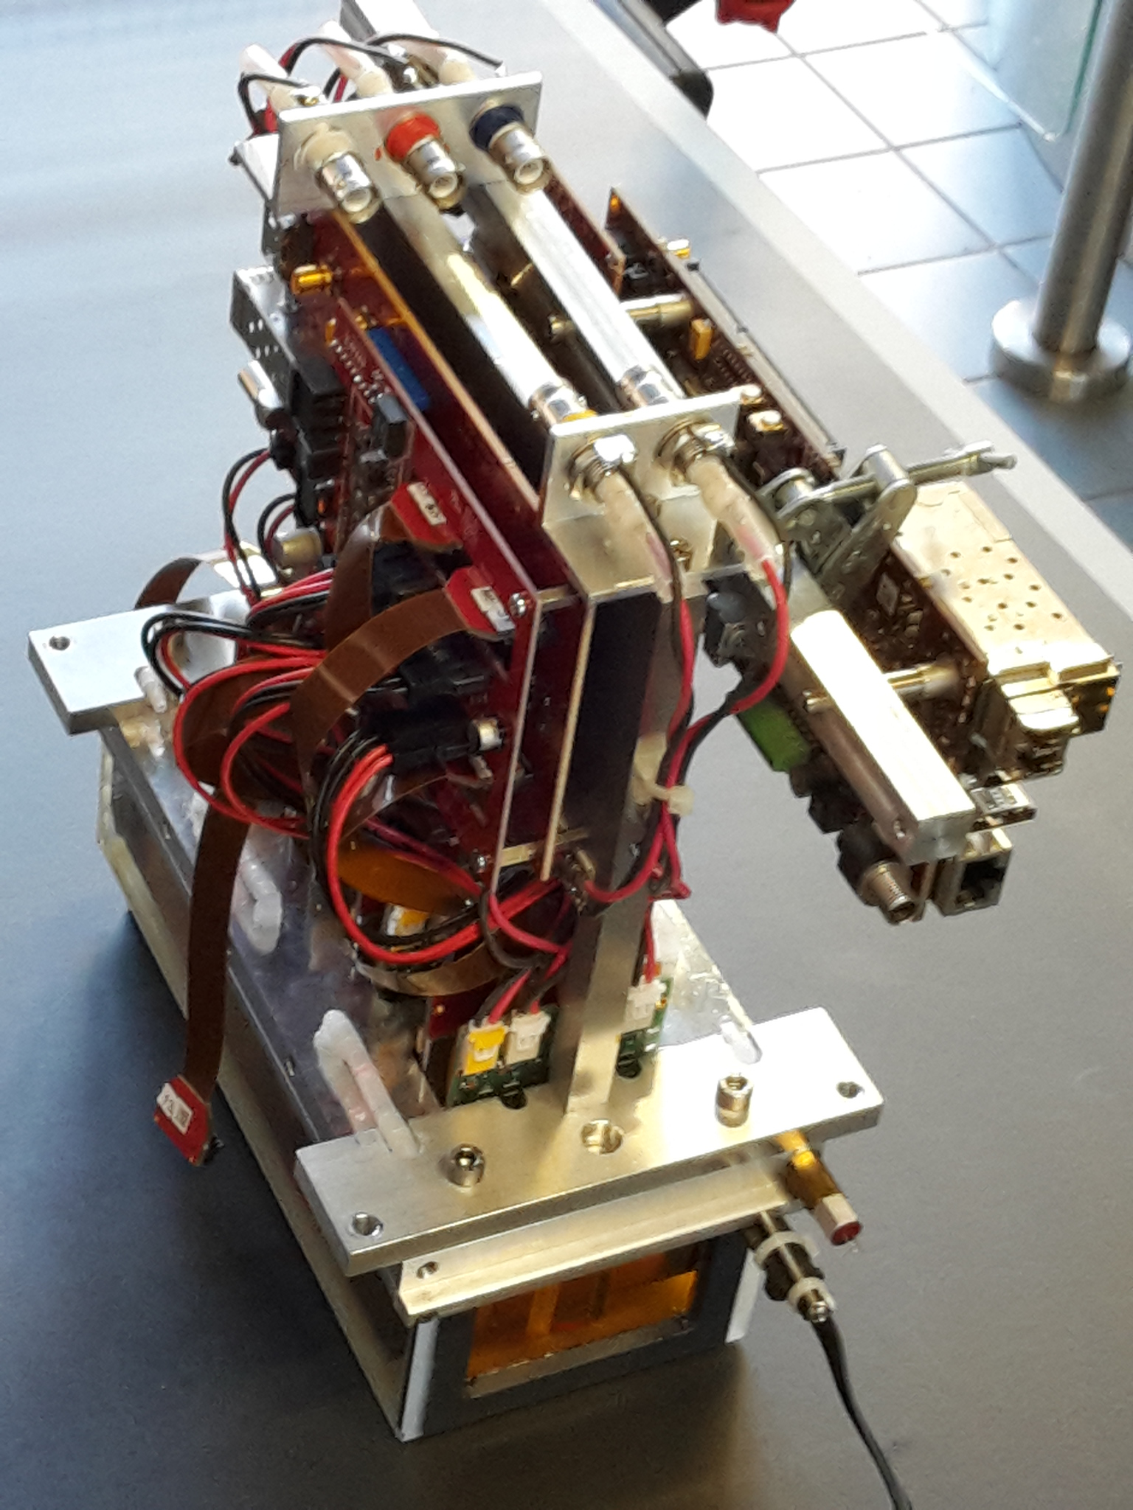
Module picture
In blue the laser track direction
0,0 sits in the upper right corner

Slide 3
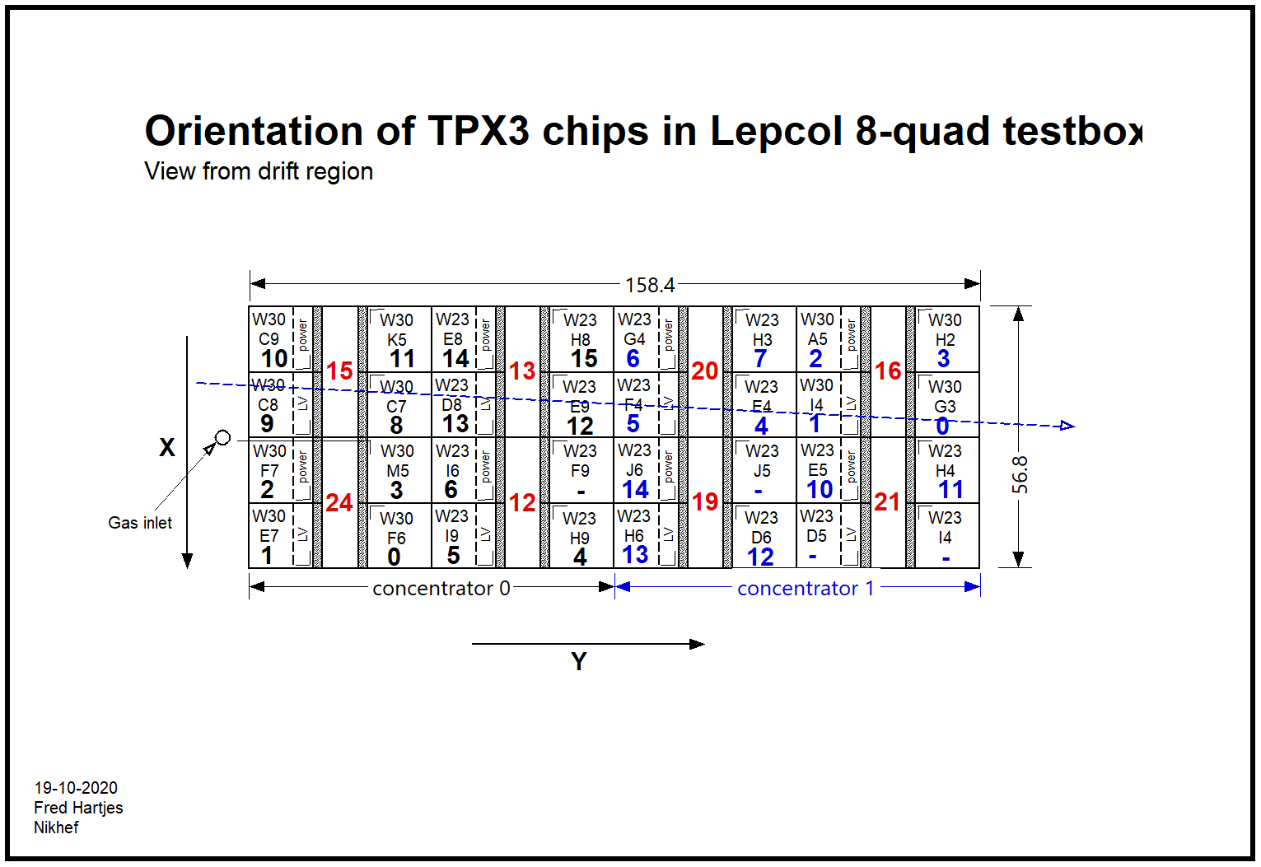
Event display layout October
1 2 9 10
0 3 8 11
6 13 14
7 12 15
29 30 21 22
31 20 23
26 17 18
24 27 16 19
VIEW FROM BOTTOM
VIEW FROM TOP
OLD Layout chip nrs
x
y
NOW=February does not look consistent
View, x direction and 0,0 are different
x = x laser
0,0 is left bottom

Slide 4
Layout chip nrs October
1 2 9 10
0 3 8 11
6 13 14
7 12 15
29 30 21 22
31 20 23
26 17 18
24 27 16 19
Corrected Layout chip nrs
2 1 10 9
3 0 11 8
6 5 14 13
7 4 15 12
30 29 22 21
31 28 23 20
26 25 18 17
27 24 19 16
Columns 1 and 2
3 and 4
flipped

Slide 5
Corrected layout Geometry
2 1 10 9
3 0 11 8
6 5 14 13
7 4 15 12
30 29 22 21
31 28 23 20
26 25 18 17
27 24 19 16
x
y

Slide 6
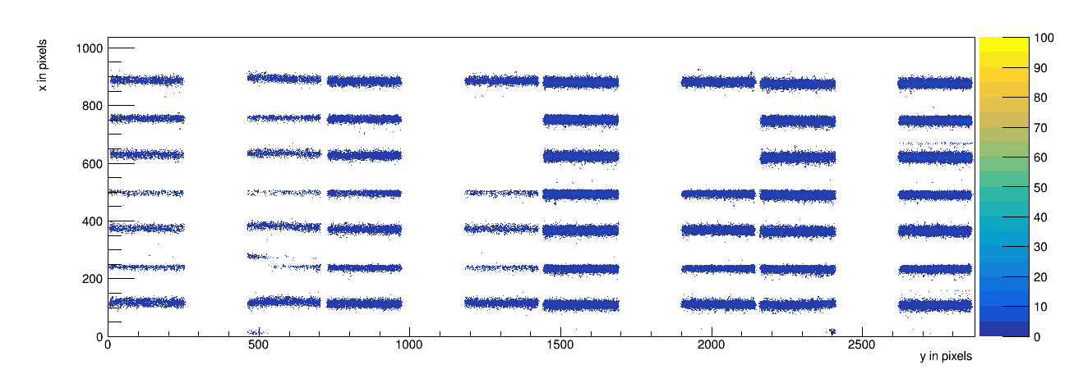
Full scan of the module run 1299
Geometry convention corrected layout

Slide 7
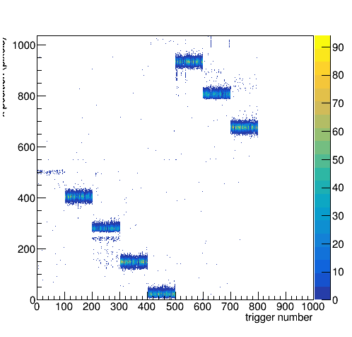
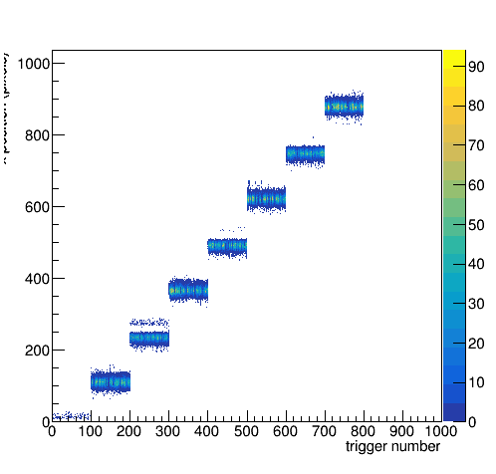
Full scan of the module run 1299
Long run 800 points laserpositions: xpos 0 – 49 in 7 mm steps
Uncorrected geometry
Corrected geometry

Slide 8
Quad read out sequence
Quad View from bottom
(from Bas vd H)
seen from drift
Old geometry
View from top
New geometry
View from top
2 3
1 0
1 0
2 3
2 3
1 0
In the left corner of the module (0,0)
Taking the quad view
one would expect the new geometry

Slide 9
Geometrical layout of module
2 1 10 9
3 0 11 8
6 5 14 13
7 4 15 12
30 29 22 21
31 28 23 20
26 25 18 17
27 24 19 16
New geometry: View from top
x
y
x = x laser and 0,0 is left bottom

Slide 10
Uncorrected and corrected geometry
1 2
0 3
5 6
4 7
29 30
28 31
25 26
24 27
View from top
1
3 0
6 5
7 4
30 29
31 28
26 25
27 24
uncorrected
Column 2
Column 1
corrected
Column 2
Column 1
x
y
x = x laser and 0,0 is left bottom

Slide 11
Uncorrected and corrected geometry
The geometries of the bottom two “colums” nrs 1 and 2 give consistent continuous tracks
Same for the top two “colums” nrs 3 and 4
To decide between the geometries one needs tracks that cross chips in colums 2 and 3
Many cosmics will give a consistent continuous track in both geometries
NB Jan his cosmic event is an example of that.

Slide 12
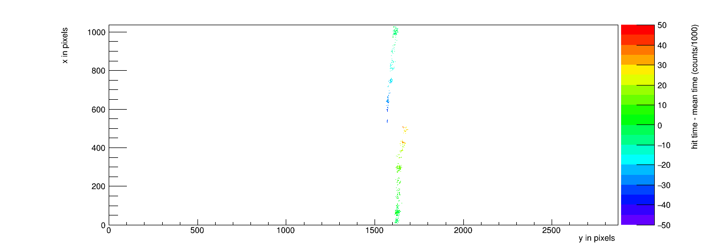
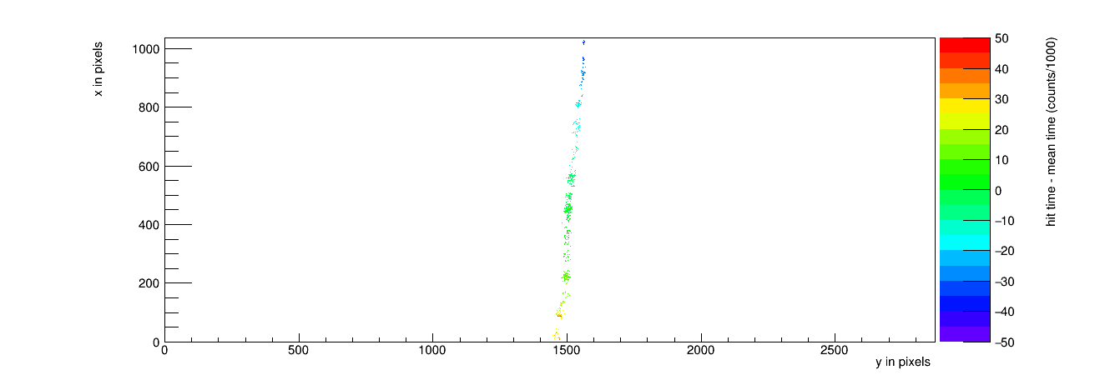
Cosmics event 18 in run1299
old geometry
Corrected geometry

Slide 13
The master table concentrator chip id
Concentrator 0
pin nr chip id
0 1e66
1 1e75
2 1e76
3 1e5d
4 1798
5 1799
6 1769
8 1e73
9 1e83
a 1e93
b 1e5b
c 1795
d 1784
e 1785
f 1788
Concentrator 1
pin nr chip id
0 1e37
1 1e49
2 1e51
3 1e28
4 1745
5 1746
6 1747
7 1738
a 1755
b 1748
c 1764
d 1768
e 176a
f 175a
Concentrator pin/socket number =
chip nr in data stream
So concentrator 0 chip 1
corresponds to chip id
1e75 = string “W0030_E07”
(see previous page for a dump)
So concentrator 1 chip 1 (or 17)
1e49 or W0030_I04

Slide 14
Dump of the equalisation log file
dev numbers are random …
chipIds (1e75) and chip nrs (1) are 1-1 related.
Note] number of active links : 2
[Note] dev 0: W0030_C08 (1e83) mapped to chip nr 9
[Note] dev 1: W0030_C09 (1e93) mapped to chip nr 10
[Note] dev 2: W0030_K05 (1e5b) mapped to chip nr 11
[Note] dev 3: W0023_E09 (1795) mapped to chip nr 12
[Note] dev 4: W0023_D08 (1784) mapped to chip nr 13
[Note] dev 5: W0023_E08 (1785) mapped to chip nr 14
[Note] dev 6: W0023_H08 (1788) mapped to chip nr 15
[Note] dev 7: W0030_F06 (1e66) mapped to chip nr 0
[Note] dev 8: W0030_E07 (1e75) mapped to chip nr 1
[Note] dev 9: W0030_F07 (1e76) mapped to chip nr 2
[Note] dev 10: W0030_M05 (1e5d) mapped to chip nr 3
[Note] dev 11: W0023_H09 (1798) mapped to chip nr 4
[Note] dev 12: W0023_I09 (1799) mapped to chip nr 5
[Note] dev 13: W0023_I06 (1769) mapped to chip nr 6
[Note] dev 14: W0030_C07 (1e73) mapped to chip nr 8
[Note] dev 16: W0030_I04 (1e49) mapped to chip nr 1
[Note] dev 17: W0030_A05 (1e51) mapped to chip nr 2
[Note] dev 18: W0030_H02 (1e28) mapped to chip nr 3
[Note] dev 19: W0023_E04 (1745) mapped to chip nr 4
[Note] dev 20: W0023_F04 (1746) mapped to chip nr 5
[Note] dev 21: W0023_G04 (1747) mapped to chip nr 6
[Note] dev 22: W0023_H03 (1738) mapped to chip nr 7
[Note] dev 23: W0023_E05 (1755) mapped to chip nr 10
[Note] dev 24: W0023_H04 (1748) mapped to chip nr 11
[Note] dev 25: W0023_D06 (1764) mapped to chip nr 12
[Note] dev 26: W0023_H06 (1768) mapped to chip nr 13
[Note] dev 27: W0023_J06 (176a) mapped to chip nr 14
[Note] dev 28: W0030_G03 (1e37) mapped to chip nr 0
[Note] 28 active devices
In black concentrator 0 chip 0-15
In blue concentrator 1 chip 16-32

