Slide 1
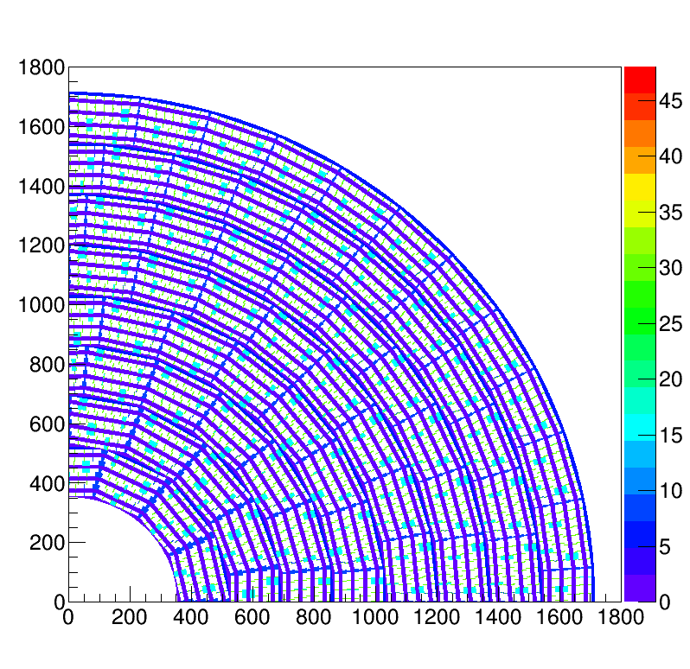
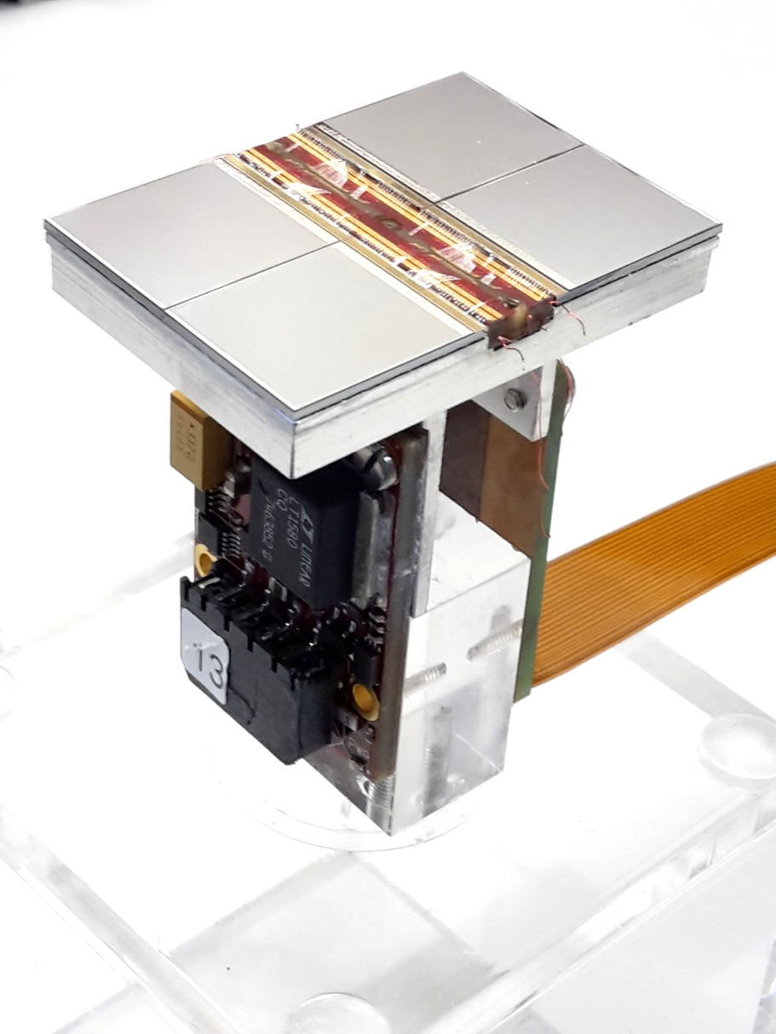
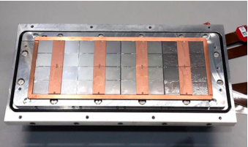
Pixel TPC
Single chip Quad Module TPC plane
2017 2018 2019

Slide 2
Overview of status
The timing puzzle (coarse time) is now solved
Puzzle nr 2 is the why some of the chips can sometimes be readout and some times not. Sander, Henk and Bas are looking into this probem.
The geometry puzzle (old/corrected geometry) is now practically solved, but we need to find out consistent defincitions.
- we can test this more precisely take data crossing different colums of chips
The residuals don’t look precise enough: see shifts up to 7 pixels
Need to take data at higher z values.

