Slide 1




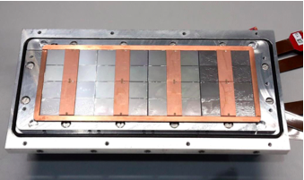



Pixel TPC
Single chip Quad Module TPC plane
2017 2018 2019

Slide 2
Heartbeats in February run 1305
Heart beats December: trigger 30 msec and pixels 22-50 msec
Heartbeats February in trigger stream 42 msec
Heartbeats in pixel stream 10 … one event at 60 msec
We need to add a heartbeat at least each 25*2²² = 104 msec (8+14 bits)

Slide 3
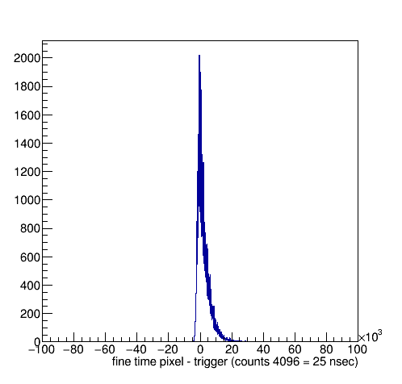
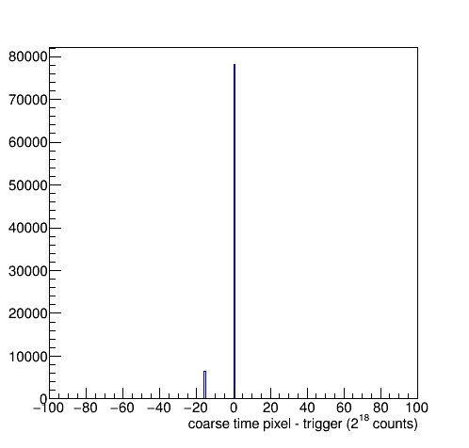
Timing plots run 1305
The coarse time is sometimes off
Much rarer than in run 1298
Off by 2 ²²
So 104 msec
Why? There are enough heartbeats …
Checked the events at -16: look like good signal

Slide 4
Coarse Time puzzle solved: 16 February
Why is the coarse time sometimes off?
Martin van Beuzekom proposed that this could be due to the logic of the extentsion of the heart beat.
One has to perform bit overlap checks of the TimePix time (spider time bits) and the hearbeat time to select the right one
This logic was not activated yet
After implementing the logic (code Packet.h) the amount of times that the coarse time is shifted wrt trigger time is reduced:
Run 1305 the coarse time WRONG/OK (wrong = 104 msec off):
WRONG OK
link0 4812 52915
link1 1708 25305
After the applying the logic
WRONG OK
link0 28 57609
link1 0 27013
Only in 3 per mille of the cases wrong

