Slide 1




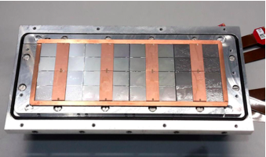



Pixel TPC
Single chip Quad Module TPC plane
2017 2018 2019

Slide 2

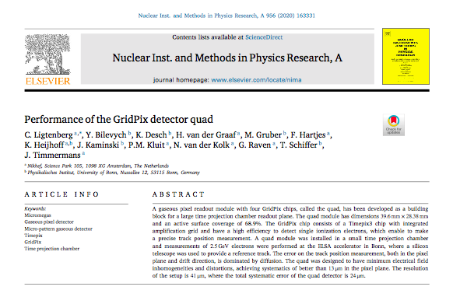

ILC and Pixel TPC highlights
Quad paper published early 2020
https://doi.org/10.1016/j.nima.2019.163331
LCTPC collaboration meeting DESY 2020:
“Pixel TPC is a baseline option for the ILD experiment at ILC”
There is large interest by CEPC community 2021
Kees Ligtenberg is finalizing his thesis: will be submitted < Summer 2021
Negative Ion TPC paper submitted end of 2020 (next slide)
Module tests and DESY test beam preparations June 2021
ILC going slowly ahead: preparations for an ILC pre-lab; Snowmass-CERN https://agenda.linearcollider.org/event/9033/contributions/47143/attachments/36266/56495/20210114fujiik.pdf

Slide 3
    Negative Ion pixel TPC paper
Submitted NIMA December 2020
  Important conclusion is that the diffusion coefficient of a NITPC is for the chosen gas mixture pretty close to the thermal limit
  For dark matter applications: using minority and majority carriers the drift distance can be determined rather accurately

Slide 4
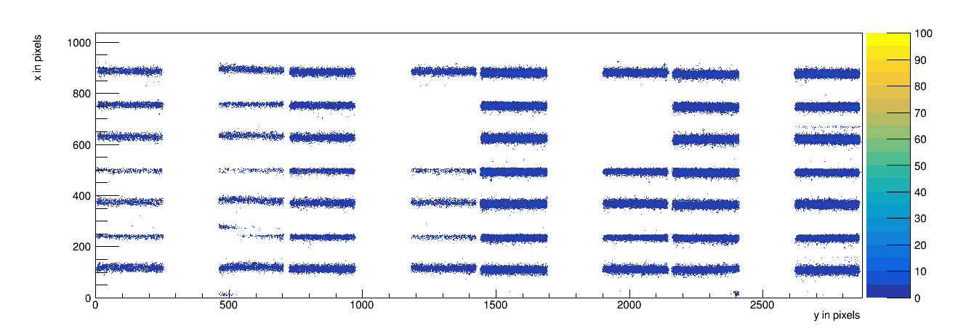
    8-Quad Module Laser test
Run 1299 scan on 22 December 2020
V_{grid} = -330 V and V_{drift} = -280 V; all pixels shown for a 4 μsec window
  High resolution (ns) timing OK
  For Testbeam get all chips working and equalized
  In May make mockup of full system in lab

