Slide 1


Mohit Saharan

Slide 2
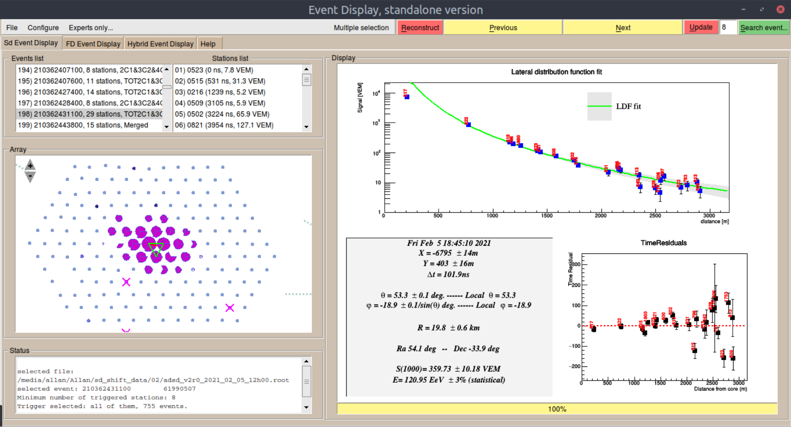
E_{CM} ≈ 335 TeV !

Slide 3


Slide 4
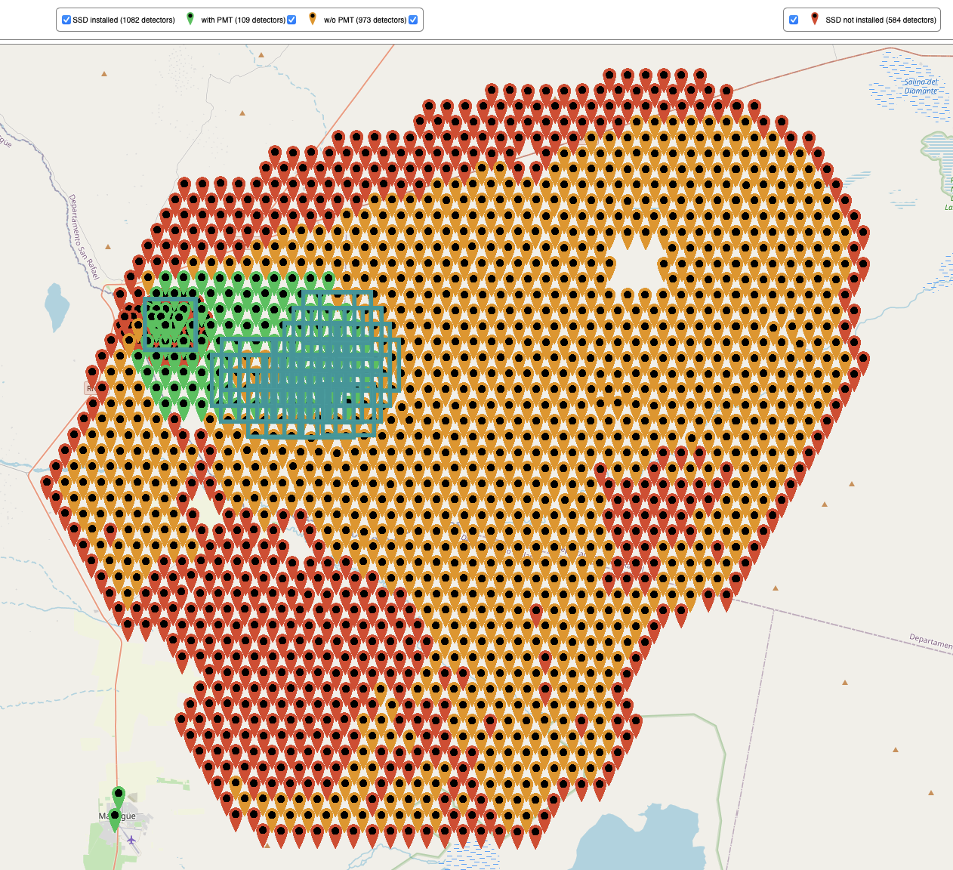
Auger SD+SSD
1329/1518 SSD modules in Malargüe
At least 1410 modules needed (leaving outer ring free)
New front-end electronics: 2000 boards in production, 31 installed in Malargüe
1550 small PMTs ordered and are being fabricated

Slide 5
Auger RD
(Small) Engineering Array in the field since November 2019, performs as expected
Final design nearly finished, acquisition quotes all in
Few stations with final mechanics and electronics
in the field soon
Expect PRR end of March 2021, then place all orders

Slide 6
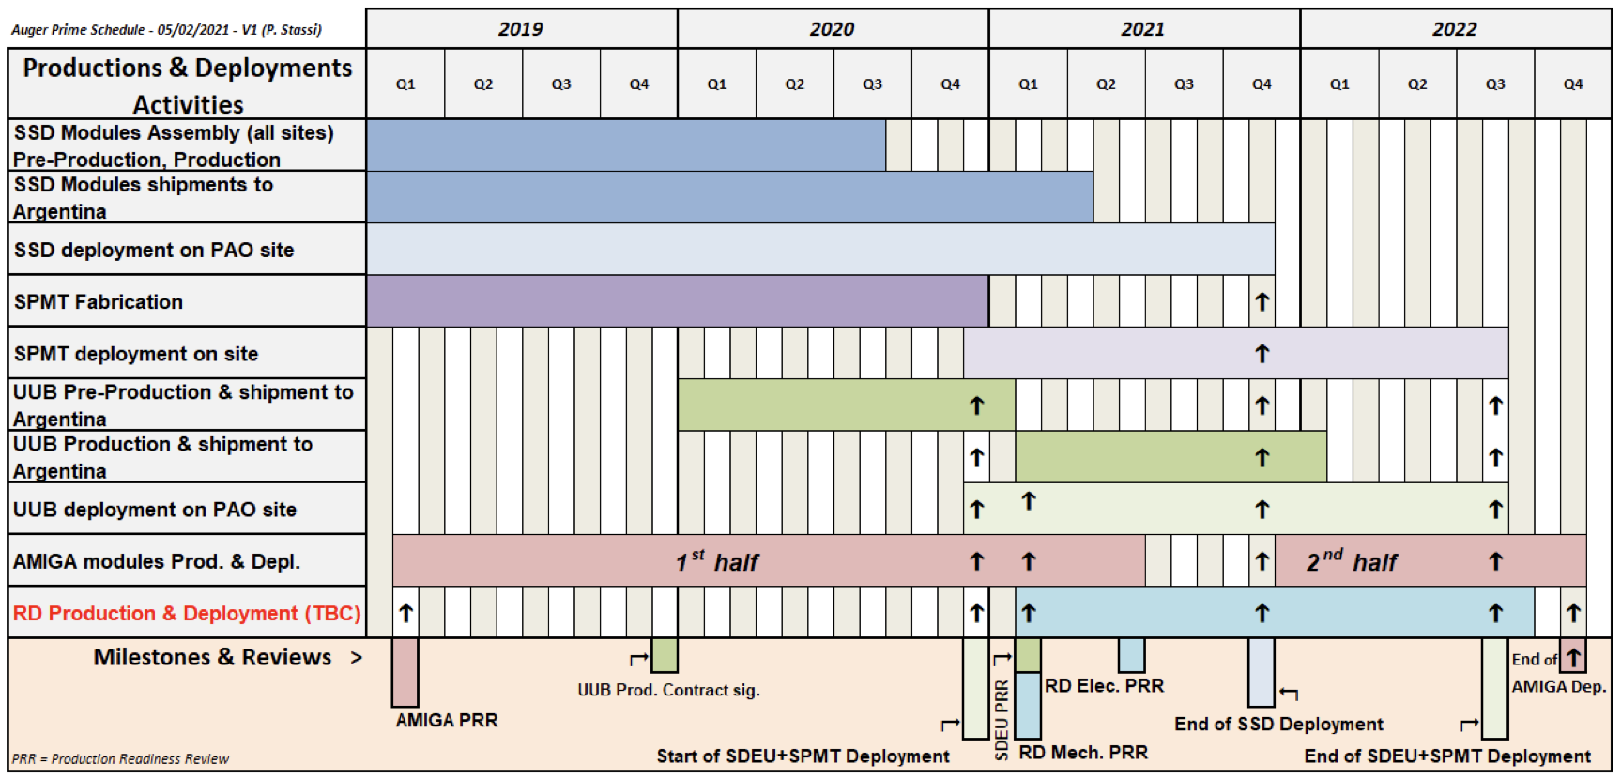
AugerPrime deployment (looking for more resources to speeds it up)

Slide 7
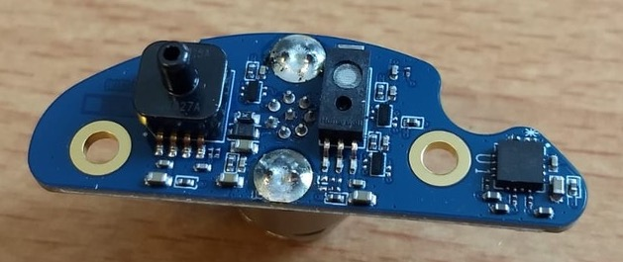
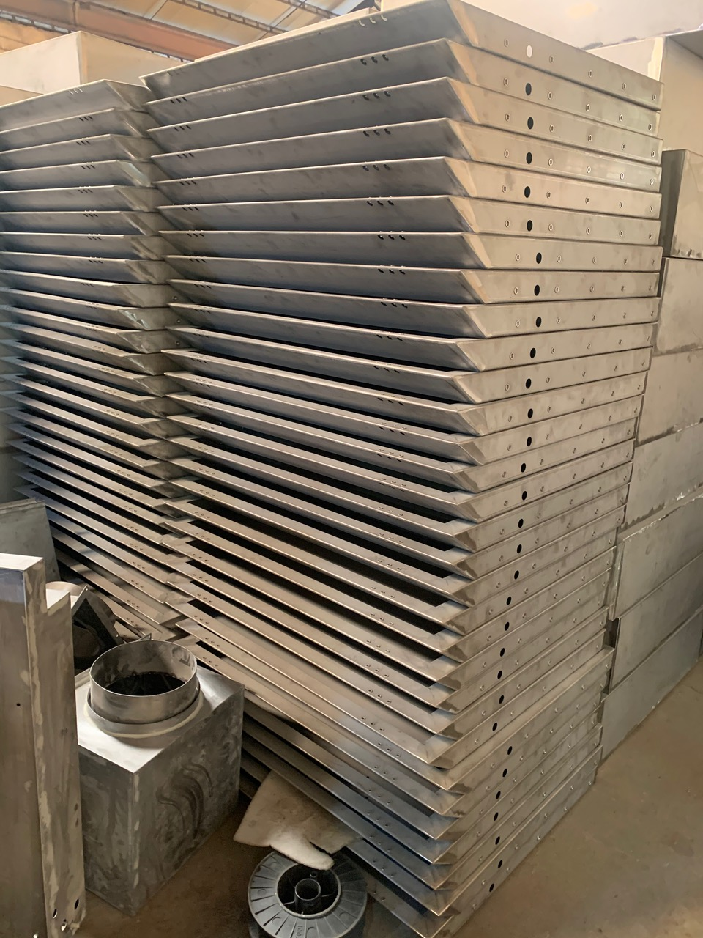
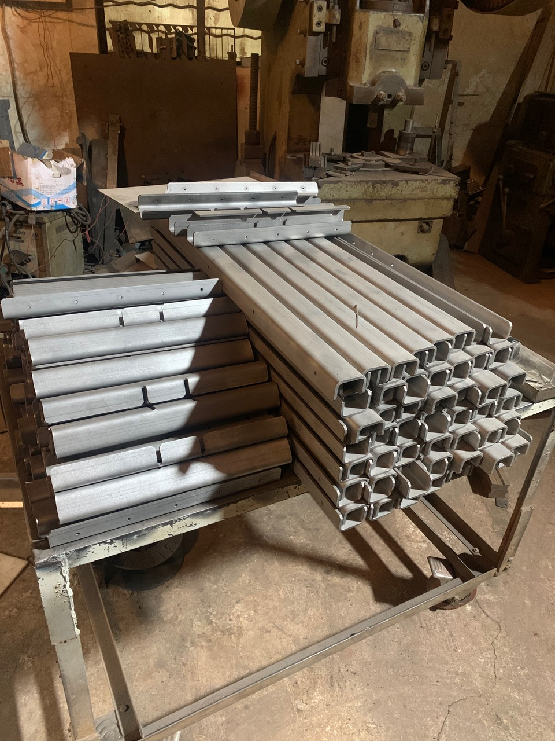
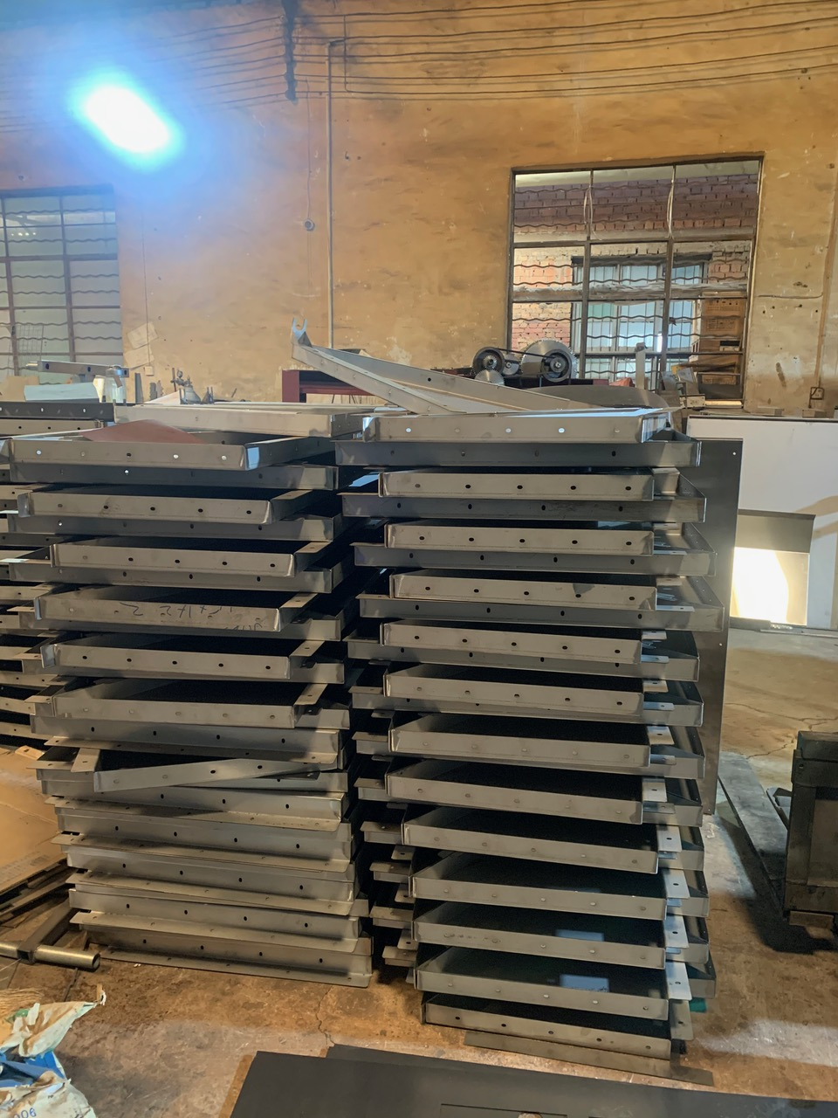
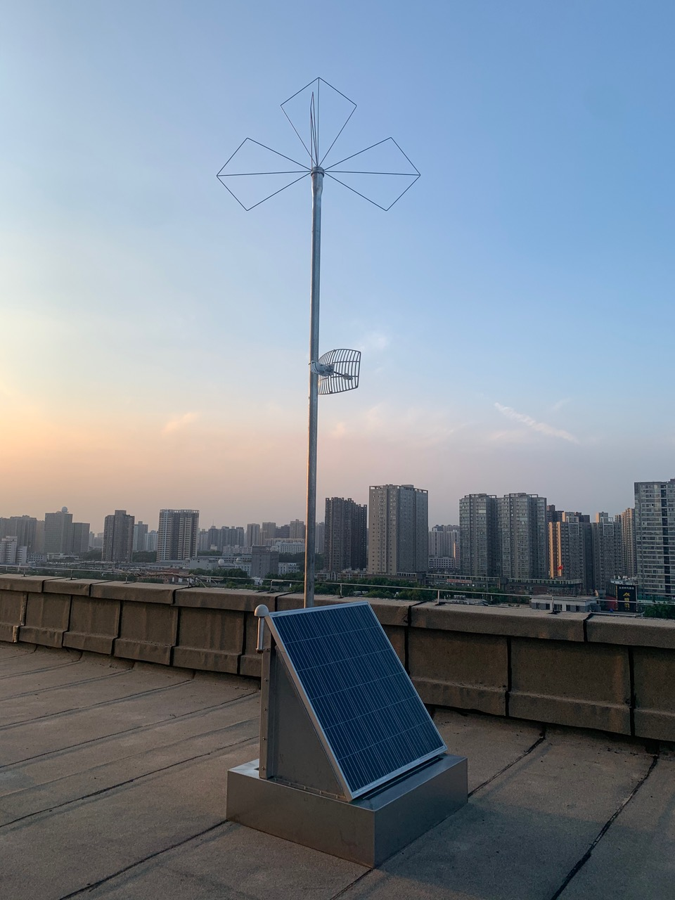
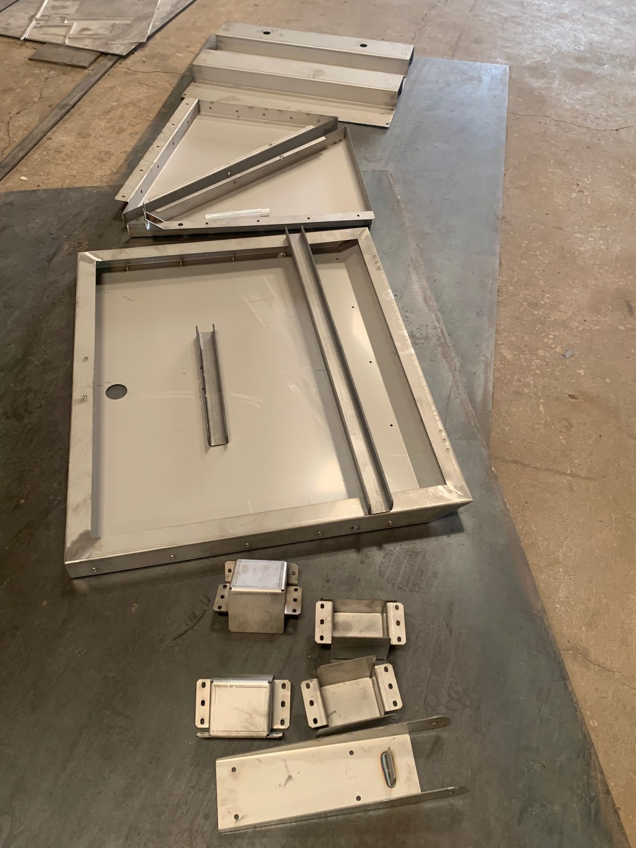
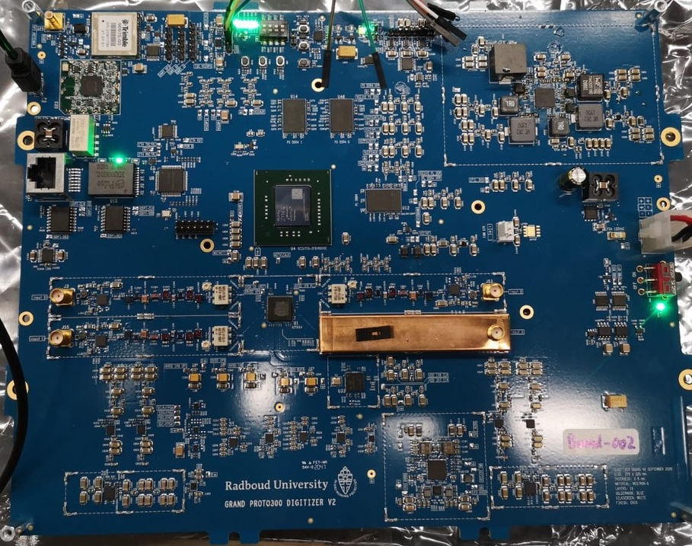
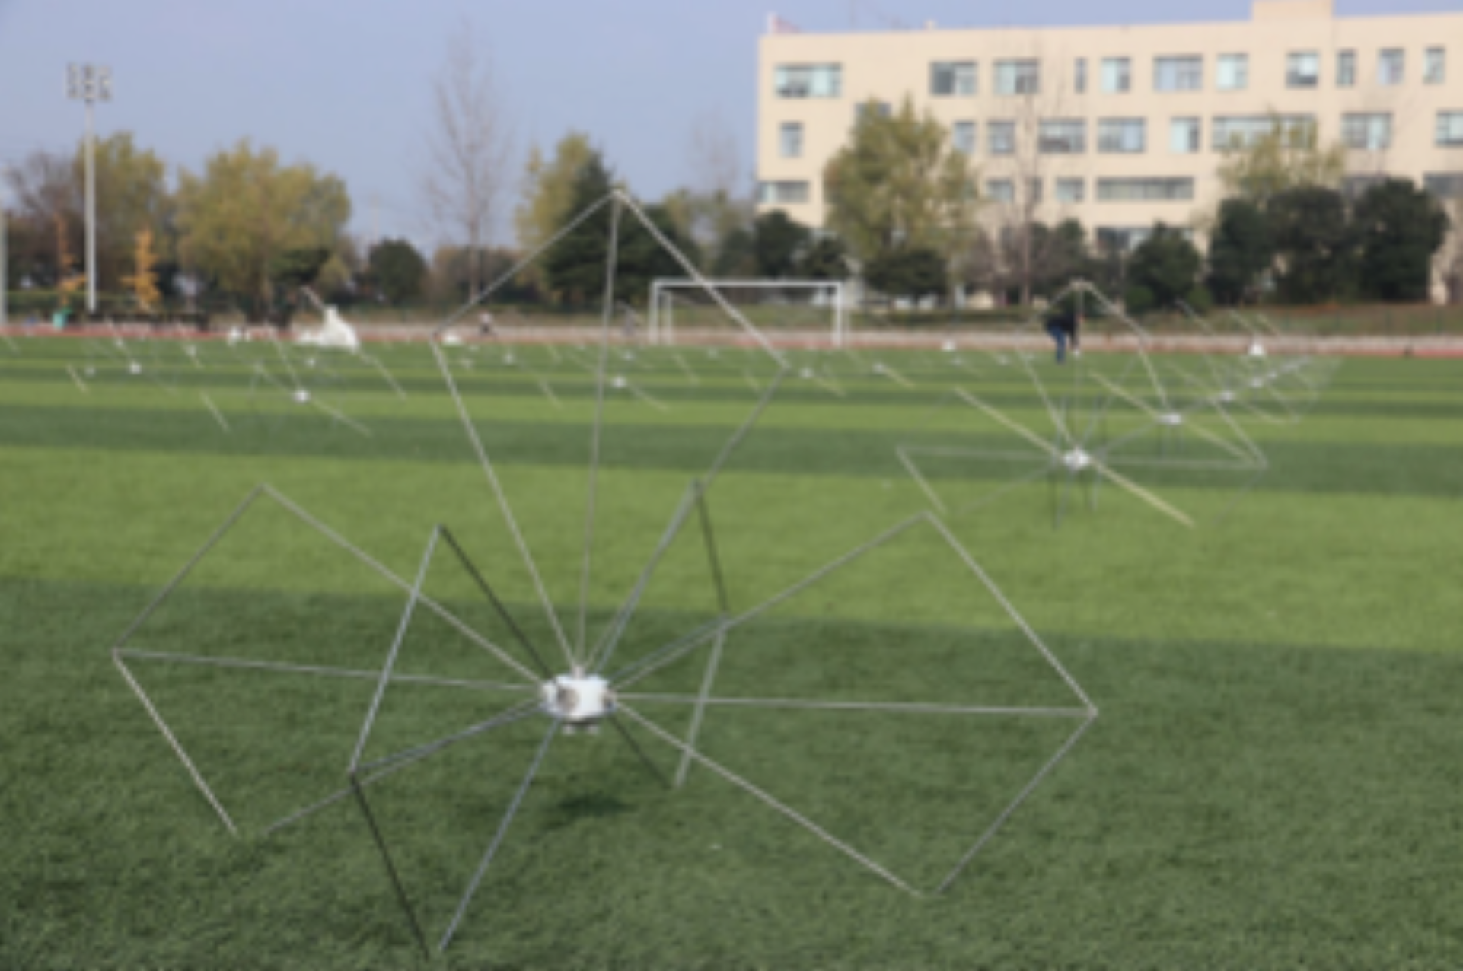
GRAND
100 Antennas and mechanical structures completed
Only component to be bought: solar panels
Station electronics to be delivered this month
100 vibration sensor cards produced,
in Nijmegen for calibration

Slide 8
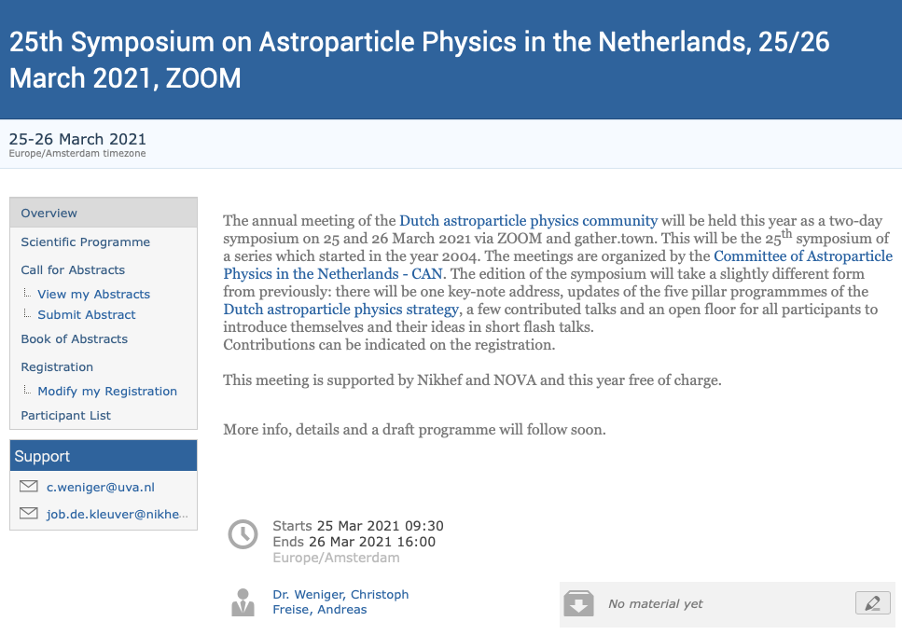
CAN
https://indico.nikhef.nl/event/2988/
https://mailman.nikhef.nl/mailman/listinfo/astroparticlephysics

