Slide 1
WISE – SCI & PDK & AUP David Kelsey (STFC-RAL, UK Research and Innovation) EUGridPMA virtual meeting, 8 Feb 2021
In collaboration with and co-supported by EU H2020 EOSC-HUB, EGI-ACE & GN4-3

Slide 2
Activities for SCI-WG (from Oct 2020 WISE workshop)
Updated baseline policy templates for Research Communities
Build on AARC Policy Development Kit (PDK)
UK IRIS leading
Policies for Edge Services/SLATE
University of Chicago/SLATE/Trusted CI leading
Guidance for maturity assessment in relation to SCI version 2
GN4-3 EnCo and EOSC-hub leading
Longer-term question: Building on experience from SCI-WG, REFEDS Sirtfi Working Group, from AEGIS and the various policy teams including use of Snctfi trust framework (Services behind an AARC BPA Proxy) all together
do we need an SCI Version 3?

Slide 3
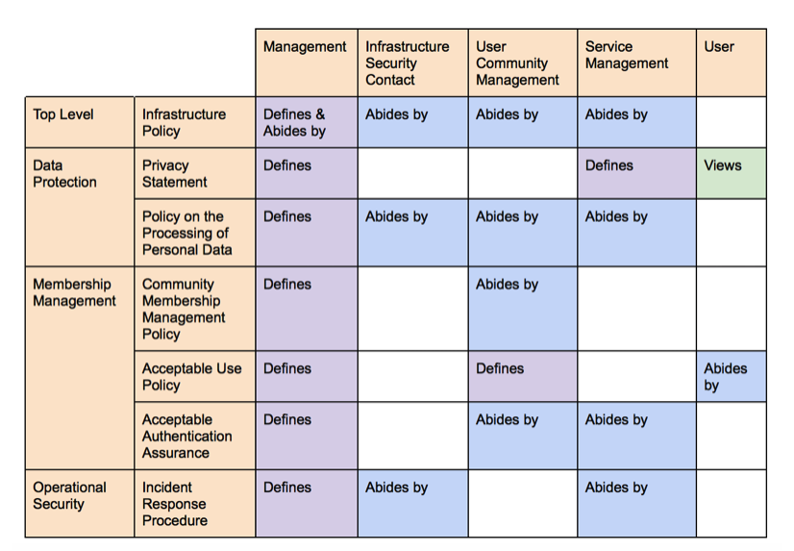
Policy Development Kit - Content
https://aarc-project.eu/policies/policy-development-kit/
Slide from Hannah Short and Uros Stevanovic
Shown at SIG-ISM/WISE Workshop, April 2019 (Kaunas)

Slide 4
Building on AARC PDK in WISE SCI-WG
Policy Area | New Template | Lead Participants
Top Level | Infrastructure Policy | IRIS (UK), EOSC-hub
Data Protection | Privacy Statement | WLCG, IRIS
Data Protection | Policy on the Processing of Personal Data | EGI, WLCG
Membership | Community Policy | IRIS, EOSC, GN4-3, IGTF
Membership | Acceptable Authentication Assurance | GN4-3, IGTF
Operational Security | Incident Response | eduGAIN, Sirtfi, GN4-3, EOSC & many opsec groups
Operational Security | Service Operations | EOSC-hub, IRIS
US SLATE & Trusted CI active in many areas
New

Slide 5
WISE Baseline AUP v1
From joint work – AARC NA3 (PDK) & all policy teams
https://wiki.geant.org/display/AARC/Acceptable+Use+Policy+and+Conditions+of+Use+-+WISE+Baseline+AUP
The aim of the WISE Baseline AUP is to
provide a common baseline set of criteria for acceptable use and terms and conditions for the professional use of IT infrastructures for research globally – and thereby ease the trust of users across infrastructures: services within an infrastructure have a common framework describing the behaviour of users coming from multiple communities;
facilitate a presentation format that allows necessary privacy notices (in Europe for GDPR compliance) to be presented at the same time and remain easily available thereafter;
support services with varying levels of support and quality guarantees;
provide for augmentation of the baseline AUP with community and infrastructure-specific terms and conditions
be applicable to both ‘community-first’ and ‘user-first’ AAI membership management services. In the conventional ‘community-first’ model, the AUP is shown to the user when registering with their research community. The model here referred to as ‘user-first’ presumes that the user first enrols in a generic, potentially multi-tenancy, membership management service (MMS), and within that service petitions membership to one or more of the research communities hosted within the MMS.

Slide 6
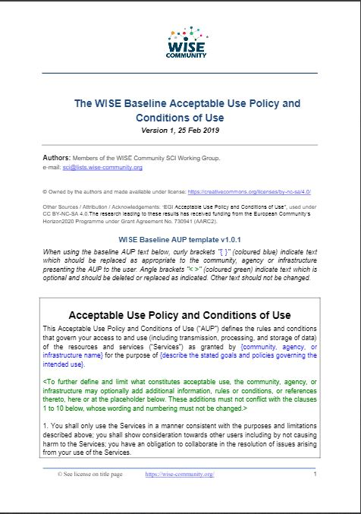
AUP v1 - history
Document completed in Feb 2019
Has been used by Infrastructures (EOSC-hub, IRIS (UK), EGI, …)
EGI AUP v3 (June 2020)
https://documents.egi.eu/document/3600
Finally (!) available from the WISE web
https://wise-community.org/wise-baseline-aup/
https://aarc-project.eu/guidelines/aarc-i044/

Slide 7
Future work on AUP?
Trusted CI Framework
See Bob Cowles talk at WISE meeting (Oct 2020)
https://events.geant.org/event/209/contributions/177/subcontributions/6/attachments/86/116/Framework_Status_for_Fall_WISE_Workshop.pdf
A template AUP will be published as part of their framework
Would like to use WISE AUP – But it does not fully work for them
Still work in progress
To ease the alignment of WISE and Trusted CI templates we may need to consider some updates (WISE AUP V2?)

Slide 8
Questions?
And discussion ….

