Slide 1




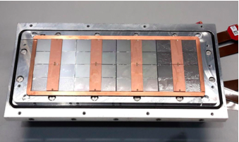



Pixel TPC
Single chip Quad Module TPC plane
2017 2018 2019

Slide 2
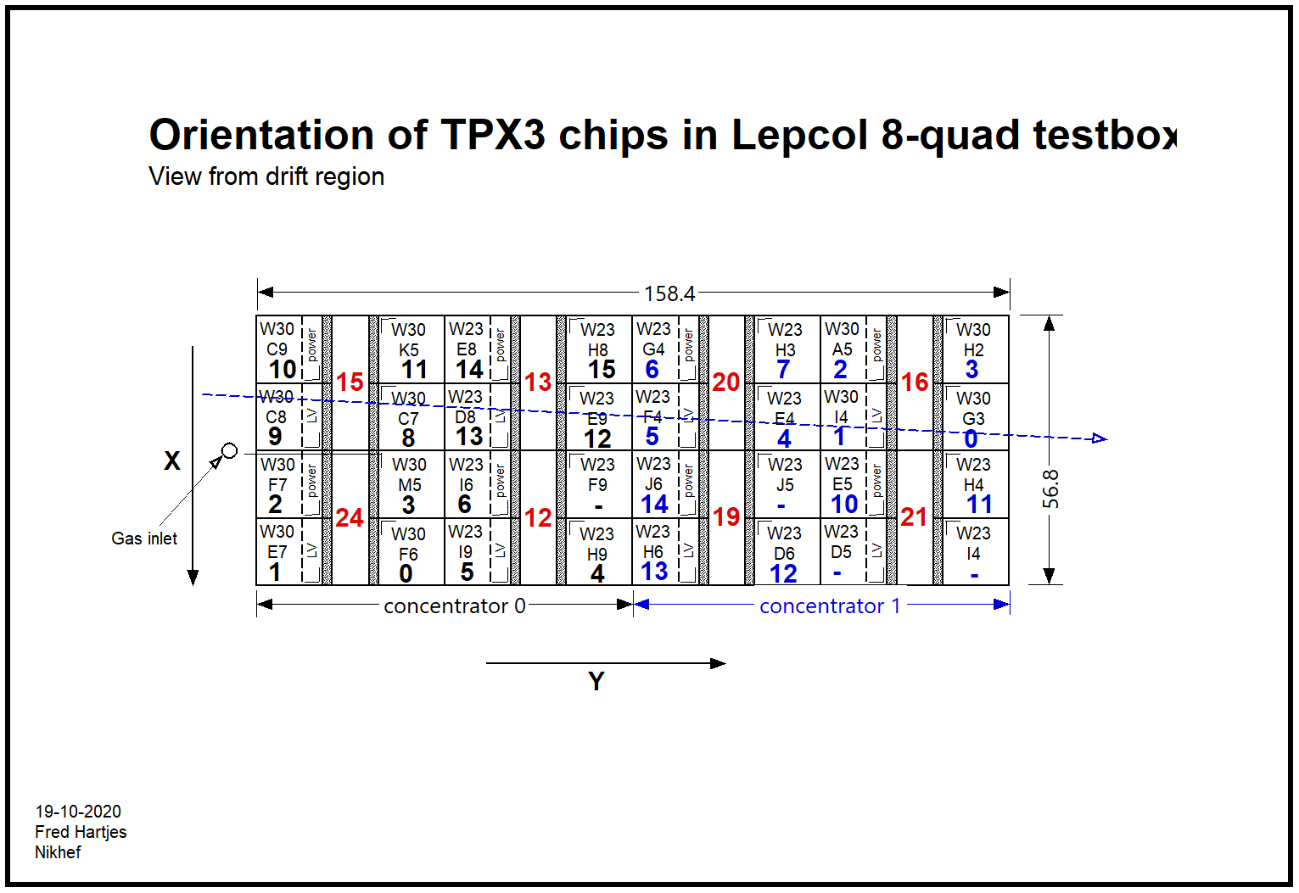
Event display layout
1 2 9 10
0 3 8 11
6 13 14
7 12 15
29 30 21 22
31 20 23
26 17 18
24 27 16 19
Layout chip nrs

Slide 3
Layout chip nrs October
1 2 9 10
0 3 8 11
6 13 14
7 12 15
29 30 21 22
31 20 23
26 17 18
24 27 16 19
Corrected Layout chip nrs
2 1 10 9
3 0 11 8
6 5 14 13
7 4 15 12
30 29 22 21
31 28 23 20
26 25 18 17
27 24 19 16
Columns 1 and 2
3 and 4
flipped

Slide 4
Laser data December and February
After some exchange with Sander and Martin, we conclude on the time structure of the time pixel data the following:
time = heartbeat spidertime toa ftoa (64 bit unsigned integer)
Quad 8-22 16 14 12 (nr of bits)
8-Quad december 7 14 12
8-Quad design 2 February 8 14 12
The toa (time of arrival) is in units of 25 nsec
The ftoa (fine time of arrival) divides this into 4096 pieces
Currently, there is a one-bit overlap between the highest bit of the toa and the lowest spidertime bits. So only 7 bits spidertime add new time information.
In the February runs Sander updated the firmware use the 8 bits spidertime without overlap.

Slide 5
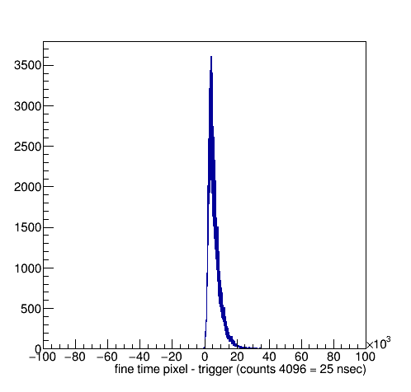
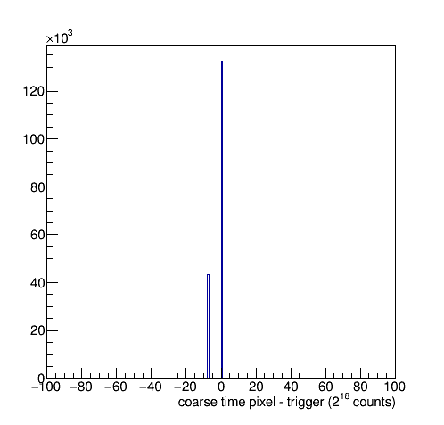
Timing puzzle solved December run 1298
The timing puzzle is now solved after debugging the decoding package Packet.h that builds up the timestamp.
We now define the fine time as the pixel time up to the spider times.
The coarse time are the higher bits (above the spider bits) coming from the heartbeat. Events can be selected by cutting on the fine time.
The coarse time is sometimes off due to the fact that not enough heartbeats were sent

Slide 6
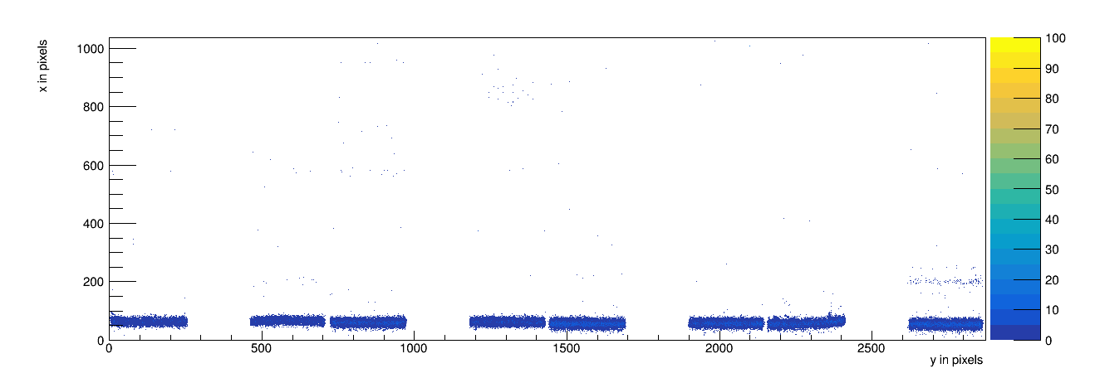
Selected events run 1298

Slide 7
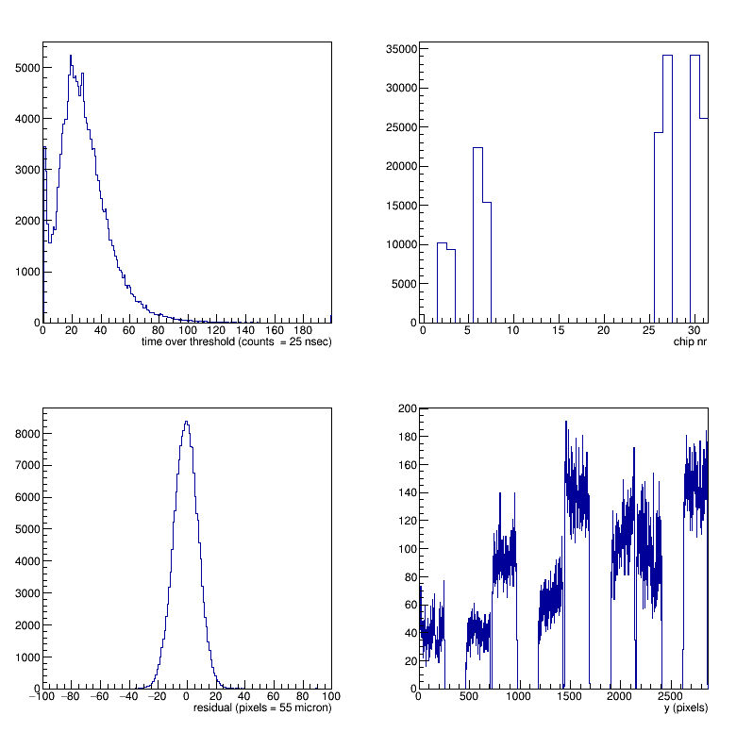
Selected events run 1298
The distributions are clean after the fine time cut

Slide 8
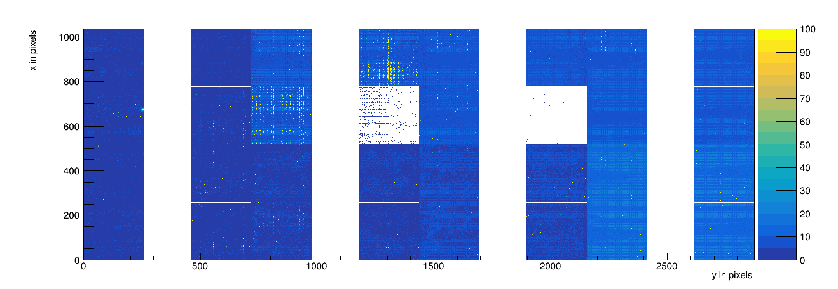
Not selected events run 1298

Slide 9
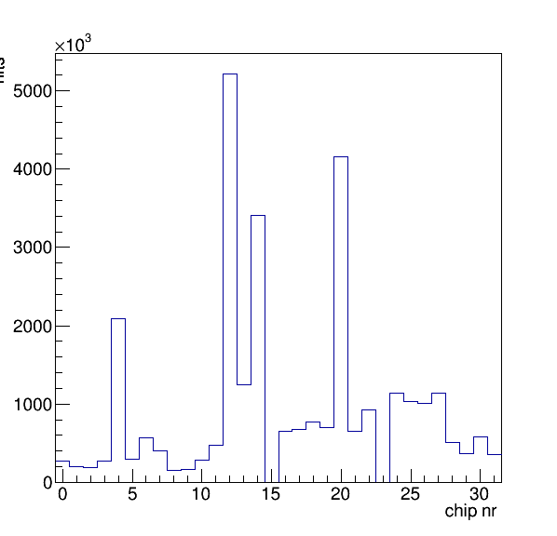
Not selected events run 1298
In this run two chips 15 and 23 could not be read out
On 2 February Sander had a look and there is correlation with switching on/off the LV power.
Also chip 9 had problems.
We have seen in total 29, 30 and 31 chips read out.
The same chips have (sometimes) problems

Slide 10
Heartbeats in February run 1305
Heart beats December: trigger 30 msec and pixels 22-50 msec
Heartbeats February in trigger stream 42 msec
Heartbeats in pixel stream 10 … one event at 60 msec
We need to add a heartbeat at least each 25*2²² = 104 msec (8+14 bits)

Slide 11
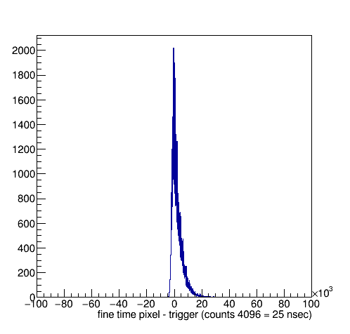
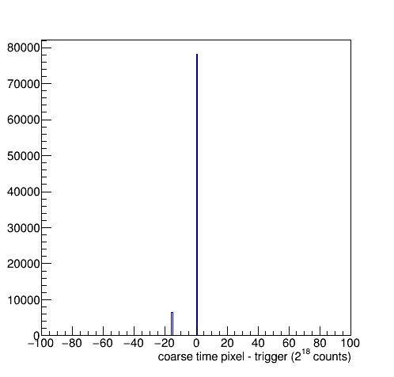
Timing plots run 1305
The coarse time is sometimes off
Much rarer than in run 1298
Off by 2 ²²
So 104 msec
Why? There are enough heartbeats …
Checked the events at -16: look like good signal

Slide 12
Timing plots run 1305
Good Event 1 conc 13 npixelsTrigger 7066 npixelsTriggerPrev 7848 dt 7791612
Good Event 2 conc 13 npixelsTrigger 10212 npixelsTriggerPrev 7066 dt 7992165
Good Event 3 conc 13 npixelsTrigger 6838 npixelsTriggerPrev 10212 dt 7761736
Good Event 4 conc 13 npixelsTrigger 6398 npixelsTriggerPrev 6838 dt 7987335
Good Event 5 conc 13 npixelsTrigger 6675 npixelsTriggerPrev 6398 dt 8407349
Good Event 6 conc 13 npixelsTrigger 7103 npixelsTriggerPrev 6675 dt 8207440
Problem Coarse Event 6 conc 13 npixelsTrigger 7103 npixelsTriggerPrev 6675 dt 3893179
Good Event 7 conc 13 npixelsTrigger 6855 npixelsTriggerPrev 7103 dt 7999946
Problem Coarse Event 8 conc 13 npixelsTrigger 12075 npixelsTriggerPrev 6855 dt 7790086
Good Event 9 conc 13 npixelsTrigger 6882 npixelsTriggerPrev 12075 dt 8130853
Good Event 10 conc 13 npixelsTrigger 7912 npixelsTriggerPrev 6882 dt 8158401
Good Event 11 conc 13 npixelsTrigger 8667 npixelsTriggerPrev 7912 dt 7747234
Problem NO time Event 12 conc 13 npixelsTrigger 8364 npixelsTriggerPrev 8667 dt 19122944
Good Event 13 conc 13 npixelsTrigger 6268 npixelsTriggerPrev 8364 dt 7786735
Good Event 14 conc 13 npixelsTrigger 327579 npixelsTriggerPrev 6268 dt 7395843
Good Event 15 conc 13 npixelsTrigger 8488 npixelsTriggerPrev 327579 dt 7808980
Good Event 16 conc 13 npixelsTrigger 7133 npixelsTriggerPrev 8488 dt 8225022
Good Event 17 conc 13 npixelsTrigger 6294 npixelsTriggerPrev 7133 dt 7794078
Good Event 18 conc 13 npixelsTrigger 6662 npixelsTriggerPrev 6294 dt 8018504
Good Event 19 conc 13 npixelsTrigger 10420 npixelsTriggerPrev 6662 dt 8008273
Good Event 20 conc 13 npixelsTrigger 6350 npixelsTriggerPrev 10420 dt 7994557
Good Event 21 conc 13 npixelsTrigger 5654 npixelsTriggerPrev 6350 dt 7802455
Good Event 22 conc 13 npixelsTrigger 10898 npixelsTriggerPrev 5654 dt 7994071
Good Event 23 conc 13 npixelsTrigger 7909 npixelsTriggerPrev 10898 dt 7764509
Good Event 24 conc 13 npixelsTrigger 7638 npixelsTriggerPrev 7909 dt 8176256
Why? Coarse time is off
No clear pattern

Slide 13

Selected events run 1305

Slide 14
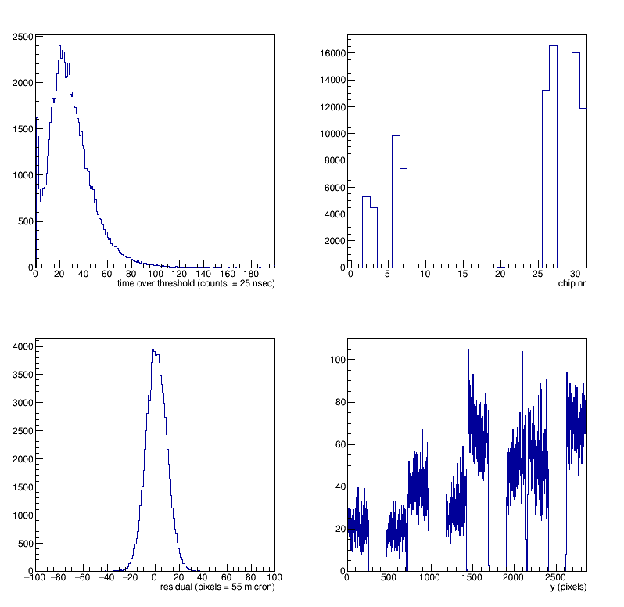
Selected events run 1305

Slide 15
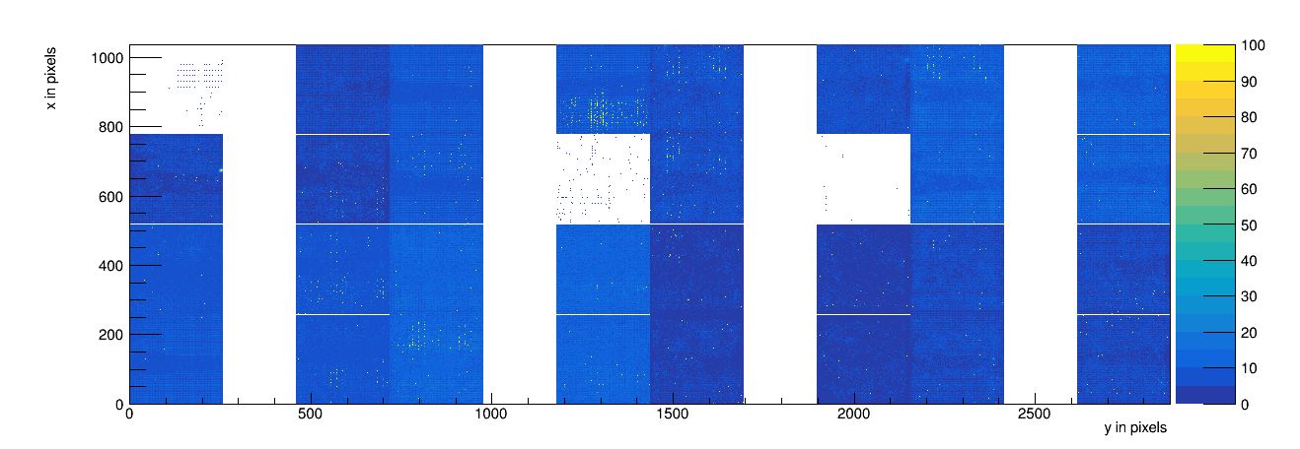
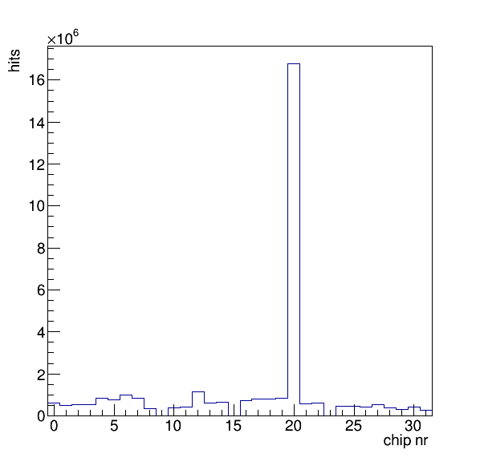
Not selected events run1305
In this run two chips 15 and 23 could not be read out
On 2 February Sander had a look and there is correlation with switching on/off the LV power.
In run 1305 chip 9 had problems.
We have seen in total 29, 30 and 31 chips read out.
The same chips have (sometimes) problems

Slide 16
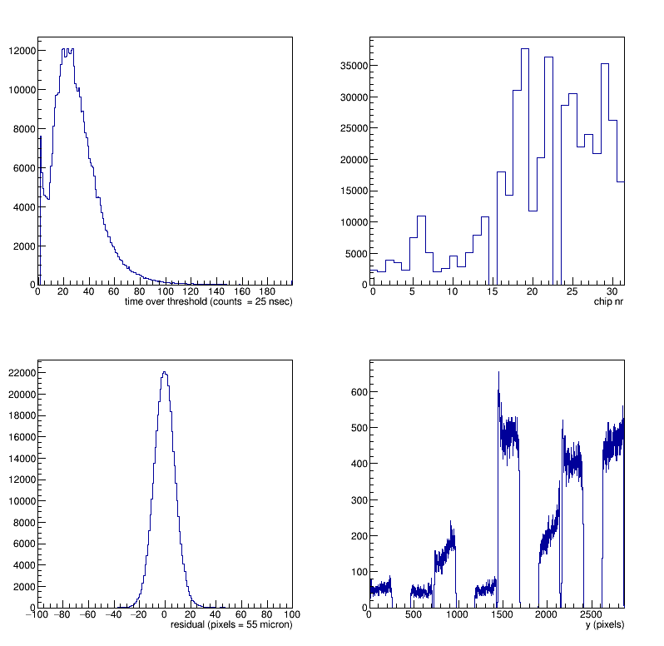
Full scan of the module run1299
Long run 800 points laserpositions:
xpos 0 – 49 in 7 mm steps

Slide 17
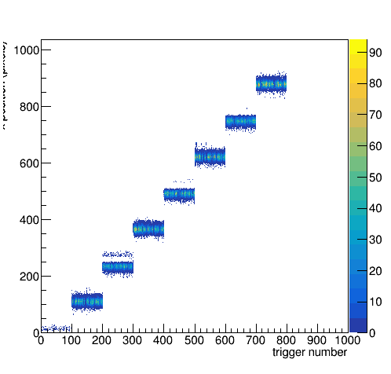
Full scan of the module run1299
Long run 800 points laserpositions:
xpos 0 – 49 in 7 mm steps

Slide 18
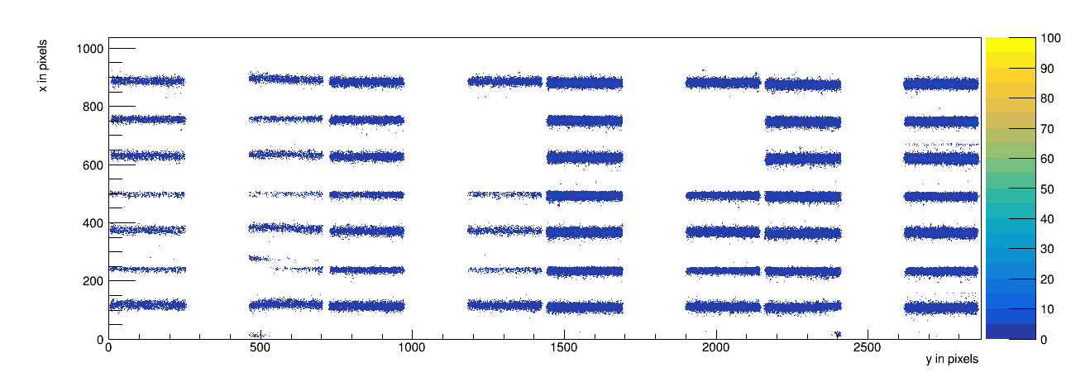
Full scan of the module run1299

Slide 19
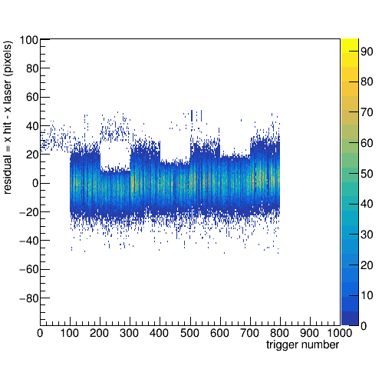
Full scan of the module run1299
Long run 800 points laserpositions:
xpos 0 – 49 in 7 mm steps
No rotation applied

Slide 20
Open puzzles
Why is the coarse time sometimes off?
Can we recuperate the chips that sometimes can be read out sometimes not: chips 9, 15 and 23?
Todo: Equalize the different chips again
Study deformations in the module using the 1299 data

