Slide 1




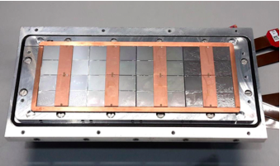



Pixel TPC
Single chip Quad Module TPC plane
2017 2018 2019

Slide 2
Pixel TPC with double grid to reduce the ion back flow
Question: can one reduce the Ion Back Flow of a GridPix detector?
We could design a GridPix detector using a double grid
The idea is that by creating two field regions, one with a medium field and one with a high field (our standard Grid Pix) one could reduce the ion backflow in two stages.
  The high field avalanche region has a measured IBF of 1.3%
  The aim is to reduce the IBF by another factor 100
  The second Grid replaces the Gating device and is always operational

Slide 3
Design of a double Grid
Drift region
Second Grid
e.g.
250 μm
Intermediate Field
GridPix
50 μm
High field

Slide 4
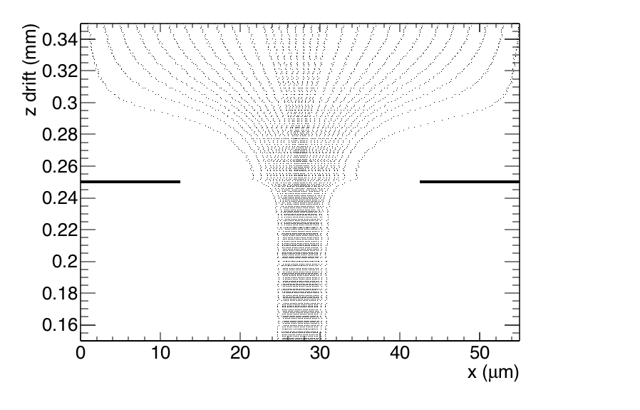
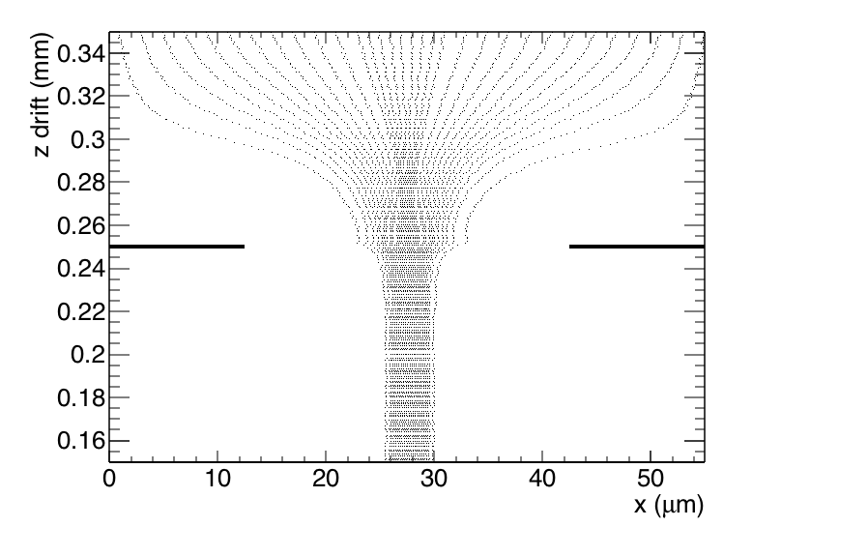
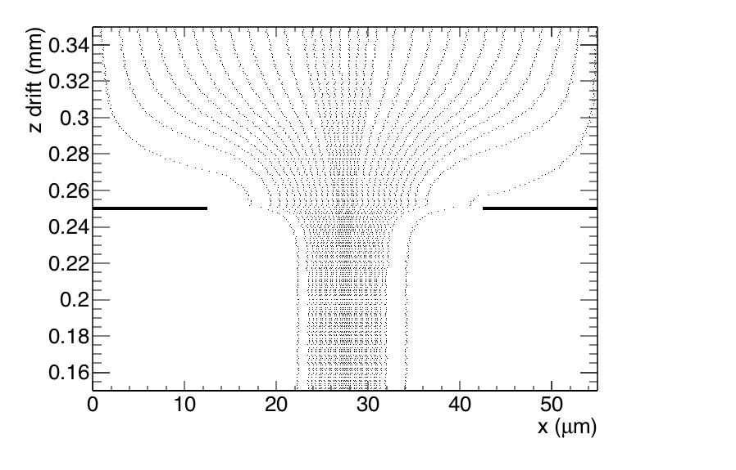
In (down) flow trajectories second Grid
Field ratio 40
Field ratio 10
Field ratio 240
Geometry: second grid at 0.250 mm (z); Cathode at 550 mm
Standard GridPix pitch 55 μm and hole 30 μm
Field ratio = mean Field (0-0.250 mm)/ mean Field z (2-550 mm)
Electron tracking without diffusion:
σ (rms) size of funnel (focussing E field) = 2.6-1.5-1.1 (Fr 10,40,240)

Slide 5
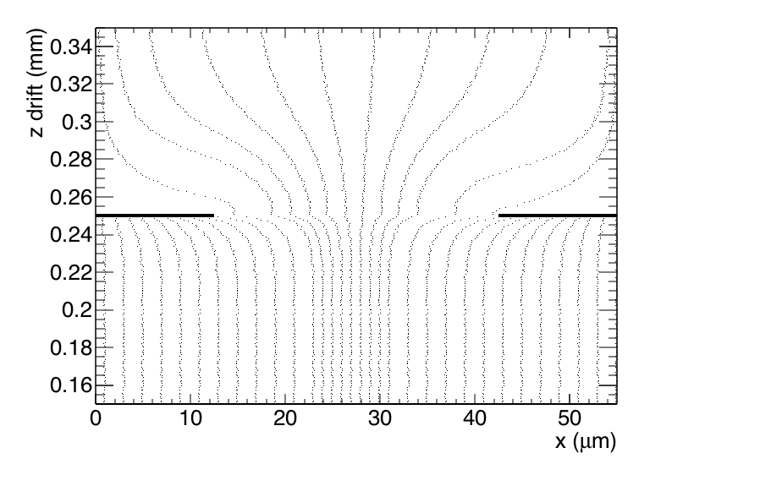
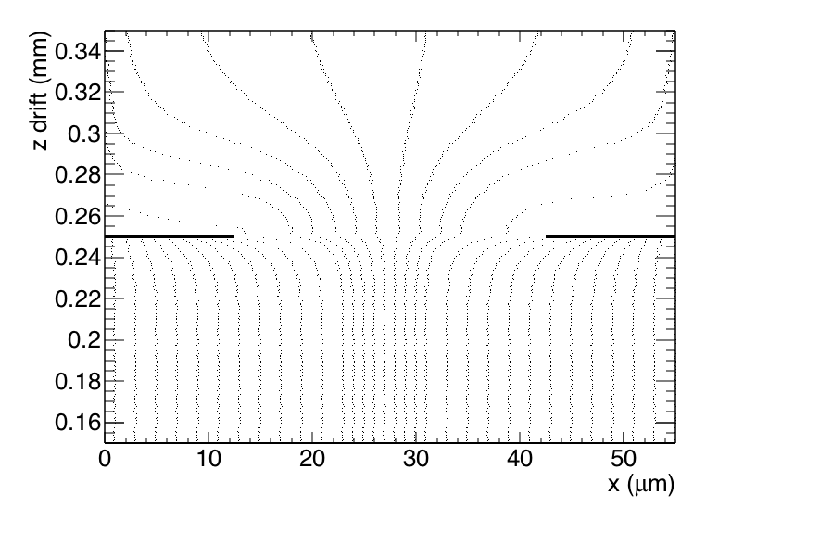

Backflow (up) trajectories second Grid
Field ratio 10
Field ratio 40
Field ratio 240
Here the trajectories of ions from the bottom upwards are shown
The differences between the different field ratios are small

Slide 6
Modeling of ion back flow
Modeling of the ion backflow is based on the measurements for a standard GridPix with FR 240. The ion backflow was measured to be 1.3%.
The Ion BackFlow is sensitive to the diffusion in the high field region.
The electron funnel size is 1.1 μm just from the field focussing.
For the GridPix (gap 50 μm) one expects an electron diffusion of 150-200 μm/√cm. This gives a smearing of the funnel of about 10-14 μm.
The calculated IBF corresponds to 1.3% for a smearing of 15 μm.
So this agrees reasonably well with expectations. The diffusion in the high field regions is on the high side (200 μm/√cm).
The performance IBF of the top grid.
What happens is that the back flowing ions that make it through the lower
grid that runs at FR240 will be flat distributed if one is 60-100 μm or more
above it.

Slide 7
IBF of the second grid
The performance IBF of the second grid.
What happens is that the back flowing ions that make it through the lower grid that runs at FR240 will be flat distributed if one is 60-100 μm or more above it.
The field ratio should not be too high to avoid gas amplification in
the top grid. Therefore we leave out the FR240 point.
IBF (% ) FR 40 | FR 10
1.2 | 3.5

Slide 8
Transparancy of the grid
Another important aspect is the electron transparancy.
Using the simulation this can be calculated.
It is important to choose a FR with a high (electron) transparancy
so with FR of 40 or higher.
Transparancy (%) FR 240 | FR 40 | FR 10
100. | 100. | 99.0

Slide 9
Further reflections on the gap size
Another important aspect is diffusion that takes place in the
intermediate field region. For the T2K gas this can be at most 400 μm/√cm. The gap is the distance between the two grids.
So in case of a 1 mm gap there is a sizeable probability that the
neigbour pixels detect the avalanche.
So a smaller gap is preferable.
Smearing σ (μm) gap 1 mm | gap 250 μm | gap 60 μm
126 | 63 | 31

Slide 10
Ion backflow for a double grid
Here calculations for the IBF of the two grids in case one has a total FR of
about 240 – normal GridPix operation. For the simulations the FR of the top
grid was put at 16. The lower Grid(Pix) was at FR 16 too. Total FR 256.
The diffusion is put to 200 μm/√cm in both regions (NB. in the low field region (slide 11-12) it could be 400 μm/√cm).
In order to reach IBF*Gain (2 10³) below one has to choose a slightly
smaller hole size of 25 or 20 microns.
Ion backflow | Hole 30 μm | Hole 25 μm | Hole 20 μm
Top grid | 2.2% | 1.2% | 0.7%
GridPix | 5.5% | 2.8% | 1.7%
Total | 12 10⁻⁴ | 3 10⁻⁴ | 1 10⁻⁴
transparancy | 100% | 99.4% | 91.7%

Slide 11
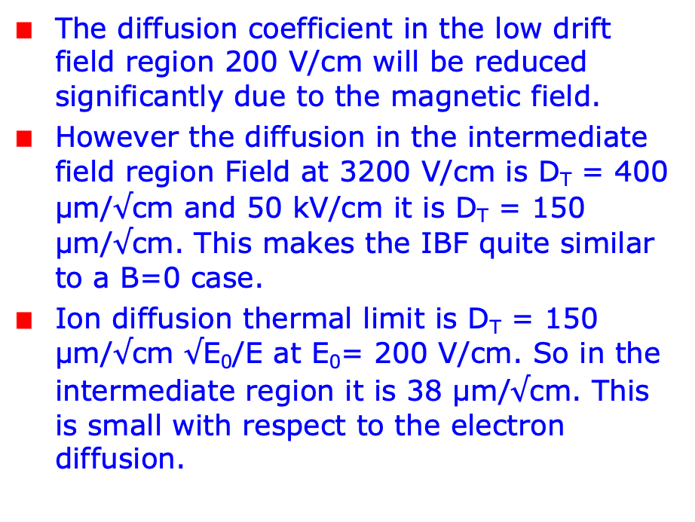
Ion back Flow in a magnetic field
The diffusion coefficient in the low drift field region 200 V/cm will be reduced significantly due to the magnetic field.
However the diffusion in the intermediate field region Field at 3200 V/cm is D_{T} = 400 μm/$√$cm and 50 kV/cm it is D_{T} = 150 μm/$√$cm. This makes the IBF quite similar to a B=0 case.
Ion diffusion thermal limit is D_{T} = 150 μm/$√$cm $√$E₀/E at E₀= 200 V/cm. So in the intermediate region it is 38 μm/$√$cm. This is small with respect to the electron diffusion.

Slide 12
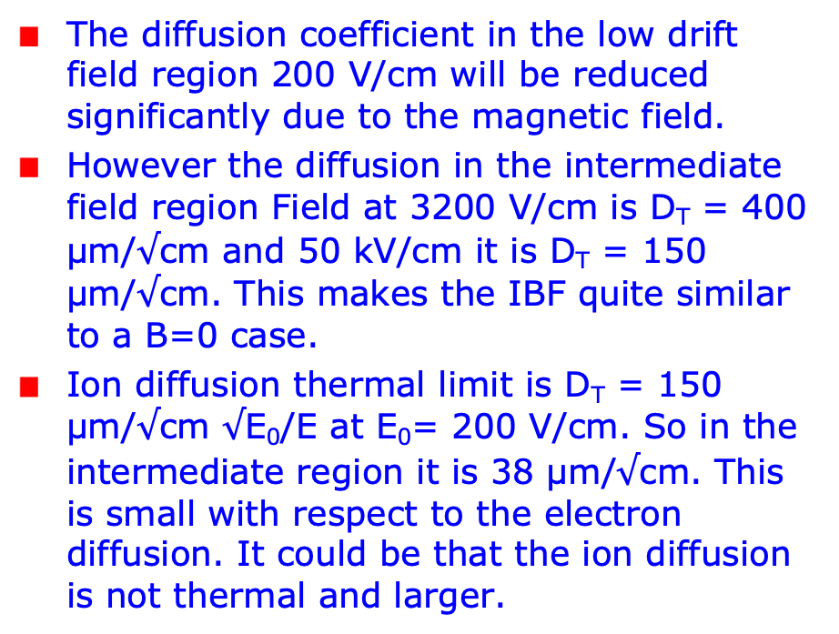
Ion back Flow in a magnetic field
The diffusion coefficient in the low drift field region 200 V/cm will be reduced significantly due to the magnetic field.
However the diffusion in the intermediate field region Field at 3200 V/cm is D_{T} = 400 μm/$√$cm and 50 kV/cm it is D_{T} = 150 μm/$√$cm. This makes the IBF quite similar to a B=0 case.
Ion diffusion thermal limit is D_{T} = 150 μm/$√$cm $√$E₀/E at E₀= 200 V/cm. So in the intermediate region it is 38 μm/$√$cm. This is small with respect to the electron diffusion. It could be that the ion diffusion is not thermal and larger.

Slide 13
Ion backflow for a double grid
As the curves on slides 12 show, the B field dependence of the transverse diffusion in the intermediate and high flied regions is similar.
This means that the IBF for with/without magnetic field wil be pretty close.
The numbers on slide 10 are “pessimistic” and could be better if one uses in the simulation the diffusion coefficient in the intermediate region. The top grid will stop more ions. This could be a factor 2-4.
The numbers are realistic because the one grid measurement is used as a reference to tune the diffusion coefficient in the high field region.

Slide 14
Conclusions: double grid
The Ion Back Flow can be significantly reduced by putting a grid with a
identical pitch and hole size on top of the Gridpix.
A device placed e.g. at 60-250 μm above the GridPix and ran with a
Field ratio of 16 (top) and 16 (lower) would do an excellent job.
The electron transparancy would be over 99 (91)% and the IBF would go
down from 1.3% to 3 (1) 10⁻⁴ for a hole size of 25 (20) μm.
This would solve the issue of IBF at CEPC and ILC.
We could do a test at Nikhef mounting this grid on top of the
Gridpix (holes 30 μm) and measure the electron transparancy and the
IBF and test the prediction on the previous slide.
It would be interesting to think about a post-processing step to
integrate the two grids.

